Slide 1
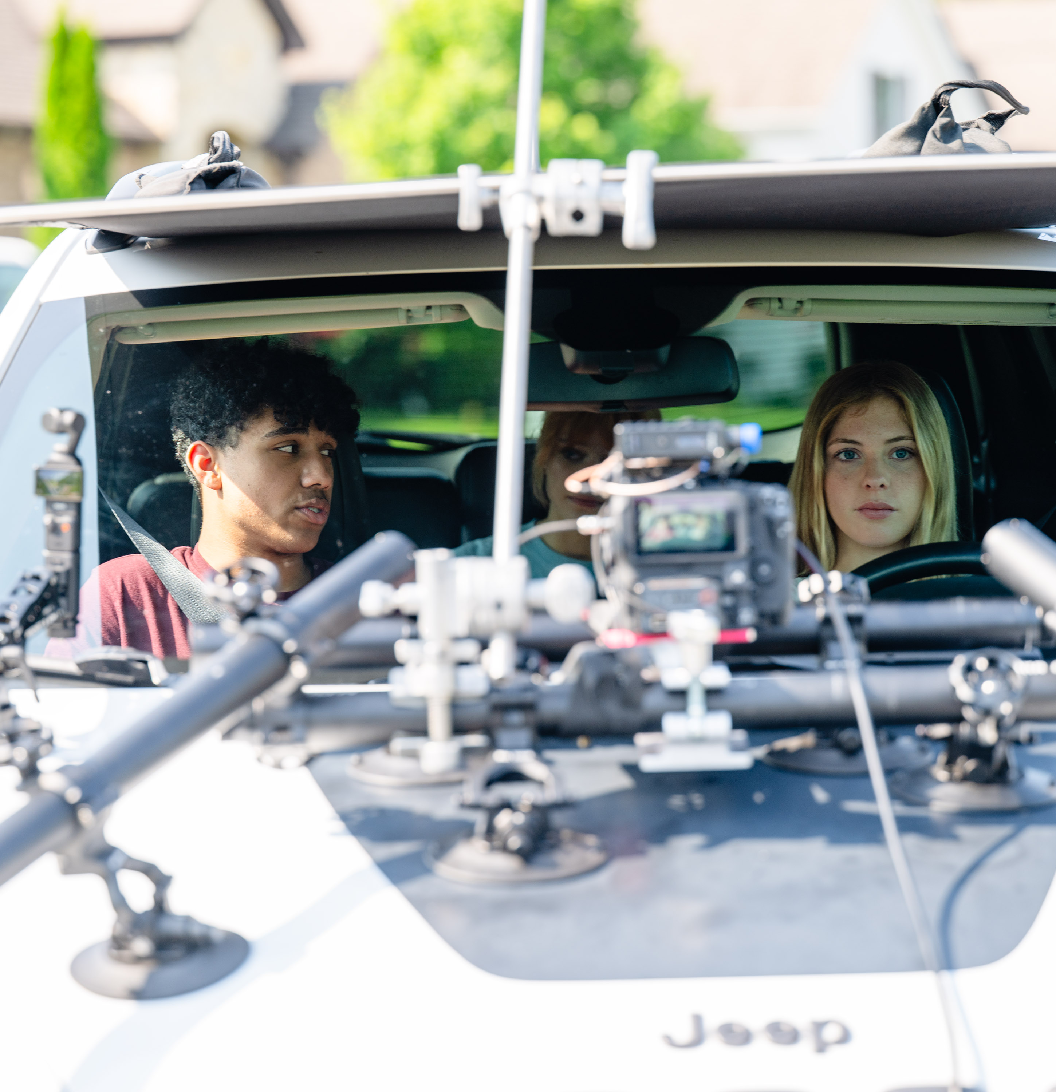



STREET SMART:
A Children’s Road Safety Education Program
ADE SUMMIT
July 14, 2026
TRAVIS BROOKS, P.E.
Division Head – Planning & Research Arkansas Department of Transportation

Slide 2
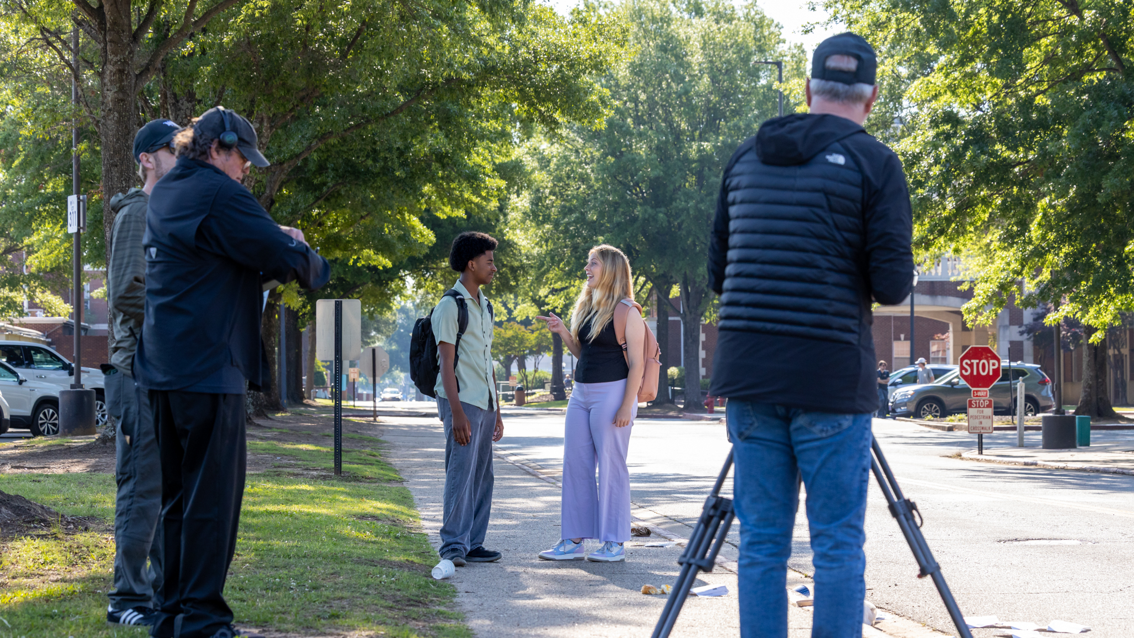
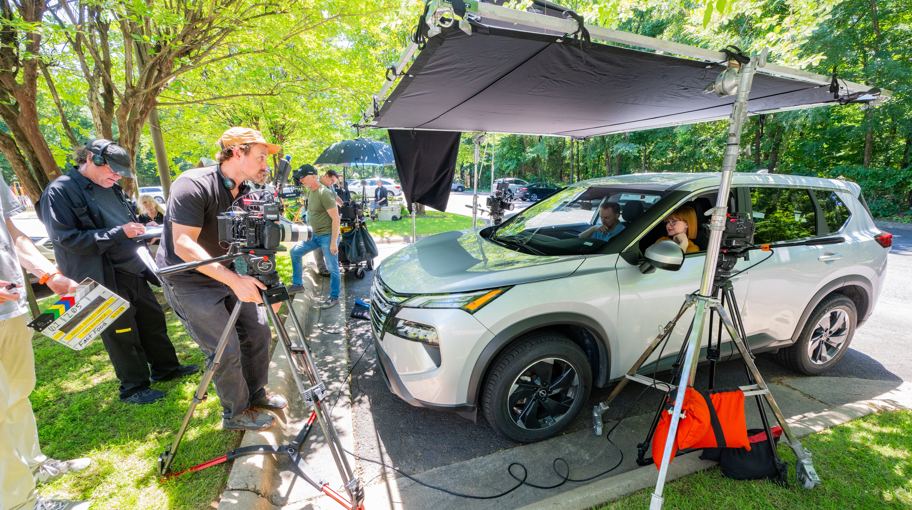
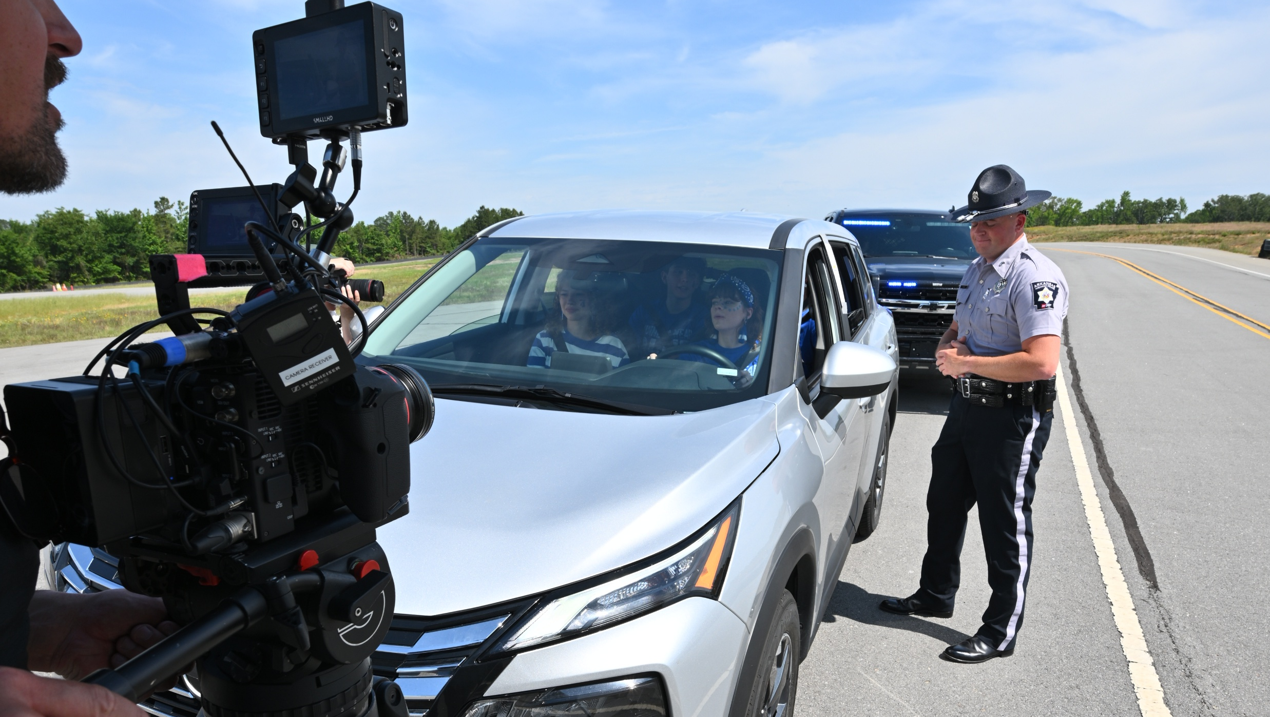
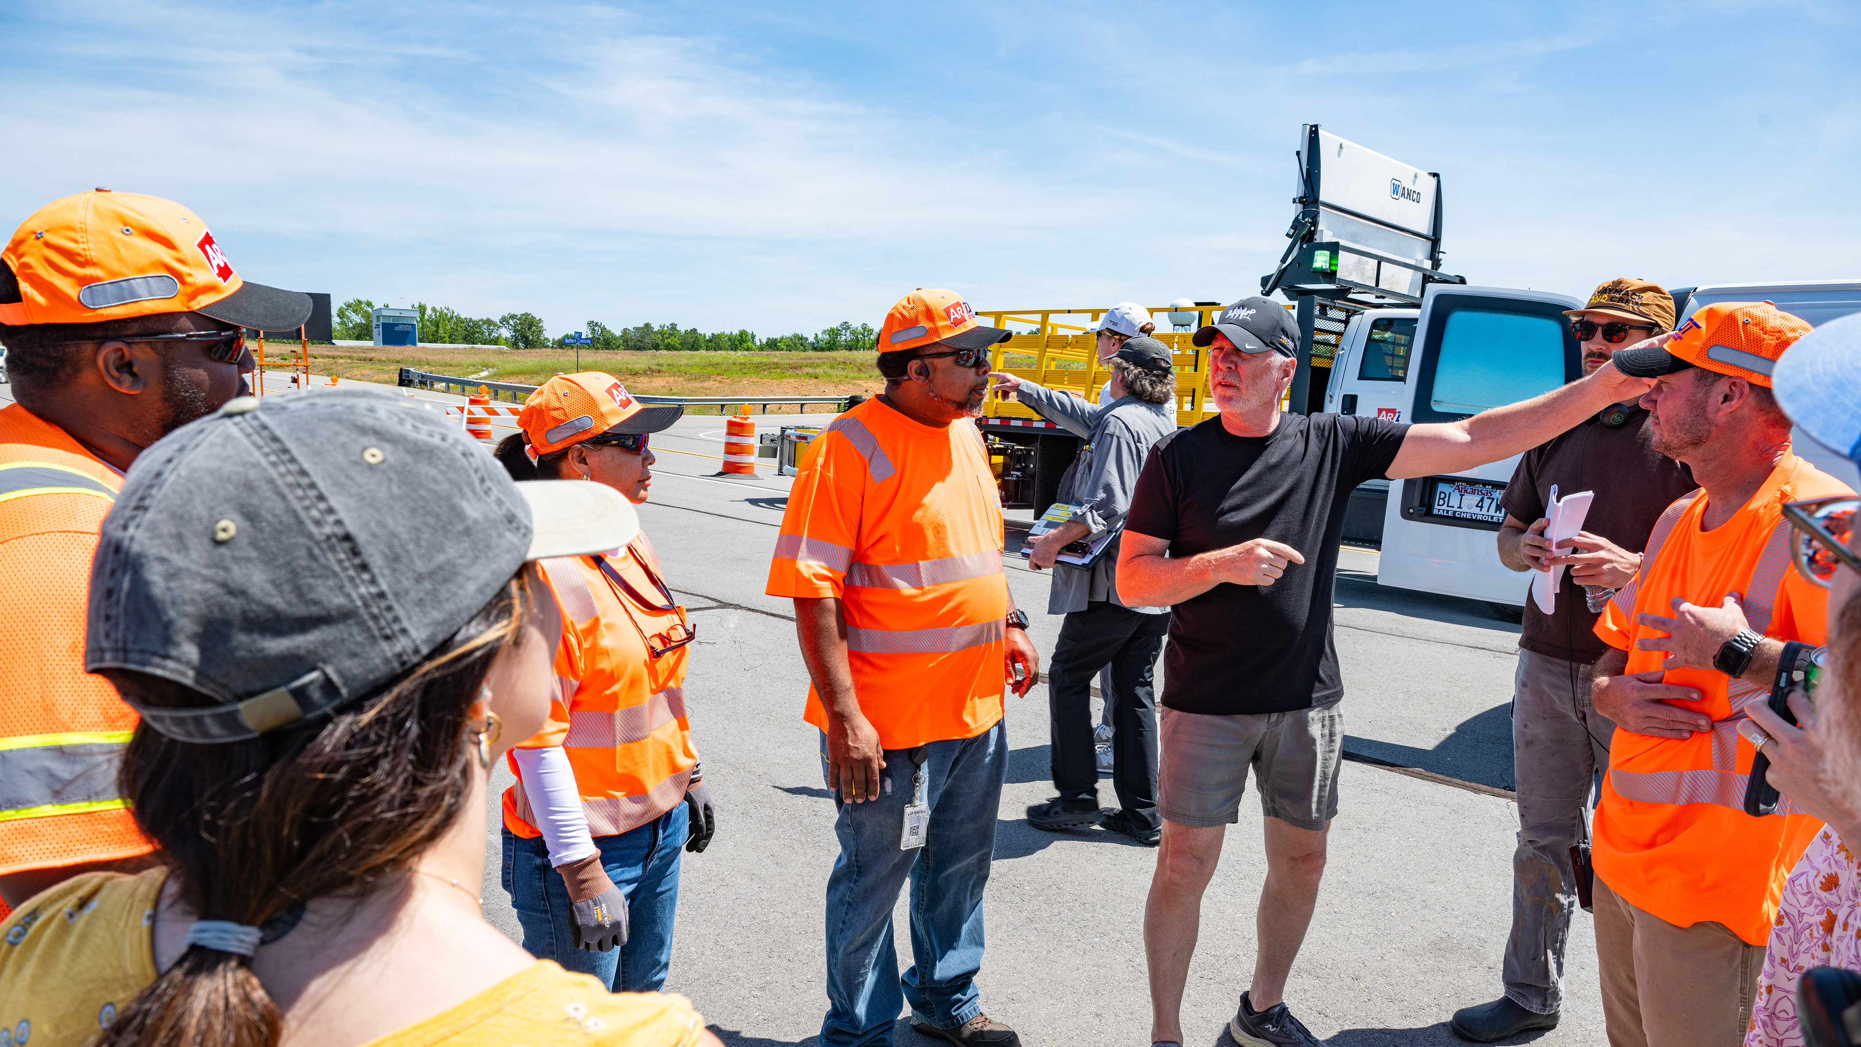

Slide 3
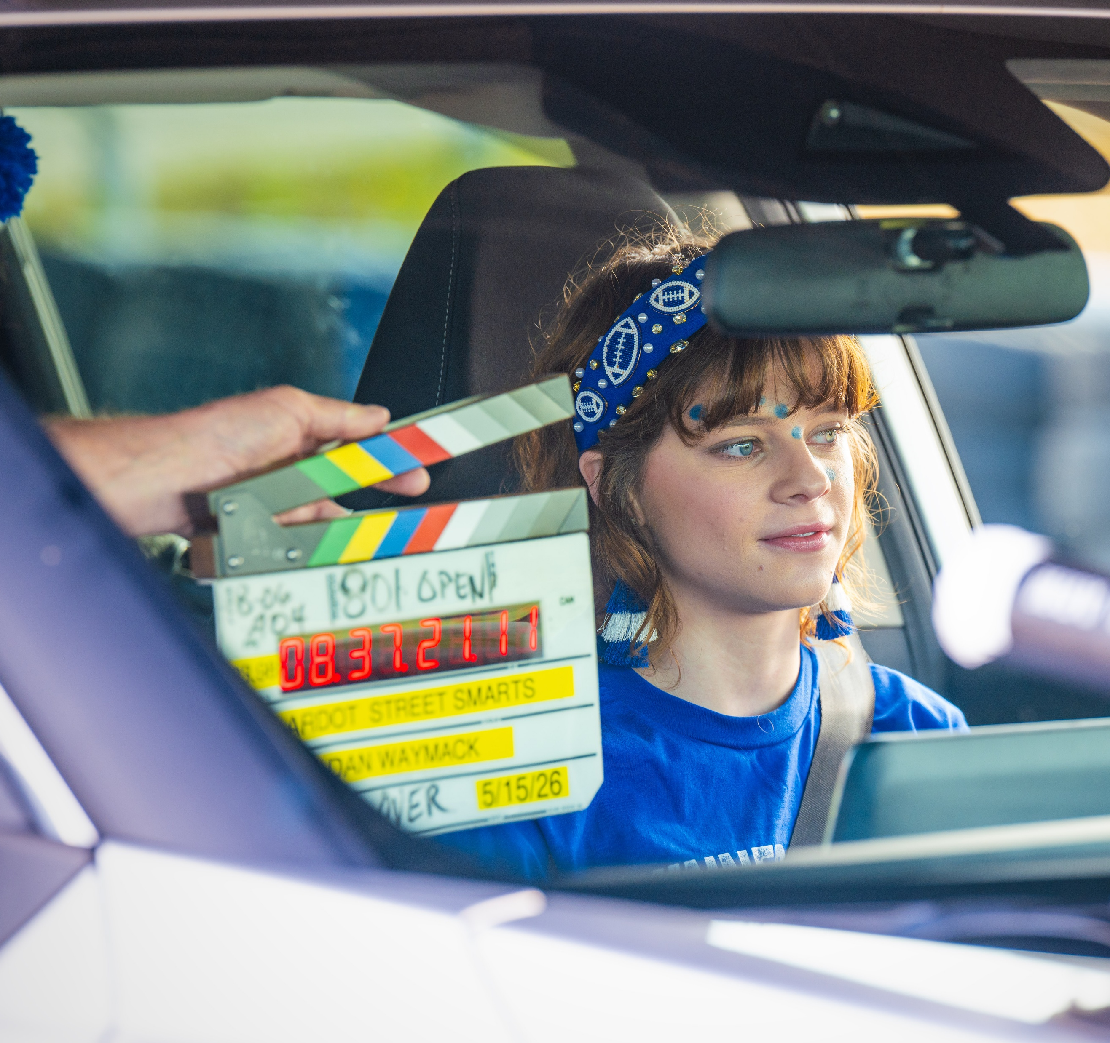
TODAY’S TOPICS
WHAT IS STREET SMART?
THE NEED FOR STREET SMART
PROGRAM OVERVIEW
PROGRAM GOALS
WHAT’S NEXT?

Slide 4
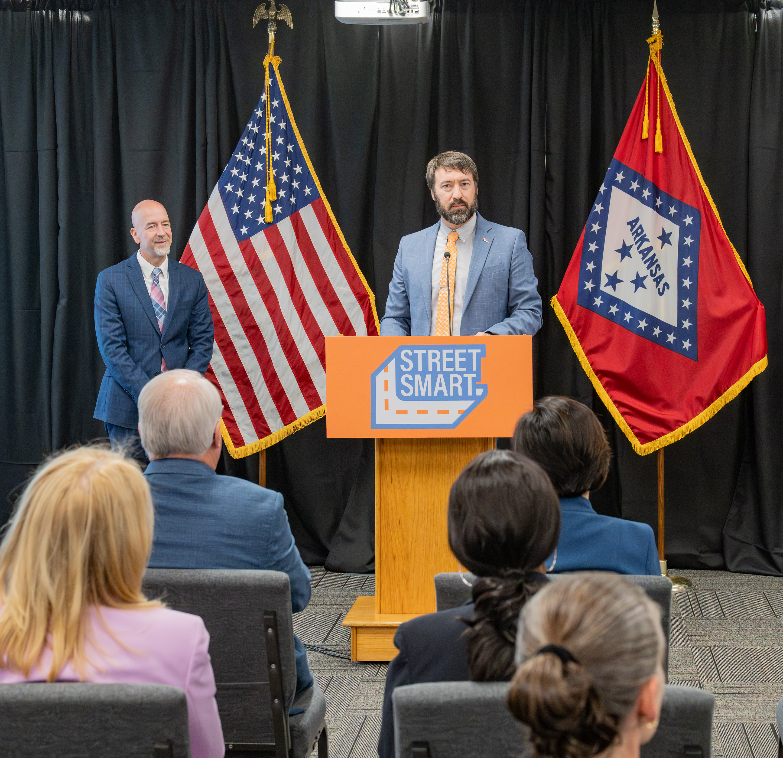

WHAT IS STREET SMART?
Free, ready-to-use, statewide road safety education program
For pedestrians, passengers, bicyclists, and drivers
6–8th grades: launched 2025-26
9–12th grades: new for 2026-27
Produced by ARDOT in partnership with ADE

Slide 5
THE PATH TO A K-12 ROAD SAFETY PROGRAM
PHASE 1
Grades 6–8
Launched 2025–26
PHASE 2
Grades 9–12
Launching 2026–27
PHASE 3
Grades K-5
coming soon!
Defensive Driving and Hazard Recognition
Traffic signs & signals
Pedestrian safety
Bicycle safety
Passenger safety
Peer influence
Seatbelts
Distractions
Bus safety
Traffic laws & rules of the road
Emergency preparedness
Work zone safety
Speeding
Impaired driving
Littering
What to do if pulled over
Sharing the road with pedestrians & bicyclists
Commercial motor vehicles
Roundabouts

Slide 6
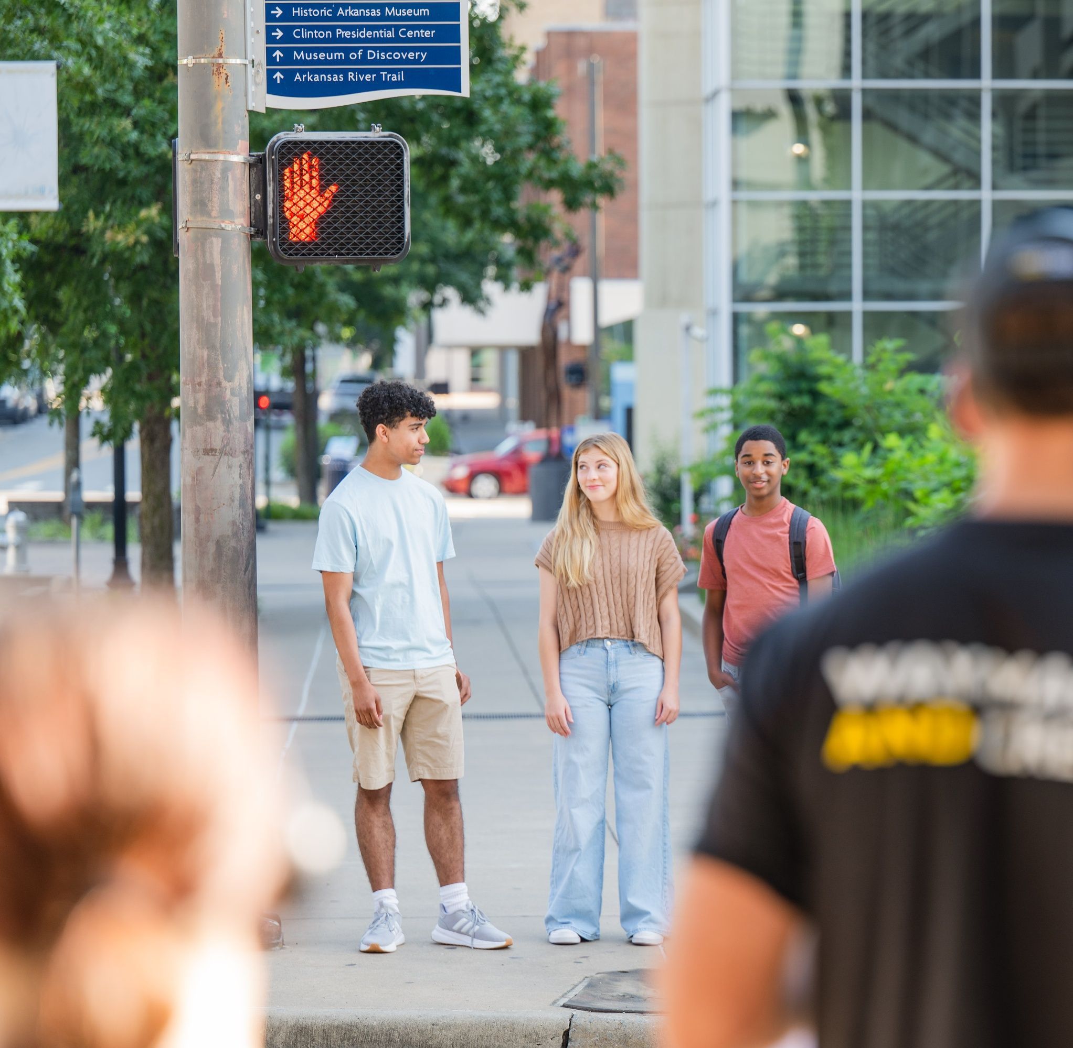
THE NEED FOR STREET SMART
Motor vehicle crashes are a leading cause of death for teens
Distractions, speeding, and lack of seatbelt usage are prevalent issues among younger drivers
Fills an existing gap in offerings – first program of its kind in Arkansas

Slide 7
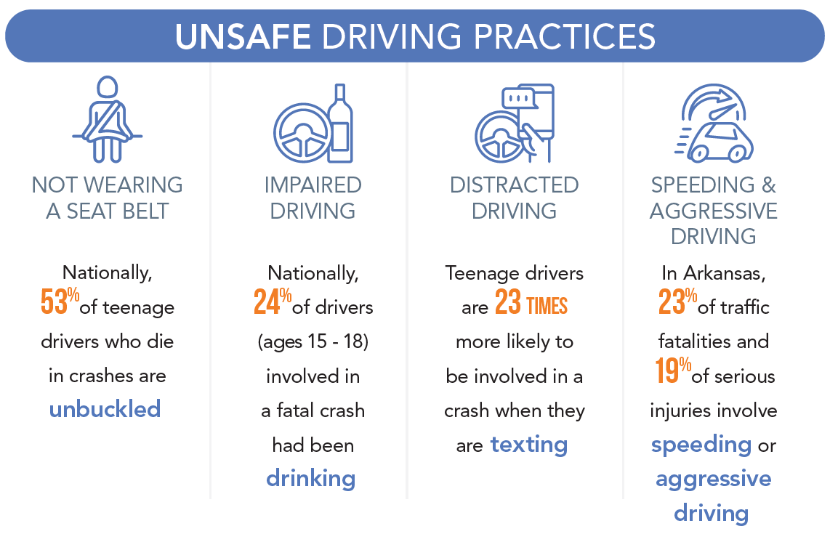

THE DATA
Defensive Driving and Hazard Recognition

Slide 8

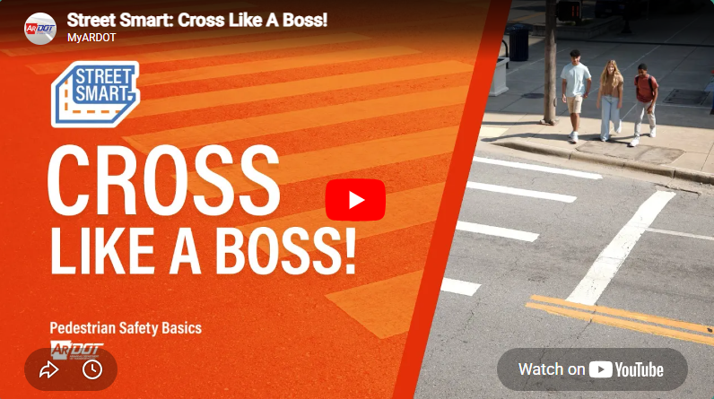
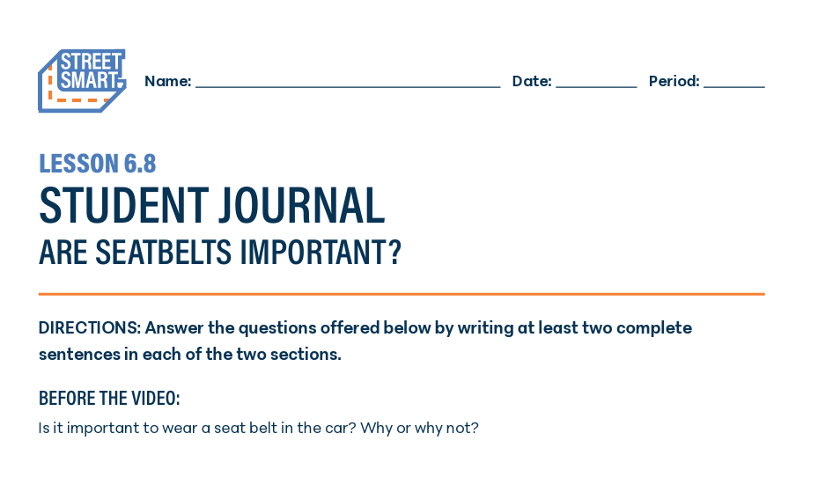
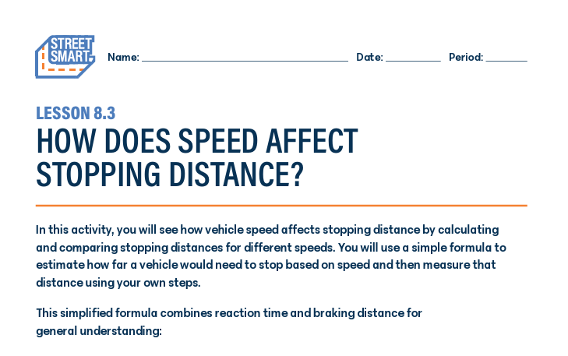
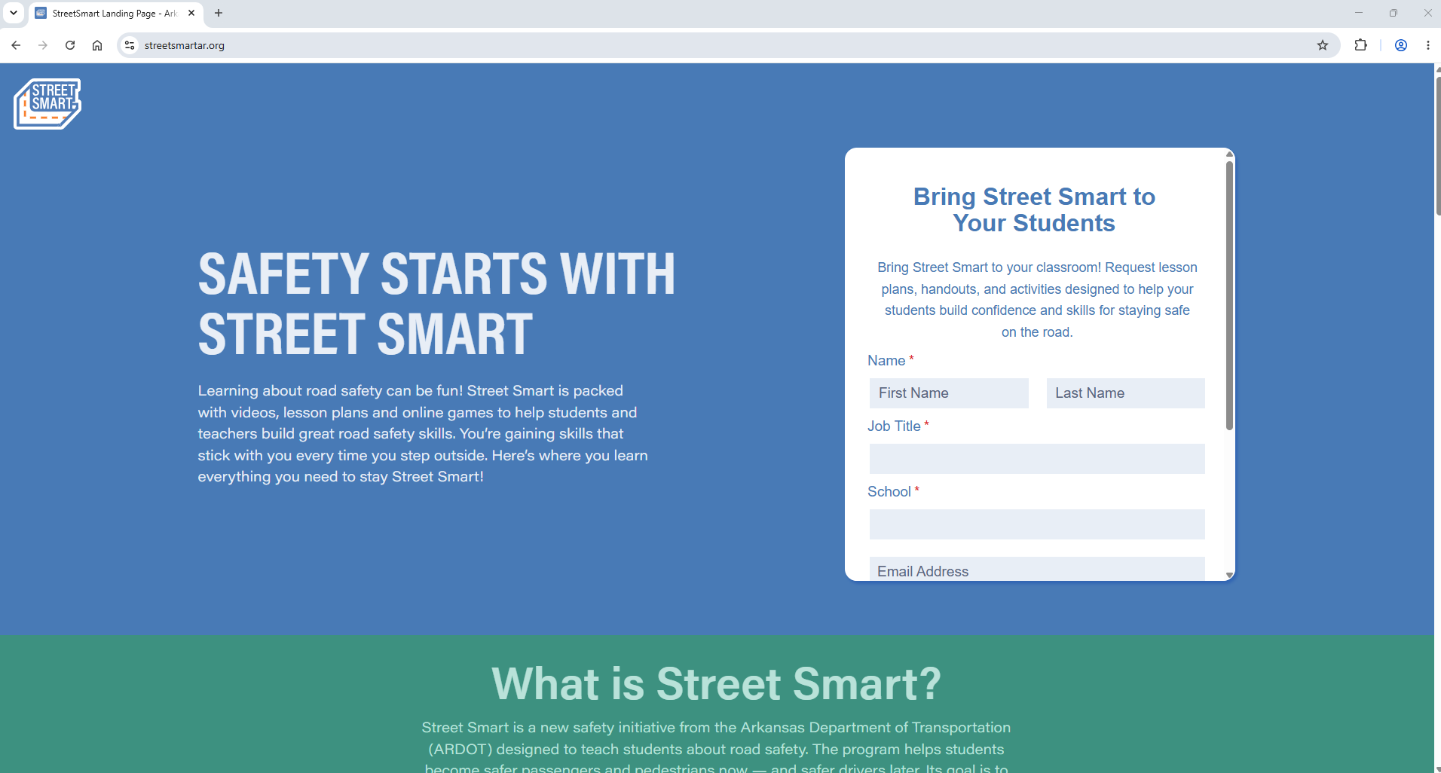

PROGRAM OVERVIEW
500+ MATERIALS REQUESTS
2 AWARDS FOR CONTENT QUALITY
INTERACTIVE WEB GAMES
VIDEOS
STUDENT HANDOUTS
CLASSROOM ACTIVITIES
STREETSMARTAR.ORG
PRESENTATIONS

Slide 9


Slide 10

SAMPLE LESSON

Slide 11
SAMPLE LESSON

Slide 12
SAMPLE LESSON

Slide 13
SAMPLE LESSON

Slide 14
SAMPLE LESSON

Slide 15
SAMPLE LESSON

Slide 16
SAMPLE LESSON

Slide 17
SAMPLE LESSON

Slide 18
SAMPLE LESSON

Slide 19
SAMPLE LESSON

Slide 20
SAMPLE LESSON

Slide 21
SAMPLE LESSON

Slide 22
SAMPLE LESSON

Slide 23
SAMPLE LESSON

Slide 24
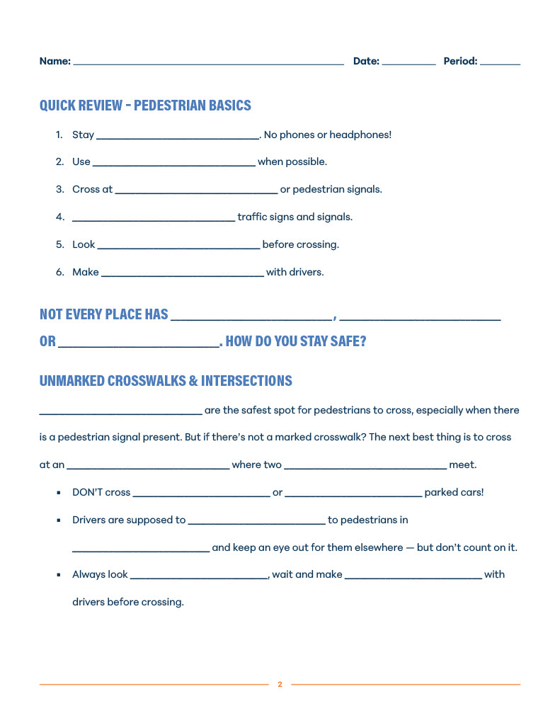
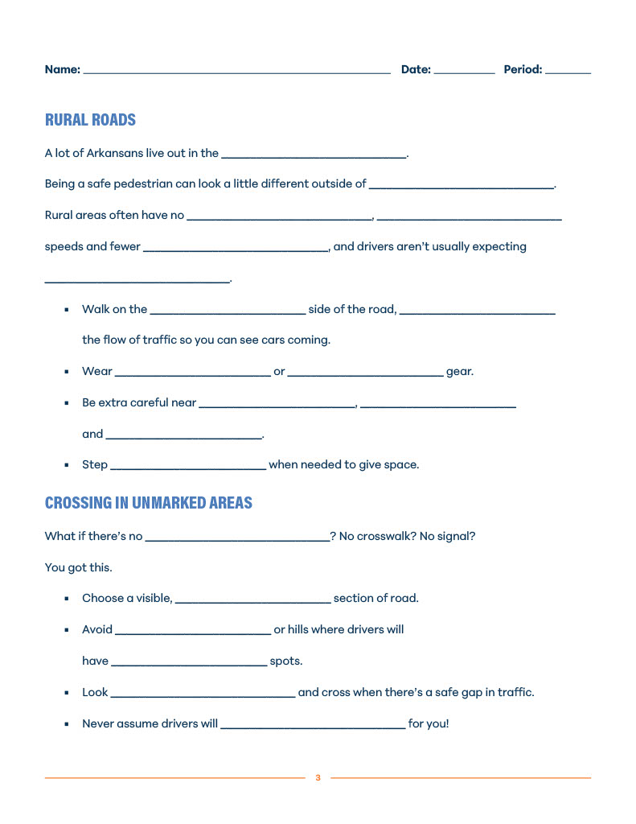
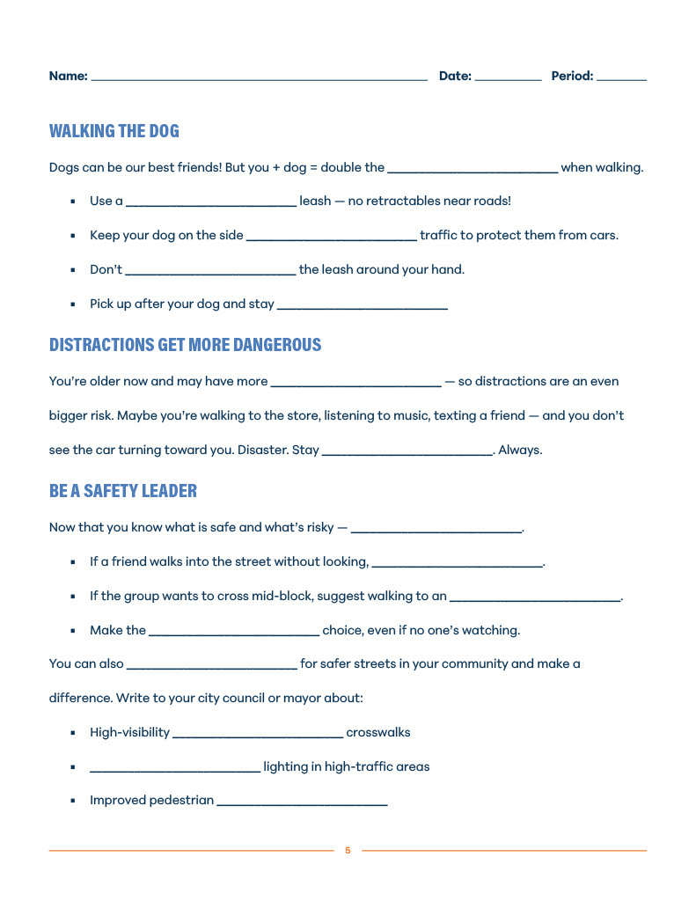
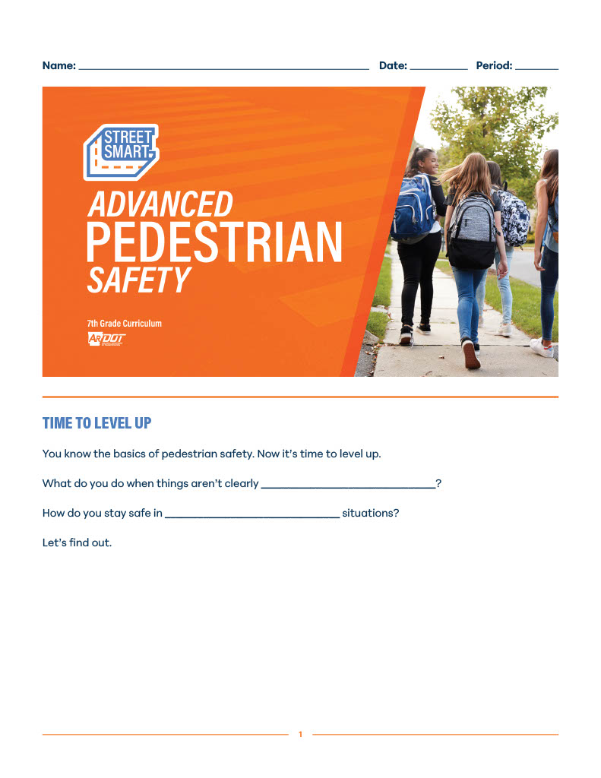
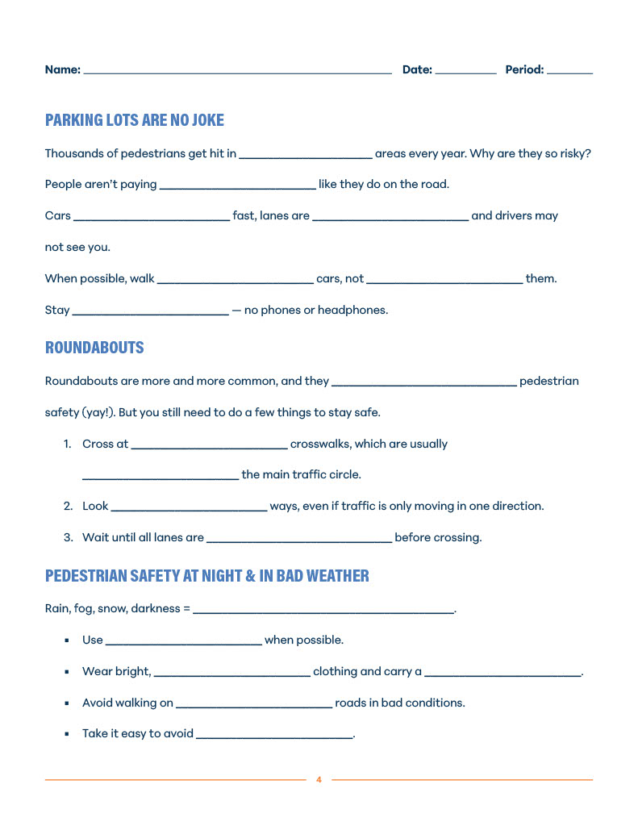
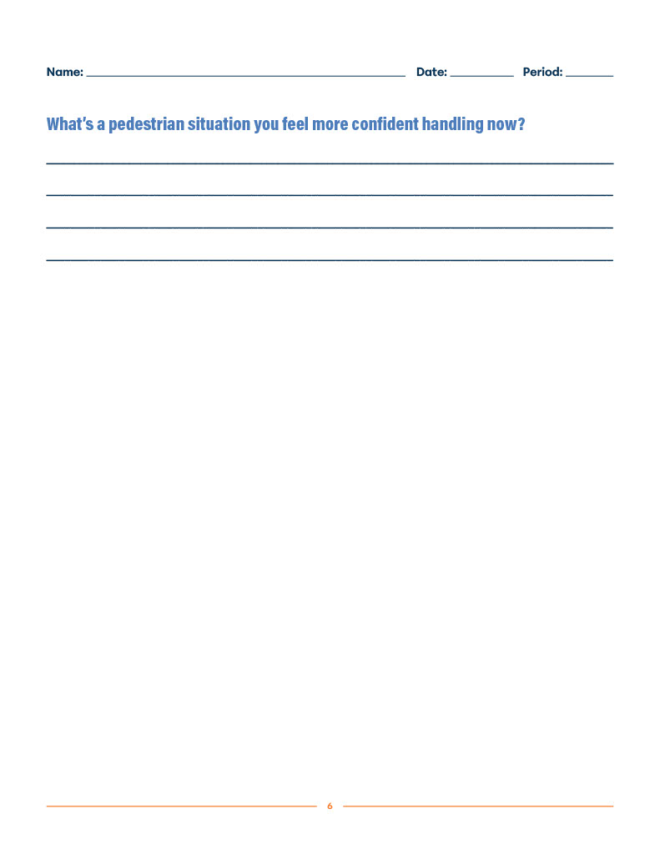
SAMPLE LESSON

Slide 25
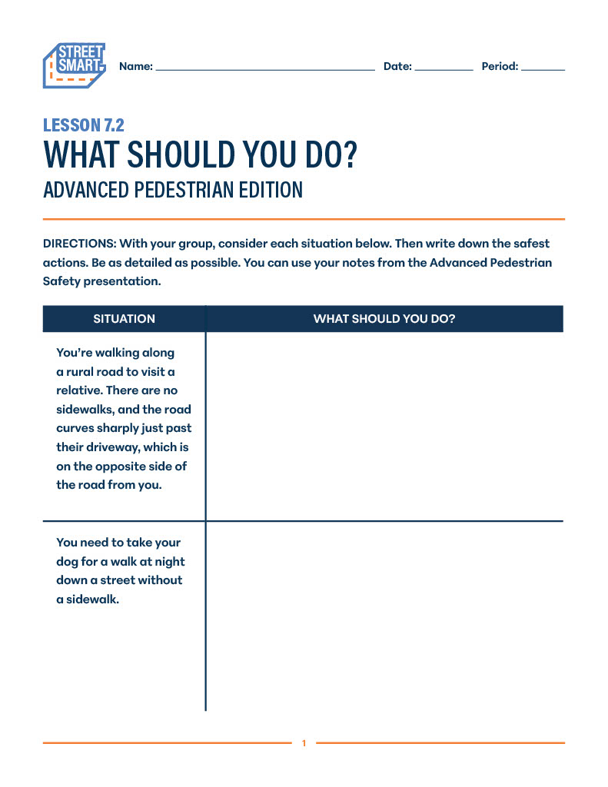
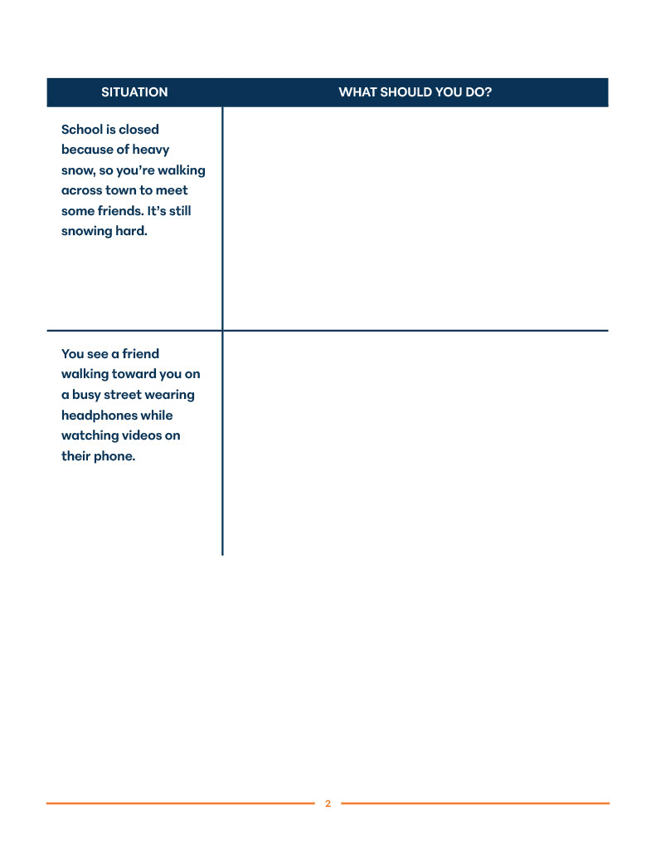
SAMPLE LESSON

Slide 26




PROGRAM MISSION
That all children in Arkansas are exposed to the Street Smart program in an impactful way, leading to safer habits, safer individuals, and safer roads.

Slide 27
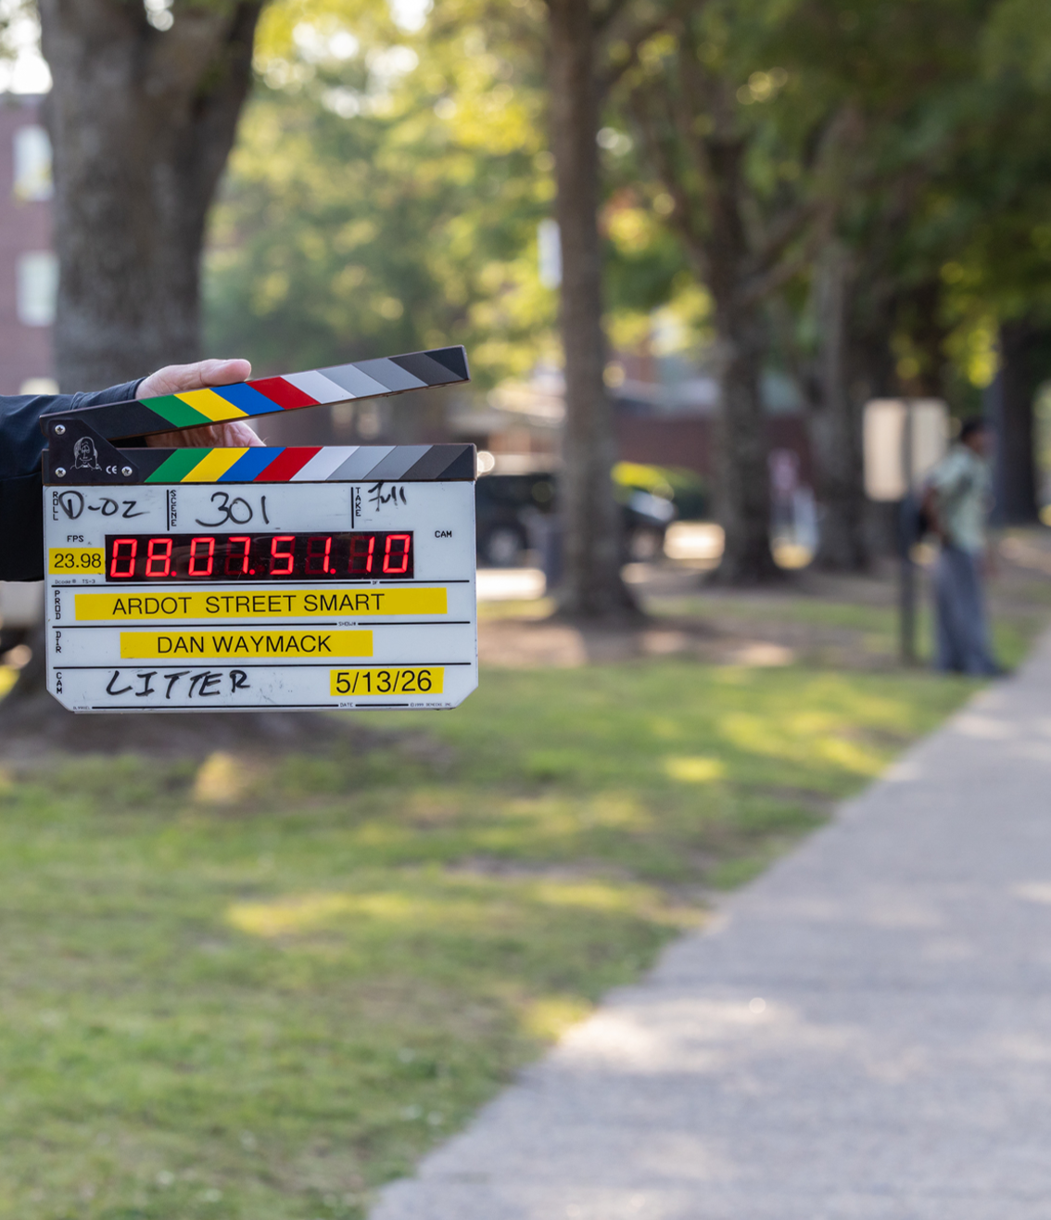


GET THE MATERIALS HERE
GIVE US YOUR FEEDBACK

Slide 28
CONTACT INFO
TRAVIS BROOKS, P.E.
Division Head – Planning & Research Arkansas Department of Transportation
(501) 569-2102
Travis.Brooks@ardot.gov

