Slide 1

Cybersecurity and privacy law updates
Acts 504 and 846

Slide 2
Agenda
Act 846
  Minimum standards
  Contrast with Act 560
  Overlap with the ADE K12 Cybersecurity Policy
  Experiences with Cyber Response Board
Act 504
  Summary of ADE K12 Cybersecurity Policy
  Phase 3 Introduction
Questions and next steps

Slide 3
Act 846

Slide 4
Act 846
Act 846 (Cyber Response Program):
Law passed in 2023, effective date July 1, 2024
School districts required to participate
Act 846 does not purchase 3rd party cybersecurity insurance. This program is self-funded by counties, cities, and public school districts to cover losses related to a cyber attack
Funded from a maximum contribution of $300,000 each from counties, cities, and public school districts for the first two years
  Individual district contributions not specified in the law
5 minimum cybersecurity standards set by the Cyber Response Board

Slide 5
Act 846 vs. Act 560
Act 560 (Cyber Liability Insurance):
Approved by the Senate 4/14/25
Cybersecurity Liability Insurance is being offered as an option for districts
  Anticipated price = $30 per employee
Managed by the Arkansas Insurance Department Risk Management Division
  Cyber Liability Insurance requirements determined by the Insurance Department, and will be separate from Act 846 program requirements
  Act 560 insurance may have different coverage amounts and different coverage options as compared to the Act 846 Cyber Response Program

Slide 6
Act 846
Minimum standard categories
  Multi-Factor Authentication (MFA)
  Offline data backups
  Cybersecurity Awareness training
  Password standards
  Patch management

Slide 7
Act 504

Slide 8
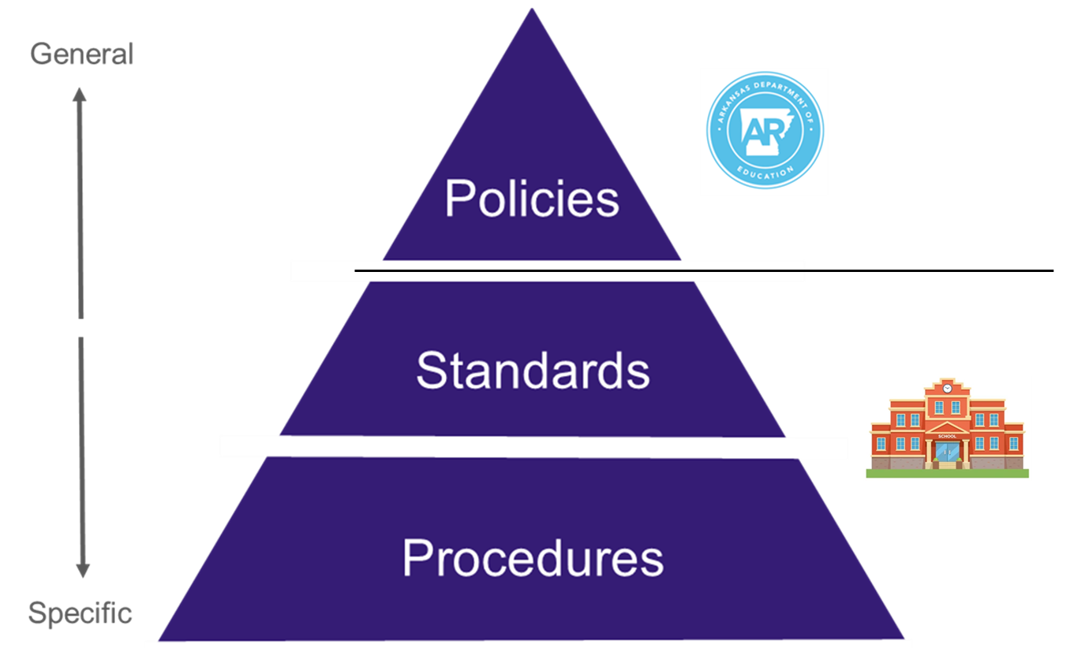
ADE K12 Cybersecurity Policy
Act 504 requires ADE to provide a cybersecurity policy.
Each public school district is responsible to develop standards and procedures to meet the policy.

Slide 9
ADE K12 Cybersecurity Policy
Cybersecurity Policy Baseline
Set by the State Cybersecurity Office (SCSO)
            Based on the National Institute of Standards and Technology (NIST) SP 800-53B Moderate
            ADE must submit to the SCSO for approval by October 1st of each even-numbered year

Slide 10
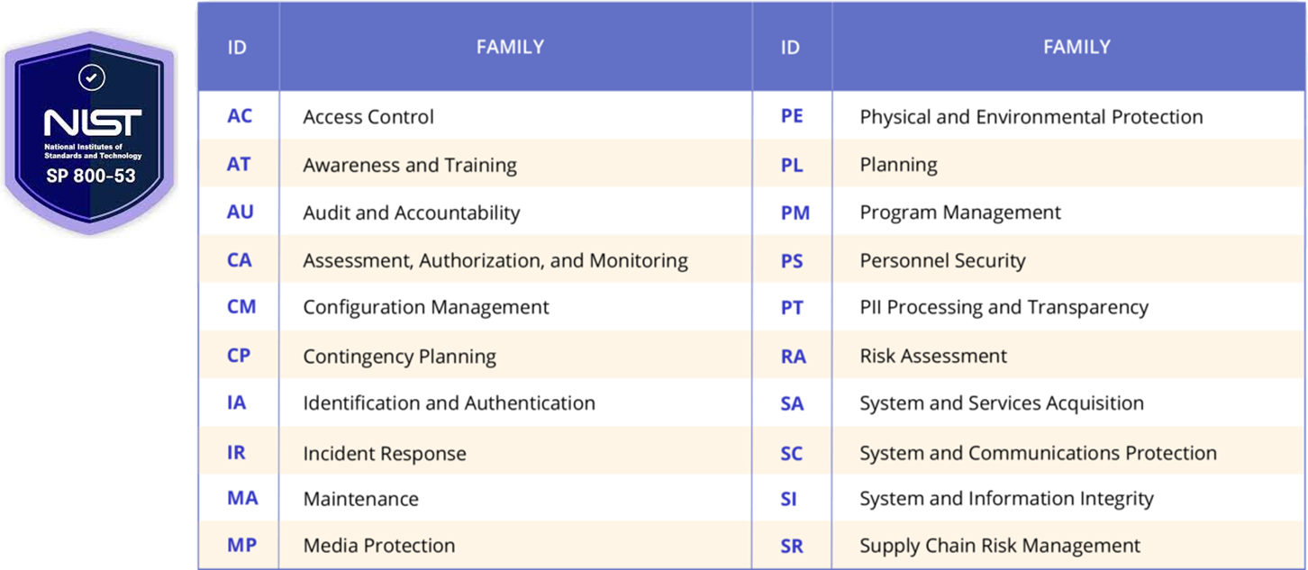
ADE K12 Cybersecurity Policy

Slide 11
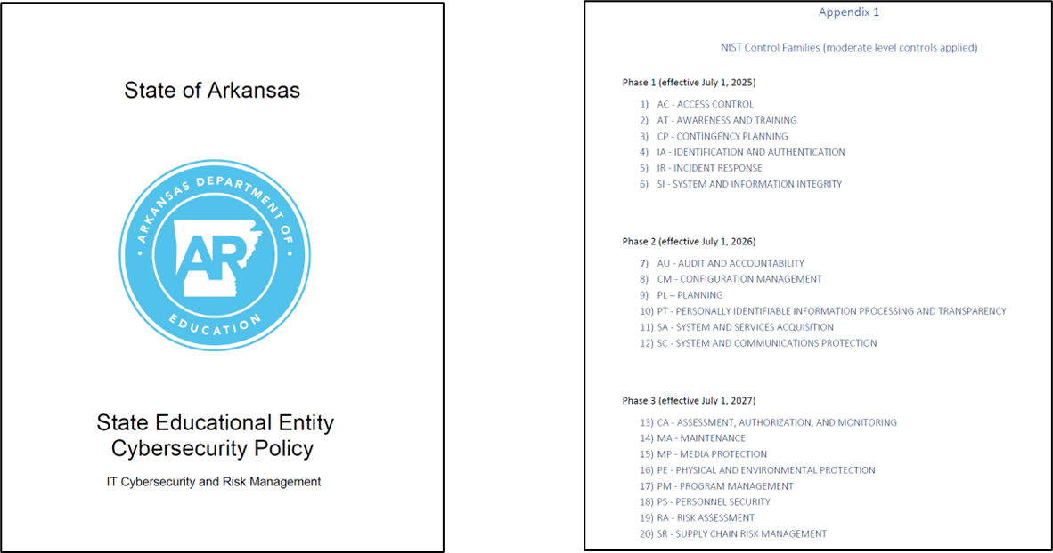
ADE K12 Cybersecurity Policy

Slide 12
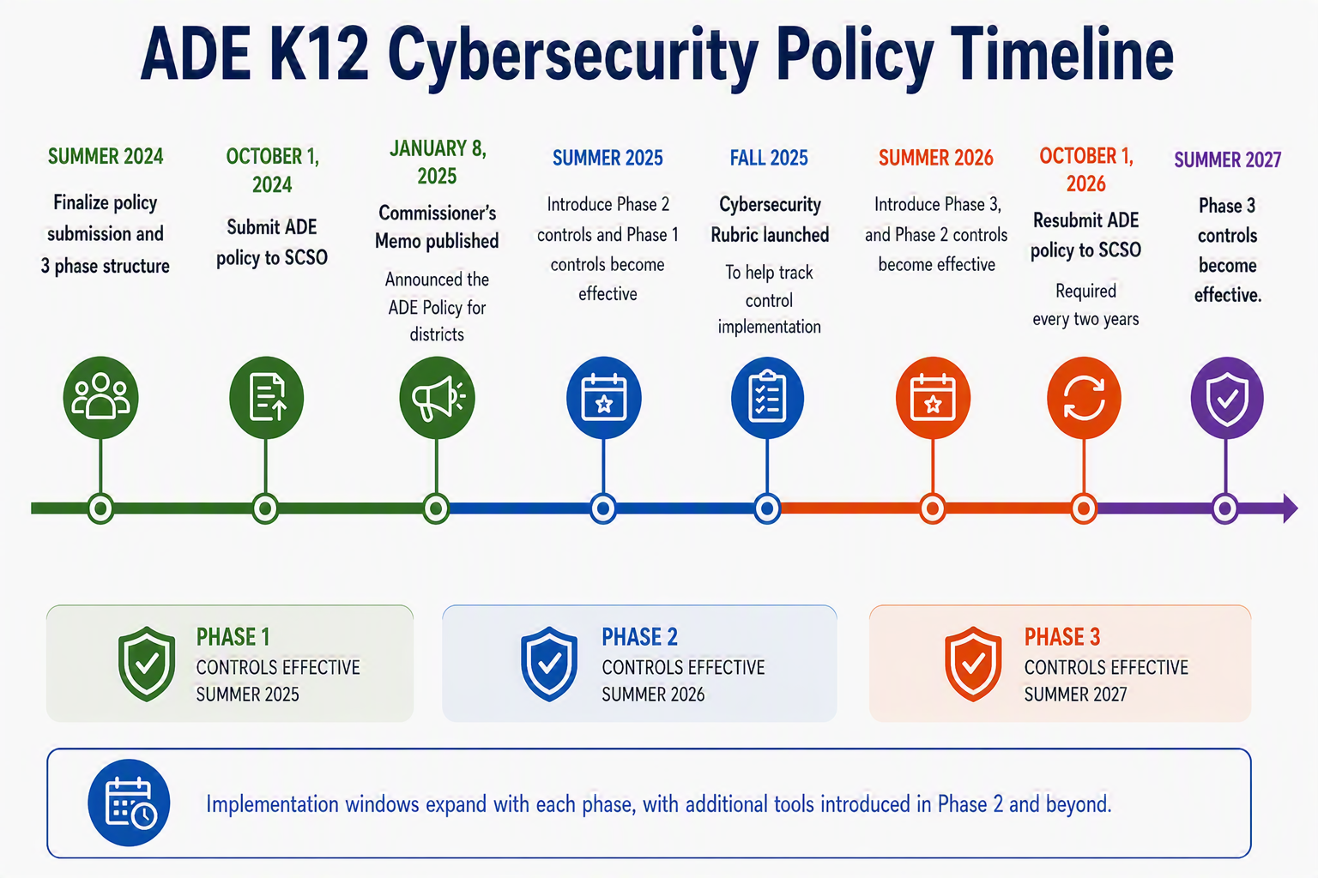
Notes:
Phase 1 aligns with recommendations from the Cybersecurity Infrastructure and Security Agency (CISA), K12SIX, DIS, and local feedback groups

Slide 13
Notes:
Phase 1 aligns with recommendations from the Cybersecurity Infrastructure and Security Agency (CISA), K12SIX, DIS, and local feedback groups

Slide 14
Notes:
Phase 1 aligns with recommendations from the Cybersecurity Infrastructure and Security Agency (CISA), K12SIX, DIS, and local feedback groups

Slide 15
ADE K12 Cybersecurity Policy
Phase 1 (effective July 1, 2025)
Policy controls chosen based on alignment with the Arkansas Cyber Response Program (Act 846) along with national and local recommendations
  Access Control
  Awareness and Training
  Contingency Planning
  Identification and Authentication
  Incident Response
  System and Information Integrity
Notes:
Phase 1 aligns with recommendations from the Cybersecurity Infrastructure and Security Agency (CISA), K12SIX, DIS, and local feedback groups

Slide 16
ADE K12 Cybersecurity Policy
Phase 2 (effective July 1, 2026)
  Audit and Accountability
  Configuration Management
  Planning
  PII Processing and Transparency
  System and Services Acquisition
  System and Communications Protection

Slide 17

ADE K12 Cybersecurity Policy
Phases 1 and 2
  Centered on technical and operational controls
  Aligns naturally with the work of the IT department
    Access control
    Passwords / MFA
    Logging
    Configuration
    System security
Phase 3
  Moves to broader organizational risk
  Less about technical controls, more about assessing, monitoring, and governing across the district
    Human Resources
    Business Office / Procurement
    Facilities
    Student Records
    District Leadership
Notes:
Phase 1 aligns with recommendations from the Cybersecurity Infrastructure and Security Agency (CISA), K12SIX, DIS, and local feedback groups

Slide 18
ADE K12 Cybersecurity Policy
Phase 3 is where districts move from implementing cybersecurity controls to managing cybersecurity risk as an organization-wide responsibility
Notes:
Phase 1 aligns with recommendations from the Cybersecurity Infrastructure and Security Agency (CISA), K12SIX, DIS, and local feedback groups

Slide 19
ADE K12 Cybersecurity Policy
Phase 3 (effective July 1, 2027)
  Assessment, Authorization, and Monitoring
  Maintenance
  Media Protection
  Physical and Environmental Protection
  Program Management
  Personnel Security
  Risk Assessment
  Supply Chain Risk Management
Notes:
Phase 1 aligns with recommendations from the Cybersecurity Infrastructure and Security Agency (CISA), K12SIX, DIS, and local feedback groups

Slide 20
ADE K12 Cybersecurity Policy
Assessment, Authorization, and Monitoring (CA)
  Assess security controls
  Track and remediate gaps
  Continuously monitor systems
  Approve new systems and major changes
Notes:
Phase 1 aligns with recommendations from the Cybersecurity Infrastructure and Security Agency (CISA), K12SIX, DIS, and local feedback groups

Slide 21
ADE K12 Cybersecurity Policy
Maintenance (MA)
  Perform routine maintenance
  Control repair activities
  Manage vendor access
  Replace aging equipment
Notes:
Phase 1 aligns with recommendations from the Cybersecurity Infrastructure and Security Agency (CISA), K12SIX, DIS, and local feedback groups

Slide 22
ADE K12 Cybersecurity Policy
Media Protection (MP)
  Protect paper and digital records
  Control media access
  Secure media transport
  Sanitize before disposal
Notes:
Phase 1 aligns with recommendations from the Cybersecurity Infrastructure and Security Agency (CISA), K12SIX, DIS, and local feedback groups

Slide 23
ADE K12 Cybersecurity Policy
Physical and Environmental Protection (PE)
  Secure technology spaces
  Manage visitor access
  Protect equipment
  Maintain safe environments
Notes:
Phase 1 aligns with recommendations from the Cybersecurity Infrastructure and Security Agency (CISA), K12SIX, DIS, and local feedback groups

Slide 24
ADE K12 Cybersecurity Policy
Program Management (PM)
  Establish cybersecurity governance
  Define leadership responsibilities
  Measure program performance
  Plan for long-term risk management
Notes:
Phase 1 aligns with recommendations from the Cybersecurity Infrastructure and Security Agency (CISA), K12SIX, DIS, and local feedback groups

Slide 25
ADE K12 Cybersecurity Policy
Personnel Security (PS)
  Screen personnel appropriately
  Establish user responsibilities
  Manage employee transitions
  Enforce policy compliance
Notes:
Phase 1 aligns with recommendations from the Cybersecurity Infrastructure and Security Agency (CISA), K12SIX, DIS, and local feedback groups

Slide 26
ADE K12 Cybersecurity Policy
Risk Assessment (RA)
  Identify threats and vulnerabilities
  Assess organizational risk
  Conduct vulnerability scans
  Prioritize risk reduction efforts
Notes:
Phase 1 aligns with recommendations from the Cybersecurity Infrastructure and Security Agency (CISA), K12SIX, DIS, and local feedback groups

Slide 27
ADE K12 Cybersecurity Policy
Supply Chain Risk Management (SR)
  Evaluate vendors
  Establish security requirements
  Monitor supplier risk
Notes:
Phase 1 aligns with recommendations from the Cybersecurity Infrastructure and Security Agency (CISA), K12SIX, DIS, and local feedback groups

Slide 28
Acts 504 and 846:
Overlap

Slide 29
Overlap
Act 504 (Phase 1)
  Access Control
  Awareness and Training
  Contingency Planning
  Identification and Authentication
  Incident Response
  System and Information Integrity
Act 846
  Multi-Factor Authentication (MFA)
  Offline data backups
  Cybersecurity Awareness training
  Password standards
  Patch management
Notes:
846 / 504 Summary document: https://docs.google.com/document/d/1g2OkDH1O4IdcZBqoXaYUGpBA7FCtjQFSwVdIhRNtozY/edit?tab=t.0

Slide 30
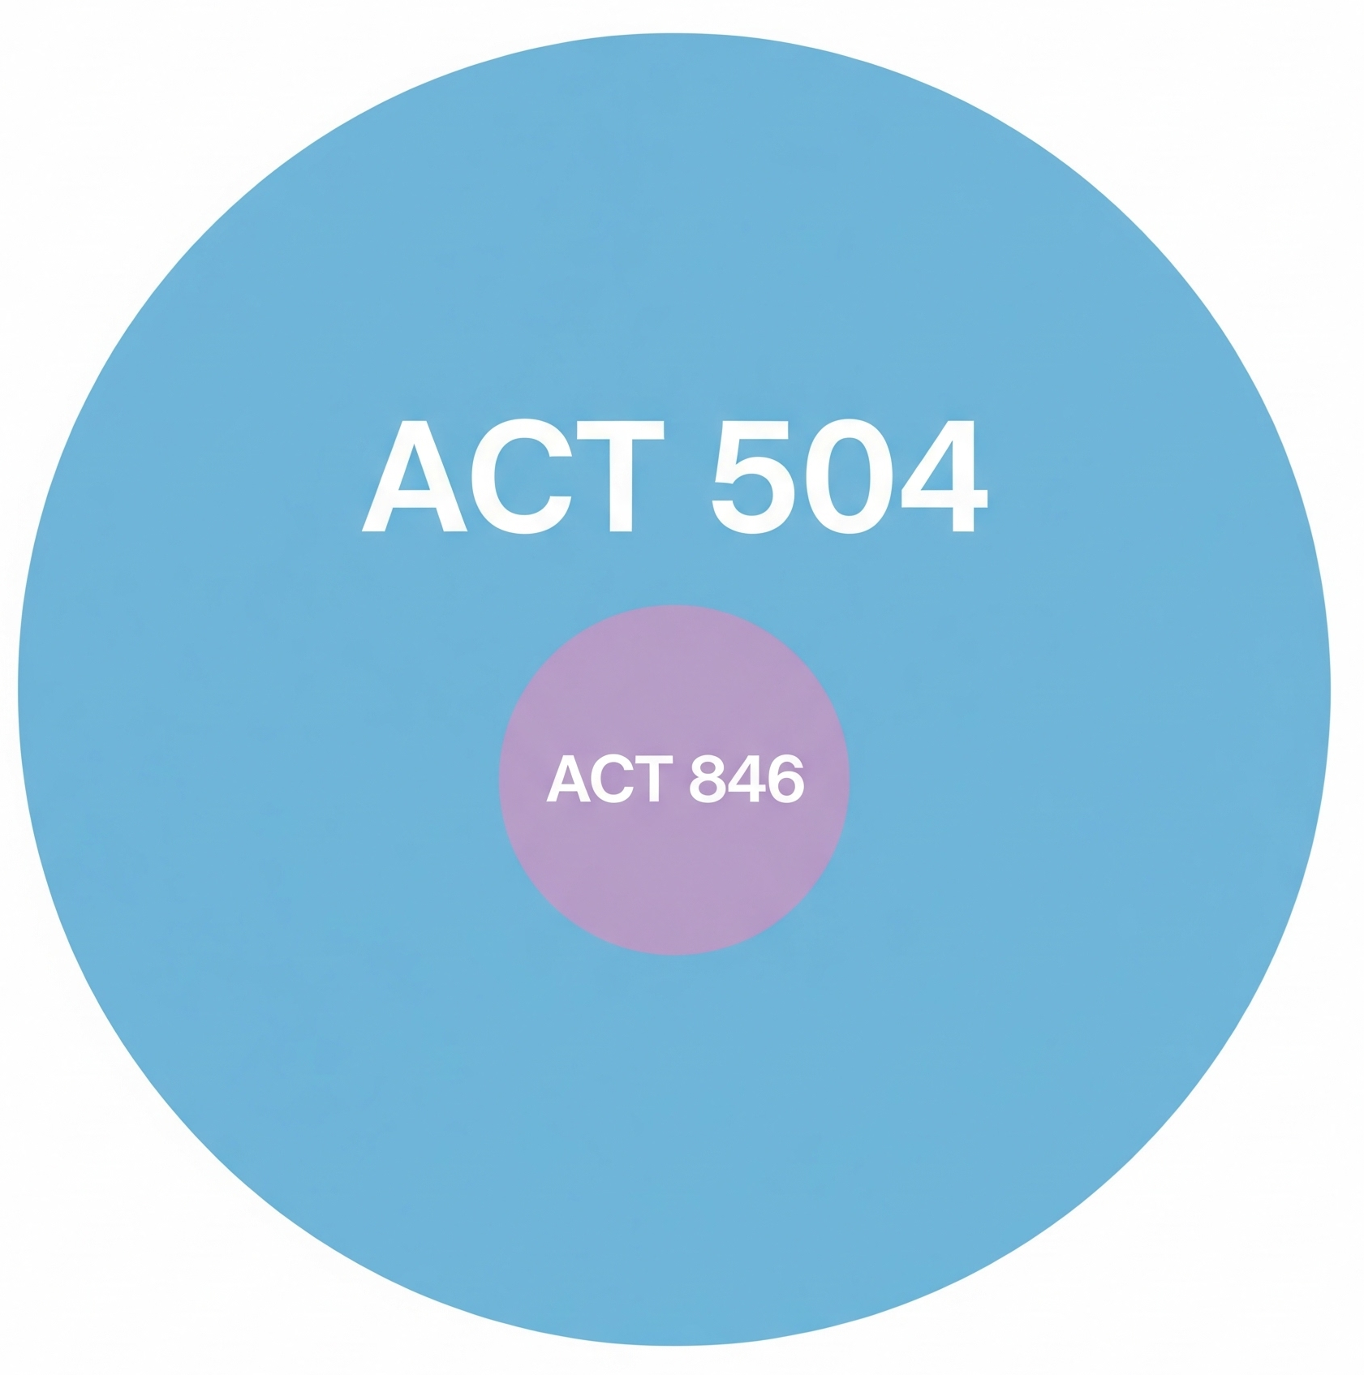
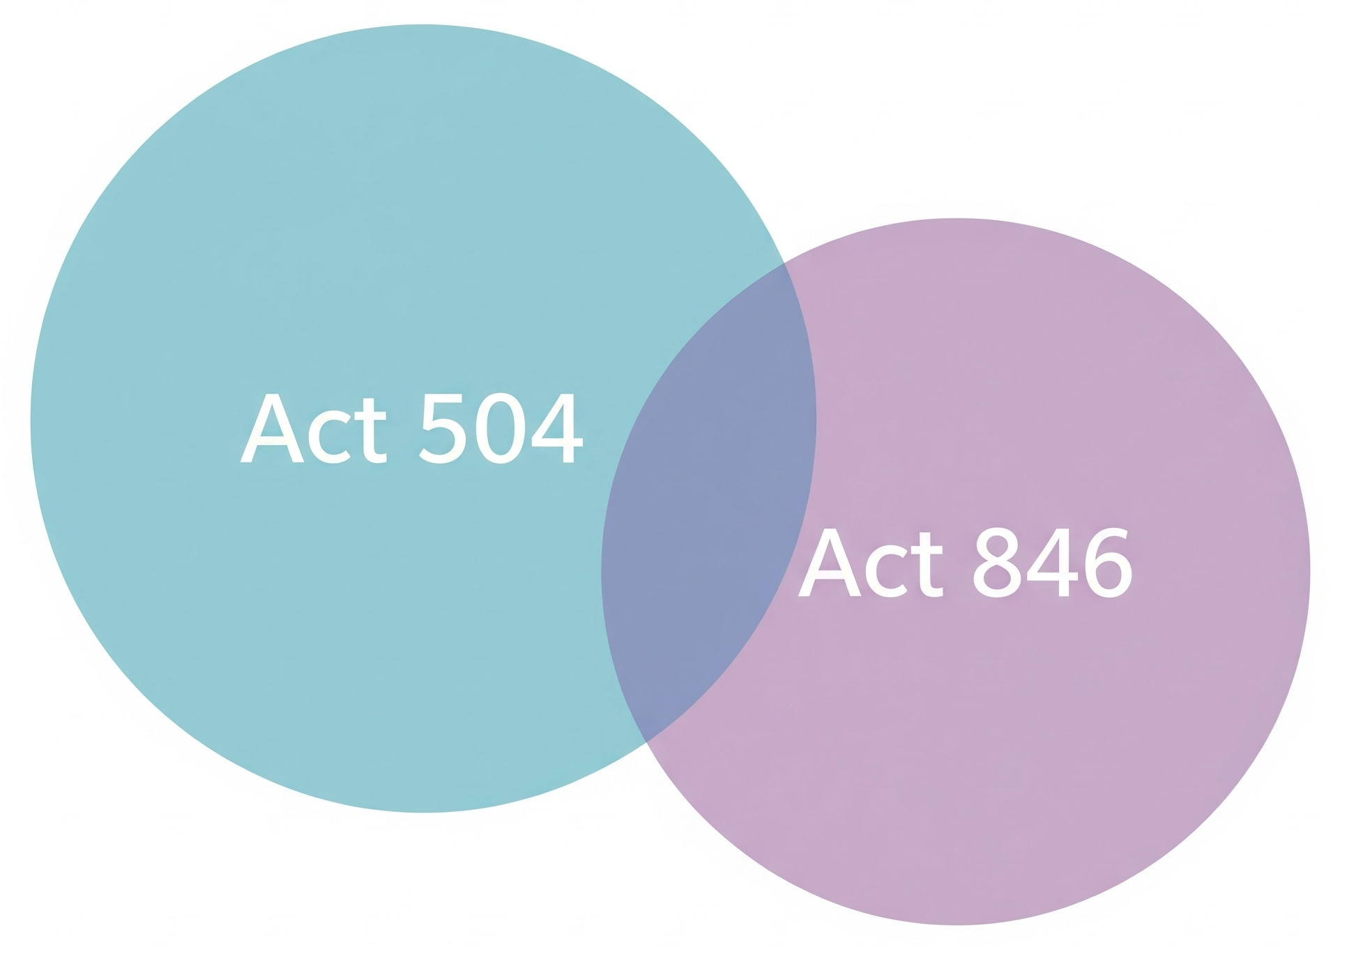
Overlap
Act 504 and Act 846 overlap is most like:
or

Slide 31

Overlap
Act 504 and Act 846 overlap is most like:

Slide 32
Next Steps

Slide 33
Next Steps
            Act 504
              Adopt ADE K12 Cybersecurity Policy
              Implement Phase 1 and 2 controls
              Prepare for Phase 3 (July 1, 2027)
            Act 846
              Implement minimum standards

Slide 34
Resources

Slide 35
Resources
ADE K12 Cybersecurity Policy
  Commissioner’s Memo
  NIST Control Family Summaries
Contact Jeff Killingsworth for:
  Cyber Response Program minimum standards
  Cybersecurity Policy Summary
  Cybersecurity Rubric and Guiding Questions
Cyber Incident Response Team (CIRT)

Slide 36


Thanks!
Any questions?
You can reach me at:
jeff.killingsworth@ade.arkansas.gov

Slide 37
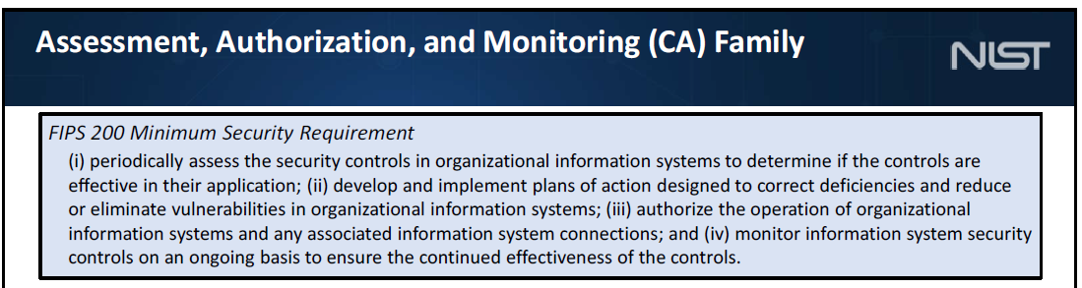
ADE K12 Cybersecurity Policy
Notes:
Phase 1 aligns with recommendations from the Cybersecurity Infrastructure and Security Agency (CISA), K12SIX, DIS, and local feedback groups

Slide 38
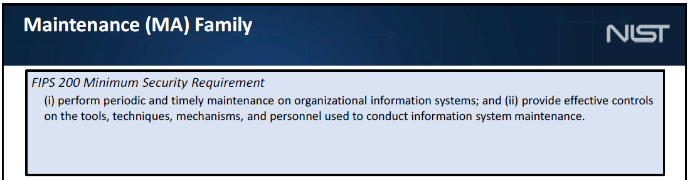
ADE K12 Cybersecurity Policy
Notes:
Phase 1 aligns with recommendations from the Cybersecurity Infrastructure and Security Agency (CISA), K12SIX, DIS, and local feedback groups

Slide 39
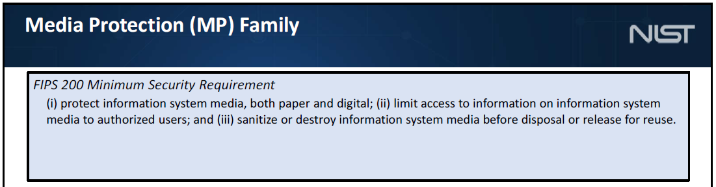
ADE K12 Cybersecurity Policy
Notes:
Phase 1 aligns with recommendations from the Cybersecurity Infrastructure and Security Agency (CISA), K12SIX, DIS, and local feedback groups

Slide 40
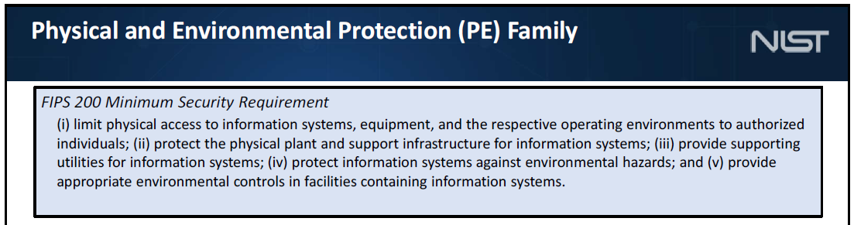
ADE K12 Cybersecurity Policy
Notes:
Phase 1 aligns with recommendations from the Cybersecurity Infrastructure and Security Agency (CISA), K12SIX, DIS, and local feedback groups

Slide 41
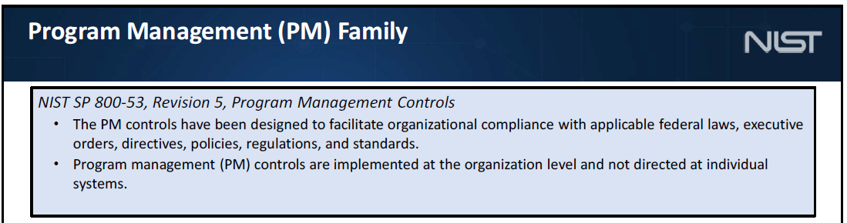
ADE K12 Cybersecurity Policy
Notes:
Phase 1 aligns with recommendations from the Cybersecurity Infrastructure and Security Agency (CISA), K12SIX, DIS, and local feedback groups

Slide 42
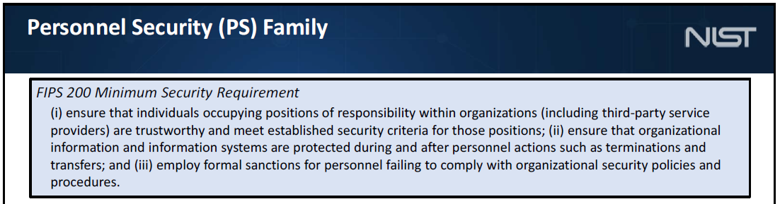
ADE K12 Cybersecurity Policy
Notes:
Phase 1 aligns with recommendations from the Cybersecurity Infrastructure and Security Agency (CISA), K12SIX, DIS, and local feedback groups

Slide 43
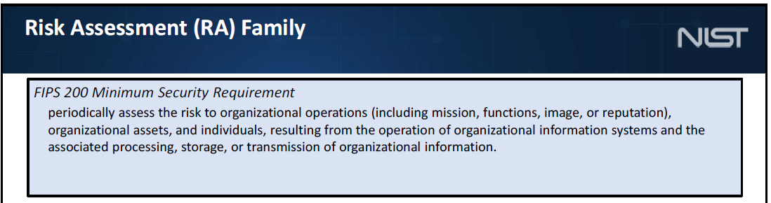
ADE K12 Cybersecurity Policy
Notes:
Phase 1 aligns with recommendations from the Cybersecurity Infrastructure and Security Agency (CISA), K12SIX, DIS, and local feedback groups

Slide 44
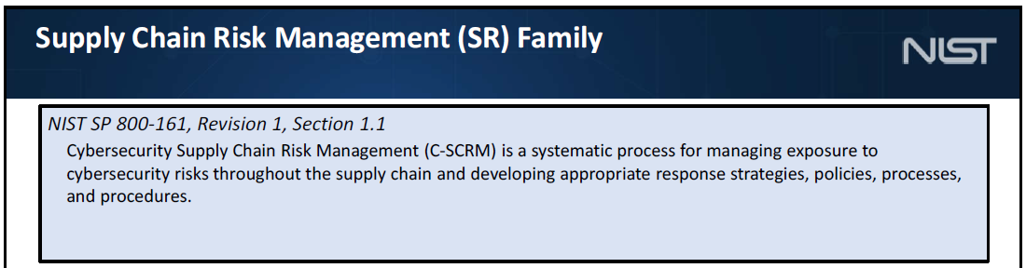
ADE K12 Cybersecurity Policy
Notes:
Phase 1 aligns with recommendations from the Cybersecurity Infrastructure and Security Agency (CISA), K12SIX, DIS, and local feedback groups

Slide 45
Act 848

Slide 46
Act 848
Act 848
  Amends a section of Act 504
  Adds requirement for a policy on Artificial Intelligence and Automated Decision Tools
    Developed by ADE in coordination with the SCSO
    Define authorized use of AI
    Require a human employee to make final decisions
    Training
    Similar restrictions as Technology Resources Policy (contacting an elected official, lobbying, etc.)
Notes:
Phase 1 aligns with recommendations from the Cybersecurity Infrastructure and Security Agency (CISA), K12SIX, DIS, and local feedback groups

Slide 47
Act 754

Slide 48
Act 754
Act 754
Effective June 1, 2024
"Increase security and transparency in the sharing and use of student data with and by third party vendors”
  Vendor lists
  Agreement language
  Vendor and district requirements

Slide 49
Act 754
Access 4 Learning (A4L)
  Part of the national Student Data Privacy Consortium
  Arkansas Alliance
    Free for districts
    Data Privacy Agreement template (AR law references)
      Used at district discretion
    Creates vendor list

Slide 50
Act 754
District questions:
Interpretation of Act 754 definitions and requirements
Approved Data Privacy Agreement
Procurement procedures
Formatting for vendor lists
New district policies
  Teacher use of school-service on-demand providers
A4L involvement
AI Vendors

