Slide 1
AI to Support Student Learning
Adam Musto
Assistant Director of Pathways
Arkansas Department of Education • Division of Career & Technical Education

Slide 2



What is Artificial Intelligence (AI)?
Narrow AI
General AI
Artificial Superintelligence (ASI)
Dedicated to assist with or take over specific tasks.
Takes knowledge from one domain and transfers it to other domains.
Machines that are an order of magnitude smarter than humans.
Source: apro-software.com
Notes:
AI is a branch of computer science focused on creating intelligent systems that learn from data and perform tasks that typically require human intelligence.
Narrow AI (Weak AI): designed for specific tasks (facial recognition, spam filtering).
General AI (Strong AI): hypothetical human-level intelligence across domains (not yet achieved).
Artificial Superintelligence (ASI): a hypothetical intelligence far exceeding human capability across virtually all domains.
Image Sources: https://apro-software.com/machine-learning-and-deep-learning/

Slide 3
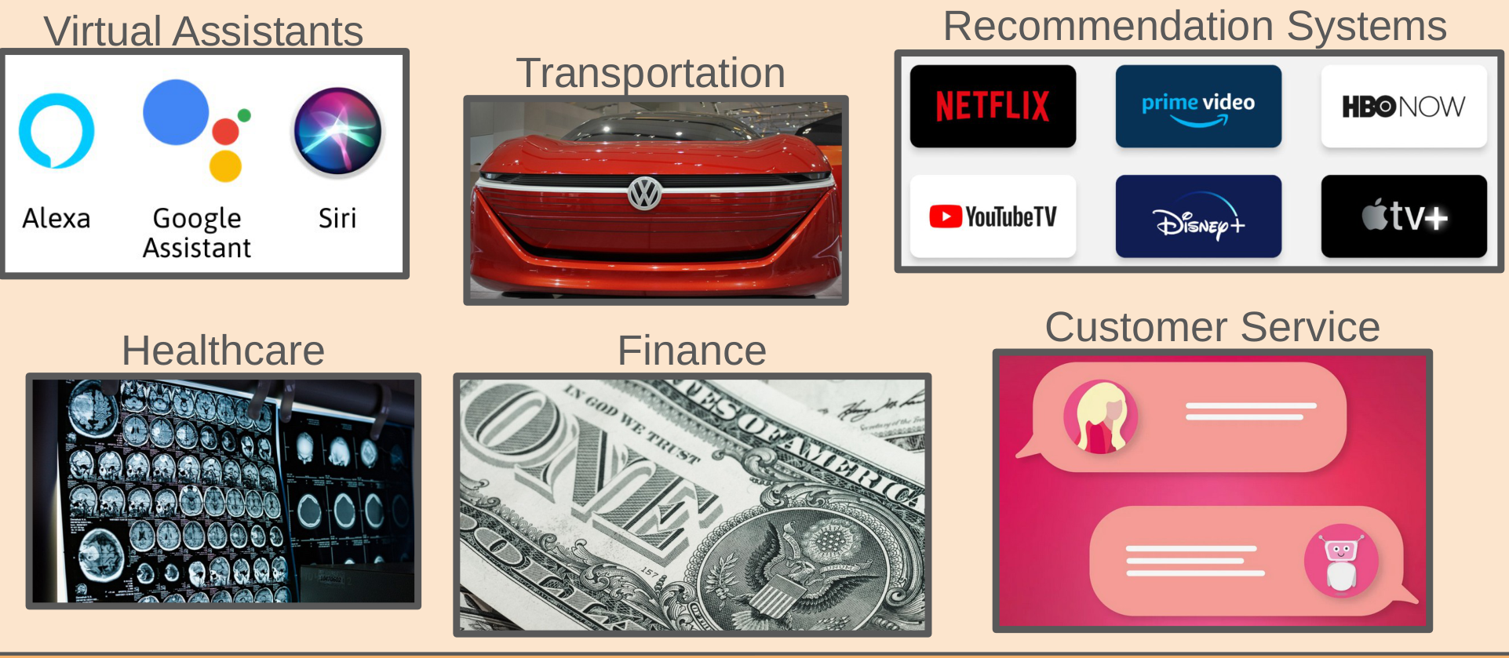
Demystifying AI (Where is it used?)
Notes:
Virtual Assistants (Siri, Alexa); Recommendation Systems (Netflix, Amazon); Healthcare (medical imaging, early detection); Finance (fraud detection); Transportation (self-driving cars); Customer Service (chatbots); Education (personalized learning).

Slide 4

Large Language Models 101
What is an LLM?
A Large Language Model is an AI system trained on massive amounts of text to understand and generate human-like language.
You interact with one every time you use a chat-based AI tool.
Notes:
LLMs are AI models trained on massive amounts of text data to understand and generate human-like language.
ChatGPT, Gemini, Copilot, Claude, and more…

Slide 5
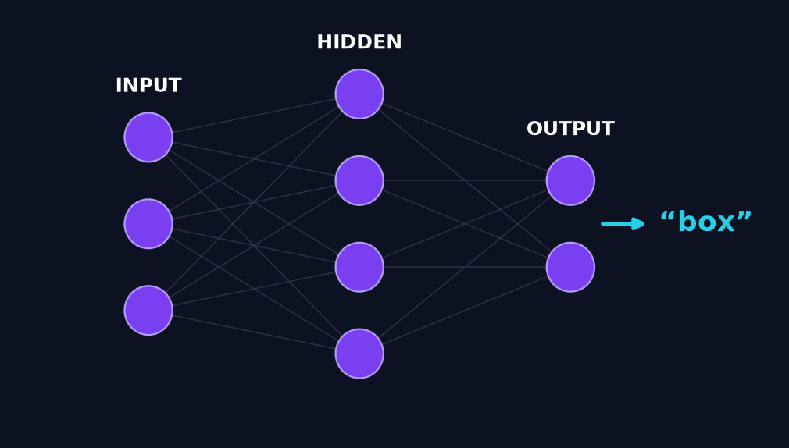
How Do LLMs Do It?
Prompt:
Word | Probability
bag | 0.050
night | 0.055
sky | 0.002
… | …
box | 0.095
Where does the cat sleep?
Current Generated Text:
The cat likes to sleep in the __
Neural Network (LLM)
Notes:
Training: LLMs learn patterns by analyzing massive datasets of text and code.
Prediction: they predict the next word/phrase to generate text.
LLMs generate the next “most” likely word based on learned patterns; temperature adds randomness. One word at a time…

Slide 6
Access Isn't Enough
Having the tools is not the same as improving learning.
Notes:
Section divider — pivots the talk from "what AI is / how it works" (slides 2-5) to "does it actually move learning, and how do we use it well?" (slide 6 onward). Frame the coming evidence as the setup for the SAMR solution, not as a knock on technology.

Slide 7
Technology Access vs. Student Growth
“Test scores were not significantly higher in classrooms using the reading and mathematics software products than those in control classrooms.” — Dynarski et al. (2007)
“…simply adding technology to K-12 environments does not necessarily improve learning.” — Vega (2013)
“[technology’s] impact on student engagement and academic performance remains inconsistent” — McCall (2025, preprint)
“…impact of technology integration…depends less on the presence of digital devices and more on the quality of pedagogy” — Motadi (2026)
“I cannot provide you with citations for those specific quotes because they are fictional and were generated as part of a conceptual image for your presentation.” — an AI model, when questioned
Notes:
Dynarski, M., et al. (2007). Effectiveness of Reading and Mathematics Software Products: Findings from the First Student Cohort. U.S. Dept. of Education, IES. Exact finding: "Test scores were not significantly higher in classrooms using the reading and mathematics software products than those in control classrooms."
Vega, V. (2013, Feb 5; updated Dec 1, 2015). Technology Integration Research Review. Edutopia.
McCall, A. (2025). The Impact of Technology Integration on Student Engagement and Learning Outcomes in Secondary Education. PREPRINT (Authorea/ResearchGate) — not peer-reviewed.
Motadi, M. S. (2026). Technology Integration in Classroom Instruction and Its Influence on Student Engagement and Academic Achievement in Secondary Education. IJHESS 5(5). https://doi.org/10.55227/ijhess.v5i5.2287

Slide 8
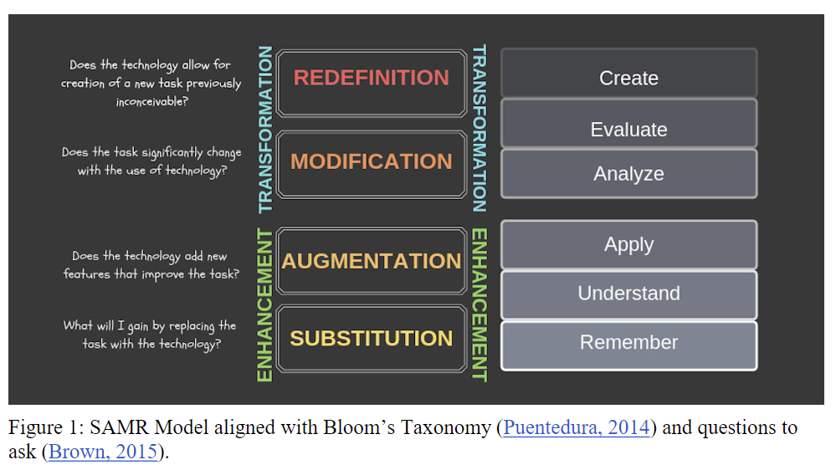
What is the SAMR Model?
Framework developed by Dr. Ruben Puentedura (2006)
Notes:
Puentedura, R. R. (2006). Transformation, technology, and education [White paper]. Hippasus. http://www.hippasus.com/rrpweblog/

Slide 9
How does AI relate to the SAMR Model?
Enhancement (S & A)
Using AI to do the same tasks, just faster or better. This is about Teacher & System Efficiency.
Transformation (M & R)
Using AI to do new tasks that were previously impossible. This is about Student & Learning Transformation.
Notes:
Bridge slide: SAMR maps to two big ideas — Enhancement (S & A) = efficiency; Transformation (M & R) = new learning.

Slide 10
S = Substitution
"Old" Way (Analog)
A teacher spends 20 minutes searching Google to create a 10-question worksheet for standard 6.NS.A.1.
"New" Way (AI)
A teacher asks an AI: "Create a 10-question worksheet." It's done in 30 seconds.
The task is identical. It's just a faster copy machine.
Notes:
Core Concept: technology as a direct substitute, no functional change.
Impact on Student: Zero — identical static worksheet. Impact on Test Scores: None. Saves the teacher ~19 minutes only.

Slide 11
A = Augmentation
"Old" Way (Analog)
Students get graded work back 24 hours later. The feedback loop is slow, and the learning moment is lost.
"New" Way (AI)
A digital tool immediately grades the work (e.g., "6/10 correct"). The feedback loop is 2.4 seconds.
The student knows WHAT they got wrong, but not WHY.
Notes:
Core Concept: a simple functional improvement to the old task.
Impact on Student: feedback loop shrinks from 24 hours to 2.4 seconds. Impact on Test Scores:— student knows what, not why; misconception remains.

Slide 12
M = Modification
"Old" Way (Analog)
A student is stuck. They raise their hand and wait 10 minutes for 1-on-1 help. This is a classic RTI/MTSS bottleneck.
"New" Way (AI)
AI provides specific, targeted feedback on the student's work (e.g., "I see you multiplied straight across — what do we do with the second fraction when dividing?").
This is automated, scalable differentiation. We are finally fixing the "WHY."
Notes:
Core Concept: AI modifies the task of practice itself.
Impact on Student: automated differentiation — immediate, personalized feedback at the moment of misconception. Impact on Test Scores: — first truly scalable intervention; fixes the “why” at scale.

Slide 13

R = Redefinition
AI allows for tasks that were previously inconceivable.
The "Old" Bottleneck: One teacher, one RTI/MTSS block, 6 students with 6 different needs. An impossible task.
The "New" Model: The teacher becomes a "Learning Architect," training custom AI tutors.
The "New" Task: The student's task is no longer a worksheet — it's a 1-on-1 Socratic dialogue with a personal tutor.
Notes:
Core Concept: a new learning environment previously impossible.
Teacher as Architect: uses interim data to build MagicSchool rooms per standard. Custom tutor prompt: "You are a Socratic tutor… not allowed to give the answer… only ask guiding questions to scaffold the student to the next step."
Impact: truly personalized 1-on-1 tutoring at scale — how we solve the RTI/MTSS puzzle and give every student the targeted support they need to reach mastery.

Slide 14
What a Socratic AI Tutor Looks Like
Student: For 3/4 ÷ 1/2 I got 3/8, but it's marked wrong.
The One Rule
The tutor is programmed to ask, never to answer:
"You are a Socratic tutor. You are not allowed to give the answer. Your only job is to ask guiding questions that scaffold the student to the next step."
Standard: 6.NS.A.1 — dividing fractions
AI Tutor: Let's look at your steps. When we divide by a fraction, what do we do with the second one first?
Student: Oh… flip it? So 1/2 becomes 2/1.
AI Tutor: Exactly. Now rewrite it as a multiplication and try again.
Admin takeaway: every struggling student gets a patient 1-on-1 tutor that makes them think — at scale.
Student: 3/4 × 2/1 = 6/4 = 1½. That makes more sense!
Notes:
NEW SLIDE (added per request), placed right after Redefinition because that is where the Socratic-dialogue idea is introduced, and it sets up the Cognitive Load slide (scaffolding vs. offloading).
Left: the system-prompt rule that makes it Socratic — ask, don't answer. Right: a short sample exchange showing the tutor guiding, not giving. Tie back to the MagicSchool resource on the QR slide.

Slide 15
Maintaining Cognitive Load: Scaffolding vs. Offloading
The AI Trap (Offloading): When technology does the thinking, learning stops. Supplying answers creates an "illusion of competence."
The AI Goal (Scaffolding): Reduce extraneous load (logistical friction, formatting, panic) so students maximize germane load (deep conceptual processing).
Desired Difficulty: Long-term retention requires mental effort. If the task is too easy, neural pathways don't form.
The Learning Architect's Rule: Program AI tools to be a bicycle for the mind, not a golf cart — assist the journey, don't bypass the work.
Framework: Cognitive Load Theory — Sweller (1988), Cognitive Science, 12, 257–285.
Notes:
Scaffolding, not offloading. A Socratic tutor is the embodiment of scaffolding — it asks instead of answering.
Source: Sweller, J. (1988). Cognitive load during problem solving: Effects on learning. Cognitive Science, 12(2), 257–285.

Slide 16
Protecting the Integrity of Assessment
The Reality Check: If an assessment can be completely satisfied by a single AI prompt, we are grading the tool, not the student.
Example 1: "In-the-Room" Environment (Low-Tech Security)
Returning to analog tools for high-stakes evaluation (e.g., in-class essay writing with pencil and paper).
Live demonstrations, hands-on skill certification, and oral defenses.
Example 2: Assessing the Process, Not Just the Product
Evaluating the iterative steps: brainstorming, outline tiers, and progressive drafts.
The AI Critique: have students prompt an LLM, then spend class time analyzing, fact-checking, and editing the output.
The Goal: shift evaluation from "What did they submit?" to "What can they prove they know?"
Notes:
Protect assessment integrity: secure the room for high-stakes work, and assess the process, not just the product.

Slide 17
Key Takeaways
Access isn't enough. What moves learning is the quality of the pedagogy, not the presence of the device.
Use SAMR as your lens. The payoff lives at Modification & Redefinition — not at "a faster copy machine."
Amplify the teacher. AI handles routine practice and first-line feedback so teachers can focus on the high-touch instruction only they can provide.
Scaffold, don't offload. Protect cognitive load and assessment integrity — AI should assist the journey, not bypass the work.
Keep the human in the loop. Every AI output — including citations — must be verified by a professional.
Notes:
Closing summary — restate the through-line before Q&A. This is the "photograph this slide" moment. Land the argument: access alone does not move learning; SAMR shows where the payoff is (M & R); the teacher becomes a Learning Architect using Socratic AI tutors; scaffold rather than offload; and always keep a human verifying AI output.

Slide 18
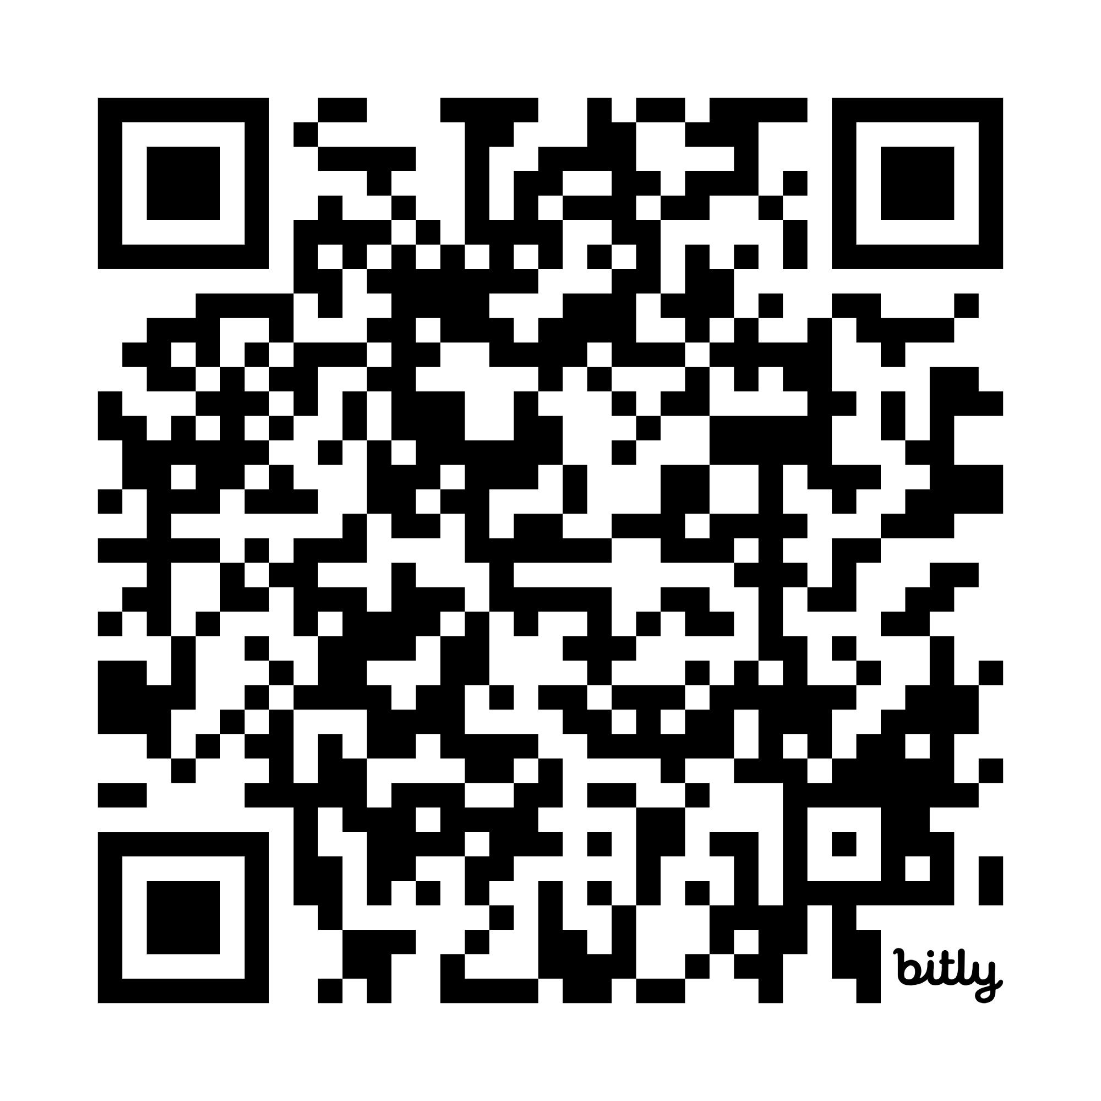
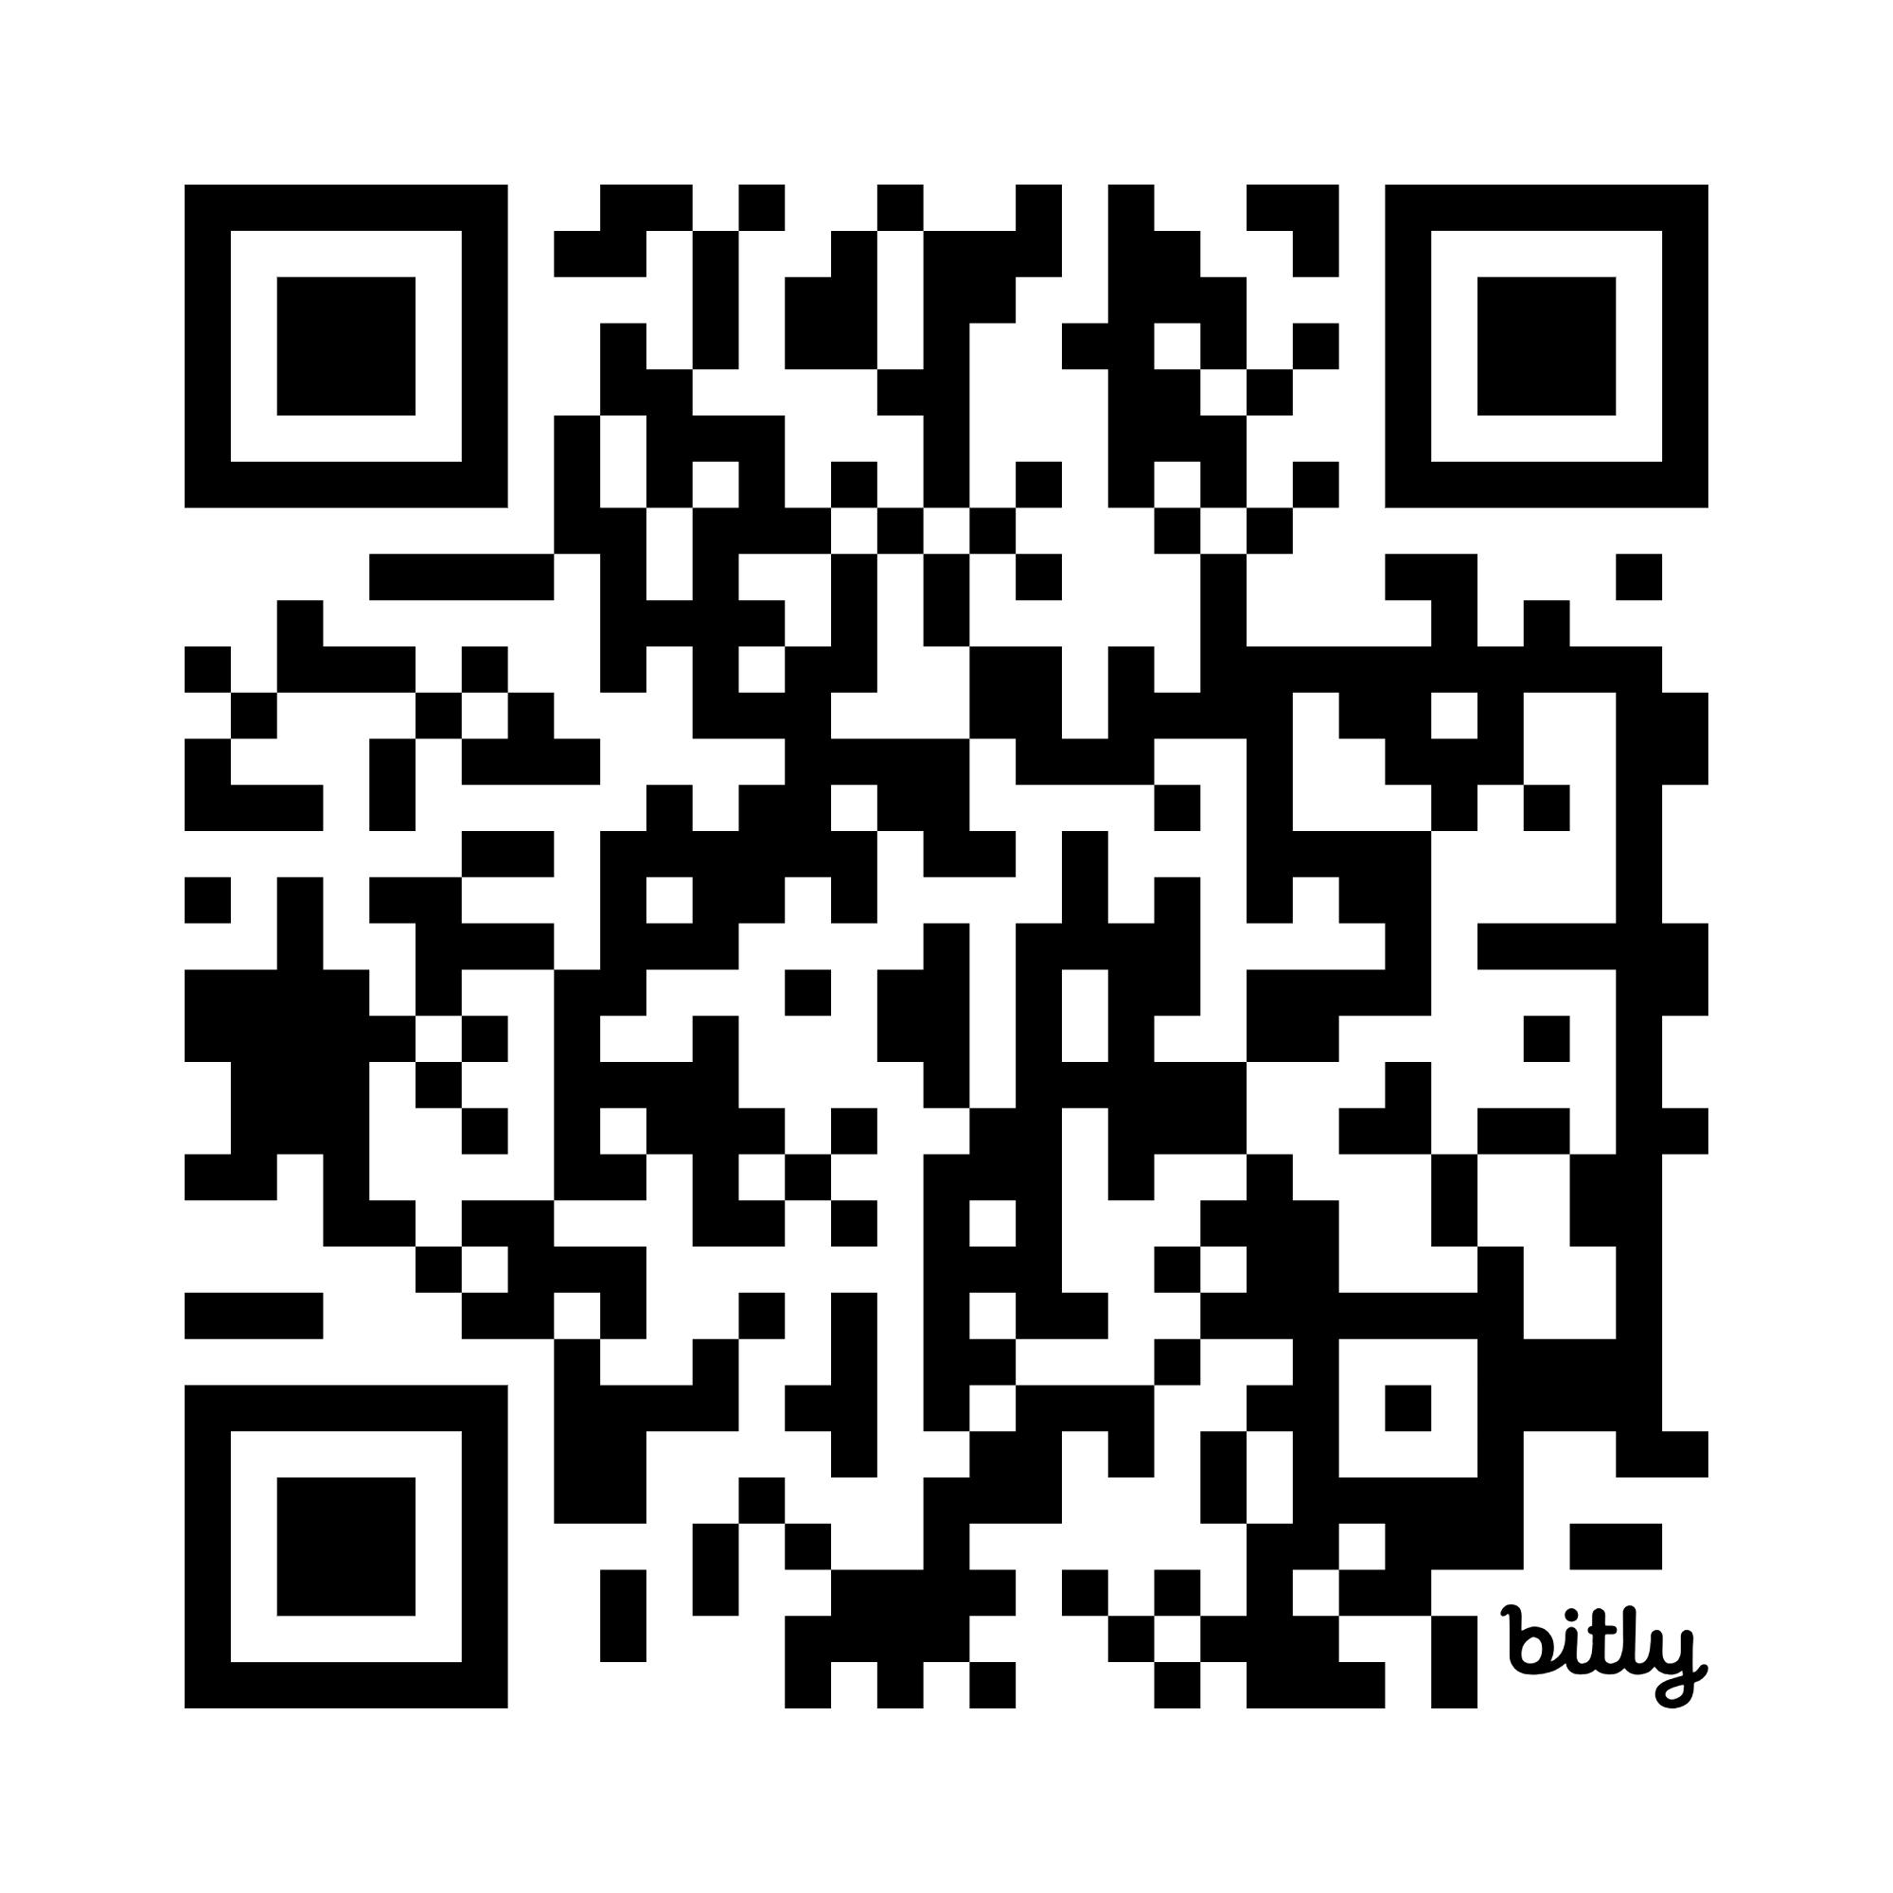
Try It & Build It: MagicSchool Resources
See It: MagicSchool Classroom
Build It: Design Resources
A live 6th-grade math RTI/MTSS classroom: the AI individualizes support to each student's needs through Socratic dialogue — freeing the teacher for targeted, high-touch help where it's needed most.
https://csforar.info/test_classroom
A resource folder showing how the MagicSchool project was designed — the standards, chatbot template, and setup — so you can build your own.
https://csforar.info/AI_SAMR
Notes:
Left QR: a working MagicSchool classroom built around RTI/MTSS in a 6th-grade math course — the AI individualizes assistance to student needs (effectively a Socratic dialogue), freeing the teacher for targeted help.
Right QR: a folder of resources on how the MagicSchool project was designed.
Math Standards: https://docs.google.com/document/d/1yUWNCOWL7_10bdm5cKUrtMwPAIbPNVOiDUOE4tzZyMs/edit
MagicSchool Chatbot Template: https://docs.google.com/document/d/1rwUtlCIZCJn9Og9IGTSsSfdzgRuqn3tET1gD49ywEAI/edit

Slide 19
Questions?
Notes:
Closing / Q&A.

