Slide 1
AR App:
How to Read/Use/Collaborate Between
General Education and Special Education
Josh Hart
Heather O'Shields

Slide 2
Agenda
Treating Symptoms
High Leverage Practices
Maintenance of Effort
CCEIS
Annual Performance Report
Tips and Tricks
Resources
Questions (feel free to ask anytime)

Slide 3
Treating Symptoms
"For every thousand hacking at the branches of evil, there is one striking at the root."
- Henry David Thorough
"Beneath every behavior there is a feeling. And beneath every feeling there is a need. And when we meet that need rather than focus on the behavior, we begin to deal with the cause, not the symptom..."
- Unknown
How can Special Education data, even fiscal in nature, be used to drive decision making?

Slide 4
Key High Leverage Practices (HLP)
HLP 1: Collaborate with Professionals to Increase Student Success; 1.36
HLP 2: Organize and Facilitate Meetings with Professionals and Families; .50
HLP 4: Use Multiple Sources of Information to Develop a Comprehensive Understanding of a Student's Strengths and Needs; .48 - 1.9
Micro-Credentials
Notes:
HLP 1: Collaborate with Professionals to Increase Student Success
Summary: Partnering across disciplines (general educators, specialists, and paraeducators) to co-plan and share instructional responsibilities.
Effect Size: 1.36 (when manifesting as Collective Teacher Efficacy). [1, 2, 3, 4, 5]
HLP 2: Organize and Facilitate Effective Meetings with Professionals and Families
Summary: Leading collaborative, agenda-driven conferences to design and monitor individualized programs.
Effect Size: 0.50 (linked to strong home-school partnership frameworks)
HLP 4: Use Multiple Sources of Information to Develop a Comprehensive Understanding of a Student’s Strengths and Needs
Summary: To understand a student's learning profile, educators collect data from various assessment tools and key stakeholders. This includes formal and informal tests, curriculum measurements, behavioral tracking, general educator input, and family insights. It ensures instructional and behavioral adjustments address a child’s whole profile rather than a single metric. [1, 2, 3]
Effect Size: 0.48 to 1.09 (Depending on the exact assessment method leveraged).
Formative Assessment Data (0.48): Using frequent, low-stakes indicators to adjust daily instructional targets.
Progress Monitoring (0.54): Creating continuous performance profiles with curriculum-based measures.
Multi-Tiered Data Profiling (1.09): Evaluating diverse student data trends to map intervention needs across school-wide tiers. [1, 2, 3, 4]

Slide 5
Key High Leverage Practices (HLP)
HLP 6: Use Student Assessment Data, Analyze Instructional Practices and Make Necessary Adjustments; .62 - .93
HLP 7, 8, 9, 10: The Behavior HLPs; .47 - 1.02
HLP 20: Provide Intensive Instruction; .48 - .77
Notes:
HLP 6: Use Student Assessment Data, Analyze Instructional Practices, and Make Necessary Adjustments
Summary: Identified as a "Pillar Practice" within the Data-Driven Planning domain, this practice requires teachers to continuously evaluate their own instruction using evidence of student learning. Educators establish baseline data, deliver an evidence-based intervention, monitor student responses weekly, and enforce explicit decision rules to pivot teaching strategies if progress stalls. [1, 2, 3]
Effect Size: 0.62 to 0.93 (Varies based on teacher analysis vs. team-wide diagnostic execution).
Data-Based Instructional Modifications (0.62): Individual teachers dynamically altering tasks or scaffolding based on lesson assessment feedback.
Collaborative Diagnostic Review (0.93): An exceptionally high impact achieved when multidisciplinary teams meet systematically to audit data metrics and collaboratively redesign targeted student programs.
The following summaries and impact sizes encompass HLPs 7 through 10, which together form the complete Social/Emotional/Behavioral Practices domain established by the Council for Exceptional Children. [1, 2]
Because these practices target behavioral modification, their efficacy is measured through metrics like increased academic engagement, reduced classroom disruptions, or reduced targeted behaviors. [1]
HLP 7: Establish a Consistent, Organized, and Respectful Learning Environment
Summary: Teachers intentionally design classroom structures, routines, and culturally responsive expectations. Expectations are positively stated, explicitly taught, and systematically reinforced. This predictable environment reduces anxiety, minimizes challenging behaviors, and maximizes instructional time. [, 2, 4]
Effect Size: 0.51 to 0.71 (Classroom management meta-analyses).
Classroom Rules/Routines (0.51): Explicitly teaching and enforcing structural parameters.
Positive Teacher-Student Relationships (0.71): Building a safe, respectful environment drives a massive positive lift in student motivation and engagement. []
HLP 8: Provide Positive and Constructive Feedback to Guide Students' Learning and Behavior
Summary: This practice involves delivering strategic, age-appropriate, and goal-directed feedback. Rather than general praise ("Good job!"), teachers give positive specific feedback when desired behaviors occur. When errors happen, they deliver objective corrective feedback rather than punitive reprimands. [1, 2]
Effect Size: 0.62 to 0.75 (John Hattie index / Behavior modification syntheses).
Feedback on Task Execution (0.62): Guiding students on how to specifically correct errors.
Behavioral Contingent Reinforcement (0.75): Utilizing high rates of specific praise immediately following a target pro-social behavior. [1, 2]
HLP 9: Teach Social Behaviors
Summary: Teachers treat social, emotional, and self-management deficits as instructional gaps rather than disciplinary issues. Using an explicit instruction framework ("Tell, Show, Practice"), educators systematically teach interpersonal skills, emotional regulation, and communication strategies until mastery is achieved. [, 2]
Effect Size: 0.47 to 0.68 (Social-Emotional Learning / Direct Instruction interventions).
School-Wide SEL Interventions (0.47): General instruction regarding empathy and school expectations.
Targeted Small-Group Social Skills Instruction (0.68): Structured role-playing and direct practice for high-risk students or individuals with emotional/behavioral disabilities. [1, 2, 3]
HLP 10: Conduct Functional Behavioral Assessments to Develop Individual Student Behavior Support Plans
Summary: When environmental adjustments (HLP 7) and universal social teaching (HLP 9) are not enough, educators use a Functional Behavioral Assessment (FBA). Teams collect data to isolate the function of a recurring challenging behavior (e.g., escape or attention) and construct an individualized behavior support plan that teaches a replacement skill. [, 2]
Effect Size: 0.70 to 1.02 (FBA-derived multi-component interventions).
Function-Based Interventions (0.70): Adjusting environmental triggers and consequences based on the FBA data.
Replacement Skill Fluency (1.02): A massive effect size achieved when the student is systematically reinforced for using an alternative positive behavior to fulfill their need. [1, 2]
HLP 20: Provide Intensive Instruction
Summary: As the defining "Pillar Practice" of the Intensify and Intervene as Needed domain, this practice requires educators to align instructional intensity with the severity of a student’s academic or behavioral deficits. Teachers decrease group size, extend instructional time, break complex tasks into smaller instructional steps, and provide highly frequent opportunities for active response and corrective feedback. [1, 2]
Effect Size: 0.48 to 0.77 (Based on multi-tiered system and individualization research).
Standardized Tier 2 Group Intensification (0.48): Delivering highly structured, research-validated commercial intervention packages in small groups.
Data-Based Individualization / Tier 3 (0.77): Customizing intervention frequency, dosage, and task design for individual students using weekly progress monitoring data [0.48, 0.77].

Slide 6
Treating Symptoms
Goal: Understand how Special Education data can identify systems, practices and trends at the local level that when improved can improve outcomes for all students.

Slide 7

Maintenance of Effort
IDEA Supplement vs Supplant test
State/Local spending on Special Education
Budgetary and Compliance Standard
4 Tests
  State & Local Total
  Local Only
  State & Local per Capita
  Local per Capita

Slide 8
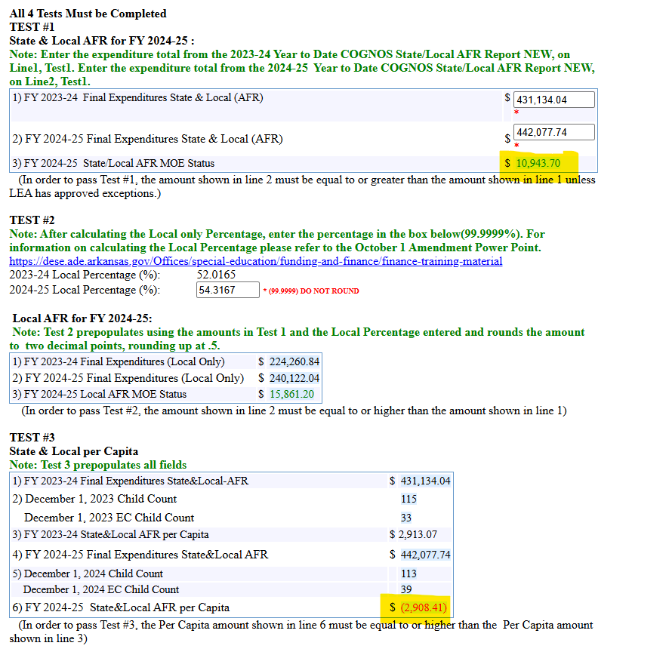
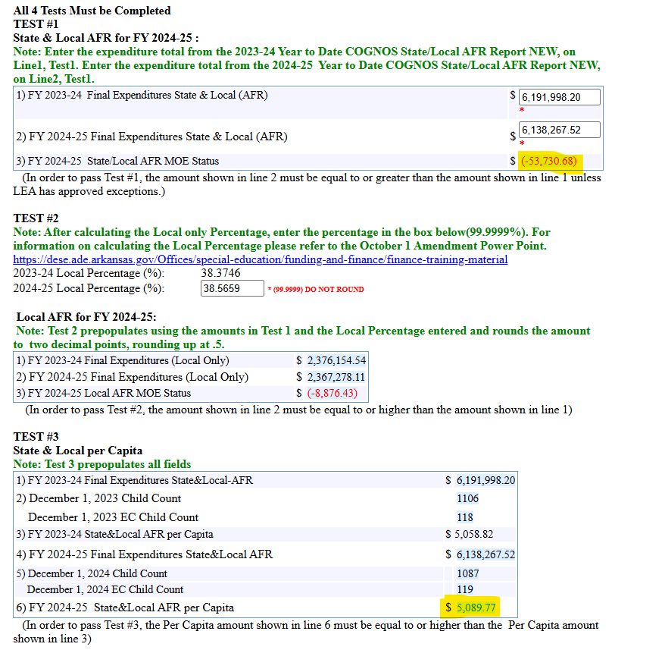
Maintenance of Effort
A tale of two LEAs
Notes:
1.6 & 1.7 - MTSS – Overall Special Education %
Increasing trends in MOE can tell us if we are missing core Tier 1 instructional components (changes in student populations); or have MTSS that needs to be reviewed
Test 3 provides a easy data tracking on year to year Dec 1 counts and how the LEA is spending per Capita. Test 1 is not always a good indicator if Special Education expenditures are tracking with changes in the Special Education population.
Look at 1.10 - Supplemental services and 1.11 wrap around services – LEA may be overserving students, or services may not be individualized in the type of support they provide to improve access to the general education and non-disabled peers.

Slide 9
CCEIS
Significant Disproportionality:
  Identification (Cycle 4)
  Placement (Cycle 4)
  Discipline
Requires 3 consecutive years with a risk ratio of 3.00 or greater

Slide 10
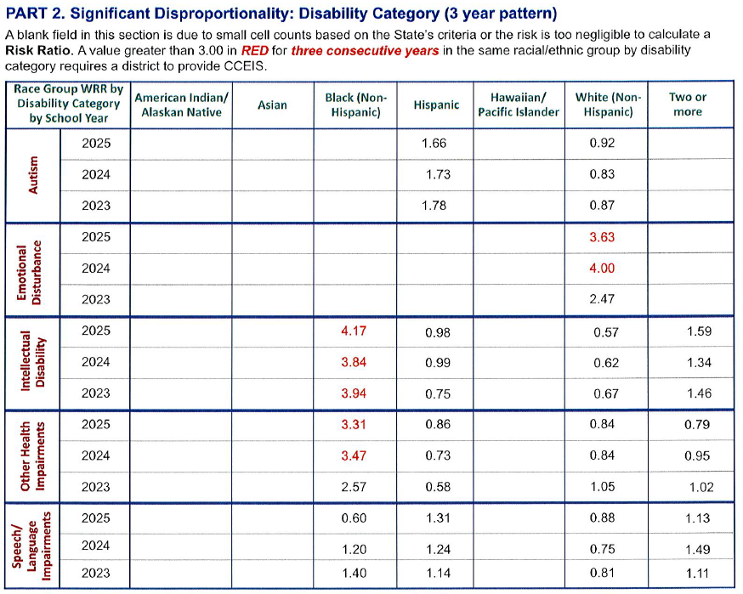
CCEIS
Identification/Disability Category & Placement
Identification:
Overall
Category
Placement:
<40% in the regular classroom
Day Schools
Key AR App Priorities:
1.5 - What Supports will the district provide for general education to ensure access
1.6 & 1.7 - Identifying and monitoring students at-risk for academic failure
2.2 - Plan to provide access to mental health services
2.3 & 2.4 - Identify and monitor students as at-risk of additional beyond academic
Notes:
1.5 - HLP 1, 2, 4, 6, 20
1.6 & 1.7 - HLP 4, 6, 20
2.2- HLP 9
2.3 & 2.4 - 4, 6, 7-9, 20

Slide 11
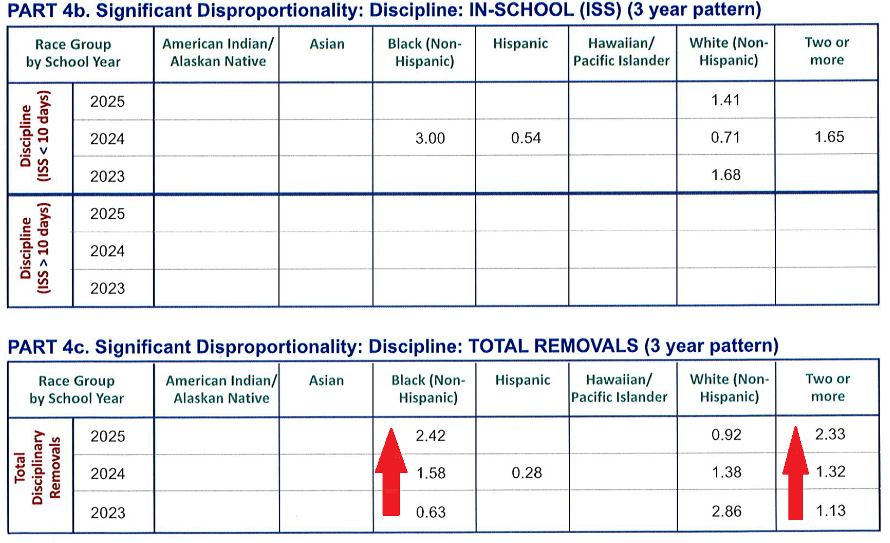
CCEIS
Discipline
Discipline:
OSS greater than 10
ISS greater than 10
Total Removals
Key AR App Priorities:
2.2 - Plan to provide access to mental health services
2.3 & 2.4 - Identify and monitor students as at-risk of additional beyond academic
2.5 - Steps to reduce the overuse of discipline practices that remove students from the classroom
*LEAs don't have to wait until they are identified for CCEIS to identify and address root causes.
Notes:
2.2- HLP 9
2.3 & 2.4 - 4, 6, 7-9, 20
2.5 - 7-9

Slide 12
Annual Performance Report (APR)
Federally required reporting of LEA performance
Looks at LEA performance against State and Federal targets
14 Indicators

Slide 13
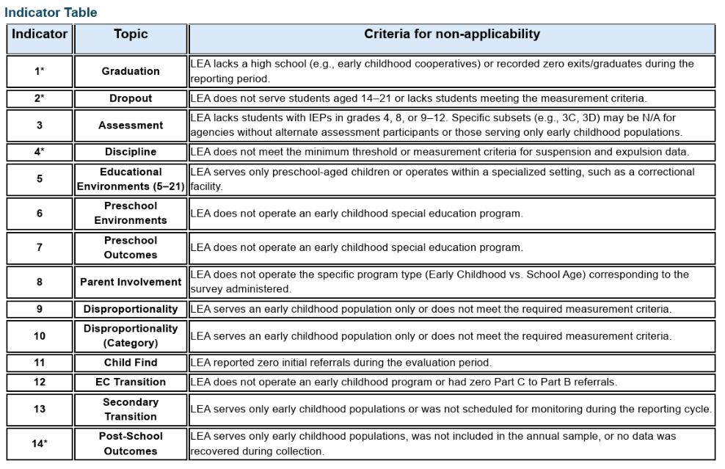

Slide 14
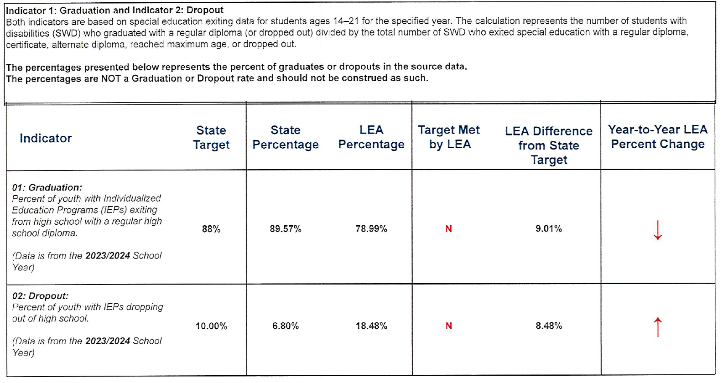
Annual Performance Report
Indicator 1 & 2
Key AR App Priorities:
1.5 - What Supports will the district provide for general education to ensure access
  Important to consider the impact of graduation requirements for the new 9th grade cohort
1.12 - Transition Strategies: High-School to Post-Secondary, Military, and/or Career
2.3 & 2.4 - Identify and monitor students as at-risk for beyond academic services
Priority 3
Notes:
1.5 - HLP 1, 2, 4, 6, 20
2.3 & 2.4 - HLP 4, 6, 7-9, 20

Slide 15
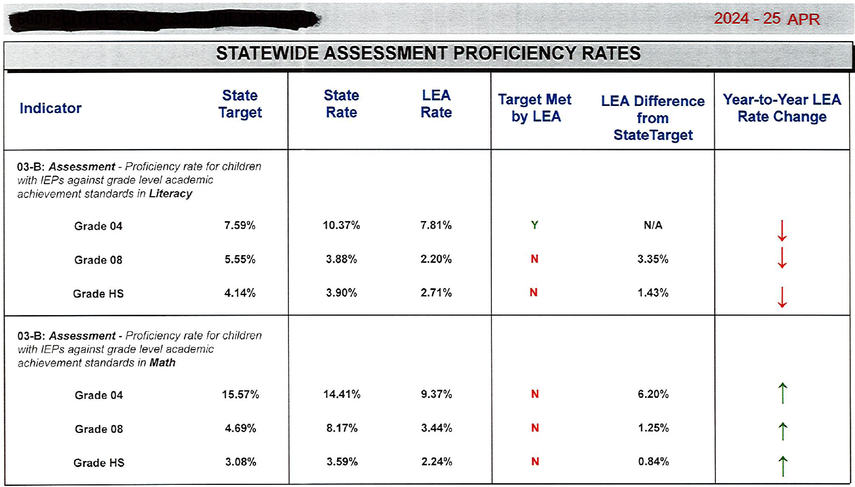
Annual Performance Report
Indicator 3
Indicator 3 -
Assessment participation
Proficiency
Proficiency on the Alt Assessment
Key AR App Priorities:
1.5 - What Supports will the district provide for general education to ensure access
1.10 - Supplemental Academic Services
1.11 - Additional Wrap-around supports
Notes:
1.5 - HLP 1, 2, 4, 6, 20
1.10 & 1.11 - HLP 4, 6, 20

Slide 16
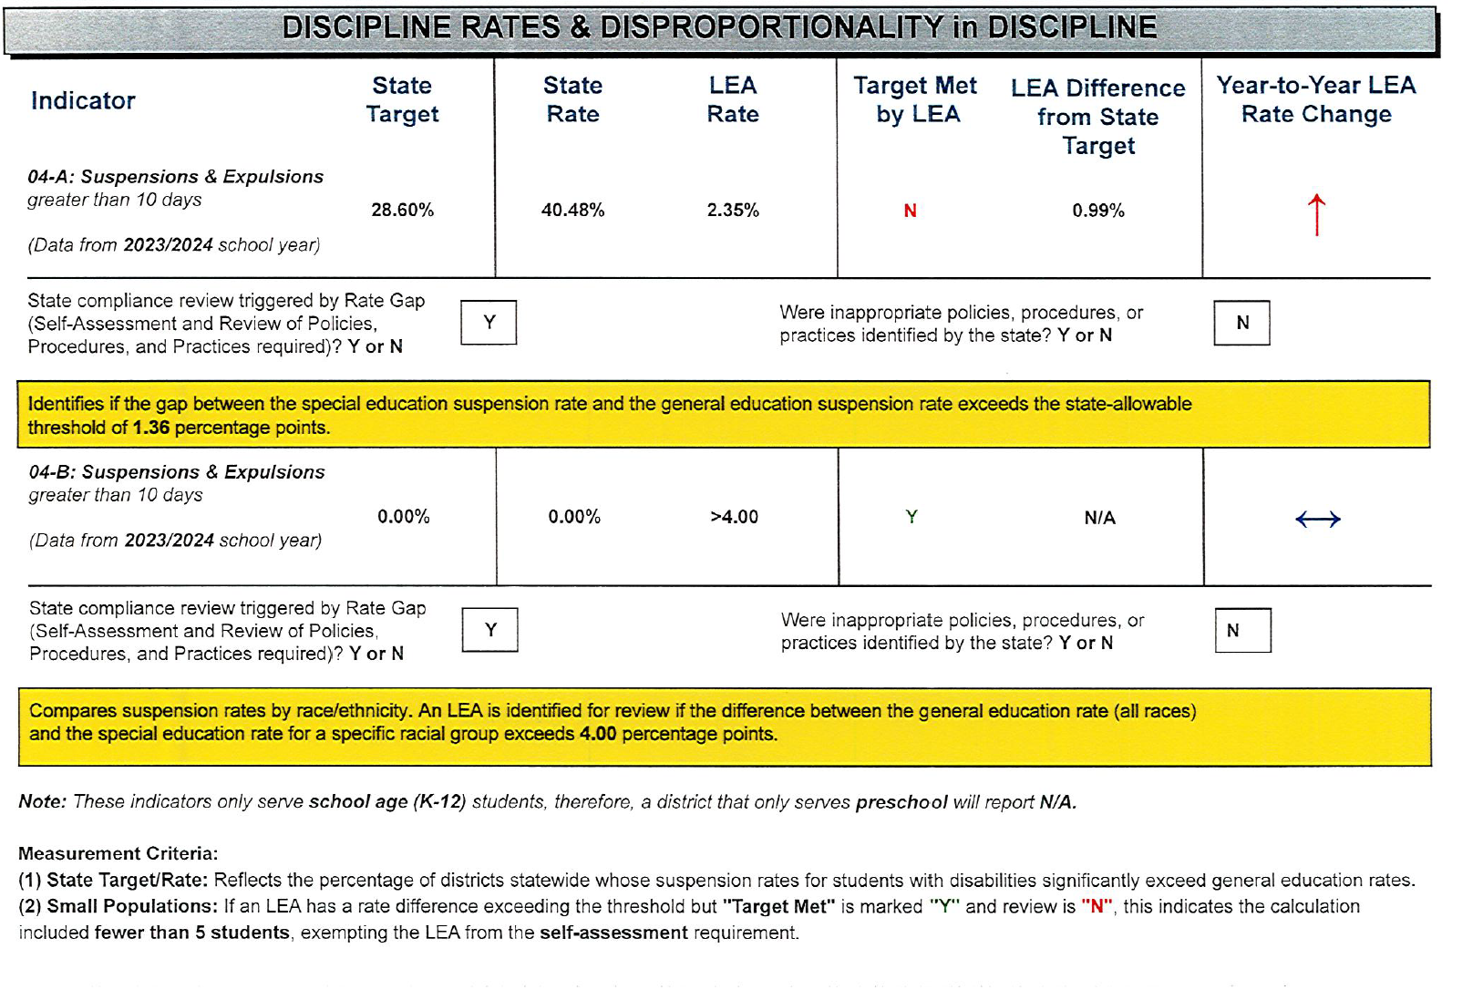
Annual Performance Report
Indicator 4
Indicator -
Suspension & Expulsions greater than 10 days
By race
Key AR App Priorities:
2.2 - Plan to provide access to mental health services
2.5 - Steps to reduce the overuse of discipline practices that remove students from the classroom
Notes:
HLP 7
HLP 8
HLP 9

Slide 17
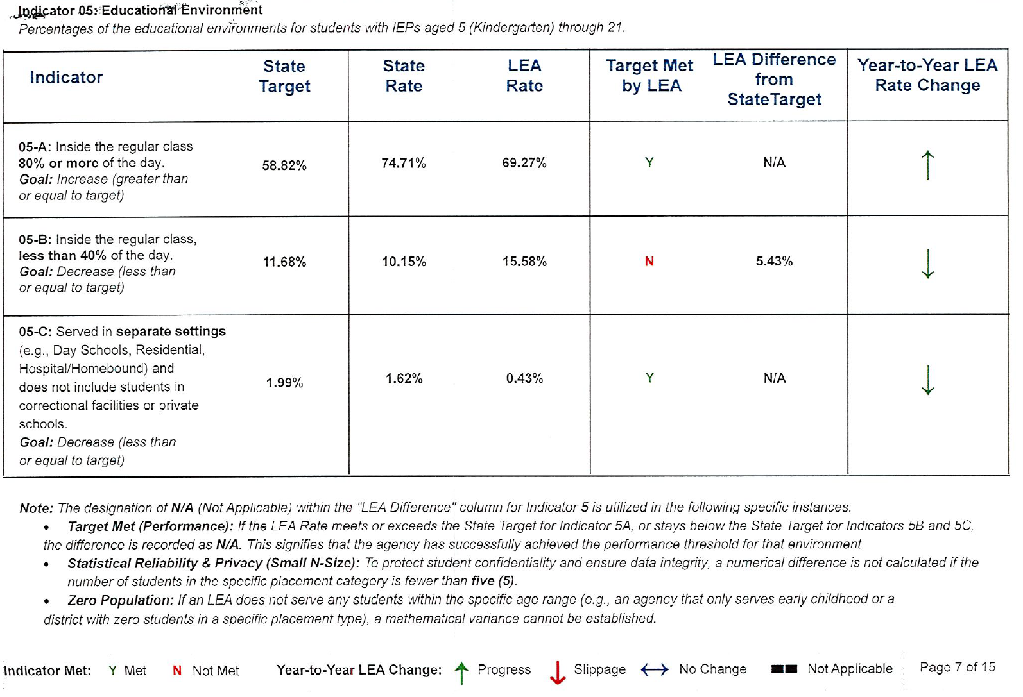
Annual Performance Report
Indicator 5
Indicator -​​
80% or more ​​
Less than 40%​​
Separate settings​​
​​
Key AR App Priorities:
1.5 - What Supports will the district provide for general education to ensure access
  Important to consider the impact of graduation requirements for the new 9th grade cohort
1.10 - Supplemental Academic Services
1.11 - Additional Wrap-around supports
Notes:
1.5 - HLP 1, 2, 4, 6, 20
1.10 & 1.11 - HLP 4, 6, 20

Slide 18
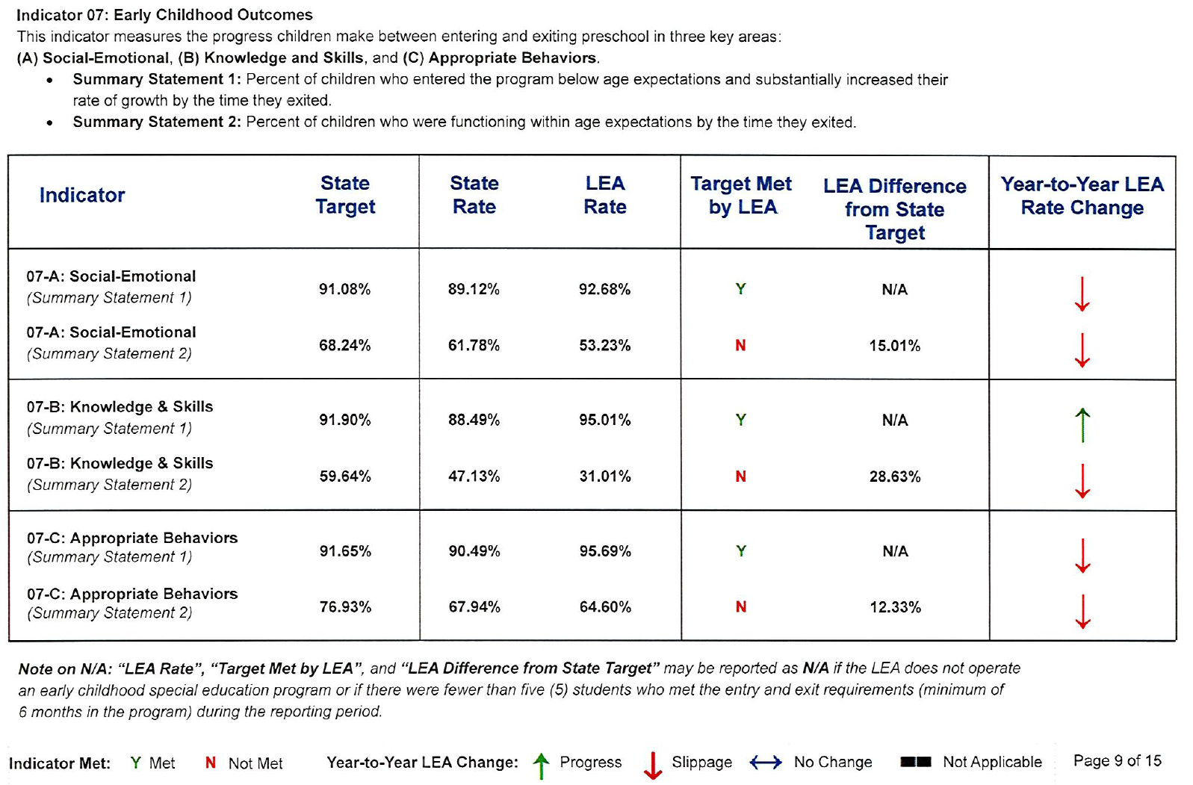
Annual Performance Report
Indicator 6 & 7
Indicator -
Preschool Environments:
  Regular EC program
  Separate Special Education class, school, or residential facility
  Special Education services in the home
Outcomes
  Social-Emotional
  Knowledge & Skills
  Appropriate Behaviors
Key AR App Priorities:
1.12- Describe your transition strategies Pre-K to Kindergarten
1.15- Services for at-risk EC
Notes:
1.12 & 1.15-1, 2, 4, 6, 20

Slide 19
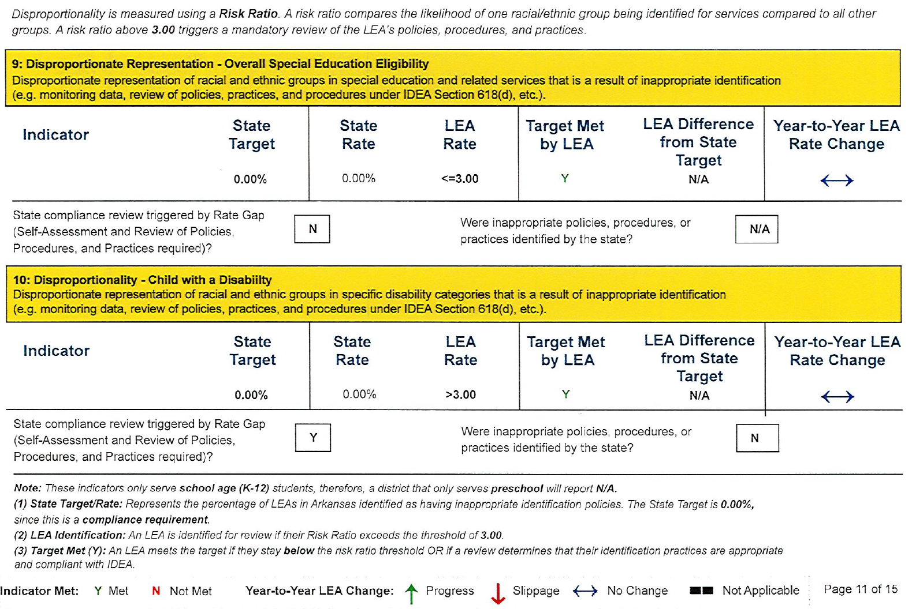
Annual Performance Report
Indicator 9 & 10
Indicator -
Disproportionate Representation – Overall Eligibility
Disproportionality – Child with a Disability
Key AR App Priorities:
1.6 & 1.7 - Identifying and monitoring students at-risk for academic failure
2.3 & 2.4 - Identify and monitor students as at-risk for beyond academic services
Notes:
HLP 7-9

Slide 20
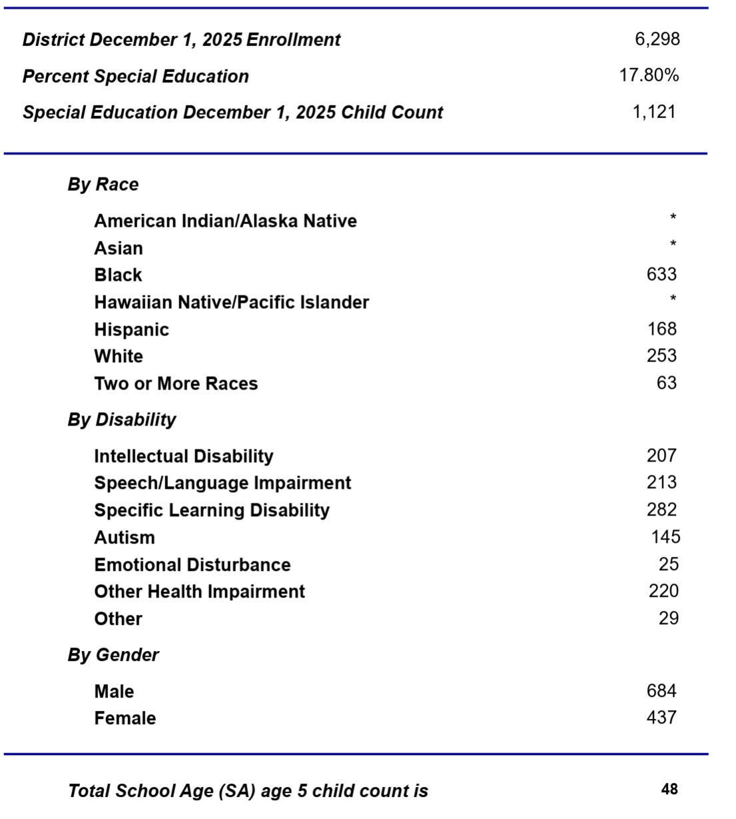
Other Data Sources
Referral Data
FTEs
Complaint Investigation Findings
Due Process Hearing Findings
ARTASC Recommendations
Results Driven Accountability

Slide 21
Tips and Tricks
Drill down to root causes
  Root Causes will be more preventative
  Symptoms will continue to be reactive
Schedule Data Reviews
Collaborate and Plan
Make Data Driven Decisions
Implement
Ensure Implementation
Assess Impact and Outcomes
Rinse and Repeat

Slide 22
Resources
Office of Special Education
OSE-Data
  LEA-APR
  OSE-Demographic Profile
  OSE- CCEIS Profile
OSE-Finance
Micro-Credentials

Slide 23
Questions?
Josh.hart@ade.arkansas.gov
Heather.Oshields@ade.arkansas.gov

