Slide 1
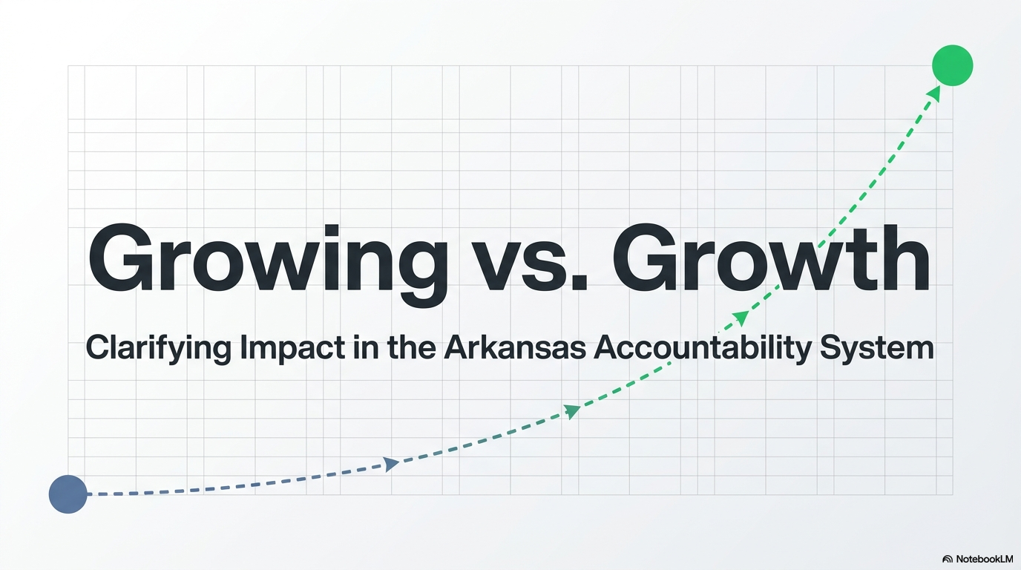

Slide 2
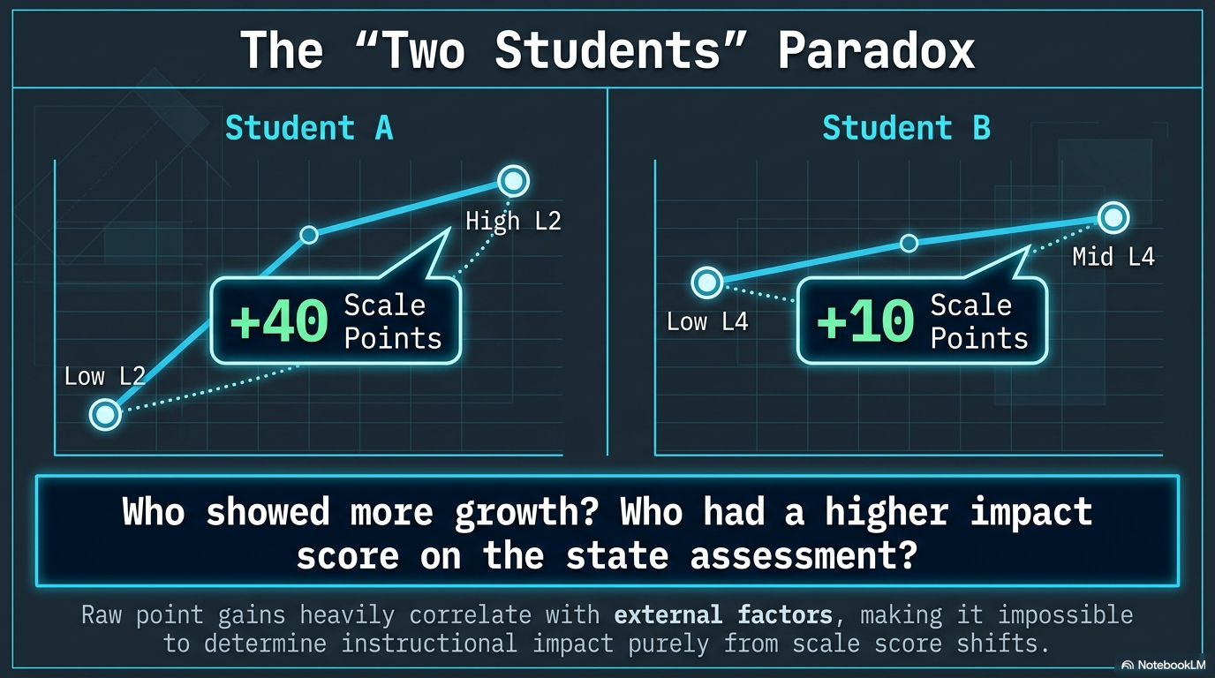

Slide 3
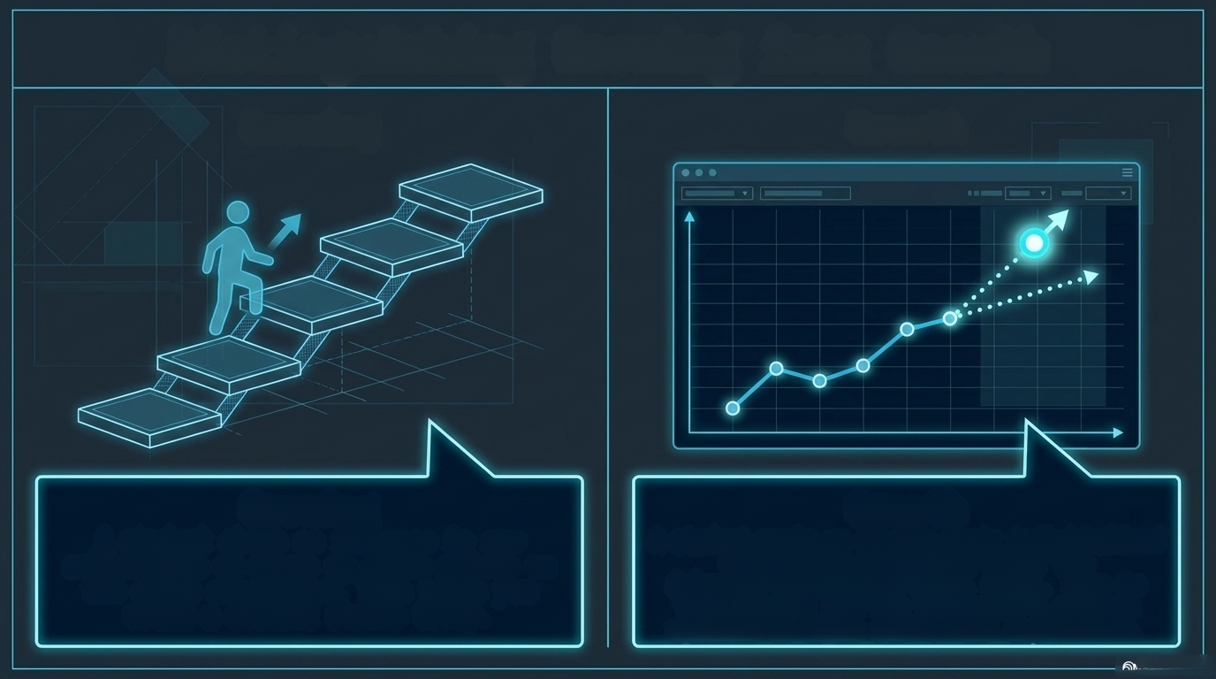
Distinguishing Growing from Growth
Growing
Growth
A student shows an increase in raw
achievement or moves up scale points on the state assessment.
This tells you where a student stands today.
A student meets or exceeds their individualized expected progress based on prior achievement.
This tells you how far the school or teacher moved a student.
NotebookLM

Slide 4
Key Takeaway: A student can be "growing" (gaining points) but
still fall short of state "Growth" expectations-and vice versa.

Slide 5

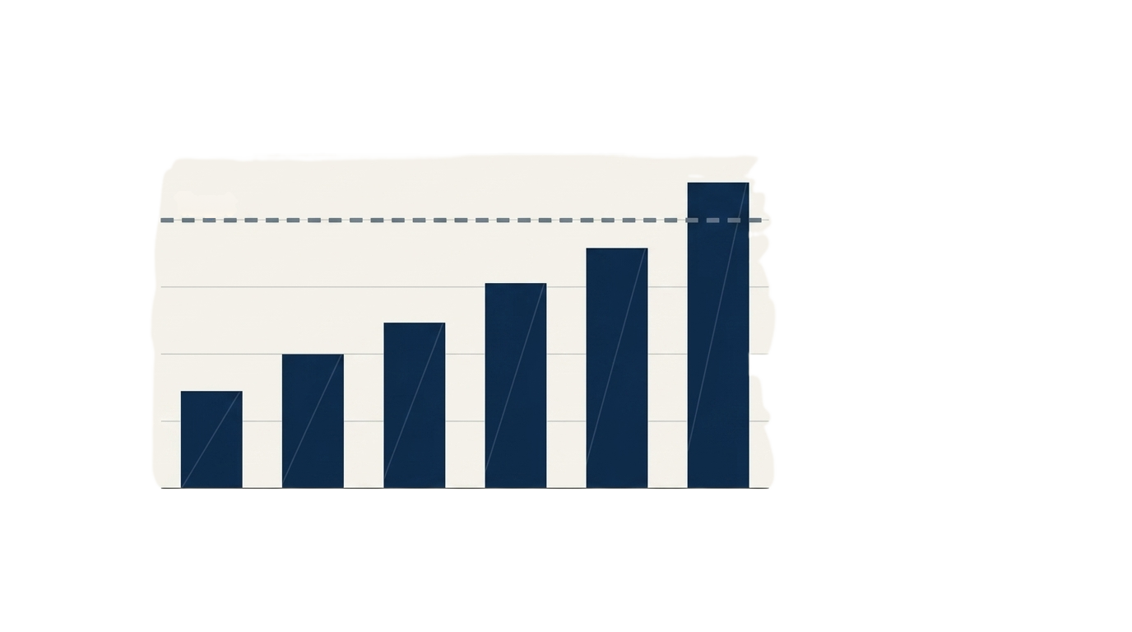
The Power (and Limits) of Achievement
125
It is encouraged to set
goals for increased
achievement
(e.g., "We want 15% more students scoring L3 or L4").
Target
100
75
Percent Proficient
50
25
Celebrating these wins is
crucial for school culture
and Tier 1 momentum.
0
Period 1
Period 2
Period 3
Period 4
Achievement matters. But it is only half the story.

Slide 6
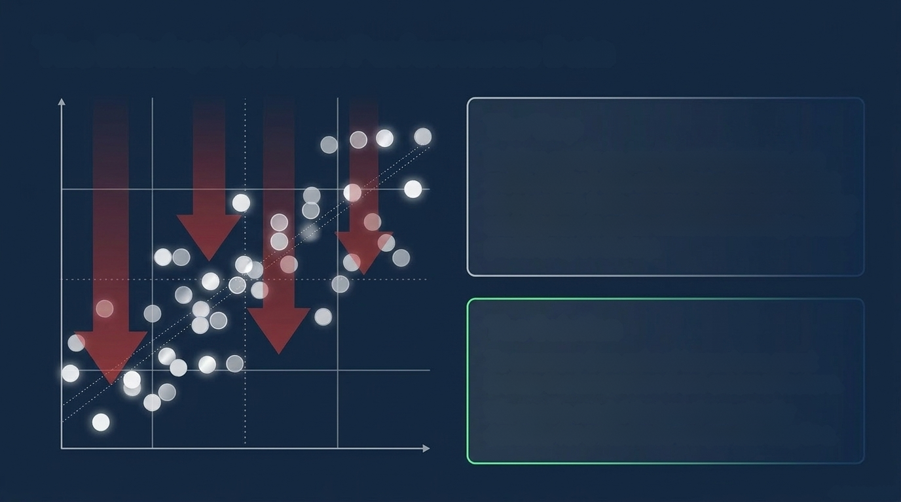
The Blindspot of Raw Performance Data
The Trap
Relying purely on raw score increases can
mask reality. High-achieving students might
be coasting. Low-achieving students might be making heroic gains without crossing a static proficiency boundary.
The Solution
To measure true school impact, we must
isolate the instruction from external factors.
We need a model that mathematically
controls for a student's unique starting line.
A NotebookLM

Slide 7
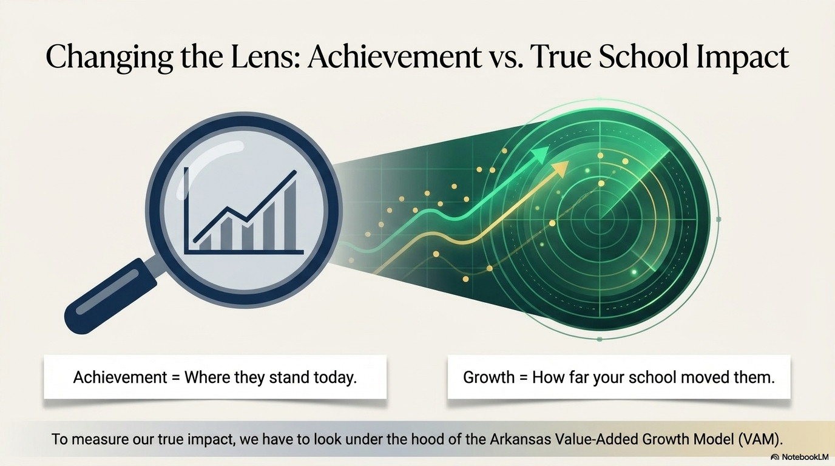

Slide 8

The Core Formula
Actual
Value-Added
Predicted
Score
Score
Score (VAS)
But how do we build
a fair prediction for
every single student?
The student's score
on this year's ATLAS
summative.
The individualized expectation based on student score history.
The true measure of
your instructional
impact.
A NotebookLM

Slide 9

Student Value-Added Score (Steps 1 & 2)
Step 1: Z-Score
Conversion
Analogy: Like
converting different
global currencies
into a single,
standardized value.
Step 2: Line of
Best Fit
Standardizes test
scores across different
assessments and
The model looks at up to
THREE
years of a student's
prior testing history to
establish their unique
academic trajectory.
years.
NotebookLM

Slide 10
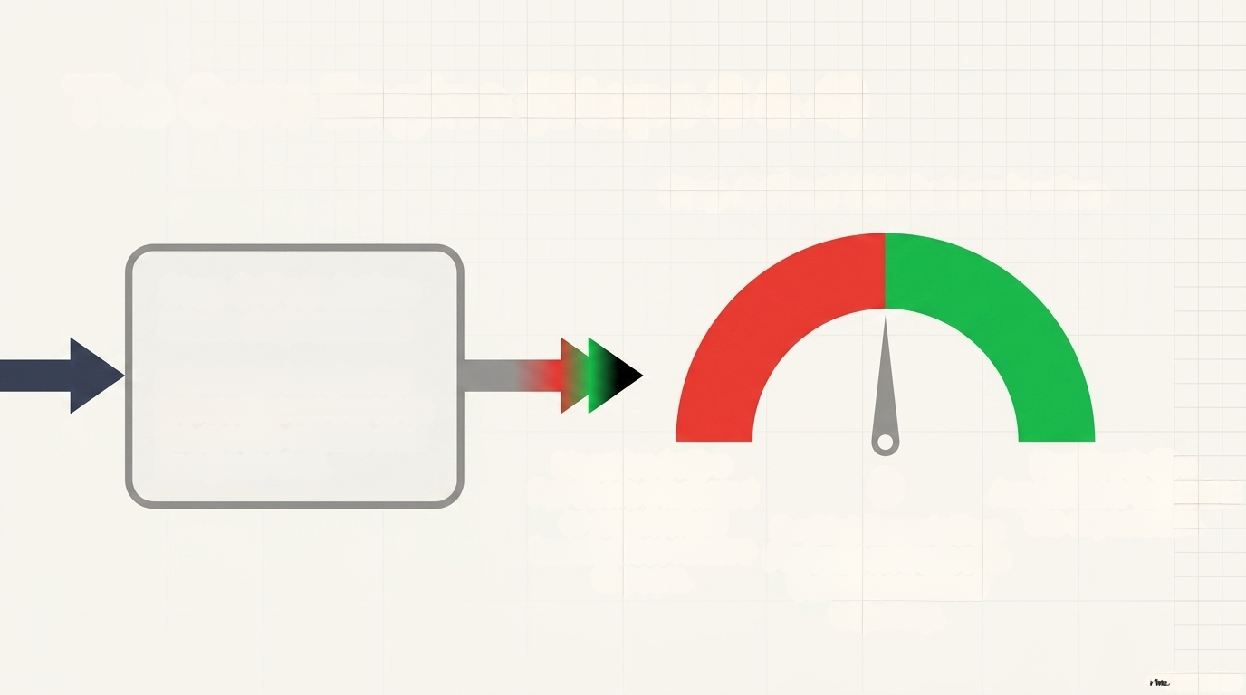
Student Value-Added Score (Steps 3 & 4)
Step 4: Final VAS Determination
Step 3: Population
Mean Adjustment
Adjusts the expectation for
reasonableness based on
the specific content area
and grade level.
Negative (<0) = Fell Short
Stagnated or experienced
learning loss relative
to peers.
Positive (>0) = Accelerated:
Exceeded
the expectation.
0
0 = Met Expectation
Perfectly on track with
their personalized
trajectory.
NotebookLM

Slide 11
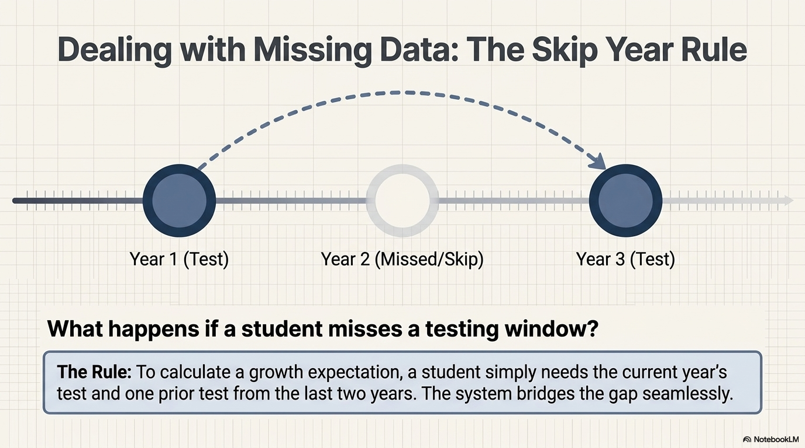

Slide 12
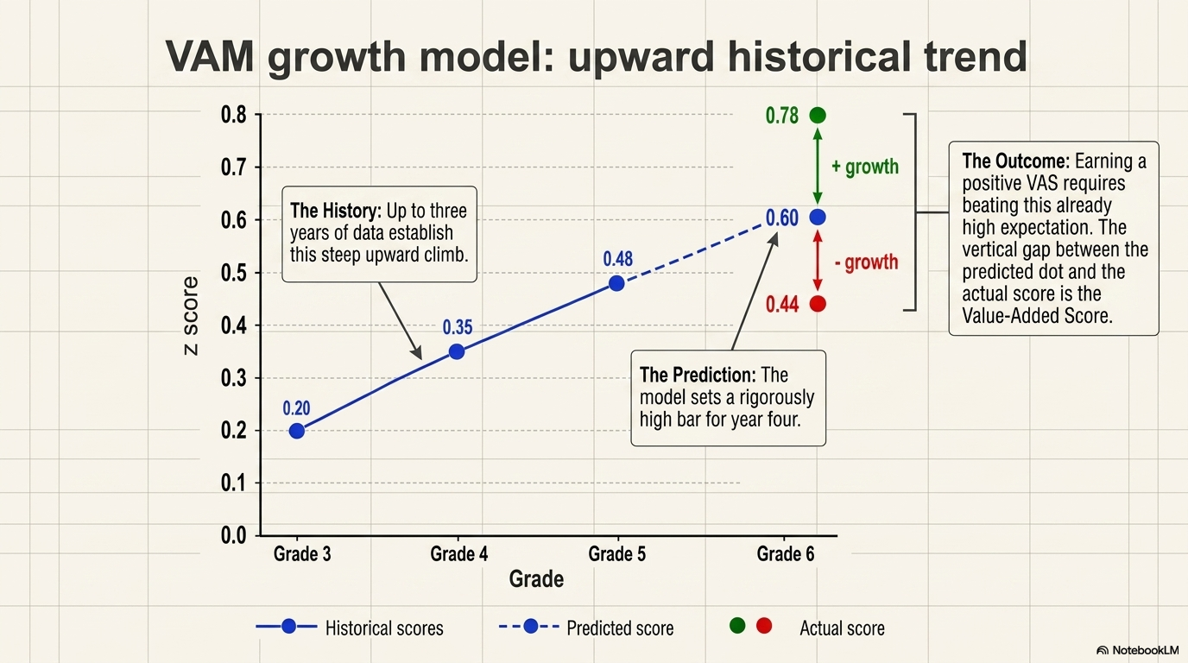

Slide 13
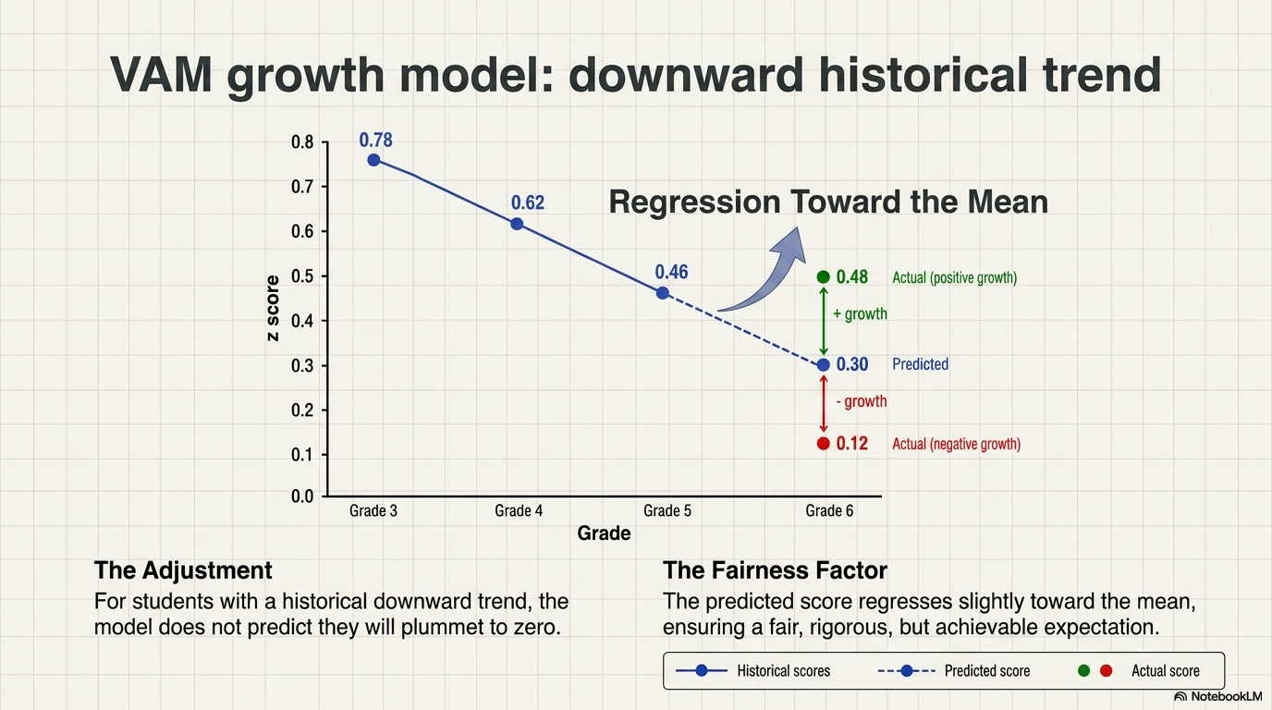

Slide 14

The 4-Step Process: Building the Prediction
1. Z-Score
Conversion
2. Line of Best Fit
3. Population
Mean Adjustment
4. Final
Determination
Actual Predicted
Score
50
2022 2023 2024 2025 20
The Skip Year Rule:
A student needs the 2026
test + at least one prior
test from the last two years
to establish the line.
Z-scores convert disparate
tests (e.g., 3rd-grade math
vs 4th-grade math) into
a universal 'currency" so
they can be compared.
Uses up to 3 years of
history.
Adjusts for
reasonableness based
on grade level and
content area statewide.
Comparing the actual
performance to the
tailored prediction.
A NotebookLM

Slide 15
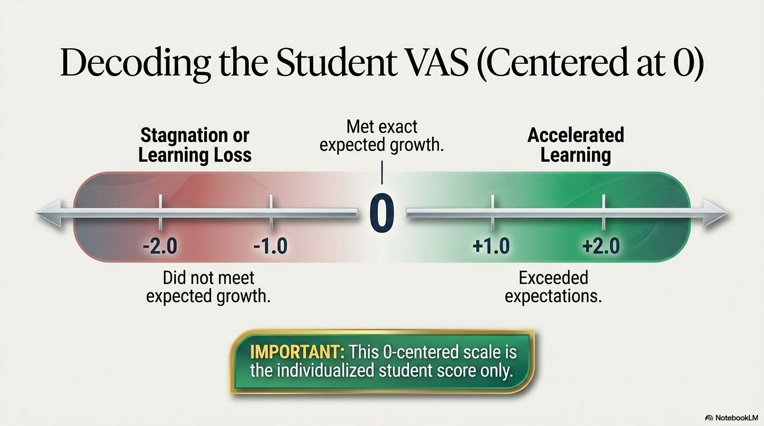

Slide 16
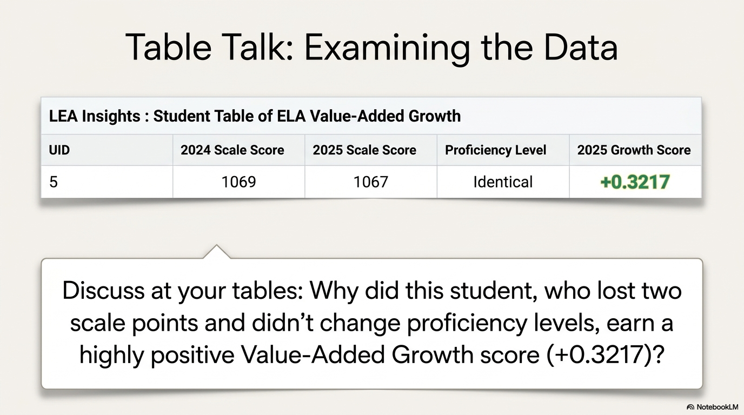

Slide 17
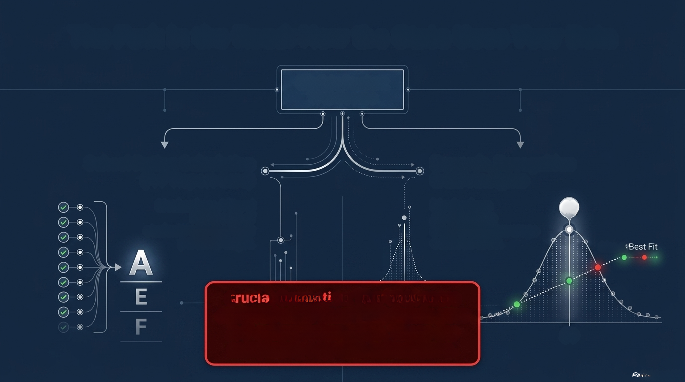
How the State Uses Student Value-Added Scores
Eligible Student
VAS Scores
School Rating Calculation (A-F Report Card) &Rewards/Recognition
Teacher Merit Pay Qualifier &
LEA Insights
Mechanism: A literal
headcount of
students who met their
personal target.
Mechanism: An aggregate
caclulation centered at 80.
80
Line of Best Fit
-O
Crucial Note: The VAM score
centered at 80 does NOT dictate your
A-F school letter grade. These are
completely separate calculations.
80
NotebookLM

Slide 18
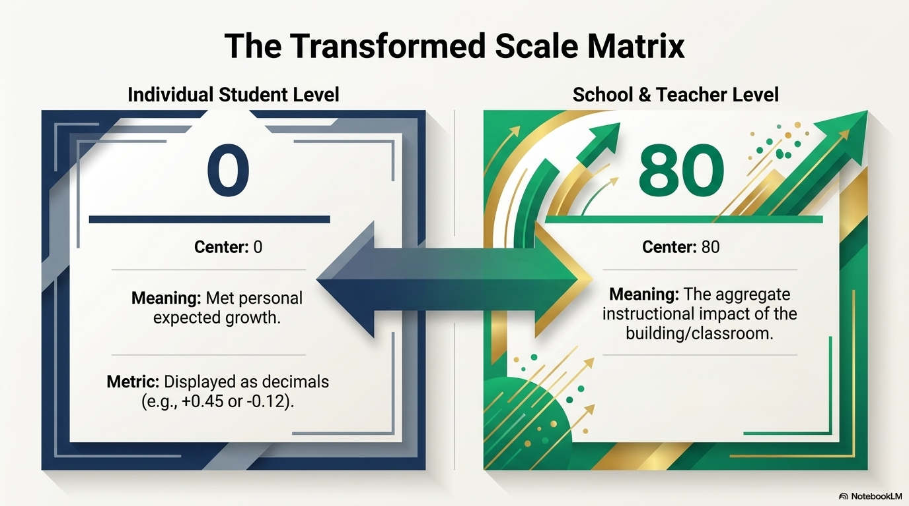

Slide 19
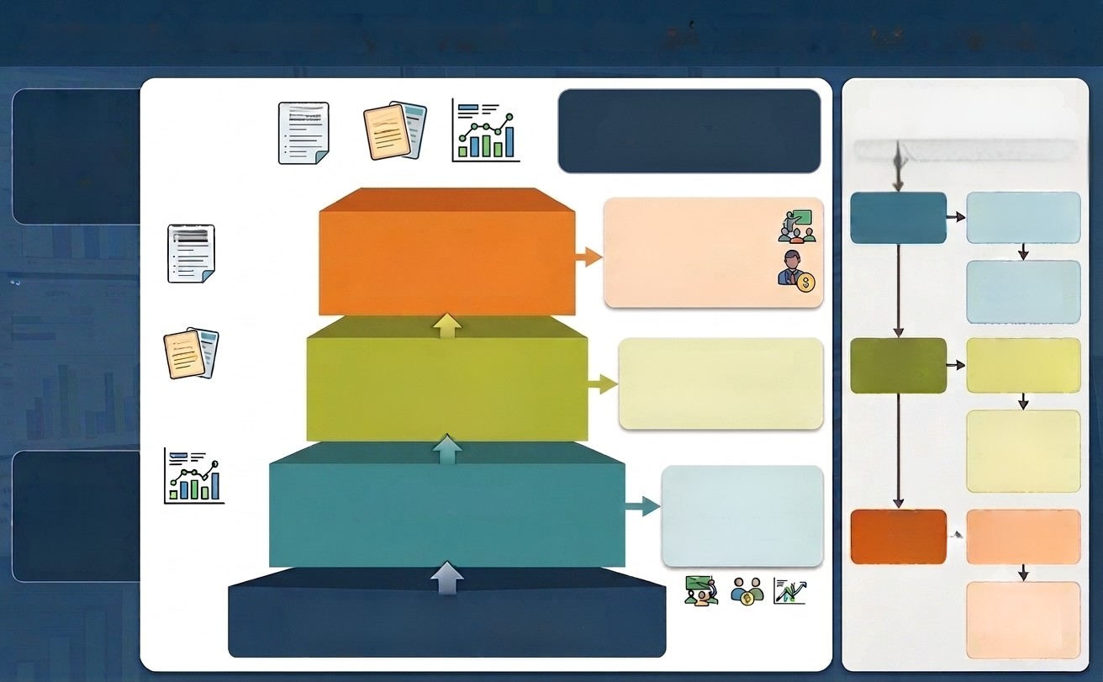
Arkansas’s Accountablity System
Equal Weights for ELA, Math and Science
Focused on academic acheivment, growth and opportunites.
STANDARDS
Growth of the
Lowest Quartile
Resource Deployment
and Supports
(Lowest Performers)
•Intensive Support Check
•Resource Allocation:
Title/1003Dollars
ESOL Programs
Tutoring
• Instructional Facilitators
ALDs
ALD
ALD
  Presence & Function of Interventions
  Student Progress Monitoring
Growth of All
Functionality of Tier 2 Interventions
(Targeted Supports)
Data Chart
Data Chart
  Standards Alignment Informed by ALDs
  Rigorous Data Review
  Balanced Assessment
Achievement
Effectiveness of Tier 1 Instruction
(AllStudents)
SUCCESS READY GRADUATE
Prepared Graduates

Slide 20
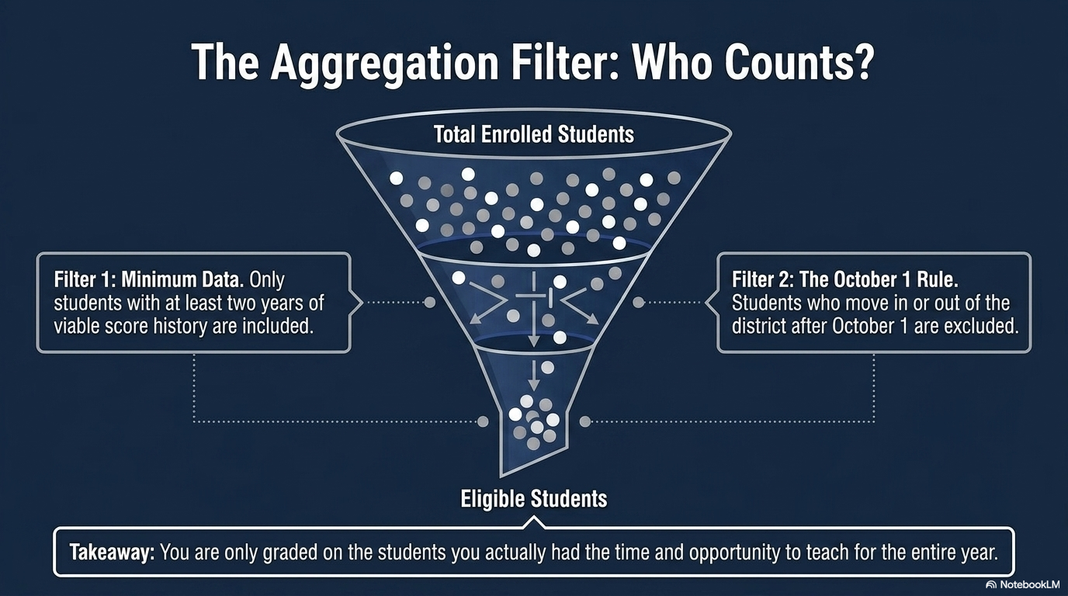

Slide 21
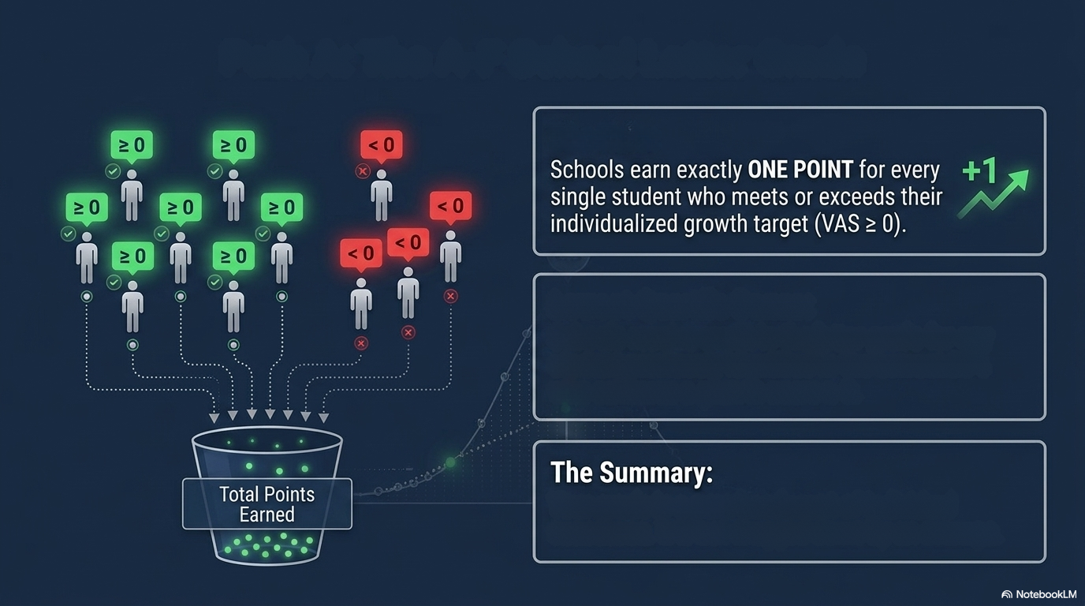
The A-F School/District Letter Grade
Growth of All
Lowest Quartile Growth:
Schools receive credit in the letter grade for any
student previously identified in the Lowest 25%
who achieves a growth score ≥ 0.
Your grade is a pure headcount of individual
successes.

Slide 22
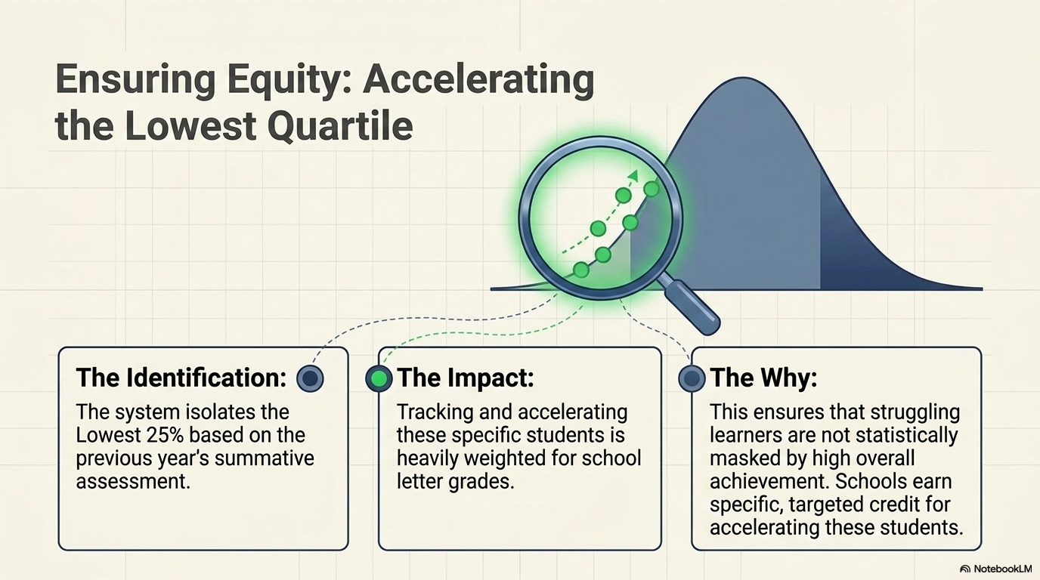

Slide 23
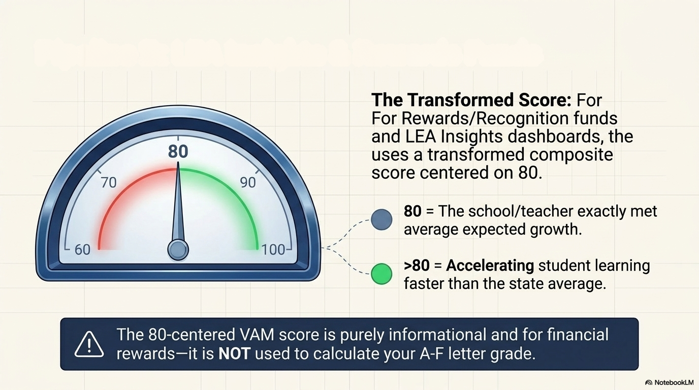
LEA Insights & Teacher Merit Pay Qualifier

Slide 24
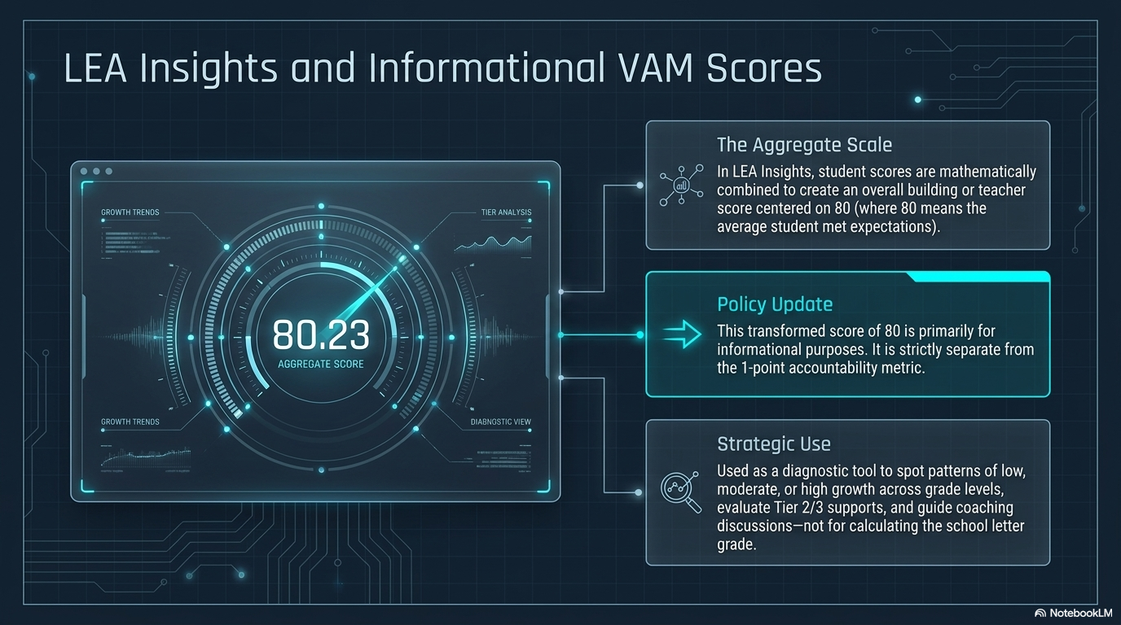

Slide 25
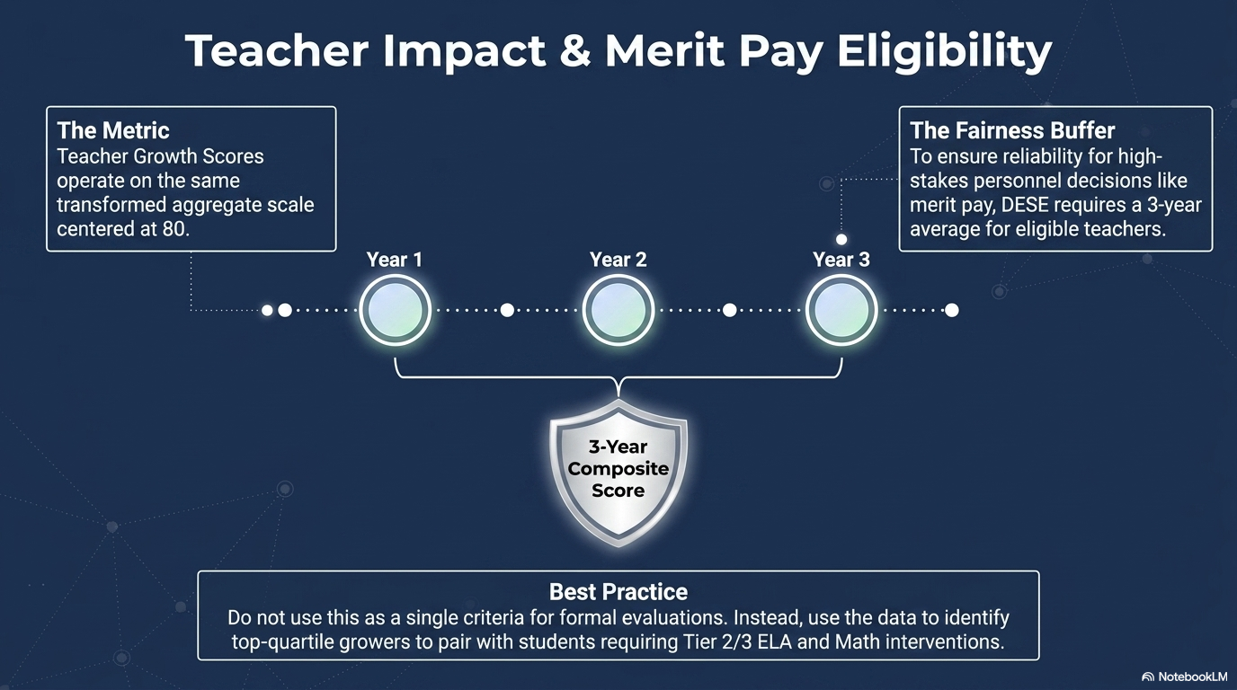

Slide 26


Slide 27
