Slide 2
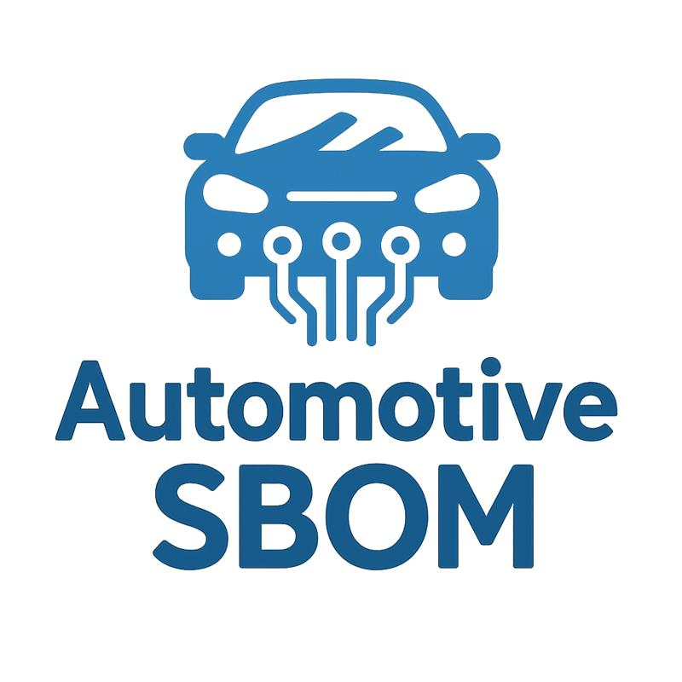
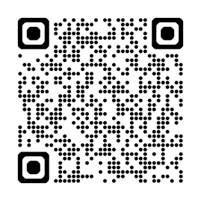
Uniting the Supply Chain:
Shaping the Automotive SBOM Together
Keisuke TAKASE , Masato ENDO (Toyota Motor Corporation)
Ayumi WATANABE (Hitachi Solution ,Ltd.)
Mary Meixia Wang (The Linux Foundation)
Github
QR

Slide 3
Agenda
1. Introduction to Openchain (10min)
2. Introduction to the concept pf Automotive SBOM (5min)
3. Details of Automotive SBOM (5min)
Status of Automotive SBOM discussion (5min)
Q&A
Mary
Masato
Ayumi
Keisuke

Slide 4
Agenda
1. Introduction to Openchain (10min)
2. Introduction to the concept pf Automotive SBOM (5min)
3. Details of Automotive SBOM (5min)
Status of Automotive SBOM discussion (5min)
Q&A
Mary
Masato
Ayumi
Keisuke

Slide 5
Mary Wang
Executive Director of Open Chain Foundation
Tokyo, 20260503

Slide 6
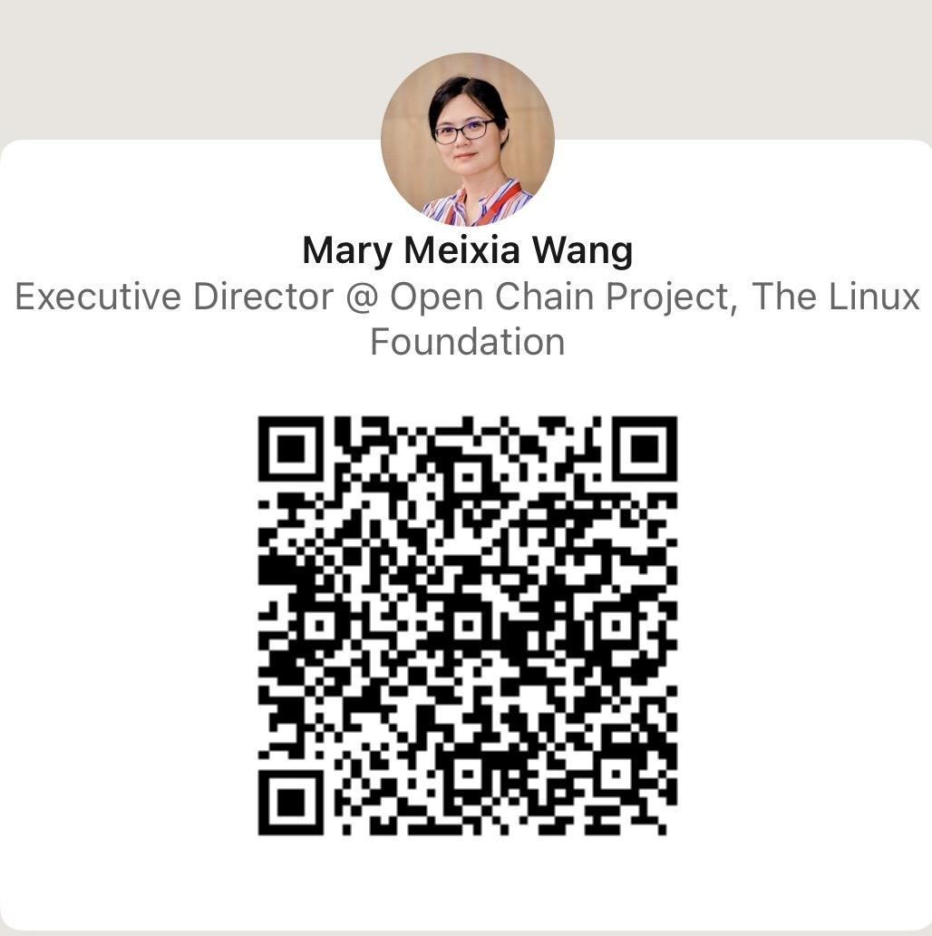

Who Am I

Slide 7

Who is OpenChain

Slide 8
What, Who,How,Future

Slide 9
Background of Open Chain
Founder: David Marr from Qualcomm
October 2015
The Linux Foundation announced an OpenChain Workgroup and a public wiki was launched.
2016 - 2026 Progress
Led the development and release of two ISO standards
Scaled OpenChain into a global community and industry initiative
Established a 25-member governance board
Drove adoption across 100+ companies worldwide
Built and grew a strategic global partner ecosystem
Formed several workgroups which focus on different subjects.
October 2016
The OpenChain Project was formally launched at Open Source Summit Europe.
Founding Platinum Members: Adobe, ARM, Cisco, Harman, Hewlett Packard Enterprise, Qualcomm, Siemens and Wind River.

Slide 10

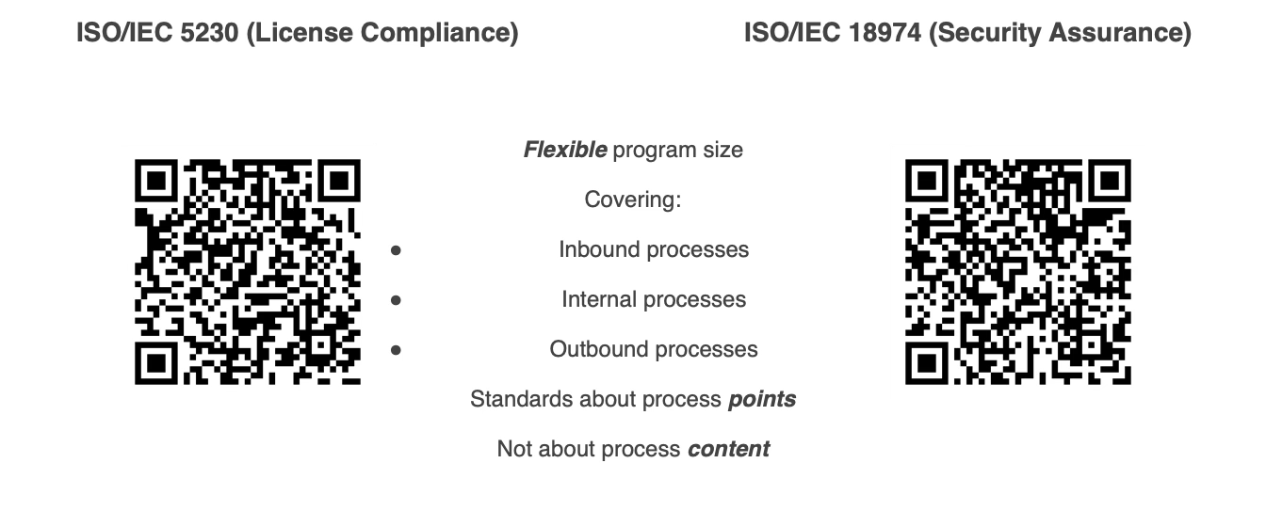
What Is Open Chain

Slide 11
Why Open Chain
Vision
Our vision is a supply chain where open source is delivered with trusted and consistent process management information.
Mission
Our mission is to make that happen.

Slide 12



Who Are We
Meet Our Ambassadors:
For more information, please visit:
https://openchainproject.org/community

Slide 13
Who Are We
Regional Work Groups
China - Zhenhua Sun - ByteDance
Germany –
India - Biju Nair
Japan - Ayumi Watanabe - Hitachi Solutions
Korea - Haksung Jang - SK Telecom
Meridian 22 - Ivo Emanuilov (Gate AI) & Slavov Vladimir (Bosch)
Taiwan -
UK - Andrew Katz - Orcro
Community Work Groups
Specification - Chris Wood - Lockheed Martin
Education - Martin Yagi (First Light Fusion)
AI - David Marr (Qualcomm) & Matthew Crawford (Arm)
Tooling - Oliver Fendt (Siemens)
SBOM - Norio Kobota (Sony)
Industry-Specific Work Groups
Automotive - Masato Endo (Toyota)
Telco - Marc-Etienne (Nokia)
For more information, please visit:
https://openchainproject.org/community

Slide 14
Adoption Method 1 - Self Certification
Self-certification to an OpenChain standard (and any other standard) involves an entity reviewing material, deciding that they meet the requirements it describes, and then advertising that fact.
OpenChain provides extensive resources to help with this, such as self-certification checklists.
The OpenChain standards are explicitly designed to work effectively with self-certification because:
They require a company to keep records of how they certified and details of each point (verification materials)
They are designed for supply chain procurement, with an expectation that customer companies can and will audit supplier company verification materials at the time of their choosing
This has proven effective, and no purposeful attempts to “cheat” have been reported to us since our public launch in 2016.

Slide 15
Adoption Method 2 - Third Party Certification
Third-party certification to an OpenChain standard (and any other standard) one legal entity with appropriate permission in the local jurisdiction to certify that another legal entity meets the requirements of the relevant standard.
This is a common approach in regulation-heavy industries such as automotive around standards such as ISO 26262 (functional safety).
Because OpenChain produces ISO standards, it supports and follows the same type of third-party certification processes used by other ISO standards.
Third-party certifiers such as Bureau Veritas, Deloitte and PwC support OpenChain standards.

Slide 16
Next Chapter of OpenChain: Hot Topics
CRA
The EU Cyber Resilience Act (CRA) mandates significant shifts for companies selling software in the EU:
Secure by Design: Build internal safety into every layer.
Full Transparency: Track all open source components.
Continuous Management: Ongoing vulnerability patching.
Rapid Reporting: Fast disclosure of security incidents.
AI Act
Expansion into AI management ensures OpenChain remains at the cutting edge of global compliance needs:
ISO Standards Foundation:
• ISO 42001, 42002, 42003 integration
ongoing:
OpenChain AI SBOM Self Certification
Chance & Opportunity: OpenChain is the strategic bridge to global regulatory compliance in CRA and AI.

Slide 17

Thank you!

Slide 18
Agenda
1. Introduction to Openchain (10min)
2. Introduction to the concept pf Automotive SBOM (5min)
3. Details of Automotive SBOM (5min)
Status of Automotive SBOM discussion (5min)
Q&A
Mary
Masato
Ayumi
Keisuke

Slide 19



Objectives
Challenges of SBOM Implementation in the Automotive Industry
Multiple Standards
Cause Confusion
Industry Specific
Business Practices and Development Methods
Study is still in Progress
Automotive SBOM
We have reconsidered the content to focus on operations in the automotive industry, and defined an Automotive SBOM as an SBOM specification that follows the general-purpose SBOM specification.

Slide 20
Mission
  For this purpose, we would like to...
      Identify key challenges, concerns, and barriers to effective SBOM adoption in the automotive industry
  So, we decided to...
      Establish a collaborative community to share and discuss best practices for SBOMs in the automotive industry
      Promote awareness and position Automotive SBOM as good practices across the automotive industry
Accelerate Smart and Effective SBOM Usage in Automotive Industry

Slide 21
Goal
  Future Goal
      Build a dynamic, collaborative community to drive the advancement of Automotive SBOMs
      Gain strong endorsements from leading industry associations to position Automotive SBOMs as best practices
      Establish Automotive SBOM as a referenced standard within industry guidelines and legal requirements
  Near-Term Strategic Goal
      Increase industry awareness and drive broader adoption of Automotive SBOM across the entire supply chain (from OEMs to Tier-N suppliers)
      Finalize Automotive SBOM as the industry’s best practice for smart and effective SBOM implementation, incorporating feedback from community (you!!)

Slide 22




Member
SCA tool
Vendor?
Multiple Approaches to Support...
Contributor
You
Auto-ISAC?
Individuals and organizations actively engaged in the evaluation, advocacy, and utilization of Automotive SBOM
OEM?
Supporter
Individuals and organizations that understand the principles of Automotive SBOM and support contributor activities
Supplier?
AGL?
User
Individuals and organizations that adopt and leverage Automotive SBOM

Slide 23

Roadmap
Governance Monthly
today
OpenChain Auto WG Meeting (11/14)
OSS J (12/8-10)
OCS (12/11-12)
Governance Monthly
AGL AMM(5/13-14)
OSS J (12/7-9)
OSS EU (10/7-9)
2025/11
2025/12
2026/2
2026/4
2026/5
2026/10
2026/12
Study Group standup
progress update
Kick off
Monthly meeting for blush up
v1.0 public comment
v1.0 release

Slide 24
Agenda
1. Introduction to Openchain (10min)
2. Introduction to the concept pf Automotive SBOM (5min)
3. Details of Automotive SBOM (5min)
Status of Automotive SBOM discussion (5min)
Q&A
Mary
Masato
Ayumi
Keisuke

Slide 25
Details of Automotive SBOM
Data Fields
Definition of Data Items to be Handled as SBOM
Automation Support
Definition of Document Format, Format of Each Data, and Implementation Examples
Practice and Process
Definition of Operational Procedures for Requesting, Generating, and Using SBOM

Slide 26
Data fields
Defined as the Minimum Data Set Required to Understand the Configuration Information of the Target Software
Data Fields
# | Name of Data Field | Required | Description | Example
1 | SBOM Metadata
1-1 | SBOM Author Name | 〇 | Name of the entity that created the SBOM | “TOYOTA MOTOR CORPORATION”
1-2 | SBOM Timestamp | 〇 | Date and time when the SBOM was created or updated | “2025-01-24T22:31:37Z”
1-3 | SBOM Type | 〇 | Information to identify when and what types of software the SBOM was generated from | (Using SBOM type like “Build” etc.. which is defined by CISA at USA)
1-4 | SBOM Primary Component | 〇 | Information to identify the components that are primarily represented in the SBOM | (Express by using Component entities#2)
2 | Component Attribute
2-1 | Component Name | 〇 | Name of the component | “Apache Tomcat”
2-2 | Component Version | 〇 | Version information of the component | “10.0.5”
2-3 | Component Supplier Name | 〇 | Name of the entity that provided the component | Woven by Toyota, Inc.
2-4 | Component Relationship | 〇 | Information to identify dependencies between components | (Express following document format)
2-5 | Component Unique Identifier | 〇 | Information to uniquely identify the component | "pkg:github/apache/tomcat"
2-6 | Component File Name | - | Name of the file of the component | "tomcat-10.0.5.tar.gz"
2-7 | Component Download Location | - | URL from which the component is downloaded | “https://github.com/apache/tomcat/........./10.0.5.tar.gz”
2-8 | Component Declared License | - | License declared by the component's author | Apache-2.0”
2-9 | Component Concluded License | 〇 | License that the SBOM author concluded applies to the component | “Apache-2.0”
2-10 | Component Cryptographic Hash | - | Hash value of the component | ”SHA256: 525………5a8”
2-11 | Component Copyright Notice | 〇※ | Copyright notice attached to the component | “Copyright © 1999-2022, The Apache Software Foundation”
2-12 | Component External Document References | 〇 | Information for external references to other SBOM documents | (Express following document format)

Slide 27



Automation support
Automation Support
Automotive SBOM
SPDX
v2.3
OK
Received from other
Hand-
written
created by SCA tool
Cyclone DX
v1.6
OK
SBOM Data
Other
(SPDX-Lite)
OK
Any format is acceptable as long as it adheres to
the Automotive SBOM data fields and practices and processes

Slide 28
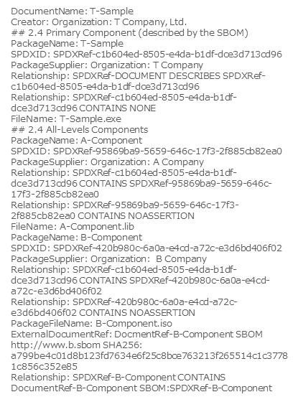
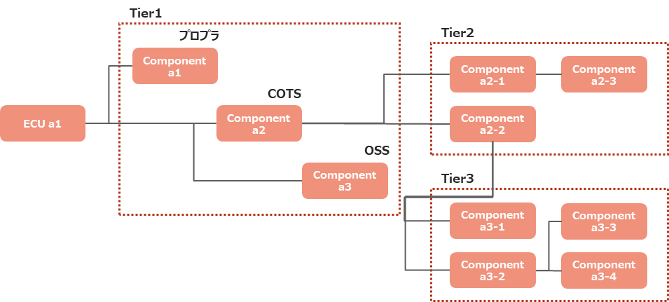

Practice and Process
Practice and Process
In a Single SBOM File
Binding SBOMs
Using External Reference Expressions
Advantages
Easy to handle as a collection of small SBOMs
High maintainability as there is no need to recreate the entire system every time a software update is made
Disadvantages
SBOM file becomes too large
Time-consuming to recreate the entire SBOM file every time you update your software

Slide 29
Agenda
1. Introduction to Openchain (10min)
2. Introduction to the concept pf Automotive SBOM (5min)
3. Details of Automotive SBOM (5min)
Status of Automotive SBOM discussion (5min)
Q&A
Mary
Masato
Ayumi
Keisuke

Slide 30

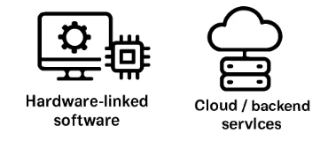
Scope expansion
SBOM for non-OSS components and for the full vehicle software surface
— not just open-source dependencies.
Commercial / proprietary SW
How to handle closed-source components and NDA-bound data. Reduced-disclosure SBOM profiles may be needed.
AI / ML models
Model cards, training datasets, and weights as SBOM entries — aligning with emerging AI BOM practice.
Hardware-linked SW
Firmware, microcode and HW–SW dependencies — linking to HBOM for the hardware side.
Cloud & backend
Connected services outside the car also ship with the product — SaaSBOM considerations.
VEX
CSAF advisories, SSVC for triage priority, and patch timing guidance.

Slide 31

Regulation alignment
Where SBOM meets cybersecurity management, software updates, and type-approval evidence.
UN R155 · CSMS
Demonstrate cyber risk management across the full vehicle lifecycle.
UN R156 · SUMS
Managed software updates, including OTA, with documented evidence.
ISO/SAE 21434
Cybersecurity engineering process for road vehicles — threat analysis and risk.
China & US rules
Connected-vehicle restrictions — data, component origin, and foreign-adversary rules.
Data privacy
GDPR and regional data rules for connected data flows.
The Cyber Resilience Act requires products with digital elements to meet
cybersecurity and vulnerability management requirements throughout their lifecycle.
Cyber Resilience Act

Slide 32


AI-driven development & OSS risk
Generative AI and coding agents make unintended OSS contamination more likely
— existing SCA tooling is not enough.
The problem
AI-generated code may include OSS snippets without clear origin or license.
SCA is almost mandatory
Running an SCA tool is the baseline of self-defense — but not 100% accurate.
Snippet matching
Source-level matching helps, but accuracy is lower than dependency analysis; forks break version identification.
Tool vendor liability
Vendors cannot take responsibility for missed OSS — the industry needs a shared practices.
Possible practice
Avoid snippet reuse in embedded dev; add prompt rules in AI-driven dev to reject snippet injection.

Slide 33
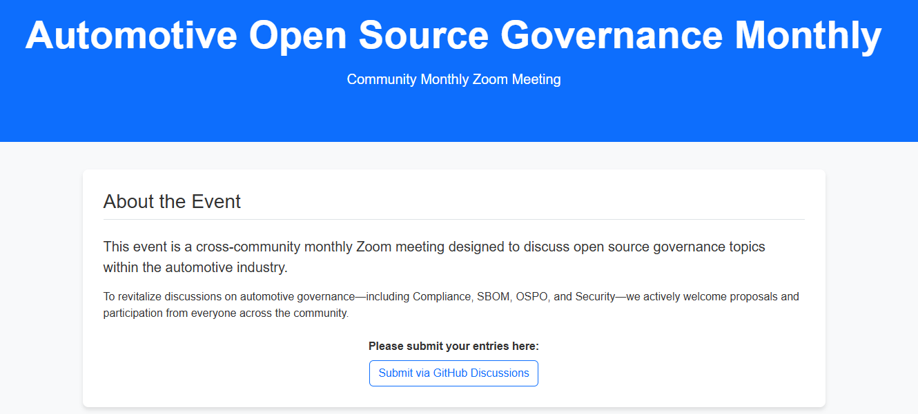
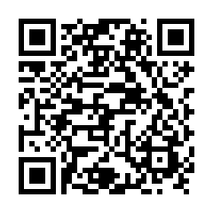
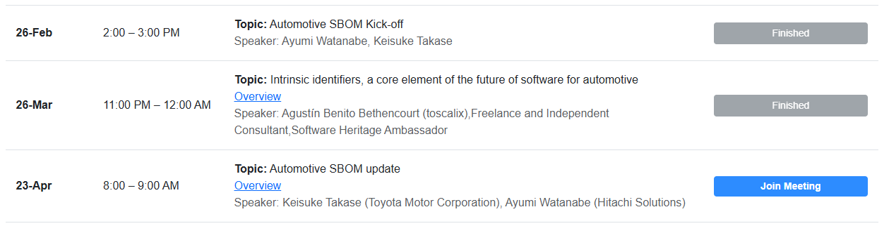
Automotive Open Source Governance Monthly
Please join us!
Please submit a topic!

Slide 34
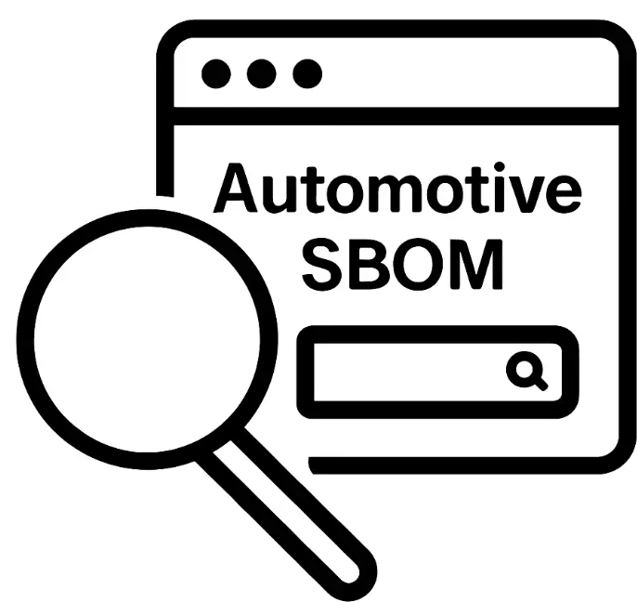
Summary
1. Community
4. Discussion Status
OpenChain Automotive WG building SBOM best practices for the automotive supply chain.
Beyond OSS and VEX
Commercial SW, AI/ML, HW, cloud scope. Standardized VEX (CSAF/SSVC) workflow needed across the supply chain.
Regulation Compliance
UN R155/R156, ISO/SAE 21434 - SBOM feeds into CSMS and type-approval evidence.
AI-Driven Development
AI-generated code raises OSS contamination risk. SCA tooling and snippet matching are the baseline defense.
…and more! (feel free comment to us!)
2. Specification
Automotive SBOM defined by three pillars:
Data Fields / Automation / Practice
3. Action Plan
Monthly governance and study group meetings through FY26.
AGL AMM (May), OSS EU (Oct), OSS Japan (Dec).
QR
Github

