Slide 1
A Unified Benchmark Framework for AGL/POSIX-Compliant RTOS on ARM
Lei Zhou
Linaro

Slide 2

Agenda
In this talk, you will learn the following:
Why it’s important to benchmark AGL(automotive grade linux) when we plan to deploy safety-related applications on top of it? Particularly WCET (Worst Case Execution Time) of OS primitives.
The concept of unified RTOS benchmarking framework and key OS primitive metrics, various stressors for “noisy neighbour” simulation to evaluate mixed-criticality application interference.
The visual insights of actual benchmark results.
Analysis of the WCET. How to use Arm PMU events and Linux kernel tracepoint instrumentation to correlate the occurrence of the outliers with various interferences.

Slide 3

About us
Seasoned tech lead specialized in semiconductor, embedded system & cybersecurity, OSS. Currently responsible for automotive technology enablement as part of Linaro Eco BU.
For more than 15 years, Linaro has helped embedded device manufacturers build secure, high-quality products at scale. Our engineering teams work at the intersection of product development and upstream open source, collaborating directly with the communities that provide a significant portion of the software used in modern devices.
Lei Zhou
Principal Tech Lead
Automotive, Testing, Linux Kernel, Cybersecurity, Cloud & Edge Computing, IoT & Embedded, AI, CI/CD, Toolchain, Virtualization

Slide 4




∞ linaro
SDV Transformation: OSS, Safety & Arm Ecosystem
High-performance processors + OSS momentum are converging to enable the SDV vision.
Arm Automotive Processors
Open Source at the Core
High-performance Arm application processors with integrated ASIL-D safety islands are emerging as the compute backbone for next-gen SDV platforms.
OSS delivers cost-efficiency, transparency, and faster innovation cycles. AGL and ELISA are the community foundation for safety-capable Linux in vehicles.
FuSa Certification Progress
Industry Validation
AGL is collaborating with the ELISA Project to build evidence frameworks for Linux in safety-critical applications, gaining traction in Tier-1 and OEM supply chains as the path toward ASIL-qualified Linux
NVIDIA DriveOS Linux qualified for ASIL-B in production ADAS/AD confirms RT-PREEMPT can reach functional safety targets — validating the AGL-RT platform direction for the broader industry
2
Notes:
Talking points:
1. Open source software and high performance Arm processor eg. Neoverse V3AE(automotive enhanced) are fundamental enablers of software defined vehicle.
2. OSS provides cost efficiency, flexibility, transparency and fast pace of innovation.
3. Ever growing, OSS community and auto industry are working together closely to address the increasing interests of embracing OSS technologies for safety applications.

Slide 5




∞ linaro
The Automotive Safety Challenge
Physical constraint: 36 ms
OS scheduler jitter
At 100 km/h, 1 metre elapses every 36 ms — every microsecond of latency margin is engineering budget.
Non-deterministic OS paths are the primary soft obstacle between specification and ASIL-B certification.
Interference channels
ASIL decomposition
Cache eviction, TLB thrash, bus contention, and DRAM refresh can each add 100s of μs to worst-case latency.
Mixed-criticality SoCs require per-partition WCET guarantees — a single outlier can invalidate a safety case.
2
Notes:
Talking points:
1. Autonomous systems have FTTI (fault tolerant time interval) window ( decision to actuation) to fail safe or operational. At 100 km/h, the difference between a median latency response and a WCET outlier is the difference between a safe stop and extra-metres overshoot, which will lead to the catastrophic result.
2. At the same time, high performance processor brings in performance and also contributes to non-deterministic interference to mission critical applications, eg. processor caching system or speculative instruction execution based on branch prediction.
3. Linux/RT kernel provides priority based real time task preemption, however it does not provide hard deterministic behavior and WCET(worst case execution time) guarantee by default due to different temporal and spatial interference from hardware or kernel non-proeemptible path.
4. Therefore, to provide empirical confidence and quantitative evidence, we design this unified benchmark framework as foundational WCET timing analysis tool to gain insights into AGL/RT’s WCET behavior under various stressors.

Slide 6
∞ linaro
WCET Matters — Certification Evidence for AGL-RT
ISO 26262 Requirement | Evidence Needed | What This Work Provides
ASIL-B: Temporal determinism evidence | Empirical WCET with stressor load | 5-metric × 3-stressor benchmark matrix
Partition temporal isolation (Part 6 §7) | P99 / P99.9 latency distribution under adversarial conditions | 500K-sample latency histograms per scenario
Kernel non-preemptible path analysis | PMU correlation Kernel non-preemptible path interference | ARM PMU counter & FTRACE correlation at outlier events
3

Slide 7
∞ linaro
Industry Context — ASIL-B Linux Qualification Trend
2023
2024
2025
Now
ELISA Project Maturity
PREEMPT_RT Mainlined
NVIDIA DriveOS Linux for ASIL-B Safety
This Work
Evidence framework for Linux in safety-critical systems gains traction in Tier-1 and OEM supply chains
PREEMPT_RT patches were fully merged into mainline Linux kernel 6.12 this year — removing the last barrier to upstream RT Linux for automotive
RT-PREEMPT qualified for ASIL-B in production ADAS platform
Empirical benchmarking fills the AGL-RT WCET evidence gap — open framework, reusable by the AGL community
4

Slide 8
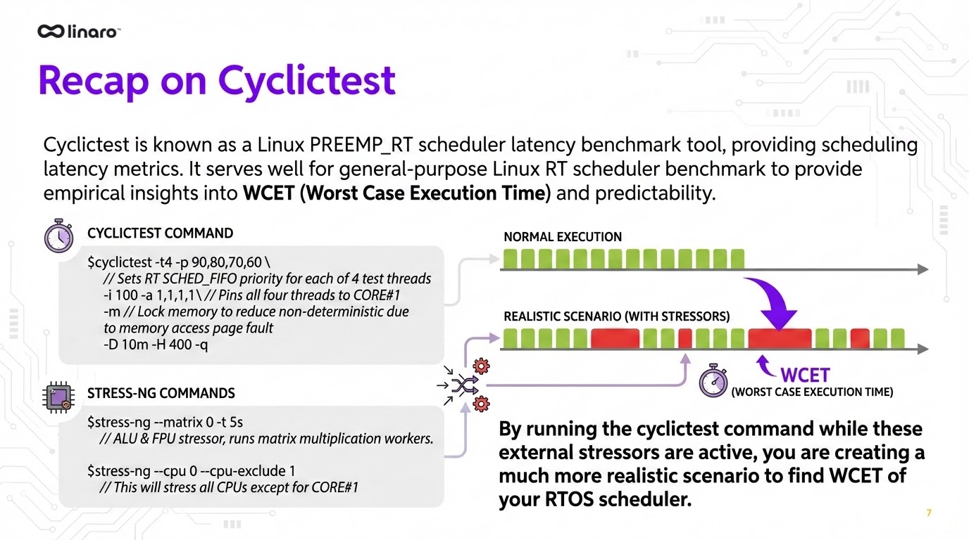
Notes:
Talking points:
1. Well-known cyclictest is good starting point for WCET analysis under stressors.
2. It benchmarks task scheduling latency.
3. It provides some run-time regulating policies to increase predictability and reduce scheduler jitter, hardware IRQ interference to real time safety applications.
However, we want more than these….

Slide 9
∞ linaro
Unified RT Benchmark framework features
Cross-compilable to POSIX-compliant RTOS
Normalised build-time & runtime constraints
CPU pinning, DVFS disabled, mlockall(), pre-faulting
Configurable cache state (cold/warm) per iteration.
Extensible RTOS metrics latency measurement.
Five OS primitive metrics × 3 stressor types (Extensible)
500K samples per scenario — Median, P99.9, WCET
Regulate interference from processors’ shared computing resource to reduce non-predictability (jittering).)
ARM PMU + Linux ftrace correlation for outlier root cause attribution
PORTABILITY & ENVIRONMENT
ROOT CAUSE ANALYSIS
4

Slide 10
∞ linaro
Framework Architecture Layer Overview
WORKLOAD LAYER
STRESSOR LAYER (stress-ng)
MEASUREMENT & COLLECTION
Task Switching Latency
Task Preemption Latency
IRQ Handling Latency
Mutex Shuffling Latency
Intertask Messaging Latency
CPU Stress
ARM cntvct_el0 (low-overhead)
Memory Pressure
500K samples / scenario
Block(network ) I/O pressure
Persistent SD storage
Combined / Idle Baseline
Median - P99 · P99.9 · WCET
5
Notes:
to reduce observer effect to hot path.

Slide 11
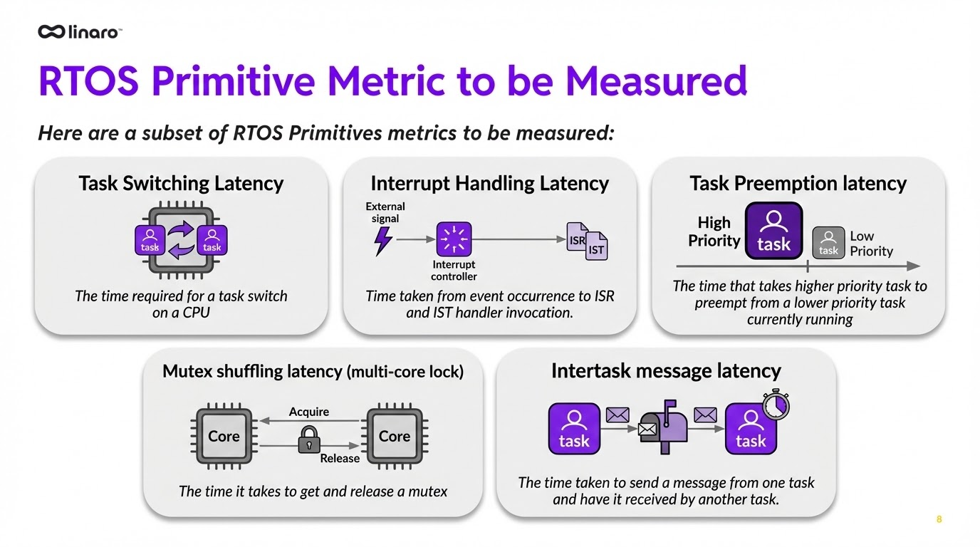

Slide 12
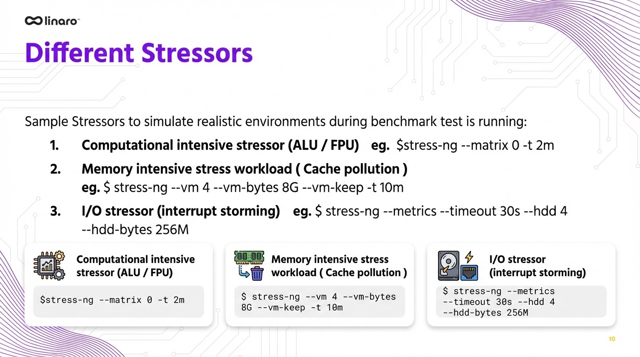

Slide 13
Normalising the Measurement Environment
Consistent build-time and runtime constraints ensure comparable, reproducible results across platforms.
BUILD-TIME CONTROLS
RUNTIME CONTROLS
Compiler flags — Consistent optimisation flags (-O2) across platforms — no LTO, no PGO variance
CPU pinning — Benchmark thread pinned to isolated core via isolcpus=3 — no OS scheduler interference
mlockall() pre-faulting — All memory locked at init — eliminates runtime allocator jitter and page fault latency during measurement
Idle state: WFI only — Deeper C-states disabled — C2/C3 add several ms wake latency and introduce cross-CPU cluster dependencies
DVFS disabled — CPU frequency fixed to maximum via cpufreq-set -g performance — eliminates frequency-scaling jitter
RT throttling disabled — echo -1 > /proc/sys/kernel/sched_rt_runtime_us — prevents kernel from throttling RT tasks for fair scheduling
Cache state control — Configurable cold/warm cache per iteration — characterises cache side-effect contribution to WCET
IRQ affinity — All non-benchmark IRQs steered away from CPU3 — eliminates interrupt-driven jitter on measurement core
13
Note: nohz_full intentionally omitted — introduces syscall overhead incompatible with context-switch benchmarking

Slide 14
Linux RT Kernel Configuration for Determinism
Three kernel-level interventions reduce WCET outliers on AGL-RT (Linux RT-PREEMPT 6.12)
CPU ISOLATION
CPU Core Isolation — isolcpus
# /proc/cmdline
isolcpus=3 rcu_nocbs=3
Removes CPU3 from the kernel scheduler — no OS tasks, timer ticks, or work-queues scheduled on the measurement core.
⚠ nohz_full excluded — incompatible with context-switch measurement
RT THROTTLE
Disable RT Throttling
# Disable RT bandwidth throttling
echo -1 > /proc/sys/kernel/sched_rt_runtime_us
By default the kernel limits RT tasks to 95% CPU to preserve system responsiveness. This must be disabled for uninterrupted RT measurement.
⚠ Re-enable after benchmarking in production systems
IRQ AFFINITY
IRQ Steering — Away from CPU3
# Steer all IRQs away from CPU3
for IRQ in /proc/irq/*/smp_affinity; do
echo 7 > $IRQ 2>/dev/null
done
Redirects all non-benchmark IRQs to CPUs 0-2. Prevents interrupt storms from polluting the isolated measurement core during stressor scenarios.
14
⚠ Benchmark IRQ (GPIO145) explicitly pinned back to CPU3

Slide 15
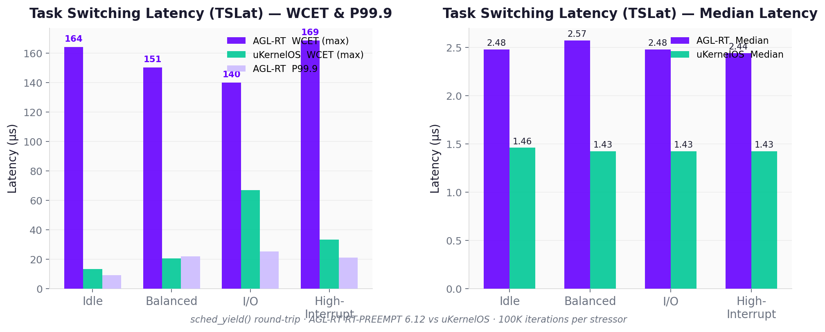
∞ linaro
Task Switching Latency
7

Slide 16
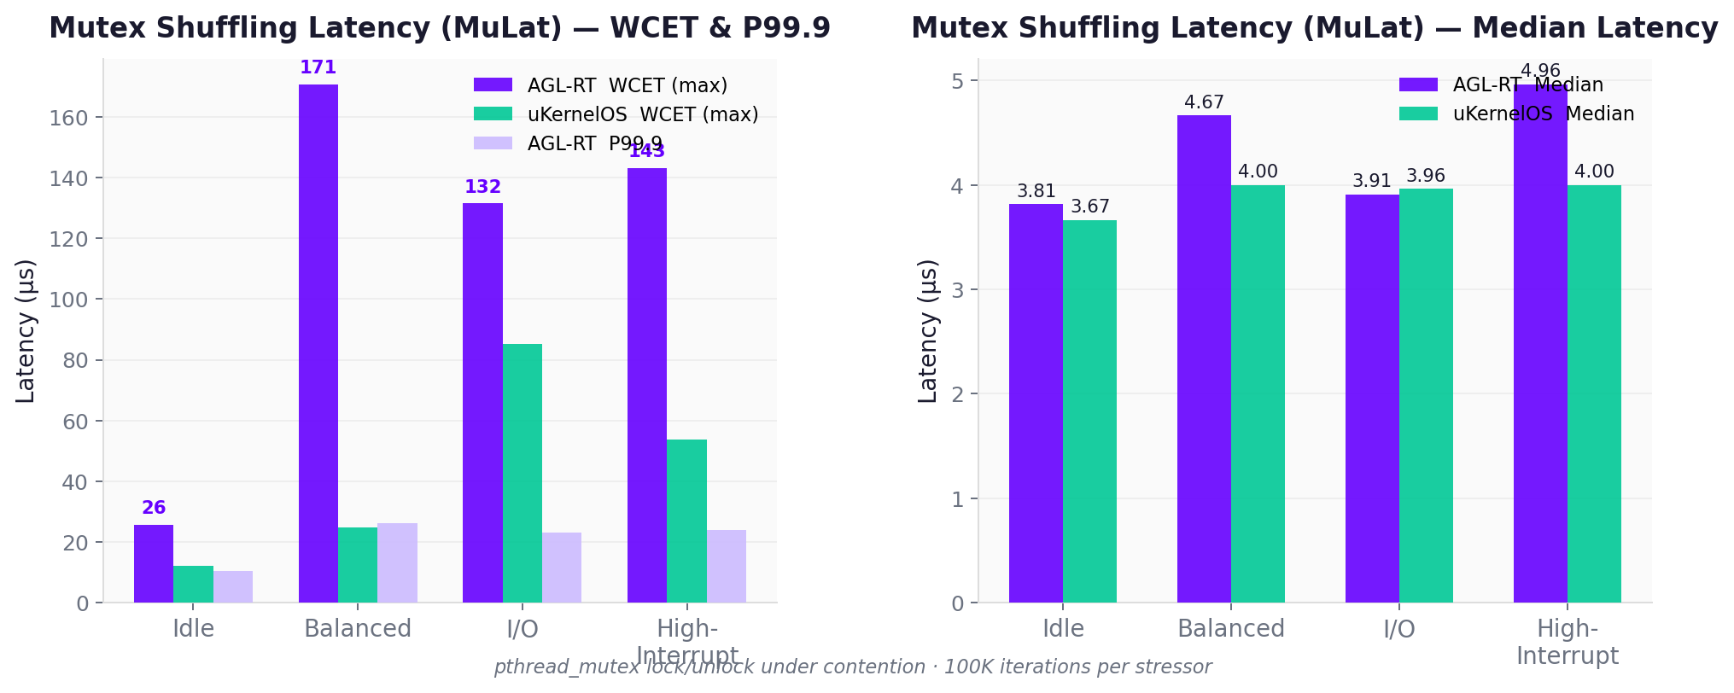
∞ linaro
Mutex Shuffling Latency

Slide 17
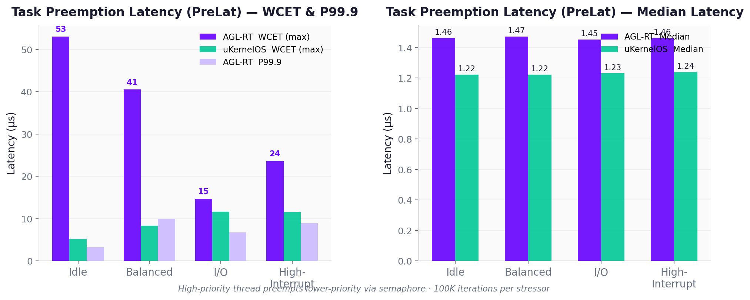
∞ linaro
Task Preemption Latency

Slide 18
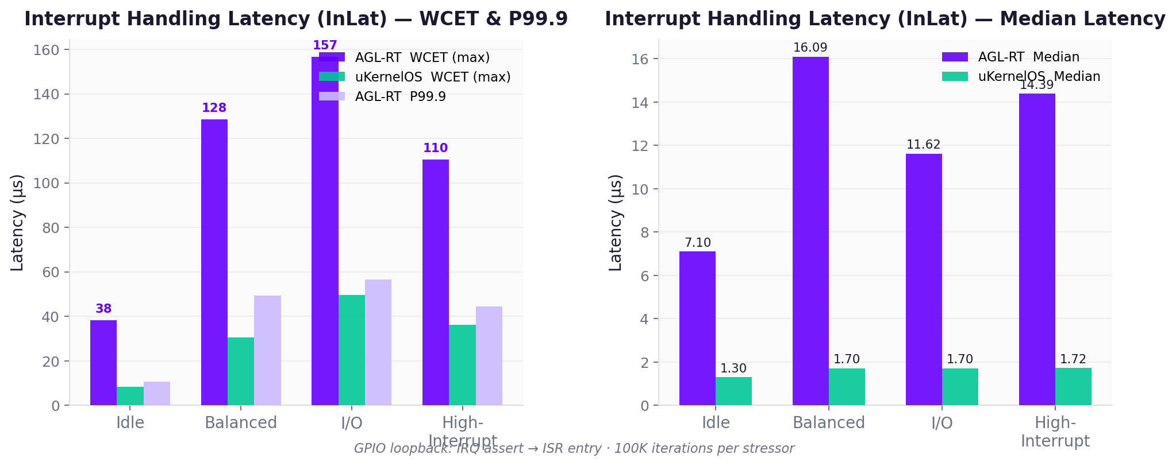
∞ linaro
Interrupt Handling Latency

Slide 19
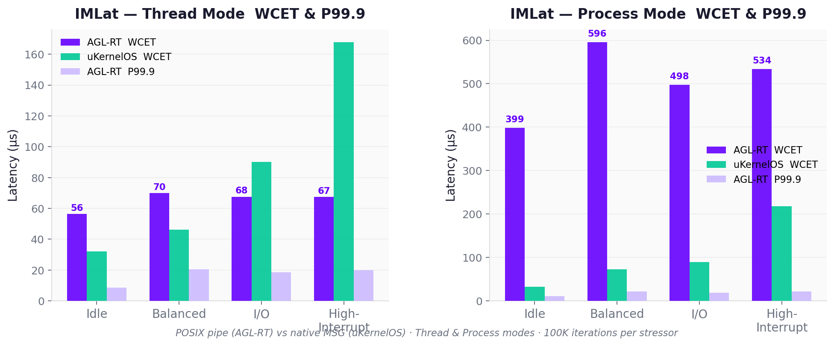
∞ linaro
Inter-Task Messaging Latency

Slide 20
∞ linaro
AGL-RT WCET Profile Under Stressor Load
AGL-RT — WCET (μs)
uKernelOS — WCET (μs)
Metric | Idle | Balanced | I/O | Interrupt Storm
Task Switch | 164.370 | 150.537 | 140.129 | 168.740
Task Preemption | 53.064 | 40.537 | 14.731 | 23.629
IRQ Handling | 38.231 | 128.481 | 156.648 | 110.481
Mutex Shuffling | 25.722 | 170.666 | 131.518 | 143.111
IMLat (Thread mode) | 56.388 | 69.851 | 67.592 | 67.444
Metric | Idle | Balanced | I/O | Interrupt Storm
Task Switch | 13.425 | 20.685 | 66.981 | 33.314
Task Preemption | 5.138 | 8.351 | 11.638 | 11.592
IRQ Handling | 8.324 | 30.388 | 49.472 | 36.055
Mutex Shuffling | 12.129 | 24.907 | 85.203 | 53.870
IMLat (Thread mode) | 16.722 | 17.222 | 19.842 | 28.074
12

Slide 21
∞ linaro
Stressor to Interference Channel Mapping
Stressor | Primary Interference Channel | Affected Metric(s) | ISO 26262 Relevance
CPU Stress (stress-ng -c N) | Scheduler preemption storms Cache thrash on hot paths | Task Switch · Preemption | Simulates parallel ADAS pipeline load — sensor fusion
Memory Pressure (stress-ng --vm N) | LLC eviction → cache cold TLB pressure → walk latency | IRQ latency Mutex overhead | Models memory-hungry DNN inference co-tenant
Block I/O Load (stress-ng --hdd N) | Bus contention (AXI/PCIe) DMA interrupt storming | IRQ handling | Simulates sensor data streaming and logging workloads
Baseline (Idle) | No external interference OS-internal jitter only | All metrics | Establishes lower bound for WCET analysis
ARM cntvct_el0 used for all timing — sub-nanosecond resolution, low overhead, fixed frequency, independent of CPU clock speed and power state changes.
6

Slide 22
∞ linaro
Outlier Root Cause Attribution (PMU Event & Ftrace Correlation)
LLC Eviction
(Cache Cold)
TLB Pressure
Bus Contention
DRAM Refresh
Scheduler Jitter & non-preemptible kernel interference path
Last-level cache capacity evictions during DNN/camera buffer co-tenancy. Primary driver of IRQ latency outliers > 100 μs on AGL-RT.
Large-footprint tasks evict page-walk entries. Materialises as 40-80 μs spikes in preemption latency under memory stress.
AXI interconnect saturation during DMA-intensive I/O workloads. uKernelOS shows lower susceptibility under I/O stressor conditions
Periodic refresh stalls (~7 μs) visible in timer jitter. Hardware-deterministic; equal across platforms.
OS-internal scheduling non-determinism. Dominant on AGL-RT
Attribution based on ARM PMU counter correlation during outlier capture events (L1D/LLC miss rate, TLB miss, bus utilisation).
13

Slide 23
∞ linaro
PMU Correlation — Identifying Outlier Mechanisms
1
Threshold Capture
ARM PMU Counter | Mechanism
LLC_MISS | Cache eviction stall
L1D_MISS | Cache cold / line fill
DTLB_WALK | TLB miss → page walk
BUS_ACCESS | AXI bus saturation
CPU_CYCLES | Scheduler run-time
MEM_ACCESS | DRAM row activation
Flag samples > P99.9 as outlier candidates during the benchmark run.
2
PMU Snapshot
At each outlier event: capture ARM PMU counters — LLC_MISS, L1D_MISS, DTLB_WALK, BUS_ACCESS.
3
Correlation
Compute correlation between PMU delta and latency delta across all outlier windows.
4
Attribution
Dominant PMU counter for each outlier cluster → root cause label.
5
SoC Input
Attribution → countermeasure spec: cache partition size, TLB way count, QoS policy.
14

Slide 24
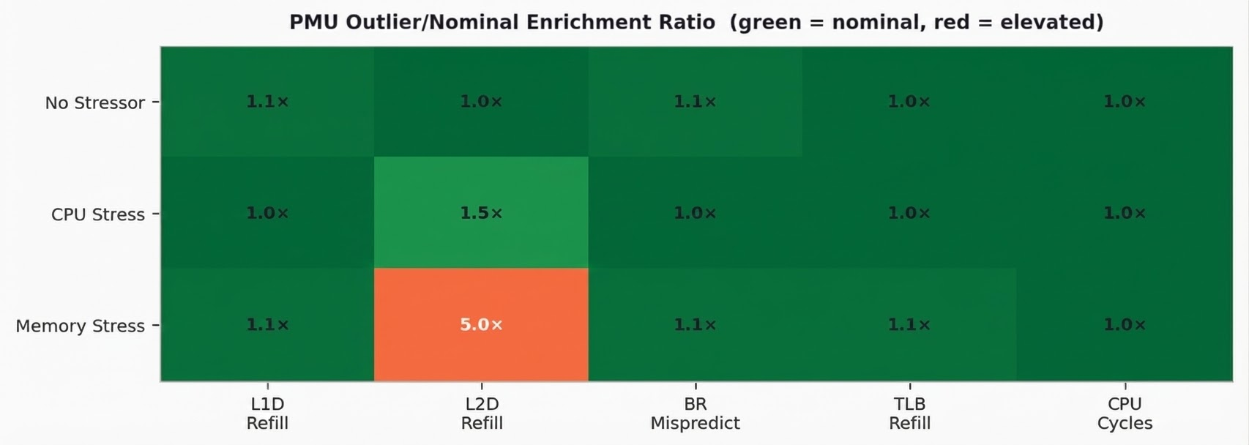
∞ linaro
Outlier Root Cause Analysis—PMU Counter Correlation
Task Switching Latency (PoC) · 400K iterations · 5 PMU counters
✓ Hardware channels clear
L1D, L2D, TLB, Branch all <2× enrichment in outlier windows under all stressor conditions — hardware interference is NOT the cause
⚠ Memory stressor co-occurrence
L2D refill 5× under memory stress but Spearman r = 0.066 — co-occurrence with scheduling displacement, not root cause
✓ Enrichment ratio (mean outlier counter value ÷ mean nominal counter value)
✓Spearman r-value ranks correlation between latency & PMU counter across 400K iterations
Notes:
Spearman r-value range is −1.0 to +1.0. F or our use: r close to +1.0 means "when latency is high, this counter is also high"
Finding: No hardware PMU counter is elevated in outlier iterations. Hardware interference (cache, TLB, branch predictor) is not the outlier source.

Slide 25
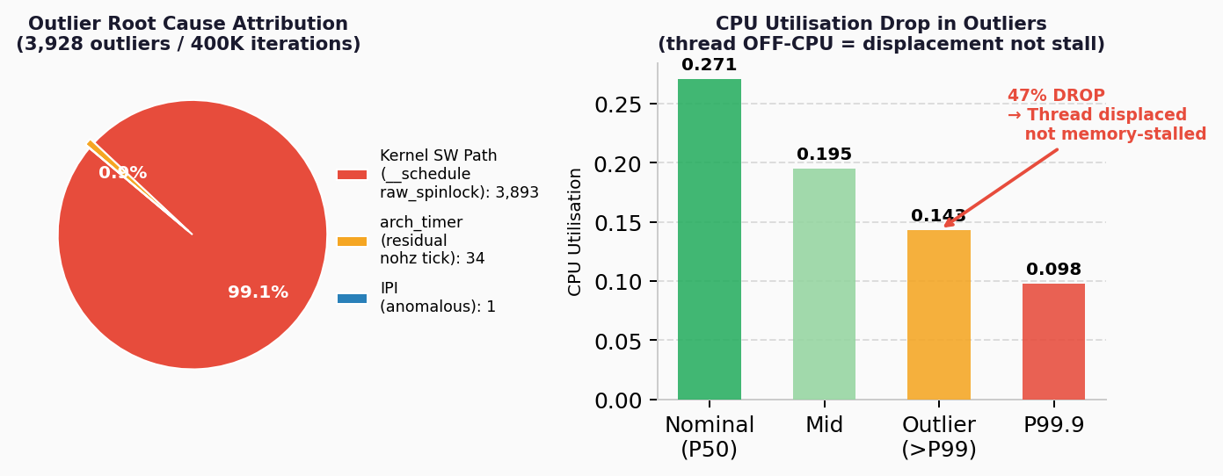
∞ linaro
Outlier Root Cause—Ftrace Non-Preempt Event Attribution
Task Switching PoC · isolcpus=3 rcu_nocbs=3 · 400K iterations · 404K ftrace events
Note: cpu_utilization = CPU_CYCLES_counted / (cntvct_elapsed × cpu_freq_ratio)
Finding
With maximum Linux RT isolation, 99.1% of WCET outliers are kernel software-path non-preemptibility — raw_spinlock in __schedule() that RT-PREEMPT cannot preempt by design.
No single IRQ source is dominant. Residual is diffuse, irreducible jitter.
IRQ Source
Outlier
Nomin
Interference
Verdict
Kernel SW path
(__schedule)
—
—
—
★ PRIMARY (99.1%)
arch_timer (nohz residual)
0.0087
0.0054
1.6×
co-occurring
IPI (anomalous)
0.0003
~0.000
24×*
n=1, low-count

Slide 26
∞ linaro
Path to Countermeasure
PHASE 01
PHASE 02
PHASE 03
BENCHMARK
LATENCY
ROOT CAUSE
ANALYSIS
OPTIMISATION &
COUNTERMEASURE
· 5 metrics × 3 stressors
· PMU correlation
· ARM MPAM resource partitioning
· 500K samples / scenario
· Outlier attribution via FTRACE
· Median · P99.9 · WCET
· CPU isolation + IRQ affinity
· Bottleneck identification per metric
· Both platforms
· Contribution to AGL community
OUTPUT: Empirical WCET dataset
OUTPUT: Mechanism attribution map
OUTPUT: AGL-RT configuration recommendations
15

Slide 27
∞ linaro
Key Takeaways
1
WCET > Median
uKernel Advantage is Real
2
For ASIL-B certification, median latency is insufficient. P99.9 and WCET under adversarial stressors are the only defensible metrics.
uKernelOS delivers 4-7× lower WCET across all metrics under different stressors. The gap is architectural, not configuration-dependent.
3
Root Cause is Attributable
4
AGL-RT is Qualifiable With Evidence
via ARM PMU correlation and kernel FTRACE events correlation, which could lead to countermeasures.
NVIDIA DriverOS Linux for Safety confirms RT-PREEMPT can reach ASIL-B. Empirical WCET data is valuable certification artefact.
16

Slide 28
Credits & Contribution
The RTOS benchmark framework was inspired by “Hard Real-Time Linux for Off-The-Shelf Multicore Architectures”, Dirk Radder, 2015
Thanks for my Linaro colleagues ( @konstantin.belov, @Rouven.Czerwinski, and @Ryosuke Saito, @ramin.zaghi, @vincent.guittot )
for their significant contributions to the benchmark framework concept discussion, technical review & design, implementation and data collection that made this work possible.

Slide 29

Thank you
Schedule a call with our automotive experts!
Contact me:
Linaro
lei.zhou@linaro.org

