Slide 1


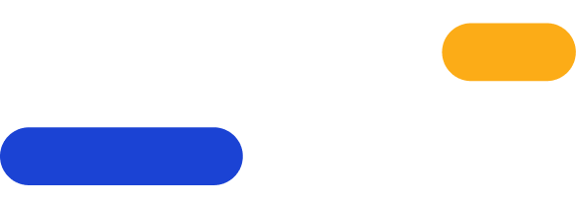
Harness engineering
Build the control loop around your coding agent
#AGNTCon #MCPCon 2026

Slide 2



Who am I
Ji Darwish
Data Engineer at Xomnia
Previously Software Engineer
MSc AI from Utrecht University
Interest in responsible AI and alignment research

Slide 3
Schedule for today
Everything gets explained first. Then the room goes quiet and you build.
Motivation
Guides and sensors
The loop
why any of this
the two axes
what you will write
Harness
The problem
Build
model is not the agent
one borrowing rule
the room codes

Slide 4
Why?
01.

Slide 5
We already built a calculator
When you learned to code
Today, in this room
You built a calculator.
You keep the agent you already use.
The world already had better ones. Free ones, already on the phone in your pocket.
We are not replacing your coding agent, and we are not competing with it.
You will build a small ring around it out of parts you can take home, and point those parts at rules only your company can write.
Maintainability
Cost and token budget
Compliance and review
architecture rules that execute instead of sitting in a doc
stop before the expensive check, cap the repair attempts
the evidence a human needs to sign off, recorded once

Slide 6
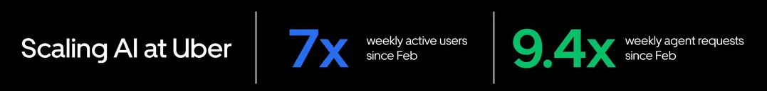
Agents have become a standard
Stripe
Google
Uber
1,000+
75%
70%+
PRs to production
each week
of new code is
AI-generated
of pull requests
come from agents
Shipped by internal coding agents. Humans review and approve every one.
Approved by engineers, up from 50% the previous autumn.
Attributed to local or cloud agents across the engineering org.
stripe.com/sessions/2026/developer-keynote
blog.google · Cloud Next 2026 keynote
uber.com/us/en/blog/efficient-software-factory
Reported by the companies themselves, not independently audited. Read them as direction of travel, not as benchmarks you are behind on.

Slide 7
the gap this workshop sits in
Delivery is scaling faster than control
Uber's own numbers, and Gartner's forecast.
Happening now
Predicted by 2027
3,600
40%
agent skills built across the software development life cycle at Uber, running more than 30,000 skill executions a day.
of enterprises will reduce or remove autonomous AI agents, due to governance gaps identified only after production incidents occur.
Gartner's point is not that governance is missing. It is that not every agent needs the same controls. An agent that only suggests code can operate with light oversight. An agent that can change or deploy software needs stronger permissions, checks, and approval gates.
Uber, Running a Software Factory Efficiently at Uber Scale. Gartner press release, 26 May 2026: a forecast, not a measurement of your organisation. The claim worth keeping is the ordering, capability first and governance later.
Notes:
an expert market research publication by Gartner, a global technology research and advisory firm, used by businesses to evaluate software vendors, understand technology trends, and guide IT investments

Slide 8
Harness
02.

Slide 9

Model is not the agent
Agent = Model + Harness

Slide 10







Same models, different harnesses
Roughly the same frontier models underneath. The difference you feel is harness.
In your terminal
In your editor
Claude Code
Cursor
Codex CLI
Windsurf
Gemini CLI
Copilot agent mode
Every one of them calls the same handful of frontier models. Swap the harness and the model does not change.

Slide 11
Why does it matter?
Resolution rate: the share of task attempts the agent completes successfully.
57.8%
52.1%
Same model both times: Claude Opus 4.5. The only thing that changed is the harness around it.
through Terminus 2
through Claude Code
Model
Harness
Resolution rate
GPT-5.2
Codex CLI
62.9%
Claude Opus 4.5
Terminus 2
57.8%
Gemini 3 Pro
Terminus 2
56.9%
GPT-5.2
Terminus 2
54.0%
Claude Opus 4.5
Claude Code
52.1%
Claude Opus 4.5
OpenHands
51.9%
Merrill et al., Terminal-Bench, arXiv 2601.11868, appendix A6. One benchmark, one model, one reported setup. Not a general ranking of harnesses, and not a cost comparison in euros or tokens.

Slide 12
Inner and
outer harness
03.

Slide 13
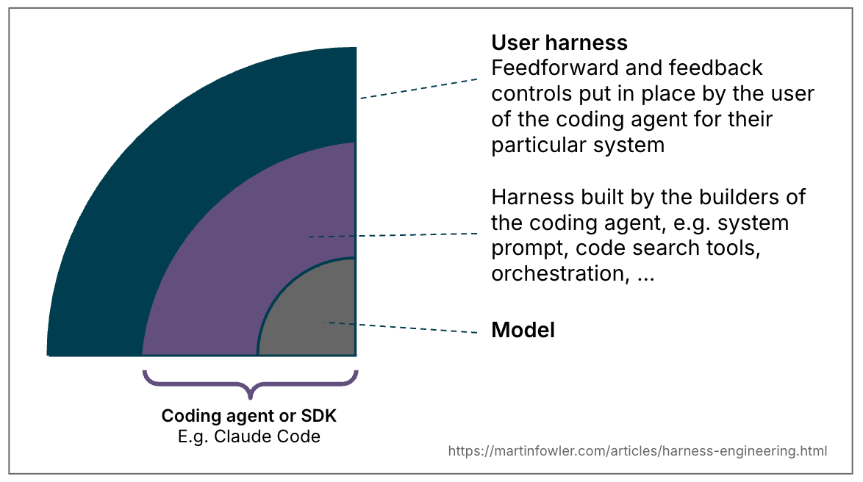
Inner loop, outer loop

Slide 14
what the inner loop actually does
The inner loop, conceptually
while (true) {
response = model.respond(context, tools);
if (response.isFinalAnswer()) {
return response;
}
results = tools.execute(response.toolCalls());
context.add(response, results);
}
Three things this already tells you
The model only chooses.
Every effect comes from a tool the harness allowed.
Context is assembled, not given.
What the model sees is a harness decision.
Nothing here decides when to stop.
Stopping is not a model property. It is a rule someone wrote.
This is the agent you already use. Today it is the part we do not write.
Everything from here on is the ring we draw around it.

Slide 15
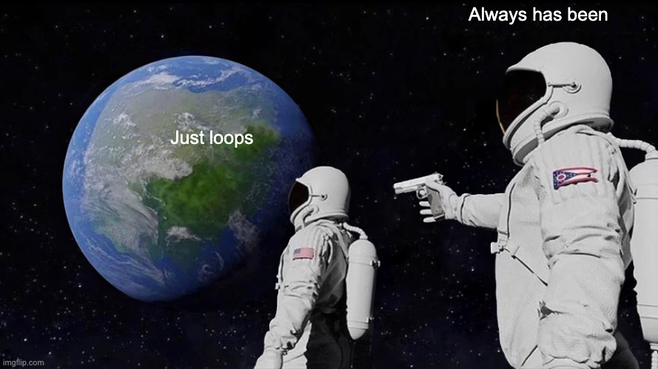

Slide 16
When it acts, and how it decides
Guide
Sensor
acts before generation
feedback after generation
Computational
Deterministic Execution
A rule the machine applies before or during generation.
It raises the chance of a good result on the first attempt, and needs no judgement at the moment it is applied.
A check that runs after the attempt and returns its own verdict.
Reliable, repeatable, and cheap enough to run on every attempt. Nobody has to be consulted to get the answer.
Inferential
non-deterministic
Guidance a person had to agree on first.
Someone decided what correct means, and is accountable for it.
A judgement about the result that no rule captures.
Useful, and capable of being wrong in both directions.
Guides and sensors, computational and inferential: the terms and the axes are Böckeler's, Harness engineering for coding agent users, martinfowler.com.

Slide 17
The same axes, with today's artifacts
Guide
Sensor
acts before generation
feeds back after generation
Computational
executes an explicit rule
A project bootstrap script, A CLI that generates approved structures, A codemod such as an OpenRewrite recipe, Language-server support
COMPILE, LINT, BUSINESS_BEHAVIOR, ARCHITECTURE_BOUNDARY, FULL_TEST_SUITE.
Each one executes and returns its own named finding.
Inferential
needs interpretation
agents.md, our LAB 1 injects approved-policy.md into the build prompt.
LLM as a judge
It can raise a concern no import rule sees, and it can reject correct code.
Notes:
For example, imagine a company wants to:
- Replace an old internal logging API
- Move classes into a new package structure
- Replace deprecated Java types
- Add required annotations
- Migrate JUnit 4 tests to JUnit 5
- Apply the organization’s formatting style

Slide 18
the boundary this workshop draws
Inner loop, outer loop
Outer harness: the code you write today
The outer loop owns four things
Inner harness: the coding agent
Policy
the approved rule, sent before the agent acts
• reads and edits Java source code
• Has access to tools
• reports success or failure, nothing more
Independent checks
named sensors run after each attempt, outside the agent's reach
Repair budget
how many attempts a failure is worth, and what stops the loop
Acceptance
what evidence, on which source version, permits a yes
Enforced, not promised

Slide 19
The problem
you will work on
04.

Slide 20
the codebase you will work in
The Bookshelf
One physical copy of each book. Nine classes. Small on purpose.
bookshelf/
approved-policy.md
src/main/java/workshop/bookshelf/
domain/
Book, Member, Loan
BorrowOutcome
service/
BorrowService
storage/
InMemoryBookshelf
src/test/java/workshop/bookshelf/
BorrowServiceTest
ArchitectureTest
BorrowPolicyTest
At work the business rule is pricing, permissions, time zones or idempotency. The size of the example is not the point.

Slide 21
the codebase you will work in
The Bookshelf
One physical copy of each book. Nine classes. Small on purpose.
bookshelf/
approved-policy.md
src/main/java/workshop/bookshelf/
domain/
Book, Member, Loan
BorrowOutcome
service/
BorrowService
storage/
InMemoryBookshelf
src/test/java/workshop/bookshelf/
BorrowServiceTest
ArchitectureTest
BorrowPolicyTest
One copy, one borrower
InMemoryBookshelf tracks at most one active Loan per book. activeLoan(bookId) is how you ask who holds it.
borrow() already refuses the easy cases
BOOK_NOT_FOUND and MEMBER_NOT_FOUND are handled. The second-borrow rule is simply not checked.
The suite is green, and wrong
BorrowServiceTest and ArchitectureTest genuinely pass. BorrowPolicyTest passes while asserting nothing at all.
At work the business rule is pricing, permissions, time zones or idempotency. The size of the example is not the point.

Slide 22
one physical copy, two members
Who holds the copy?
1
2
3
4
Alice borrows book 1
Bob requests book 1
Alice returns book 1
Bob borrows book 1
→
→
→
active borrower: Alice
Bob's result: ?
active borrower: ?
active borrower: nobody
Bob's result: ?
active borrower: ?

Slide 23
Who holds the copy?
1
2
3
4
Alice borrows book 1
Bob requests book 1
Alice returns book 1
Bob borrows book 1
→
→
→
active borrower: Alice
Bob's result: BOOK_UNAVAILABLE
active borrower: Alice
active borrower: nobody
Bob's result: BORROWED
active borrower: Bob

Slide 24
run this before you write anything
A green suite that asserts nothing
bookshelf/.../service/BorrowService.java
bookshelf/src/test/java/.../BorrowPolicyTest.java
public BorrowOutcome borrow(long bookId, long memberId) {
if (!shelf.hasBook(bookId)) return BOOK_NOT_FOUND;
if (!shelf.hasMember(memberId)) return MEMBER_NOT_FOUND;
// the agreed second-borrow rule is not checked here
shelf.record(new Loan(bookId, memberId));
return BORROWED;
}
@Test
void aSecondMemberCannotBorrowAnAlreadyLoanedBook() {
var service = new BorrowService(shelf());
service.borrow(1, 10);
// no assertion follows
}
./mvnw -pl bookshelf test
PASS
and Bob can still replace Alice as the active borrower.

Slide 25
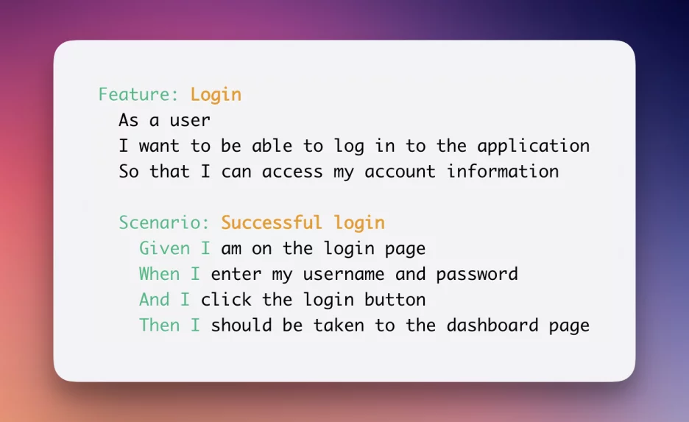
https://testomat.io/blog/mastering-bdd-tips-tricks-and-best-practices-for-setting-up-a-testing-framework/

Slide 26
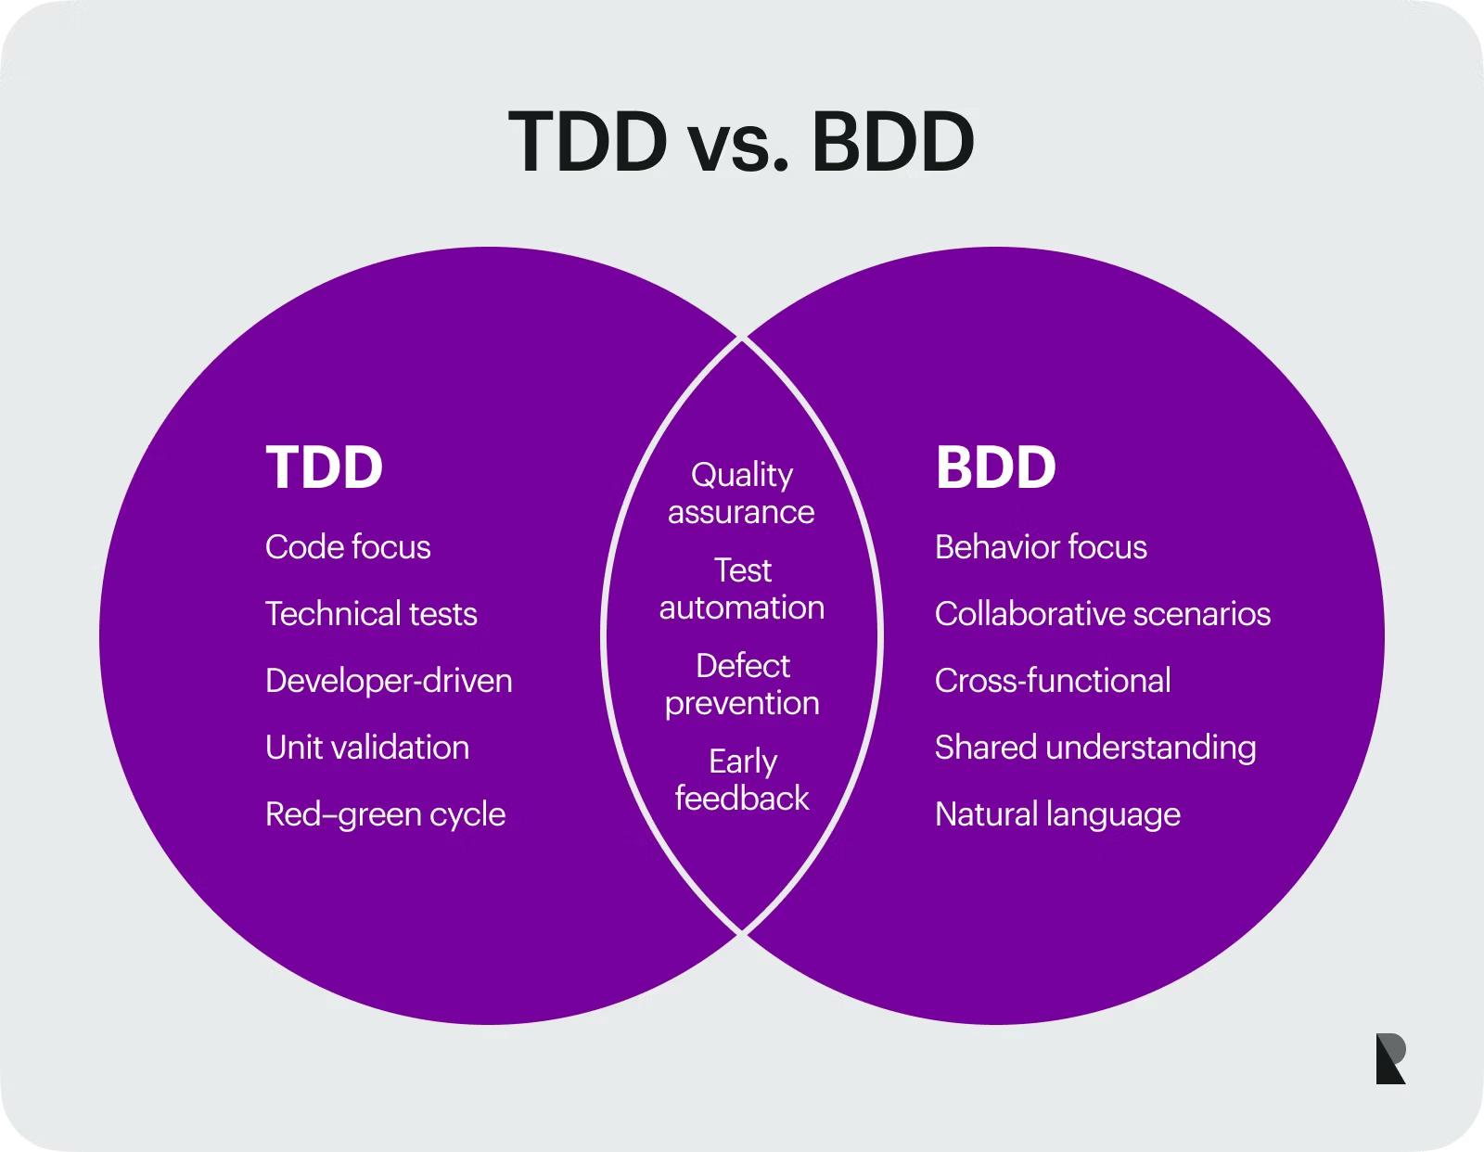
TDD & BDD
https://www.ramotion.com/blog/tdd-vs-bdd/

Slide 27
The loop
you will build
05.

Slide 28
Looping is not reliability
%82
%67,3
%84,7
correct after one revision
correct after two
ever correct at some point
Stale evidence is the mechanism
What you already built, for this reason
Verification traces from an earlier version harmed 34 of 135 initially correct attempts. With current traces: 4 of 135.
One repair at most (for now). Acceptance judged on the final source attempt. Never reuse a PASS from before a repair.
A repair budget is not stinginess. It is the control that stops a loop thrashing away a correct answer.
Gao, Yang and Yang, Looping Is Not Reliability, arXiv 2607.24604.

Slide 29
Three decisions, three labs
Each lab is one decision you make and can defend.
LAB 1
LAB 2
LAB 3
the guide,
then the sequence
bound the repair,
and make it useful
decide acceptance
on the final attempt
The approved rule reaches the agent, and the checks run in an order you chose.
One repair at most, carrying every failing finding in a single prompt.
A PASS from before the repair does not count toward the answer.

Slide 30
LAB 1 | the order you choose
The sequence you wire
build with approved policy
Two rules that are not negotiable
• An ordinary FAIL must not hide another independent finding.
• An ERROR stops the sequence. It is not a result to repair against.
COMPILE
prerequisite: a FAIL skips everything below
LINT
BUSINESS_BEHAVIOR
ARCHITECTURE_BOUNDARY
independent findings, collected for one repair prompt
FULL_TEST_SUITE
only if all three focused checks PASS
./harness.sh check
one repair for current application FAIL findings, or stop
PASS COMPILE
PASS LINT
FAIL BUSINESS_BEHAVIOR
PASS ARCHITECTURE_BOUNDARY
SKIPPED FULL_TEST_SUITE
repeat the entire sequence on the repaired source
accept the exact final PASS set, or report UNRESOLVED

Slide 31
Acceptance is decided on the final attempt
Attempt 1
Attempt 2, after one repair
BUSINESS_BEHAVIOR
FAIL
BUSINESS_BEHAVIOR
PASS
ARCHITECTURE_BOUNDARY
PASS
ARCHITECTURE_BOUNDARY
FAIL
FULL_TEST_SUITE
SKIPPED
FULL_TEST_SUITE
SKIPPED
Verdict: UNRESOLVED
Two green labels exist. They belong to two different versions of the source, and neither version passes everything that was required. Accumulating green across attempts is the single easiest way to build a loop that accepts broken work.

Slide 32
Where to look further
The outer harness is getting attention
No single tool has settled the whole design. The same pieces keep appearing separately.
Instructions
Claude code, codex…
repository-local guidance that reaches the agent first
Deterministic hooks
Claude Code, GitHub Copilot…
commands at lifecycle events: format, test, scan, block
Checks and repair
Dagger, Aider, Qodo Cover
run checks after edits, feed failures back, cap iterations
External verification
Harbor
Evaluate agent’s result with task-defined verifiers outside the agent loop
Guarded delivery
GitHub Agentic Workflows
sandboxed jobs, read-only defaults, timeouts, approval gates
Many pieces exist. Deciding which properties matter, which sensors establish them, what justifies another attempt, and who may accept the result is still yours.

Slide 33
Over to you
06.

Slide 34
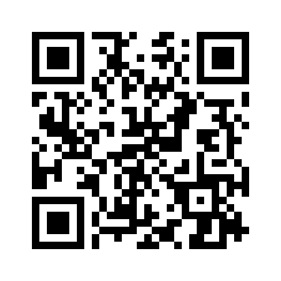


Contact
Thank you for participating in this workshop
Data Engineer
Xomnia B.V.
Amsterdam
xomnia.com
Ji Darwish
ji.darwish@xomnia.com
github.com/JiDarwish/outer-harness-workshop

Slide 35
visit us at:
xomnia.com

