Slide 1
AGNTCON + MCPCON EUROPE 2026 · AMSTERDAM · 17 SEPTEMBER
v1.0
A2A Goes Stable
What changed, why, and what's next
A2A
Sam Betts
Agent
Agent
Engineering Technical Lead · Cisco Systems
Kuba Herczyński
Staff Software Engineer · Google
Both A2A Protocol maintainers · #AGNTCon #MCPCon

Slide 2
WHO'S TALKING
Two core maintainers
Sam Betts
Kuba Herczyński
Engineering Technical Lead · Cisco Systems
Staff Software Engineer · Google
Contributor to the A2A specification and SDKs. Works on AGNTCY. Fourteen years building cloud-native platforms, security and AI systems.
Contributor to the A2A specification and its adoption. Authored the v0.3 to v1.0 backward-compatibility design.
A2A is a hosted project of the Agentic AI Foundation — the foundation running this conference.
150+ partner organisations. TSC: AWS · Cisco · Google · IBM Research · Microsoft · Salesforce · SAP · ServiceNow
A2A Protocol v1.0 · AGNTCon + MCPCon Europe 2026
2

Slide 3
PRIMER
A2A in 60 seconds
Agent A
A2A
Agent B
reasoning + orchestration
reasoning + orchestration
1 · discover the Agent Card
via MCP
2 · delegate a Task
via MCP
Tools
Data
Context
3 · stream · poll · webhook
Tools
Data
Context
MCP is inside an agent. A2A is between agents.
Most production systems run both.
A2A Protocol v1.0 · AGNTCon + MCPCon Europe 2026
3

Slide 4
THE OBVIOUS QUESTION
Why not MCP to agent?
Agent A
MCP
Agent B
reasoning + orchestration
reasoning + orchestration
The agent becomes a tool,
if you treat it like a tool.
via MCP
via MCP
Tools
Data
Context
Tools
Data
Context
Agents adapt, plan and solve problems. Tools reply.
A2A Protocol v1.0 · AGNTCon + MCPCon Europe 2026
4

Slide 5
THE CASE FOR v1.0
Why v1.0 — and why now
01
02
03
Governance
Reach
Design intent
A Linux Foundation project with an eight-company steering committee. Not one vendor's spec.
Six official SDKs shipped: Python, Go, Java, JavaScript, .NET and Rust.
A hardening release, not a reinvention. Core ideas intact, rough edges removed.
v0.3 was something to experiment with. v1.0 is something to commit to.
A2A Protocol v1.0 · AGNTCon + MCPCon Europe 2026
5

Slide 6
DEFINITIONS
What “stable” actually means
01
One normative source of truth
a2a.proto is now the universal definition of the protocol, not a gRPC-specific file.
02
Explicit compatibility rules
A defined versioning strategy, with the protocol version declared per interface.
03
Bindings that must agree
JSON-RPC, HTTP+JSON and gRPC are formally specified with equivalence guarantees.
Stable ≠ finished. Stable means you can plan around it.
A2A Protocol v1.0 · AGNTCon + MCPCon Europe 2026
6

Slide 7
ACT II
What v1.0 delivers
Signed Agent Cards · Web-aligned architecture · Multi-tenancy · Modern security

Slide 8
ENTERPRISE CAPABILITIES
Four things v1.0 puts on the table
Signed Agent Cards
Multi-tenancy
Cryptographic verification of identity and metadata — trust established before interaction.
A single endpoint can securely host many agents.
Heterogeneous environments
Improved security posture
Multi-protocol bindings and version negotiation. No lock-in to one stack.
Modern auth flows in, legacy patterns out.
Highlighted: the two we will look at in detail.
A2A Protocol v1.0 · AGNTCon + MCPCon Europe 2026
8

Slide 9
DEEP DIVE 01
Signed Agent Cards
In v0.3, an Agent Card was effectively trust-on-first-use.
STEP 1
STEP 2
STEP 3
Fetch the card
Verify the signature
Then interact
Client retrieves the Agent Card from .well-known or from a registry.
A JWS signature (RFC 7515) over the RFC 8785 canonical form of the card.
Credentials and tasks flow only after identity is proven.
Closes at the discovery layer
lookalike cards in registries · stale cards with swapped auth · compromised discovery paths
Verify before you send credentials, before you send a task — before you send anything.
A2A Protocol v1.0 · AGNTCon + MCPCon Europe 2026
9

Slide 10
DEEP DIVE 02
Web-aligned architecture
WIRE
JSON + HTTP · JSON-RPC · gRPC
“An A2A interaction can begin with a single HTTP request.”
DELIVERY
polling · streaming · webhooks
STYLE
stateless · layered · HTTP semantics
— A2A v1.0 announcement
Your existing load balancers, API gateways, WAFs and tracing already work. You do not need an agent mesh.
A2A Protocol v1.0 · AGNTCon + MCPCon Europe 2026
10

Slide 11
ENTERPRISE, BRIEFLY
Multi-tenancy and modern security
Multi-tenancy
Improved security posture
Route by URL sub-path, auth credentials, or an opaque tenant field in the Agent Card.
✓
Device Code flow (RFC 8628)
one A2A endpoint
✓
pkce_required on Auth Code (RFC 7636)
✕
Implicit and Password flows removed
agent-a
agent-b
agent-c
Aligned with the OAuth 2.0 Security BCP.
Enterprise-ready ≠ enterprise-heavy. Same protocol, better defaults.
A2A Protocol v1.0 · AGNTCon + MCPCon Europe 2026
11

Slide 12
ACT III
Migration & extensibility
Breaking changes · backward compatibility by design · extensions and bindings

Slide 13
THE HONEST SLIDE
Yes — v0.3 → v1.0 breaks the wire
IMPACT
WHAT CHANGED
WHY
CRITICAL
TextPart / FilePart / DataPart → one unified Part
Member presence replaces the kind discriminator
HIGH
Enum values → SCREAMING_SNAKE_CASE
ProtoJSON compliance: completed → TASK_STATE_COMPLETED
HIGH
Stream events lose kind and final
Wrapper members statusUpdate / artifactUpdate instead
HIGH
Agent Card collapses into supportedInterfaces[]
One interface list; protocolVersion moves inside each
HIGH
Errors now use google.rpc.Status
Replaces RFC 9457; ErrorInfo carries reason and domain
Ordered by the impact rating in the spec's own migration guide. →
A2A Protocol v1.0 · AGNTCon + MCPCon Europe 2026
13

Slide 14
DESIGN DECISION 01
Compatibility, baked into the Agent Card
The Agent Card is public — it lives in .well-known files, registries and emails between teams. You cannot ship two versions of it.
PROTOBUF DEFINITION
JSON WIRE FORMAT
v1.0 fields only
v1.0 + v0.3 fields
Clean. No legacy debt carried into the type definitions.
Legacy field names preserved. SDKs translate on marshal and unmarshal.
A v0.3 client can still parse a v1.0 server's card — and the reverse.
Clean core. Compatibility at the edges.
A2A Protocol v1.0 · AGNTCon + MCPCon Europe 2026
14

Slide 15
DESIGN DECISION 02
Per-interface versioning
v0.3: the protocol version was a property of the whole Agent Card. One agent, one version.
v1.0: protocol_versions moved into each interface.
https://agent.example.com/v03
JSON-RPC
v0.3
One agent
agent.example.com
https://agent.example.com/v1
JSON-RPC
v1.0
grpc://agent.example.com:443
gRPC
v1.0
Version negotiation becomes part of transport negotiation.
Separate routes for your LB
Separate metrics in tracing
Opt into back-compat per transport
A2A Protocol v1.0 · AGNTCon + MCPCon Europe 2026
15

Slide 16
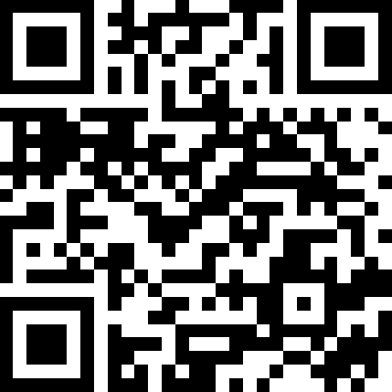
THE PAYOFF
All four combinations work
v0.3 SERVER
v1.0 SERVER
✓
✓
v0.3 client
Native
Legacy interface + card back-compat
✓
✓
v1.0 client
Card back-compat
Native
Progressive migration. No flag day. No frozen ecosystem.
MEASURED, NOT ASSERTED — SCAN FOR THE LIVE DASHBOARD
Every night the ITK tests 8 SDK/version pairs — v1.0 and v0.3, all three bindings.
The v0.3 cells above use each SDK's compatibility layer: opt-in in JS, not yet in Rust.
A2A Protocol v1.0 · AGNTCon + MCPCon Europe 2026
16

Slide 17
ROOM TO GROW
A stable core, not a frozen ecosystem
Custom protocol bindings
Replace the default transport while preserving A2A semantics.
Extensions
Add capabilities on top of the core. Advertised on the Agent Card, so clients can negotiate.
A2A core
Stable. Governed. Protected by semver.
Both extension points have governance, so the ecosystem does not fragment.
A2A Protocol v1.0 · AGNTCon + MCPCon Europe 2026
17

Slide 18
ROADMAP
What the community is building now
NEXT PROTOCOL VERSION
v1.1 — bidirectional streaming, later this year
Backward compatible within v1.x — the semver promise, in practice.
01
02
03
SDK parity
Validation tooling
Community-led development
All six SDKs support v1.0. Four have cut stable releases; .NET and Rust are pre-stable.
Inspector, the TCK, the ITK — and a new official A2A CLI.
Standard processes for contributing to the spec, SDKs and tooling.
Full roadmap: a2a-protocol.org/latest/roadmap
A2A Protocol v1.0 · AGNTCon + MCPCon Europe 2026
18

Slide 19
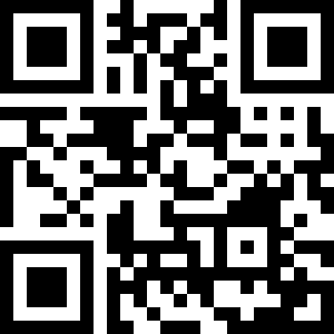
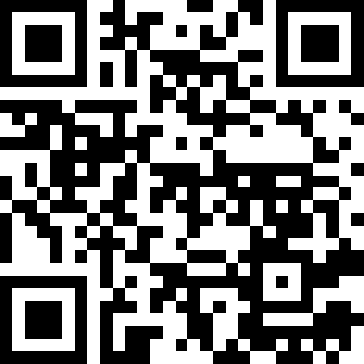
TWO THINGS TO DO
Try it. Then help shape it.
01
02
Try v1.0 today
Join the working group
a2a-protocol.org
github.com/a2aproject
NEW · official A2A CLI
Concrete asks right now: bidirectional streaming for v1.1, .NET and Rust SDK parity, custom protocol bindings.
Pick your SDK, or start with the CLI. On v0.3? Migration is progressive, not a rewrite.
If you're building an agent — not just a long-running tool — expose it over A2A.
A2A Protocol v1.0 · AGNTCon + MCPCon Europe 2026
19

Slide 20
Thank you
Questions?
Sam Betts · Cisco Systems · github.com/tehsmash
Kuba Herczyński · Google · github.com/herczyn
a2a-protocol.org
a2a-protocol.org · github.com/a2aproject
A2A Protocol is a Linux Foundation project. TSC: AWS · Cisco · Google · IBM Research · Microsoft · Salesforce · SAP · ServiceNow

