Slide 1

AGENTCON + MCPCON EUROPE 2026 · AMSTERDAM
We built AI agents to fix security findings in production
Here's what developers actually merged.
Amine Boudraa · Gianfranco Romani
Product Security · Thomson Reuters
Notes:
30 seconds. Introduce yourselves and the thing. Product Security at Thomson Reuters. We built two agents that remediate security findings and raise pull requests against production repositories. Set the story: why assistants are useful but insufficient, what makes the two agents specialised, the system around them, and what it takes for a developer to choose to merge.

Slide 2

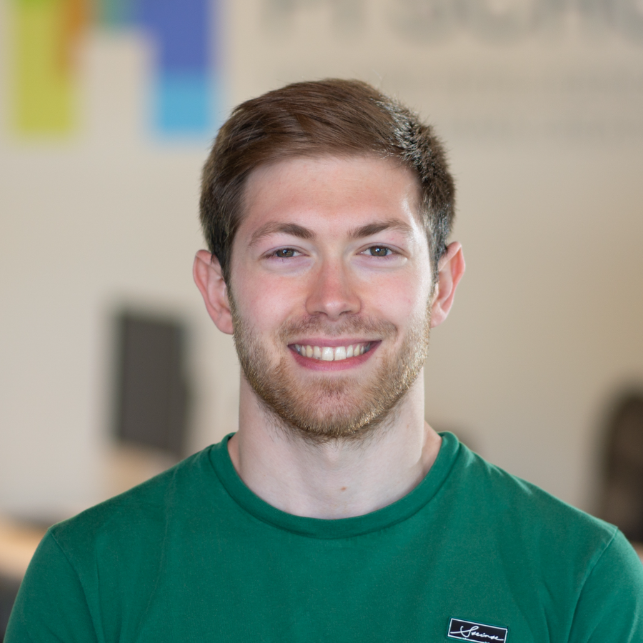
PRESENTERS
Today's presenters
Amine Boudraa
Gianfranco Romani
Senior Product Security Engineer
Senior ML Engineer · Cybersecurity
02 / 20
Notes:
20 seconds. Introduce Amine and Gianfranco; do not read biographies. Amine is a Senior Product Security Engineer. Gianfranco is a Senior ML Engineer in Cybersecurity, focused on AI security and automated vulnerability discovery and remediation. The point is complementary expertise applied to the same production system.

Slide 3
THE REMEDIATION GAP
The state of vulnerability remediation
THE GAP ALREADY EXISTS
AI-ASSISTED DEVELOPMENT
AI-ENABLED DISCOVERY
2025 — Vulnerability volume reaches record levels. NIST reports CVE submissions grew 263% from 2020 to 2025.
2026 — HackerOne’s 2026 platform data reports vulnerability submissions up 76% year over year, while remediation improved only 19%.
Cumulative security findings
Reducing this gap is our focus today
Open remediation backlog
2020
2021
2022
2023
2024
2025
2026
Findings discovered
Findings remediated
Conceptual model, not measured data
03 / 20
Notes:
70 seconds. Six clicks. Conceptual model, not measured data; do not read the curves as CVE counts or as proof of any organisation's backlog. Click 0, 2020 to 2022: the gap already exists. Automated discovery and disclosure grow faster than repository-specific remediation. Click 1: shade the open backlog that was already there. Click 2, 2023 to 2024: AI-assisted development adoption accelerates, more software change to assess; patches are faster to author, but generating a patch is not validating, reviewing, tracking and merging it, so green improves only slightly. Click 3, 2024 to 2025: AI-enabled discovery adds capacity; orange steepens again. AI did not cause the earlier rise. Click 4 shows the evidence on the right: GitHub Innovation Graph, NIST CVE growth, HackerOne 2026 platform data; say the NIST figure supports inflow but is not attributable to AI. Click 5: the evidence goes away, the gap is bracketed and the shading deepens. Reducing this gap is our focus today. Slide 4 answers: for contained fixes, sometimes yes.

Slide 4
WHERE ASSISTANTS WORK
AI Assistants can help when the fix is cheap
The more of the application a fix must understand, the less an assistant can prove it worked.
SPECIALIZATION
TAKES OVER
HERE
FIX
RELIABILITY
NEED FOR
SPECIALIZATION
ONE LINE, ONE FILE
A FUNCTION'S DATA FLOW
MULTIPLE FILES, ONE MODULE
THE WHOLE APPLICATION
SCOPE THE AI MUST UNDERSTAND →
Conceptual model, not measured data
04 / 20
Notes:
30 seconds. The more of the application a correct fix has to understand, the less an unaided assistant can prove it worked. Small, local findings close on the spot. The large ones stay open — and those are exactly the ones we need a system for. That system is the next slide.

Slide 5
ENTERPRISE SCALE
A valid fix does not scale by itself
Specialization is the engine. Scaling needs a system around it.
THE REMEDIATION SYSTEM
REPOSITORIES
PULL REQUESTS
across many
teams
→
Create fixes that are
optimized and valid
Follow them through their
lifecycle until they get
merged
→
one per fix
THE REMEDIATION BACKLOG
merged
PR green, waiting on a human
PR red, the agent repairs it
no PR yet
05 / 20
Notes:
50 seconds. Specialization gets you one reliable fix. At enterprise scale, that's necessary but not sufficient — you need a system on top of it that can invoke that agent across many repositories and teams. That's what the rest of this talk is about.

Slide 6
OUR APPROACH
Two specialist agents, one remediation system
SPECIALIZATION
what it takes to get one fix right
static application security testing
software composition analysis
SAST AGENT · FIRST-PARTY
CODE
lib-core 2.8.0
SCA AGENT · THIRD-PARTY
LIBRARIES
The code your team wrote. A flagged
path runs from untrusted input to a
dangerous operation.
lib-net 4.1.2
CVE
A library version in your dependency
tree carries a known vulnerability.
Not a line you wrote.
user_input →
lib-io 1.3.9
query()
Optimization MCP
Modernization Skills
OpenRewrite
Minimal set MCP
SCALE
what it takes to run this everywhere
ONE REMEDIATION SYSTEM
PULL REQUESTS
REPOSITORIES
Runs both agents, tracks, and keeps every result
moving.
opened
→
CI green
→
reviewed
→
merged
across many
teams
→
→
↶ the system follows each one: repairs,
revises, re-verifies
18 jobs running 126 PRs open 40 repositories
06 / 20
Notes:
45 seconds. Two words first. SAST is first-party code — the code your team wrote, where a flagged path runs from untrusted input to a dangerous operation. SCA is third-party dependencies — a library version with a known vulnerability. Each agent carries its own tools, which is what specialisation means here. One system runs them across every repository: repositories in, pull requests out, and the system follows each one until a developer merges it.

Slide 7
SAST · TAINT ANALYSIS
The best place to fix is rarely the place it was flagged
1 · TAINT ANALYSIS
1 · TAINT ANALYSIS
2 · POSSIBLE FIXES
2 · POSSIBLE FIXES
3 · THE MINIMAL SET
3 · THE MINIMAL SET
4 · WHAT IT COSTS
4 · WHAT IT COSTS
SOURCE
→
FLOW
→
SINK
Untrusted input enters the application: a request parameter, a form field, a header.
The value passes through functions and variables, unchanged or transformed.
It reaches a dangerous operation: a query, a shell command, a render.
The line the scanner reports.
possible location
minimal set
MEASURED ON ONE APPLICATION
36 XSS findings across 6 route files
/search
trim(q)
buildRow(q)
layout(q)
res.send(html)
q = req.query.q
46
16
65%
response body
→
LLM turns
fewer tokens
/profile
clean(q)
renderTemplate(q)
res.render(view)
q = req.body.bio
The comparison runs in our MCP, not in the model’s context.
template output
shared code
minimal set · 2 locations cover all 3 paths
/export
toCsv(q)
writeRow(q)
fs.write(path)
q = req.query.fmt
file on disk
A finding is not a line. It is a path from untrusted input to a dangerous operation.
Every node on a path can host a valid fix. The scanner only reports the last one.
One change at the shared helper closes two of the three paths. The third needs its own.
Choosing where to fix is analysis work. Done outside the model, it costs a fraction of the context.
07 / 20
Notes:
70 seconds. One click. Three routes, three tainted paths. Several nodes accept a valid fix — at the source, mid-flow, or at each sink. The optimal one is none of those: it is the shared template helper where two of the paths meet, because one change there closes both and touches one file. Our MCP does that comparison before the model reasons. On an application with 36 XSS findings across 6 route files, it took us from 46 LLM turns to 16, and 65% fewer tokens.

Slide 8
SCA · THIRD-PARTY DEPENDENCIES
An SCA fix is a version change the application must
survive
1 · THE FINDING
1 · THE FINDING
2 · THE MINIMAL SET
2 · THE MINIMAL SET
3 · THE CHANGE
3 · THE CHANGE
4 · WHAT IT COSTS
4 · WHAT IT COSTS
OUR MCP RESOLVES THE MINIMAL SET
THE CHANGE · WHO DOES WHICH PART
lib-net 4.1.2
4.1.7
THE APPLICATION’S DEPENDENCY TREE
14
→
412
3
3
14
→
AVERAGE INPUT PER FIX · SPRING BOOT 2.6.7 → 3.0.0, SEVERAL REPOSITORIES
CVEs across its dependencies
the version the scanner flagged
the version that fixes it
Reading dependency files into context and reasoning through each upgrade is the
expensive part.
edits settled by the OpenRewrite recipe
CVE-2025-1904
the finding · in lib-net 4.1.2
CVEs across its dependencies
version changes clear them all
problems left for the agent
nothing may regress: the build still compiles · the tests still pass
CVE-2024-9121
CVE-2025-0416
CVE-2024-7733
OPENREWRITE RECIPE · DECLARATIVE, RUNS OUTSIDE THE MODEL
40k
560
CVE-2025-2210
CVE-2024-8802
+ 8 more
ONE OF THE THREE
lib-net 4.1.2 → 4.1.7
CVE-2025-1904
the finding · in lib-net 4.1.2
→
a stale import left behind by a rename
recipeList:
CVE-2024-9121
CVE-2025-0416
CVE-2024-7733
- UpgradeDependencyVersion: spring-boot → 3.0.0
FOUR WAYS TO GET THERE
tokens without
lib-core 2.8.0 → 2.9.1
Conceptual model, not measured data
CVE-2025-2210
CVE-2024-8802
+ 8 more
tokens with OpenRewrite
- ChangeType: javax.* → jakarta.*
Patch bump
same API, lowest risk
Minor bump
new features, compatible by
convention
Pin / override
force the transitive version; fast,
adds debt
Major upgrade
fixes it properly, brings a migration
- ChangeMethodName: Client.exec → Client.execute
The dependency files never enter the model’s context.
Conceptual model, not measured data
lib-io 1.3.9 → 1.4.0
Same input, same result, every run.
SMALLER BLAST RADIUS
LARGER BLAST RADIUS
No code you own changes. You declare someone else’s version, and the tree re-resolves around it.
One bump can retire several CVEs; our MCP finds the smallest set that clears them all.
Deterministic operations carry the bulk of the change, so the model only reasons about what is left.
The expensive part is reading dependency files into context. OpenRewrite removes it.
08 / 20
Notes:
Four beats, three clicks. Four beats. One: an SCA finding is a version, and an upgrade re-resolves the whole tree — build, tests and deployment all have to survive it. Two: our MCP resolves the minimum viable set of bumps that closes the most findings. Three: OpenRewrite performs the change deterministically, with skills carrying the known pitfalls, so the agent only reasons about small build problems. Four: the cost. We ran Spring Boot 2.6.7 to 3.0.0 across several repositories. Average input per fix is about 40,000 tokens when the model has to ingest dependency files itself, against 560 tokens when OpenRewrite does the work.

Slide 9
THE REMEDIATION SYSTEM · WHERE IT RUNS
One system underneath both agents
OUR CLOUD ACCOUNT
Queue
SCALE
one identity, one bill, source only to the model and the scanner
remediation requests in, many repositories at once
MANAGED AGENT RUNTIME
SCALE
State store
SCALE
one isolated micro-VM per job · ephemeral · destroyed after
where each job is: queued, running, PR open, merged
OUR CONTAINER
Hosted model
SCALE
Agent SDK
Security scanner
Bedrock, inference stays in our account
the agent loop
Snyk, SAST + SCA, over MCP
SPECIALIZATION
GitHub App
SCALE
how the agent works on the pull request: opens it,
replies to comments, listens for events
git + gh
Skills
worktrees, commits, branches
build / test / upgrade playbooks
SPECIALIZATION
Observability
SCALE
traces tagged with the pull request URL: what was done,
what was skipped, and why
SPECIALIZATION what it takes to get one fix right SCALE what it takes to run this everywhere
09 / 20
Notes:
65 seconds. Two clicks, three layers: cloud, agent, platform. Pick up from Amine: he showed you two specialised agents, this is the system underneath both of them. On open stay general, no absolutes: this runs in your own cloud account, same identity, same billing, and your code never leaves it. Inside it a managed runtime, one isolated micro-VM per job, destroyed when the job ends. We did not build that isolation ourselves, the platform gives it to us. Then our container. Click 1 is the agent layer, inside the container, and this is where we answer the complexity problem Amine described: the security scanner over MCP, so the agent checks its own work with the same tool that found the problem, and the skills that carry build, test and upgrade knowledge for the repository. Click 2 is the platform layer, around the agents, and this is where we answer scale: a queue for incoming work; a state store, so we always know where every job is, which is the answer to Amine's question about where each remediation stands; the model on Bedrock, inference inside your own account; the GitHub App, the agent's identity on the pull request; and observability, every run traced to the pull request URL. Land the closing line: each agent knows its own domain, neither one decides whether it worked. Do not read the COMPLEXITY and SCALE tags out loud, they are a second read. Bridge out: both run the same path through these components, here it is.

Slide 10
THE REMEDIATION SYSTEM
Two halves with the pull request in the middle
BEFORE THE PR
ON THE PR
CREATE SOMETHING WORTH REVIEWING
KEEP IT MERGE-READY
HUMAN
Reviews
then requests changes
TRIGGER
Trigger with a repository
merges
or closes
MANAGED
PULL REQUEST
Agent
A living PR
runtime
OPERATIONS
opens, updates, replies
GitHub
App
reacts to comments, CI, base branch
calls the runtime again
The system keeps the pull request worth reviewing; the human decides whether to merge it.
10 / 20
Notes:
60 seconds. No clicks. Bridge in from the previous slide: both agents run the same path through those components, here it is end to end. Two halves. Before the PR, on the left, we create something worth reviewing: trigger with a repository, then the isolated agent runtime, the model and agent loop with the Snyk scanner over MCP and the specialised skills, OpenRewrite living inside the SCA upgrade skills. On the PR, on the right, we keep it merge-ready: pull-request operations through the GitHub App, which opens and updates the pull request and reacts to comments, CI and base-branch events. Between the two halves sits the living PR. This is not a one-way pipeline, pull-request operations can call the runtime again, which is why that arrow points both ways, and it is what makes revise and self-heal possible on the slides after this. Then the human reviews, and then requests changes, merges or closes. Land the closing line: the system creates a pull request worth a review, keeps it healthy, and the human decides whether to merge it. Bridge out: now open the runtime, starting with planning.

Slide 11
BEFORE THE PR · PLANNING
Planning: understand the repository before any change
1
2
3
4
DISCOVER
READ THE CONVENTIONS
BASELINE
SCAN, THEN PLAN
language, build system,
and the projects inside
the repository
the repository’s own
build and test
conventions
run build and tests
before anything changes
SAST batches findings
by file and bug class.
Ground truth for what was
already broken, so we can tell
our failures from the
repository’s.
SCA builds an upgrade
plan, at the blast radius
the repository owner
chose.
We treat these files as
untrusted input.
Nothing has changed in the code yet.
11 / 20
Notes:
60 seconds. No clicks. Four steps, left to right. Bridge in from the previous slide: now we open the runtime, starting with planning. One, discover: language, build system, and the projects inside the repository, because one repository can hold several. Two, read the conventions: the repository's own build and test setup. We read them and we treat them as untrusted input, which matters to this room because repository files are an injection surface. Three, baseline: run build and tests before anything changes. Production repositories are often already failing, so this is the ground truth that lets us tell our failures from the ones that were already there. Four, scan and then plan: SAST batches findings by file and bug class; SCA builds an upgrade plan at the blast radius the repository owner chose, which is the callback to Amine's SCA slide. Land the closing line: analyse the repository, set the rules, structure the run, and nothing has changed in the code yet. Bridge out: now the agent is allowed to touch the code.

Slide 12
BEFORE THE PR · ACTION
The model writes the fix, the checks judge it
1 · CHANGE
2 · TWO CHECKS
3 · GATE
Only what the plan defines,
inside an isolated copy of
the repository.
No regression. Build and tests fail only
where the baseline already did.
Both checks pass, or there is
no pull request.
Fix proved. Findings counted per file
and per bug class, before and after.
FINDINGS 3 → 0
NEW ISSUES 0 → 1
blocks · no pull request
The system retries within a fixed budget. If the gate still fails, the change is reverted and nothing is
published.
12 / 20
Notes:
65 seconds. Action. Three steps: the model changes the code, two checks measure it, the gate decides. CHANGE: only what planning defined, in an isolated copy of the repository, so nothing touches the real branch. TWO CHECKS. No regression: build and tests fail only where the baseline already did, which is how a repository that is already red can still be worked on. Fix proved: findings counted per file and per bug class, before and after. FINDINGS 3 to 0 is the fix landing. NEW ISSUES 0 to 1 is a new finding appearing, and that blocks the gate. GATE: both checks pass, or there is no pull request. Say here, not on the slide: if a check cannot complete, that is recorded as a failure, never narrated as a pass. On failure the system retries within a fixed budget, then reverts the change and publishes nothing. The model is never the authority on whether its own work succeeded. Say aloud: the two checks by name, and that a red repository is still workable. Do not say the word worktree.

Slide 13
BEFORE THE PR · MAKE IT FIT
Correct is not the same as mergeable
fix(security): parameterise SQL queries in UserDao
AI Generated
sast-remediation-agent
BRANCH AND COMMIT RULES
remediation/sast-sql-injection → main
SAST VULNERABILITY REMEDIATION
VULNERABILITY IMPACT
Three SQL injection findings in two files. Post-fix scan
confirms all three resolved.
TYPE
FIXED
REMAINING
SQL Injection
3
0
PR STRUCTURE
FILES CHANGED
REVIEW GUIDANCE
UserDao.java · parameterised SQL query
Prepared statement binds every user input
SearchServlet.java · added output encoding
Encoding helper is the project’s own
Linked to work item AB#1234 · tracks the remediation
WORK ITEM
Before we handled this, correct fixes were closed on format alone.
13 / 20
Notes:
60 seconds. Verification is not enough. A correct fix still has to be mergeable, and everything that makes it mergeable is something we built around the model. Show the pull request rather than describing it. Three things to point at. One, the title and the labels: conventional-commit format because that is what the repository requires, and AI Generated plus the agent name on every pull request, so an org can find every change an agent authored afterwards without trusting anyone's memory. Two, the impact table: three fixed, zero remaining. Same counts the gate used on the previous slide, now written where a human reads them. Three, the work item: the pull request is linked to the ticket that tracks the remediation, so the work is visible outside GitHub. Review guidance tells the reviewer where to look, and it is on the card without a callout because it explains itself. The standard we build to: a senior engineer should be able to assess risk in under 30 seconds. Close on the evidence: before we handled this, correct fixes were closed on format alone. That is first-hand and it is why this slide exists. Do not say: transition keywords, or that the system creates the work item. It references one that is handed to it.

Slide 14
ON THE PR · THE SECOND HALF
The pull request is the midpoint, not the finish
A pull request nobody maintains goes stale and is closed.
The finding goes back to the backlog.
REVISE
SELF-HEAL
LEARN
HUMAN CONTROL
A reviewer asks for a
change. The agent revises
on the same branch and
re-verifies.
CI turns red or the base
branch moves. The agent
repairs, updates and
re-verifies.
Review comments and
outcomes are collected.
They change how we build
the agents.
The agent keeps the pull
request ready. Only the
repository owner merges
or closes it.
14 / 20
Notes:
30 to 45 seconds. Divider between the two halves. One question: why does a pull request need a second half at all? The answer is the claim at the top. A pull request nobody maintains goes stale and is closed, and the finding goes straight back to the backlog we opened the talk with. Then read the four columns fast, one clause each, because the next three slides are the detail. REVISE, a reviewer asks. SELF-HEAL, the repository moves. LEARN, we collect comments and outcomes and we change how we build the agents, nothing changes itself. HUMAN CONTROL, the agent keeps it ready, the owner decides. Do not expand any column here. Every one of them gets its own slide next, except human control, which was already said on the high-level view slide. If I am running hot, cut human control entirely and say it with a glance.

Slide 15
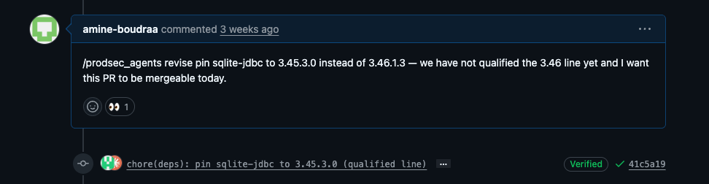
ON THE PR · REVISE
Ask for changes without restarting the process
WHAT HAPPENS IN BETWEEN
Recover the context
Change the same branch
Re-run the same verification
Push and reply
The agent reads the thread and its
own original plan, so it knows what it
already changed and why.
No second pull request. The review
history and the conversation stay in
one place.
Build, tests and the scanner again. A
comment does not get a shortcut
past the gate.
The new commit and its evidence
land on the same thread.
Developers used to close the PR and open a new one. Almost nobody added the changes by hand.
15 / 20
Notes:
55 seconds. Revise. First of the three ways the pull request stays alive. This is a real comment on a real pull request. A reviewer asks for a change in ordinary English, starting with one command word, and a verified commit appears underneath. Two details worth saying out loud. The commit carries a Verified badge and a SHA, which is the GitHub App identity from the architecture slide showing up as a signed, attributable commit. And read the reviewer's own words: he wants this pull request to be mergeable today. That is our whole argument, said by someone who was not thinking about this talk. Then the four steps on the right, quickly. The one that matters is re-run the same verification: a comment does not get a shortcut past the gate. Same two checks, same gate as before. Close on the evidence. Developers used to close the pull request and open a new one, and almost nobody added the changes by hand. Tell Amine beforehand that his handle is on this slide.

Slide 16
ON THE PR · SELF-HEAL
Nobody has to ask for any of this
EVENTS IT REACTS TO
WHAT IT CANNOT DO
CI goes red
Keeping a branch current is exactly when an
agent would reach for rebase or force-push.
Reads the failing job log, repairs the cause, re-verifies, pushes.
The base branch moves
It cannot. A PreToolUse hook blocks the call before
it runs. It is not an instruction a prompt can override.
Merges the new base into its own branch, re-verifies, pushes.
CI goes green
force-push
amend
Green is not proof. If the repository’s checks only scan secrets
or metadata, the agent builds the change itself, or says in its
reply that it did not.
cherry-pick
The same hook blocks gh pr merge and gh pr close, so the
agent cannot merge or close its own pull request. That is
enforced in code, not left to good behaviour.
Opening a pull request and walking away is what makes an agent untrustworthy.
16 / 20
Notes:
50 seconds. Self-heal. Second of the three. Here nobody asks, the repository moves and the agent reacts. Three events. CI goes red: it reads the failing job log, repairs the cause, re-verifies and pushes. The base branch moves: it merges the new base into its own branch and re-verifies. Say merges, never rebases, the agent is forbidden to rebase in code. CI goes green: green is not our proof. A repository's checks might only scan secrets, so the agent builds the change itself, or it says in its reply that it did not. That is the slide 13 principle meeting someone else's CI. Then the right half, and say the connecting sentence out loud: keeping a branch current is exactly when an agent would reach for rebase or force-push, because that is the normal way to do it. It cannot. Refused at the tool layer, not asked of it in a prompt. Close: opening a pull request and walking away is what makes an agent untrustworthy. Open with Amine: whether merge-conflict handling exists on the GitHub App side. It is off the slide until someone confirms it.

Slide 17
ON THE PR · ADAPT AND OBSERVE
Nothing gets thrown away
INSIDE ONE PULL REQUEST
ACROSS EVERY PULL REQUEST
Every comment and event is new input
Every run is traced
review requests, replies, CI and base branch events
Langfuse for the agent loop, Datadog for the platform, the
GitHub App for what humans did on the pull request
Each revision starts from everything before it
the full pull-request history, never from zero
Every signal feeds the next run
merges, closures, comments and recurring review
patterns
What it picks up here changes what it does next, in this
same pull request.
One collection layer, and it is the track record. Per run it
shows what the agent did and skipped. Aggregated, it
shows where every repository stands.
Everything you have just seen is measured. So we can show you what developers actually merged.
17 / 20
Notes:
60 seconds. My last slide. Adapt and observe, and the point is that it is the same idea at two speeds. Inside one pull request: every comment, reply, CI event and base-branch move is new input, and each revision starts from the whole history rather than from zero. What it picks up changes what it does next, on the same pull request. Across every pull request: every run is traced. Langfuse for the agent loop, Datadog for the platform, the GitHub App for what humans actually did. Merges, closures, comments and recurring review patterns feed the next version. One collection layer, two readings. Per run it shows what the agent did and skipped. Aggregated, it shows where every repository stands. That is the visibility Amine promised earlier, and it is the observability box on the architecture slide, explained. Close on the handoff: everything you have just seen is measured, so we can show you what developers actually merged. Then stop and let Amine take the numbers. Do not say the system improves itself. Do not say we do it by hand either. The signals feed back, that is the claim. CHECK before the talk that we are cleared to name Datadog publicly. Langfuse is already public in the OSS repo.

Slide 18
CONCLUSION
Four things to take away
1
More code shipped plus better scanners equals a bigger backlog.
WHAT DEVELOPERS MERGED
100
2
A coding assistant works when the fix is contained. It does not hold at enterprise scale.
PRs merged in the last 2 weeks
3
Merged, not closed. The pull request only counts when it lands.
70%
4
Use deterministic operations wherever you can.
Merged
18 / 20
Notes:
50 seconds. Three takeaways. One: assistants are useful, but broader context makes quality harder to predict and prove. Contained vulnerabilities are good use cases; cross-file and framework-dependent remediation needs broader context and proof. Two: enterprise remediation is a system problem around the model, not merely a prompting problem. Specialised tools improve quality; skills, state, events and observability make the work operable across repositories. Three: a good pull request is the midpoint. Verify and fit before opening; revise, self-heal and learn while a human decides whether to merge. The model is one component. The outcome that matters is a verified, reviewable pull request that stays healthy through collaboration.

Slide 19
THE TEAM
The people who built this
Yassine Ilmi
Ruchita Kshirsagar
Nihit Gupta
Director Product Security & Security Architecture
Senior Product Security Engineer
Senior Product Security Engineer
Piyush Chhiroliya
Raul Sandoval
Nicolai Nielsen
Senior Product Security Engineer
Senior Product Security Engineer
Product Security Architect
Efstathios Chouliaris
Adam Drews
Leonardo Axel Ortiz
Manager in Software Development Engineering
Staff Software Engineer I
Software Engineer I
19 / 20
Notes:
20 seconds. Bridge in: before the repository, the people. Two of us are on stage; these nine built this with us and could not be here. Name them; do not read the roles. Yassine Ilmi, Ruchita Kshirsagar, Nihit Gupta, Piyush Chhiroliya, Raul Sandoval, Nicolai Nielsen, Efstathios Chouliaris, Adam Drews, Leonardo Axel Ortiz.

Slide 20
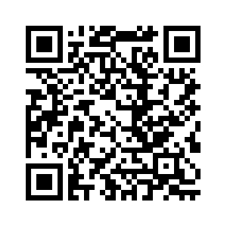
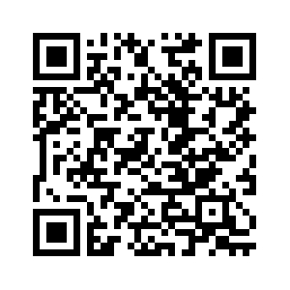
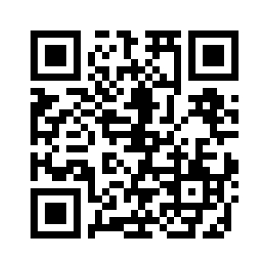
OPEN SOURCE
Take the agents home
RUN IT
Try it on a real repository and tell us where it breaks.
Remediation agents:
EXTEND IT
Add a language or build tool through markdown playbooks.
MCP Scanner:
SHAPE IT
Challenge the verification approach, refusal list and safe defaults.
Codeflow solver:
20 / 20
Notes:
40 seconds, then questions. This is the slide to leave on screen. Both agents are being released for the community: one for SAST findings in first-party code and one for SCA findings in third-party dependencies. The repositories are not public yet; give the month, not a link. Ask for three concrete contributions: run them and report failures, add language or build-tool playbooks, and challenge the verification approach, the refusal list and safe defaults.

