Slide 1
DebugAssist
AI-Powered Bug Investigation at Scale
Presenters:
Kriti Dangi
Mohit Singhal
Drishti Singh

Slide 2
Agenda
01 Debugging in reality
02 What is DebugAssist?
03 Demo
04 Architecture
05 Impact

Slide 3
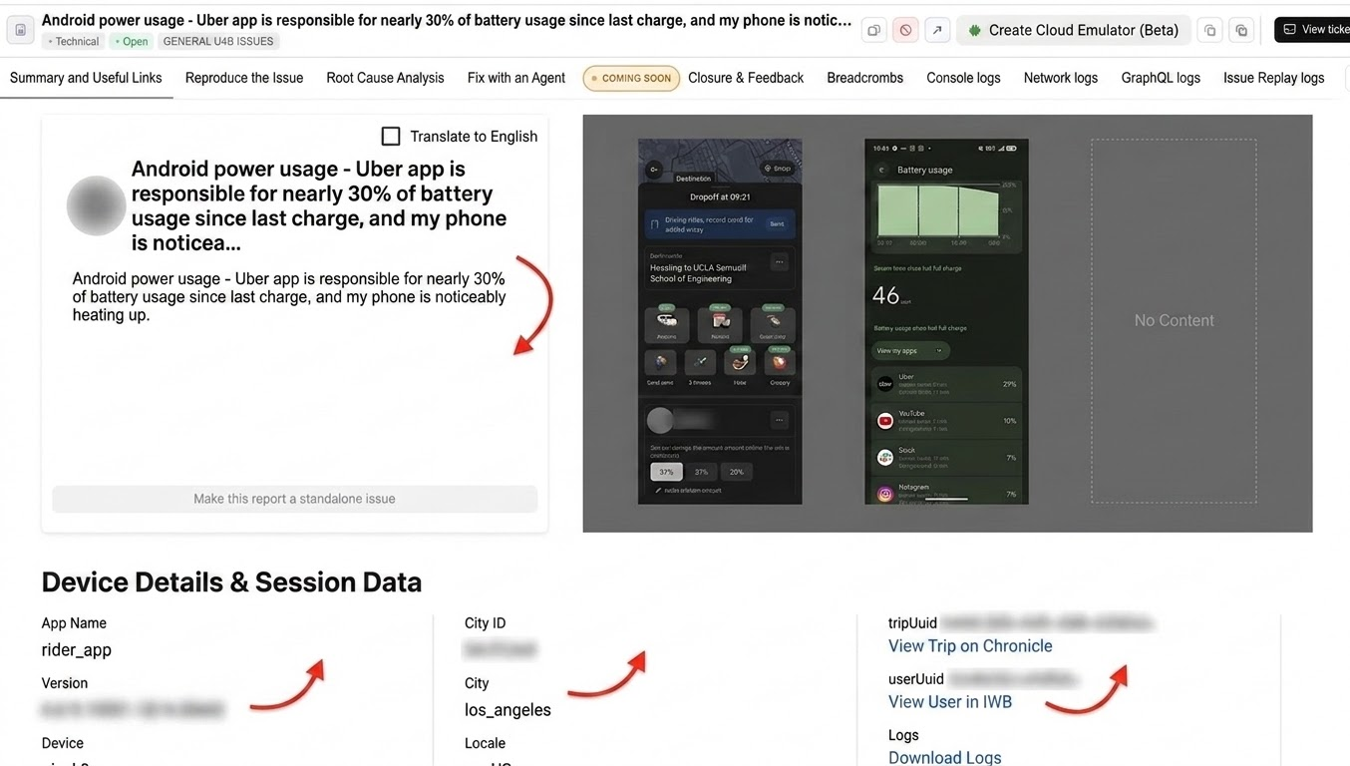
Bug description in natural language
—-Issue metadata—-
Issue logs
Notes:
Speaker: Kriti

Slide 4
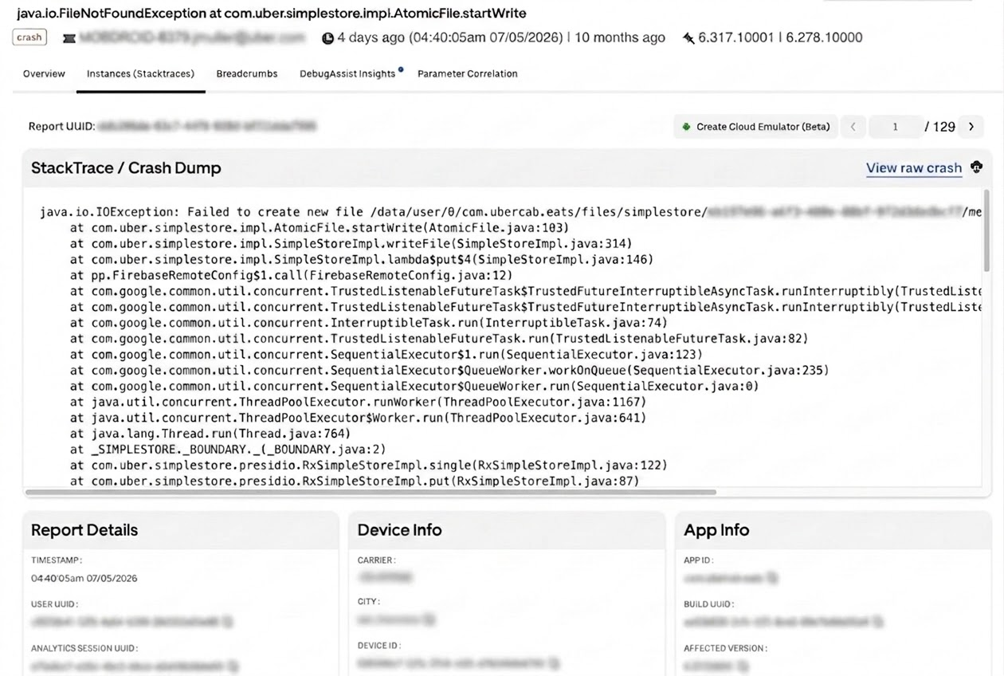
Metadata and logs
Notes:
Speaker: Kriti
Insights about the health and stability of various Uber apps
Clustering of similar crashes into issues
Pivots crash information around different app versions, devices, geographies, etc.
Ticketing & Alerting
Solves Production debugging for developers
Important tool for release managers to measure the bug free rate before the release

Slide 5


Issues reported via Healthline / Wisdom
Healthline
Healthline captures mobile crashes, backend exceptions, and performance issues.
Wisdom
Wisdom powers In-App Bug Reporter and provides logging for all automated test executions.
90%
of issues are customer impacting
12K
PagerDuty alerts paged per year
50K
Issues assigned to engineers per year

Slide 6
Debugging in reality
28 days
Mean Time To Fix an Issue
Unclear errors
Forcing engineers to dig through unfamiliar logic.
Scattered context
Logs, configs, and repos are dispersed across tools.
40%
Dev time spent on debugging
Vast codebases
Make it hard for any team to have complete knowledge.
Cross-team dependencies
Identifying and reaching owners delays resolution.
Time spent by developers on debugging, bad code, refactoring, modifying per stripe report
‹#›

Slide 7

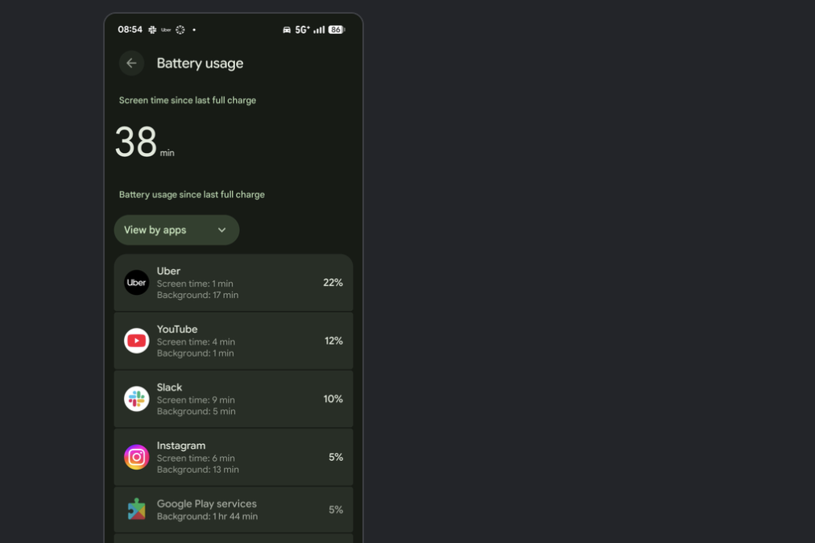
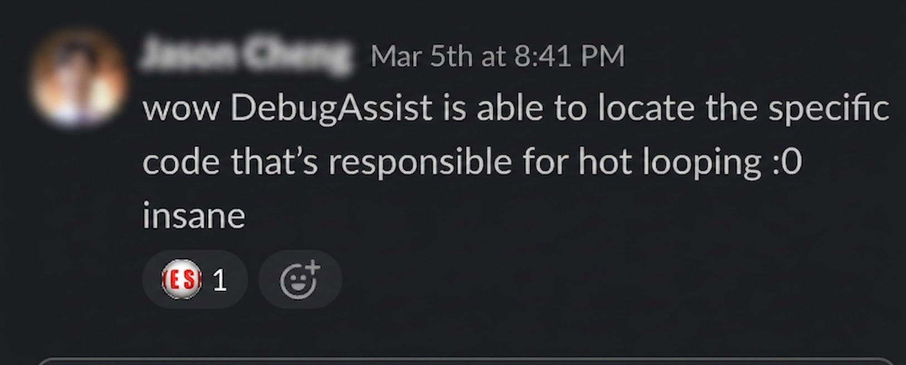
DebugAssist: End-to-End Agentic Resolution Journey
1. Discovery
2. Auto-Triage
3. DebugAssist
4. Resolution
bolt
check_circle
Auto-triaged to correct team
Identifies ownership and routes to Jira automatically.
Deep RCA in <30 min
Analyzes stack traces, suspicious diffs, and rollout impact.
Accepted & landed same day
Caught at 5% rollout, preventing impact to ~2.8k users.
User reports overheating and excessive battery usage via Slack or in-app tools.
Notes:
Mohit

Slide 8

Demo: User files a bug, all logs/screenshots are captured, gets auto triaged to right team
Bug description in natural language
— Issue metadata —
Issue logs
Notes:
Mohit

Slide 9
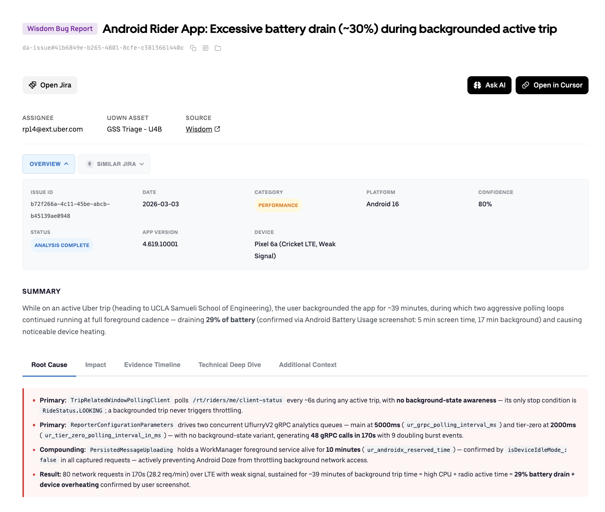
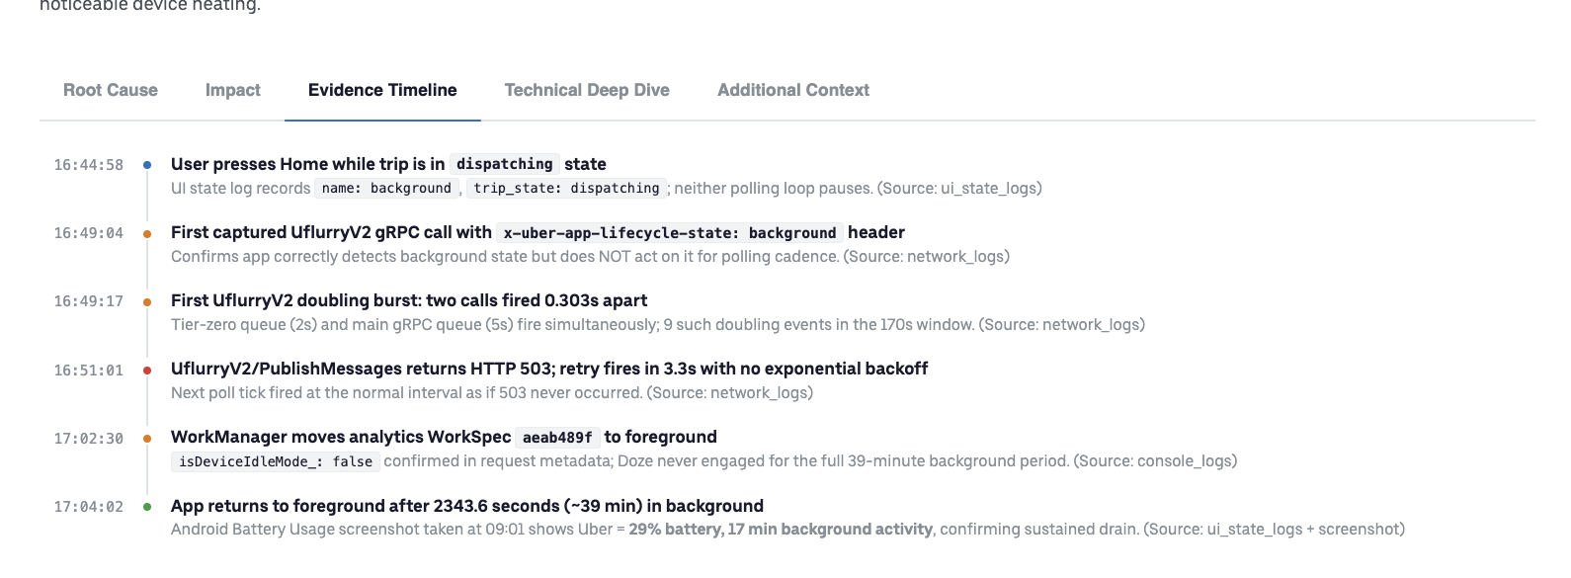
Demo: Debugging Assisted
Notes:
Mohit

Slide 10
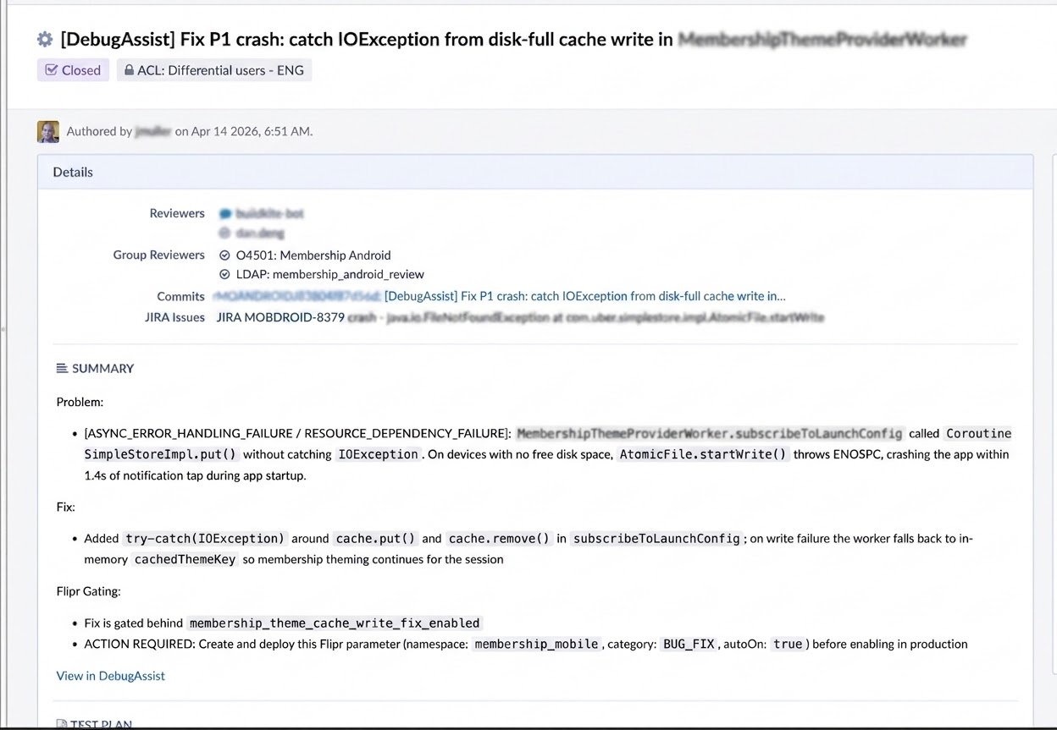
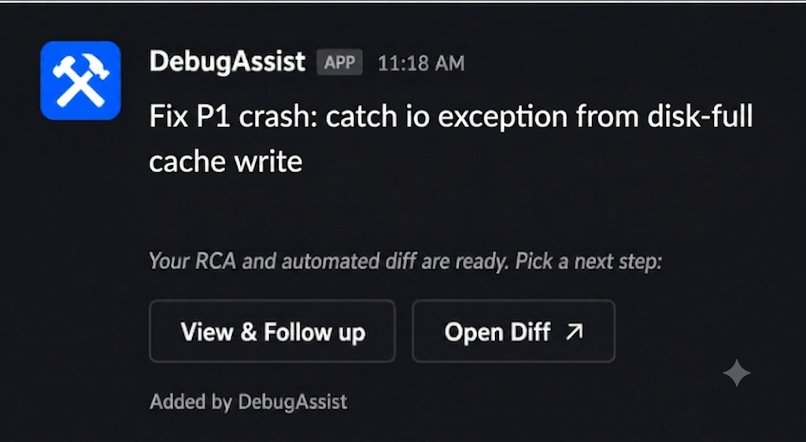
Demo: Debugging Assisted
Notes:
Mohit

Slide 11
Under the Hood — Agent Pipeline
LangGraph Pipeline (Deterministic + AI)
context_collector
① classify/RCA
② fix
③ bazel_test
④ create_diff
① Classify/RCA
Claude Sonnet + plugin skills + 20 max turns → structured XML
(Skill: category, requires_code_fix, confidence, MCP: jaeger, logging etc)
RCA via Subagents
② Fix
Claude Opus + plugin skills + 30-50 max turns
(Plugin: android-debugger, go-debugger, wisdom-debugger etc
MCP: flipr-mcp)
③ Bazel Test
Claude Sonnet + 20 max turns
Iterative Bazel testing until command passes or reproduces NPE
④ Create Diff
Claude Sonnet + 20 max turns
Generates diff and attaches link to JIRA, updates internal database with metadata
Skills/Plugins are cloned from marketplace at runtime.
→ Marketplace skills contain core business logic, while the LangGraph pipeline is a reusable skeleton.
→ Creating new agents (e.g., ANR debugging) is a matter of crowdsourcing & refining skills
Notes:
Drishti
Langgraph, skills/plugins in marketplace, LLM/claude configs
Optional nodes - STR in wisdom, offending diff if present, breadcrumb/session analysis, crash-release-correlation

Slide 12
Under the Hood — Productionize at Uber scale
8 agent types, 5 monorepos, 1 shared codebase
Python
agent code (Python) → bazel build → PEX
Artifactory
stores PEX binaries
Docker image registry
Docker images (Claude Code + Uber specific dependencies)
Pipeline Configs
go / java / web / android / ios
Runtime job: pulls PEX + runs agent
Each agent type: own Docker image, own pipeline config, own marketplace plugin.
Code shared via agent_type param.
Notes:
Drishti
The deployment complexity is real — 5 Docker images, 5 pipeline configs, 1 shared codebase. But the agent_type parameterization means one code change serves all agents. The marketplace runtime clone is the key iteration enabler.

Slide 13
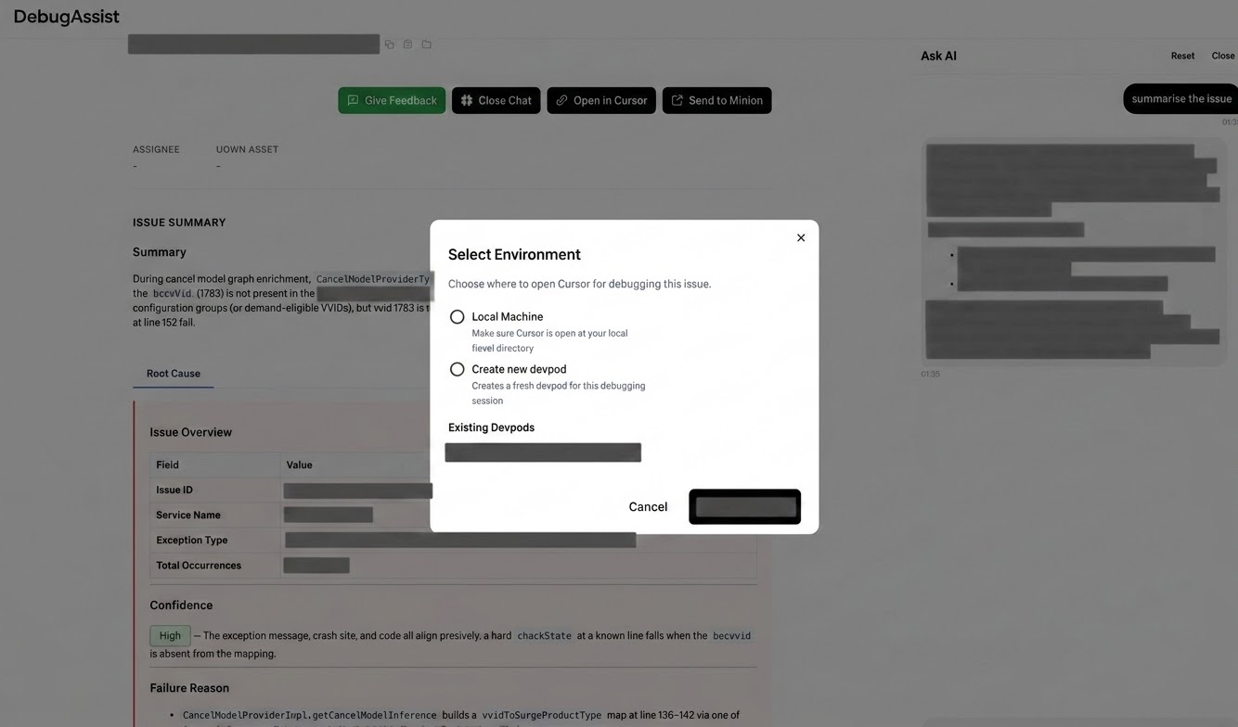
UX
features
Minion
Ask AI Chat
Open in Devpod
https://debugassist.uberinternal.com/
Notes:
Drishti

Slide 14
Impact
Scale
~9,000
RCAs per month
RCA Accuracy
50%
As compared against developer fixes
Jira resolution
~2X
higher fixed resolution on jira where agent run
PR Merge Rate
5% → 30%
Service exceptions fixed via landed Debug Assist diffs
‹#›
Notes:
Drishti

