Slide 1
AGENTCON JAPAN
Aksh
Stop Giving Agents
Tokens
Securing with Side-Car Proxies
Separating reasoning from authority.
Ritwik Ranjan | Girish Motwani
AKSH | Security sidecar for AI agents
1
Notes:
Good afternoon; Ritwik, software engineer; vibe coding a recent passion.
Girish: Microsoft principal engineering manager; 20+ years in cloud networking/security; unable to travel.
Aksh: collaboration with Girish and Mugesh, former Microsoft colleagues.
Today's question: who should authorize an agent's actions?

Slide 2
THE HOOK
Ordering food. Writing code?
REPORTED VIRAL SCREENSHOT
Persuaded off-task
An ordering chatbot apparently generated linked-list code.
Off-task text is not yet an authorized action.
AKSH | Security sidecar for AI agents
2
Notes:
Remember the viral McDonald's chatbot screenshot?
Reported, not independently verified; code generated, not executed.
Funny as a text response; consequential when tools and credentials enter.
Bridge: an instruction in context must not become permission.
Sources: News18: reported screenshot; article explicitly says not independently verified. https://www.news18.com/viral/mcdonalds-chatbot-answers-python-coding-question-before-returning-to-nugget-order-internet-says-stop-paying-for-claude-ws-l-10292776.html

Slide 3
THE TRUST BOUNDARY
Prompts are not permissions
Traditional software
Agentic software
Engineers define operations
Code constrains control flow
Models select actions
Untrusted context influences plans
Model output is input, not authorization.
AKSH | Security sidecar for AI agents
3
Notes:
Traditional software also has bugs and runtime variation.
Agents select actions from context; prompts do not replace schemas or checks.
English/Japanese interpreter analogy: meaning can shift; a black box can misunderstand.
Even reliable interpretation is not permission.
Enforce authorization outside the model; credentials amplify mistakes.
Sources: DESIGN.md:33-49 (threat model).

Slide 4
THE PROPOSAL
The agent asks. Aksh authorizes.
Agent
Aksh sidecar
APIs
Reason + request
Policy + credentials
Approved requests
Separate reasoning from authority.
AKSH | Security sidecar for AI agents
4
Notes:
Attach a sidecar around the untrusted workload.
Managed credentials stay outside the agent runtime.
Intercept captured egress; inspect HTTPS through trusted local TLS termination.
Allow defined requests; deny unmatched ones within this boundary.
The model reasons; policy, not persuasion, authorizes.
Sources: internal/runtime/assembly.go:79-103; internal/pipeline/runner.go:57-138.

Slide 5
ENFORCEMENT
Four enforcement properties
Credential custody
Per-request policy
Outside the agent runtime
Host + method + path
Fail closed
Decision evidence
No usable state? Deny.
Metadata, never token values
AKSH | Security sidecar for AI agents
5
Notes:
Entra tokens and static keys have different lifecycles; both held outside the agent.
Strip caller Authorization; attach a credential only for an allowed rule.
Valid cached tokens and fresh-enough policy remain usable.
Missing required usable state or failed audit: deny.
Record credential identity, never its value.
Sources: api/v1alpha1/types.go:20-105; internal/pipeline/sanitise.go:24-81; internal/pipeline/runner.go:57-138.

Slide 6
UNDER THE HOOD
After injection: the request path
Admission webhook injects Aksh
No agent code changes
01
02
03
04
eBPF capture
Listener + TLS
HTTP parser
Policy
Redirect
Terminate
Validate
Match rules
capture / bpf
listener / tlsterm
requestpath / pipeline
pipeline / policy
08
07
06
05
Upstream
Auth header
Audit
Token broker
TLS + relay
Inject
Record
Acquire / cache
upstream
pipeline
audit
token
Allowed HTTPS path shown. Kernel redirects; proxy authorizes.
AKSH | Security sidecar for AI agents
6
Notes:
Webhook runs at pod admission, not on each request.
Follow arrows: eBPF redirects; Go parses and authorizes.
Strip caller auth; host/method/path policy; acquire or reuse tokens when required.
Audit before injection and upstream TLS; denial or failure stops forwarding.
Capture exemptions still apply.
Sources: internal/injector/server.go:239-320; internal/runtime/assembly.go:79-134; internal/pipeline/runner.go:57-138.

Slide 7
CURRENT STATE
Implemented today
PRE-1.0
Webhook injection
Policy + audit
Credential brokering
No agent code changes
CRD rules + metrics
Entra WIF + static bearer
Documented runs on kind and AKS.
AKSH | Security sidecar for AI agents
7
Notes:
Mutating admission webhook adds Aksh, credential mounts and pod-local CA trust.
No agent source or SDK changes; platform still configures enrollment and policy.
Implemented, pre-1.0; documented kind and AKS runs.
OpenAI uses static credentials; Microsoft reads use Entra federation.
CA signing key stays private.
Sources: internal/injector/server.go:239-320; internal/injector/sidecar_injector.go:157-209; demo/agentcon-japan/PRESENTER.md:5-36.

Slide 8
PERFORMANCE
What does Aksh add?
+0.85 ms median latency in this run
AKS | 200 req/s | 16 keep-alive connections
AKSH | Security sidecar for AI agents
8
Notes:
Same HTTPS upstream; 200 requests/s, 16 keep-alive connections.
AKS Standard_E4s_v5, 4 vCPU; documented snapshot, not a new measurement.
Median: 0.55 ms baseline versus 1.40 ms with Aksh.
Warm connections; workload-dependent overhead.
New connections differ: default TLS handshake limit 50/s.
Sources: test/e2e/aks-soak/README.md:165-186; linked from README.md:120-151.

Slide 9
PRACTICAL OUTCOMES
What this boundary can stop
Unapproved destination
Managed credential theft
No matching rule: deny
Remove secrets from runtime
Disallowed method/path
Direct-connect bypass
Constrain destructive calls
Socket capture still applies
Within the configured capture and policy boundary.
AKSH | Security sidecar for AI agents
9
Notes:
Unapproved captured HTTPS request: denied.
Managed credentials removed from agent mounts; other sensitive data still needs protection.
Method/path restrictions can deny destructive API requests.
Clearing proxy environment variables does not disable eBPF capture.
Reduce blast radius; allowed operations and exempt paths remain risks.
Sources: api/v1alpha1/types.go:20-105; internal/dataplane/bpf/aksh_capture.c:202-307.

Slide 10
WHY AKSH
Beyond a firewall or auth proxy
SCENARIO
AKSH BOUNDARY
SCOPE
Indirect prompt injection
Deny unapproved egress
Today
Credential theft
Isolate managed credentials
Today
Proxy bypass
Capture at socket layer
Today
Destructive API calls
Check method + path
Today
Poisoned MCP tools
Tool / argument policy
Future
Cross-service exfiltration
Data-flow + redaction
Future
Credential custody + request policy + transparent capture
AKSH | Security sidecar for AI agents
10
Notes:
Ticket injection: Graph mail to an unapproved endpoint.
Env-secret theft, proxy bypass, destructive DELETE: distinct controls.
Poisoned MCP arguments and SharePoint-to-public-GitHub flows: future work.
Human approvals also future; method/path checks exist today.
Differentiator: the combined boundary, not exclusive capabilities; conventional firewalls/auth proxies remain complementary.
Sources: Combined from the two supplied scenario slides; api/v1alpha1/types.go:20-105; README.md:262-292.

Slide 11
SCOPE + DIRECTION
The boundary today. The work ahead.
Today
Future
Future
Egress / HTTP/1.x
Host / method / path
MCP / approvals
Ingress / more IdPs
Data-flow policy
Response redaction
Allowed channels can still be abused.
AKSH | Security sidecar for AI agents
11
Notes:
Today: captured egress, not a complete agent sandbox.
No MCP tool/argument or body-content authorization yet.
Allowed-channel exfiltration remains possible; remote tools need their own boundary.
Proxy UID, loopback, configured DNS/CIDRs are exemptions.
Trust kernel, cluster and proxy; future directions, not delivery promises.
Sources: api/v1alpha1/types.go:20-105; README.md:262-292; DESIGN.md:33-49.

Slide 12
Demo
Same agent. Baseline credential leak, then policy enforcement and credential brokering with Aksh.
Notes:
Baseline: controlled leak; fresh chat for each state.
Optional strip-only: header removal, not payload scrubbing.
Broker-inject: approved Microsoft read; Entra acquisition/cache.
Protect: same prompt, 403, unchanged collector, placeholder credential.
Show sanitized evidence; disclose model/network fallback honestly.
Sources: demo/agentcon-japan/PRESENTER.md:147-265.

Slide 13
Q&A
Notes:
Let agents reason; keep authorization outside the model.

Slide 14
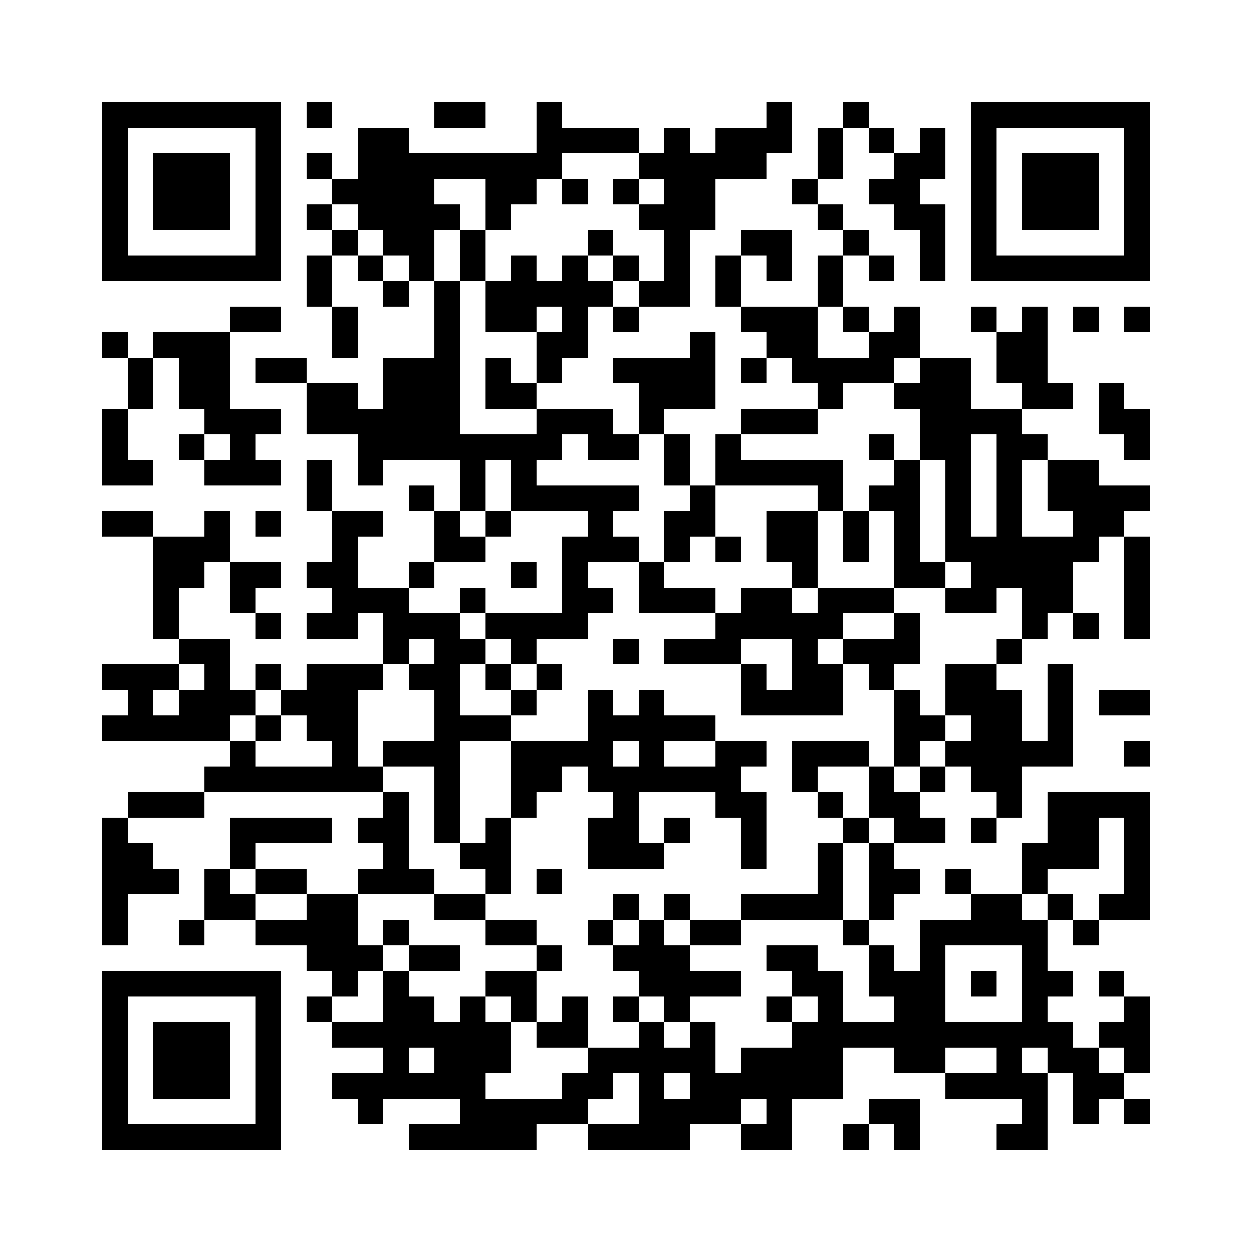
BUILD WITH US
Star Aksh
on GitHub
Help us build safer agents.
github.com/girishmotwani/aksh
SCAN FOR THE MAIN BRANCH
Notes:
Scan for the main branch; star the repository if this was useful.
Feedback and contributions welcome. Thank you.
Sources: https://github.com/girishmotwani/aksh/tree/main

