Slide 1
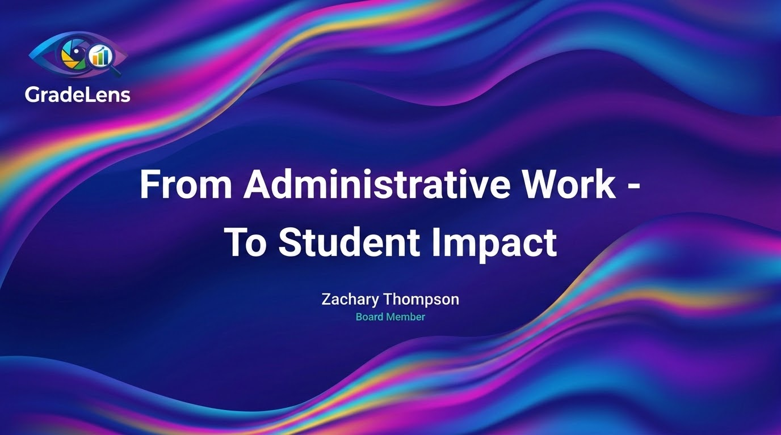

Slide 2
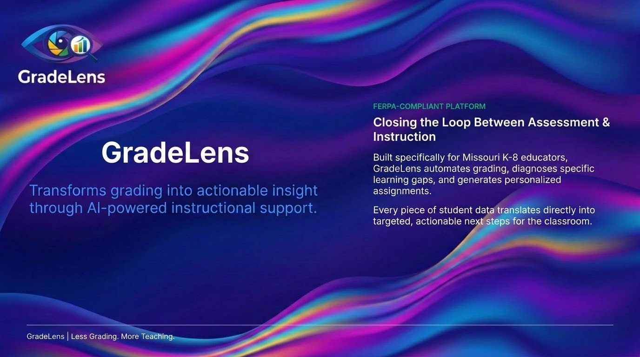

Slide 3
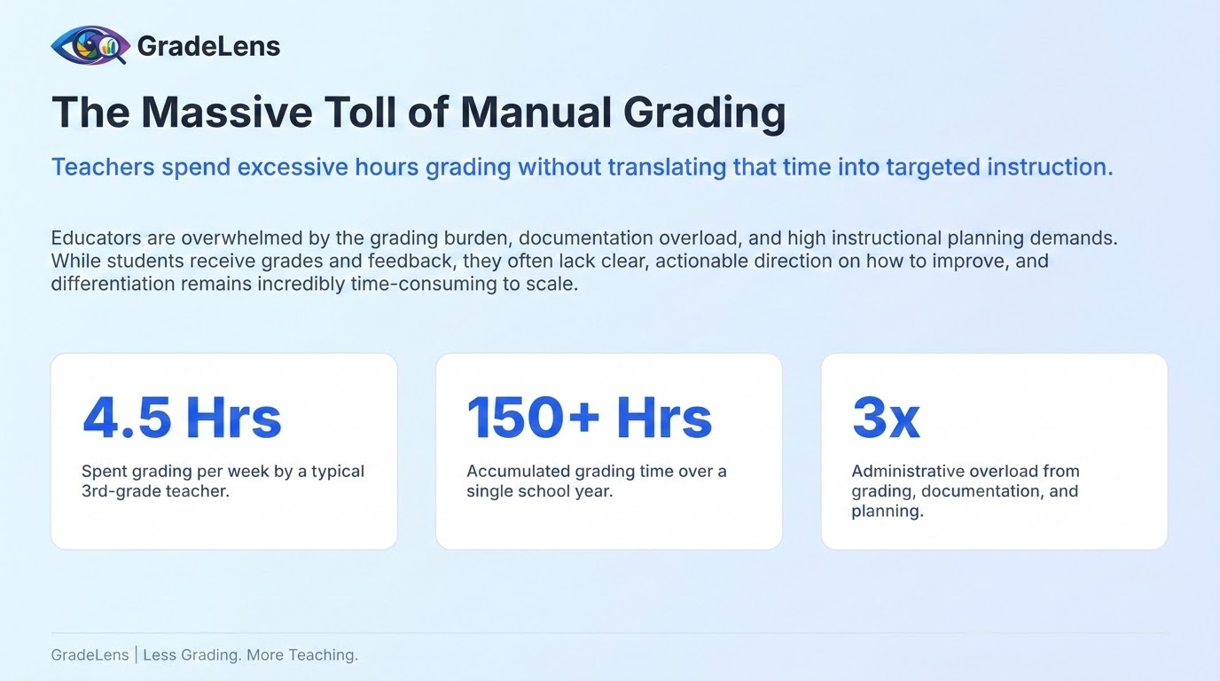

Slide 4
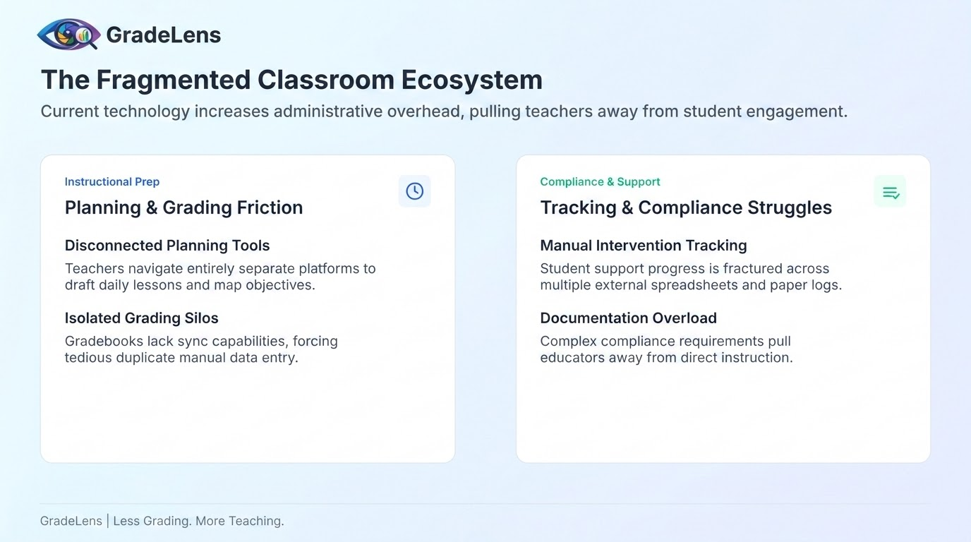

Slide 5
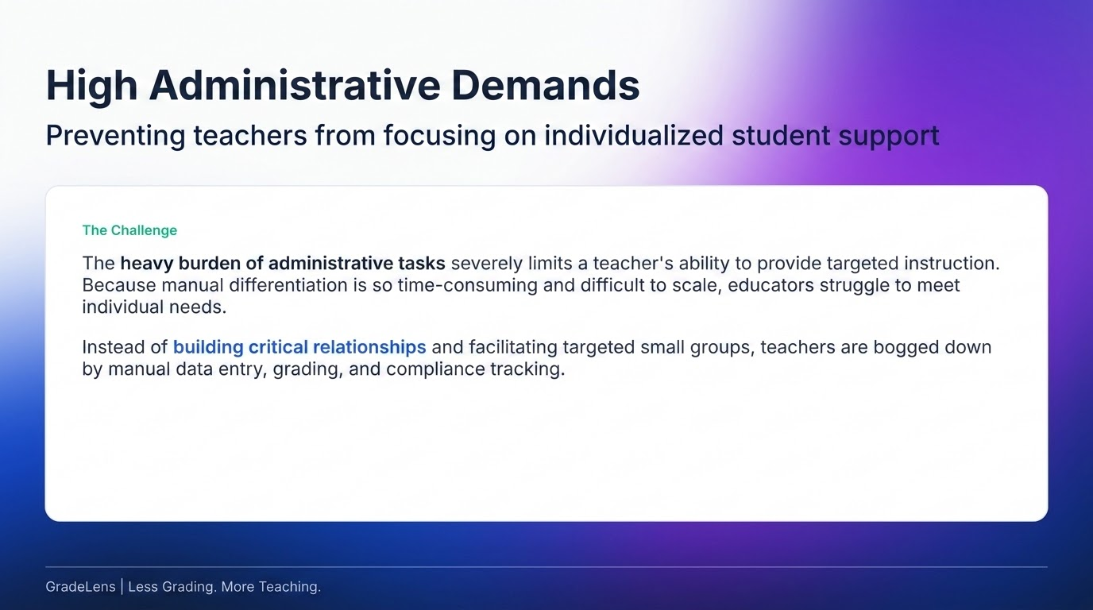

Slide 6
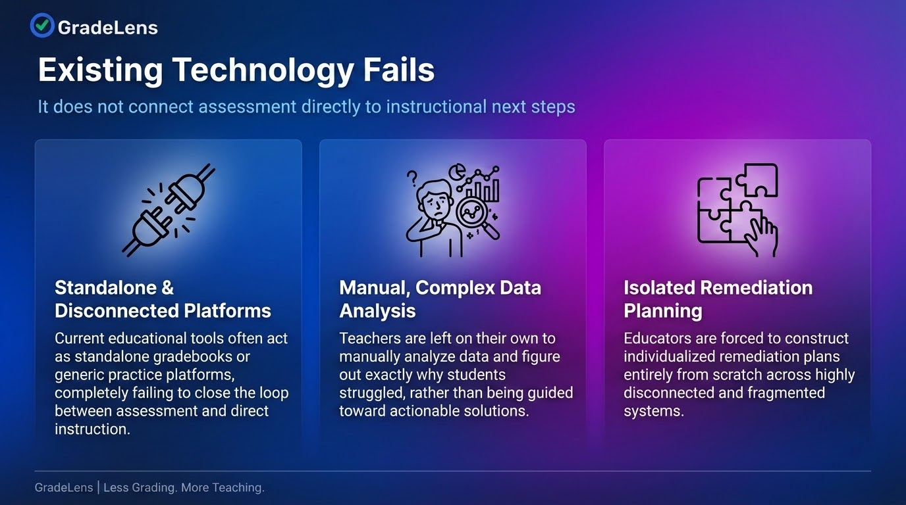

Slide 7
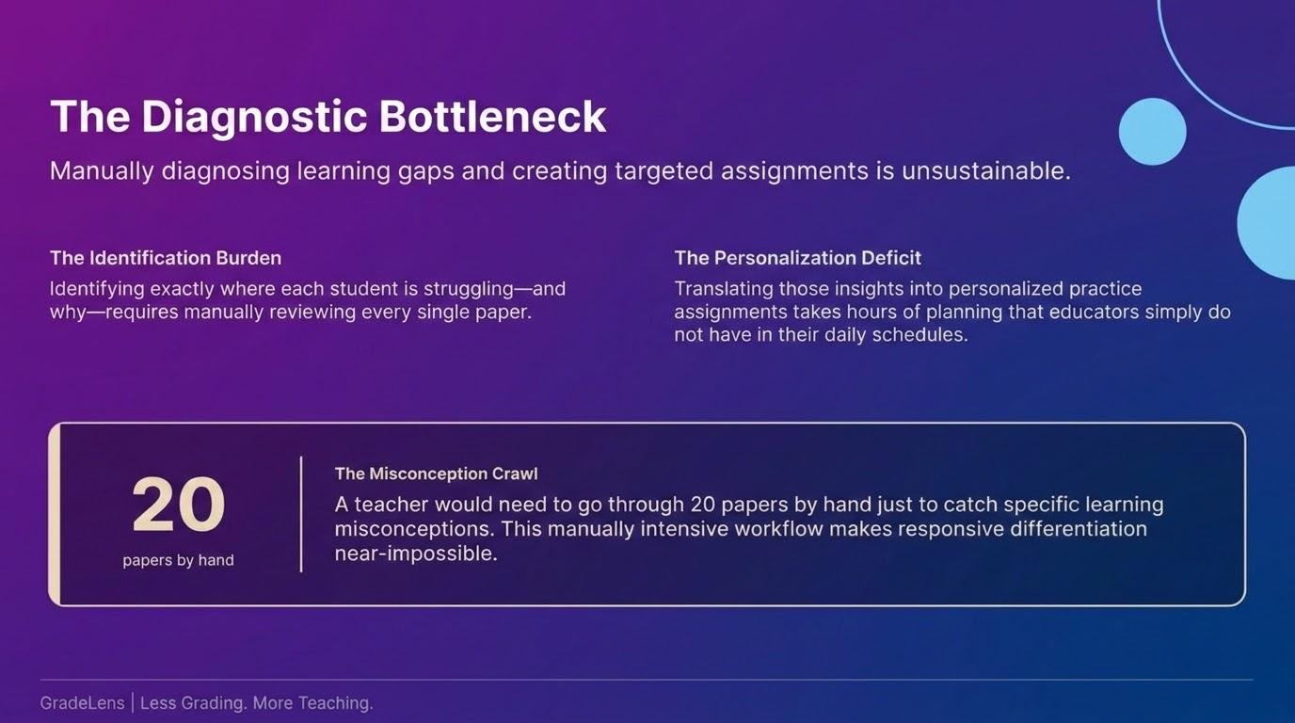

Slide 8
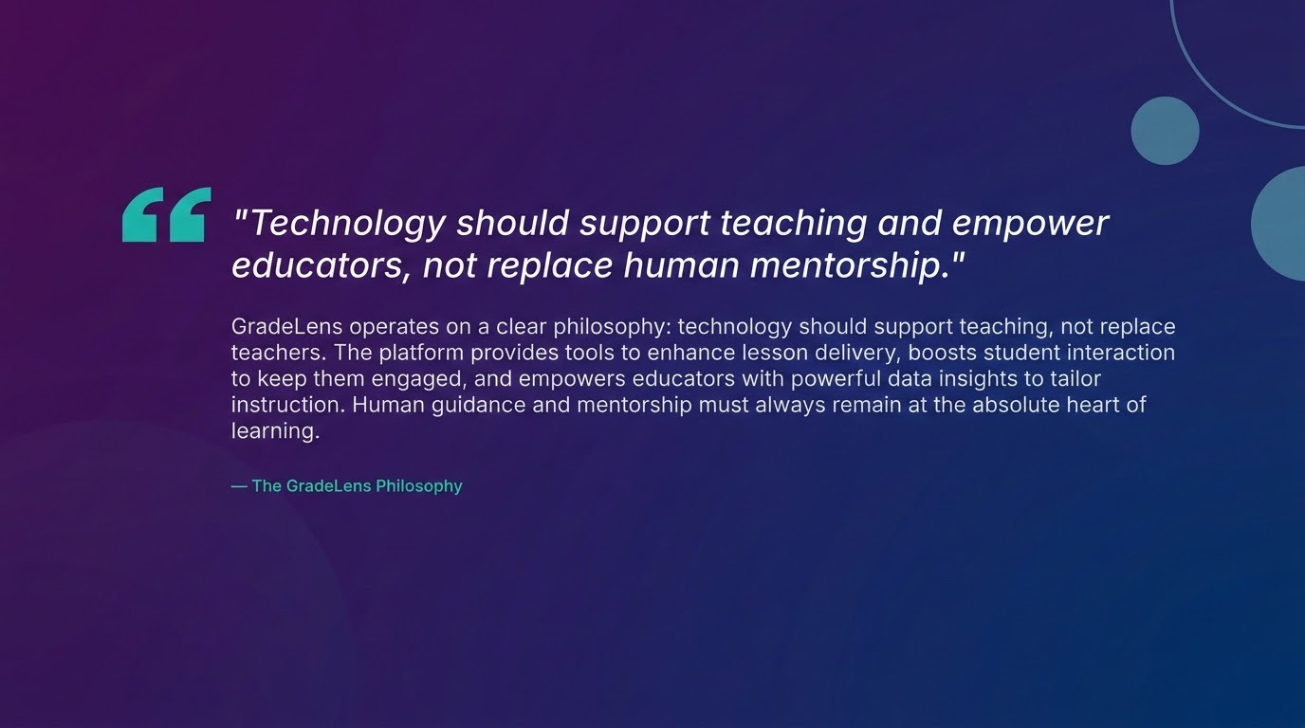

Slide 9
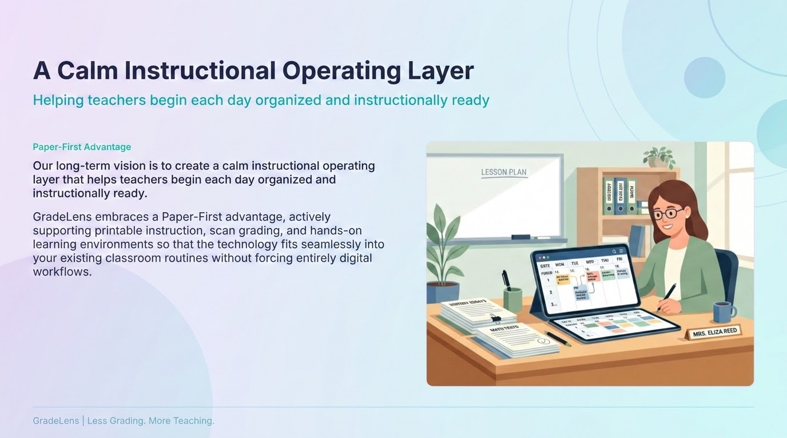

Slide 10
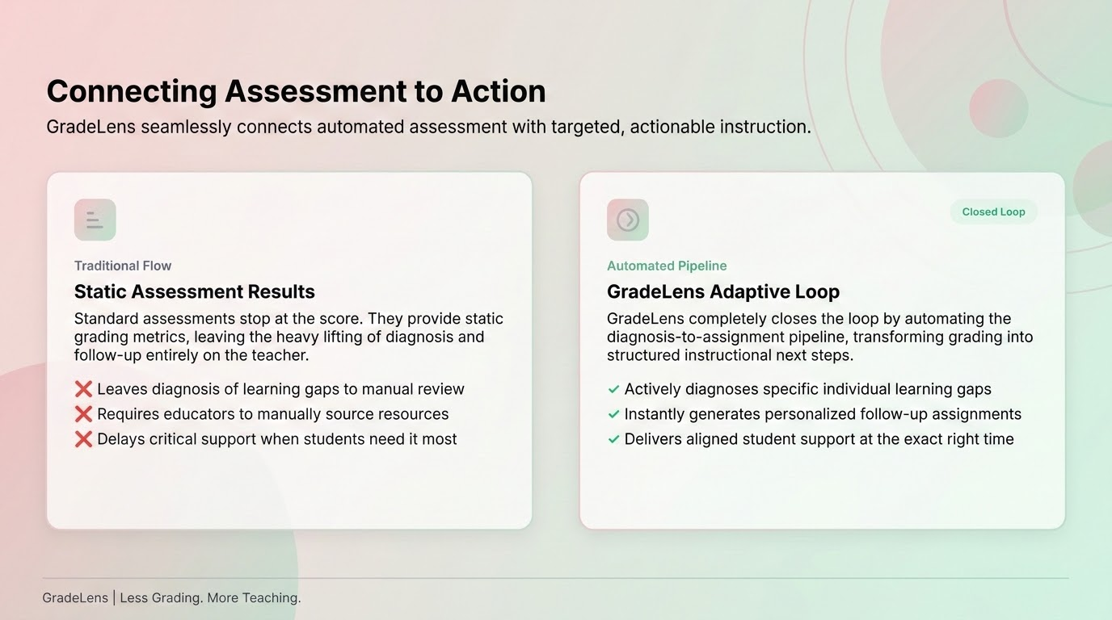

Slide 11
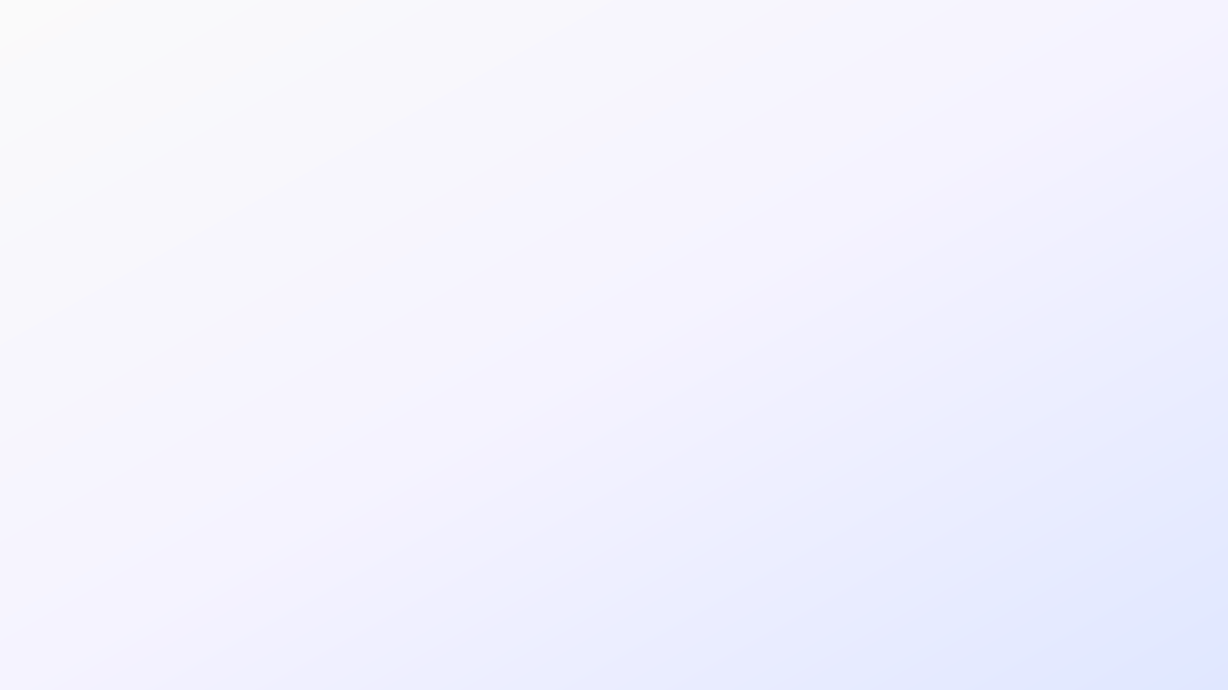

The Core Value Loop
Transforming assessments into personalized learning experiences.
01
02
03
04
Create & Import
Teachers easily create or import assessments to initiate the instructional workflow seamlessly.
Submit
Students complete and submit their work effortlessly using paper or streamlined digital links.
Diagnose
The platform automatically analyzes grading results and diagnoses student error patterns to reveal underlying learning gaps.
Remediate
With one click, teachers generate high-impact, custom practice tasks targeting each student's unique needs.
Less Grading. More Teaching.

Slide 12
Seamless Tool Integration
GradeLens integrates seamlessly with existing tools to structurally plan, store, and track lessons.
share
fact_check
Google Integration
GradeLens connects directly to existing Google Forms and Sheets. This means teachers can continue collecting student work exactly the way they do today, with no transition friction.
Standards Tracking
The platform features built-in tracking, reporting, and curriculum alignment for all Missouri Learning Standards for grades K-12 across core subjects, ensuring comprehensive compliance.
GOOGLE FORMS
GOOGLE SHEETS
MISSOURI LS
K-12 CORE
GradeLens | Less Grading. More Teaching.

Slide 13
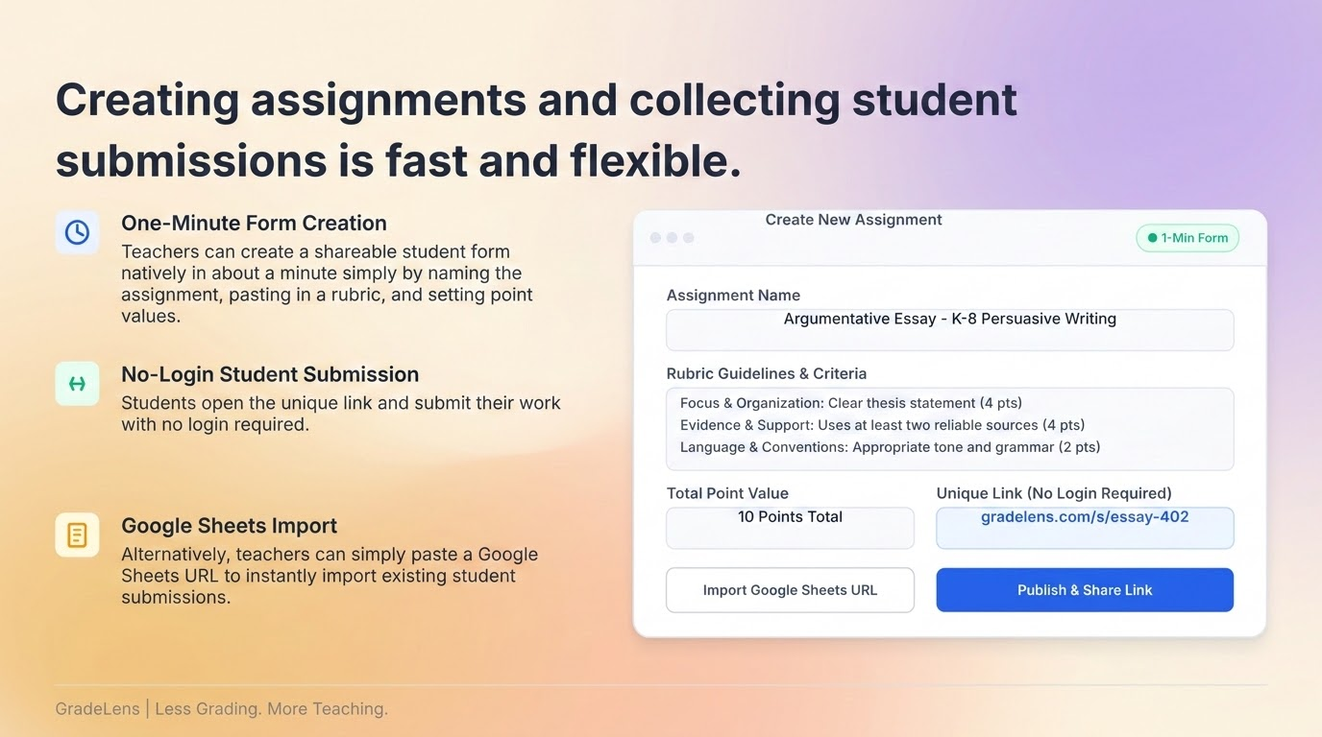

Slide 14
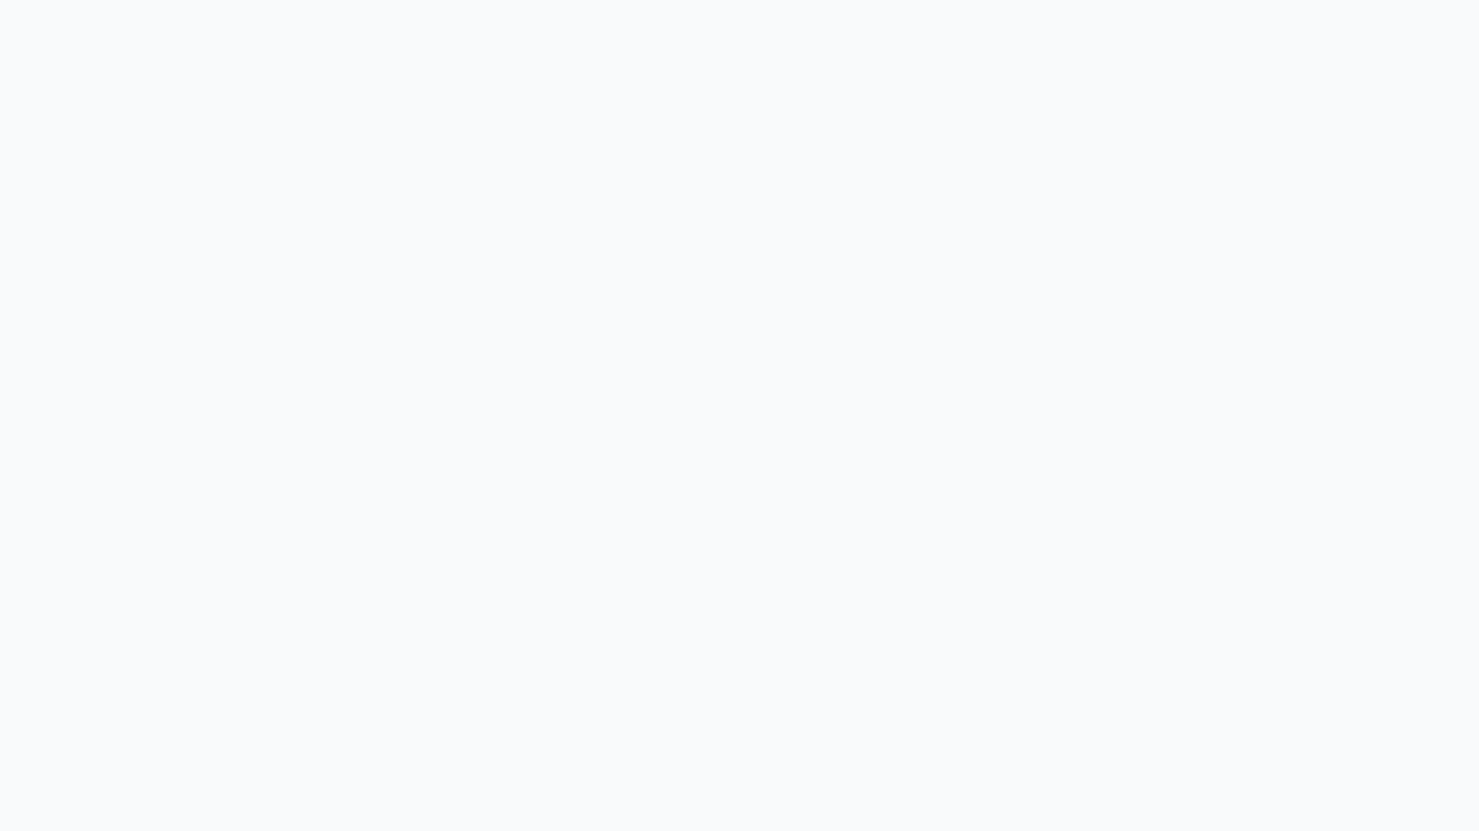
Assisting Teachers with a Secure, Private Evaluation Engine
Analyzing written responses in seconds strictly against your rubrics and instructions.
analytics
assignment
chat_bubble
Numeric Scores & Letter Grades
Instantly processes complex essay questions and short answers to deliver clear, reliable core performance metrics.
Automated Evaluation
Objective Scaling
Detailed Written Rationale
Provides an objective grading explanation aligned with your standards, allowing easy review and adjustment.
Teacher-Facing Evidence
Standards Alignment
Student-Facing Feedback
Delivers constructive, personalized commentary to guide further growth, saving educators approximately 5 minutes per submission.
Actionable Study Paths
Personalized Coaching
GradeLens | Less Grading. More Teaching.

Slide 15
The Misconception Diagnosis Engine
Identifying root causes to generate targeted practice sets
GradeLens goes beyond simple grading to diagnose exactly why a student struggled. The rule-based engine provides an actionable, teacher-facing diagnosis note to pinpoint student misconceptions instantly.
Scaffolded Learning
CRA Practice Scaffolding
Concrete-Representational-Abstract (CRA) framework to target diagnosed gaps.
16 Built-In Rule Patterns
Identifies conceptual errors automatically, such as directly adding denominators when adding fractions.
Wrong Answer
16-Rule Check
CRA Practice
✨ Generate CRA Practice Set
GradeLens | Less Grading. More Teaching.

Slide 16
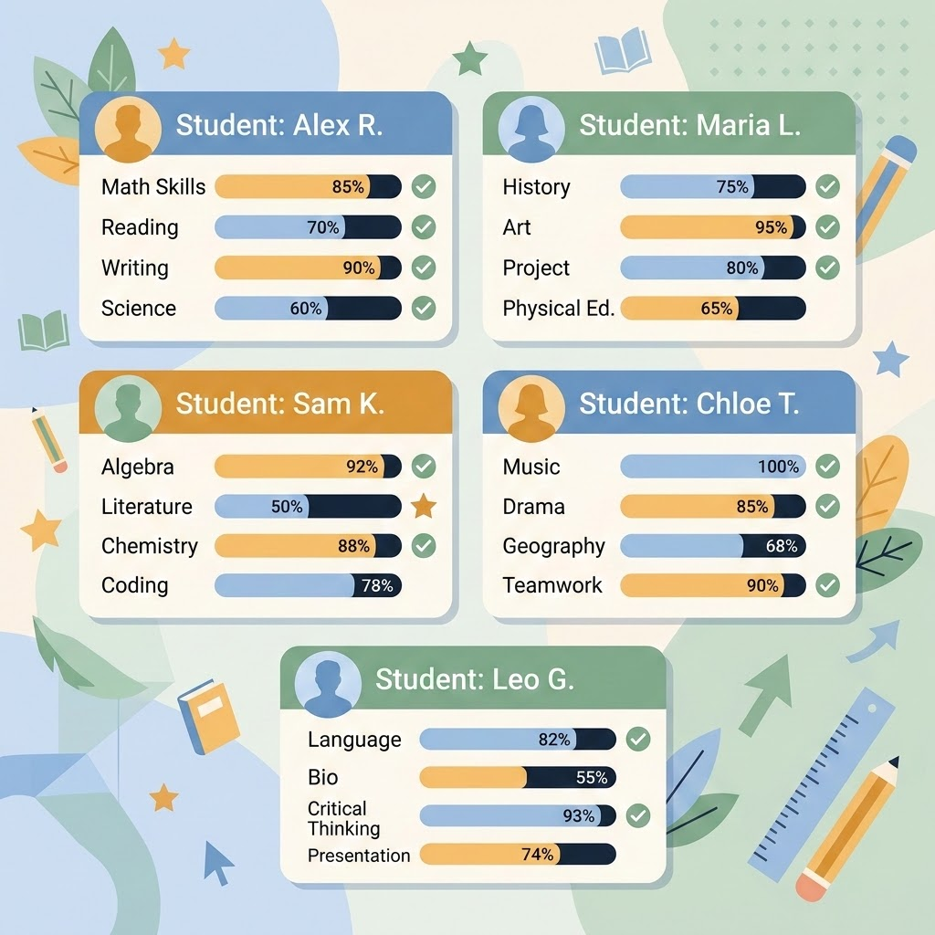
Standards Gaps & Adaptive Assignments
Automatically identify class-wide standards gaps and generate targeted, adaptive assignments.
analytics
assignment
Step 1: Diagnose Gaps
Class Analytics Dashboard
The Class Analytics Dashboard clearly highlights which Missouri Learning Standards have the highest percentage of students below proficiency.
Tracks student mastery automatically across multiple core topics.
Step 2: Close Gaps
Adaptive Assignment Generation
Teachers can instantly create customized assignments tailored to any detected learning gap.
Diagnosis-aware, automatically targeting root causes with step-by-step scaffolding.
GradeLens | Less Grading. More Teaching.

Slide 17
Special Education & Intervention Tracking
Comprehensive student tracking, compliant workflows, and automated differentiation
assignment_turned_in
analytics
auto_awesome
IEP & MTSS Workflows
Manage complete life-cycles for IEP workflows, MTSS tracking, and therapy service scheduling to simplify administration.
Student Analytics Flags
The analytics dashboard prominently displays IEP, 504, and ELL flags for each student, keeping critical individual needs visible.
Accommodation Integration
Tailored assignments automatically incorporate differentiation notes and specific accommodation language to seamlessly support educators.
GradeLens | Less Grading. More Teaching.

Slide 18
Secure Data Handling & Integration
GradeLens ensures secure data handling and integrates smoothly with existing student information systems.
security
file_download
sync
FERPA Compliance
GradeLens is fully FERPA-compliant; all parent API calls are scoped exclusively to their own children, and no student data is ever used for AI training.
Effortless CSV Imports
The platform supports effortless CSV imports from systems like i-Ready and Infinite Campus, automatically creating student profiles.
Automated Records
Automatically detects rosters, gradebooks, and assessment data to populate student performance records seamlessly.
GradeLens | Less Grading. More Teaching.

Slide 19
Actionable Insights & Significant Time Savings
GradeLens delivers impact for both teachers and administrators
Teacher Empowerment
Focus on Teaching
Teachers save hours of administrative work, allowing them to redirect their focus to relationship-building and small-group instruction.
Admin Analytics
Real-Time Visibility
School and district leaders gain access to a comprehensive dashboard tracking 7 key metrics, including Teacher Time Saved, Student Growth Rate, and Standards Mastery Rate, providing real-time visibility into student performance and intervention effectiveness.
GradeLens | Less Grading. More Teaching.

Slide 20
Initial Pilots Prove Massive Time Savings
Clear improvements in instructional efficiency and educator engagement.
schedule
trending_down
task_alt
4+ Hours
Saved per class grading
Auto-grading just 54 submissions saves over 4 hours of grading time for a single class.
150 to <30
Annual hours grading drop
Dramatically reduces the annual grading burden, giving educators more time for direct student engagement.
100%
Pilot onboarded & active
Initial pilots are successfully completed, with active subscriptions and fully operational onboarding pathways.
GradeLens | Less Grading. More Teaching.

Slide 21
Our Philosophy & Vision
Keeping human mentorship at the true heart of K-12 education.
format_quote
"GradeLens empowers teachers to begin every day calm, organized, and instructionally ready."
favorite
A Calm Operating Layer
By automating the most tedious parts of assessment and diagnosis, GradeLens ensures every student gets the right support at the exact right time. Our ultimate vision is to significantly reduce the grading burden, allowing human mentorship to remain at the core of education.
GradeLens | Less Grading. More Teaching.

