Slide 1


The
Rithm
Project
UNPACKING THE RESEARCH
Youth, AI, & the Relationships That Shape Them
Share with the person next to you: which Harry Potter house are you?
🦁 Gryffindor — Courage, standing up for others 🐦‍⬛ Ravenclaw — Curiosity, learning how things work 🦡 Hufflepuff — Loyalty, kindness, community 🐍 Slytherin — Ambition, strategy, big goals
We reference Harry Potter as a beloved cultural touchstone that has meant a great deal to generations of young people, including many in the LGBTQ+ community who found belonging in its themes of difference and chosen family. We wholeheartedly support the transgender community and do not endorse J.K. Rowling's public stance on transgender people.
We reference Harry Potter as a beloved cultural touchstone that has meant a great deal to generations of young people, including many in the LGBTQ+ community who found belonging in its themes of difference and chosen family. We wholeheartedly support the transgender community and do not endorse J.K. Rowling's public stance on transgender people.
Notes:
Jose Leads
Jose asks folks to quickly identify then share with the person next to you
Jose asks for a show of hands by house. Picks 2-3 people to explain their choice. Asks: Who felt torn? Who had an aspiration house vs. a realistic house?

Slide 2





The
Rithm
Project
Today’s Guides
Nate Kerr
Youth Strategy & Partnerships Lead
José Guallpa
Brown University Student and Rithm Youth Fellow
Notes:
Quick re-intros
Jose leads:
"What does Harry Potter have to do with AI and young people? This winter, we set out to understand how this generation engages with AI. And just like the Houses, what we found were patterns. Useful categories for reflection. Where do we see ourselves? Where do we see the people we love?"
Three framing points (keep tight, conversational):
1. No hierarchy. No good or bad portrait. Young people tell us judgment shuts down conversation.
2. Variance within groups. Harry is different from Ron is different from Hermione.
3. Agency matters. Harry said "not Slytherin" and the hat listened. Choices shape where you end up.

Slide 3
The Rithm Project is on a mission to:
Build the intergenerational leadership force needed to reclaim and evolve human connection in the age of AI.
Notes:
Jose Leads

Slide 4
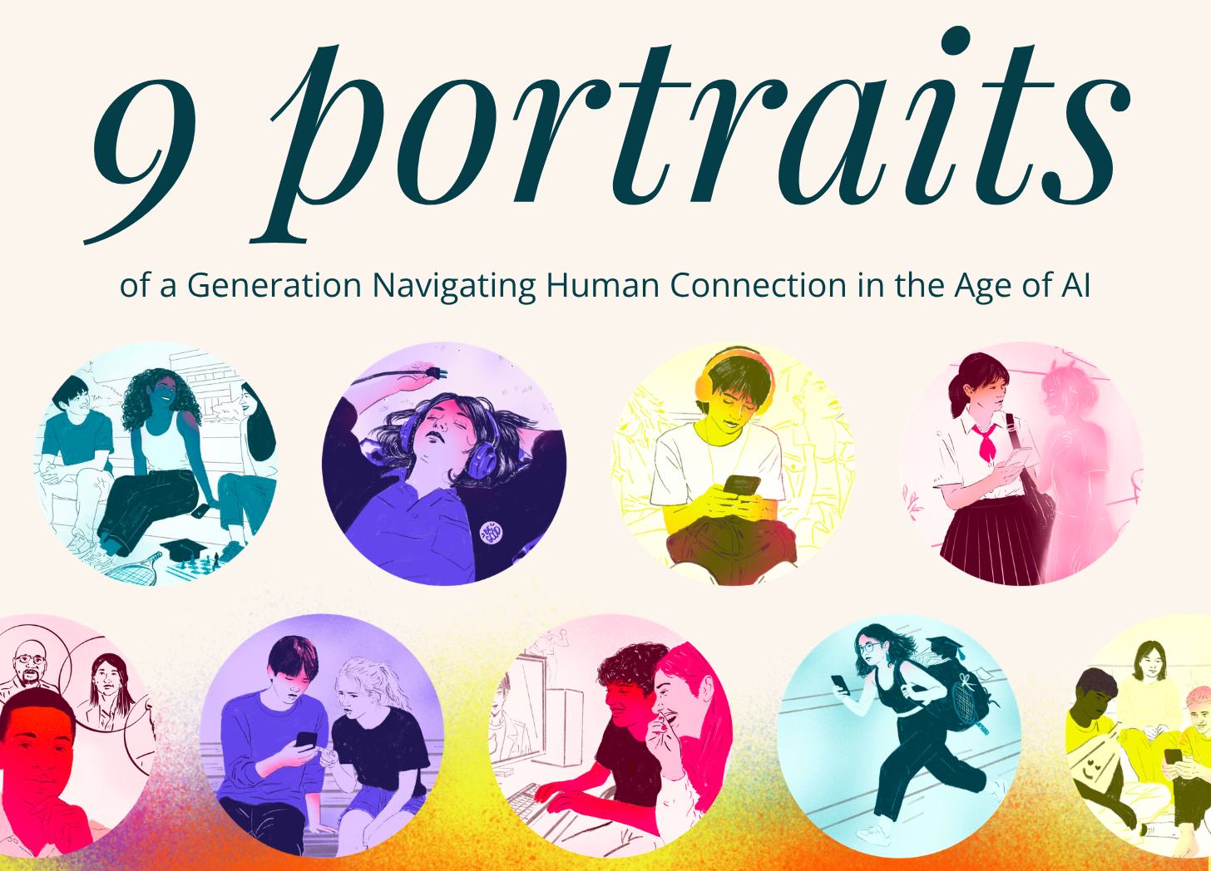
How might a young person's human relationships shape their AI use —
and how might AI shape those relationships in return?
Notes:
Jose Leads

Slide 5
What does Harry Potter have to do with this?
1
2
3
No “good” or “bad”
Variance within any group
Agency matters
Notes:
Jose Leads
Offer these categories– 9 portraits– as a vehicle for reflection (similar to the houses): Where do we see ourselves? Where do we see the people we love? Where our youth today– how might it be different from what we might see or expect?
How is that similar or different from our aspirations– that reflection is a critical launching point to act our way into the futures we want– for ourselves and others No hierarchy. Each has its own upsides and risks. There is no "good" or "bad" house. In fact, this is essential in a context where young people are telling us that convos about AI use are drenched in judgment and it's shutting down meaningful conversations. So we invite you to really channel that spirit of curiosity as we jump in.
Variance within any group. We know that even in Gryffindor there are a whole spectrum of different people, with different motivations and context: Harry is different from Ron, who's different from Hermione. They might share some values, but they come in very different forms.
Agency matters. These aren't destiny. Despite the Sorting Hat seems all powerful, your choices and intentions influence where you end up. You might remember Harry saying "not Slytherin" and the hat listening to that.

Slide 6
Where we’re heading
See the
research
Explore the distinct
portraits that emerged
Go deeper together
Build a plan
for action
Notes:
Nate Leads

Slide 7
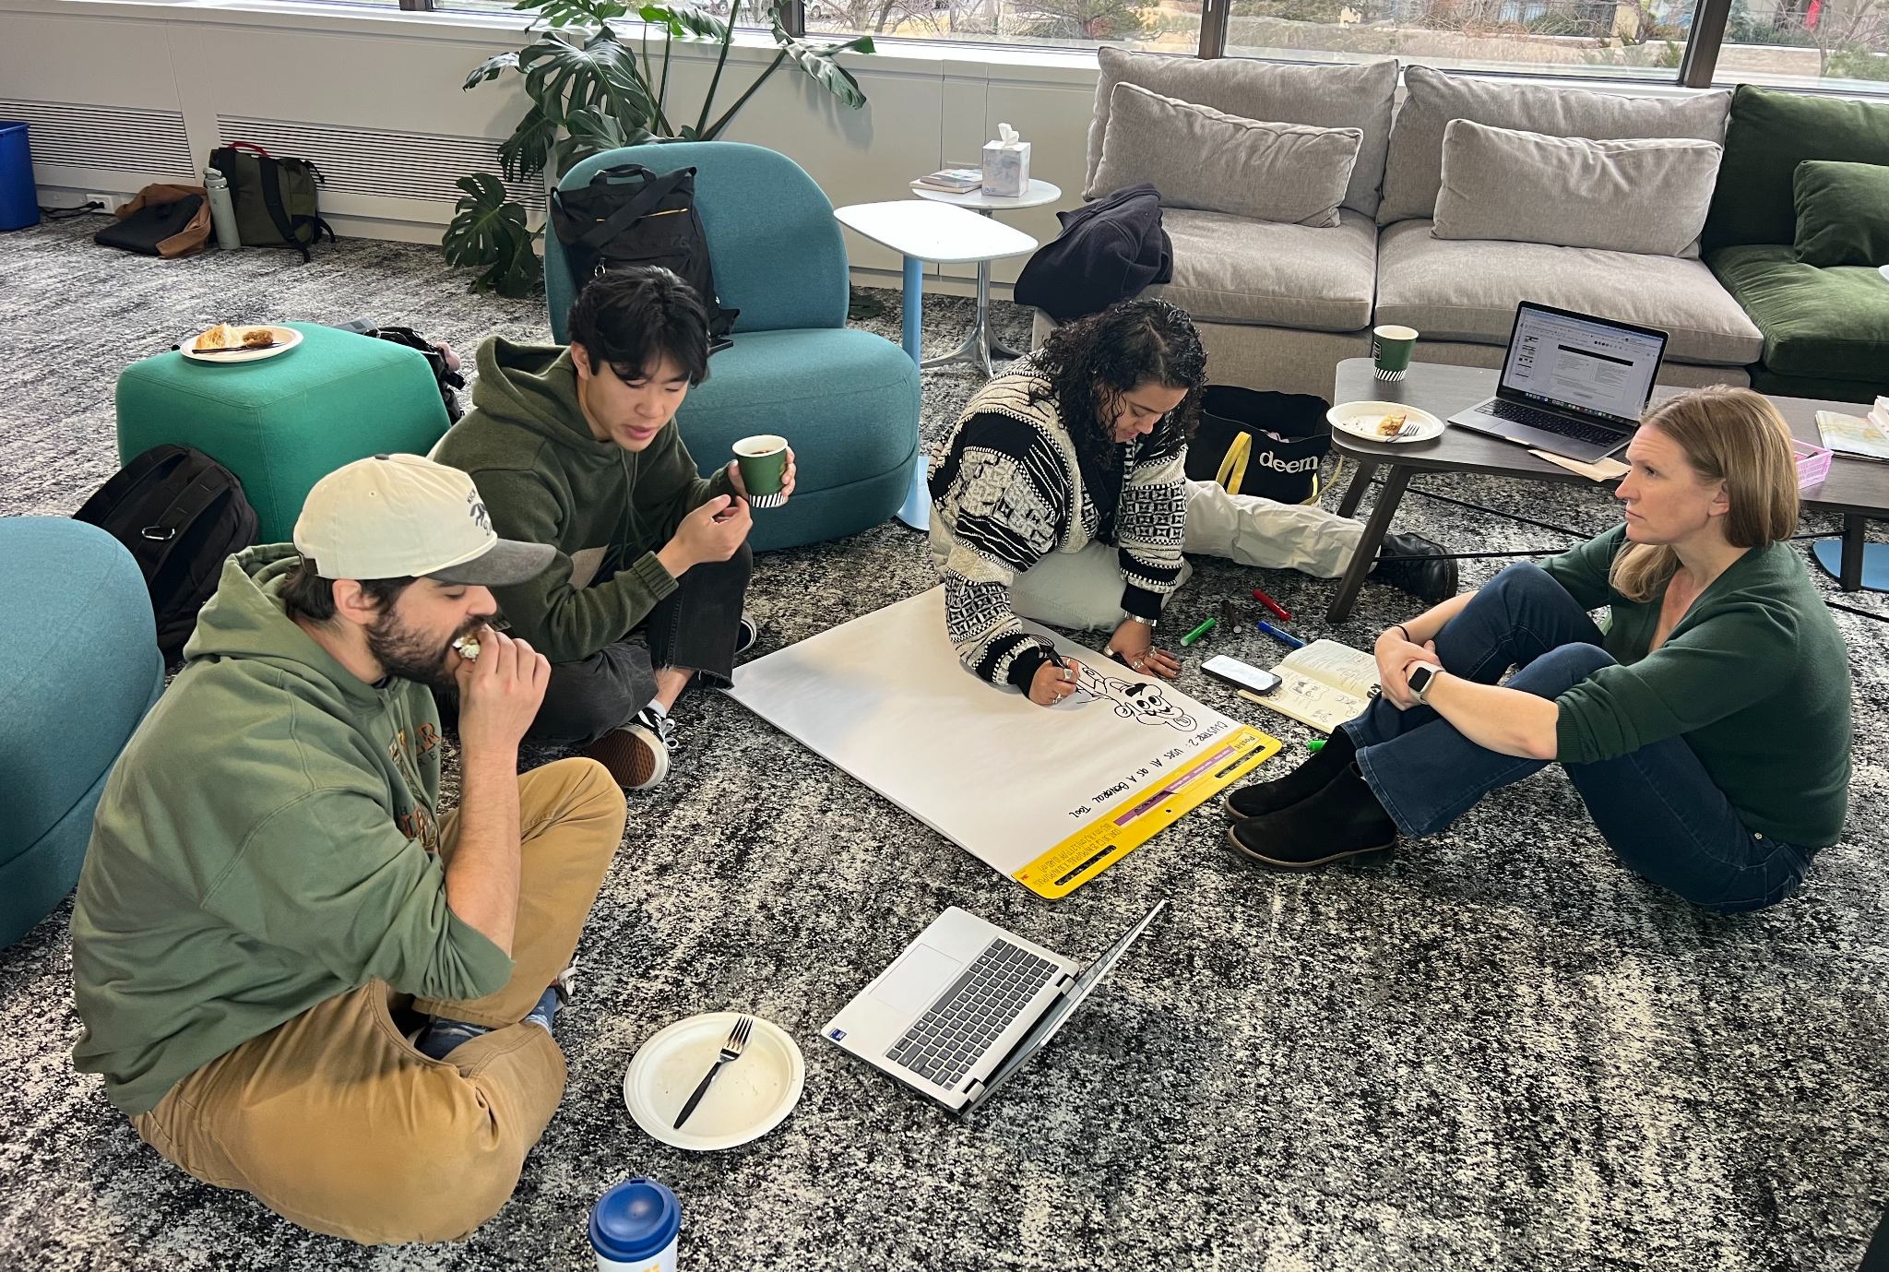
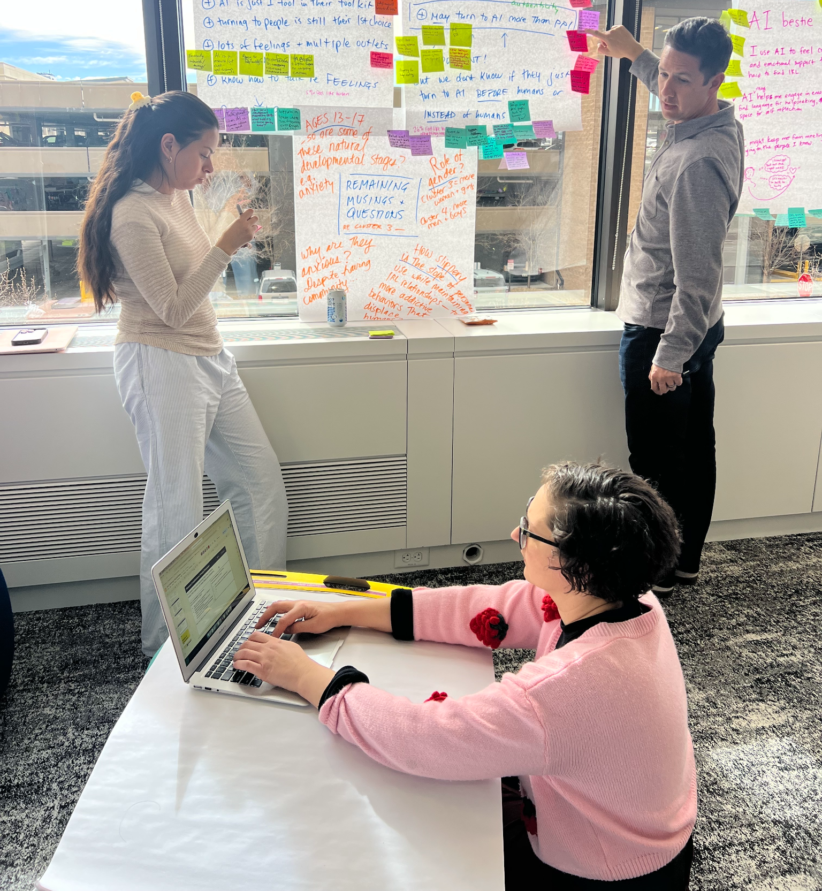
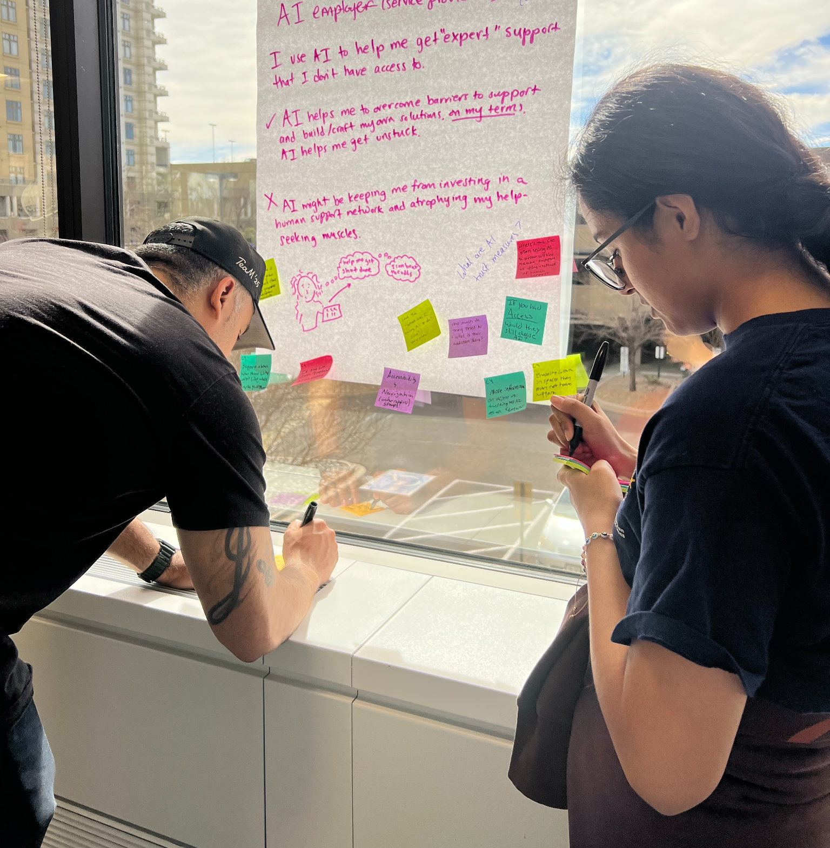
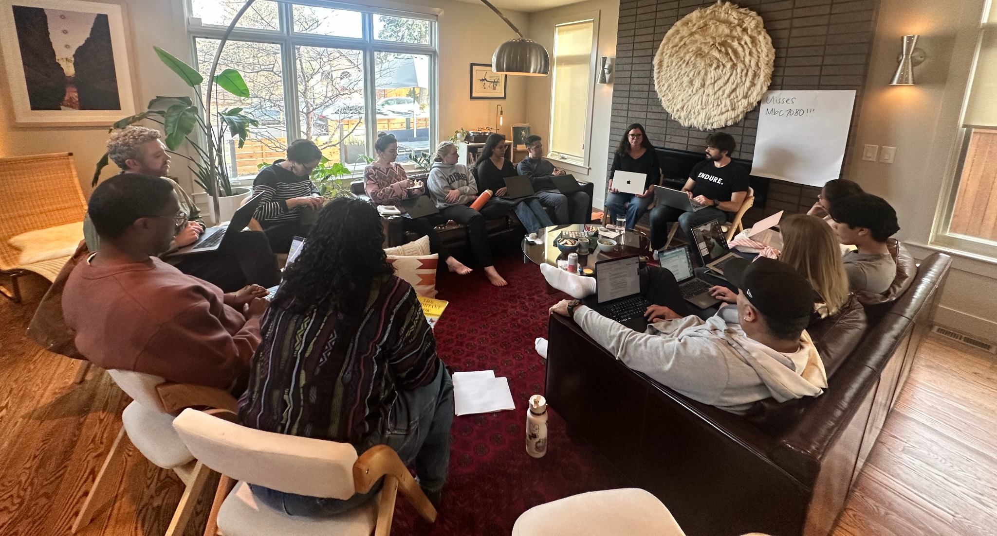
Research scope + process
2,383
13-24
young people
ages
Three-step methodology:
Survey
Interviews
Changemaker
co-interpretation
Notes:
Nate Leads

Slide 8
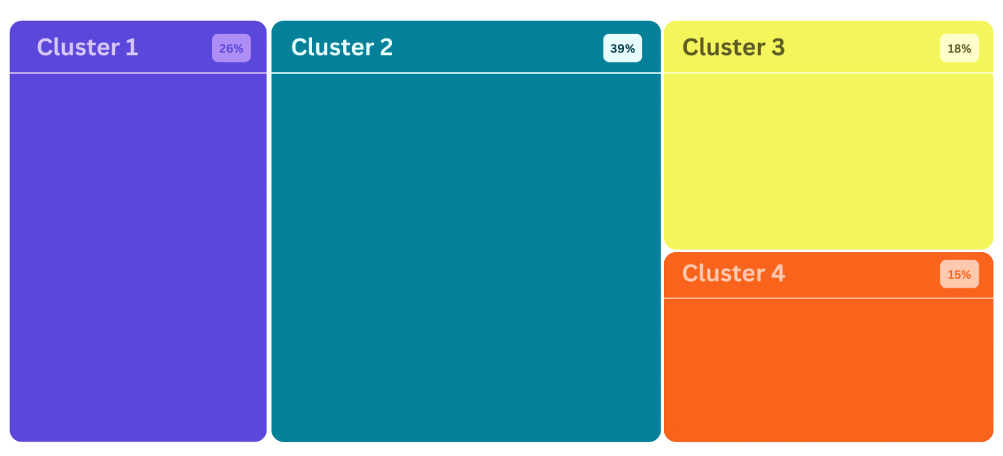
Four Clusters
Note: Each box is sized proportionally to its percentage of the total.
Use AI for personal & emotional support
Uses AI infrequently or never
Uses AI as a tool or for information
Talk to AI characters and personas
Notes:
Nate Leads 📄Full Report; Cluster Descriptions start on page 11: https://bit.ly/youth-ai-and-relationships

Slide 9
Cluster 1
1 in 4 of our survey respondents largely abstain from AI, either as a values-driven decision or because of limited interest, access, awareness or social context.
61%
have never used AI
#1
Loneliest cluster in the study
69%
receive zero adult guidance on AI
28% of young people Uses AI Infrequently or Never
More likely to be:
From a lower-earning household
Aged 19+
Women (54% of Cluster 1 vs. 49% of survey)
Have fewer close friends and family members
Report higher rates of anxiety, feel down on themselves, feel like a burden to others. of survey)
Notes:
Nate Leads More than 1 in 4 don’t use AI. They also report the highest loneliness and social isolation outcomes in the study

Slide 10
Cluster 2
The largest group in our study treats AI as a tool: useful, frequent, and firmly in its lane.
These young people use AI a lot — but keep a clear boundary between what they perceive AI is for and what humans are for.
77%
Use AI weekly or more
#1
Strongest social lives and wellbeing in the study
25%
have used AI to write or polish texts and DMs
39% of young people Uses AI as a tool
More likely to be:
From a higher-earning household ($150K+)
Ages 16–18
Have low rates of loneliness, anxiety, or sadness
61% more likely to report strong sense of belonging at school.
Notes:
Nate Leads
Speaker notes: 75% "never" turn to AI more than people when they're upset or alone. Only mild indicators of high-risk AI use. The 25% texting/DM stat is important — even the most boundaried users are bringing AI into their relational lives. This is the cluster that complicates the clean line between "tool use" and "relational use." 31% report daily AI use. Report trusting chatbots somewhat.

Slide 11
Cluster 3
This cluster has big feelings and lots of places to process them — both human and AI.
They talk to people and AI about their emotions, have ample social connections, and yet feel socially insecure and anxious. The critical question: is AI supplementing their human connections or starting to substitute for them?
90%
Use AI weekly — the highest in the study
47%
turn to AI more than people when upset
54%
process emotions with humans weekly — also the highest in the study
18% of young people use AI for Personal & Emotional Support
More likely to be:
Black (21% of C3 vs. 13% of survey)
Women (57% of C3 vs. 48% of survey)
Average sized-social circles and extracurricular participation.
Highest rates of anxiety.
Notes:
Jose Leads
Speaker notes: 75% "never" turn to AI more than people when they're upset or alone. Only mild indicators of high-risk AI use. The 25% texting/DM stat is important — even the most boundaried users are bringing AI into their relational lives. This is the cluster that complicates the clean line between "tool use" and "relational use." 31% report daily AI use. Report trusting chatbots somewhat.

Slide 12
Cluster 4
The deepest AI engagement in the study.
These young people aren't just using AI — they're in relationship with it, assigning it roles as friends, therapists, and creative collaborators. They show the highest rates of high-risk use.
55%
feel the urge to use AI more and more — the highest of any cluster
1 in 3+
report feeling an emotional connection with AI
52%
are daily users
15% of young people talk to AI characters & personas
More likely to be:
Men (overrepresented vs. survey average)
Aware that their relationship with AI may not be understood or accepted by those around them.
Notes:
Jose Leads
Speaker notes: 75% "never" turn to AI more than people when they're upset or alone. Only mild indicators of high-risk AI use. The 25% texting/DM stat is important — even the most boundaried users are bringing AI into their relational lives. This is the cluster that complicates the clean line between "tool use" and "relational use." 31% report daily AI use. Report trusting chatbots somewhat.

Slide 13
Same cluster, different story
Notes:
Nate Leads

Slide 14
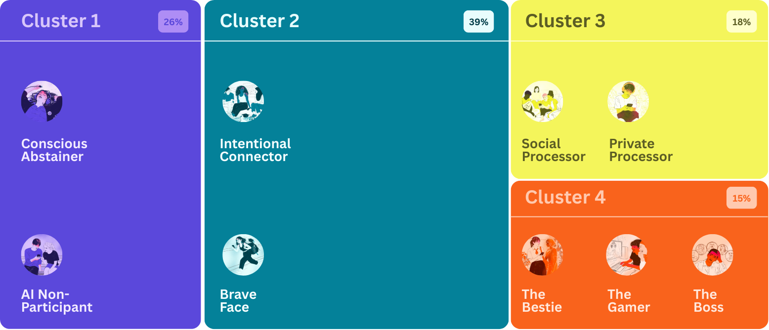
9 Portraits
Note: Each box is sized proportionally to its percentage of the total.
The Expert Seeker
Notes:
Nate Leads

Slide 15
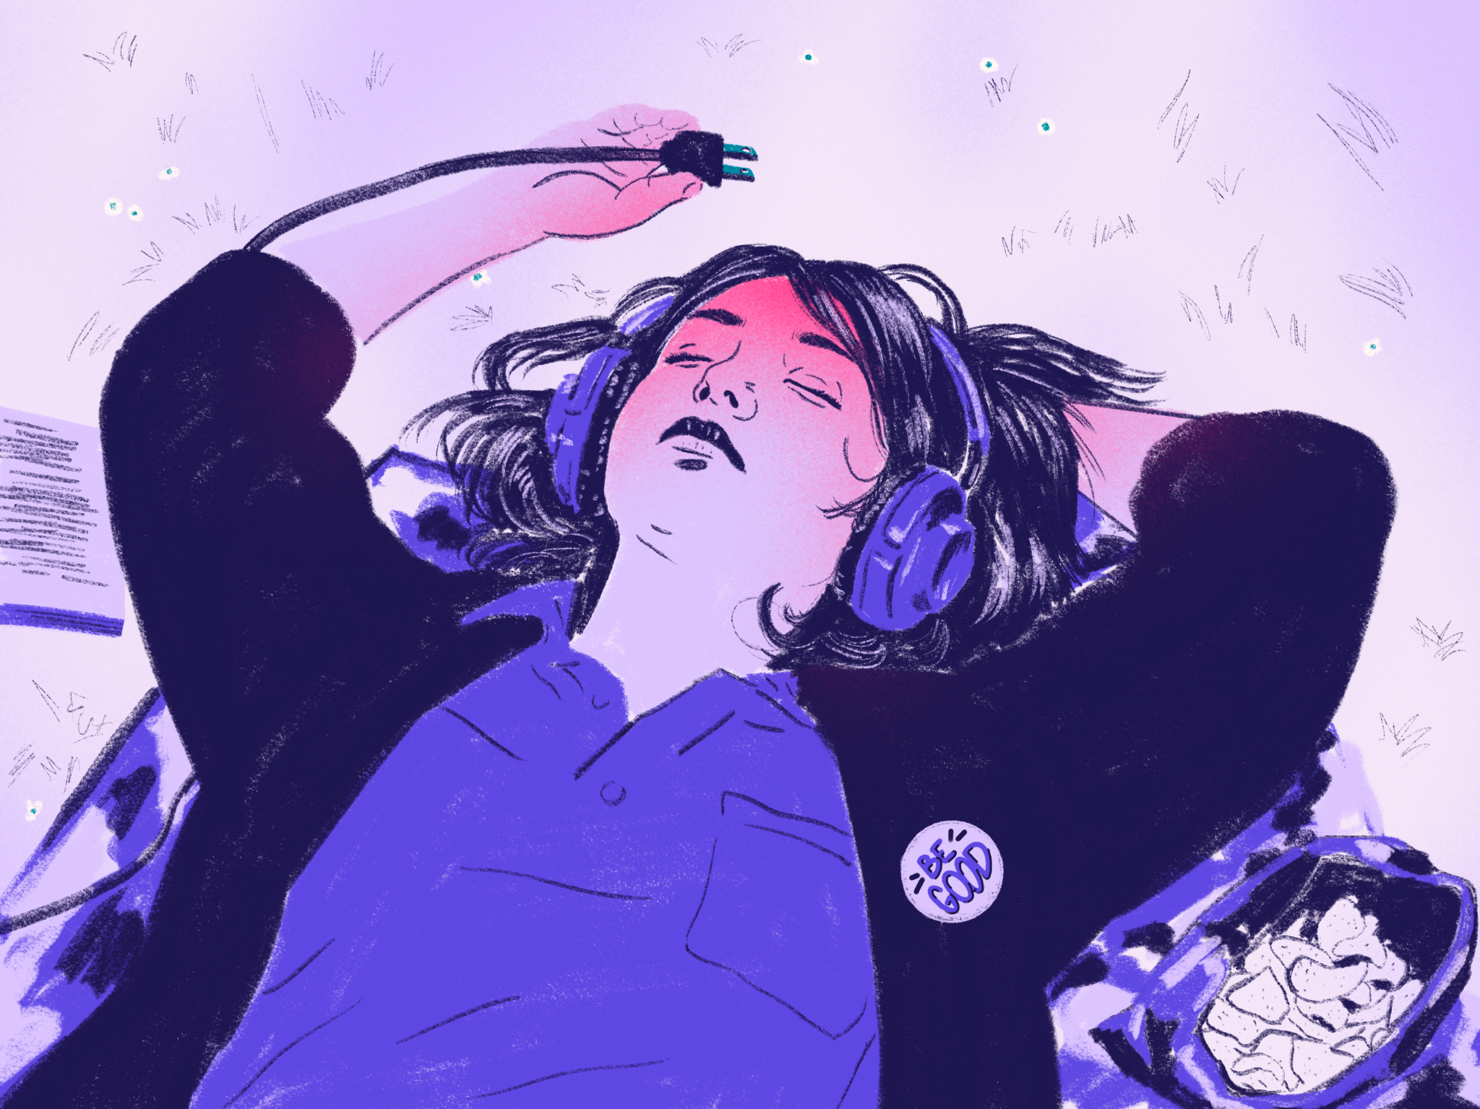

Cluster 1
Uses AI infrequently
or never
The Conscious Abstainer
55%
AI Non Participant
45%
of Cluster 1
of Cluster 1
“It’s bad for the environment because of its water usage... It steals art and makes things generally much more difficult or frustrating for artists.”— Female, 19 years old.
“I’ve just never used it.” — Male, 21 years old
Conscious Abstainers don't trust AI or believe it's harmful. They name environmental impacts, erosion of creativity and artistic integrity and negative impacts on concentration and learning as reasons.
Instead of explicit refusal, AI Non-Participants don't know how to use AI or aren't sure how it would help them. They experience more emotional distress than Conscious Abstainers.
54% say AI chatbots are not at all trustworthy
66% often or always real and unfiltered with friends
9% “never” have no one to turn to
39% say AI chatbots are not at all trustworthy
47% often or always real & unfiltered with friends
18% feel lonely often or all the time
Notes:
Nate Leads

Slide 16
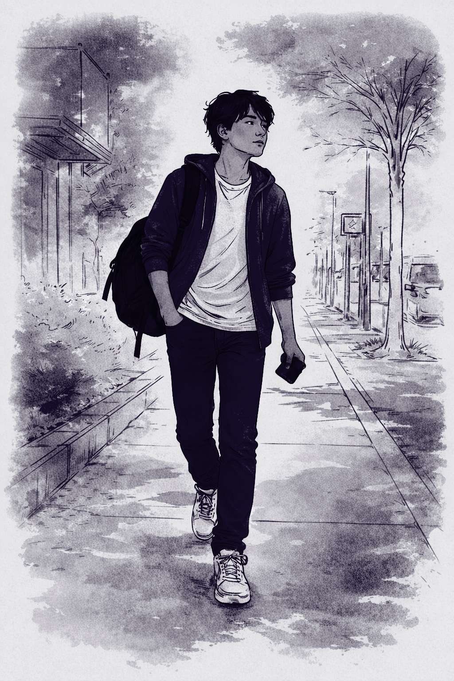
Think of a young person you care about.
Notes:
Jose Leads
We're going to head into small groups to dig into what we're noticing, but before we do, I want you to do something for me.
[Embodied exercise — 60 seconds]:
Call into your mind a real person, 13–25, you know and care about — a friend, a student, a family member.
Picture their face. Picture their day to day. Picture the people around them. Channel their hopes, wants, fears. Now, imagine how AI might be showing up in their life — and why.
Open your eyes. That's who you're going to bring into this conversation.

Slide 17
As You Explore the Portraits
Who is the young person you're picturing — and which portrait might they be?
What strengths does this person bring?
What risks or challenges might they face?
Notes:
Jose Leads
Who is the young person you're picturing — and which persona might they be?
What strengths does this persona bring?
What risks or challenges might they face?

Slide 18
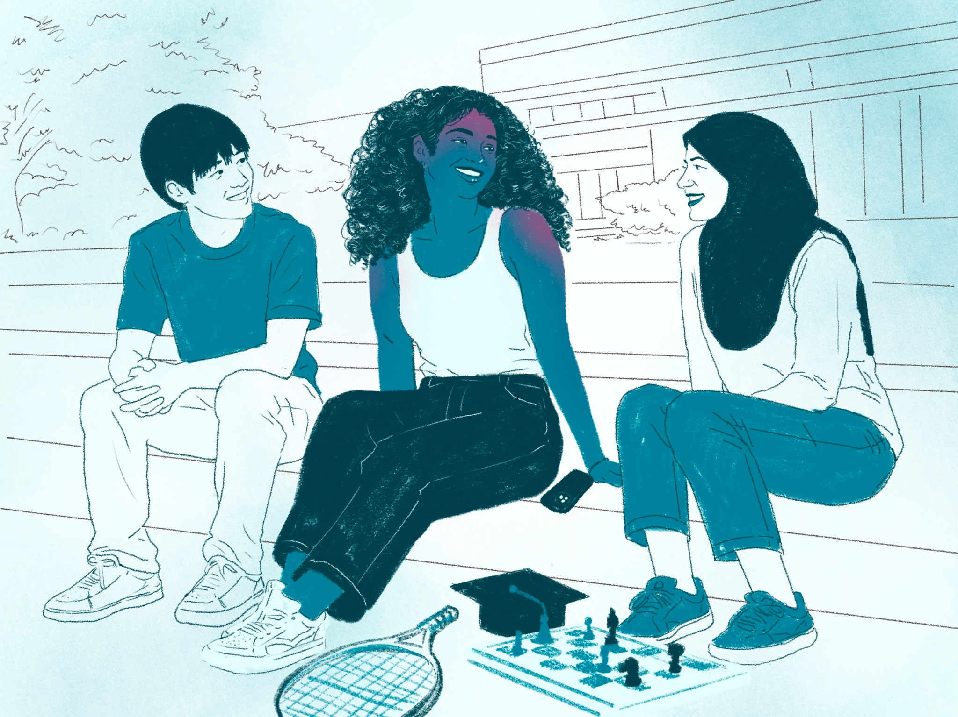
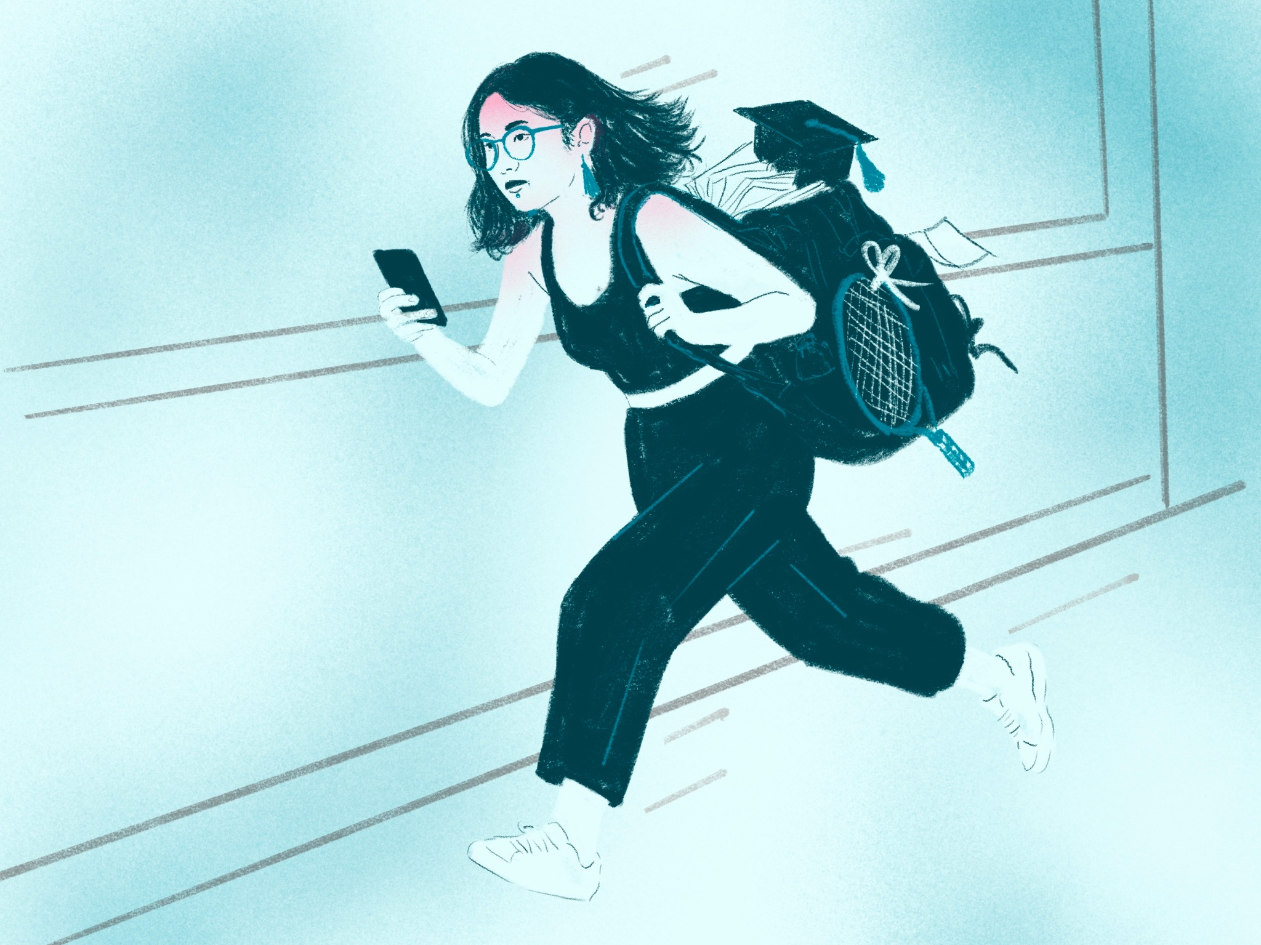
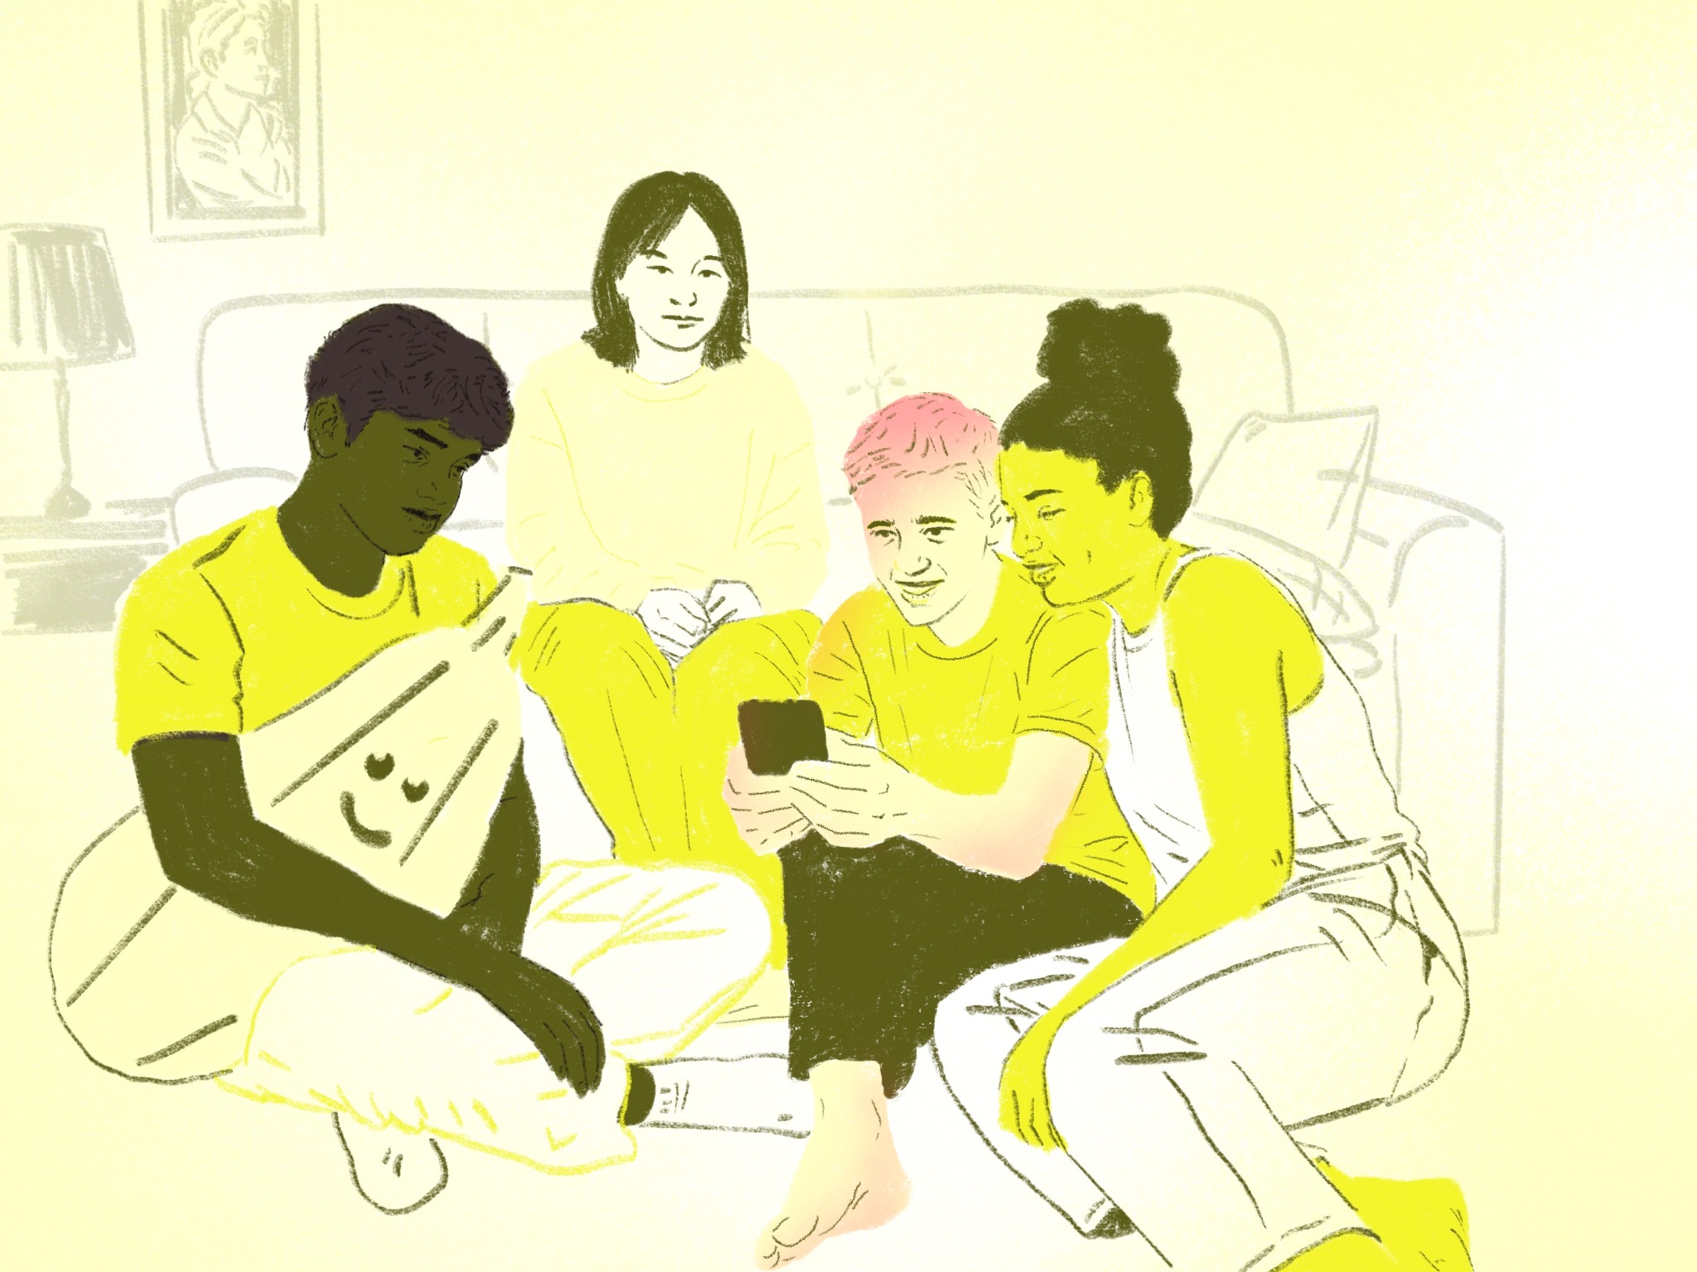
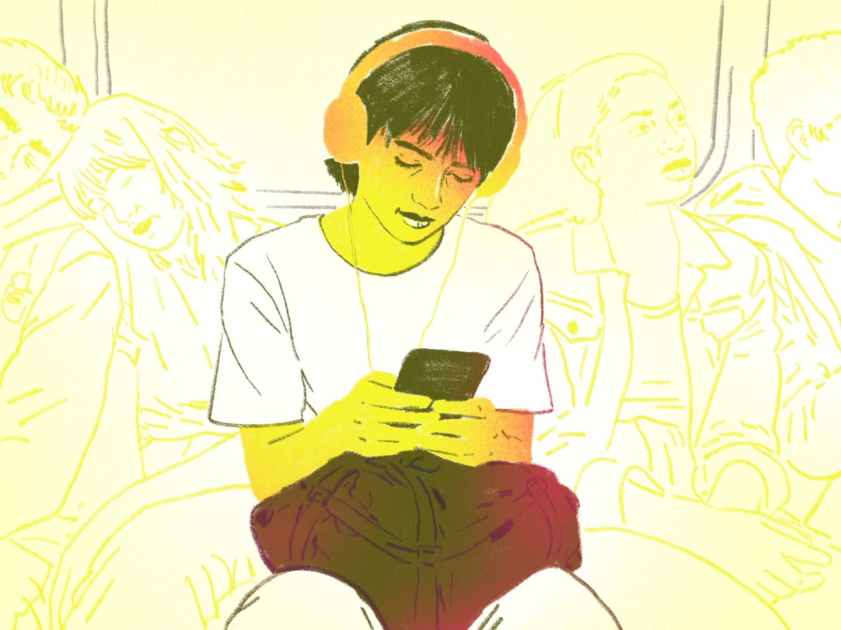
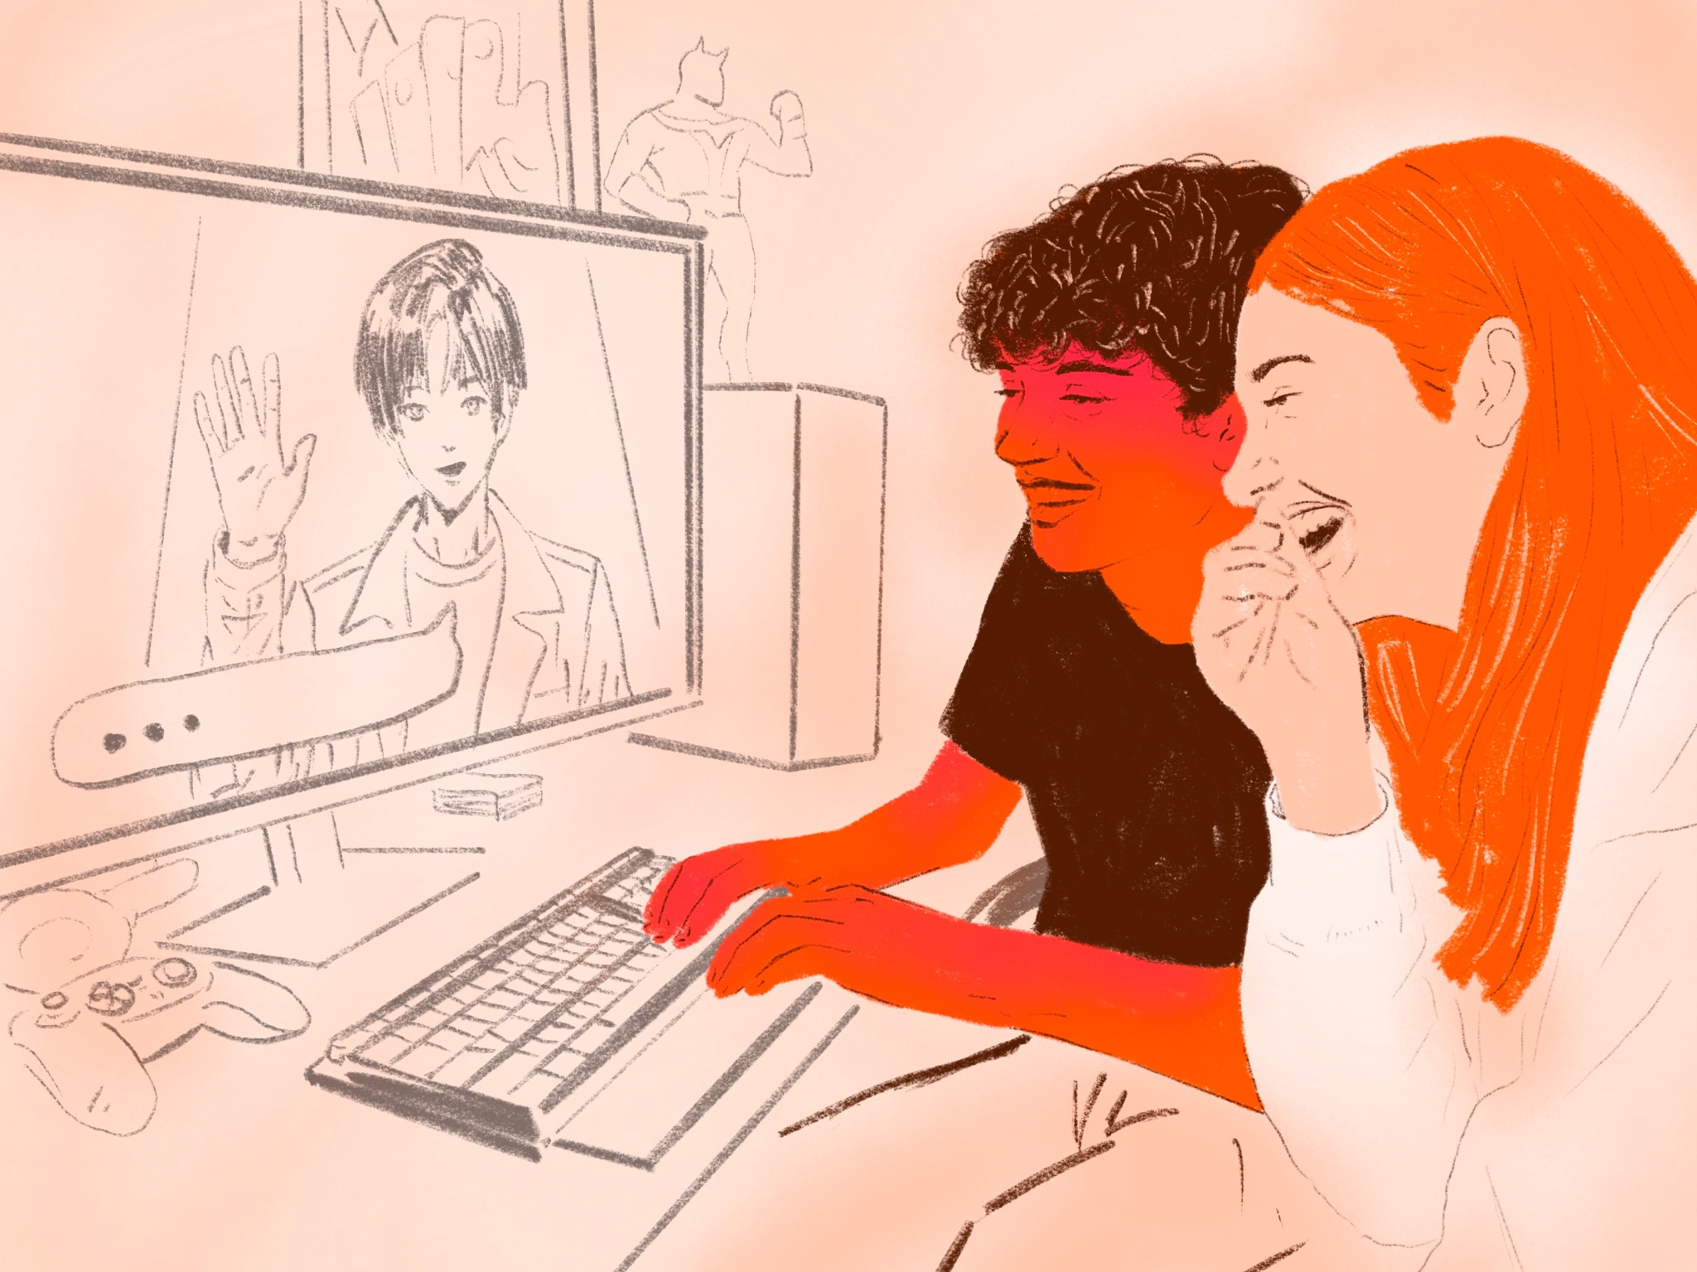
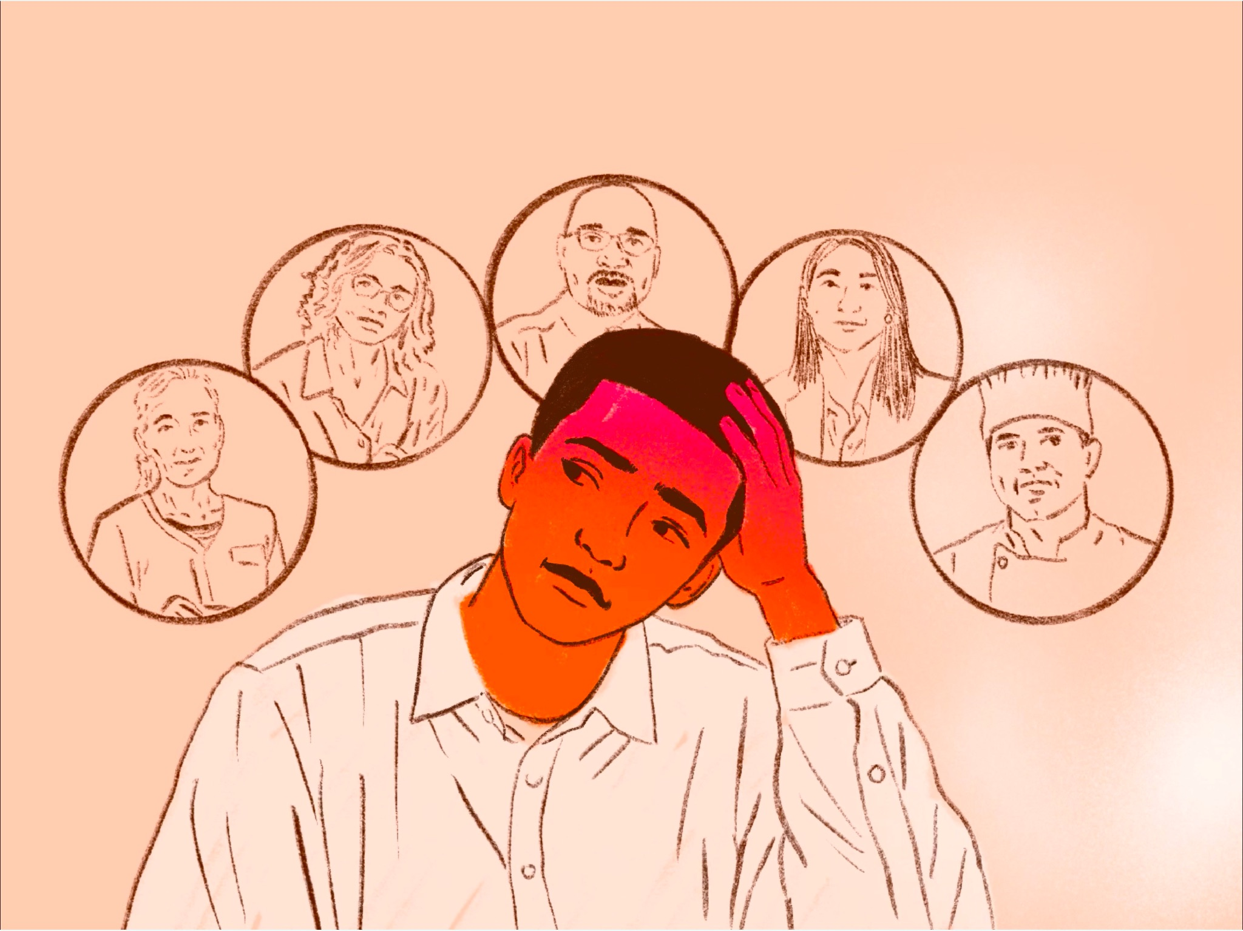
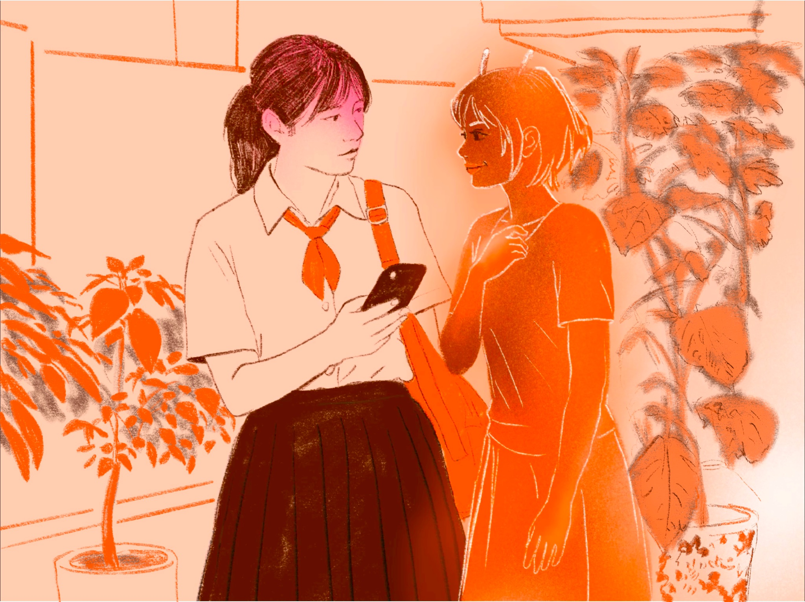
The 9 Portraits
Cluster 1 - The Conscientious Abstainer
Cluster 1 - The AI Non Participant
Cluster 2 - The Intentional Connector
Cluster 2 - The Brave Face
Cluster 3 - The Social Processor
Cluster 3 - The Private Processor
🔍
Explore the portraits: Which one sounds most like you? Which are you most curious about?
Cluster 4 - The Gamer
Cluster 4 - The Expert Seeker
Cluster 4 - The Bestie
Notes:
Jose Leads
🎴Explore the portraits: Which one sounds most like you? Which are you most curious about?
https://www.canva.com/design/DAHE532WBoc/LA1VFfPVYg9iE_wWeJTVxw/view?utm_content=DAHE532WBoc&utm_campaign=designshare&utm_medium=link2&utm_source=uniquelinks&utlId=h9fbe0e8bee

Slide 19
Lets debrief
What was important or surprising from your convos– and why?
Notes:
Jose Leads
Let's share out some of the ideas and thinking from the room:
As you looked across the portraits and the research, did anything challenge what you expected?
What's helpful about naming one's "AI user" type? What's risky?
Building on what you're all naming — what does this make us think young people need most at this moment? Not from AI. From us. The Changemaker network who is committed to ensuring AI strengthens, but doesn't erode human connection?

Slide 20
Designing for Support
Move to a Cluster Section
As a group re-review your cluster’s portraits
Discuss and decide: what types of supports, resources, or experiences might our youth-development spaces focus on for this cluster?
Create a poster with ideas and recommendations
Cluster 1
Cluster 3
Cluster 2
Cluster 4
Notes:
Nate Leads

Slide 21
Public discourse is likely overestimating the number of young people in relationships with personified AI characters (15%), while underestimating the people whose relationships are already being reshaped by AI (45%).
Use AI for personal & emotional support
Uses AI infrequently or never
Uses AI as a tool or for information
Talk to AI characters and personas
Notes:
Nate share these quickly as inspiration for these groups

Slide 22
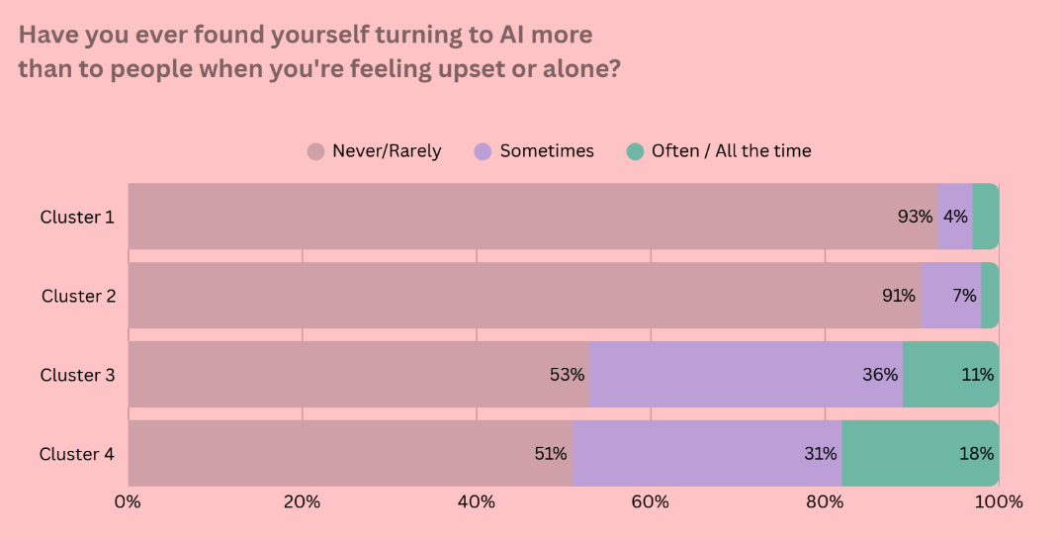
When the AI use turns personal and intimate, it becomes
nearly 5x more likely to begin substituting human relationships.
Notes:
Nate share these quickly as inspiration for these groups

Slide 23
The strongest protection against high-risk AI use isn't simply more relationships — it's specifically relationships where young people feel genuinely seen, safe, and like they matter.
 | Human Displacement | AI Dependency |  | AI Attachment
Human Connection | Turning to AI before people when Upset/Alone | AI Urgent Use | Hiding AI Usage | Emotional Connection
Loneliness
Feeling Like a Burden
No One to Turn To
# Who Show You Matter
Can Be Real/Unfiltered
Belonging at School
Number of Close Friends
= direct; = inverse. Color intensity = strength of correlation Size of circle = statistical significance
Notes:
Nate share these quickly as inspiration for these groups

Slide 24
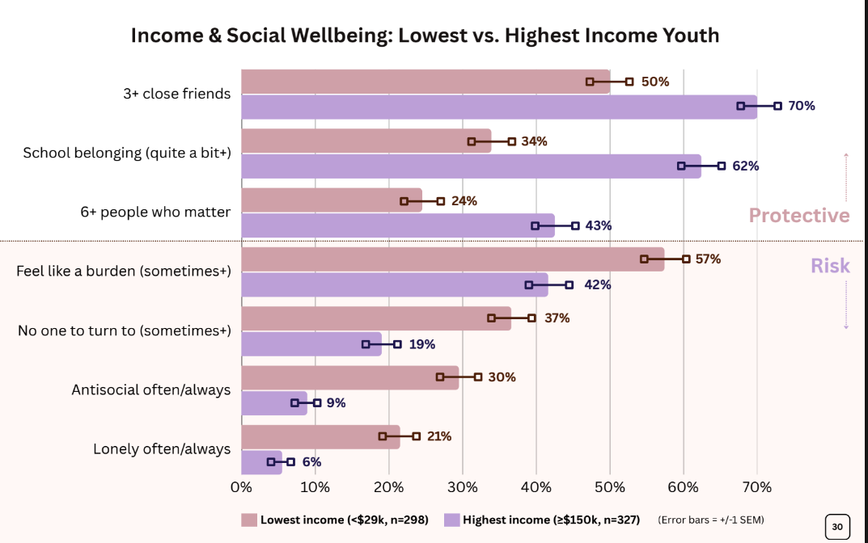
Youth from low-income households face a compounding gap: they're three times less likely to engage with AI and report greater vulnerability across measures of connection and well-being.
Notes:
Nate share these quickly as inspiration for these groups

Slide 25
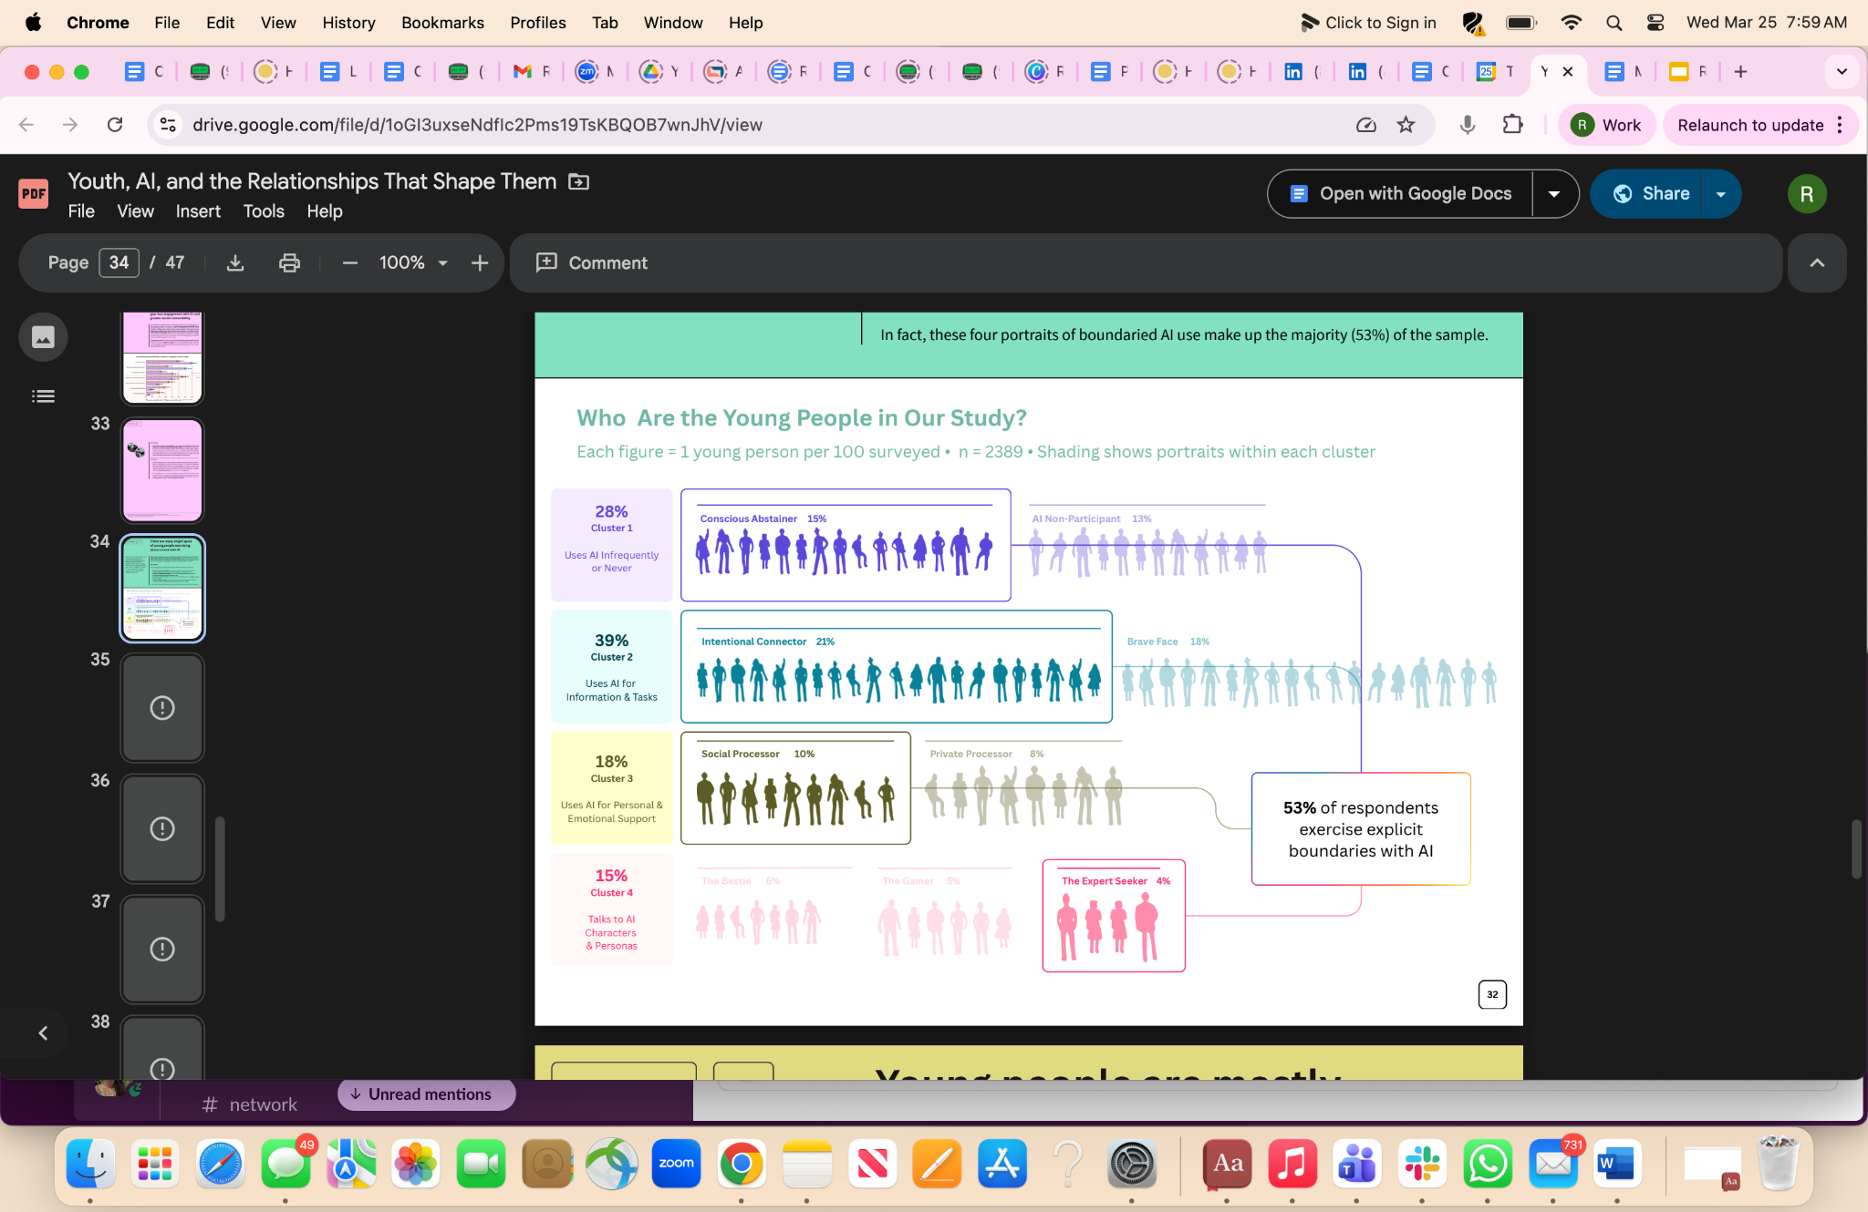
There are meaningful bright spots to grow: 53% of young people in our study report setting boundaries with AI, grounding their use in values, or using AI alongside — not instead of — human support.
Notes:
Nate share these quickly as inspiration for these groups

Slide 26
Questions to Consider in Your Groups:
What assets or unique strengths might this group have that we can build from?
What are the biggest risks for this group’s well-being?
What skills or competencies would this group most benefit from (adult support seeking? tech-use discernment? Network building? Identity development?)
Cluster 1
Cluster 3
Cluster 2
Cluster 4
Notes:
Leave these up during slides

Slide 27
Jose’s Reflections
The
Rithm
Project
Notes:
Use this to quickly transition from groups to closing reflections from Jose (next slide too)

Slide 28
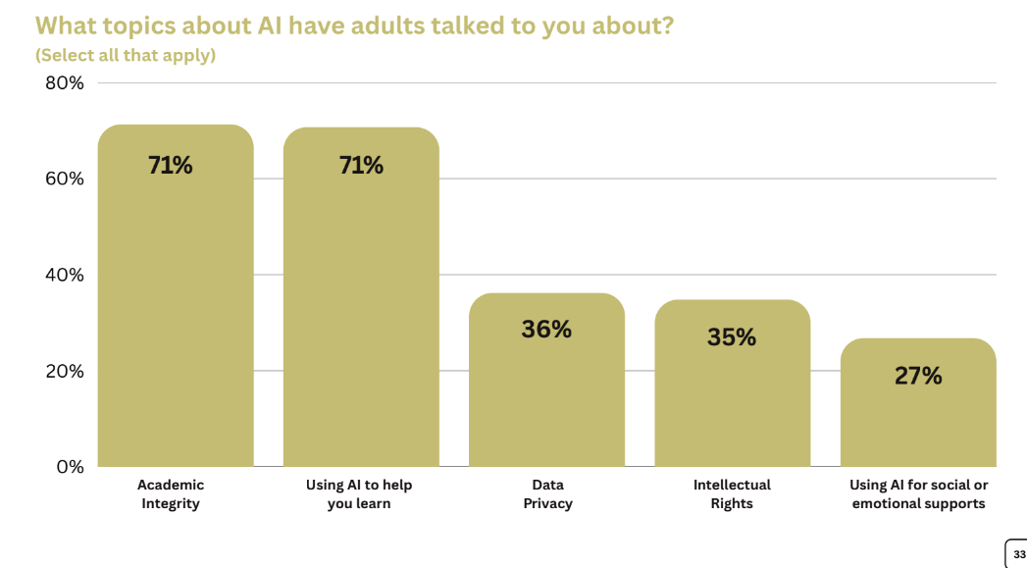
Most young people are navigating all of this alone.
61% say parents rarely or never talk to them about AI, and 53% say the same about teachers.
Conversations are mostly about academics and rarely touch relational dimensions of AI use.
Notes:
Jose Leads With his Own Story

Slide 29
Revisiting Other Key Headlines
The
Rithm
Project
Notes:
Nate Leads

Slide 30
Three truths:
1
2
3
Curious
Genuinely non-judgmental about young people’s real lives, not our assumptions.
Precise
Clear and specific about how AI is used, by whom, and with what impact.
Accountable
Owning our choices while pushing for the systems and safeguards we need.
Notes:
Michelle

Slide 31
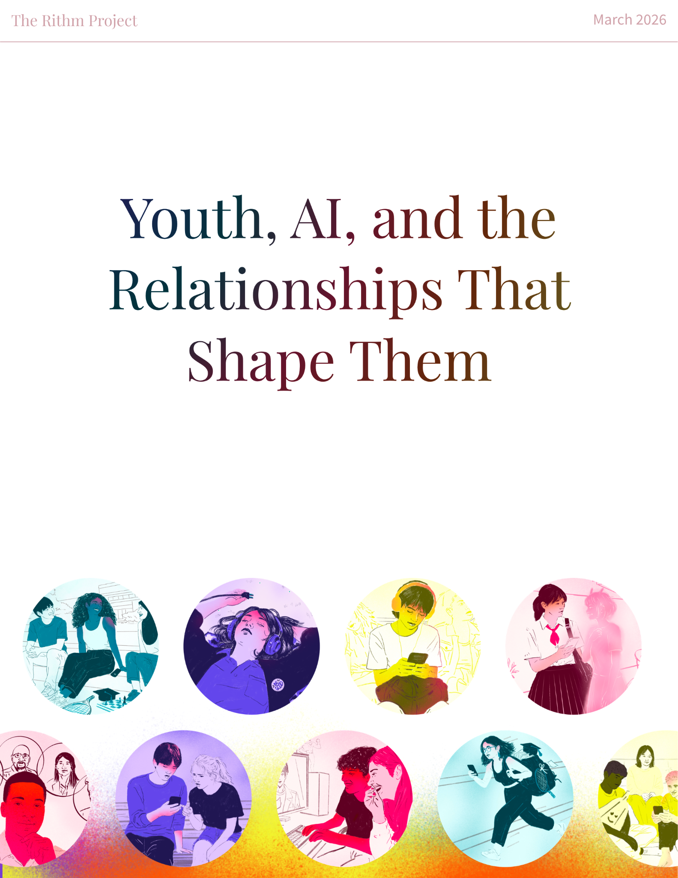
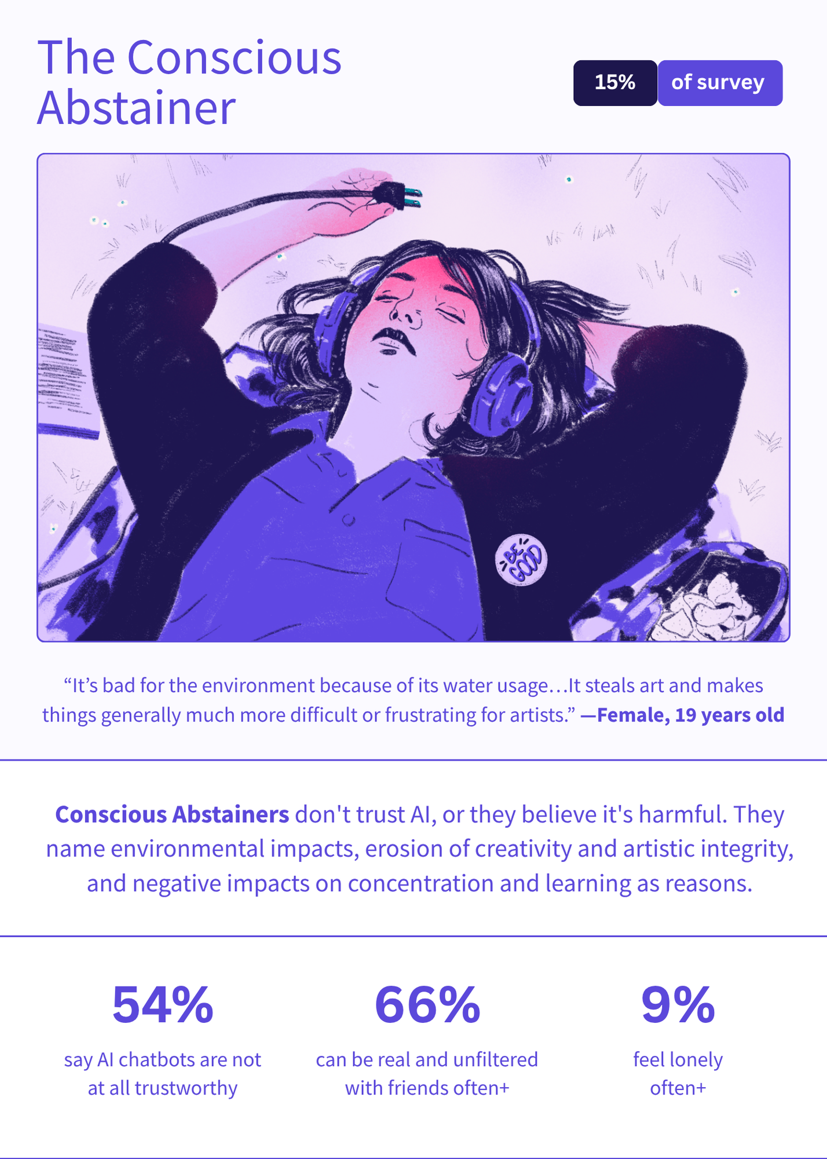
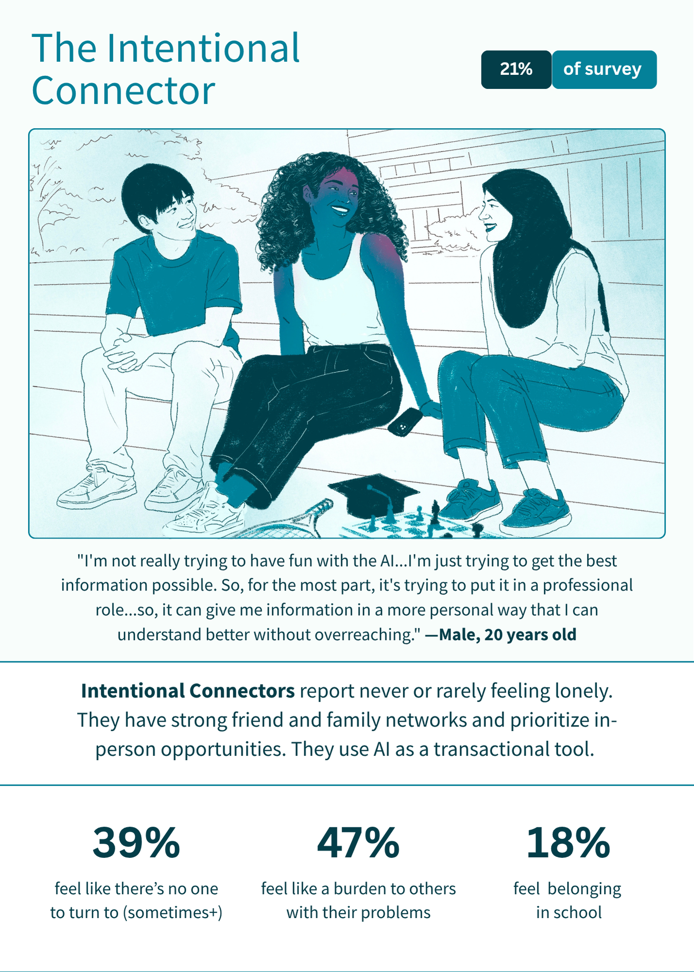
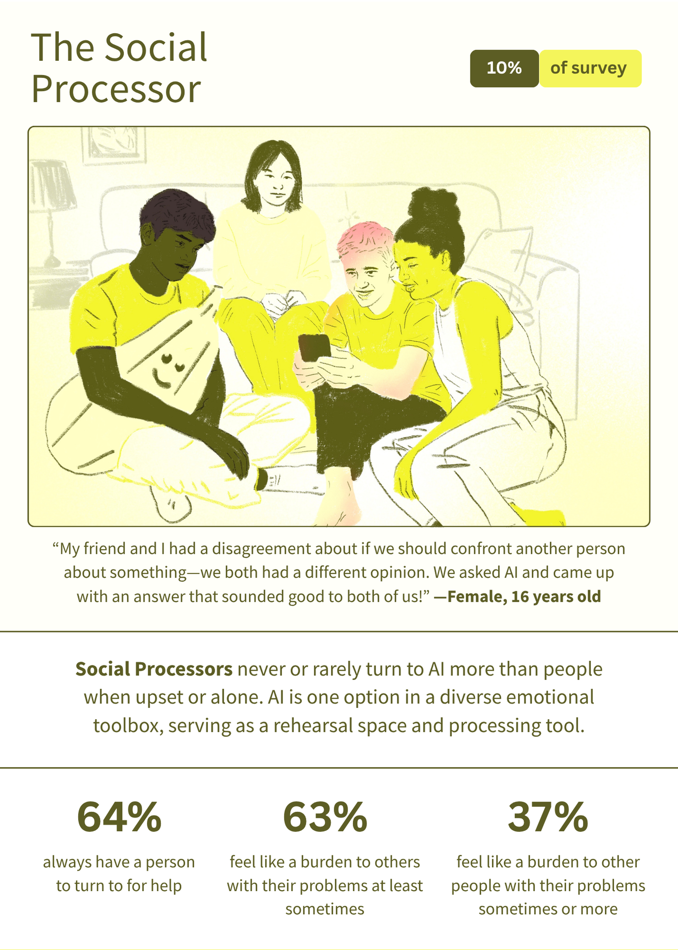
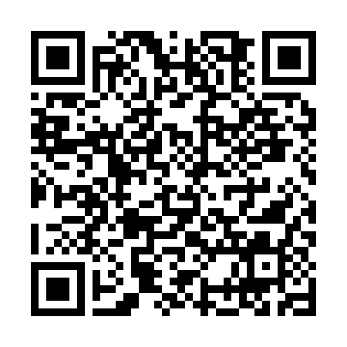
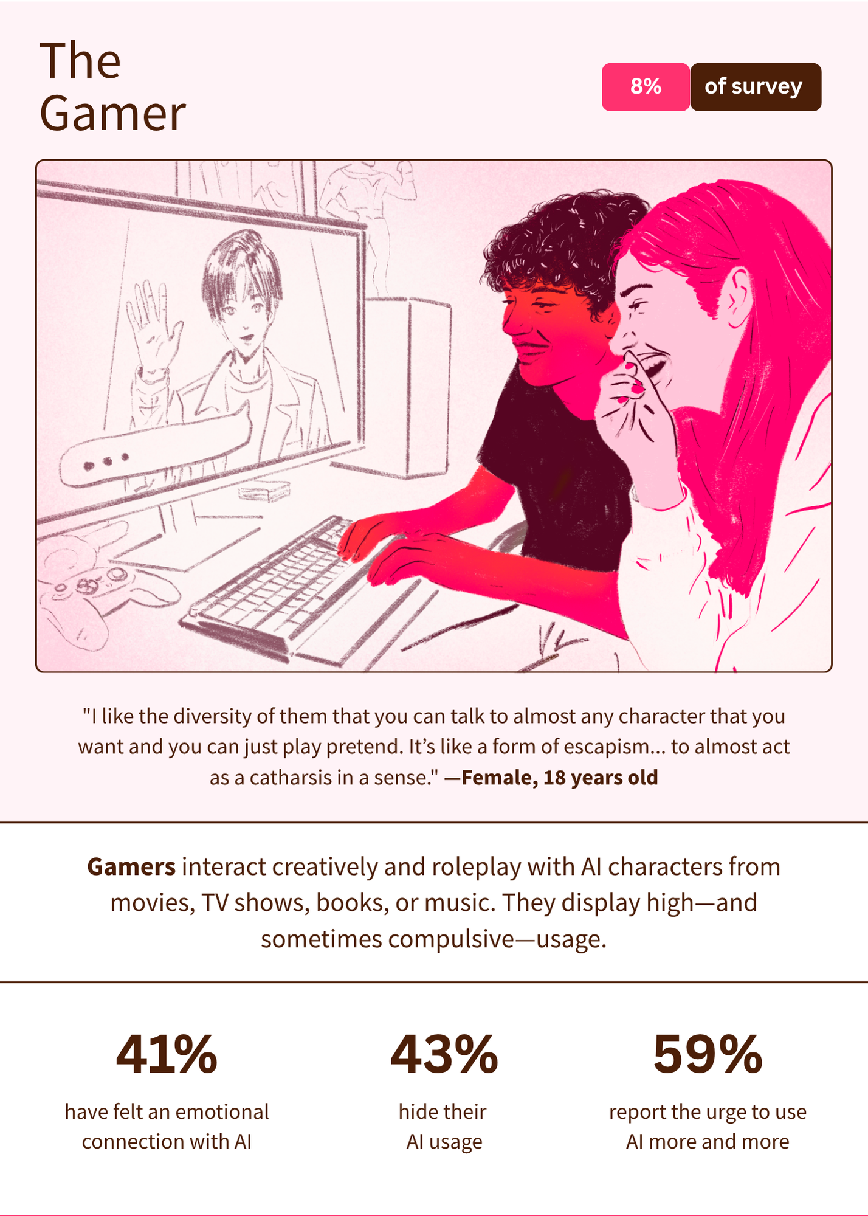
Spread the word
therithmproject.org/research
Join the waitlist for a printed set (and/or class sets) of the portrait cards
Notes:
https://us06web.zoom.us/meeting/register/aDPWwWk4QzO1bNUKHWK9zg

Slide 32
Final Share
A commitment
A
question
A
learning

Slide 33


Thank you
"It is our choices, Harry, that show what we truly are."
— Dumbledore

Slide 34
Appendix

Slide 35
Spread the word
therithmproject.org/research

Slide 36
The
Rithm
Project
UNPACKING THE RESEARCH
Youth, AI, & the Relationships That Shape Them

