Slide 1



Natalie Hanni | Oregon Partnerships
natalie@magicschool.ai

Slide 2




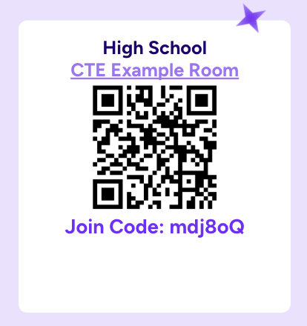



Natalie Hanni
Keely Nunez
DO NOW!
Try A Student Room!
District Partnerships
District Partnerships

Slide 3


Our Agenda
Quick Intros
Panel Presentation
Q&A
Norms
Ask questions! Offer ideas!

Slide 4
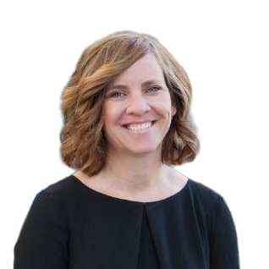
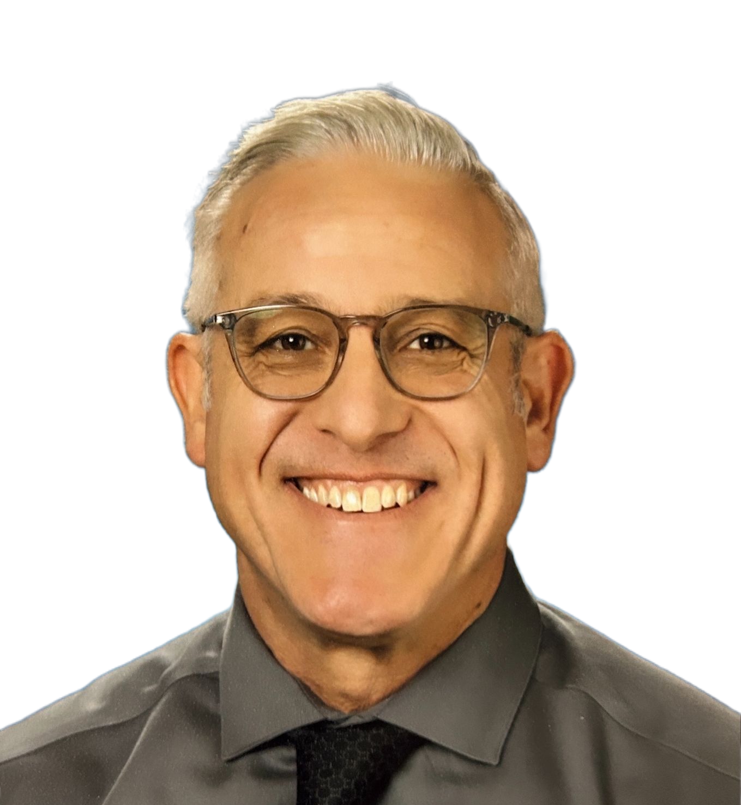
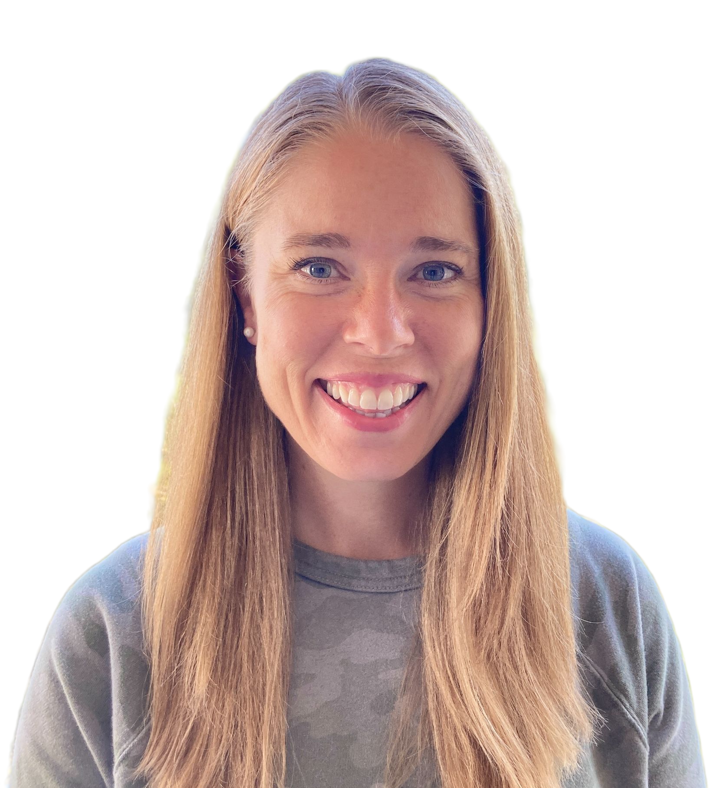


Our Panelists
Angela Adzima
Tech Integration TOSA
Hillsboro
Jessie Nies
Secondary Tech TOSA
Hillsboro
Bruce Schmidt
Assistant Superintendent
Greater Albany
Tracy Howk
Educational Technology
Bend La-Pine
Robbie Faith
Instructional Technology Coach
Bend La-Pine

Slide 5


Hillsboro School District
Class Writing Feedback
Serve 19,000 students
37 Schools
27 Elementary
4 Middle
4 High
1 Alternative HS
1 K-12 Online Academy
Angela Adzima
Tech Integration TOSA
Hillsboro
Jessie Nies
Secondary Tech TOSA
Hillsboro
Strategic Plan 2023-2027

Slide 6
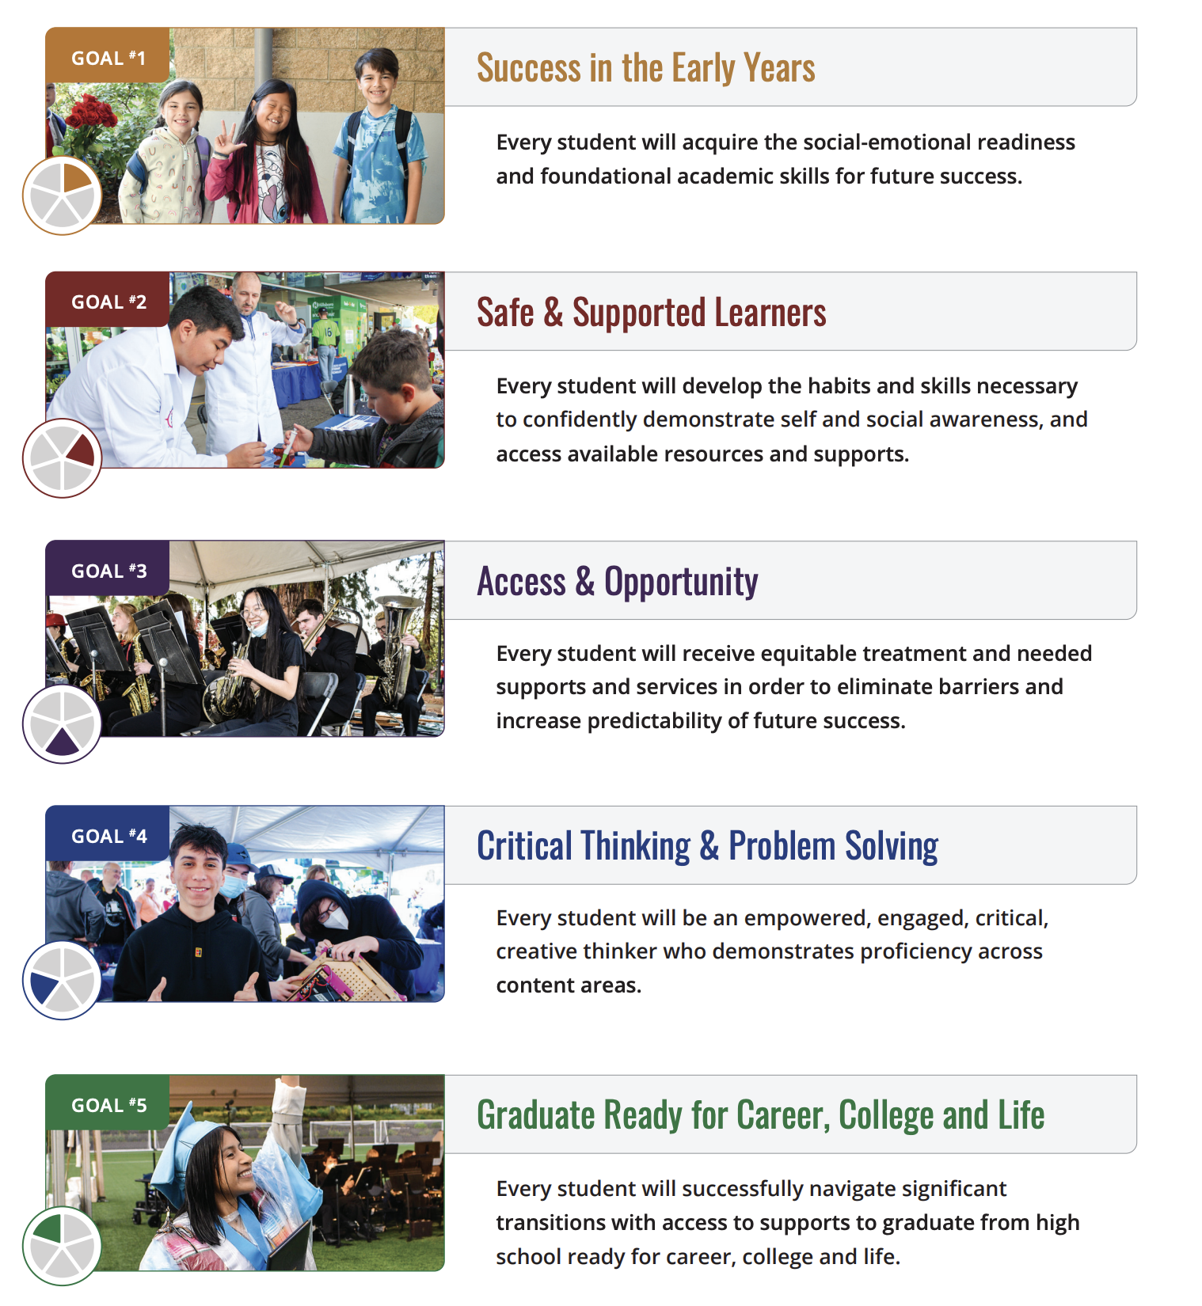
Hillsboro School District Strategic Plan

Slide 7
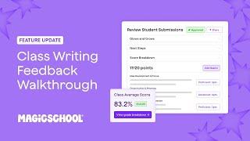
Class Writing Feedback
Notes:
https://www.youtube.com/watch?v=VGkdzeHsqQo&t=1s

Slide 8
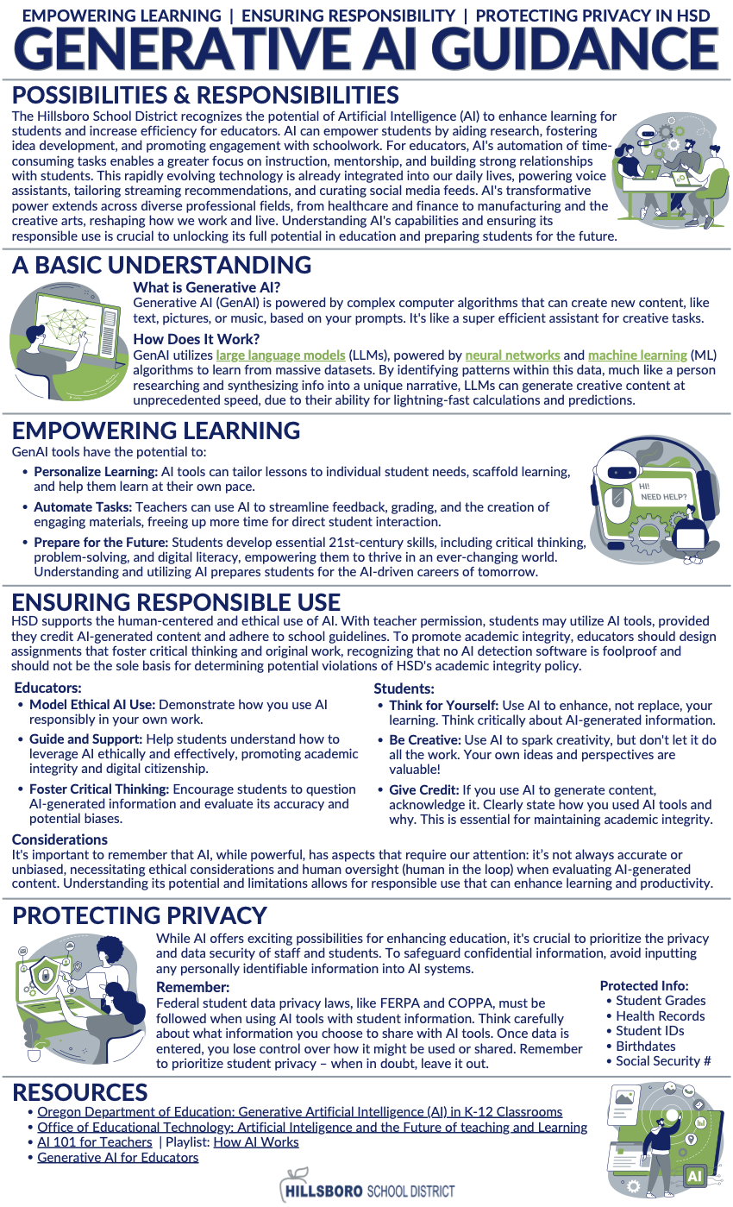
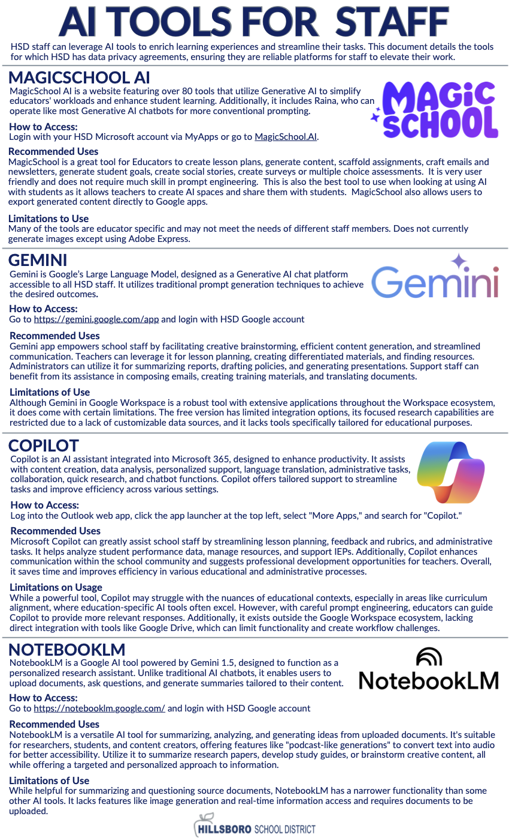
AI implementation in Hillsboro School District
AI Task Force Reviwing our Guidance and Policies
Purposeful Technology for Elementary Classrooms
Task Force:
Crafting Responsible Use Scales for AI
Join Us!
“From Guidance to Policy: Balancing Innovation and Student Safety”
Balancing Innovation and Student Safety

Slide 9
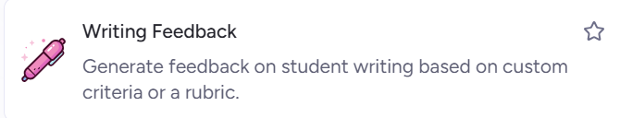
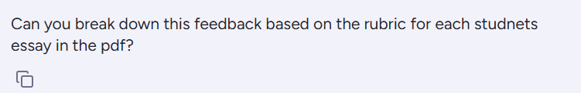
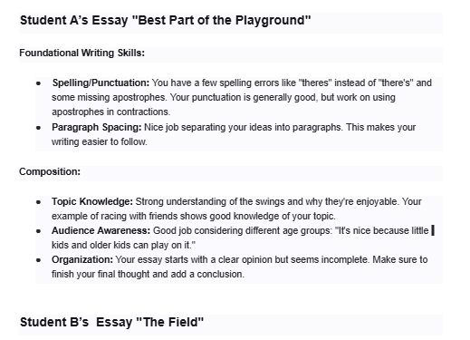
Elementary-
Increase writing instruction and feedback without overwhelming teachers?
Using Class Writing Feedback for digital writing and using Writing feedback with scanned copies of handwritten work for other Assignments.

Slide 10
Secondary -
Balancing meaningful writing feedback for students with Standards-based Grading and Teacher Burnout
Move to Standards-Based Grading
Writing Course Outcomes
Writing CO-specific Rubrics
Generating Feedback with MagicSchool
Integrating Course Outcome Rubrics (Generated with Rubric Tool) with Class Writing Feedback Tool
Notes:
secondary

Slide 11

Questions?

Slide 12
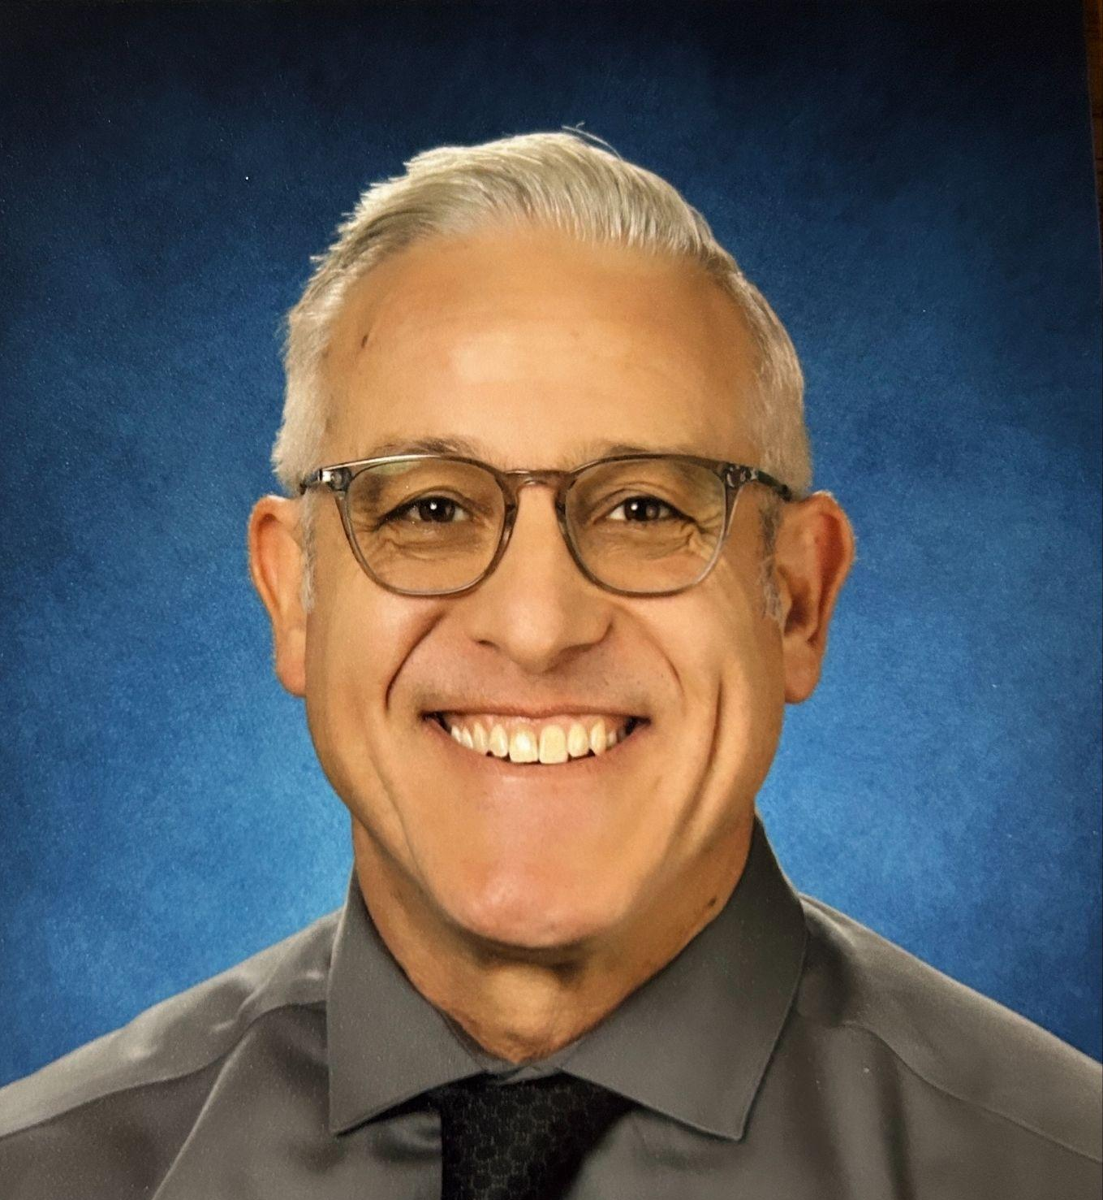
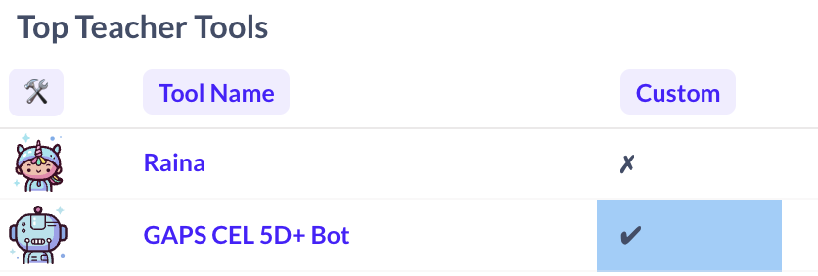
Greater Albany Public Schools (OR)
CEL 5D+ Teacher Observation Chatbot
Bruce Schmidt
Assistant Superintendent

Slide 13


But first,
Some Context
Serve 8,500 students
21 Schools
14 Elementary
4 Middle
3 High
Focus:
2024-25 implemented CEL 5D evaluation rubric
Increase the number of classroom observations and feedback loop for instructional improvement.
Develop AI tools to assist in observation load.
Build capacity of administrators in AI tools and expand to teachers.
District Focus on Instructional Improvement

Slide 14
Problem of Practice:
Why did we build this tool?
Provide administrators with a tool to increase efficiency and consistency during classroom observations.
  On average each administrator will need to complete 120 observations
Serve as a thought partner while developing feedback for teachers.
Increase the rate of feedback post observation.
Provide teachers with a tool to increase self-reflection and growth.
Improve instructional quality to directly impact student outcomes and experience

Slide 15
Implementation
Steps we took to ensure fidelity
2024-2025
2025-2026
2025-2026
2025-2026
Several staff as independent users
Chris Sullivan, an ES Principal, developed CEL 5D chatbot in 24/25
Tech Dept. Vetting
Formed AI Pioneers Group
Developing Board Policy
Developing Student Use Policy
Trained Admin. in summer
Team use during walkthroughs
Promote teacher use of tool
Ongoing reflection
Admin
Teachers
Introduced to Collaborative Steering Committee

Slide 16
Demo
: CEL 5D+ Instructions for Transcribing and Processing Observation
Record Your Lesson
  Use a video or audio recorder to capture the lesson.
Upload to Google Drive
  Open Google Drive.
  Click the New button (the "+" icon).
  Select File upload and choose your recording file
Transcribe with Notta.ai
  Go to Notta.ai.
  Click Upload and Transcribe.
  Scroll to the bottom of the page and select Upload from URL.
  Paste the Google Drive link you copied.
  Once the transcription is complete, return to Google Drive and change the video's sharing setting back to Restricted for privacy. Share the video only with the teacher..
Process with Magic School – CEL 5D+ Bot
  Go to Magic School.
  From the tools menu, select the CEL 5D+ Bot.
  Click Generate.
  Click the paperclip icon and choose Upload.
  Select and upload the transcript file from Drive
  Follow the prompts, ask questions, ask it to “elaborate”
Finalize
  Copy and paste the desired feedback from the Magic School analysis into your teacher's Observation Report document.
  Share the report, video, and transcript with teacher.

Slide 17
Challenges we encountered & addressed
Challenges
Initial administrator reluctance to use AI tools
Fear that “evaluation is being done by a robot”
Quality of audio recording for transcription of lessons
Lack of understanding of tool with teaching staff
Solutions
Provide team base support for administrators
  Collaborative walkthroughs, collegial use, ongoing reflection
Engage teachers in process
Provide hands-on exposure to Collaborative Steering Committee
Experiment with new recording devices and video based recording
  Lapelle microphones
  AI video cameras

Slide 18
Next Steps……
Develop board policy and Administrative Rule to include acceptable use practices
Developing strategic lesson planning tools for staff
  Guidance and suggestions for differentiation
    IEP, 504, Language Learners
  Use of data from interim assessments for lesson design and/or interventions
    e.g. iReady Math and Reading
Developing a professional development model for classroom integration for the 2026-27 school year
Innovate: “WAHS Question Bot”
Have fun engaging in the process

Slide 19
Questions?

Slide 20
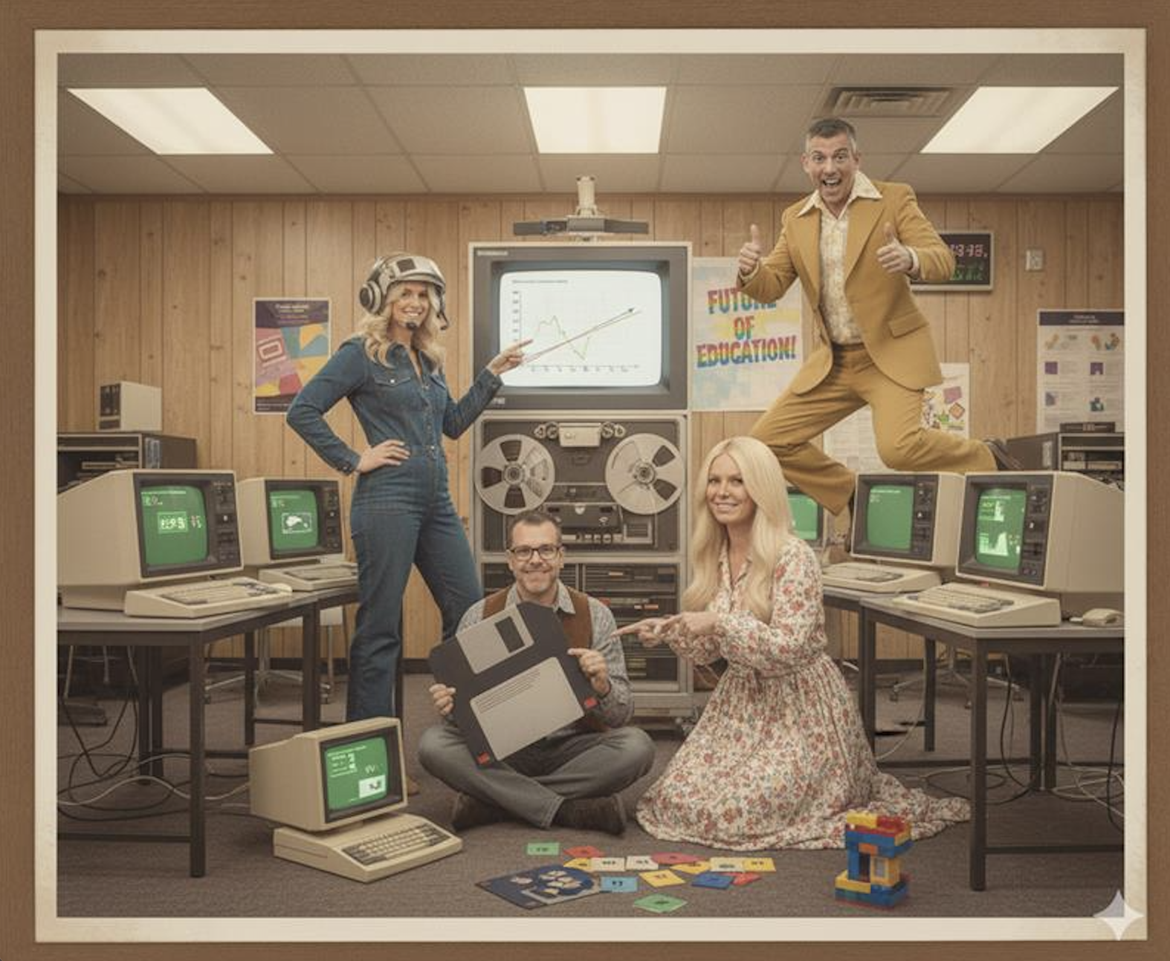
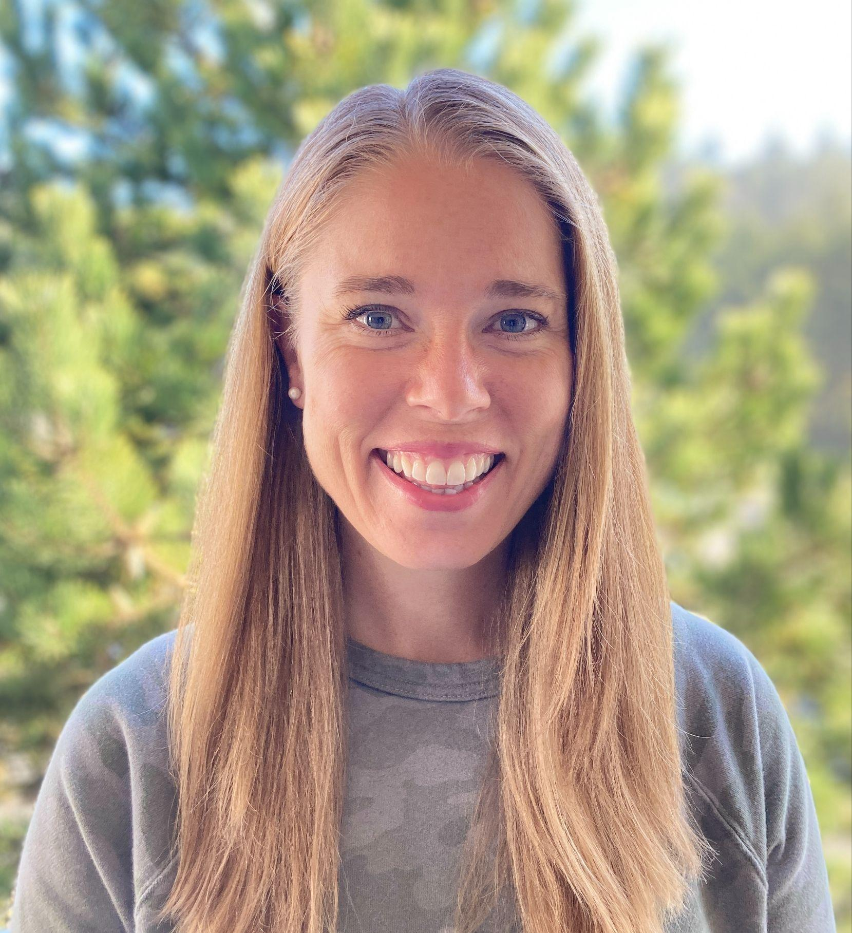

Bend-La Pine School District
Tracy Howk
Educational Technology
Robbie Faith
Instructional Technology Coach
BLS Educational Technology Team: Image created in Google Gemini

Slide 21
What We Do
Bend-La Pine Educational Technology
focuses on using classroom technology to
engage students,
enhance learning, &
increase student morale.
This includes the ethical and responsible use of
Artificial Intelligence in Education.

Slide 22
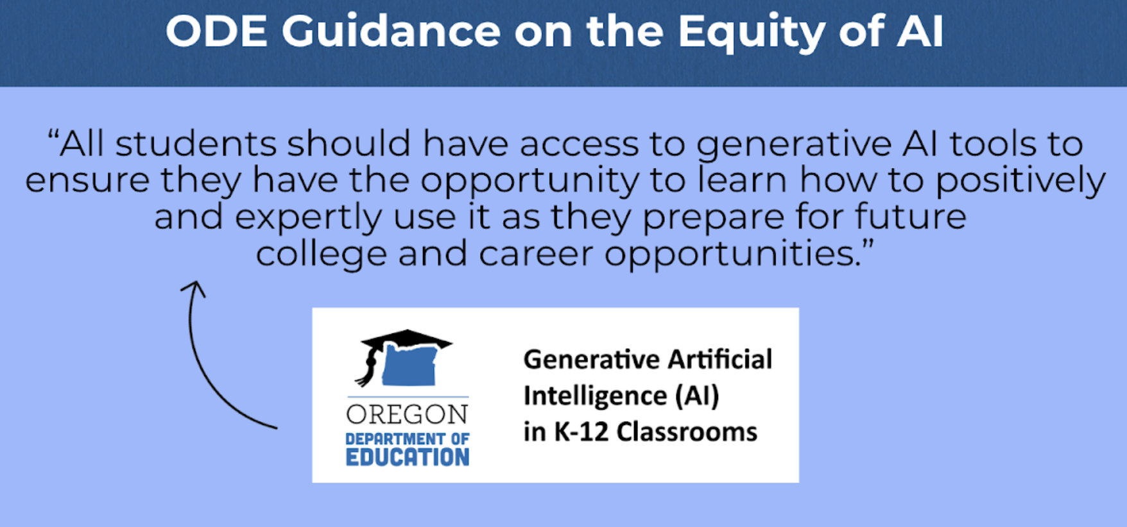
Why Equity of Access Matters:
Students are already using AI outside of school.
The risk is uneven access and no guidance.
Our goal is structured, visible, supported use.

Slide 23

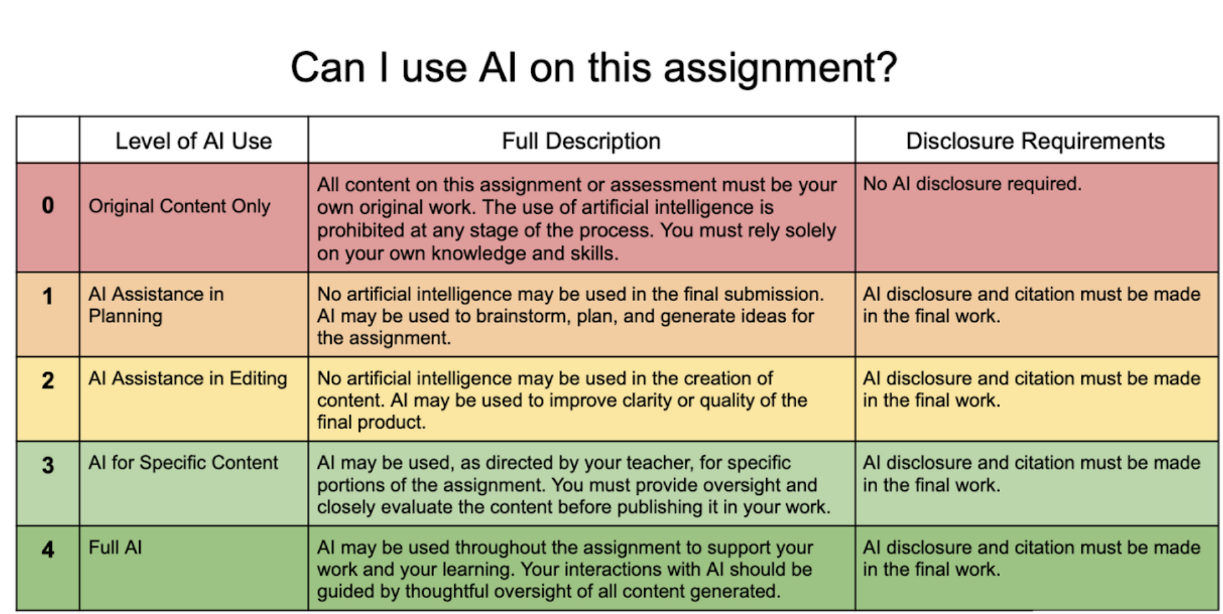
Creating the conditions for student engagement
Create Student Facing Documents:
Syllabus Statement
AI Acceptable Use Scale
Proactive Disclosure
Promote AI literacy:
Advisory slide decks
Wayfinder
Common Sense Education
Assure Teachers of Autonomy:
Policy & Guidance
Trainings
Swag Bags
Highlight Guardrails:
Output history
Flagged content
Customized tools

Slide 24
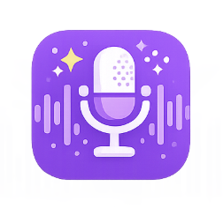

Elementary School
Examples
“After drafting and peer editing, students use MagicSchool’s proofreading tool to get suggestions and decide which changes make sense, often revising more than once. The neutral feedback helps take the pressure off, reducing anxiety and keeping students engaged in their writing.” - 4th Grade Teacher
“I set up a Research Room for a 5th grade study on holidays around the world. I was able to curate a number of sites and adjust reading level as well. It was a breath of fresh air.” - Library Media Manager
“After reading a few articles about their chosen animal, students use MagicSchool to continue their research. They also use a character chatbot to talk directly with their animal, which students find VERY engaging.” - 4th grade TAG Teacher
Let’s hear from elementary students

Slide 25
Middle School
Examples
“The day before the test, students ask Raina questions they have about concepts they need refreshing on. Students enjoy it because Raina meets them where they are with their knowledge.” - 7th Grade Language Arts Teacher
“Simply put, my science colleagues and I are using MagicSchool as a research tool. We chose it because you can view and track student usage and searches on one screen.”- Middle School Science Teacher
“I enjoy being able to watch students in real time in MagicStudent from my computer. I bounce around from student to student reading their outputs. I like the fact that the quality of their dialogue with Raina gets rated as high, moderate, minimal, and distracted.” - 8th Grade Language Arts Teacher
“Looking up definitions of vocabulary terms in a scientific context - as a simple Google search will give generic definitions that may be completely different.” -6th Grade Science Teacher
Let’s hear from middle school students

Slide 26
High School
Examples
“I have found that it's really helpful with assessing the Writing Process standard for ELA. I specifically use the Writing Feedback tool and then make templates for specific assignments that can be reused in other classes or even with other teachers.” - 9th Grade Language Arts Teacher
“Another cool feature is the Character Chat to help students engage with texts. We specifically used it in with our Born a Crime unit in which they had conversations with Nelson Mandela and Trevor Noah.”- 11th Grade Language Arts Teacher
“I have found that students can go 5-10 rounds of feedback and revisions with this tool which I would never have the time to do with them through conferencing.”- High School Teacher, ICCL
Let’s hear from high school students

Slide 27
5 Things We’ve Learned
Letting teachers opt in made all the difference
Highlight guardrails early and often
Support teacher champions
Teach students how to use AI, don’t just allow it
Build resources teachers can use, like customized report card comments & PDF reader
5 Things We’re Still Learning
How to deepen AI literacy beyond tool use
How to keep messaging consistent district-wide
How to meaningfully include student voice
How to support teachers who are still hesitant
How to determined the need for customized tools and build what teachers will actually use

Slide 28
Questions?

Slide 29
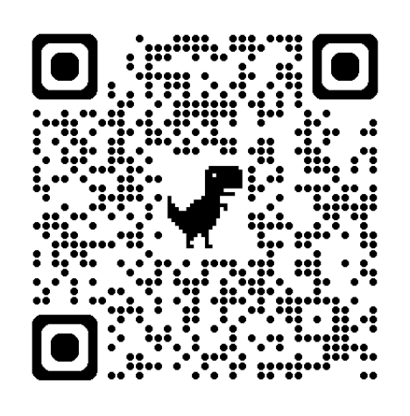
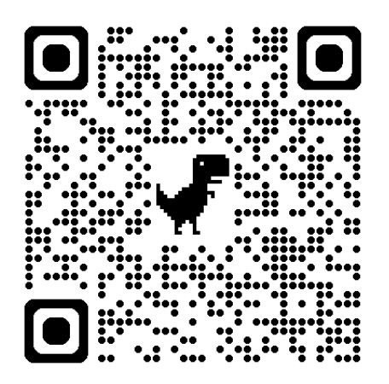

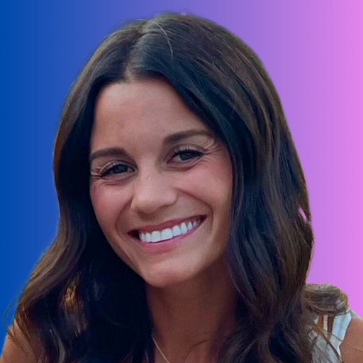
Lets schedule a chat!
Additional Materials
Scan me!
Scan me!
Materials included:
Oregon MagicSchool Brief
The AI Safety Loop for Students | Whitepaper
Safe Student-Facing AI: Mitigating Companionship Risks in Schools | Whitepaper
Natalie Hanni | Oregon Partnerships
natalie@magicschool.ai

