Slide 1
Rehumanizing the Future
Responsible AI Stewardship Through Psychology, Ethics & Presence
Jasmine Ayse Evans
CX Project Manager | Author | MAP Candidate | Creator, CLEAN Model
Notes:
I want to start by telling you something honest. I work in tech. I’ve watched AI change everything around me – the pace, the pressure, the conversations.
And for a long time, I heard the question everywhere I went: how do we keep up?
But then something shifted. I started noticing it wasn’t a technology problem at all. It was a presence problem. People were so focused on what AI could do – they were quietly losing track of who they were.
That’s when I realized – the future doesn’t need less technology. It needs more of us in it. Fully. Consciously. Present.
That’s what Rehumanizing the Future means to me. And that’s what we’re here to explore together today.
I’m Jasmine Evans. I’m an author, a speaker, and I spend a lot of time thinking about what it means to be human in the age of AI. My book, The Clean Mind, came out of eactly this work.

Slide 2
Human Clarity
AI
Rehumanizing the Future
What should AI never replace?
Take a moment, think about it.
Experience
Notes:
(You click. The question appears. You let it sit for a full breath before you say anything.)
"I want to start here. Not with a definition. Not with a policy. With you.
What should AI never replace?
Take a moment. Don't overthink it. What comes up first?”
(Open the floor. Take 3-4 responses. Don't comment heavily — just receive them. Nod. Affirm briefly. Let the room hear itself.)
Facilitation notes for this moment:
If the room is quiet: "There's no wrong answer here. Think about your work, your relationships, your leadership.”
If someone says something unexpected: "Say more about that.”
If answers are similar: "Anyone have something different?”
After 3-4 responses:
"What I'm hearing from this room is — (reflect back a theme from their answers). And I want to show you something.
Because everything you just said? It lives right here.”
(Click. AI circle appears.)
"AI is getting smarter, faster, more capable. That part isn't stopping.”
(Click. Human Clarity circle appears.)
"But none of it means anything without this — our ability to think clearly, lead with values, and know who we are.”
(Click. Experience circle appears.)
"And underneath everything — lived, felt, human experience. The one thing AI can simulate but never actually have.”
(Click. Center label appears — Rehumanizing the Future.)
"Where all three meet — that's not an AI problem. That's a human opportunity.”
(Click. Everything fades except "Rehumanizing the Future.")
(Pause. Let it breathe.)

Slide 3
An interconnected leadership system for moving from reactive to intentional.
INTRODUCING THE CLEAN MODEL
C | L | E | A | N
Clarity | Language | Emotion | Anchoring | Narrative
Separating what is true from what fear is narrating | Words frame reality — they shape how change is experienced | Acknowledge what you feel without being governed by it | Return to what is stable and known within uncertainty | Rewrite the story — from threat to intentional response
C
Clarity
Separating what is true from what fear is narrating
C | L
Clarity | Language
Separating what is true from what fear is narrating | Words frame reality — they shape how change is experienced
C | L | E
Clarity | Language | Emotion
Separating what is true from what fear is narrating | Words frame reality — they shape how change is experienced | Acknowledge what you feel without being governed by it
C | L | E | A
Clarity | Language | Emotion | Anchoring
Separating what is true from what fear is narrating | Words frame reality — they shape how change is experienced | Acknowledge what you feel without being governed by it | Return to what is stable and known within uncertainty
"Organizational change doesn't happen to companies first. It happens inside people first."
Notes:
(You click. The five letters appear — minimal, clean, centered.)
"So now I want to give you something practical to take with you.
Something you can use — in a meeting, in a decision, in a moment where you're not sure if you're leading the technology or the technology is leading you.
This is the CLEAN Model. It came out of my research and my book — and at its core it's a return mechanism. A way back to yourself when things move fast."
(Walk through each letter slowly. Let each one land.)
"C — Clarity. What do I actually know here? What am I assuming? Before you act — get clear.
L — Language. What words am I using? What words is the system using? Language shapes reality. In AI — it literally trains the model.
E — Emotion. What am I feeling right now? Fear? Pressure? Excitement? Emotion isn't noise — it's data. Name it before it names you.
A — Anchoring. What are my values here? What does this decision need to be grounded in? Come back to what matters.
N — Narrative. What story am I telling about this situation? About myself? Is that story true — or is it just familiar?"
(Pause.)
"Now let's use it."
(You introduce the activity.)
"I'm going to give you three scenarios. Real situations leaders face with AI every day. Pick the one that hits closest to home for you — as a leader, a business owner, someone who works with people.
Scenario 1: You use AI to write performance reviews for your employees.
Scenario 2: You use AI to screen job applicants before any human sees their resume.
Scenario 3: You personalize customer experiences using AI — without telling them.
Turn to the person next to you. Pick your scenario. Then run it through CLEAN. You have three minutes."
(Let them work. Walk the room. Listen. Don't interrupt.)
(After 3 minutes:)
"Let's come back together. What came up for you?"
(Take 2-3 responses. Reflect back themes. Connect back to the Venn — where does their scenario live? AI? Human Clarity? Experience?)
Does that feel right before we build the closing?

Slide 4
What makes you irreplaceable?
© 2026 Cisco and/or its affiliates. All rights reserved.
Notes:
So what do we do with this?
One of the most practical tools inside the CLEAN Model is Anchoring.
Anchoring is the ability to return to the present moment before pressure takes over the interaction.
Because most leadership stress isn’t actually happening in the room.
It’s happening in anticipation of the future.
Pause.
Before your next high-pressure conversation…
just pause for a moment.
Notice what’s happening internally.
Take one breath.
And ask yourself:
“Am I responding to what’s actually happening…
or to what I’m afraid might happen?”
Pause.
Lead the room you’re actually in —
not the future you’re afraid of.

Slide 5
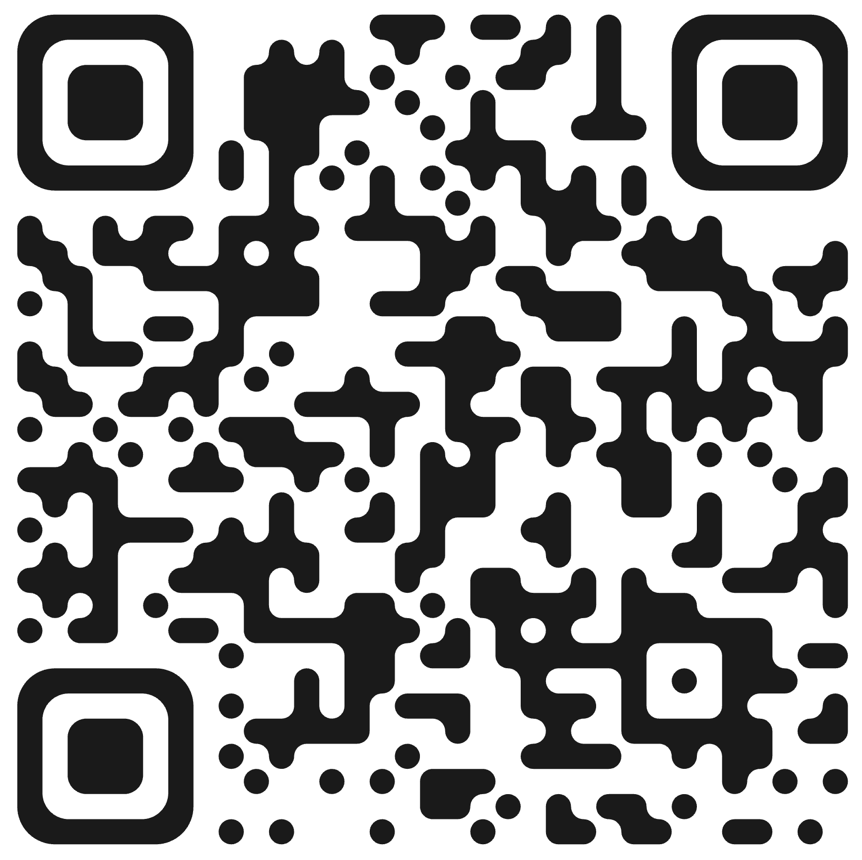
“Presence is the most advanced technology we have.”
Thank you!
Jasmine Ayse Evans
Project Manager | MAP Candidate | Creator, CLEAN Model
Notes:
The conversation around AI often asks:
“How do we keep up?”
I think the better question is:
How do we stay human…
while everything accelerates?
Pause.
Because the leaders who navigate this era most effectively won’t simply be the fastest.
They’ll be the ones who can remain present,
grounded,
and intentional —
while leading others through uncertainty.
Presence is the most advanced technology we have.
Thank you.

