Slide 1

The Executive OS
An advanced software terminal workshop prepared for the National Black MBA Association. Translating elite management theory into deployed intelligence pipelines.

Slide 2
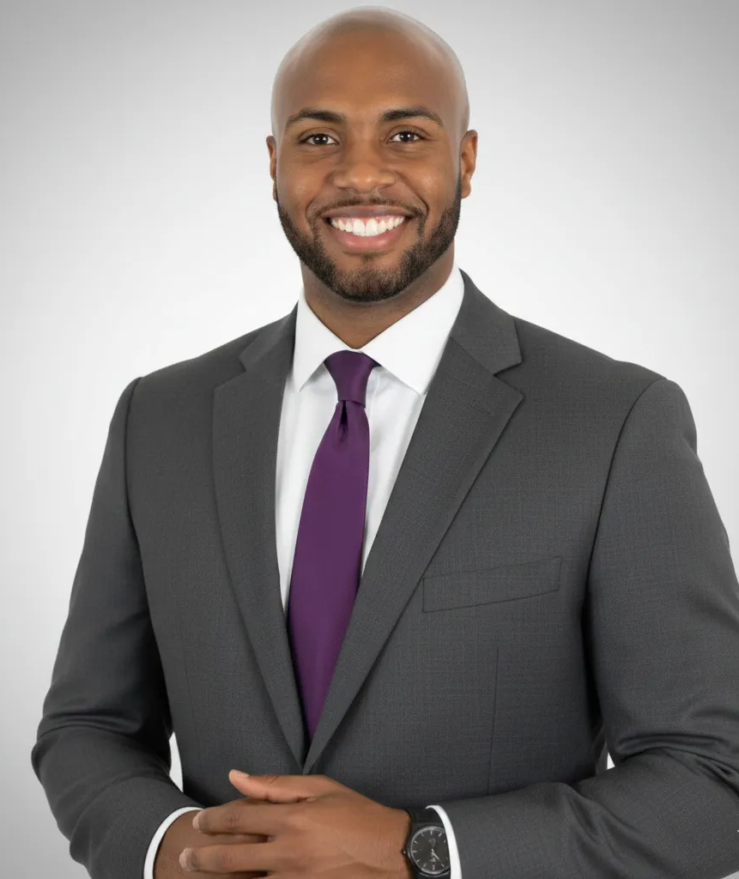
About Leland Baptist
"Leland Baptist is a visionary Systems Architect and Information Strategist dedicated to bridging the 'Complexity Gap' for operator-led, mid-market service firms. As a Global Executive MBA at the University of Notre Dame and a lecturer at the UNCG Bryan School of Business and Economics, he merges institutional-grade business theory with 'in-the-trenches' technical execution.
As the Chief Systems Architect at Ignite Business Software, Leland has deployed proprietary frameworks like the C.L.E.A.R.™ Infrastructure, a methodology used to audit and automate operational pillars for firms generating $600k to $10M+. His work, recognized by Insider Weekly as the Most Innovative AI Company of 2026, focuses on providing mid-market enterprises with the 'Operational Certainty' and 'Revenue Protection' typically reserved for Fortune 500 companies."
Website: https://lelandbaptist.com/
Press: https://lelandbaptist.com/press

Slide 3






Companies I’ve Worked With…

Slide 4
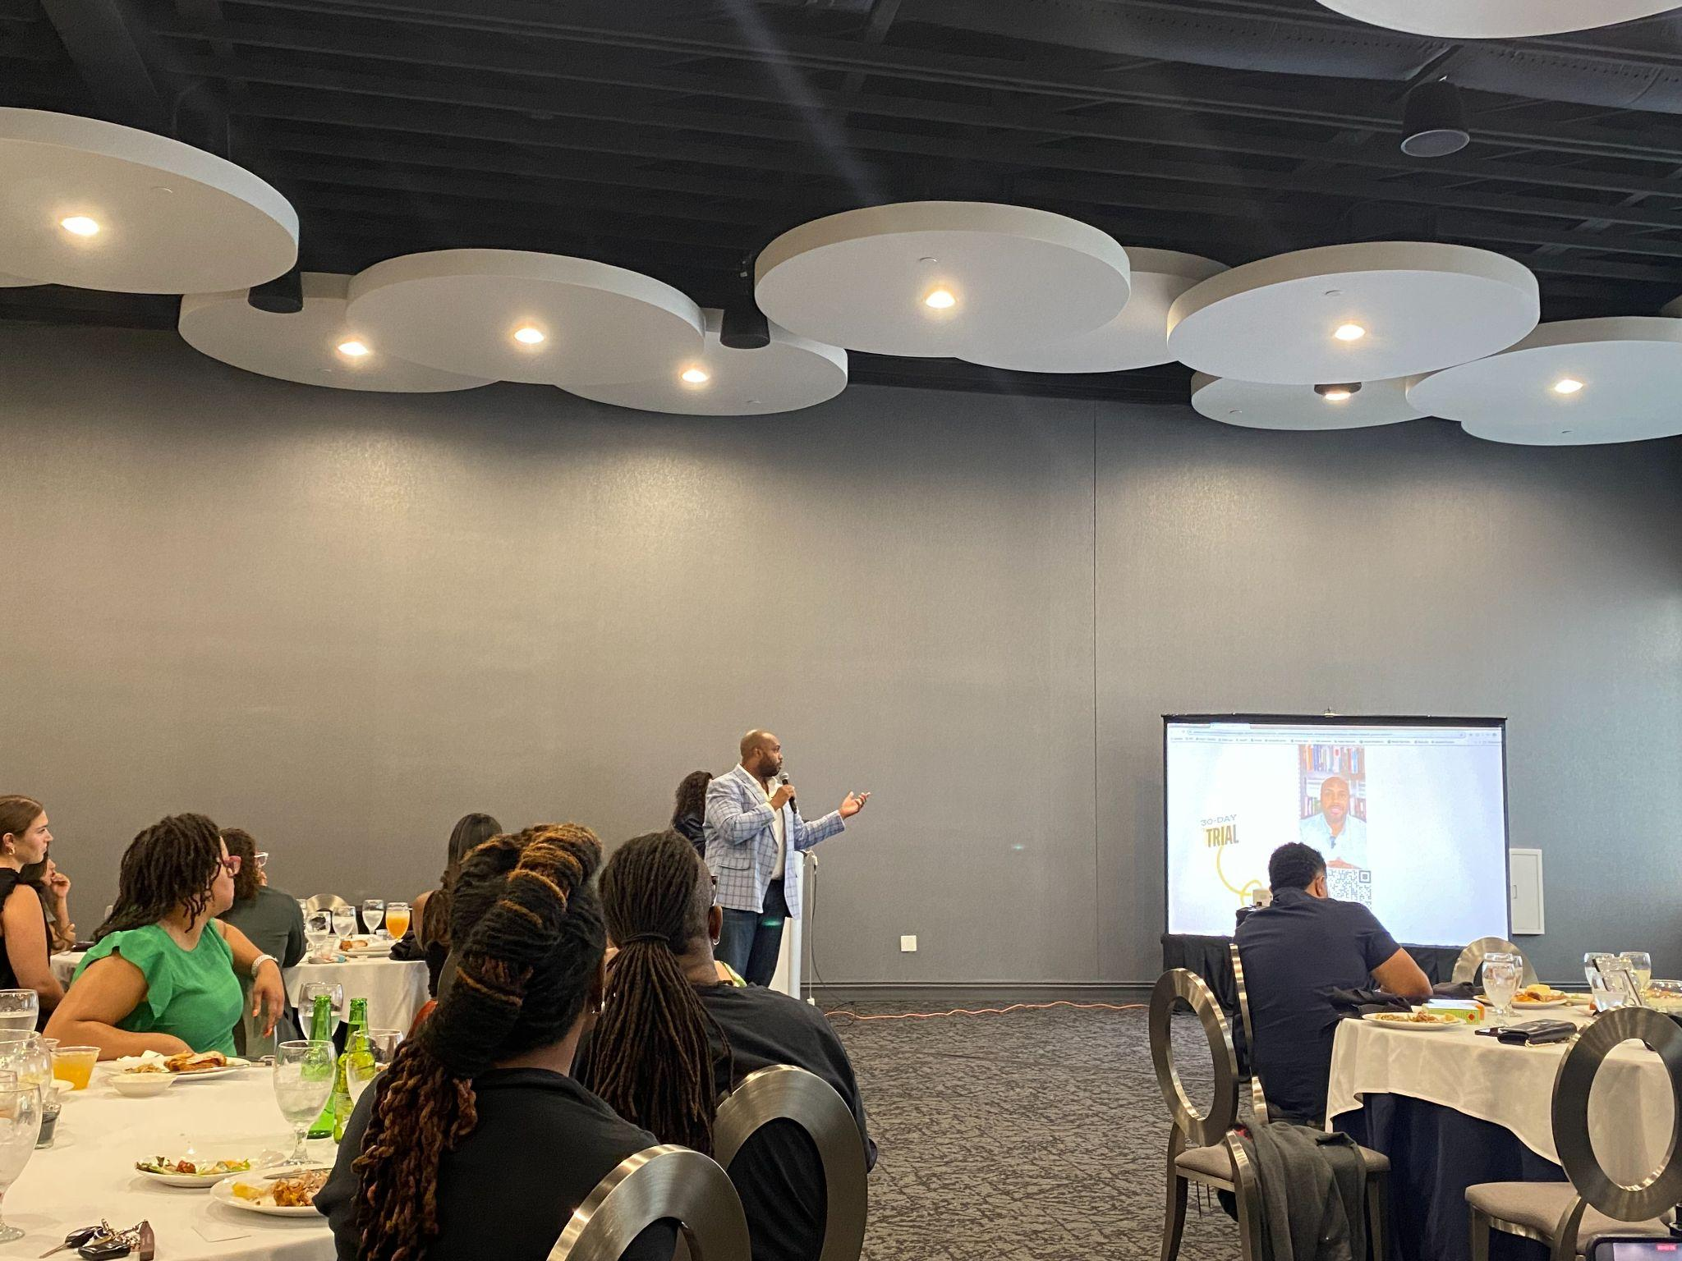
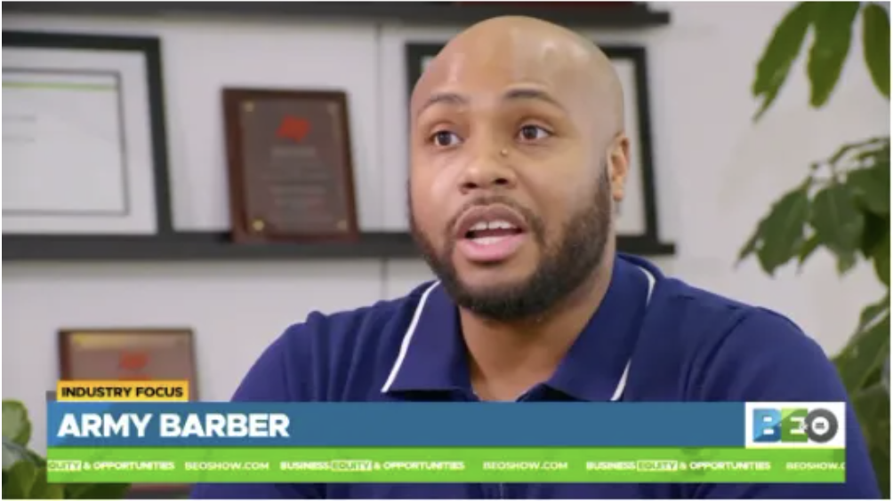
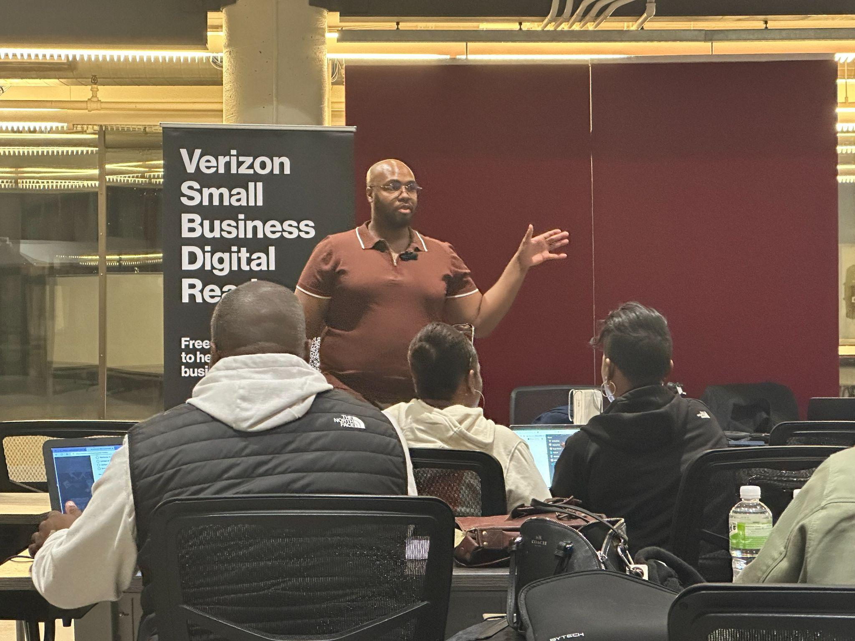
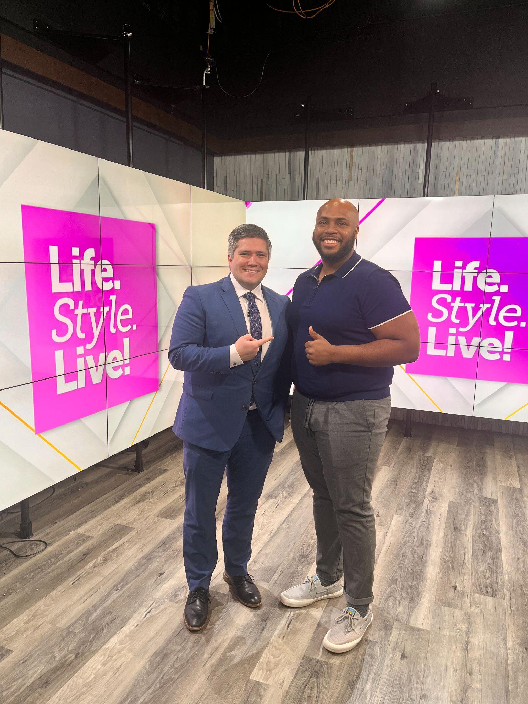
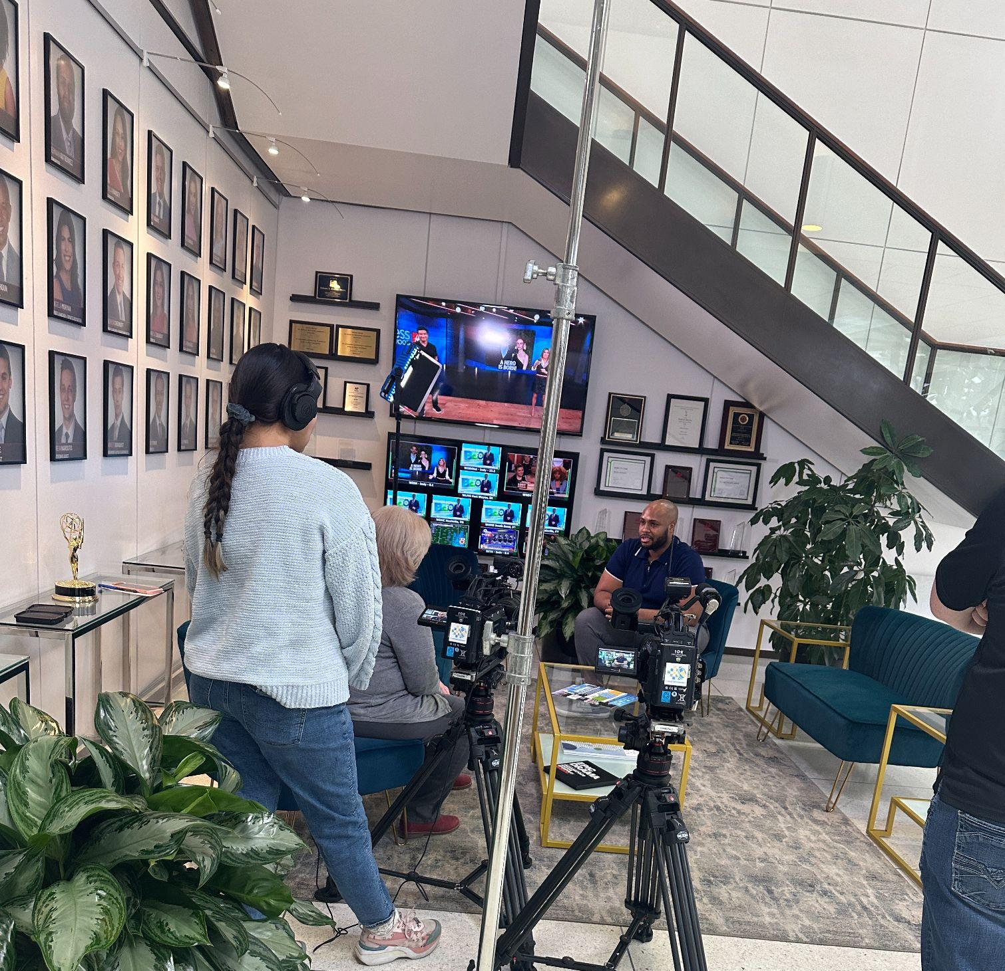
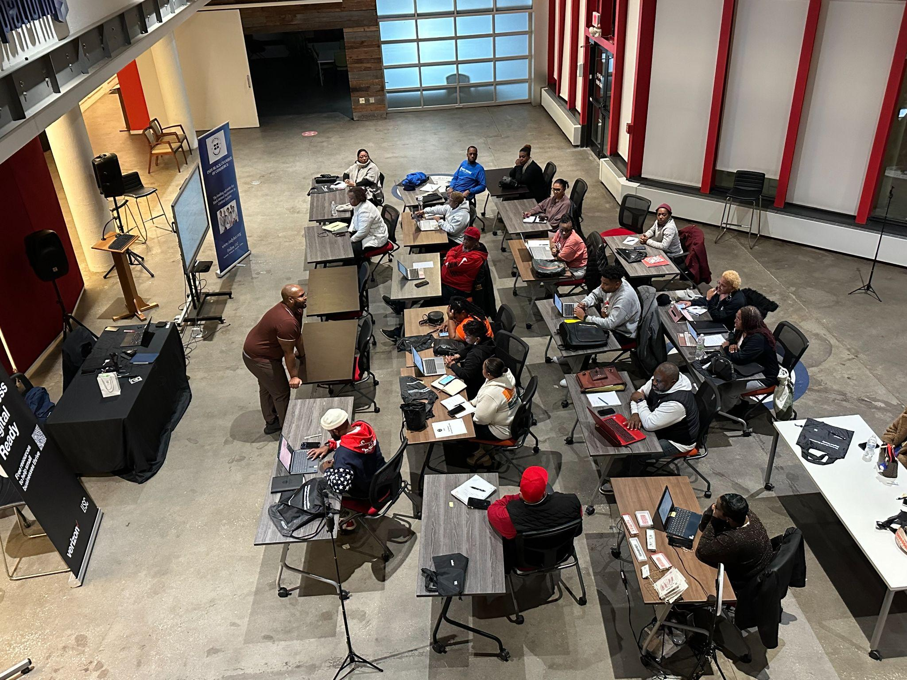
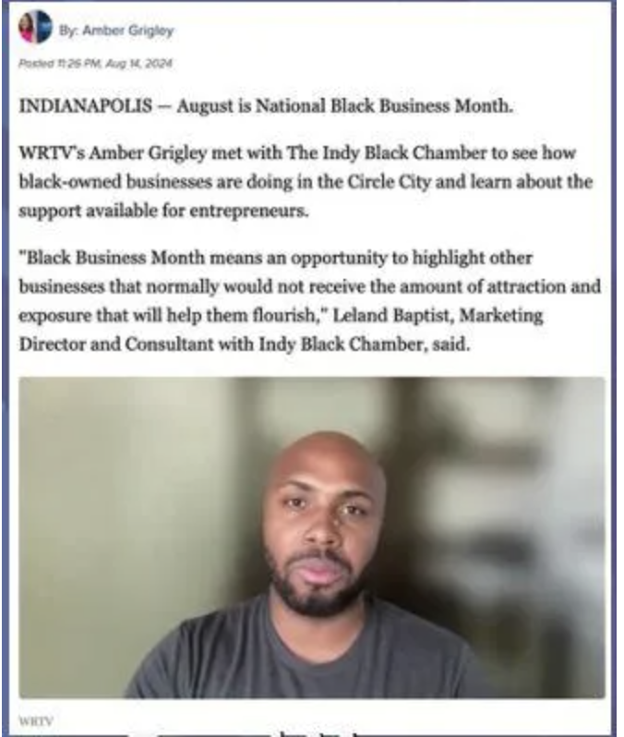

Slide 5
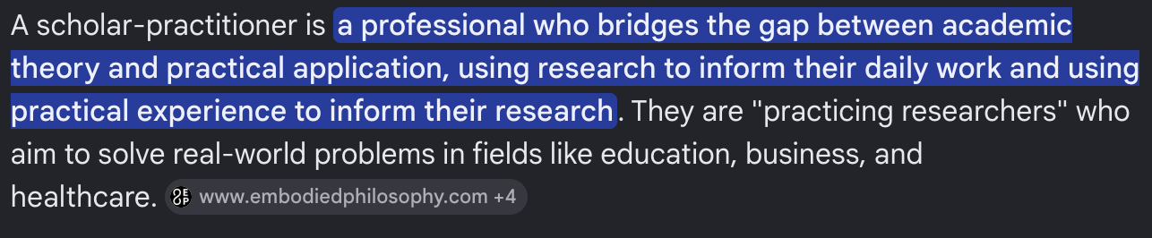
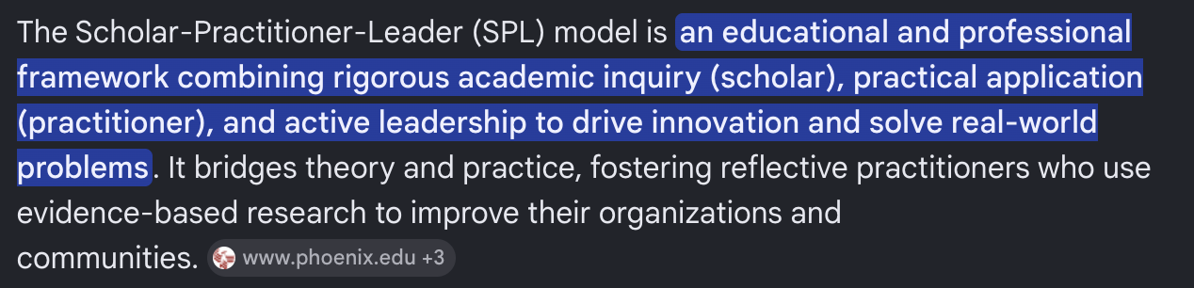
All That Matters...

Slide 6
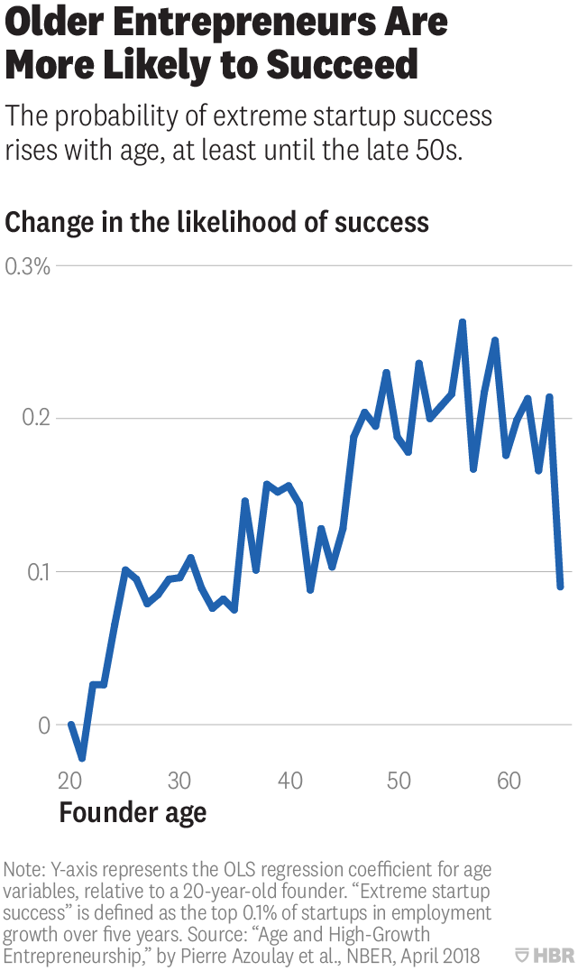
You’re Going To Be Just Fine!

Slide 7
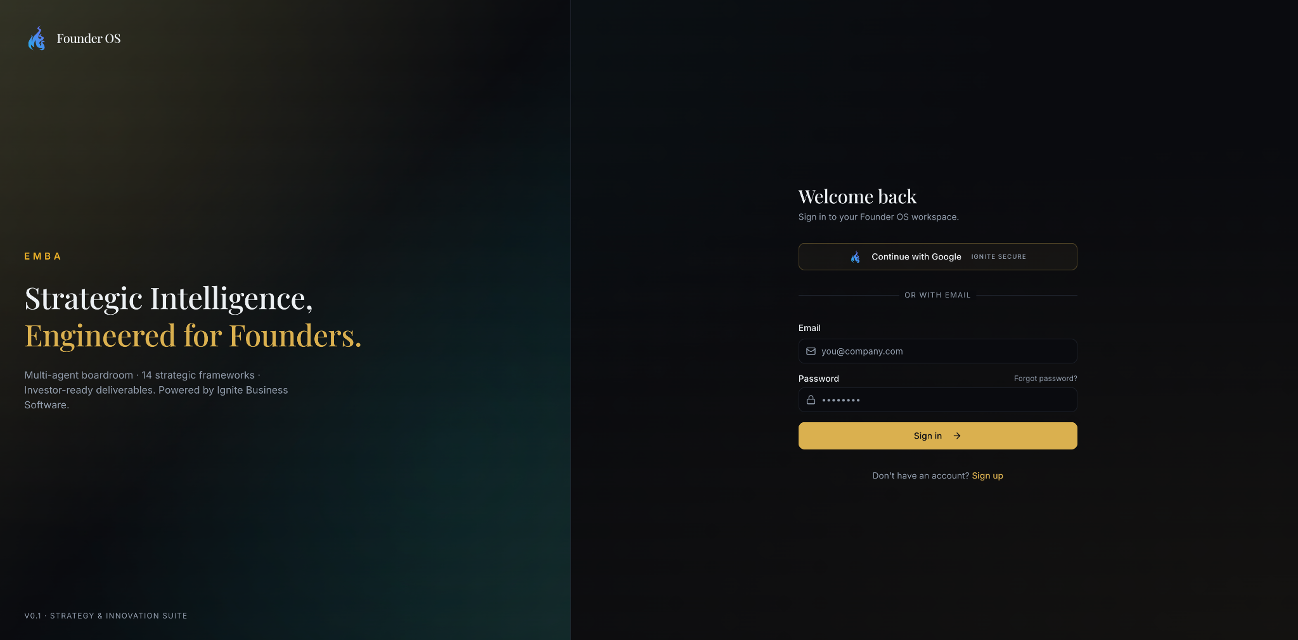
FREE GIFT #1
EMBA Frameworks
https://founder.ignitebusinesssoftware.com/

Slide 8

What We Will Create…
Operating System For Busy Professionals
Modern executives digest over 10,000 data signals daily. True performance requires a structured personal command center, designed to prioritize focus, mental clarity, and tactical execution.

Slide 9
What Is ‘AI’?
What is ‘GPT’?
Modern executives digest over 10,000 data signals daily. True performance requires a structured personal command center, designed to prioritize focus, mental clarity, and tactical execution.

Slide 10
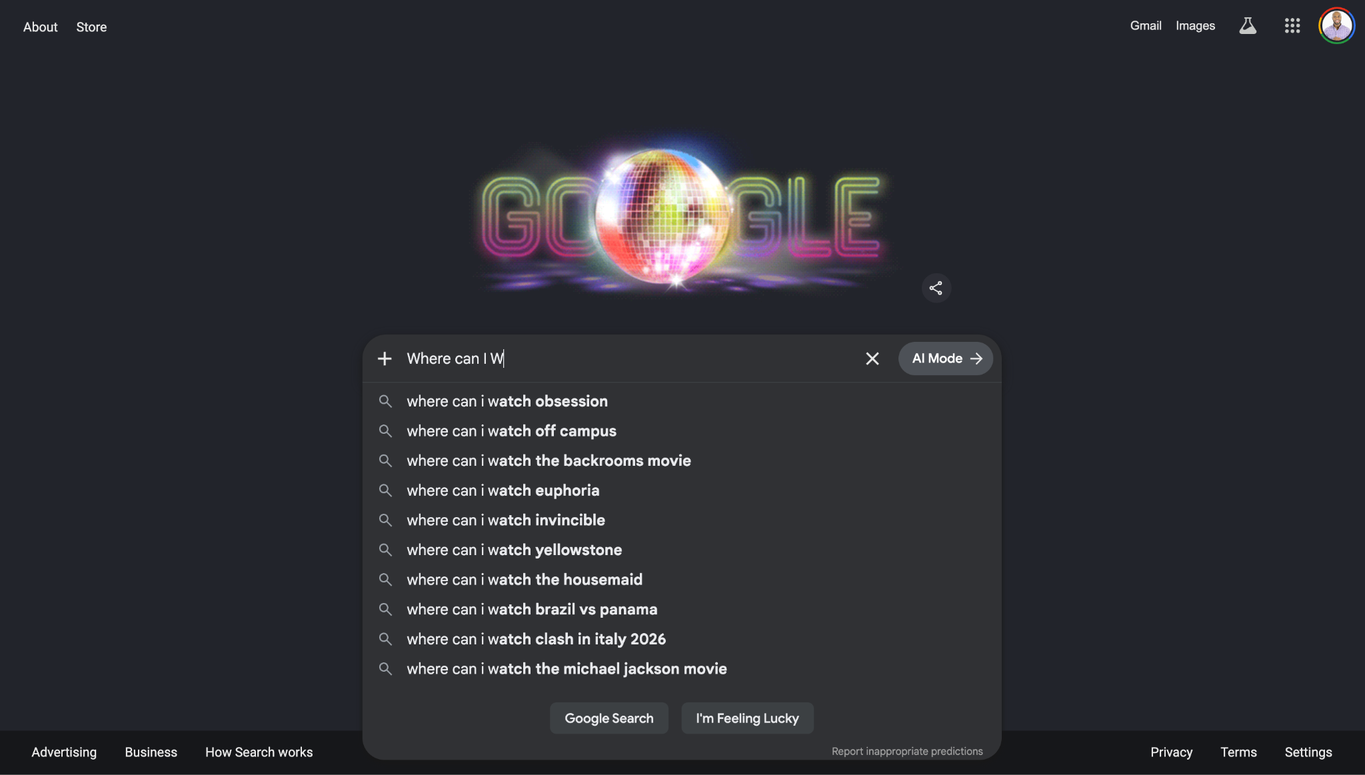
What Is ‘AI’?
Where Have We Seen This?

Slide 11







Core System Grid
Morning Briefing
Inbox Intelligence
Jarvis Protocol
Dynamic AI-curated analysis of top action tasks, calendar roadblocks, and key daily initiatives waiting in queues.
Natural language parsing node grouping high-priority communications into scannable single-sentence alerts.
A persistent motivation portal delivering high-frequency, tactical corporate philosophy quotes instantly upon launch.

Slide 12


What You Will Create
Here’s Your Base System

Slide 13



The Only Tool We Need
Projections Live Calculation
Integrating predictive finance algorithms directly into the executive terminal. Users track target retirement timelines dynamically computed against variables.
Instant changes in monthly corporate deposits dynamically recalculate compound runways, illustrating future equity horizons inside the dashboard environment.

Slide 14

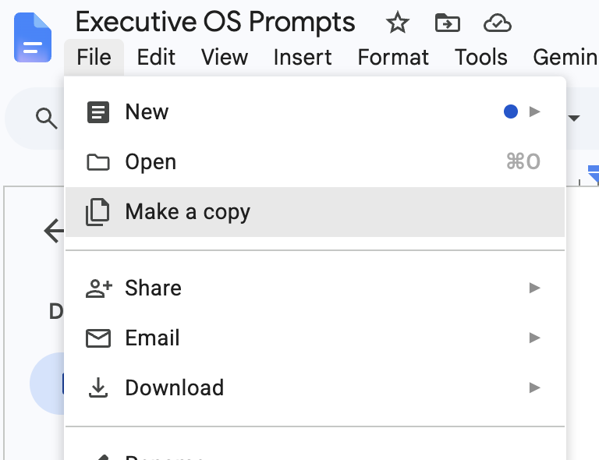


Follow These Instructions
Scan This
MINDFUL REST WINDOW

Slide 15

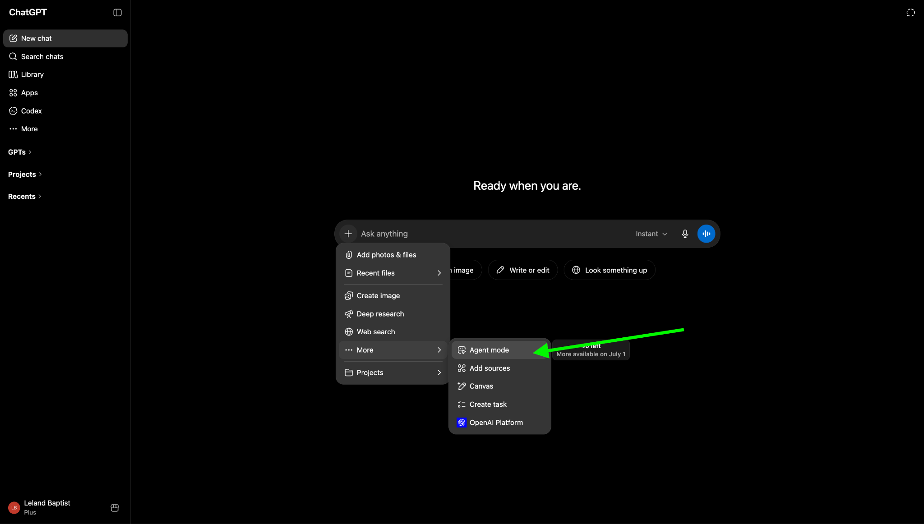
Do It For Me…

Slide 16

No-Code AI Architectures
Moving from high-level wireframes to live engineering databases using Lovable. How natural language prompts completely replace thousands of legacy code blocks in modern engineering teams.

Slide 17
Deploy Your System
Access prompt files and templates. Begin your build in Lovable.
NBMBAA Chapter AI Readiness Summit • Cisco RTP Campus Building 10

Slide 18
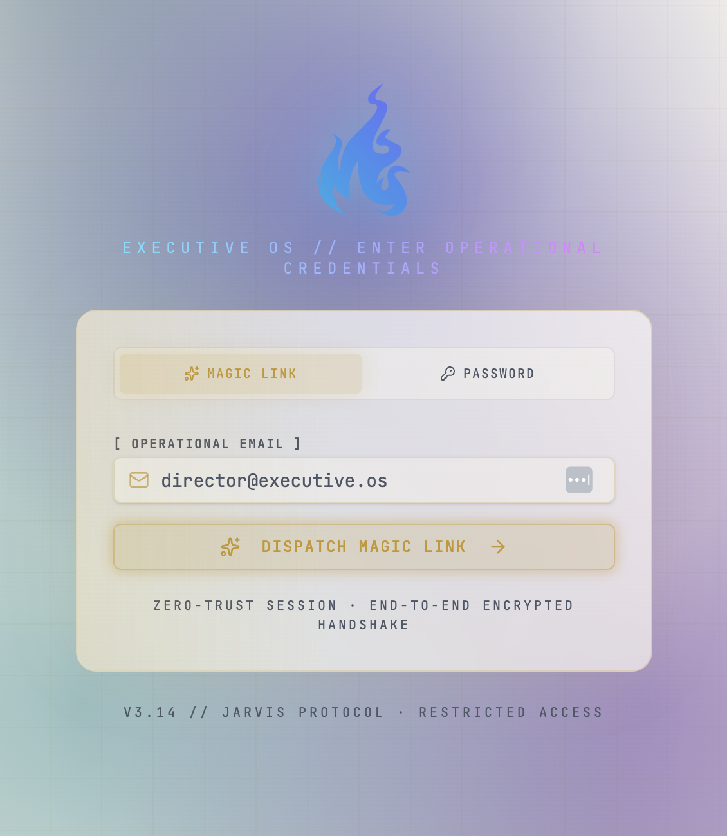
Deploy Your System
Here’s Your Base System

Slide 19
Deploy Your System
Here’s Your Base System

Slide 20

Connect With Leland Baptist
Here’s Your Base System

Slide 21
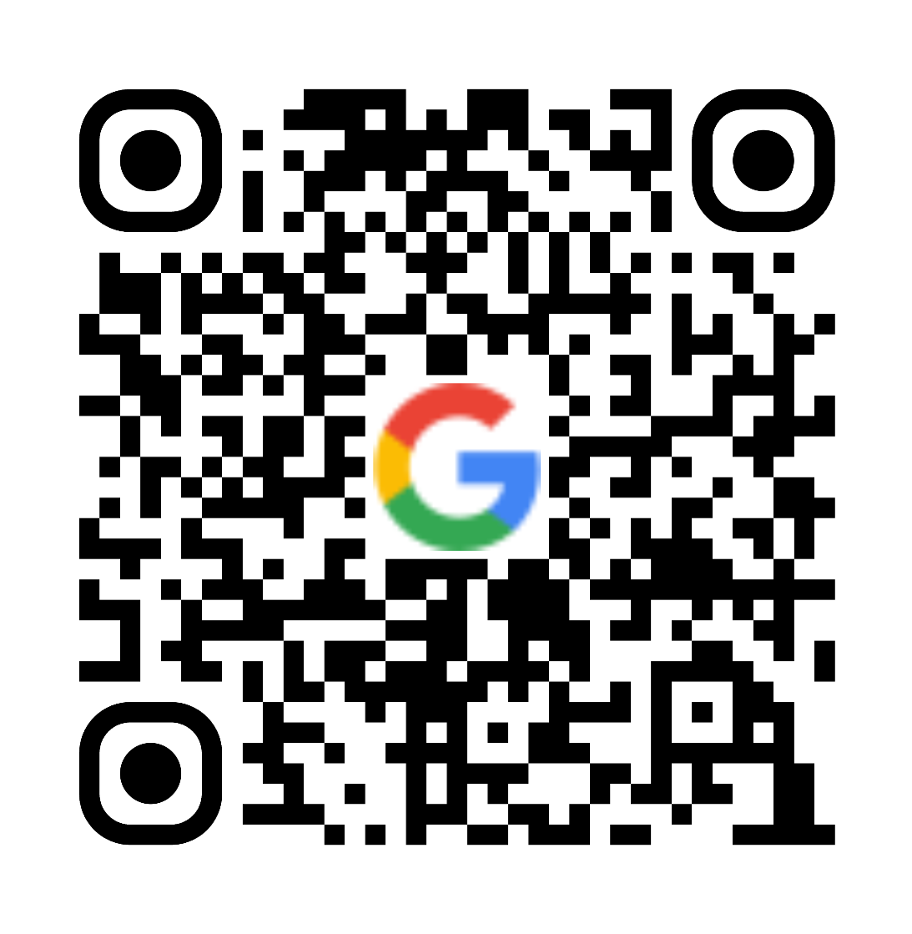
Review & Bonus

