Slide 1
Prompting Like a Pro.
AI Readiness Summit 2026 | Interactive Workshop
April 2026
Notes:
Today, I'm going to show you how a simple shift in the way you communicate with AI can dramatically improve the quality of what it gives back to you. By the end of this session, you'll have a framework (maybe 2) you can use immediately to get better results, save time, and potentially begin creating AI agents that work on your behalf.“
Where are we in the room on the spectrum of usage?

Slide 2
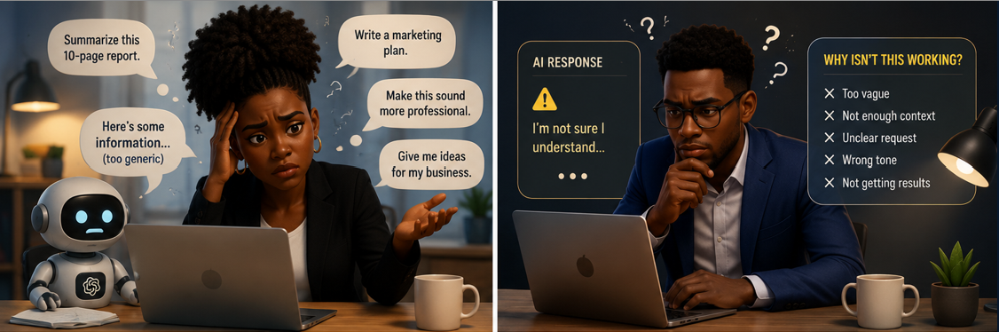
Why AI Isn't Broken... Our Instructions Are.
Notes:
Anyone see themselves in these images?

Slide 3
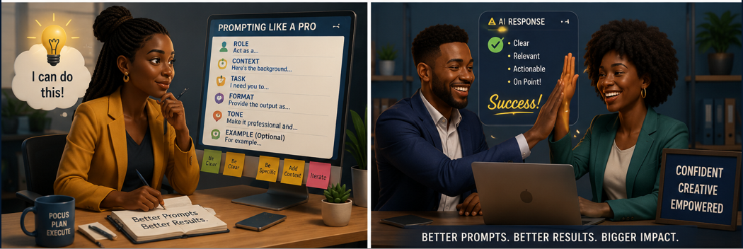
The Difference Is Communication
Notes:
So the question becomes: what exactly should we tell AI to get results that have us high fiving?

Slide 4
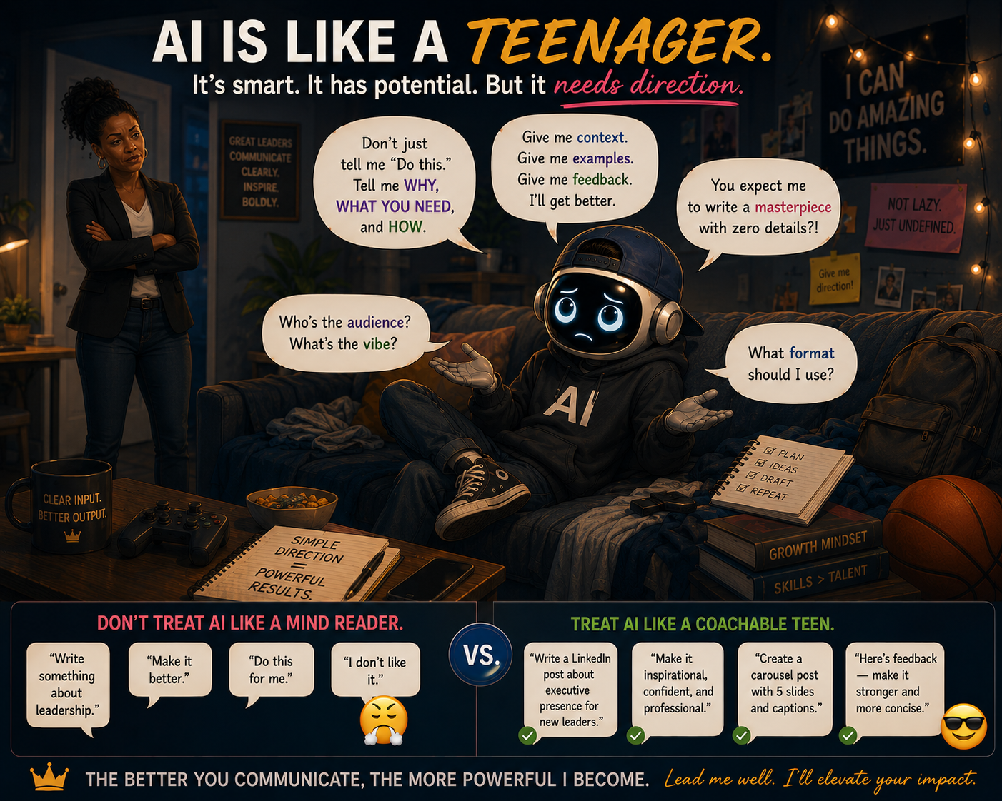
Notes:
"Before we get into frameworks, prompting, and agentic AI, I want you to change the way you think about AI.
I want you to think about AI like a teenager.
Stay with me for a second.
A teenager can be incredibly smart.
A teenager can be creative.
A teenager can have unlimited potential.
But if you walk into a room and say,
'Do something productive.'
You're probably not going to get the result you were hoping for.

Slide 5
Head. Heart. Hands.
Great prompting is strategic communication.
🧠
HEAD
♥
HEART
✋
HANDS
COGNITIVE CLARITY
EMOTIONAL INTELLIGENCE
PRACTICAL EXECUTION
Context
Role
Tone
Emotion
Action
Output
Data
Audience
Empathy
Human Connection
Format
Deliverable
Objective
Constraints
Brand Voice
Energy
Workflow
Execution
“Tell AI what to think about.”
“Tell AI how it should feel.”
“Tell AI what to create or do.”

Slide 6
Anatomy of a Great Prompt
Prompting is leadership through clarity.
PROMPT.LIVE
INSIGHT
Write me a LinkedIn post about AI.
Weak prompts
create generic
results.
Specificity
creates strategy.
HEAD — Context & Role
HEART — Tone & Feel
HANDS — Format & Action
Clarity is the new currency of leadership.
HEAD · HEART · HANDS — three layers, one intentional message

Slide 7
Anatomy of a Great Prompt
Prompting is leadership through clarity.
PROMPT.LIVE
INSIGHT
“Act as a Fortune 100 operations leader creating an inspiring but executive-level LinkedIn post for professionals exploring AI transformation. Use a confident but approachable tone. Keep it concise, engaging, and actionable with a strong closing statement.”
Weak prompts
create generic
results.
Specificity
creates strategy.
HEAD — Context & Role
HEART — Tone & Feel
HANDS — Format & Action
Clarity is the new currency of leadership.
HEAD · HEART · HANDS — three layers, one intentional message

Slide 8
LIVE
WORKSHOP / 03
Let’s Build One Together.
AI responds to intentional communication.
01
02
03
🧠
♥
✋
HEAD
HEART
HANDS
ASK YOURSELF
ASK YOURSELF
ASK YOURSELF
What problem are you solving?
How should this feel?
What do you want AI to create?
Who is the audience?
What tone do you want?
What format should it be?
What context matters?
What emotional response matters?
What action should happen next?
“Prompting is leadership. Clarity creates outcomes.”

Slide 9
The Future Isn’t AI.
The Future Is AI + You.
The professionals who thrive won’t be those who compete wit AI. They’ll be the ones who learn to lead it.
The future belongs to people
who communicate clearly with
both humans and machines.

Slide 10

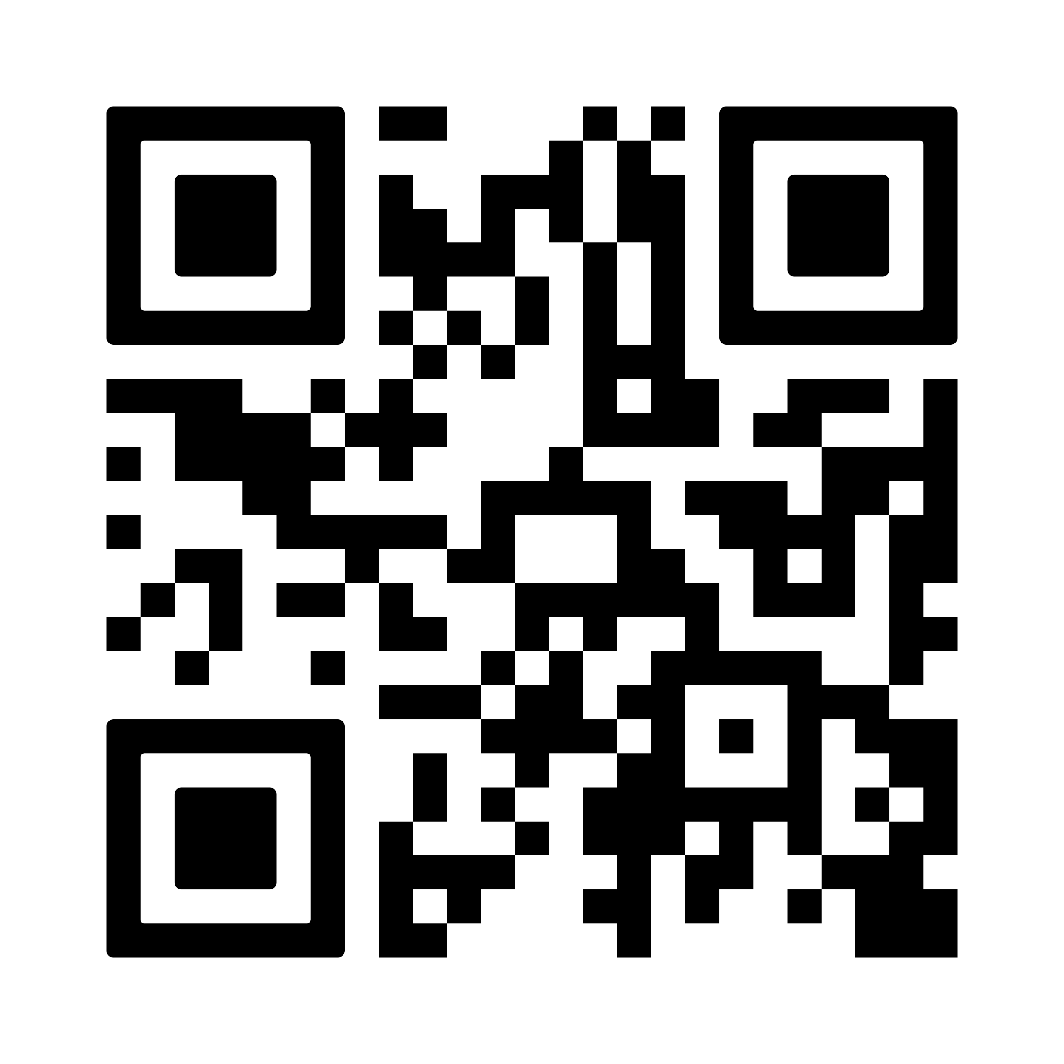

Slide 11
But wait…
… there’s more
What is Agentic AI?

Slide 12
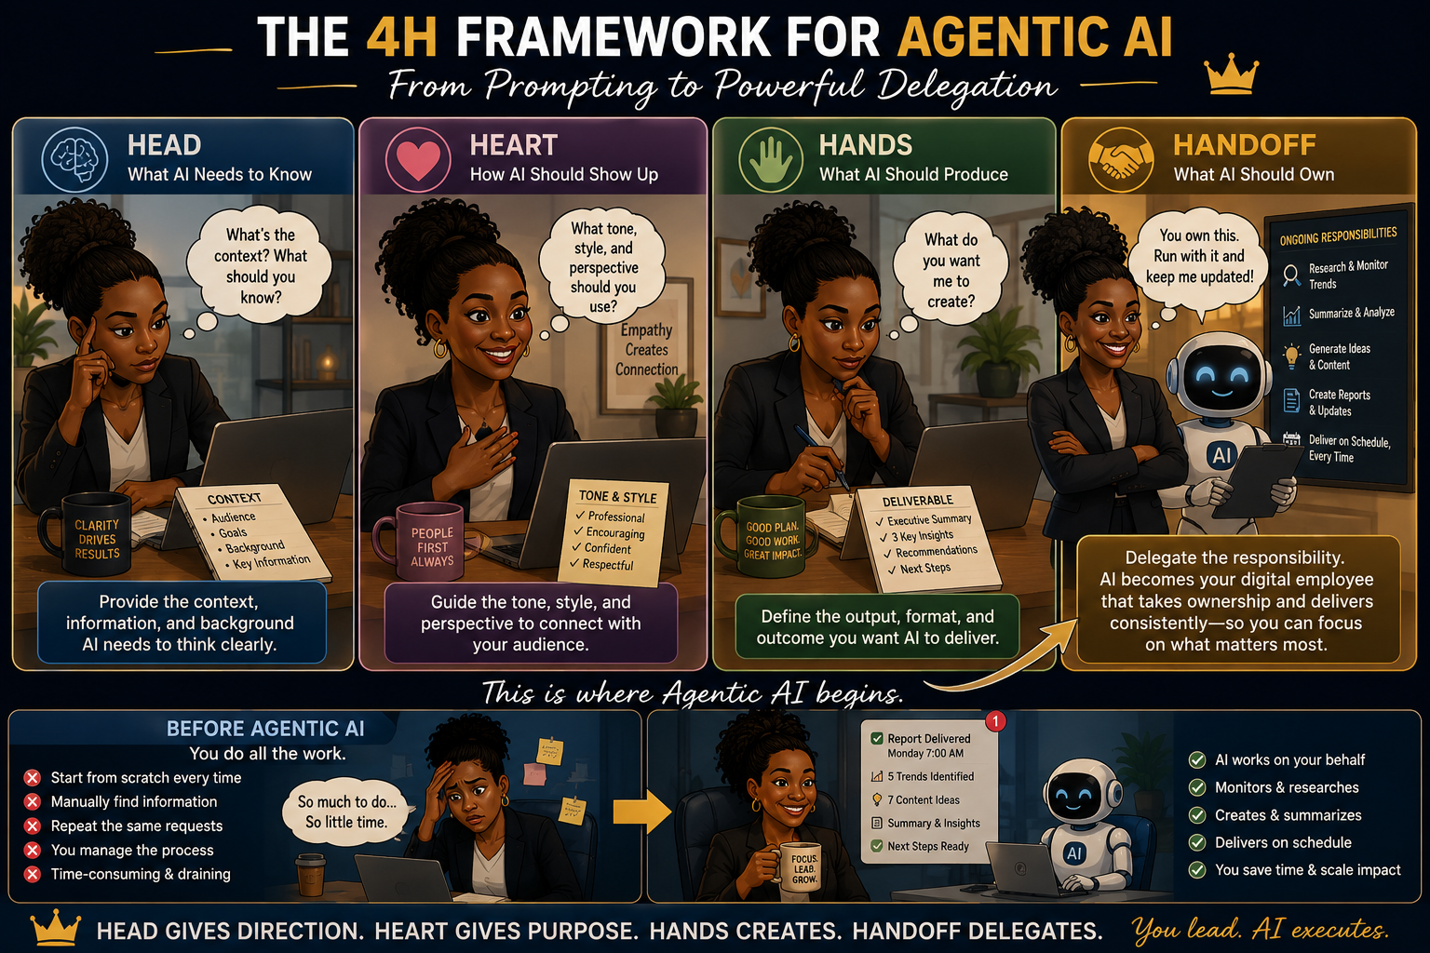

Slide 13
Anatomy of a Great Agent
THE DIFFERENCE
Prompting is leadership through clarity.
Head + Heart + Hands
PROMPT.LIVE
= A Great Prompt
“Act as a Fortune 100 operations leader creating an inspiring but executive-level LinkedIn post for professionals exploring AI transformation. Use a confident but approachable tone. Keep it concise, engaging, and actionable with a strong closing statement.”
DELEGATION CREATES SCALE
Head + Heart + Hands + Handoff
AGENT.LIVE: This is where Agentic AI begins
“Every Sunday evening, research emerging AI leadership trends, identify relevant conversations, generate three content ideas, and draft one complete post ready for Monday publishing..”
= A Great Agent
DELEGATION CREATES SCALE.
The most powerful AI users don’t just ask better questions — they build systems that keep working after the conversation ends.
HEAD — Context & Role
HEART — Tone & Feel
HANDS — Format & Action
HAND OFF — Delegation
HEAD · HEART · HANDS — three layers, one intentional message

Slide 14
LIVE
WORKSHOP / 03
Let’s Build One Together.
AI responds to intentional communication.
🧠
01
♥
02
✋
03
🤝
04
HEAD
HEART
HANDS
HANDOFF
ASK YOURSELF
ASK YOURSELF
ASK YOURSELF
ASK YOURSELF
What problem are you solving?
How should this feel?
What do you want AI to create?
What can AI own?
Who is the audience?
What tone do you want?
What format should it be?
What can be automated?
What context matters?
What emotional response matters?
What action should happen next?
What should happen repeatedly without me?
“Head gives direction. Heart gives purpose. Hands creates. Handoff delegates.”

