Slide 1

HERE’S YOUR
TICKET
COURTNEY JOHNSON 5TH GRADE ELAR

Slide 2


MISCONCEPTIONS
Band...
Too Much Work
Time:
Consuming
Where:
Does it Really Make a Difference?

Slide 3
REALITY
Band:
Solid Feedback
Time:
Minimal
Where:
Data Speaks Volumes

Slide 4
STRATEGY
The process:
Whole Group Teach
Explaining the Steps
Giving The Ticket

Slide 5
WAYS TO CHECK
Take One - Whole Group Discussion
Take Two - Tables Sort
Take Three - Self Accountability

Slide 6
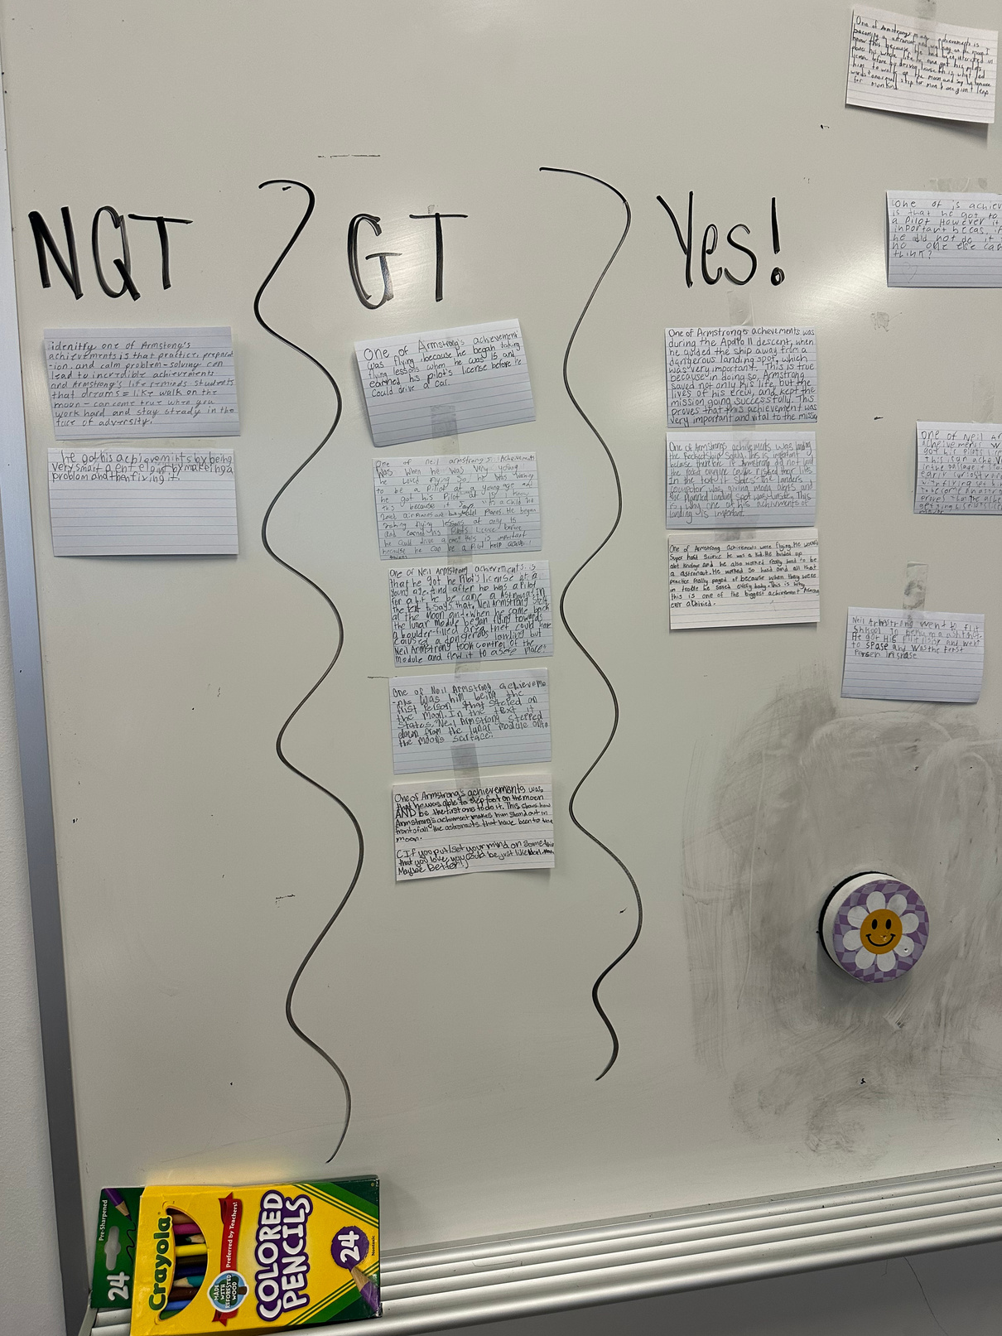
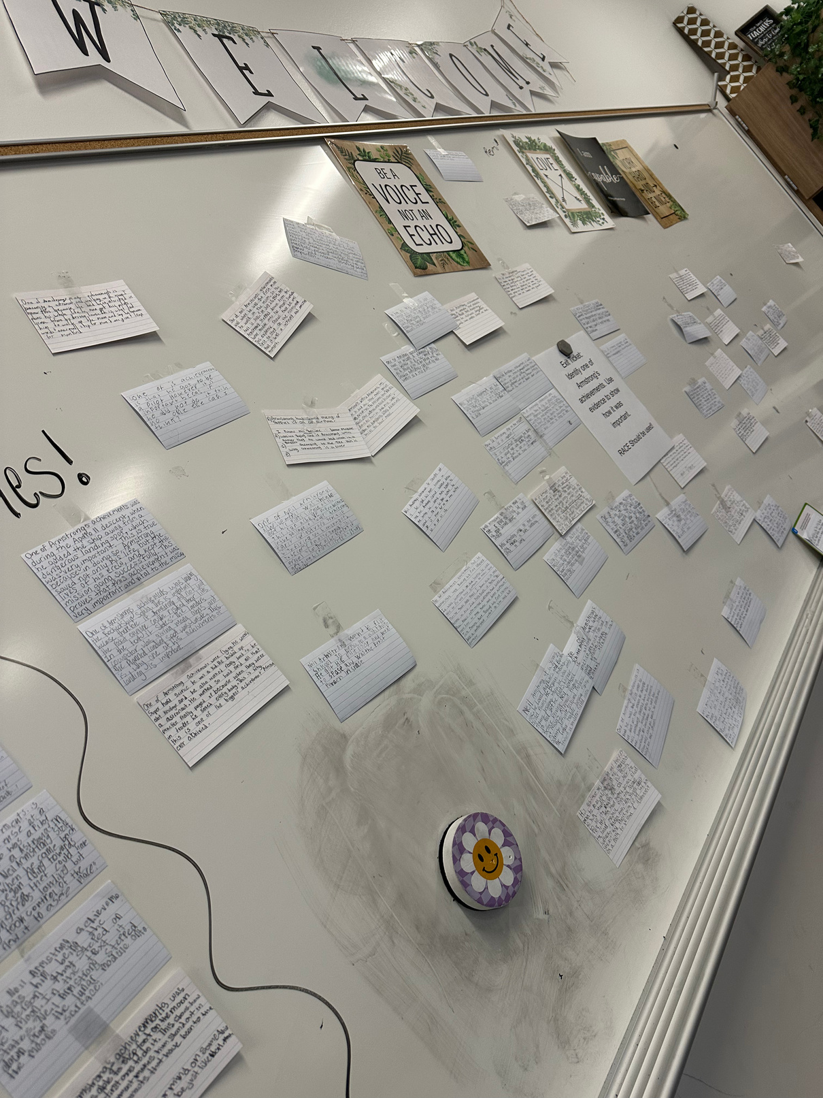
EXAMPLE
Let’s see
how it works!

Slide 7
TRACK THE DATA
Your paragraph text
Stations Example:
https://canva.link/p1juh97md7dhrzo

Slide 8
WAYS TO INCORPORATE
Student Led Discussions
Independent Reviews
Teacher Evaluations

Slide 9
HOW TO INCORPORATE INTO DIFFERENT CONTENTS
Math: Finding the Errors
Writing Out the Process
Science:
Explaining the process
Really, it can work for ANY content area!
TIP: I always use the assessments to create the exit tickets. This helps prepare them for what they will see. I will often take a multiple choice question and have them write it out.

Slide 10

LET’S PRACTICE!
Find people in your content and create a question based on what you are currently teaching.
Create an example of a Not Quite There, Getting There, and a Yes!
Discuss with your group ways you could potentially implement this in your subject area. Feel free to take this time to make additional examples.

Slide 11
Thank
you!

