Slide 1



BACK-TO-SCHOOL: BLUEBONNET MATH APPLICATION COMPONENT
Supporting Elementary Teachers for Effective Math Practice
Anam MacBale

Slide 2


WHAT IS THE APPLICATION COMPONENT?
The Application Component is a daily 5-10 minute opportunity for students to apply their math learning.
Purpose: deepen understanding through consistent problem-solving in a structured, supportive format.
*This is NOT a time for new content*

Slide 3
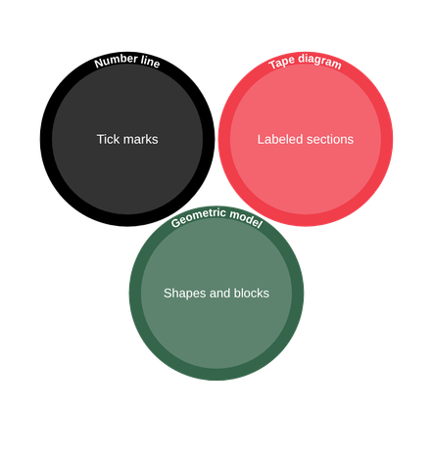


BUILDING UNDERSTANDING THROUGH TOOLS AND MODELS
Tools: Number lines, tape diagrams, and drawings
Why do we use tools/models?
  Flexible thinking
  recognizing patterns and relationships
*Tools and models support deeper conceptual understanding and builds strong problem-solving skills*

Slide 4



THE RDW PROCESS
Read: Understand the problem carefully.
Draw: Create a model or diagram representing the problem.
Write: Formulate an equation or statement explaining the reasoning.
*This routine helps students organize thinking and communicate clearly.*

Slide 5


WHAT APPLICATION SUPPORTS
• Connects math concepts to real-world situations
• Encourages explaining and justifying thinking
• Builds independence and confidence in problem solving
• Practices perseverance with challenging problems
*Remember: Focus on strengthening understanding, not introducing new content.*

Slide 6


PLANNING CONSIDERATIONS FOR TEACHERS
• Present problems in varied ways based on student ability
• Scaffold or model problem-solving with think-alouds
• Use guided whole group, partner work, or independent practice
• Adjust timing (usually 5-10 minutes) for student needs
• Incorporate turn and talk to boost engagement
• Prepare strategic questions to encourage deeper thinking and multiple strategies

Slide 7


MAKING THE APPLICATION WORK IN YOUR CLASSROOM
  Internalize the purpose to keep Application student-centered and meaningful
  Focus daily on building problem-solving skills, not speed
  Share and discuss strategies with colleagues
*REFLECT ON WHAT WORKS AND ADJUST ACCORDINGLY*

Slide 8


PLANNING TIME: PREPARING FOR THE FIRST TWO WEEKS
• Dedicate time to planning Application activities for upcoming lessons
• Select and adapt problems that align with your curriculum and student needs
• Consider scaffolding approaches for diverse learners and skill levels
• Encourage teacher collaboration: share ideas, strategies, and resources with colleagues
• Prepare questions that promote deeper thinking and multiple problem-solving strategies

Slide 9
OVERVIEW
Strong internalization ensures that Application time remains purposeful, student-centered, and focused on building problem-solving skills!

Slide 10
Thank you!
Thank you for your commitment to building strong problem solvers!
Anam MacBale
4th Math Harlow Elem.entary
anam..macbale@annaisd.org

