Slide 1







Development and Implementation
of a Research Journal
in a First Year Seminar Course
  Anne Beschnett, Lizzy Tegeler & Preeti Gupton
  St. Catherine University

Slide 2


  Who We Are
St. Catherine University
PowerPoint
Library
College for Women: 1471 students
  BIPOC: 52%
  First Generation: 42%
College for Adults (Bachelor’s and Associate): 1131 students
Graduate College: 1097 students
5 Reference & Instruction Librarians
3 Technical Services Librarians
1 Archivist
1 Director
Notes:
Anne

Slide 3


  The Reflective Woman (TRW)
First term shared experience course
  21 College for Women sections (in-person only) in Fall 2024
  8 College for Adults/Associates sections (online only) in Fall 2024
Part of Core curriculum
Writing Intensive course
Taught for the past 30+ years
  Library involvement since the beginning
Many different iterations with different Core directors, different curricula, students goals, etc.
Library involvement ranging from nothing to single info lit sessions to embedded librarianship scaffolded throughout course
Hello
  there!
Notes:
Anne

Slide 4

  Why a Research Journal?
TRW was being redesigned and new opportunities to collaborate!
More consistent teaching experience across 5 different R & I librarians in order to create a more consistent TRW experience
Break the research process into stages
  Research journal works students through the process and helps them not jump ahead and get overwhelmed
Updated Information Literacy Student Learning Outcomes in 2023
  based on the ACRL Standards and St. Kate’s University Goals
TRW course infotmation literacy learning outcome
  Utilize sources that are credible, authoritative and appropriate to the real world question(s) and/or topic(s) under consideration
Notes:
Preeti

Slide 5


  What is the Research Journal?
A very fancy Google doc that scaffolds the research process throughout the semester
  Background Information Gathering & Concept Mapping
  Brainstorming a Research Topic
  Types of Sources
  Search Strategies
  Critical Reading & Evaluating for Relevance
  Citing Your Sources
  Reflecting on the Research Process
Carries one example (book bans) throughout the journal, and invites the student to practice with their own topic that is connected to their final project
Integrates videos, learning modules, and activities along with text
Notes:
Lizzy

Slide 6



  Implementing the Journal
First used in courses in Fall 2024
Timing of TRW’s redesign worked in our favor, since built-out assignment ideas were welcome
Modules in Canvas Commons allow instructors to connect the journal to their gradebook
Google Doc’s “force copy” (/copy) allows students to have their own version
  Then they share with their instructor and librarian
  Librarians provide feedback for select entries
Notes:
Lizzy

Slide 7
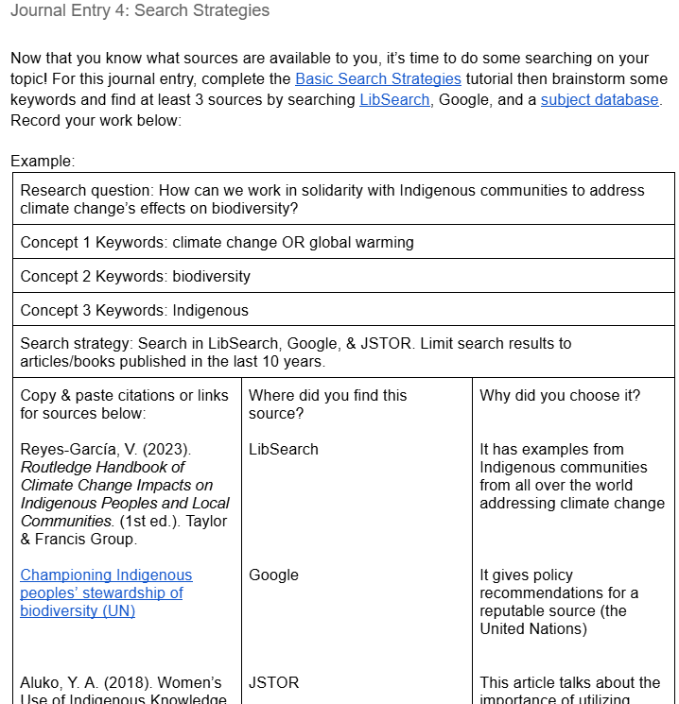
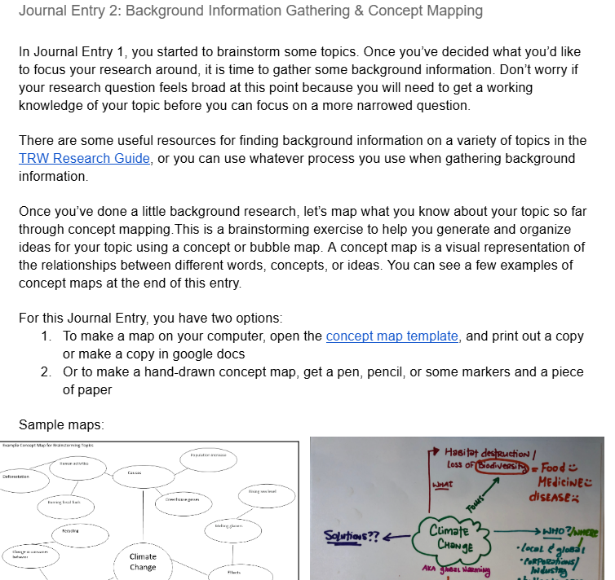



  2024 Research Journal–the OG
Notes:
Lizzy

Slide 8






  Reactions & Assesment
Anecdotally - positive reaction from faculty
Distributed Faculty Survey after Fall 2025 semester
  Part of standard TRW survey, but with added questions specific to the journal
    Was the Research Journal a graded activity?
    Please indicate your level of agreement with the following statements regarding the Research Journal assignment…
    Please rate the effectiveness of each Research Journal entry…
    Reflecting on the Research Journal as a whole, what worked well? What could be improved?
Notes:
Anne

Slide 9

  Assessment
Please rate the effectiveness of each Research Journal entry:
 | Needs Improvement | Fair | Good | Excellent
1: Brainstorming a Research Question | 1 | 0 | 2 | 6
2: Background Information Gathering & Concept Mapping | 1 | 1 | 4 | 3
3: Types of Sources | 1 | 0 | 3 | 5
4: Search Strategies | 0 | 1 | 1 | 7
5: Evaluating for Authority/Quality | 0 | 1 | 2 | 6
6: Critical Reading and Evaluating for Relevance | 1 | 1 | 2 | 5
7: Citing | 0 | 0 | 2 | 7
8: Entry 8: Reflecting on Research/Taking Stock of What You Have | 0 | 1 | 5 | 2
Notes:
Anne

Slide 10
  Assessment
Please indicate your level of agreement with the following statements regarding the Research Journal assignment:
 | Disagree | Agree | Strongly Agree
The Research Journal was presented in a clear and organized manner | 1 | 4 | 4
The content of the Research Journal supported my course | 0 | 6 | 3
Students reacted positively to the Research Journal and incorporated skills into their assignments | 1 | 7 | 1
I would recommend using the Research Journal to other TRW faculty | 0 | 5 | 4
Notes:
Anne

Slide 11
  Assessment
Successes
  Engagement
  Sequencing
  Project-based learning approach
Challenges
  Seen as “busywork”
  Disconnect between research journal and class assignment
  Online vs. in-person delivery
Opportunities
  Reorganization
  Content timing
  Formatting
Notes:
Anne

Slide 12

  Changes for Spring 2025
Fewer TRW sections offered
  2 in-person; 2 online
Small changes in number/order of journal entries
Fall 2024
1: Brainstorming a Research Question
2: Background Information/Concept Mapping
3: Types of Sources
4: Search Strategies
5: Evaluating for Authority/Quality
6: Critical Reading and Evaluating for Relevance
7: Citing
8: Reflecting on Research
Spring 2025
1: Exploratory Research
2: Background Information/Concept Mapping
3: Brainstorming a Research Question
4: Types of Sources
5: Search Strategies
6: Evaluating for Authority/Quality
7: Critical Reading & Evaluating for Relevance
8: Citing
9: Reflecting on the Research Process
Notes:
Anne

Slide 13

  Changes for Fall 2025
TRW major course redesign, Research Journal had to change in response
  Removed the research assignment, new writing assignment not conducive to the research process
Also wanted to incorporate faculty feedback
Research Journal Changes:
  Shortened journal overall
  Moved around some entries for a better flow
  Updated the example
  Made a truncated version for 7 week courses
Notes:
Preeti

Slide 14
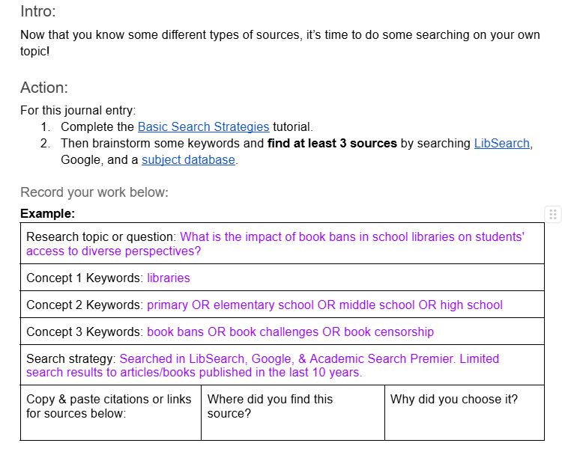
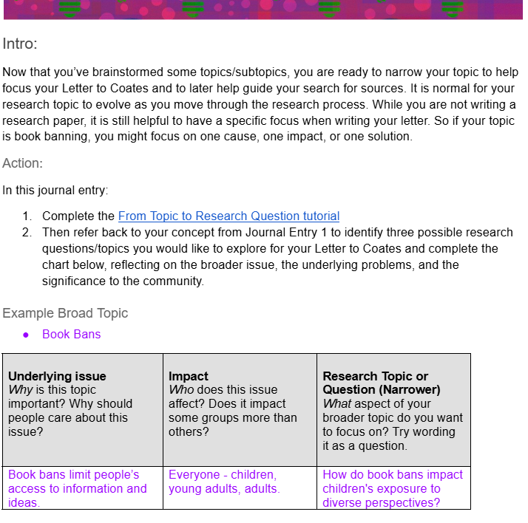
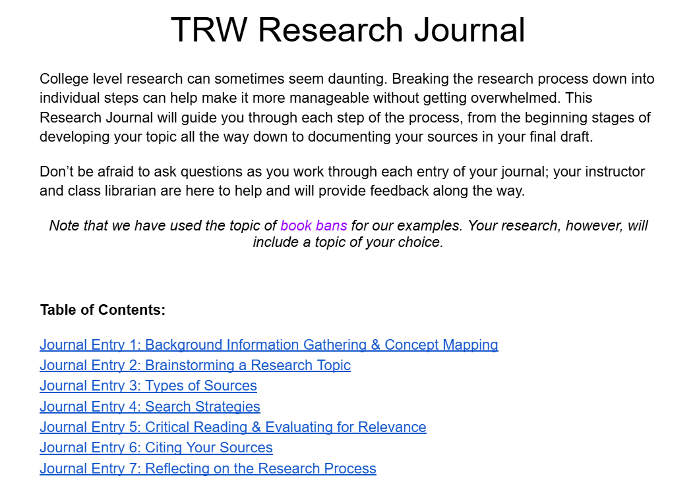
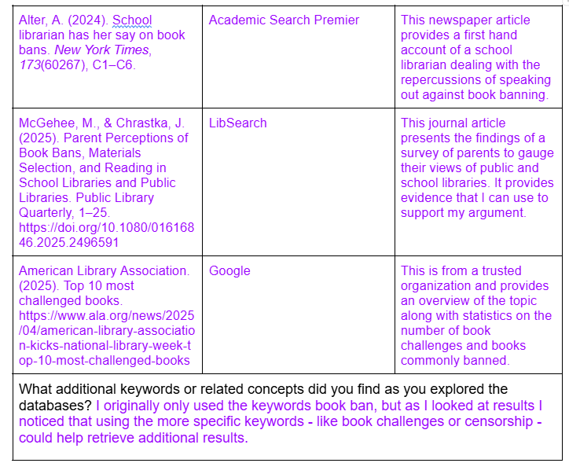


  2026 Revised Research Journal
Notes:
Preeti

Slide 15


  Feedback from Fall 2025
Reflecting on the Research Journal as a whole, what worked well? What could be improved?
  I liked the journal, but I think that there were so many diff erent journals through TRW that some students felt like it was just another in a long line.
  I really like this assignment, but students often describe it as busywork. What could we do to change that?
  I used this journal both as a place for students to take notes on their readings and to summarize their research. I think this worked well; however, giving students a clearer format may make grading easier.
  Yes, it continues to be an excellent learning activity for students, especially with interaction from a class librarian.
Notes:
Anne

Slide 16
  Overall Challenges
7-week TRW sections are now offered in our College for Adults
  Less faculty buy-in with this model
Faculty buy-in & implementation remains inconsistent
  Journal encouraged, but not required
  Structural challenges with TRW hamper journal usage
Points vs. completion vs. honor system
Role of librarian feedback
Older versions in Canvas Commons still cause trouble
Not (yet) AI-proofed
Notes:
Lizzy

Slide 17
  Future of the Research Journal
Adapt for “new” TRW and/or move to Global Search for Justice (GSJ)
  GSJ was formerly the undergraduate Capstone course; will transition to a second year course in 2025-26
  Opportunity to incorporate Research Journal into a more traditional research process
  Investigate how to assess student learning outcomes more effectively
Longer interviews with faculty to understand perceptions of student research habits and assess journal effectiveness
AI proof the journal
Notes:
Anne

Slide 18





  Questions for us?
We have questions for you too!
What trends are you seeing in assignments & info literacy (re: students)?
What trends are you seeing in research assignments (re: faculty)?

Slide 19
  Thank you!
Hello
  there!
Anne Beschnett
ambeschnett@stkate.edu
Lizzy Tegeler
ejtegeler865@stkate.edu
Preeti Gupton
pgupton986@stkate.edu

Slide 20








  Resource Page
  Use these design resources in your Canva Presentation.
  Use these design resources in your Canva Presentation.
You can find these fonts online too. Happy designing!
  Titles: Dingos Stamp Headers: Kollektif Body Copy: Kollektif

Slide 21



Happy
Designing!
  Credits
This presentation template is free for everyone to use thanks to the following:
SlidesCarnival for the presentation template
Pexels for the photos

