Slide 1



GALION MIDDLE SCHOOL
The Galion
PIZZA PROBLEM
- A SLICE OF HAPPINESS IN EVERY STEP -

Slide 2
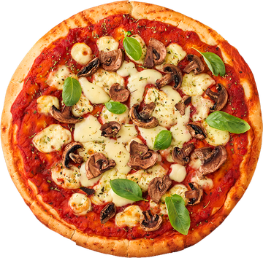

BACKGROUND
  Authentic Learning Challenge
  Extension of Equations Unit/Working with Two-Variables
  The Standards Covered:
6.EE.9 Use variables to represent two quantities in a real-world problem that change in relationship to one another; write an equation to express one quantity, thought of as the dependent variable, in terms of the other quantity, thought of as the independent variable. Analyze the relationship between the dependent and independent variables using graphs and tables, and relate these to the equation. 7.EE.4 Use variables to represent quantities in a real-world or mathematical problem, and construct simple equations and inequalities to solve problems by reasoning about the quantities. a. Solve word problems leading to equations of the form px + q = r and p(x + q) = r, where p, q, and r are specific rational numbers. Solve equations of these forms fluently. Compare an algebraic solution to an arithmetic solution, identifying the sequence of the operations used in each approach.
- PIZZA CONNECTS PEOPLE THROUGH FLAVOR -

Slide 3
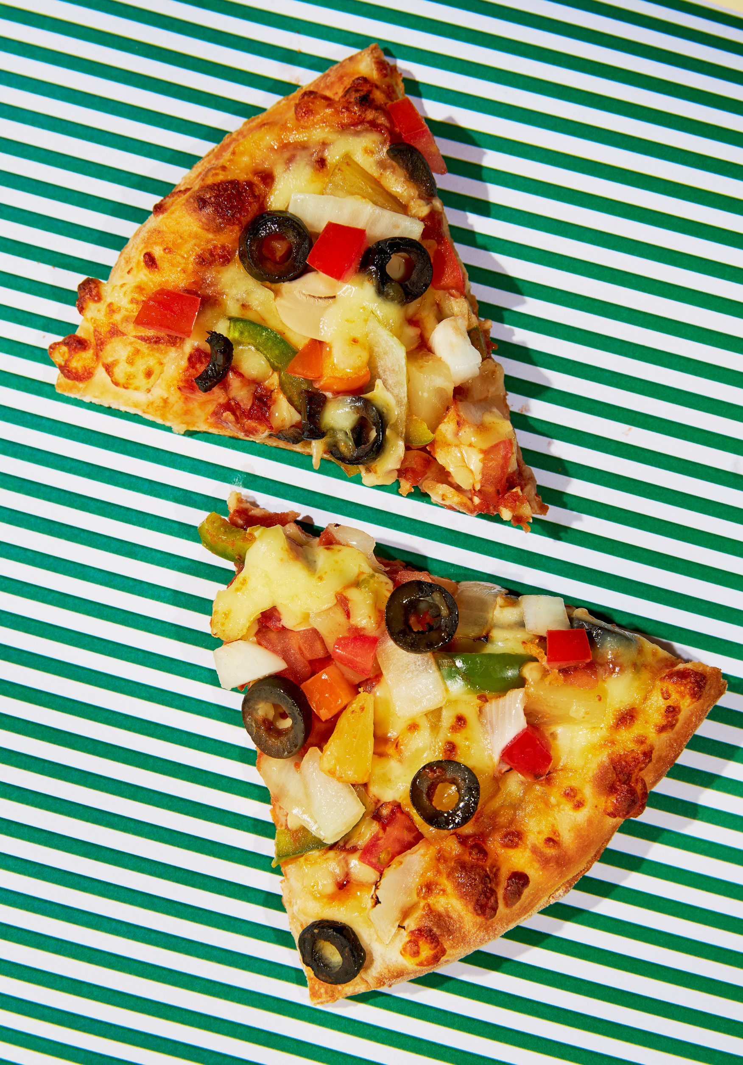
THE
Question
- A SLICE FOR EVERYONE -
When you want pizza, where do you go? How do you know which place has the best deal? The best pizza?
Intro Activity
Project Packet

Slide 4
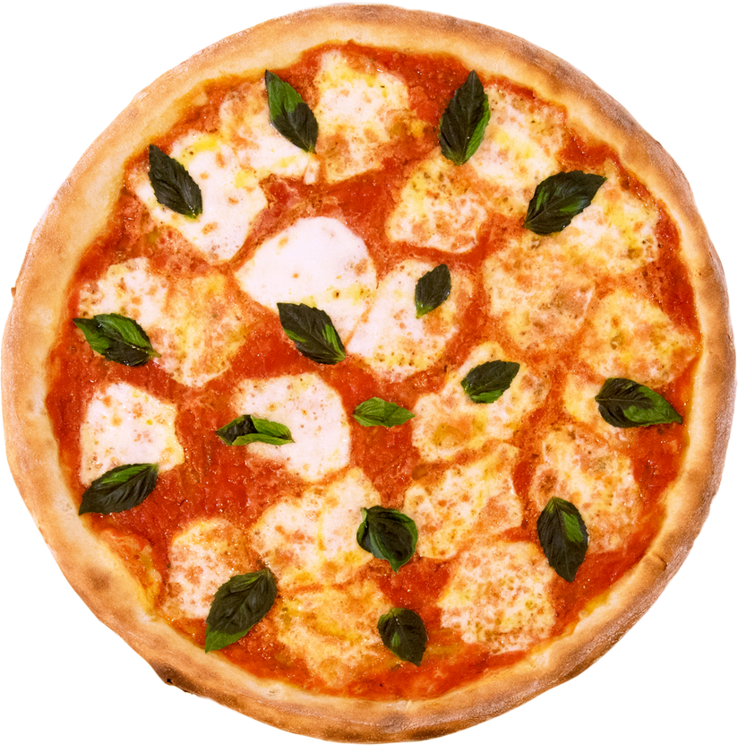
HOW WE
Started
  Day 1 Guest Speaker
    To introduce the project we had the owner of East of Chicago in Galion come talk with the class about being a small business owner, expenses and profits
- FROM HUMBLE FLATBREAD TO GLOBAL DELIGHT -

Slide 5
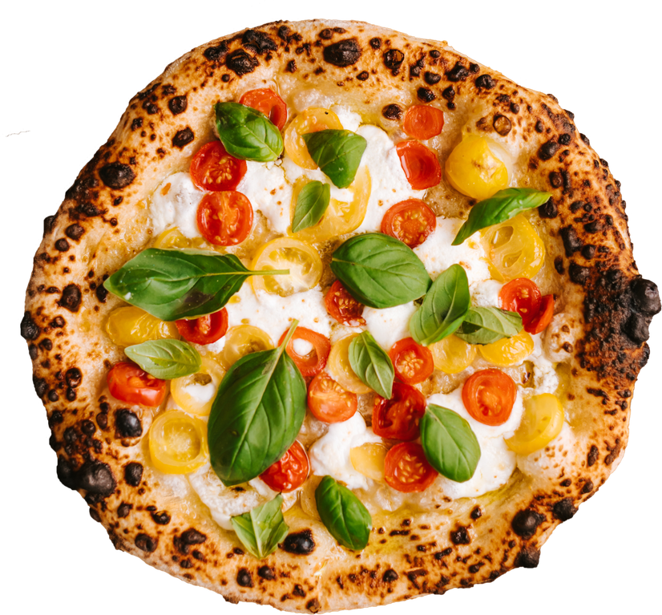
- SIMPLE INGREDIENTS, ENDLESS CREATIVITY -
THE PROCESS
Work To Be Done
  Day 2 Introduction and Research
    Students practiced completing a table and writing an equation using a fictional pizza place scenario
    Students started the project by researching 2 of 5 different pizza places in Galion in their small groups

Slide 6
THE PROCESS
Continued
  Days 3 and 4 Work Days
    Students used the information they found to complete the questions from their packets
    They created a digital or physical presentation on what they found including a graph to present to the class
-A GLOBAL FAVORITE -

Slide 7
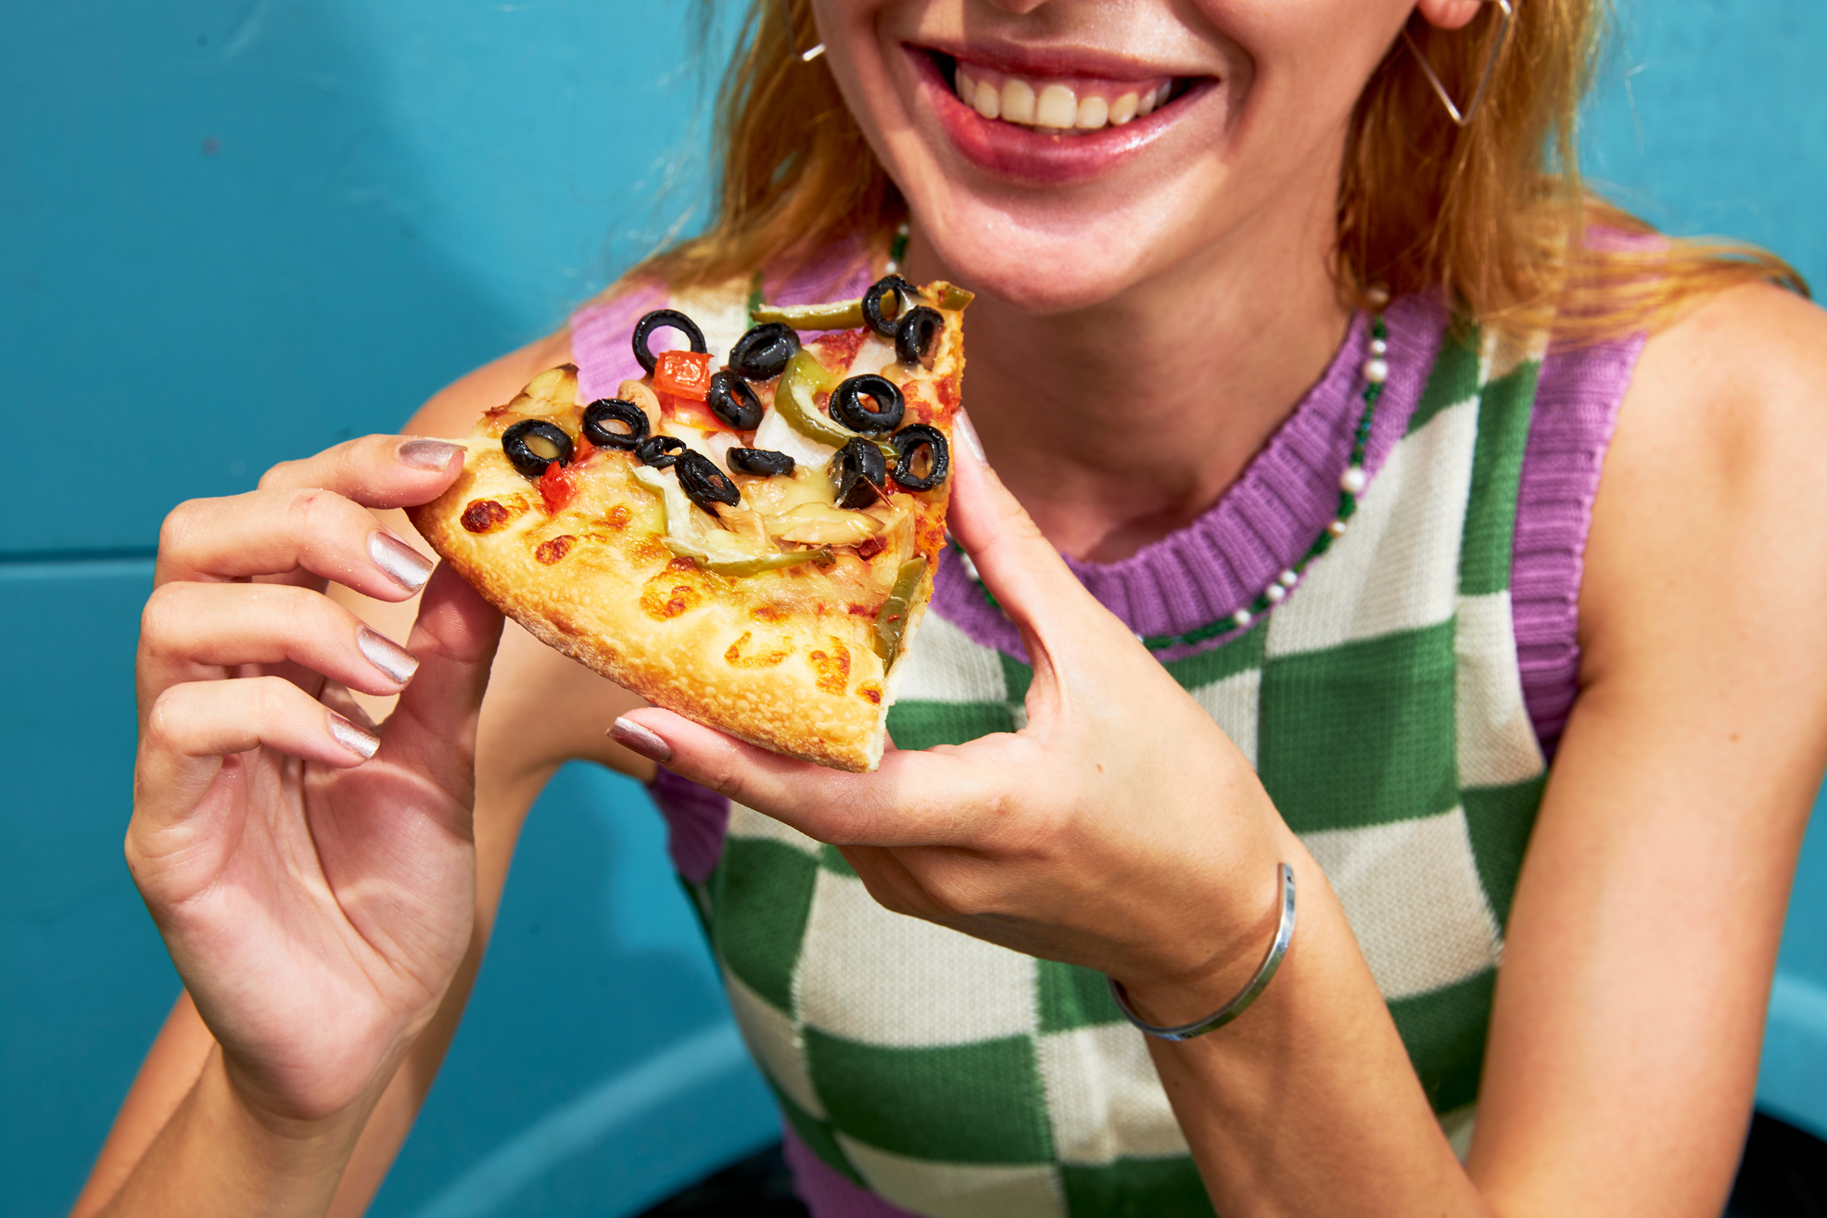
MAKING
Choices
  Day 5 Presentations
    Students presented what they found including the equation, how they organized the information and a graph to represent the prices for their two pizza places
- FROM DOUGH TO OVEN -

Slide 8
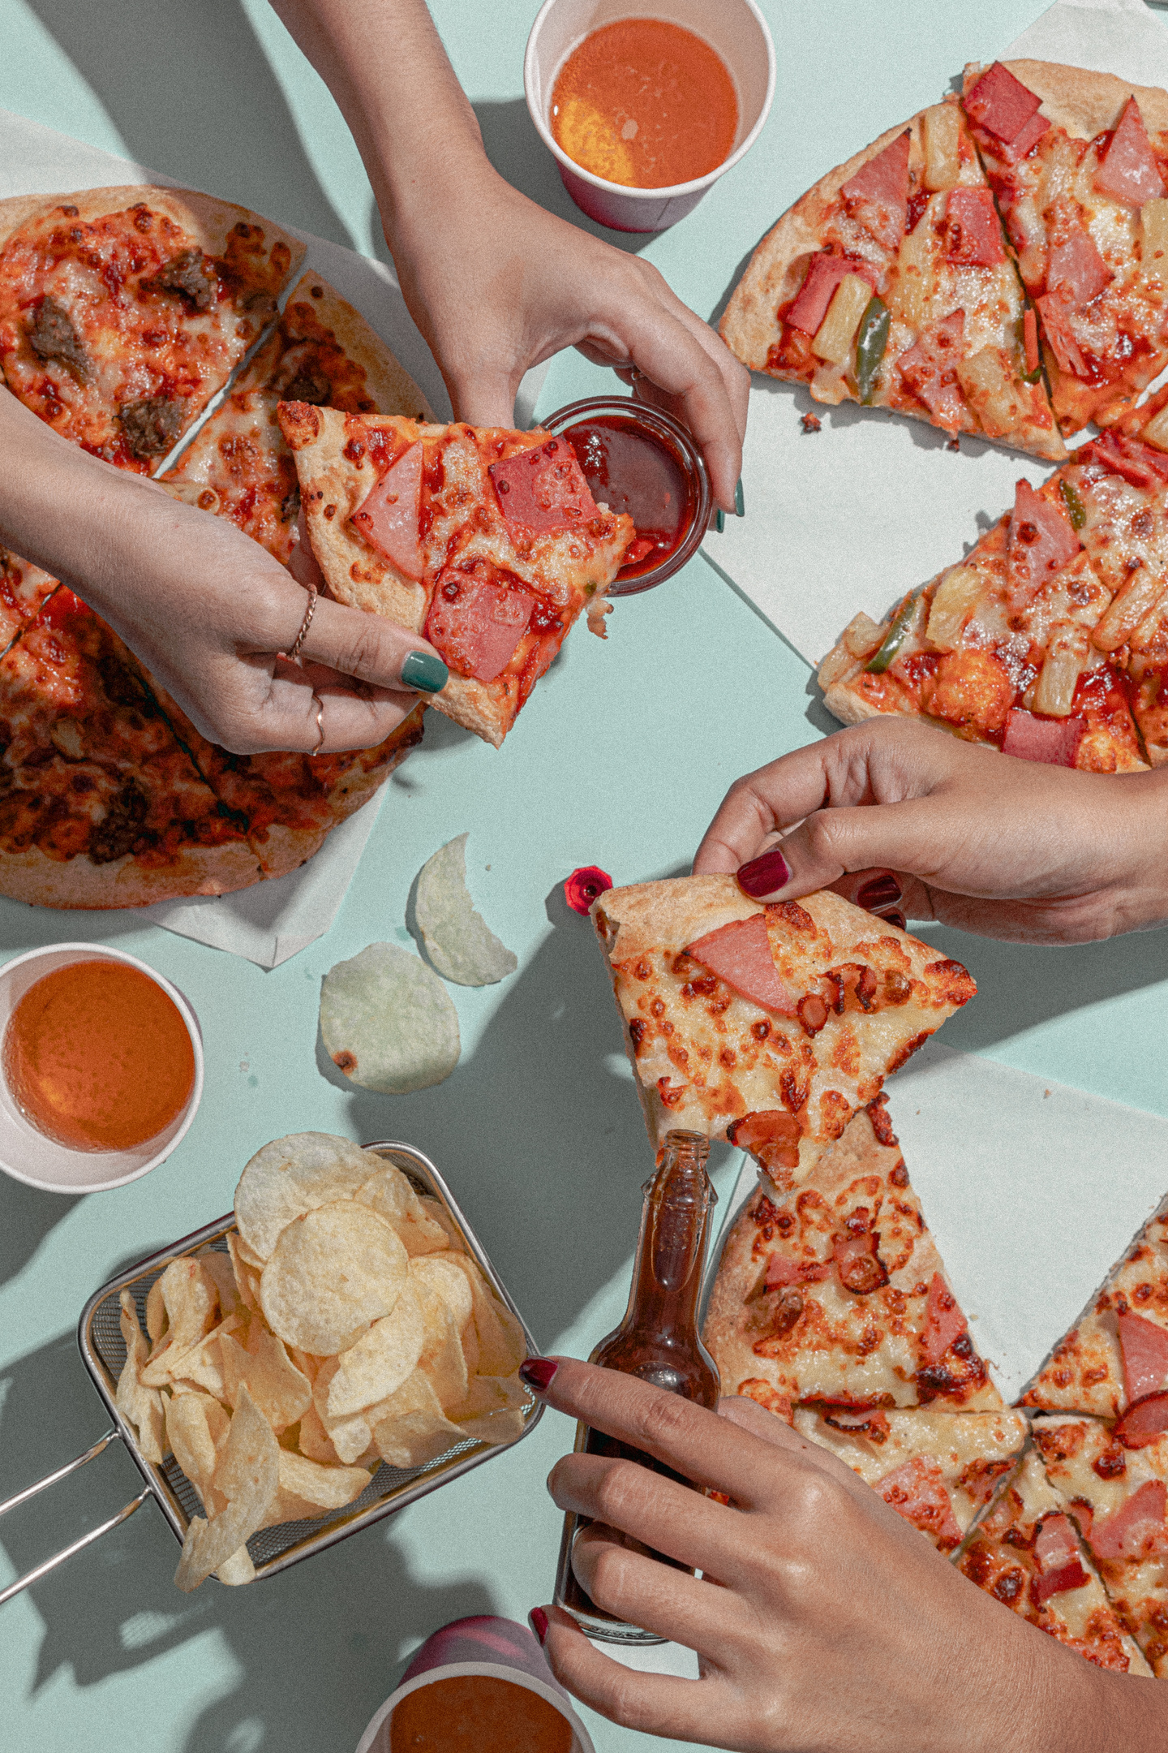
PIZZA AND
Community
  Day 6 Final Choice
    We brought in pizza from 4 of the 5 places we researched
    Students tasted all the pizzas and were able to vote based on taste
    We discussed price, customer service and taste to make our final decision
-SHARING A SLICE -

Slide 9
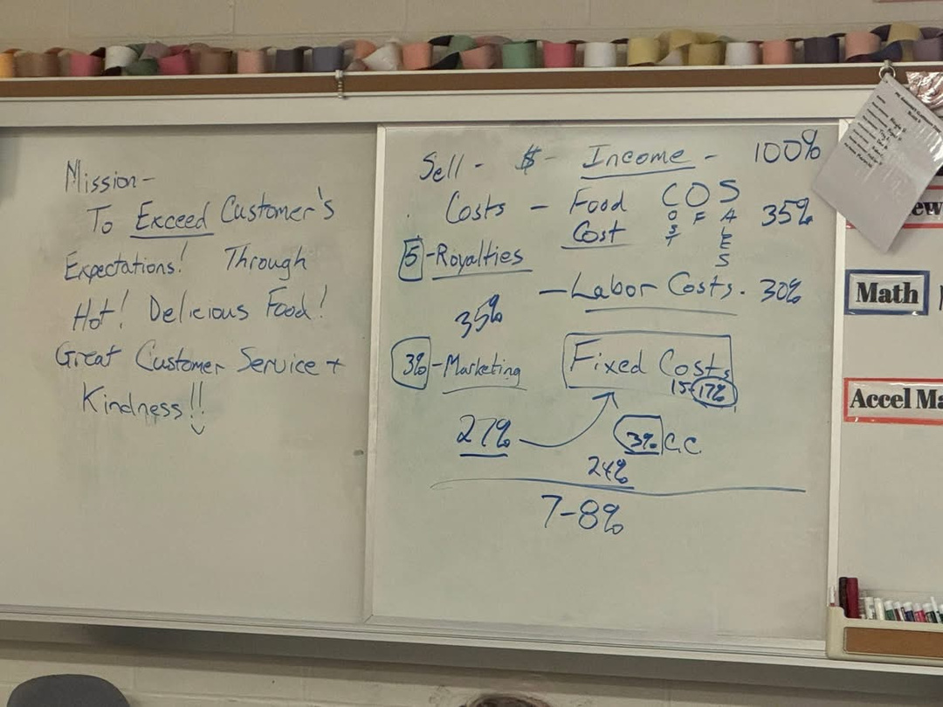
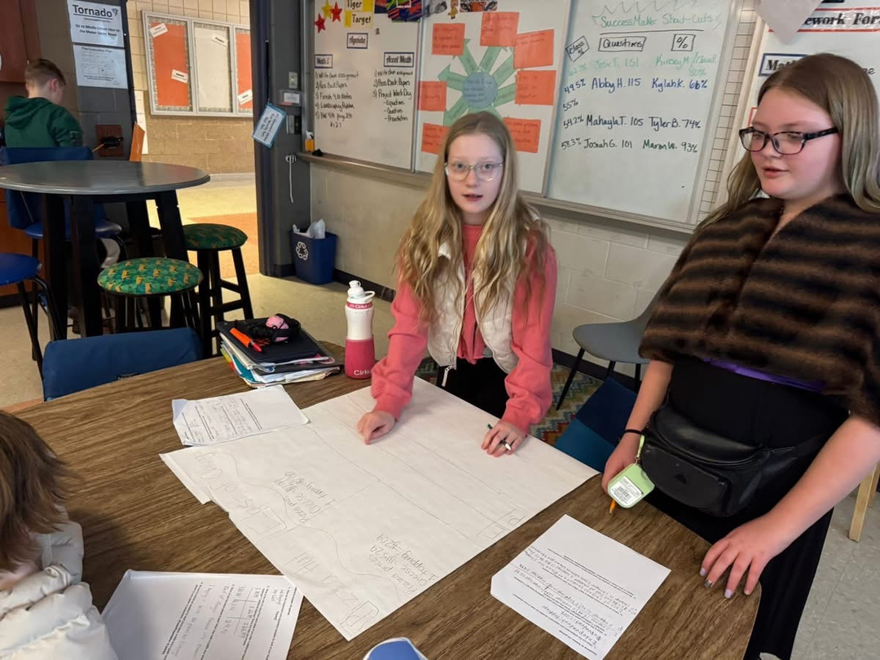

Slide 10
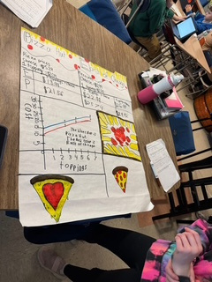
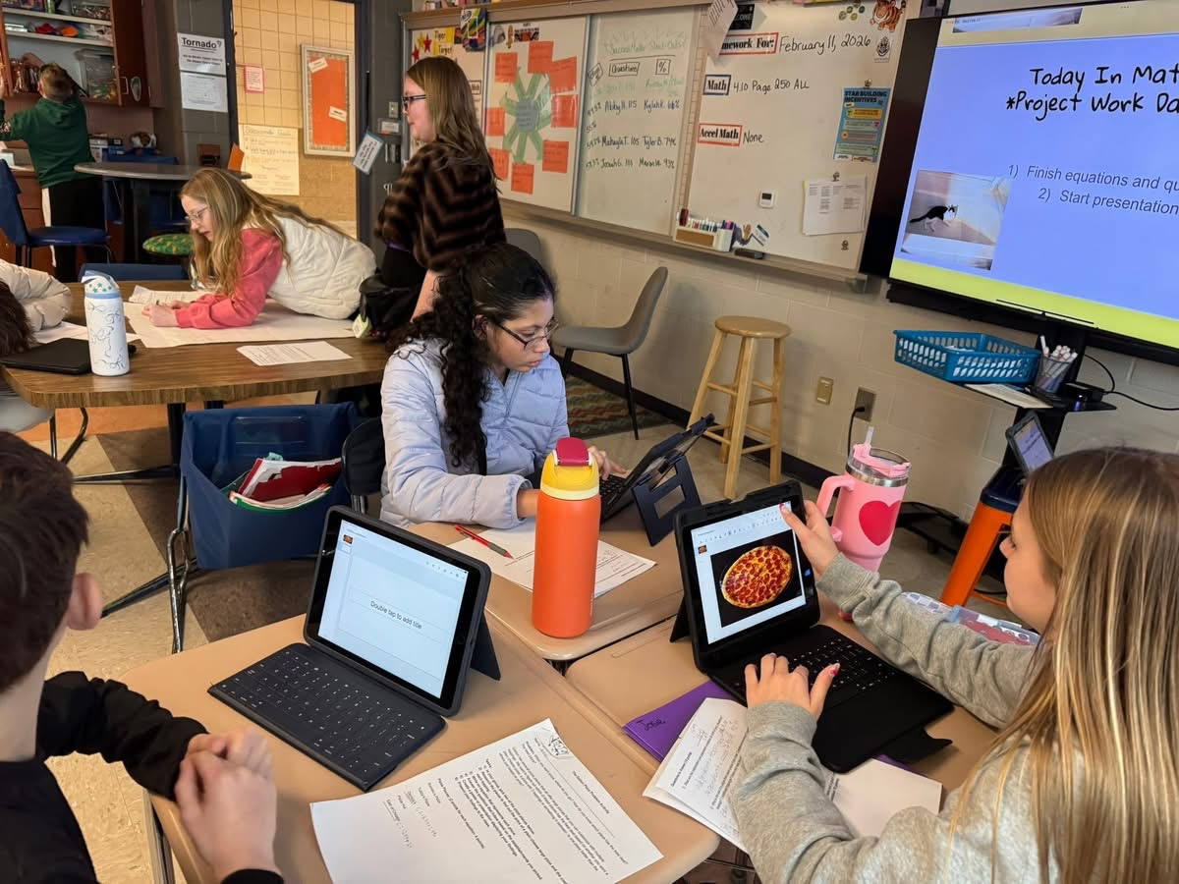

Slide 11
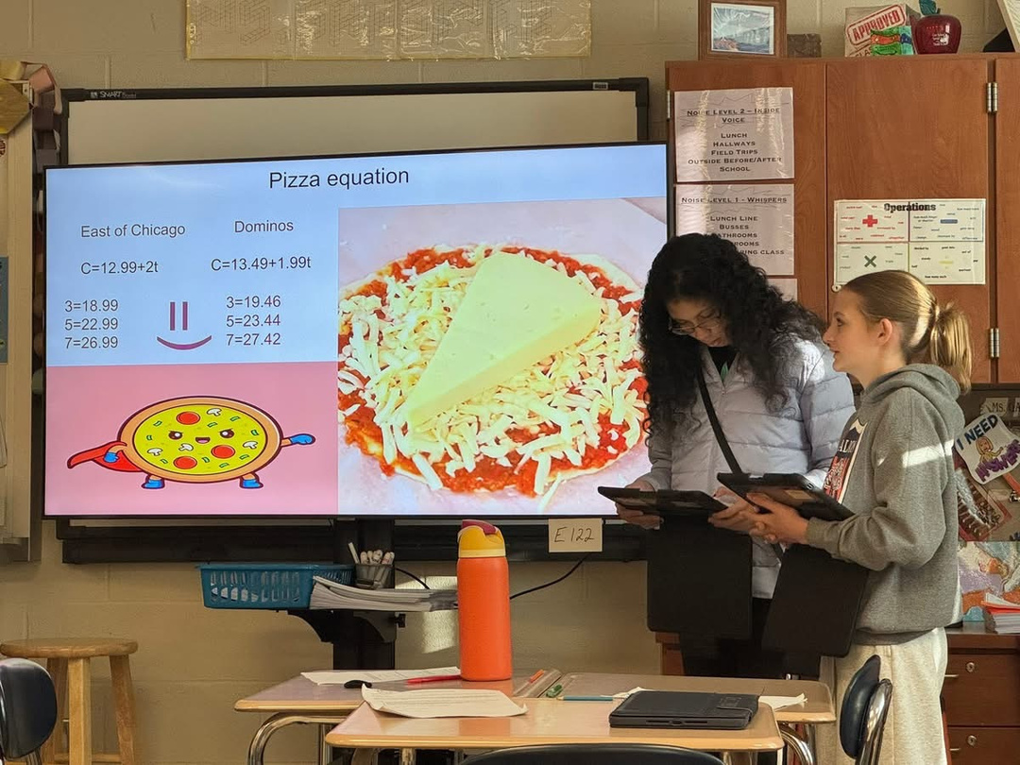
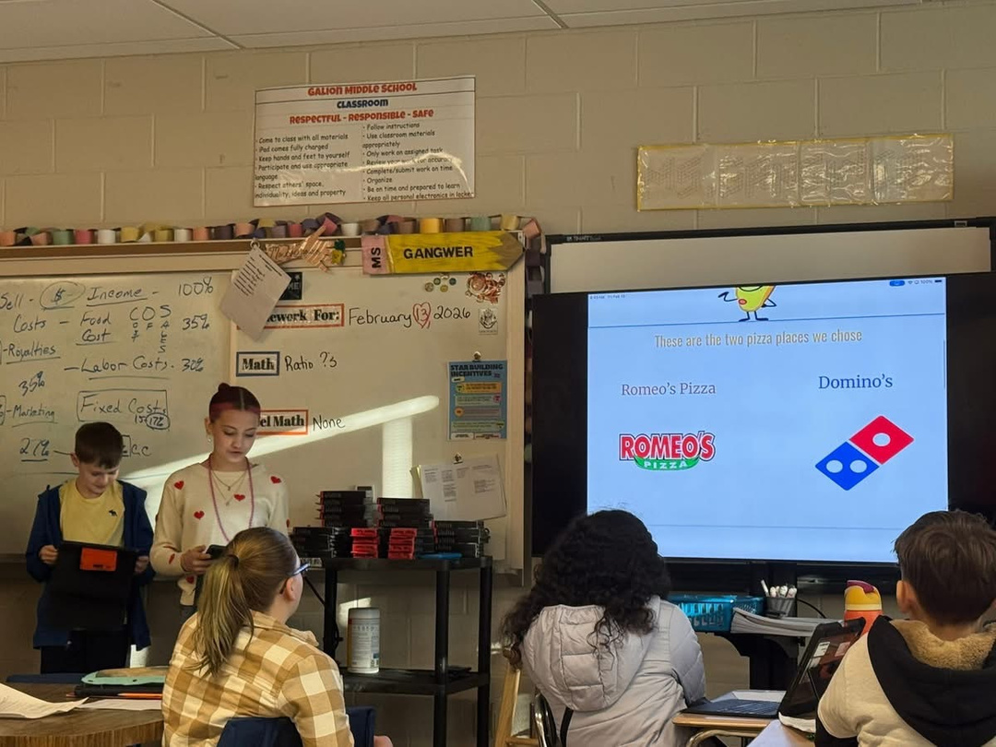

Slide 12
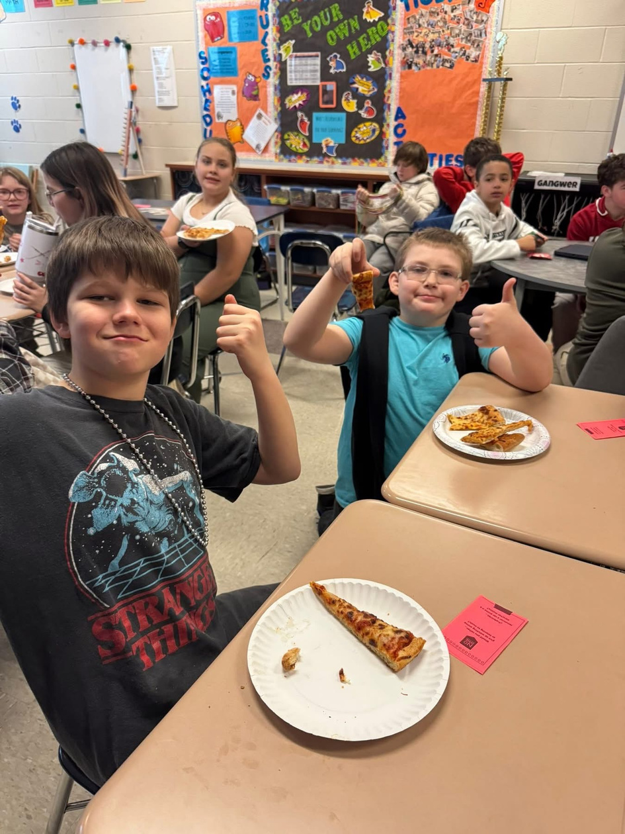
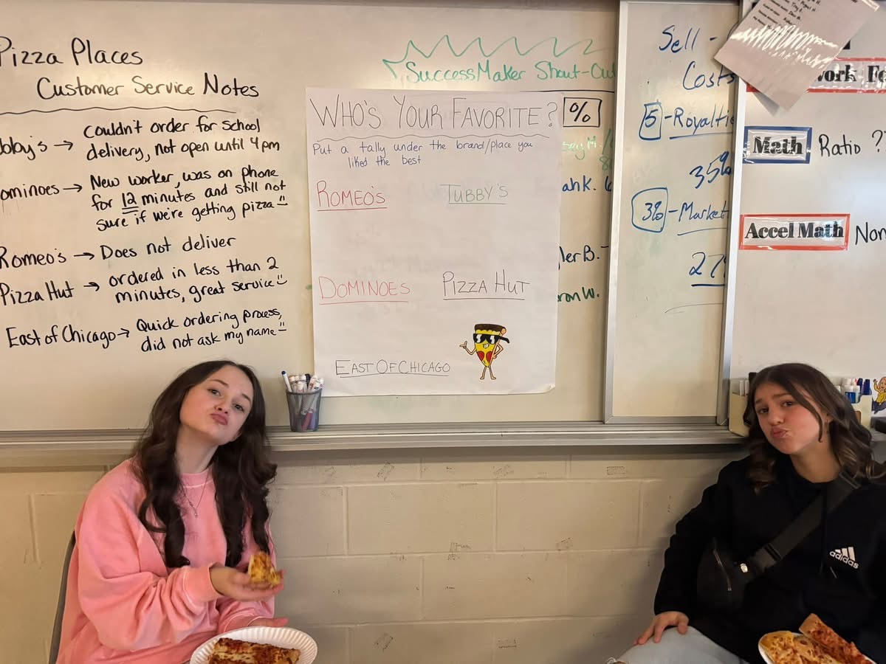

Slide 13
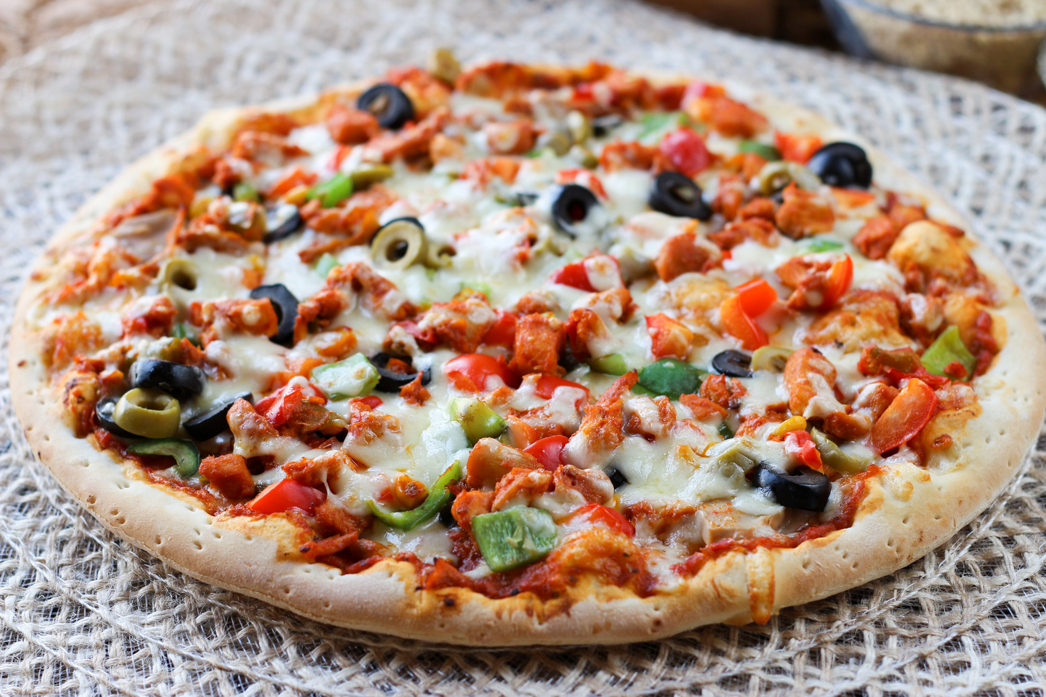
- YOUR PERFECT SLICE IS WAITING -
EXTENSIONS
Extentions
  Having students present to the entire grade or writing individually about how the toppings affected the cost
  Rating each pizza place 1-10 and using data to practice mean, median, mode, and other graphiing methods
Adaptations
  using rating systems to create a data project instead of linear equations project
  Including concepts of slope and y-intercept for higher level standards
Adaptations

Slide 14
Thank
YOU
- PIZZA IS LIFE, SHARED ONE SLICE AT A TIME -

