Slide 1

Shaping Perspectives
through Podcasting
Let's Brainstorm how to Guide Students with the Right Balance of Choice and Structure
EDITION NO. 2026-05-28 | LATEST NATIONAL NEWS | WASHINGTON D.C.

Slide 2

Who am I?
PROFESSIONAL BACKGROUND
NYC Experience: Taught at an all-gifted school with a PBL-focused curriculum.
Overlap with progressive principles, but lacked emphasis on democratic principles and advocacy.
UA Transition: Moved to UA and taught in the Progressive Program.
Current Role: In the gifted program, continuing to infuse progressive education and PBL principles.
EDITION NO. 2026-05-28 | LATEST NATIONAL NEWS | WASHINGTON D.C.

Slide 3

NPR Student Podcast Challenge
CONTESTS FOR
RULES & EDITORIAL GUIDELINES
4th Grade
Elementary Division
Middle School
Grades 5th - 8th
High School
Grades 9th - 12th
DURATION: Entries must be between 3 and 8 minutes in length.
AUTHENTICITY: Submissions must be entirely original student work.
PLATFORM: Audio files must be hosted on SoundCloud for judging.
MUSIC: Use only self-composed music; no copyrighted external tracks.
LEGAL: Ensure no privacy, copyright, or intellectual property violations.
EDITION NO. 2026-05-28 | LATEST NATIONAL NEWS | WASHINGTON D.C.

Slide 4

Grand Prize Rewards
WHAT THE GRAND PRIZE WINNERS RECEIVE
Each of the Grand Prize winning Entrants (each, a "Grand Prize Winner"), will receive the following "Grand Prize":
Expert Mentorship: An NPR and/or NPR member station journalist or journalist will meet and interview each Grand Prize Winner and the student(s) who contributed to the winning Submission in or around August 2025.
National Broadcast: NPR will air a segment on an episode of NPR's All Things Considered or Morning Edition which will discuss the winning Submission; that segment may include portions of the Submission itself and/or recorded audio from NPR's visit to the Grand Prize Winner's school.
Official Recognition: A trophy and a certificate!
EDITION NO. 2026-05-28 | LATEST NATIONAL NEWS | WASHINGTON D.C.

Slide 5
Topic Recommendations
NPR'S SUGGESTED ENTRY POINTS
While topic choice is completely free, NPR recommends these five starting points:
Local Stories: Tell us a story about your school or community: about something that happened there — recently or in the past — that your audience should know about.
Historical Moments: What is a moment in history that all students should learn about?
Debate: Show us both sides of a debate about an issue that's important to you.
Future Change: What do you want to change about the world? What's a big change that you want to make in the future?
Youth Perspective: Explain something to us that kids understand and grown-ups don't.
EDITION NO. 2026-05-28 | LATEST NATIONAL NEWS | WASHINGTON D.C.

Slide 6
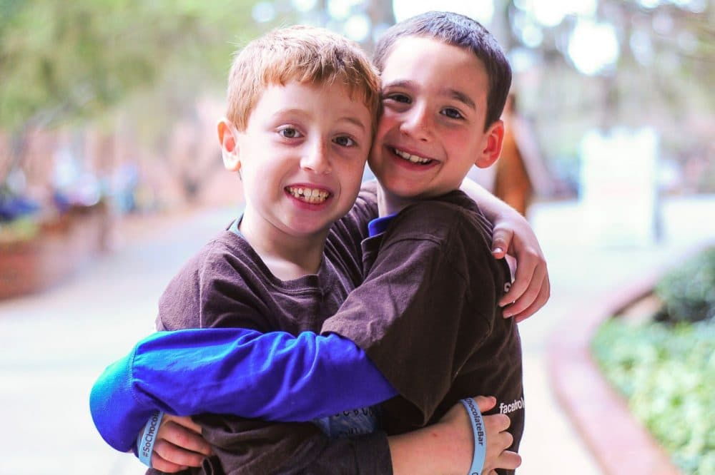
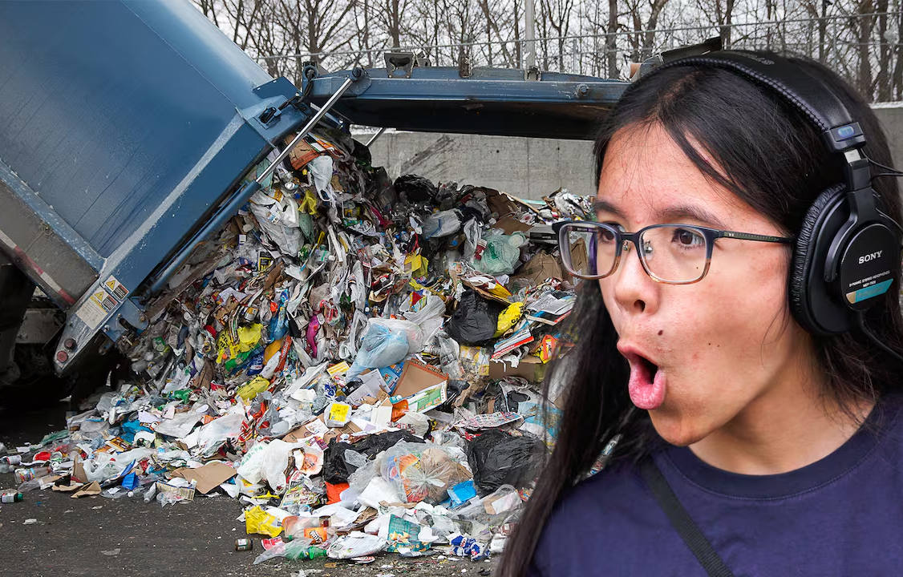
Podcast Exemplars
TOP PICKS RECOMMENDED BY NPR
So Chocolate Bar
How Do We Fix Recycling?
EDITION NO. 2026-05-28 | LATEST NATIONAL NEWS | WASHINGTON D.C.

Slide 7
The Motivation
WHY PODCASTING WORKS FOR STUDENTS
Influencer Culture: Students are exposed enough to the concept of influencers to be thrilled at the idea of making their own podcast.
Authentic Task: The task feels authentic - a real radio station is asking for this and wants to hear from them. This isn’t just something their teacher made up!
Creative Freedom: The task is loosely structured - students have completely free choice about what they want to do.
Collaborative Communication: Multimedia communication enables students with unique strengths to shine and collaborate together.
EDITION NO. 2026-05-28 | LATEST NATIONAL NEWS | WASHINGTON D.C.

Slide 8

The Enthusiasm
THE IMPACT OF AUTHENTIC ENGAGEMENT
Introduced the project on a Friday and told students we would learn more about how to get started on Monday…
Students came in on Monday with scripts already written!
Led to some “quality control” issues, but when else do you have students who cannot be stopped from completing a research project than when you’ve convinced them it is truly authentic and that their voice matters?
EDITION NO. 2026-06-12 | CLASSROOM INNOVATION REPORT | NEW YORK

Slide 9
The Problem
GUIDING WITHOUT STEERING
Past: Five Years Ago
Students had limited prior knowledge, making them highly receptive to guidance.
"Right there with me" in guidance
No competing ideas in themes or structure
Present: Current Challenges
Students enter with fixed favorites and preconceived structures.
Scripts finished before structure presentation
Fitting ideas into forced structures
Resistance to exemplar podcasts
Exploration day felt meaningless
EDITION NO. 2026-05-28 | LATEST NATIONAL NEWS | WASHINGTON D.C.

Slide 10

The Framework
GUIDANCE FOR SUCCESSFUL PODCASTING
Core Philosophy
Center around a driving question and a quest for answers.
A good question can't be a yes/no; it must require exploration.
Topic must spark personal passion.
Ensure the topic appeals to a broader audience.
Exemplar: Students connected well with Mark Rober.
Recommended Structure
The Why:
Explain why the topic matters and share initial research.
The Journey:
Chart your path of exploration and discovery.
The Results:
Discuss what was learned and the final outcomes.
EDITION NO. 2026-05-28 | LATEST NATIONAL NEWS | WASHINGTON D.C.

Slide 11
Expected Discovery
ADULTS’ IDEAS VS. STUDENT REALITY
Expected Topics:
Bullying
Litter
Animals (adopt black cats, learn about Emperor Tamarin Monkey)
Screen time
Homework
Immigration
EDITION NO. 2026-06-12 | CLASSROOM INNOVATION REPORT | NEW YORK

Slide 12
Unexpected Discovery
ADULTS’ IDEAS VS. STUDENT REALITY
Unexpected Topics:
Black holes
What am I Going to Be when I Grow Up?
The price of medical care
Sports (friendships, career impact, NCAA v. NCA, football history)
Conspiracy theories
How would the Wizarding World of Harry Potter have reacted to COVID? To AI?
EDITION NO. 2026-06-12 | CLASSROOM INNOVATION REPORT | NEW YORK

Slide 13

Internal Struggle
SECOND DISCOVERY: NAVIGATING COMPETING DESIRES
The Desire for Excellence
On the one hand, I want students to deliver what NPR is looking for:
Want them to have success
Would love personal accolades for my work
The Commitment to Voice
On the other hand, I want to really hear them:
Don’t want to be the one to tell them to fit inside of the box an adult has imagined for them
When I heard the passion behind the student’s choice to focus on conspiracy theories, I couldn’t tell him his passion wasn’t good enough
EDITION NO. 2026-06-12 | CLASSROOM INNOVATION REPORT | NEW YORK

Slide 14
The Quality vs. Choice Dilemma
OBSERVATIONS BASED ON INTERNAL STRUGGLE
The Risk of Abandonment
Project after project is abandoned after a few years because teams feel they can't guarantee work quality.
Consequently, they pivot to other tasks that offer more rigid structure.
The "Clamp Down" Effect
On the other hand, teachers often "clamp down," sacrificing student choice to ensure a baseline of quality.
This leads to abandoning opportunities for student agency in favor of predictability.
EDITION NO. 2026-05-28 | LATEST NATIONAL NEWS | WASHINGTON D.C.

Slide 15
Why This Project Has Been So Special…
VOICES FROM THE CLASSROOM: THE POWER OF CHOICE
Stakeholder Feedback
“As long as I don’t have to write an essay, I’m so excited to research!” — Student
“I feel like this gives me a chance to really SEE them in a new way.” — Parent
“Can we continue making episodes to our podcast?” — Student
“Can students start a Barrington podcast?” — Teacher
The "Choice" Reflection
Would I have gotten this feedback if I had clamped down on student choice for topics?
Maybe some…
EDITION NO. 2026-06-12 | CLASSROOM INNOVATION REPORT | NEW YORK

Slide 16
Reflection: The Value of Perspective
STUDENT INSIGHTS ON AI vs. HUMAN VOICE
The Sonnet Comparison
“5th graders were able to articulate that the sonnet didn’t have their unique perspective or voice.”
EOY Activity: Students compared their own sonnets to AI-generated versions. Despite the "funny" results, they felt a profound loss of identity in the AI content.
The 9th Grade Gap
Rising 9th graders in summer tutoring view AI usage through a binary lens:
“Cheating”
“Lazy”
“They cannot articulate any ideas about the value of their unique perspective.”
EDITION NO. 2026-06-12 | AI ETHICS & EDUCATION REPORT | REFLECTION SERIES

Slide 17
Reflection
CULTIVATING AUTHENTIC VOICES
“Listening - really listening - to a child matters!!!”
Their ideas are “Out of This World!”
EDITION NO. 2026-06-12 | CLASSROOM INNOVATION REPORT | NEW YORK

Slide 18
Where I was Coming From...
PEDAGOGICAL REFLECTIONS & CHALLENGES
The CCSS Connection
Coaching students to perform a verbal 5-paragraph essay using interviews as textual evidence.
Results:
Many internalized structure (some went "completely rogue")
Rigid structure conflicted with the process of discovery.
Conservation Alignment
Placing the podcasting unit immediately after ocean conservation essays.
“Hoping to capitalize on the ‘save the world’ mindset (really didn’t work).”
EDITION NO. 2026-06-12 | PEDAGOGY & PRACTICE | REFLECTION SERIES

Slide 19
Next Iterations…
FROM ANALYSIS TO ACTION: THE PODCASTING PIVOT
Structural Realignment
Moving the project to follow the novel The Science of Breakable Things by Tae Keller.
Students maintain a year-long journal exploring a "driving question".
Utilizing SOBT as the primary exemplar for discovery as opposed to a 5-paragraph essay exemplar.
Shift from "oceanic conservation" essays to authentic research journeys.
Pedagogical Goals
"Focus on the journey, not just the destination."
Reframing "wrong avenues" as research interest points.
Identity shift: From "influencer" to "researcher".
Connecting to Mark Rober's methodology and the recycling exemplar.
Enhancing critical thinking through non-traditional forms.
EDITION NO. 2026-06-12 | CURRICULUM EVOLUTION | STRATEGY REPORT

Slide 20
Next Iterations…
OPEN FORUM: COLLABORATIVE BRAINSTORMING
“Would welcome any feedback from you!”
(And maybe your feedback will help get others’ juices flowing during brainstorming period)
EDITION NO. 2026-06-12 | CURRICULUM EVOLUTION | STRATEGY REPORT

Slide 21
Brainstorming Time
REFLECTIVE QUESTIONS FOR CURRICULUM PLANNING
Podcasting Integration
“Whether you submit to NPR or not...”
Could you incorporate podcasting into your curriculum next year? How?
Unrestricted Choice
“Fostering agency through autonomy...”
Are there ways you can incorporate more unrestricted choice into your curriculum for next year, even if you aren’t doing a podcasting project? How?
EDITION NO. 2026-06-12 | PEDAGOGY & PRACTICE | BRAINSTORMING SESSION

Slide 22
Final Thought
IT REALLY ISN'T ABOUT PODCASTING
Human Voice in the AI Era
"It’s about creating a classroom culture in which every student knows they have something to say (that AI can’t say) that is worthy of being heard."
Fostering Agency
I think we all have tried-and-true beginning-of-year activities that establish the value of each student’s contribution.
What are ways to tie these to ideas of responsible AI use so we foster students who don’t want to surrender their power by using AI?
EDITION NO. 2026-06-12 | FINAL THOUGHTS | REFLECTION SERIES

