Slide 1

MINDS IN MOTION
A CREATIVE STEM JOURNEY FOR EVERY CHILD

Slide 2
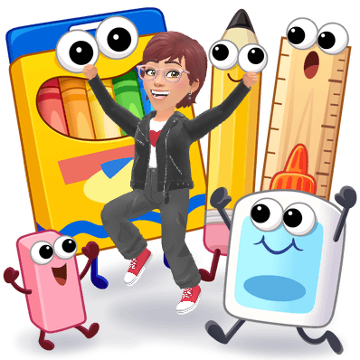
Presented by:
Theresa Knapp
Intervention Specialist
Heritage Elementary
theresa_knapp@olsd.us

Slide 3



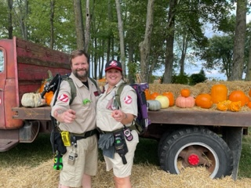
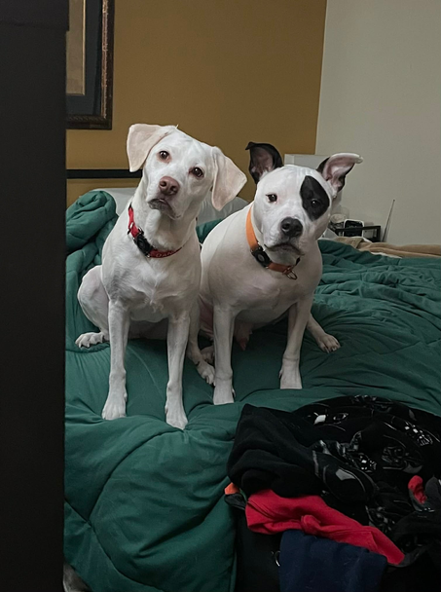

Presenter Theresa Knapp
  K-5 Intervention Specialist for 23 years
  Olentangy Schools
  Masters in Special Education from Bowling Green State University
  Bachelors in Speech Pathology and Audiology from Miami University
  Passionate about STEM, Student Agency and Authentic Learning
Outside of School
  Ghostbusting with my husband, Jamie
  Dog Parent of Dana (Lab/Beagle mix) and Luna (Husky/French Bulldog)
  Foster with Rico Pet Recover and Heart of Michigan Bernese Rescue

Slide 4
Whose in the Room?
Tell Me:
Your Name
Your Occupation
Grade Level(s) You Work With
Your Experience Level with STEM

Slide 5
STEPS OF MY JOURNEY
  Define STEM for my students
  Adapt the Design Thinking Process
  Engage in STEM activities with my students
  Collaborate on STEM activities
  Grow my STEM knowledge
  Build an Accessible Maker’s Space

Slide 6
WHAT IS STEM?
According to the Ohio STEM Learning Network:
Strategies to Engage Minds

Slide 7

Question
What are the steps in designing and building a STEM project?

Slide 8

1
Ask
2
Research
3
Plan
4
Create
5
Test
STEPS IN DESIGNING AND BUILDING A STEM PROJECT
6
Improve
7
Communicate
8
Reflect

Slide 9
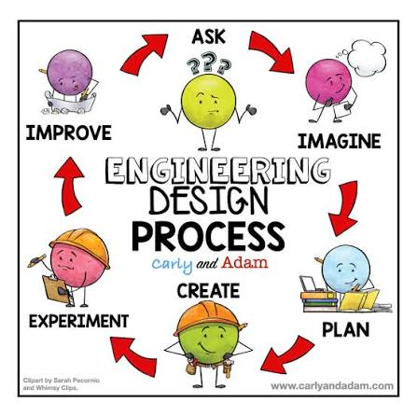
Introducing the Steps of STEM to my Students
  This Year I introduced Each Step Using Kid Friendly Language
  Next Year, high school freshmen STEM students will be explaining the steps
  In the future- search for books or videos geared for elementary students to introduce design thinking
  Or, find a community partner that could explain it to students

Slide 10

PROJECT TARGETS
STEM
Student Agency
Collaboration
Interdisciplinary Studies
Culture

Slide 11
STEM Project 1
video games

Slide 12
Video Game Development
High School Students from Olentangy Academy
My Students from Heritage Elementary
Story Creation- Elementary Students
Video Game Developers- High School Students

Slide 13

Video Game Project Timeline
August
Elementary Students Use Story Maps to Develop their Video Games
September
Elementary Students meet with their high buddies to share their video game ideas
November
High school students share the coded games with the elementary students. The elementary students proide feedback and fill out a rubric for their high school buddy.

Slide 14
STEM Project 2
Valentine’s day

Slide 15

Valentine’s Day STEM
Mrs. Knapp’s Students
Her Classroom
Theme: Dissolving Candy Hearts
What happens when we put candy hearts
in water, soda and vinegar?

Slide 16
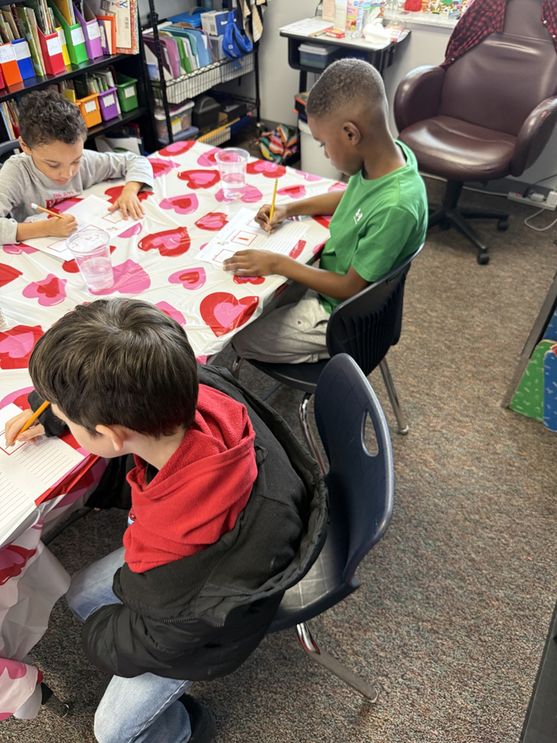
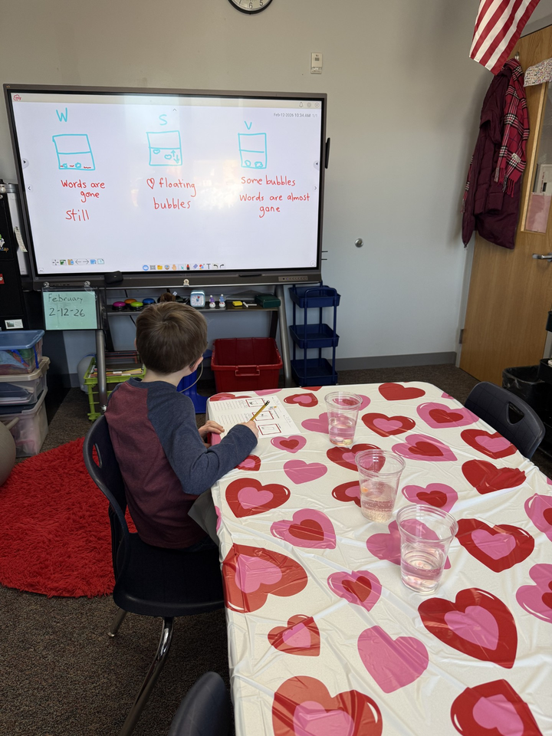
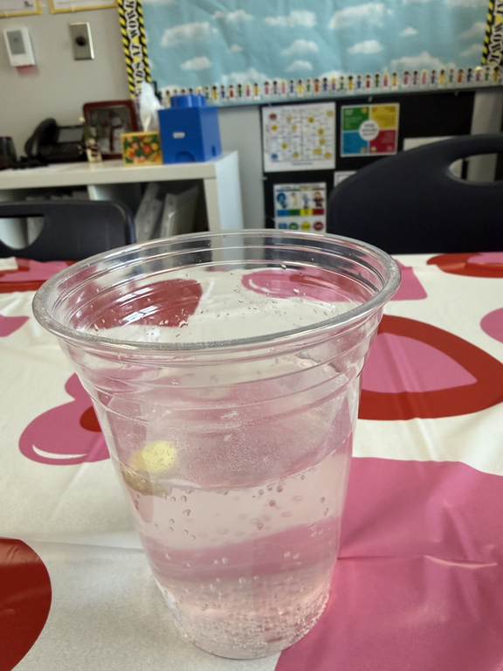

Slide 17
STEM Project 3
Earth day

Slide 18

Earth Day STEM
Mrs. Knapp’s Students
Her Classroom
Theme: What happens when
the Earth
becomes polluted?

Slide 19
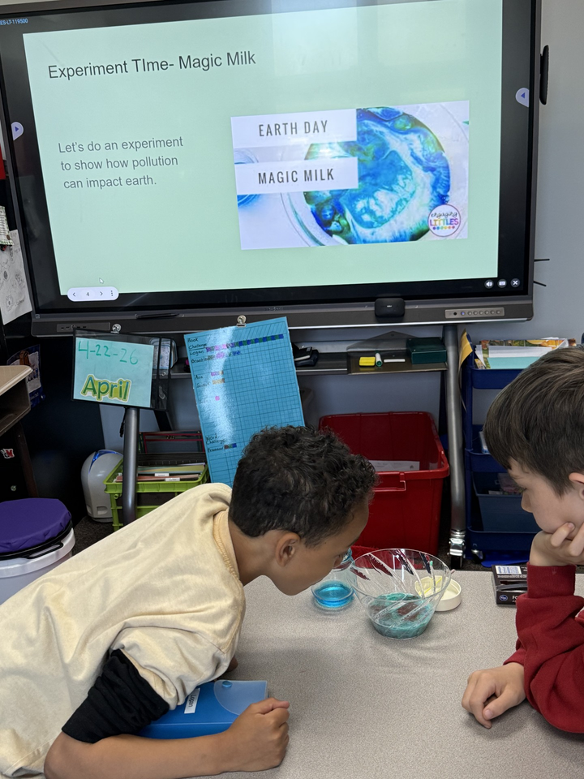
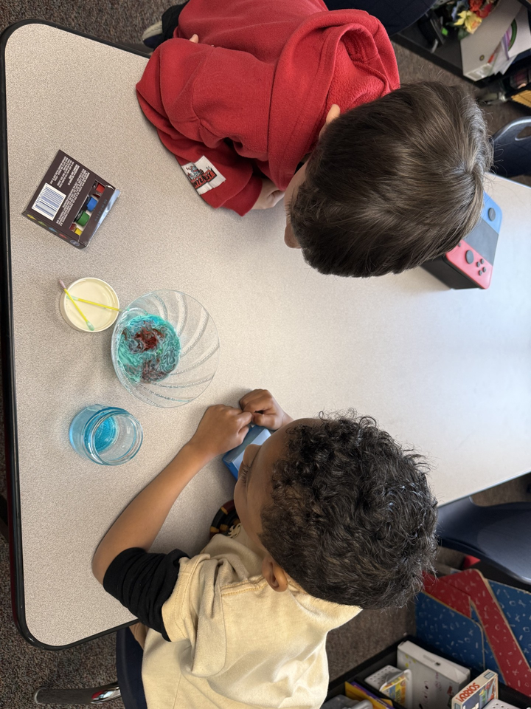

Slide 20
STEM Project 4
The most magnificent thing

Slide 21
The Most magnificant thing by Ashley Spires
Mrs. Knapp’s Students
Her Classroom
Interdisciplinary Studies: Phonics, Vocabulary,
Writing, Math

Slide 22
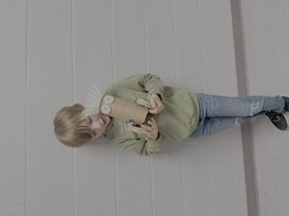

The Most magnificant thing by Ashley Spires
Mrs. Knapp’s Students
Her Classroom
STEM Project- create a magnificent thing for this classroom

Slide 23
Final Project
End of the Year Fun

Slide 24
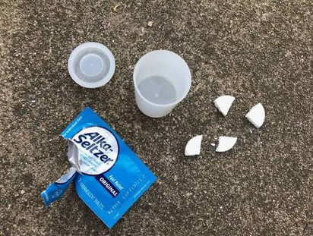
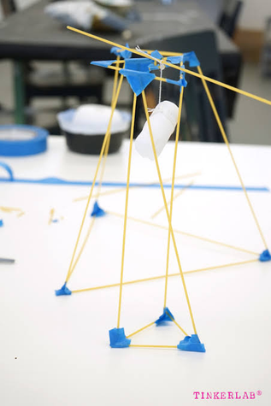
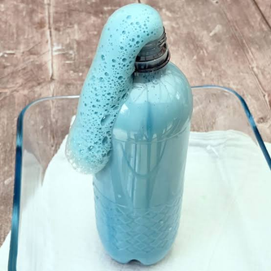
End of the Year STEM Fun
The High School students came over for one last morning of STEM activities.
  They challenged elementary kids to build the tallest tower made of noodles and marshmellows.
  Then they took them outside to shoot off film canister rockets. Elementary kids had to decided how many alka seltzer tablets they were going to use.
  Finally, the high school students made elephant toothpaste with their elementary friends.

Slide 25
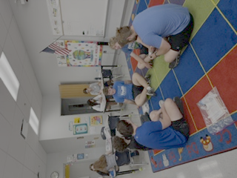
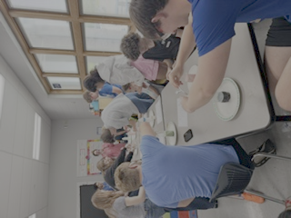
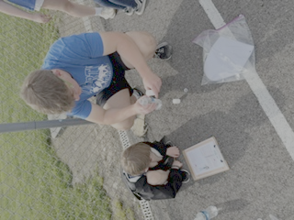
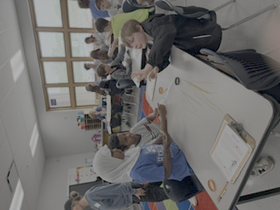
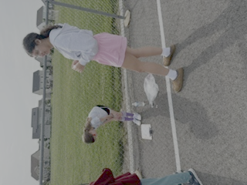

Slide 26

Embedded stem thinking
Mrs. Knapp’s Students
Lean into Curiosity to Solve Problems- in our classroom, in our school, with our own learning:
Digital Portfolios, Student Led Conferences, Students Becoming Teachers

Slide 27
FUN
Authentic Learning

Slide 28

Question asked by my students
How do we bring learning fun
to others?

Slide 29
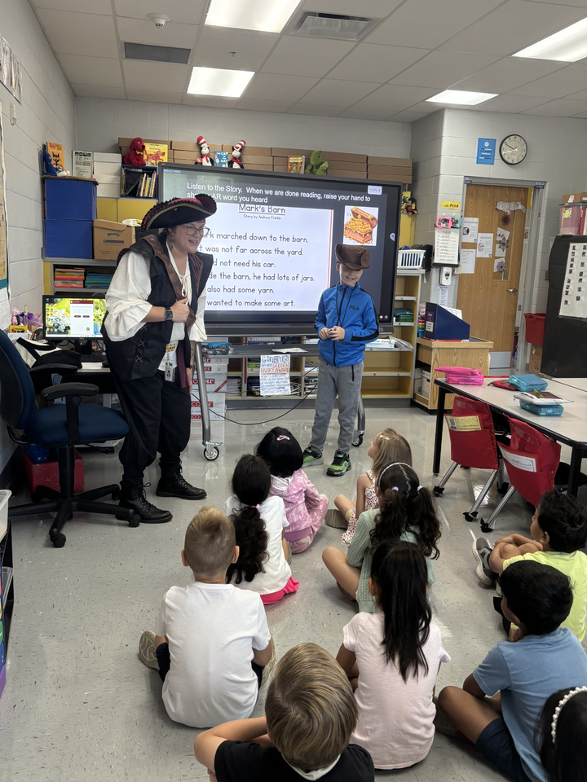
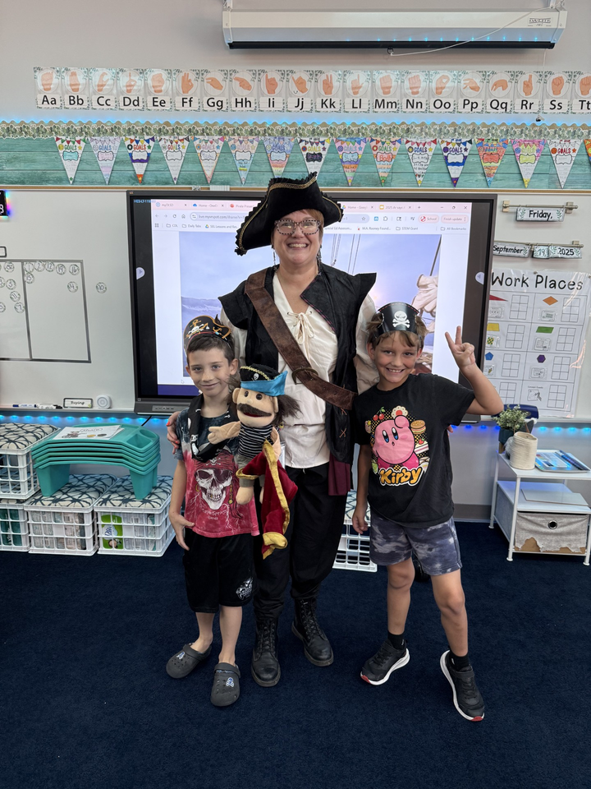
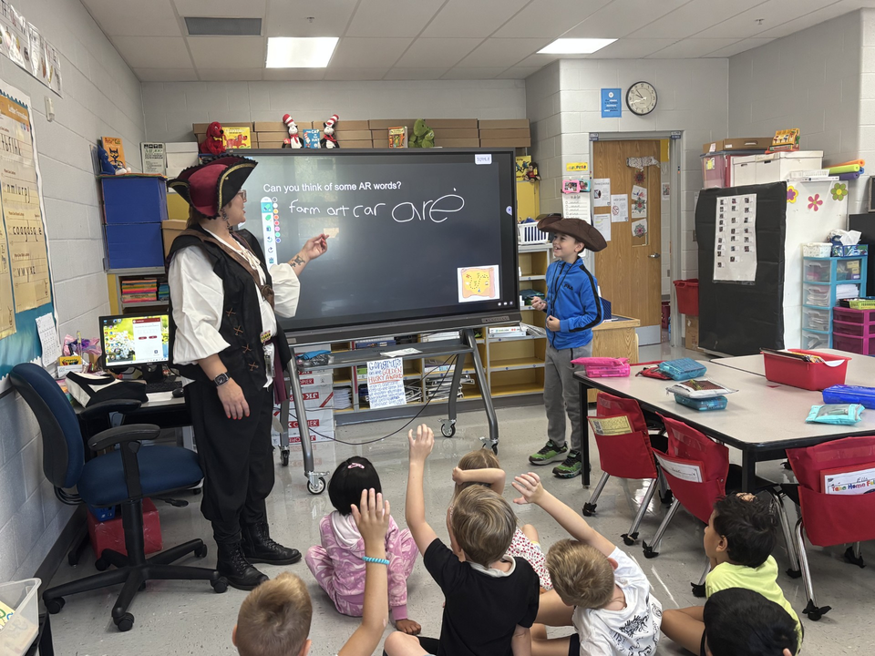
International Talk Like a Piarate Day!

Slide 30
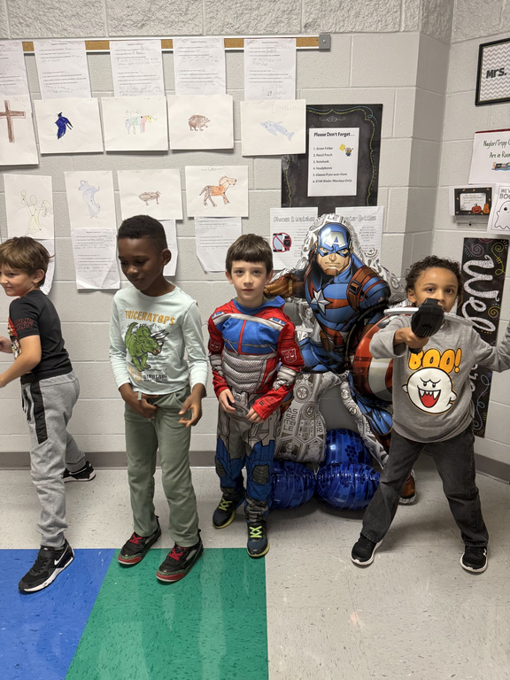
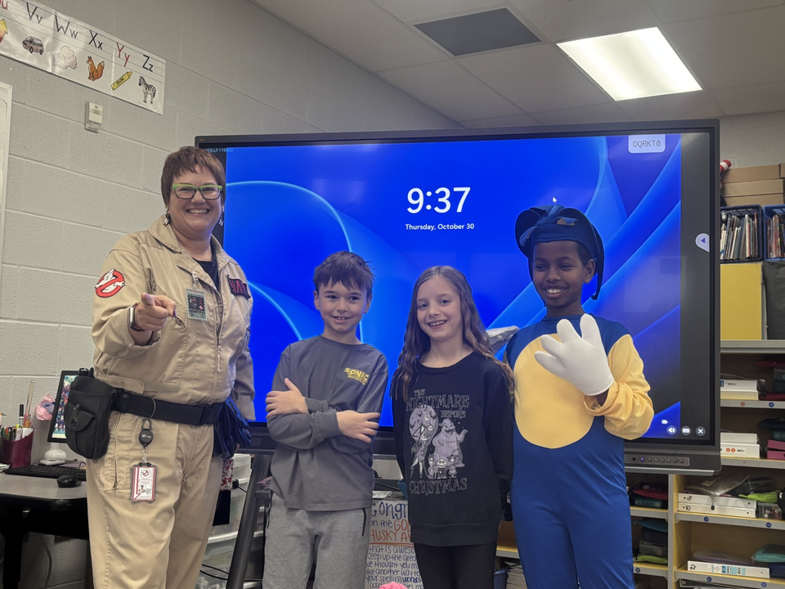
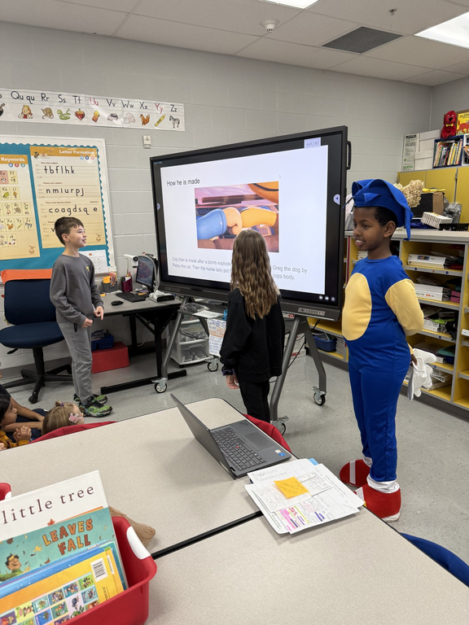
Super Hero Day!!

Slide 31

GINGERBREAD BOOK
2 First Grade Classrooms
Mrs. Knapp’s Students
Theme: Gingerbread
Interdisciplinary Studies: Reading, Writing, Science
STEM
German Culture

Slide 32

NATURE SQUAD HUSKY HUDDLE
Cross Grade Level- K, 1, 2, 3,Service Learning Group
Theme: “Saving the Bees”
STEM Thinking
Student Agency

Slide 33

Next Steps
  Putting together our Maker’s space
  Future Planning with Kelsey Smith Oletangy Academy (High School)
  Bring more STEM Thinking and Activities into my classroom
  Continued Collaboration with 1st grade

Slide 34

Words of Advice
  Introduce the Design Thinking Process in a Simple Way
  Start with small STEM projects
  Maybe focus on holidays
  Or, activities that tie in with curriculum that you need to teach
  Look for partners in your school, your district and your community
  Remember that you failing moves you forward

Slide 35

Discussion Time
How can we use STEM experiences to:
Reimagine Education
Reconnect with the joy of teaching
Empower Students to Change the World

Slide 36
planning/collaborating time

Slide 37


thank
you
for Attending!
theresa_knapp@olsd.us

