Slide 1
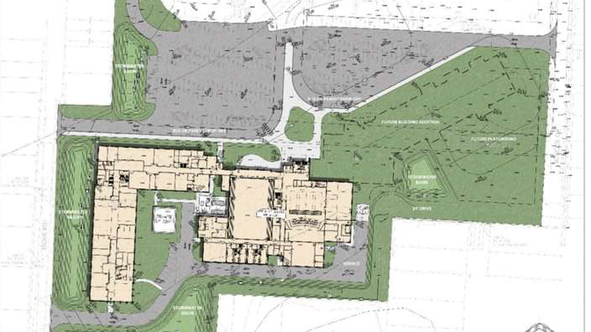

BELPRE CITY SCHOOLS
From Portrait to Practice to Place
Building educator capacity, system alignment, and a school designed for 21st-century teaching & learning
Notes:
Welcome. Over the next 55 minutes I'm going to tell you the story of how one small, rural Appalachian district in Ohio moved from a traditional, content-only model of school toward a 21st-century vision for every graduate — and how that vision literally reshaped our professional development, our classrooms, and eventually the buildings themselves. Behind the title, ghosted, is the actual site plan for the new building — the literal 'Place' we ended up at.
The title is 'From Portrait to Place' because that is the whole arc: we started with a Portrait of a Graduate — a picture of the competencies we wanted every student to leave us with — and we finished with a Place, a new PreK-12 building designed to make that Portrait possible. Keep one sentence in your head the entire time: the Portrait of a Graduate was always about the building, and the building was always about the Portrait of a Graduate.

Slide 2
THE THROUGHLINE OF THIS ENTIRE STORY
The Portrait of a Graduate
was always about the building.
The building was always about
the Portrait of a Graduate.
Vision, professional learning, and physical space are one connected system — not three separate projects.
Belpre City Schools | From Portrait to Place
02
Notes:
Before we start, the big idea. It would be easy to hear this as three stories: a story about a Portrait of a Graduate, a story about professional development, and a story about a construction levy. It is not. It is one story.
Every decision about how we would teach was a decision about what kind of space we'd need. And every decision about the building was justified by, and in service of, the competencies we promised our community. If you take nothing else away today, take this: vision, adult learning, and physical space have to be designed together. When districts treat them as separate initiatives, they fail. When they treat them as one system, they compound.

Slide 3
WHERE WE'RE GOING
Our roadmap for the next 55 minutes
01
Our theory
02
Diagnosing the system
03
The Eagle Flight Plan
A conversation with the whole community (2019)
Root causes and a theory of action
Job-embedded professional learning in three domains
04
Did it work?
05
From learning to place
06
A 21st-century building
What the research on our own teachers revealed
The hardest capital levy campaign in 60 years
Guiding principles, design, and a sneak peek
Belpre City Schools | From Portrait to Place
03
Notes:
Here's the map. We'll begin in 2019 with the community conversation that produced our Portrait of a Graduate. Then we'll look at how we diagnosed the system's real problems and built a theory of action. Third, the heart of the work — the Eagle Flight Plan, our job-embedded professional development. Fourth, the evidence: I actually studied my own teachers, and I'll share what we found. Fifth, the levy — a genuinely hard, emotional campaign to fund a new building. And finally, a sneak peek at what a building designed around all of this actually looks like.
Watch for the throughline reappearing in every section.

Slide 4
PART 01 · 2019
It started with
a conversation
Before we changed a single classroom, we asked our whole community what a Belpre graduate should become.
Belpre City Schools | From Portrait to Place
04
Notes:
[Section transition] Part 01 · 2019 — It started with a conversation. Pause here. Signal the shift and set up what's coming: Before we changed a single classroom, we asked our whole community what a Belpre graduate should become.

Slide 5
KNOW THE CONTEXT
A small, rural, Appalachian district
~900
Students, grades K–12
~50
Faculty members
Belpre City Schools sits in Washington County, Ohio, along the Ohio River — a proud Appalachian community that celebrated 150 years of service. Change here is treated cautiously; as one scholar put it, “what people resist is not change per se, but loss.”
52.6%
Eligible for free / reduced meals
13 yrs
Avg. teacher experience — the least in the county
So any new vision had to feel like carrying the best of Belpre forward — never replacing it. That single insight shaped how we introduced every change that follows.
Belpre City Schools | From Portrait to Place
05
Notes:
First, context, because context is everything. Belpre is small — about 985 students, roughly 50 teachers — rural, and Appalachian, sitting right on the Ohio River. We had just celebrated 150 years. In a community like ours, people are wary of outside leaders and wary of change; the sociology of Appalachia is that folks fear losing what's familiar. Heifetz's line guided me constantly: people don't resist change, they resist loss.
A few numbers that mattered later: over half our students qualify for free or reduced lunch, and our faculty was actually the least experienced in the county, averaging 13 years versus 16.5 county-wide, with a wave of retirements coming. That youth turned out to be an asset for this work — but it also meant we had to build capacity deliberately. The lesson: whatever we launched had to honor local identity and feel like taking the best of Belpre forward with a few upgrades.

Slide 6
HOW THE VISION WAS BUILT
200+ voices, not a back room
▪ Everyone at the table. Parents, students, teachers, school and district leaders, church congregations, the PTA, civic groups, business leaders, and city council.
▪ Structured sessions. Facilitated 1.5-hour conversations grounded in the research on 21st-century competencies.
▪ Community chose the competencies. Stakeholders directly named the skills a Belpre graduate must carry into the future.
▪ A two-day board retreat (Sept 2019) synthesized the input; the Board formally adopted the Portrait in February 2020.
▪ The dividend came later. This same trust became the political capital we spent at the ballot box.
200+
stakeholders across Belpre helped define what our students should know AND be able to do
Not a vision written in a back room.
Belpre City Schools | From Portrait to Place
06
Notes:
This is the part districts skip and later regret. We did not write a vision in a conference room. Early in 2019 we opened a genuine, sustained conversation with more than 200 stakeholders — parents, students, teachers, principals, pastors, the PTA, Rotary and the other civic clubs, business owners, city council. We ran facilitated 90-minute sessions that started with the research and ended with stakeholders literally choosing the competencies they wanted.
Why does that matter? Two reasons. One, it's better vision — the community owns it. Two, and remember this for the levy section: those same relationships and that same credibility became the political capital we drew on years later when we asked the community to fund a building. The Board took all that input into a two-day retreat in September 2019 and formally passed the Portrait of a Graduate in February 2020.

Slide 7
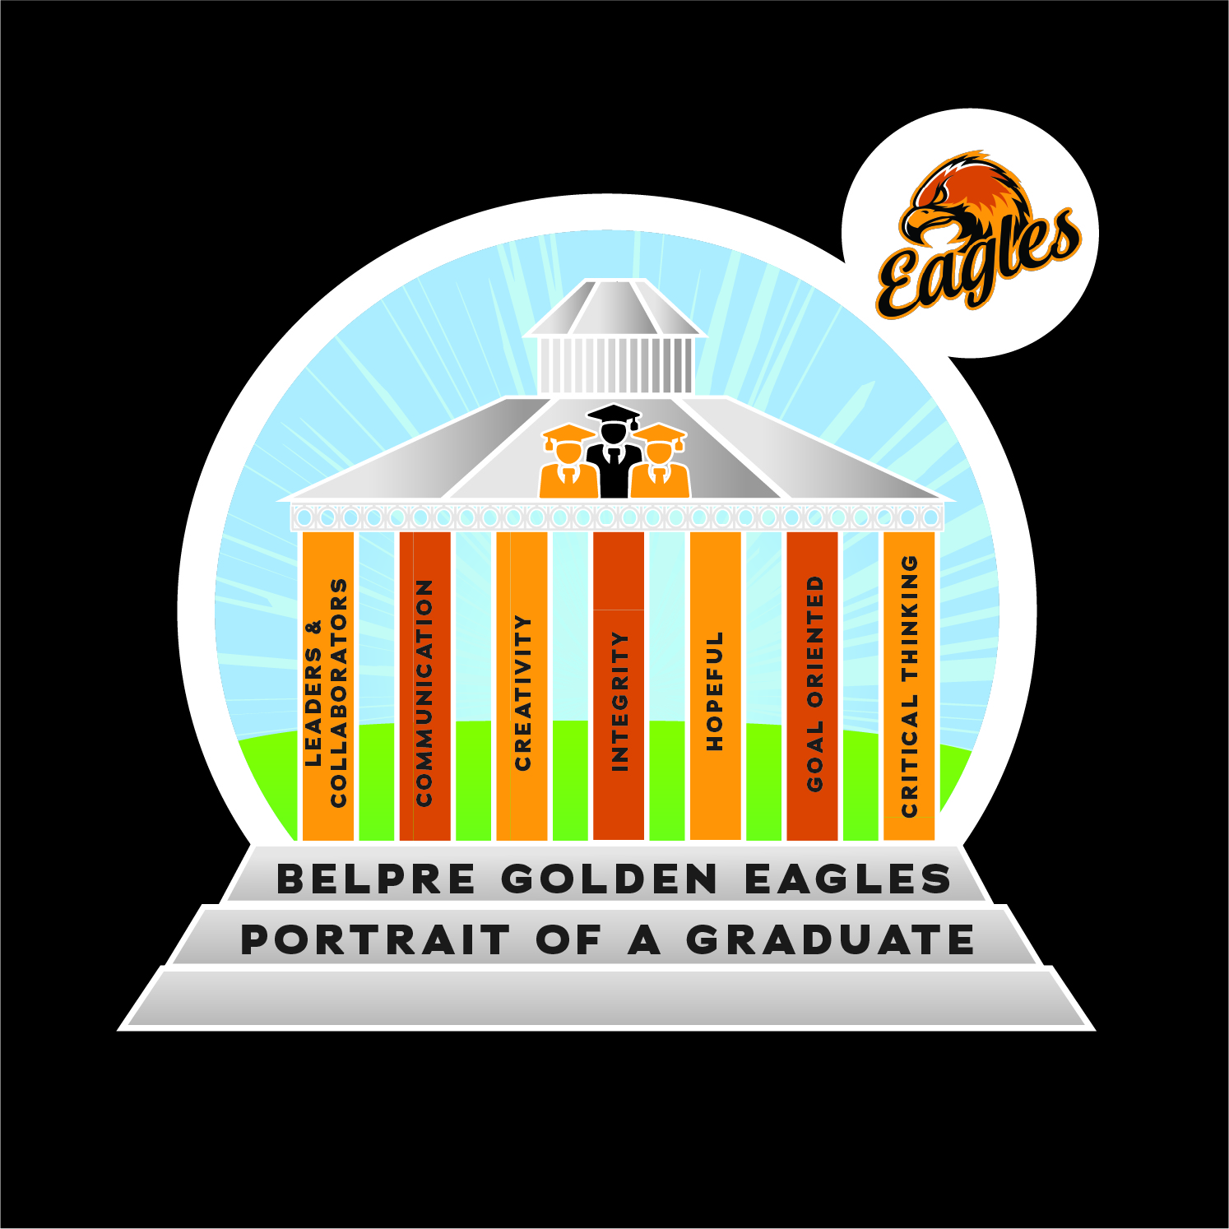
THE BELPRE PORTRAIT OF A GRADUATE
Eight competencies, chosen by us
▪ Critical Thinking
▪ Creativity
▪ Communication
▪ Collaboration (Leaders & Collaborators)
▪ Integrity
▪ Hope
▪ Goal Orientation
▪ Content Mastery — still essential
Named by the community — our district’s North Star.
Belpre City Schools | From Portrait to Place
07
Notes:
Here is the Portrait itself. In addition to content mastery — which we never abandoned — our community named these competencies: critical thinking, creativity, communication, collaboration, integrity, hope, and goal orientation. This became, in our language, the district's 'North Star.'
The research case for this is strong: Golinkoff and Hirsh-Pasek's '6 C's,' Costa and Kallick on habits of mind, and work showing these skills can be up to ten times more predictive of long-term success than test scores. In a world where knowledge is a commodity and any answer is a Google search away, the value shifts to what you can DO with knowledge. That's the shift we committed to — from students consuming content to students producing work while practicing these competencies.

Slide 8
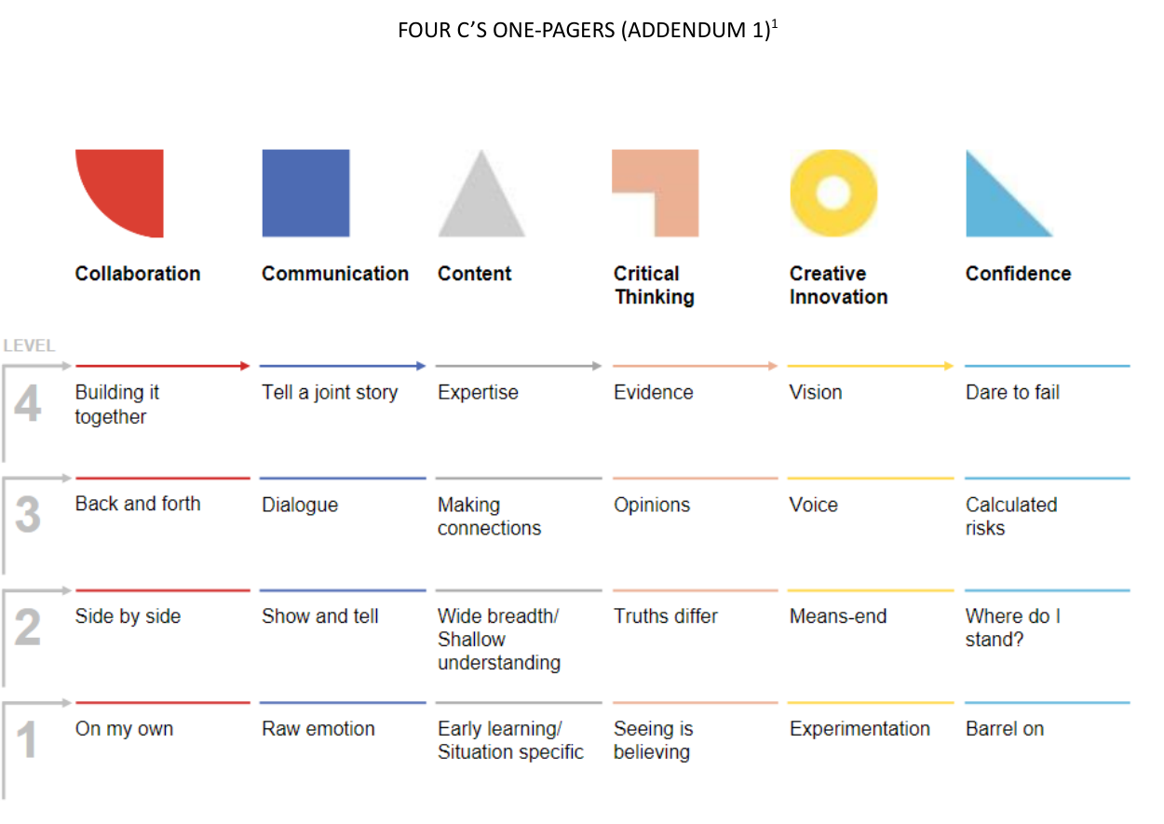
MAKING THE PORTRAIT REAL · SHAREABLE TOOL 1 OF 3
“Experience the Four C’s” professional learning
Adults don’t read about the competencies — they live them.
Built because staff had heard of the Portrait but weren’t sure what it meant in their room. ~90 minutes; ideal group of 10–20.
▪ Collaboration — the Cracker Barrel peg game, played in rounds from solo to full teamwork.
▪ Creativity — teams use a “creativity kit” of odds & ends to build the school of the future.
▪ Critical Thinking — a facilitated case-study discussion; peers spot each level live.
▪ Communication — name the level of communication modeled in short film & TV clips.
Each “C” grows across four levels — the shared language beneath our Portrait.
↓
YOURS TO DOWNLOAD & ADAPT — free for your district, in today’s session resources
Belpre IP · 4C content adapted from Becoming Brilliant (Golinkoff & Hirsh-Pasek, 2016)
Belpre City Schools | From Portrait to Place
08
Notes:
Now, the natural question after seeing the Portrait is the one our own staff asked: 'That's nice, but what does it mean for me on Monday morning?' This is the first of three tools I'm sharing with you today that you're free to download and adapt.
Rather than a book study, we built a 90-minute experiential PD called 'Experience the Four C's.' Adults don't just hear about the competencies — they live them. They play the Cracker Barrel peg game in rounds to feel the levels of collaboration; they build 'the school of the future' from a bag of odds and ends to experience creativity; they discuss a case study to surface critical-thinking levels; and they watch film clips to identify levels of communication. The intellectual content behind the four levels comes from Golinkoff and Hirsh-Pasek's 'Becoming Brilliant,' shown in this matrix. It's ideal for 10-20 people and we even use it for onboarding. The full facilitator's guide is in your resources.

Slide 9
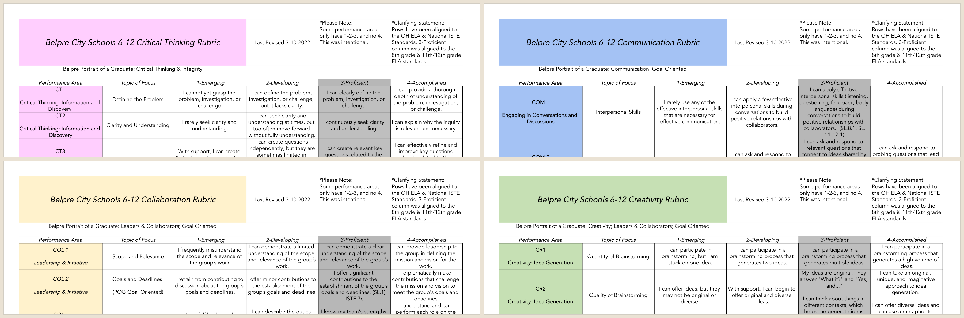
MAKING THE PORTRAIT REAL · SHAREABLE TOOL 2 OF 3
Student rubrics for every competency
We turned the Portrait into something students can actually track.
▪ Four rubrics — Critical Thinking, Communication, Collaboration, Creativity.
▪ Four levels — Emerging → Developing → Proficient → Accomplished.
▪ Student-facing — written in “I can…” language kids can own.
▪ Standards-aligned — each row maps to Ohio ELA & national ISTE standards.
▪ The connective tissue — between a big vision and Monday’s lesson.
Color-coded by competency — the Proficient column is anchored to grade-level standards.
↓
YOURS TO DOWNLOAD & ADAPT — free for your district, in today’s session resources
Belpre City Schools IP · 6–12 Portrait of a Graduate rubrics (rev. 2022)
Belpre City Schools | From Portrait to Place
09
Notes:
Tool two, also downloadable. Naming competencies isn't enough — you have to define them so students and teachers know what growth looks like. So we built student-facing rubrics for four of our competencies: critical thinking, communication, collaboration, and creativity. Each has four levels, from Emerging to Accomplished, written in student 'I can' language, and — importantly — every row is aligned to Ohio's ELA standards and national ISTE technology standards, with the Proficient column pegged to grade-level expectations. These are the connective tissue between the big vision of the Portrait and the daily work in classrooms, and they're the yardstick students use to see their own progress on the competencies. Take them, adapt them to your own Portrait.

Slide 10
PART 02
Understanding
our current state
A vision is only as good as your honesty about the system that has to deliver it.
Belpre City Schools | From Portrait to Place
11
Notes:
[Section transition] Part 02 — Understanding our current state. Pause here. Signal the shift and set up what's coming: A vision is only as good as your honesty about the system that has to deliver it.

Slide 11
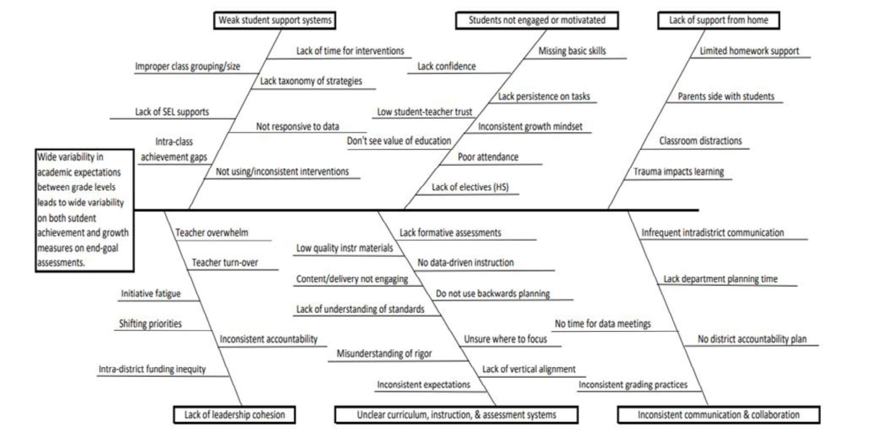
ROOT-CAUSE ANALYSIS
We named the barriers out loud
Six focus areas
▪ Weak student support systems
▪ Students not engaged / motivated
▪ Lack of support from home
▪ Lack of leadership cohesion
▪ Unclear curriculum, instruction & assessment
▪ Inconsistent communication & collaboration
Belpre City Schools | From Portrait to Place
12
Notes:
Once we had the vision, we got brutally honest about the current state. Teacher leaders — facilitated by the School Performance Institute — built this fishbone, or root-cause, diagram. On the head of the fish: wide variability in academic expectations across grade levels producing wide variability in student outcomes. The bones name the causes across six areas: weak student support, disengaged students, limited support from home, lack of leadership cohesion, inconsistent communication, and — the one we'd tackle first — unclear curriculum, instruction, and assessment systems.
I show teachers this because it models something important: you cannot improve a system you're unwilling to describe honestly. This wasn't done TO our staff; it was done BY our teacher leaders.

Slide 12
WHERE WE CHOSE TO START
“Unclear curriculum, instruction,
and assessment systems.”
We deliberately targeted adult implementation first — the decisions teachers make — rather than jumping straight to student measures. Fix how adults design learning, and student results follow.
Belpre City Schools | From Portrait to Place
13
Notes:
Of those six areas, we made a strategic choice to begin with 'unclear curriculum, instruction, and assessment systems.' And a subtle but crucial decision underneath that: we targeted ADULT implementation measures before student outcome measures. In other words, rather than obsess first over test scores, we focused on the concrete decisions our educators make when they design and deliver learning — because those are the levers adults actually control, and improving them is what ultimately moves students. This reframing is what made the whole professional development program coherent.

Slide 13
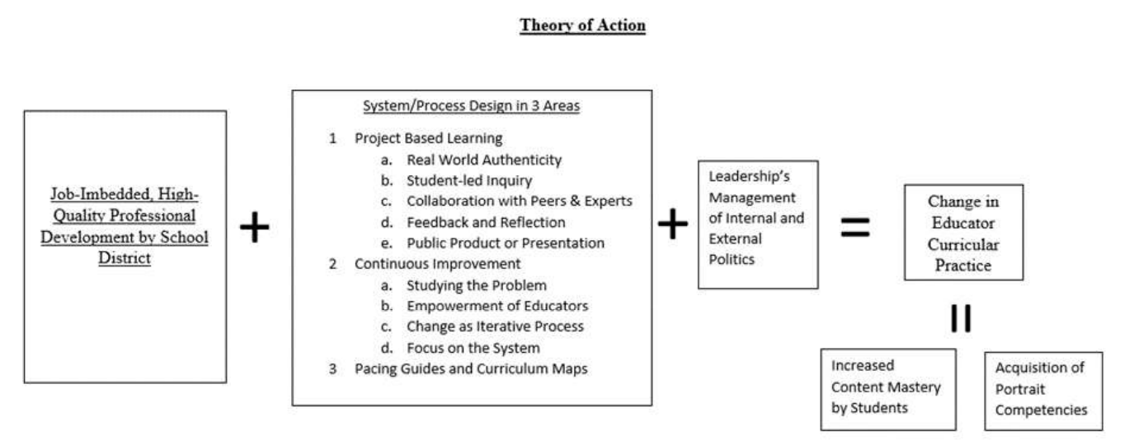
OUR THEORY OF ACTION
If we do this, then that will follow
The bet
Train teachers in job-embedded sessions, manage the internal and external politics, and educators will redesign pacing guides, adopt project-based learning, and reflect through continuous improvement — lifting both achievement and competencies.
Job-embedded PD + system/process design (PBL, continuous improvement, curriculum maps) + managing the politics of change = changed educator practice → content mastery + Portrait competencies.
Belpre City Schools | From Portrait to Place
14
Notes:
From that focus we built a theory of action — an if/then logic model. If we provide job-embedded, high-quality professional development, plus intentional system and process design in three areas — project-based learning, continuous improvement, and curriculum maps/pacing guides — plus leadership that manages the internal and external politics of change, THEN we get real change in educator curricular practice. And that change, in turn, yields increased content mastery AND acquisition of the Portrait competencies.
Notice 'managing politics' is baked right into the equation. We knew from the research that change efforts don't usually fail on strategy; they fail on politics. More on that in the levy section.

Slide 14
WHY MOST PROFESSIONAL DEVELOPMENT FAILS
The problem we were determined to beat
$18K
spent per teacher, per year on PD (national avg.)
3 in 10
teachers actually improved — some lost ground
10,507
teachers studied by The New Teacher Project (2015)
Jacob & McGovern (2015) found districts spend enormous sums on PD with little to show for it. Our theory attacked the root cause: make professional learning job-embedded, cumulative, and tied to the whole system — not an expensive, disjointed experience for isolated individuals.
Belpre City Schools | From Portrait to Place
15
Notes:
Here's the national backdrop, and it's sobering. The New Teacher Project surveyed over 10,500 teachers and 500 leaders. Districts were spending on average around $18,000 per teacher per year on professional development — and only about three in ten teachers showed any improvement, with some actually losing ground. Billions of public dollars, minimal return.
We were determined not to be that statistic. The design principle: professional learning had to be job-embedded, cumulative, and connected to changes in the district's systems and processes — an investment in the district as a whole, not a menu of disconnected workshops for individuals. The public funds this; the public deserves impact. That conviction shaped everything in the next section.

Slide 15
PART 03 · 2020–2024
The Eagle
Flight Plan
A four-year, job-embedded professional learning program to build capacity for authentic units — for every learner.
Belpre City Schools | From Portrait to Place
16
Notes:
[Section transition] Part 03 · 2020–2024 — The Eagle Flight Plan. Pause here. Signal the shift and set up what's coming: A four-year, job-embedded professional learning program to build capacity for authentic units — for every learner.

Slide 16
PROGRAM AT A GLANCE
How the Eagle Flight Plan works
4 yrs
Rotational plan, 2020–21 → 2023–24
3
Training domains every teacher rotates through
Job-embedded means real.
Training happened during the work day, during the school year — not tacked onto summer. Each cohort also received on-going virtual coaching, on-demand support, and asynchronous learning between sessions.
Format adapted with help from the Dayton Regional STEM School and Ohio’s SOAR network.
8 days
Job-embedded training days built into the calendar — 4× prior commitment
All
Faculty split into cohorts by team / grade level
Why 8 days? Time is the resource teachers never have. Building it into the contract made growth the default — not an option to opt out of.
Belpre City Schools | From Portrait to Place
17
Notes:
The Eagle Flight Plan is our four-year professional development program, 2020-21 through 2023-24. Every teacher rotates through three training domains, and by the end everyone has trained in all three and produced a capstone artifact for each.
The non-negotiable was job-embedded time: eight dedicated training days built into the school calendar — four times what we'd ever committed before — during the work day, during the year. Between formal days, cohorts got virtual coaching, on-demand help, and asynchronous options. We didn't invent this alone; we adapted formats from the Dayton Regional STEM School and collaborated in Ohio's SOAR network. And I'll foreshadow the research: teachers told us the single most important design choice was that the time was embedded and therefore not optional.

Slide 17
TRAINING DOMAIN 1
Standards-Based Unit Design
Using the Ainsworth & Donovan framework, teachers rebuilt curriculum guides and pacing calendars so priority standards AND Portrait competencies are planned for on purpose.
THE CAPSTONE ARTIFACT
▪ Priority standards. Cover what matters most from Ohio’s Learning Standards.
▪ Competencies by design. Build in time to practice and master Portrait competencies.
▪ Performance tasks. Inquiry + real-world problem solving where students engage authentically.
▪ 4–6 week units created and ready to teach.
A new curriculum map + pacing guide, and a full unit plan that names the priority standards, Portrait competencies, big ideas, essential questions, performance tasks, and assessments.
Belpre City Schools | From Portrait to Place
18
Notes:
Domain one: standards-based unit design. Teachers used the Ainsworth and Donovan curriculum framework to rebuild their pacing guides so that priority academic standards AND the Portrait competencies were planned deliberately — not left to chance. A key ingredient here is the 'performance task': an activity where, through inquiry and real-world problem solving, students authentically engage the curriculum. We adapted that definition to explicitly include opportunities to practice Portrait competencies. The capstone: a new curriculum map plus a full 4-6 week unit plan naming standards, competencies, big ideas, essential questions, performance tasks, and assessments. This is the 'clarity in curriculum' the fishbone demanded.

Slide 18
TRAINING DOMAIN 2
Project-Based Learning
PBL is the engine that lets a single task teach rigorous content and the Portrait competencies at the same time — real-world, student-led, and public.
THE CAPSTONE ARTIFACT
▪ Real-world authenticity and student-led inquiry.
▪ Collaboration with peers and outside experts.
▪ A public product or presentation with an authentic audience.
▪ Feedback & reflection built into the process.
A fully designed PBL task ready to deploy: standards assessed, competencies explored, a driving question, assessment plan, learning activities, culminating event, resources, and student reflection.
Belpre City Schools | From Portrait to Place
19
Notes:
Domain two: project-based learning. If domain one is the blueprint, PBL is the engine. A well-designed project can teach demanding academic content and the Portrait competencies simultaneously — because real, authentic work naturally demands communication, collaboration, critical thinking, and creativity. Teachers trained with an outside vendor on designing projects with real-world authenticity, student-led inquiry, collaboration with peers and experts, feedback and reflection, and a public product. The capstone was a complete, ready-to-run PBL task. And remember the research from my STEM work at Penn: a randomized controlled trial found PBL students were 8-10 percentage points more likely to score a 3+ on AP exams — across income levels. This isn't fluff; it moves achievement.

Slide 19
TRAINING DOMAIN 3
Continuous Improvement
New units and projects need ongoing tuning. Teachers learned a structured protocol (adapted from Berger and the Dayton Regional STEM School) to reflect, get feedback, and improve — together.
THE CAPSTONE ARTIFACT
▪ Study the problem of practice, honestly.
▪ Empower educators to lead their own improvement.
▪ Change as an iterative process — formative or summative.
▪ Focus on the system, not blame on individuals.
A tuning-protocol session captured in a presentation: the problem of practice, concerns, non-negotiables, structured peer feedback, and the team’s reflection on what they heard.
Belpre City Schools | From Portrait to Place
20
Notes:
Domain three: continuous improvement. Designing a great unit once isn't enough; teachers need dedicated structure and time to keep improving. Using a tuning protocol adapted from Ron Berger's work and the Dayton Regional STEM School, teachers bring a real problem of practice, share non-negotiables and concerns, and receive structured feedback from colleagues who ask clarifying questions and offer suggestions — then the presenting team reflects. The capstone captured that process. The mindset shift is important: change is iterative, educators are empowered to lead it, and we focus on improving the system rather than assigning blame. This closes the loop from the fishbone's 'inconsistent accountability' and 'no time for data meetings.'

Slide 20
A DELIBERATE DESIGN CHOICE
Why cohorts, not everyone at once?
1
Mirror reality
2
Innovate on all fronts
3
Defuse the politics
Nonlinear, rolling change reflects how society and school systems actually change — messier than ‘everyone learns the same thing at once,’ but truer.
Leadership could execute all three pathways immediately and make small course corrections with small groups instead of one giant, risky pivot.
Splitting teachers into three groups lowered the ability of any single faction to stall the whole change initiative’s momentum.
THE RESULT Messier than a single, synchronized rollout — but we innovated on all three fronts at once, corrected course in small batches, and no one faction could stall the whole thing.
Belpre City Schools | From Portrait to Place
21
Notes:
One design question split our leadership team: should the whole district focus on one domain at a time, or should we run cohorts moving through different domains simultaneously? We chose cohorts, for three reasons. First, it mirrors reality — real change is nonlinear and rolling, not a tidy synchronized march, and we wanted the experience to feel like the real thing. Second, it let us innovate on all three pathways at once and make small corrections with small groups, rather than betting everything on one massive pivot. Third — and this is the political insight — splitting teachers into three groups meant no single faction could stall the entire initiative's momentum. Change dies from politics; we designed against that from day one.

Slide 21
PROOF OF LEARNING
Every cohort produced something usable tomorrow
Standards-Based Unit Design
A curriculum map + a complete 4–6 week unit plan
Project-Based Learning
A ready-to-deploy PBL task with driving question & assessment
Continuous Improvement
A tuning-protocol session on a real problem of practice
The capstone is the point — teachers built work they could use in class immediately.
Belpre City Schools | From Portrait to Place
22
Notes:
Across all three domains, the design principle was the same: the capstone had to be immediately usable in a real classroom. Not a reflection paper, not a quiz — an actual artifact. In unit design, a curriculum map and a full unit. In PBL, a ready-to-run project. In continuous improvement, a real tuning session on a genuine problem of practice. This is how you close the knowing-doing gap: you don't just tell teachers about good practice, you have them build the real thing, with coaching, during the work day. Which brings the obvious question — did any of it actually work? I decided to find out.

Slide 22
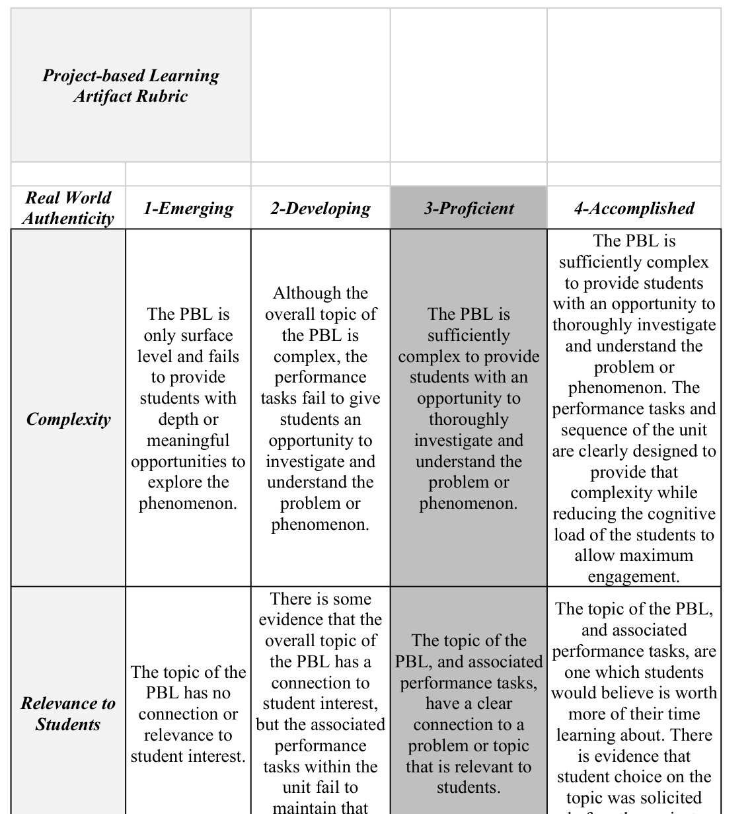
MAKING THE PORTRAIT REAL · SHAREABLE TOOL 3 OF 3
How we defined a great capstone
One research-based rubric per training domain — each scored 1-Emerging → 4-Accomplished.
Standards-Based Unit Rubric
Priority standards, pacing, performance tasks, transfer, big ideas, and formative/summative assessment.
Project-Based Learning Rubric
Real-world authenticity, student-led inquiry, collaboration, feedback & reflection, public product.
Continuous Improvement Rubric
Defining the problem, desired change, empowering educators, iterative process, focus on the system.
Sample: the Project-Based Learning artifact rubric
↓
YOURS TO DOWNLOAD & ADAPT — free for your district, in today’s session resources
Belpre City Schools IP · Capstone Artifact Rubrics
Belpre City Schools | From Portrait to Place
23
Notes:
The third downloadable tool answers a fair question: how did we judge whether a capstone was any good? We built a research-based rubric for each of the three training domains — a Standards-Based Unit rubric, a Project-Based Learning rubric, and a Continuous Improvement rubric — each scored on the same four-level scale from Emerging to Accomplished. On the left is a sample: the PBL artifact rubric, with dimensions like real-world authenticity, student-led inquiry, and a public product. These aren't just grading tools; they define quality and gave our teachers a clear target. And — this is the bridge to the next section — these are the exact instruments I used to study my own teachers' artifacts. So hold these in mind: they're yours to take, and they're about to become the measuring stick for our results.

Slide 23
PART 04
Did it work?
I studied my own teachers — rubrics on their artifacts and interviews in their own voice — to see if the program changed practice.
Belpre City Schools | From Portrait to Place
24
Notes:
[Section transition] Part 04 — Did it work?. Pause here. Signal the shift and set up what's coming: I studied my own teachers — rubrics on their artifacts and interviews in their own voice — to see if the program changed practice.

Slide 24
THE STUDY
Three questions drove the research
01
Did the artifacts score well?
How did trained teachers’ capstone artifacts score on research-based rubrics — and did scores differ by school or teacher characteristics?
02
What made it possible?
How did teachers describe the way their PD experience led to their ability to create the artifacts — and how could it be improved?
03
What happened with students?
For teachers who implemented their artifact in real practice, how did they describe their own and their students’ experiences?
Belpre City Schools | From Portrait to Place
25
Notes:
As part of my doctoral work at Penn, I ran a program evaluation on our own project-based learning cohort. Three research questions. One: did teachers' capstone artifacts actually score well on research-based rubrics, and did that vary by school or teacher characteristics? Two: how did teachers describe the way the PD led to their ability to create those artifacts — and how could we improve it? Three, and most important to me: for teachers who actually used their artifact with kids, what happened for them and their students? I used a mixed-methods design — rubric scores on artifacts, plus interviews and questionnaires so I could hear educators in their own voice.

Slide 25
HEADLINE FINDINGS
Knowledge grew — but practice changed more
Knowledge & skill — up, with variance
Practice — changed consistently
▪ Most participants could identify the core elements of a well-designed PBL.
▪ Some variance remained; a few struggled to recall the exact protocol steps.
▪ Questionnaire wording may have understated true understanding.
▪ 7 of 9 questionnaire respondents had already attempted a PBL.
▪ 3 of 4 interviewees had run one or more — two had done multiple and were planning the next.
▪ The lone teacher who hadn’t yet was actively preparing to.
WHY IT MATTERS Behavior change — not recall — is the real test of professional development. Most of our teachers actually changed what they do. Three themes explain why.
Belpre City Schools | From Portrait to Place
26
Notes:
The headline is a little counterintuitive. On knowledge, we saw an increase but with real variance — most teachers could identify the core elements of a strong project, though some couldn't recall the exact protocol, and honestly one of my questionnaire items may have been read as asking for something narrower than intended.
But on PRACTICE — actual behavior change — the results were more consistent and, frankly, more important. Seven of nine questionnaire respondents had already tried a PBL. Three of four interviewees had run at least one, two had done multiple and were planning more, and the one holdout was actively preparing his first. For a profession where new initiatives usually die on the vine, getting most teachers to actually change what they do is the whole ballgame. Then three themes explained why.

Slide 26
FINDING THEME 1
Time — the make-or-break resource
“
Where it was embedded in the work day, it’s not really an option — you’re just going to do it. I don’t think you would have had as much participation from teachers otherwise.
— Teacher B (early-career)
TAKEAWAY Job-embedded time turned professional growth from optional to inevitable. But teachers also named time as the biggest barrier to implementation.
Belpre City Schools | From Portrait to Place
27
Notes:
Theme one: time — and it cut both ways. On the one hand, teachers were emphatic that embedding the training in the work day is what made it happen. Teacher B, an early-career teacher, said plainly that if it had been sign-up-on-your-own-time, she and many others would have skipped it; embedded, it simply gets done. A veteran, Teacher C, said she never would have gone as deep without protected time, because building a real PBL is enormously time-consuming.
On the other hand, time was also the number-one barrier to implementation. Snow days derailed units; one teacher abandoned the mock-trial finale she was most excited about; another feared 'wasting' time in a post-No Child Left Behind world where you must 'cover' the curriculum. So the paradox: protected time was both the key ingredient AND the chief obstacle. Design implication for later: the building itself needed to make collaborative time easier.

Slide 27
FINDING THEME 2
Collaboration — the accelerator
“
We had a lot of collaborative time to work, which I loved because I learned through doing — just like we want the kids to do. It was a group effort.
— Teacher B
TAKEAWAY Cohorts let teachers work with colleagues — even across buildings and departments — breaking the isolation that stalls most change.
Belpre City Schools | From Portrait to Place
28
Notes:
Theme two: collaboration. Teachers repeatedly credited each other — sometimes colleagues they'd never worked with before — for the breakthrough ideas in their projects. Teacher B talked about learning by doing, as a team, with the coach popping in for tuning-protocol feedback. Teacher C, the only person in her department, said having colleagues from other subjects to bounce ideas off was 'extremely helpful.' Even Teacher D, who hadn't yet run his project, lit up talking history with the other social studies teachers.
Teacher isolation is the default in American schools. My Army experience taught me you build teams by putting strangers together on something hard and novel — that's exactly what the cohorts did. No one person brings everything; collaboration covered people's blind spots. This is why the cohort structure mattered, and it's a direct design cue for spaces that let adults work side by side.

Slide 28
FINDING THEME 3
Student engagement — the fuel
“
To them it felt like a game, but they were learning another language at the same time — which was really exciting. They had so much fun.
— Teacher C, after her second PBL
TAKEAWAY Seeing kids light up is what convinced teachers to keep going. Evidence of engagement fueled the next attempt — the change snowballed.
Belpre City Schools | From Portrait to Place
29
Notes:
Theme three: student engagement — the fuel that kept the change going. Teacher A said the whole point was engagement, and she saw kids who usually check out get genuinely into it, forced to communicate and have a say — 'the portrait competencies are brought out from that.' Teacher C's projects snowballed: her first felt like enjoyable work to students; by her second, tuned to their interests, they said it felt like a game while they learned another language.
This is the virtuous cycle. It's unlikely any of these teachers would have continued without visible proof that students were more motivated. Evidence of success fuels the next risk. The knowing-doing gap is wide, but a classroom full of engaged kids is what carries a teacher across it. Bottom line for this section coming up next.

Slide 29
WHAT THE PROGRAM ACTUALLY BUILT
Capacity to design authentic
units — for all learners — and
alignment across the system.
▪ Teachers who can build rigorous, competency-rich learning experiences on purpose.
▪ Shared language and consistent practice — the antidote to the fishbone’s ‘unclear systems.’
▪ A professional community that reflects, gives feedback, and improves together.
Belpre City Schools | From Portrait to Place
30
Notes:
So here's the bottom line of the professional development story. The Eagle Flight Plan built three things. First, individual capacity: teachers who can now design rigorous, authentic, competency-rich units on purpose — for all learners, not just honors kids. Second, system alignment: shared language and more consistent practice, which directly attacks the 'unclear curriculum, instruction, and assessment' root cause from our fishbone. Third, a professional culture of continuous improvement.
That's real, and I'm proud of it. But it also exposed a hard ceiling. Teachers were designing collaborative, hands-on, public, project-based learning — inside buildings designed in 1928, 1959, and 1969 for rows of desks and content delivery. The pedagogy had outgrown the place. Which takes us to the levy.

Slide 30
PART 05
From Practice to Brick
The pedagogy had outgrown the building. Now the community had to decide whether to fund a place worthy of the vision.
Belpre City Schools | From Portrait to Place
31
Notes:
[Section transition] Part 05 — From learning to place. Pause here. Signal the shift and set up what's coming: The pedagogy had outgrown the building. Now the community had to decide whether to fund a place worthy of the vision.

Slide 31
A DISTRICT AT A CROSSROADS
Repair the past, or build the future?
Our buildings had reached end-of-life — the newest opened the year we landed on the moon:
1928
1959
1963
1964
1969
Lawton
High School
Stone Elem.
HS Addition
Elementary
$44–$62M
$62.3M
+$22.3M
to REPAIR aging buildings — with NO state help
to BUILD a new PreK–12 facility
Ohio state match — only if voters pass the levy
Belpre City Schools | From Portrait to Place
32
Notes:
By 2022 the district was at a genuine crossroads. Our facilities had reached end of life. The oldest, Lawton, opened in 1928 — the year sliced bread was invented and Herbert Hoover was elected. Our newest opened in 1969, the year of the moon landing. Decades of deferred maintenance left us facing something like $44 to $62 million just to repair — with, critically, no state help for repairs.
Here's the key financial insight the community had to grasp: because Ohio would contribute a roughly $22 million match ONLY toward new construction, building new was actually cheaper to the taxpayer than repairing old. Over the life of the project, repairs would cost about the same over ten years as a new building would over thirty-seven. Doing nothing wasn't free; it was the most expensive option of all.

Slide 32

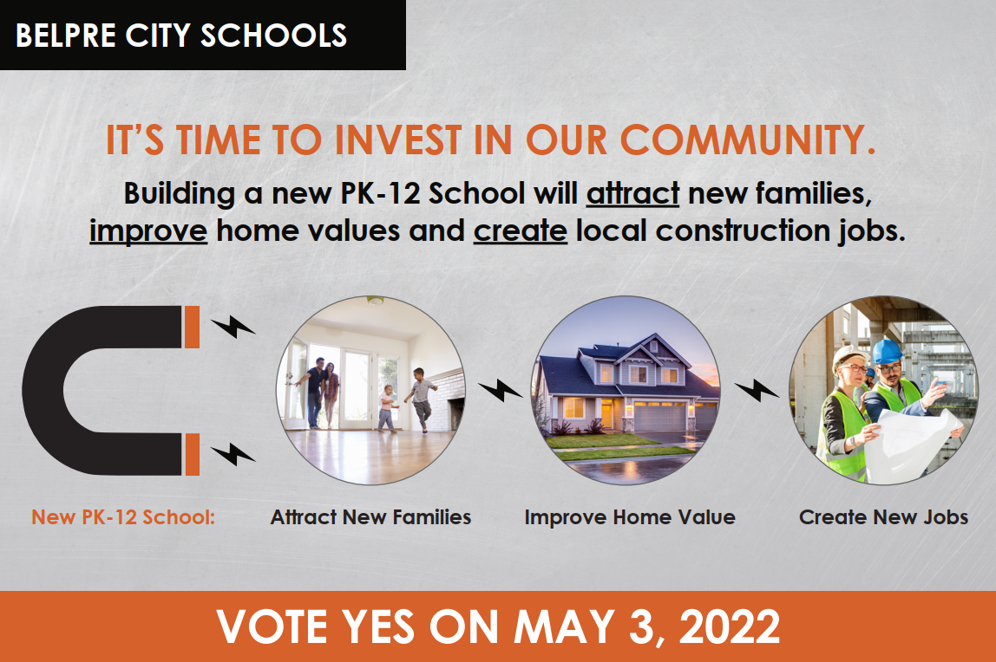
BE HONEST ABOUT THE ODDS
A community that had said ‘no’ for decades
7
failed capital attempts over 32 years
83
votes — the margin the May 2022 levy failed by
~2,000
ballots cast — the town split almost in half
Belpre City Schools | From Portrait to Place
33
Notes:
And I have to be honest about the odds, because this is where leadership gets real. Belpre had failed SEVEN previous capital attempts over thirty-two years. This community said 'no' to buildings as a matter of habit.
We put it on the May 2022 ballot anyway. Then the world turned against us: post-pandemic inflation, supply-chain chaos, and the war in Ukraine spiked our construction estimate by millions in a matter of months. Gas hit four dollars a gallon on primary morning. A vocal anti-levy coalition bought signs, pushed to consolidate Belpre with a neighboring district, and attacked our stewardship. We got closer than ever — nearly 2,000 votes cast — and lost by 83 votes. The town split almost exactly in half. Our volunteers were devastated. And that set up the hardest decision of my superintendency: do we run it again in November?

Slide 33
THE LEADERSHIP CALL
This was an adaptive challenge — not a technical one
Heifetz draws a crucial line: technical problems are solved with expertise and resources; adaptive ones require the community itself to change in order to survive.
TECHNICAL WORK
ADAPTIVE WORK
Solvable with know-how & resources
The real challenge — hearts, not just dollars
▪ Running a levy campaign
▪ Construction timelines & bidding
▪ Ballot mechanics and financing
▪ Securing the state’s matching funds
▪ Helping a wary community see the school as the heart of its future
▪ Moving people through the fear of loss that drives resistance
▪ Re-energizing volunteers jaded by seven past failures
“What people resist is not change per se, but loss.” The task wasn’t to argue harder — it was to help Belpre adapt and see the future as a gain, not a loss.
Belpre City Schools | From Portrait to Place
34
Notes:
How do you make that call well? My Penn coursework gave me the frame. Heifetz distinguishes technical problems from adaptive ones. Technical problems you solve with expertise and resources — how to run a levy campaign, how long construction takes, the mechanics of getting on the ballot, the financing. We could hire and consult our way through those.
But the heart of this was adaptive. An adaptive challenge is one where the organization — here, the whole community — has to change in order to survive. Convincing a cautious Appalachian town that the school is the heart of its future, moving people through the fear of loss that actually drives their resistance, and re-energizing volunteers who'd been burned by seven previous failures — none of that is solved with a spreadsheet. Heifetz's line was my compass: what people resist is not change per se, but loss. So my job wasn't to argue harder or louder. It was to help Belpre adapt — to reframe a new building not as losing the past, but as carrying the best of Belpre forward. That reframing is exactly what the next slide is about.

Slide 34
THE ARGUMENT THAT CONNECTED IT ALL
We didn’t sell a building.
We sold the Portrait — in brick.
▪ Instruction needs space. Project-based learning, multimodal creation, and collaboration require rooms our 1928–1969 buildings simply don’t have.
▪ Trust from the Portrait work. We pointed to the 200+ stakeholder process as proof the district shares decisions with its community.
▪ The school as community anchor. A school generates the social capital and pride a small town needs to attract families and survive.
Belpre City Schools | From Portrait to Place
35
Notes:
And here is the throughline made explicit — the argument that connected everything. We did not campaign on a building. We campaigned on the Portrait of a Graduate, rendered in brick.
The case was: the instructional strategies our teachers had just spent years learning — project-based learning, multimodal creation, collaboration, public presentation — physically require spaces our 1928-to-1969 buildings don't have. Bigger, flexible classrooms; small-group areas; presentation spaces. Second, we leaned on the trust we'd built during the Portrait process; that 200-plus-stakeholder collaboration was our evidence that this district genuinely shares decisions with its community. And third, drawing on Putnam, Hanifan, and the research on schools as sources of social capital, we argued the school is the anchor of the whole town — not just a service for the 20% of households with kids in it. The Portrait gave the building its meaning, and the building gave the Portrait a home.

Slide 35
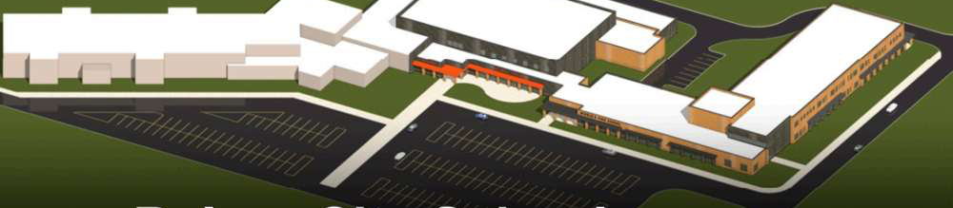
THE COMMUNITY SAID YES
Belpre’s first capital bond
in roughly sixty years.
▪ A new PreK–12 facility funded by a 9.10-mill bond + 0.5-mill permanent-improvement levy.
▪ ~$68M total project with a ~$22M state match secured through the ELPP program.
Belpre City Schools | From Portrait to Place
36
Notes:
We ran it again — and the community said yes. After seven failures across three decades, Belpre passed its first capital bond in roughly sixty years. It funds a new PreK-12 facility: a 9.10-mill bond issue paired with a half-mill permanent-improvement levy to maintain the building for its lifetime. The total project is about $68 million, with roughly a $22 million state match, and we used Ohio's Expedited Local Partnership Plan to start with the most critical piece, grades 6-12, then complete the PreK-5 wing as state funding comes in.
That 'yes' is not really a vote for concrete and steel. It's the community formally deciding to fund the Portrait of a Graduate. So the last thing I want to show you is what a building actually looks like when you design it, from the studs out, around a vision for teaching and learning.

Slide 36
PART 06
A building for
21st-century learning
Guiding principles first, then space. The vision drives the blueprint — never the other way around.
Belpre City Schools | From Portrait to Place
37
Notes:
[Section transition] Part 06 — A building for 21st-century learning. Pause here. Signal the shift and set up what's coming: Guiding principles first, then space. The vision drives the blueprint — never the other way around.

Slide 37
VISION BEFORE BLUEPRINT
Three guiding principles for teaching & learning
GP 1
GP 2
GP 3
Active & authentic
Belonging & well-being
Adults learn together
Students learn by doing — producing work, solving real problems, demonstrating Portrait competencies.
Relationships, safety, and emotional well-being form the foundation of academic success.
Educators collaborate, reflect, and improve through job-embedded learning — the Eagle Flight Plan lives on.
TEACHING & LEARNING
TEACHING & LEARNING
TEACHING & LEARNING
▪ Authentic problems, projects, and performance tasks.
▪ Standards connected to real-world issues and careers.
▪ Students set goals and reflect to build ownership.
▪ Classrooms cultivate safety, empathy, and connection.
▪ SEL skills designed alongside academic skills.
▪ Every student known — enabling personalized learning.
▪ Structured collaboration and reflection are routine.
▪ Curriculum aligned to standards AND competencies.
▪ Coaching and cross-district networks build coherence.
Belpre City Schools | From Portrait to Place
38
Notes:
This is the discipline that makes 21st-century buildings actually work: you write your teaching-and-learning principles BEFORE you draw a floor plan. Our current draft names three. One: Belpre is a district where learning is active, authentic, and anchored in real-world meaning — students learn by doing. Two: belonging, relationships, and emotional well-being are the foundation of academic success — every student known and valued. Three: adults learn together, innovate together, and model continuous improvement — the Eagle Flight Plan isn't a program that ended, it's a principle we're building into the walls.
These principles are the bridge. They translate the Portrait into instructions an architect can actually use. Which produces our design implications.

Slide 38
FROM PRINCIPLES TO SPACE
Six design implications for the building
1
Belonging & Safety
2
Space for Authentic Learning
3
Community Connection
Students feel known and safe.
Real work needs real room.
The school opens outward.
4
Spaces That Grow Educators
5
Learning is Visible
6
Environments That Flex
Adults learn side by side.
Student work has an audience.
Space adapts to the learner.
Every imperative that follows traces back to a Portrait competency — nothing here is a bell or a whistle.
Belpre City Schools | From Portrait to Place
39
Notes:
Those principles produce six design implications — the categories that guide our architects. Belonging and safety. Space that supports authentic learning. Community connection. Spaces that grow educators. Learning that is visible. And environments that flex with purpose. I'll group them into three quick pairs and show you the concrete 'space imperatives' behind each — because this is where it gets tangible for the educators in the room thinking about your own facilities.

Slide 39
DESIGN IMPLICATIONS 1 & 2
What the vision demands of the space
1 · Belonging & Safety
2 · Authentic Learning
When students feel seen, learning opens up.
When space mirrors the real world, learning comes alive.
SPACE IMPERATIVES
SPACE IMPERATIVES
▪ Small-group areas, comfortable seating, flexible layouts for mentoring and collaboration.
▪ Natural light, calming aesthetics, and visibility that reassures rather than surveils.
▪ Classrooms with views of the outdoors.
▪ Quiet / regulation zones integrated as normal, stigma-free spaces.
▪ Space anticipates student needs — nurturing independence and care.
▪ Learning extends beyond classroom walls into varied spaces.
▪ Adjacencies planned with intention; supervision plus student independence.
▪ Presentation space at small, medium, and large-group scale.
▪ Shared studios and open collaboration zones for real, hands-on work.
▪ Layouts let students shift from solo work to team problem-solving.
Belpre City Schools | From Portrait to Place
40
Notes:
Design implications one and two. Belonging and safety: this isn't decoration, it's a condition for learning. The space imperatives are concrete — small-group areas and comfortable, flexible seating for mentoring; natural light and calming aesthetics; visibility that reassures rather than surveils; classrooms with views of the outdoors; and quiet regulation spaces built in as normal, not stigmatized. Notice this is Guiding Principle two — belonging — turned into square footage.
Authentic learning: because students now learn by doing, the space has to mirror the real world. Learning extends beyond classroom walls; adjacencies are planned so students can move with independence while staff still supervise; and there's presentation space at small, medium, and large scale — because a PBL ends in a public product, and a public product needs an audience and a place to present.

Slide 40
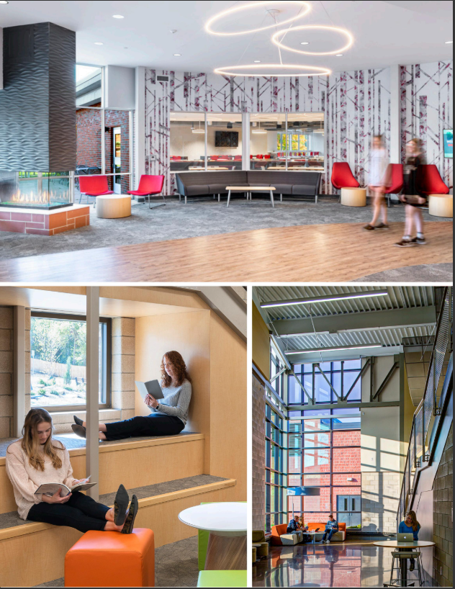
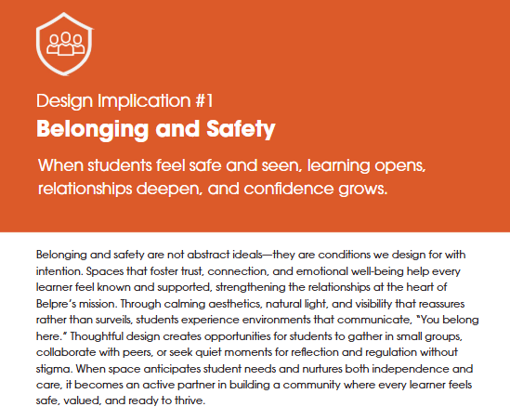

Belpre City Schools
Empathetic Communicators · Leaders and Collaborators · Hopeful · Critical Thinkers with Integrity · Goal-Oriented · Creative

Slide 41
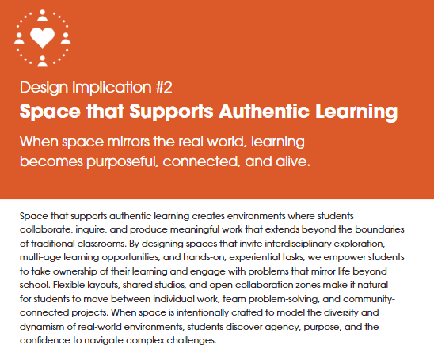
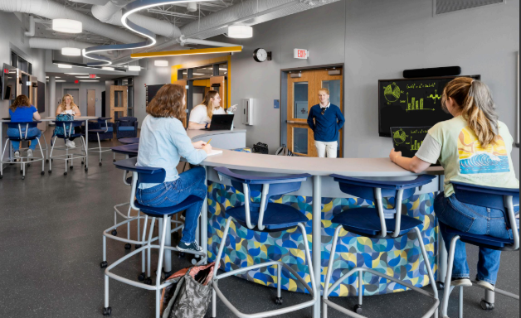
Belpre City Schools
Empathetic Communicators · Leaders and Collaborators · Hopeful · Critical Thinkers with Integrity · Goal-Oriented · Creative

Slide 42
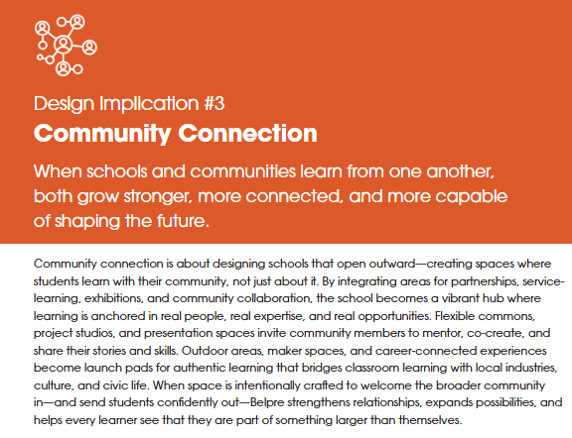
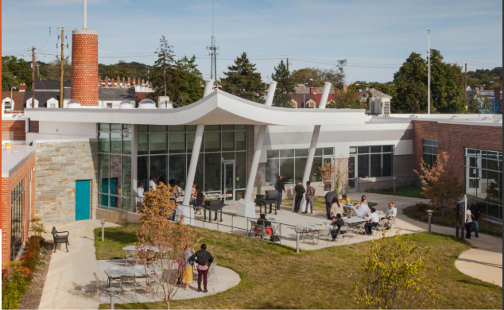
Belpre City Schools
Empathetic Communicators · Leaders and Collaborators · Hopeful · Critical Thinkers with Integrity · Goal-Oriented · Creative

Slide 43
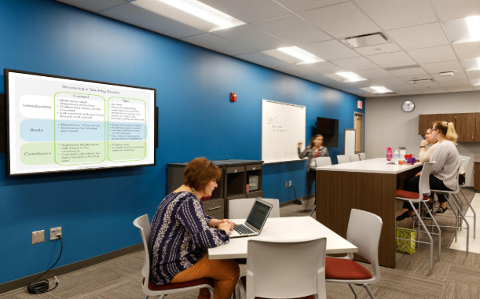
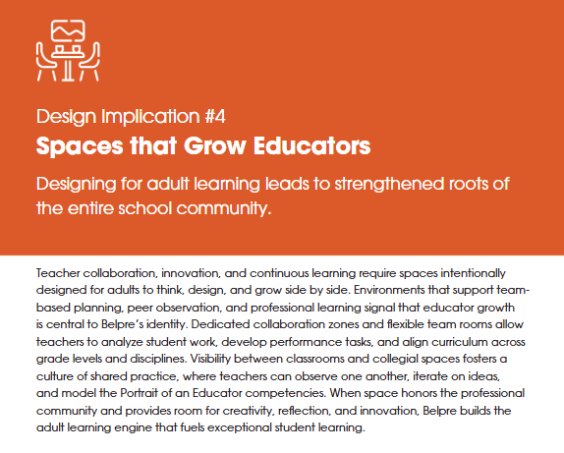
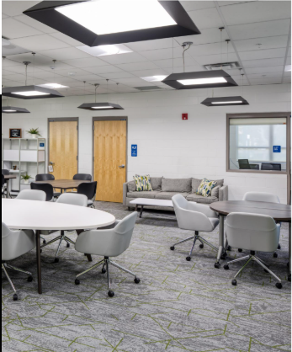
Belpre City Schools
Empathetic Communicators · Leaders and Collaborators · Hopeful · Critical Thinkers with Integrity · Goal-Oriented · Creative

Slide 44
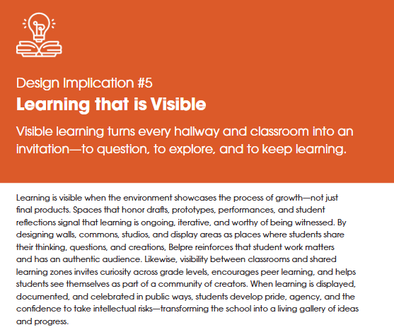
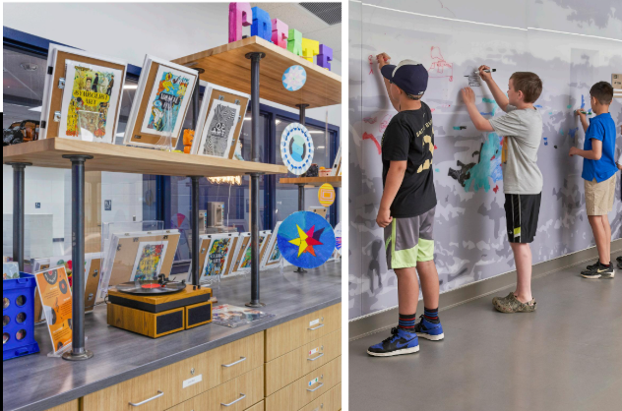
Belpre City Schools
Empathetic Communicators · Leaders and Collaborators · Hopeful · Critical Thinkers with Integrity · Goal-Oriented · Creative

Slide 45
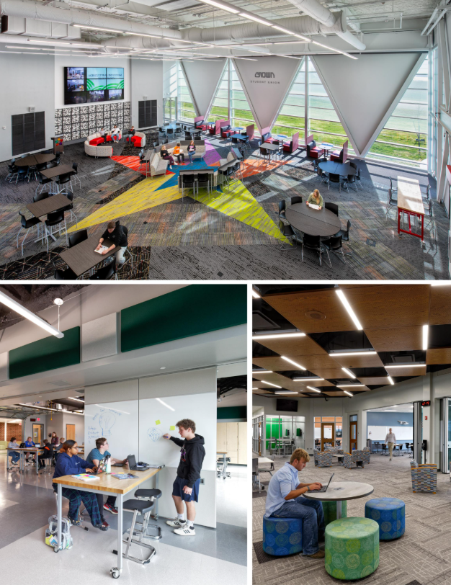
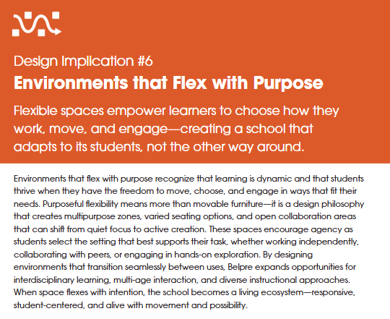
Belpre City Schools
Empathetic Communicators · Leaders and Collaborators · Hopeful · Critical Thinkers with Integrity · Goal-Oriented · Creative

Slide 46
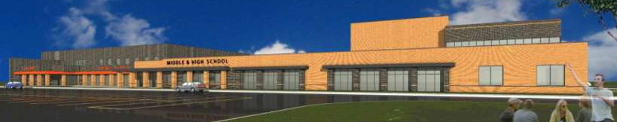
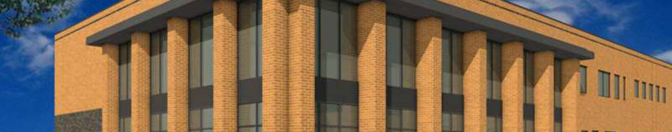
THE SNEAK PEEK · DESIGN COMPLETE (2026)
A place worthy of the Portrait
The completed Middle & High School
Warm brick, abundant daylight, and a single welcoming, secure front door.
Durable & timeless
Brick and glass built to serve for generations.
Belpre City Schools | From Portrait to Place
43
Notes:
Here's the sneak peek — and unlike the early massing models, these are the renderings from our completed design. Across the top is the finished exterior of the new Middle & High School: warm brick, lots of daylight, and a single welcoming, secure front door, which also fixes a real safety problem in our current buildings where students cross a parking lot for lunch and we have nearly forty entry points.
Bottom left is a closer look at the brick-and-glass materials, chosen to last for generations. And the highlights on the right capture a few things I'm proud of: that single secure entry; an energy model that returned an ENERGY STAR design score of 99 — responsible and efficient for our kids and taxpayers; and a site with room to grow, with future additions already planned. You saw the full site plan behind our title slide and opening this section — every one of these decisions was reviewed with the staff who will actually use the building.

Slide 47
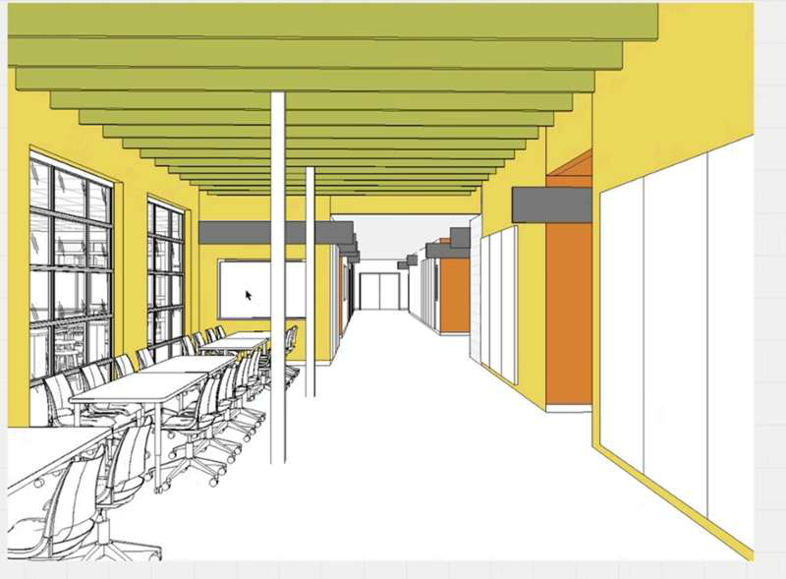
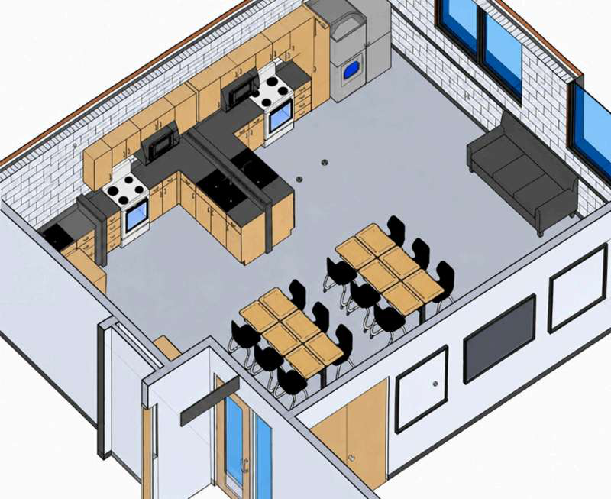
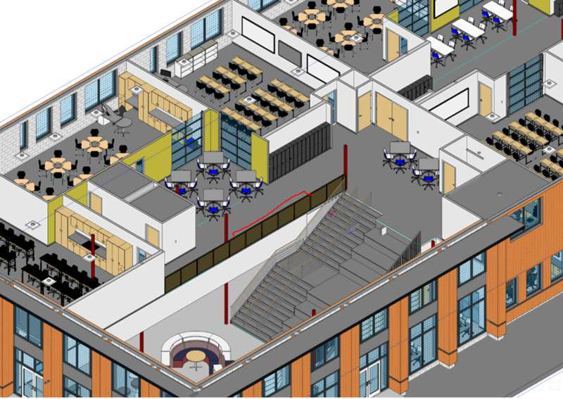
THE SNEAK PEEK · INSIDE THE BUILDING
Spaces built for the Portrait
Collaboration & the learning stair
Open, flexible zones where teams gather, build, and present.
Extended learning areas
Hallways become studios and small-group workspace.
Authentic, hands-on rooms
Real-world spaces — like the Life Skills kitchen — for doing.
Belpre City Schools | From Portrait to Place
44
Notes:
And here's what it looks like on the inside — this is where the Portrait becomes physical. On the left, the collaborative areas and the learning stair: open, flexible zones where teams of students gather, build, and present their work to an authentic audience. In the middle, extended learning areas — the design deliberately turns hallways and the space between classrooms into studios and small-group workspace, so learning isn't confined to four walls. On the right, authentic hands-on rooms like the Life Skills kitchen, where students do real-world work.
Look back at our six design implications and our guiding principles and you'll see every one of these spaces tracing directly to them: belonging, authentic learning, spaces that grow educators, visible learning, and environments that flex with purpose. This is the Portrait of a Graduate, rendered in brick, daylight, and furniture.

Slide 48
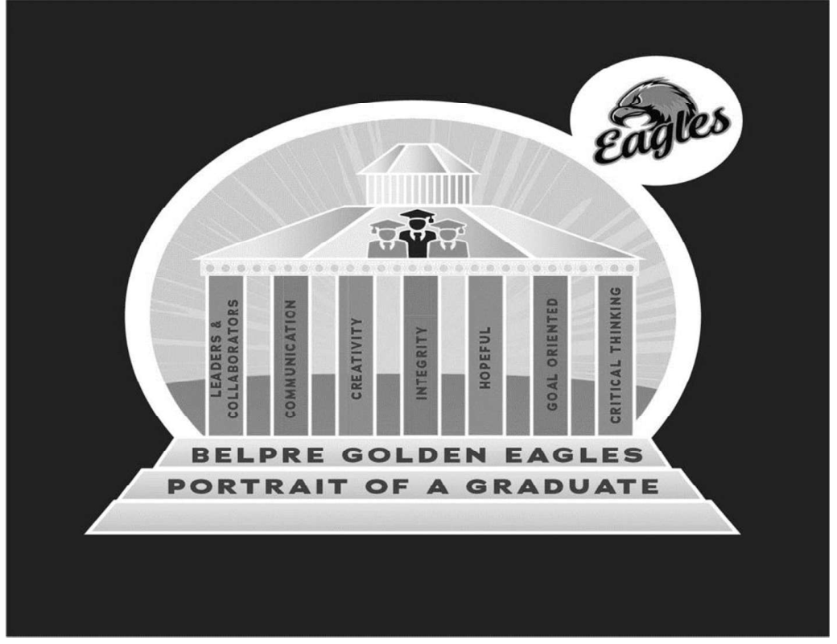
FULL CIRCLE
One system,
not three projects.
▪ A community-built Portrait defined the vision.
▪ The Eagle Flight Plan built educator capacity to deliver it.
▪ The research proved practice actually changed.
▪ The levy funded a place designed to make it all possible.
Belpre City Schools | From Portrait to Place
45
Notes:
So we come full circle. What looks like three separate accomplishments — a Portrait of a Graduate, a professional development program, and a construction bond — is really one coherent system. The community-built Portrait defined the vision. The Eagle Flight Plan built our teachers' capacity to actually deliver it, for all learners. The research confirmed that practice genuinely changed, powered by time, collaboration, and student engagement. And the levy funded a place designed, from the studs out, to make the whole vision sustainable. Pull any thread and the others move. That's what it means to say the Portrait was always about the building, and the building was always about the Portrait.

Slide 49
IF YOU’RE STARTING THIS WORK
Five lessons for your district
1
Start with community voice.
Vision built WITH stakeholders becomes the trust you’ll spend later — including at the ballot box.
2
Diagnose honestly.
Name your root causes out loud; target adult practice before student outcomes.
3
Make PD job-embedded.
Protected time during the work day is what turns growth from optional into inevitable.
4
Manage the politics.
Change fails on politics, not strategy. Map stakeholders; focus allies; ignore the loudest.
5
Design space from vision.
Write teaching-and-learning principles first; let them drive every square foot.
Belpre City Schools | From Portrait to Place
46
Notes:
If you're beginning this work in your own district, here are five transferable lessons. One: start with community voice — vision built with stakeholders becomes trust you can spend later, including at the ballot box. Two: diagnose honestly, and target adult practice before student outcomes. Three: make professional development job-embedded — protected time in the work day is what makes growth inevitable rather than optional. Four: manage the politics deliberately; change fails on politics, not strategy, so map your stakeholders, focus your allies, and don't let adversaries set your agenda. Five: design space from vision — write your teaching-and-learning principles first and let them drive every square foot. Do those five things and you're not running three projects; you're building one system.

Slide 50
THANK YOU
Questions & conversation
The Portrait of a Graduate was always about the building.
The building was always about the Portrait of a Graduate.
Belpre City Schools · www.belpre.k12.oh.us
Notes:
Thank you. I'll leave the throughline on the screen because it's the whole point: the Portrait of a Graduate was always about the building, and the building was always about the Portrait of a Graduate. I'd love to take your questions — about the professional development design, the research, the levy campaign, or the building — and hear how this might translate to your own context. Let's talk.

