Slide 1



Reimaging
Special Education

Slide 2
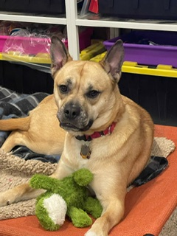

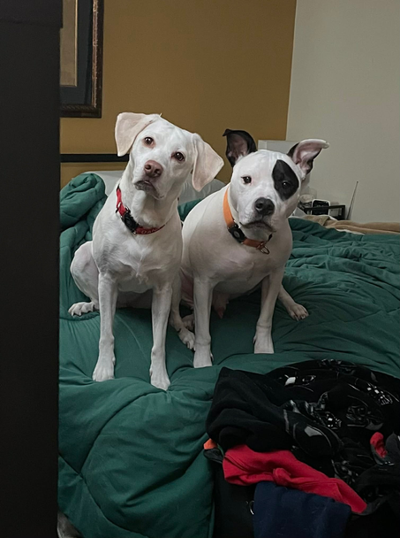
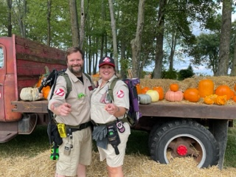
Presenter Theresa Knapp
K-5 Intervention Specialist for 23 years
Olentangy Schools
Masters in Special Education from Bowling Green State University
Bachelors in Speech Pathology and Audiology from Miami University
Passionate about STEM, Student Agency and Authentic Learning
Outside of School
Ghostbusting with my husband, Jamie
Dog Parent of Dana (Lab/Beagle mix) and Luna (Husky/French Bulldog)
Foster with Rico Pet Recover and Heart of Michigan Bernese Rescue

Slide 3

Whose in the Room?
  Tell me your name
  Tell me your occupation
  What grade level(s) do you work with?
  What is your experience level with special education?

Slide 4


Reimaging
Education

Slide 5



My Purpose
From Eye Rolls and Sighs
to Smiles and Skipping

Slide 6


Questions to Reflect On
What does it mean for students with Individualized Education Plans (IEPs) to have a reimagined school experience?
How do we get students more involved so that they have a positive experience with special education services?

Slide 7

Building Success
in Special Education
  Gets Students Involved in their IEPs and the IEP Process
  Build Student Self Esteem
  Authentic Learning Experiences
  Student Agency

Slide 8
Empowering Students

Slide 9

The Beginning of My Journey
  Eye rolls and Sighs from Students
  Student Surveys- Why do you work with Mrs. Knapp?
  Students: Lack of understanding why they
worked with me. Many felt like they were dumb.
  Miscommunication/Misunderstandings with
parents

Slide 10

Shifting Student Mindset
Students felt that they were pulled out because:
  They needed to get better at reading, writing;
  They needed more support than others with reading, spelling writing;
  They think differently than others;
  Not as good at OG as others in my class;

Slide 11

Step 1: Student Involvement
  Introduce the concepts of special education services and IEPs to students.
  Make sure that parents are aware of the conversation and that they understand talking to their child about their disability is crucial.

Slide 12

Step 1 Cont.: Kid Friendly IEP Goals
  Created IEP Objective sheets for each student.
  Objectives were summarized to focus on the main skill
  Criteria was often changed from a percentage to a fraction out of 10 to make it easier for students to understand.
  Behavior and writing rubrics were also rewritten so that students could understand and score them with me.
  Goals lines were highlighted.
  Many discussions about the “rolling hills” of progress. Progress isn’t just a straight shot up the mountain. It ebbs and flows.

Slide 13
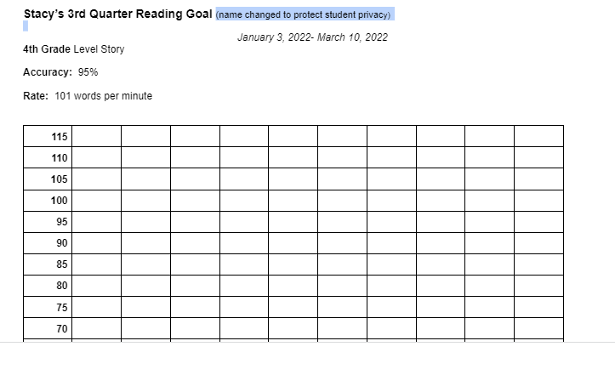

Slide 14
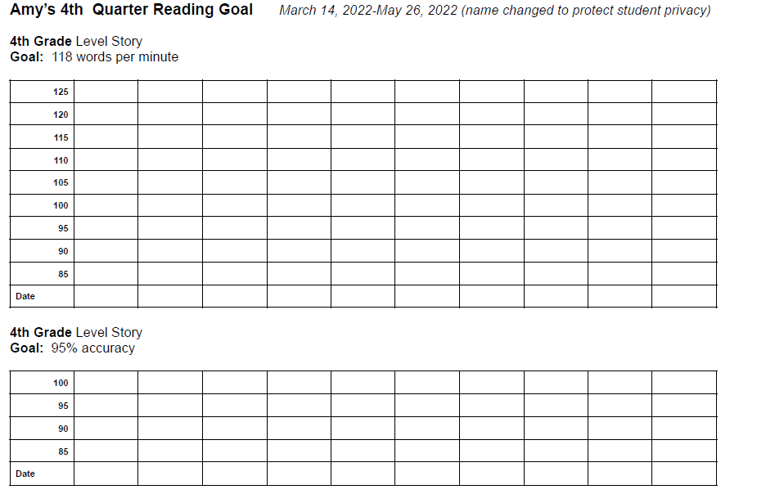

Slide 15
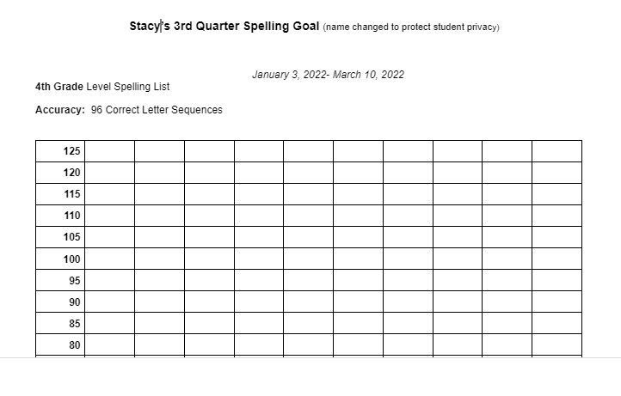

Slide 16



Step 2: Building Self Esteem
Through Read Aloud Lessons:
So Many Smarts by by Michael Genhart
  Discuss Student's smarts
  Draw a picture of their Smarts
Just Ask, by Sonia Sotomayor
  Shows kids differences in the world.
  Students can research famous people and the challenges they overcame.

Slide 17
Step 2 Cont: Create resilient learners through SEL lessons
Work on Keys to Success:
  Perserverance
  Resilence
  Fail Foward
  Supporting Others
  Learning about people with disabilities who have succeeded

Slide 18
Step 2 Cont: Create resilient learners through SEL lessons
Great Way to Start the Year-
  Do some social emotional lessons at the start of school while you are working on building your schedule and creating relationships with students.
  Weave more SEL lessons into the year during four day weeks when IEP minutes can be more flexible.
  Weave in IEP skills into these lessons such as students reading the lesson book aloud or writing about what they learned.
  Invite staff, parents, older students to teach SEL Lessons as well.

Slide 19
Step 2 Cont: Curating Student’s Keys to Success
  Generate a list of tools or accommodations to help students be successful.
  I often pull these from books we have read aloud and discussed.
  We have created a bulletin board of all the keys we have learned about.
  Then students select the ones they feel would help them and record them in their IEP binders.

Slide 20
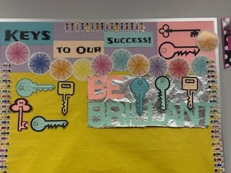
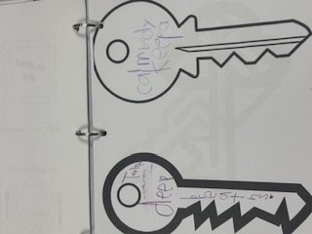
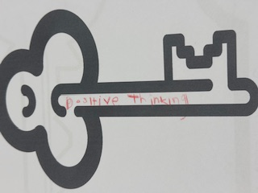
Step 2 Cont: Keys to Success

Slide 21
Reconnecting with the joy of teaching

Slide 22
Step 3: Authentic Learning
  Students are in charge.
  Pick subjects that help students showcase their learned skills that encompass IEP goals.
  Use these lessons as formative assessments to ensure students are retaining skills.
  Have students push into younger grade classrooms. Former teachers love to see their growth!

Slide 23
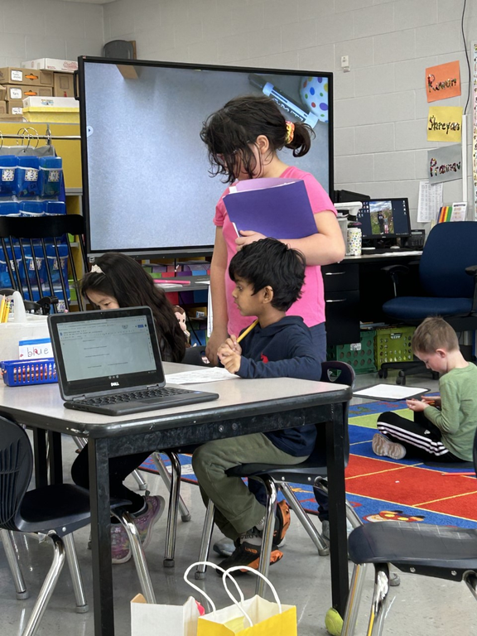
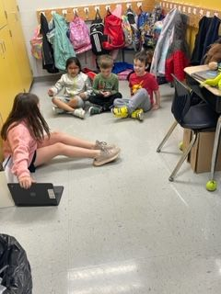
Step 3: Student Led Literacy Centers

Slide 24
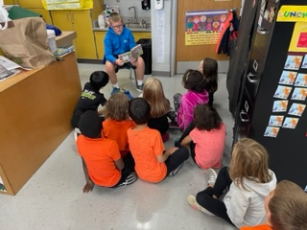

Step 3: Small Group Read Aloud

Slide 25
Reimaging
Education
Empowering Students

Slide 26
Step 4: Student Agency
Student Led Conferences
  Virtual and In Person Conferences
  Step by Step Script for Students
  Practice sessions with peers provided practice with language skills and executive functioning skills
  Shared IEP binders with parents and discussed progress with goals
  The next year, used digital portfolios to share with parents
  Discussed future goals and the help they needed to reach those goals

Slide 27
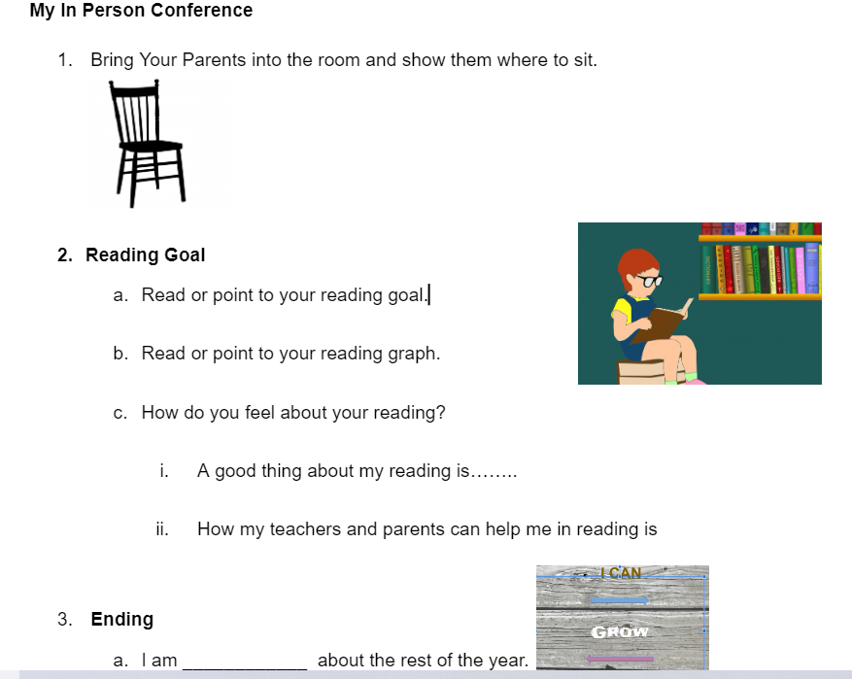
Step 4: Student Agency

Slide 28
Step 4: Student Agency
Helping Parents Foster Agency
  Discussed how to Talk about IEPs, 504s and Differences with Their Children
  Recommended building an open relationship with their child so they feel comfortable to tell them things.
  Conversation starters can be: What do you need in school? What is going great in school? What is a struggle?
  Use an analogy that pulls in your child’s interests- They are going to be the captain of their school journey. Or they are going to be the quarterback of their school experience.
  Talk about human diversity (and neurodiversity) with children

Slide 29


Some Advice
  Introduce one new idea a quarter
  What is the easiest thing for you to start with?
  Is their a colleague or parent that could help you?
  Give yourself grace if things don’t work out well
  Get input from students, parents, coworkers

Slide 30


Turn and Talk:
Where you want to start with your special education journey?
  Kid Friendly IEP Goals
  AUTHENTIC LEARNING
  Explaining IEPs and Special Education to Students
  SEL Lessons
  Students Tracking IEP Goals

Slide 31

Planning
Exploring Collaborating Time

Slide 32
Wrap Up
  Help Students develop a sense of purpose.
  Get students more involved in their learning.
  Provide opportunities for positive learning experiences at school
Thank You
for Coming Today!!
Questions/Comments/Thoughts:
email me at theresa_knapp@olsd.us

