Slide 1
Building Resources in Times of Scarcity and Unending Change.
Acsenda School of Management acknowledges that it is situated on the traditional, ancestral and unceded territories of the Coast Salish People, including the Musqueam (xʷməθkʷəy̓əm), Squamish (Sḵwx̱wú7mesh Úxwumixw) and Tsleil-Waututh (səlil̓ w̓ətaʔɬ) Nations.

Slide 2
Agenda
Timeline of the change.
Impact of the change
ASM Learning Commons
Building the Learning Commons
Challenges & Successes
What does the future look like?

Slide 3
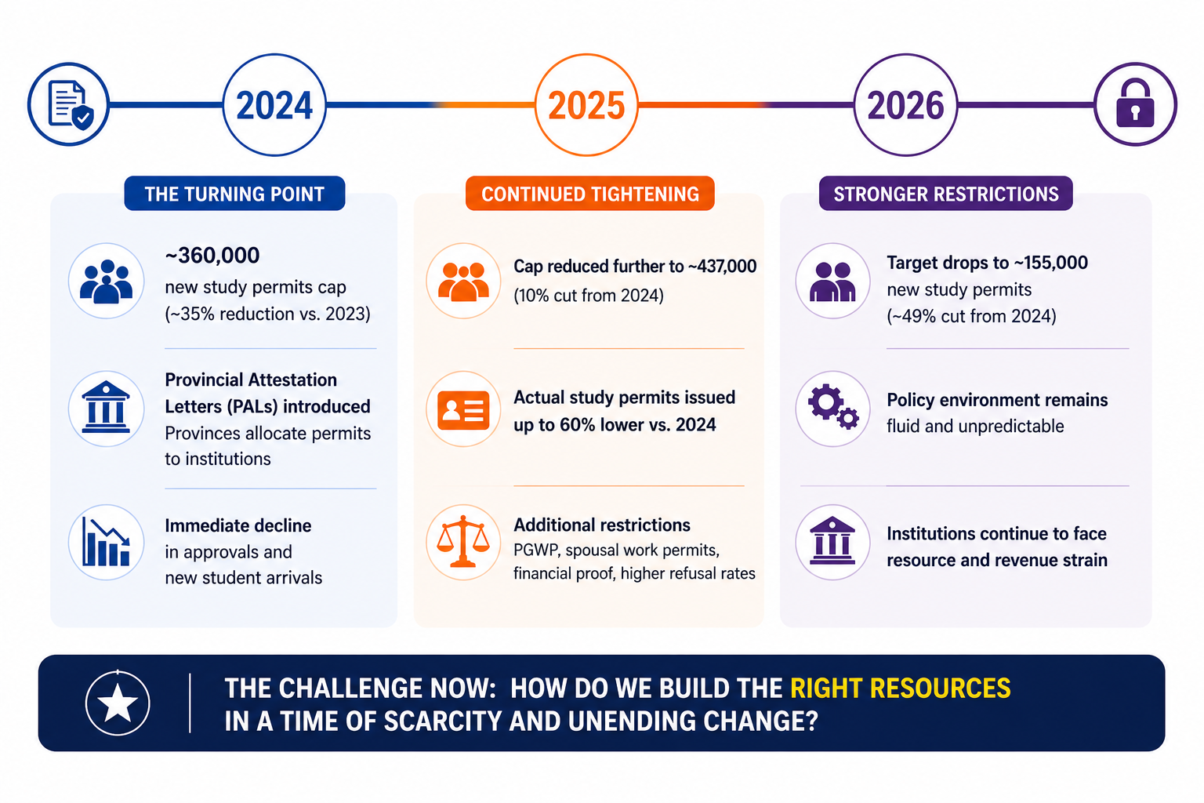
Timeline
GENAI (2026, April 27)

Slide 4
Impact of the Change
Scarcity of resources
(finances, people)
Deadlines, Stress, Certainty + Uncertainty
Demand for support services (academic/non-academic)

Slide 5
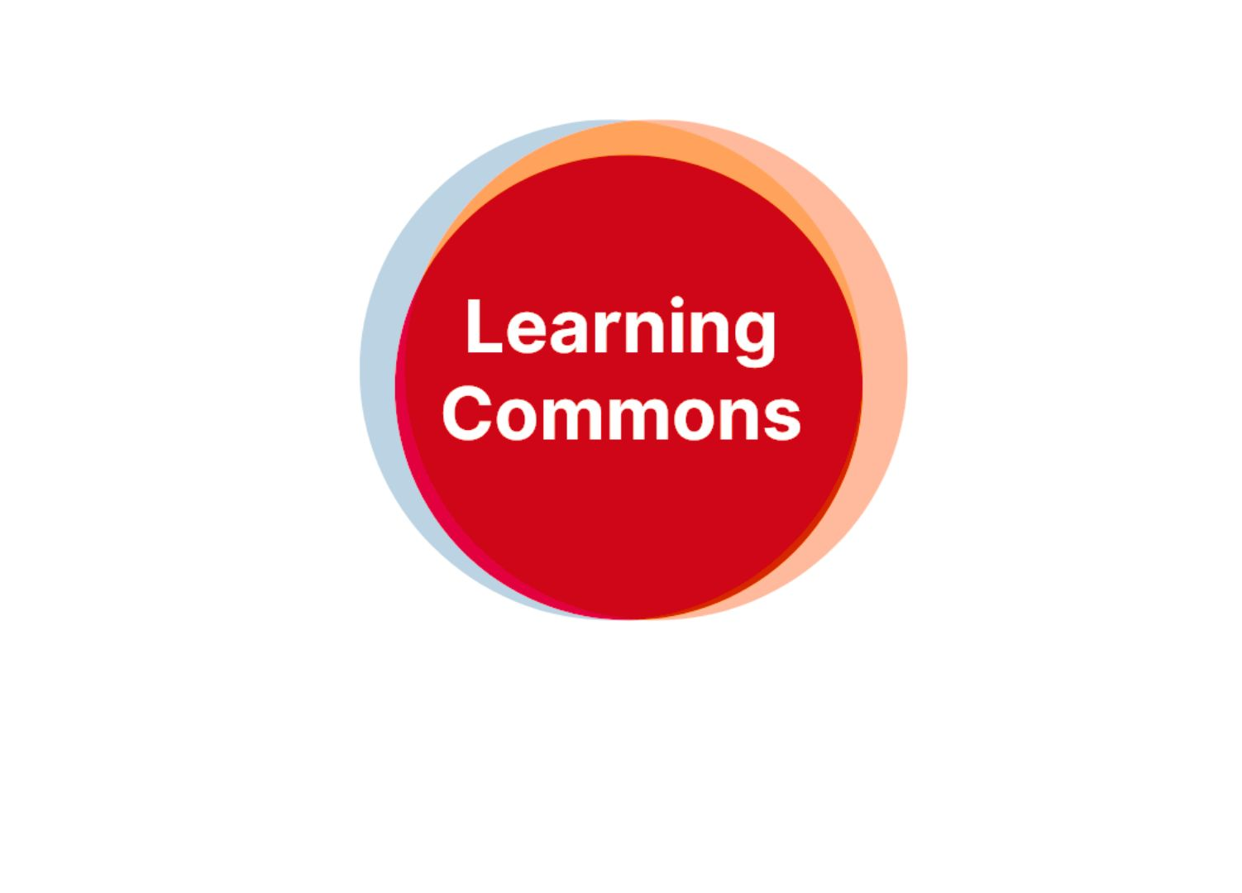
ASM Learning Commons
The Learning Commons (LC) is the central hub of academic support at ASM.
Our role is to assist students in achieving their academic goals by providing support services in a welcoming and respectful environment.
Our services:
Academic onboarding
Academic Advising
English Support & Writing Centre
Research & APA Support
Math & Accounting Support
Digital Literacy & Technology Support

Slide 6
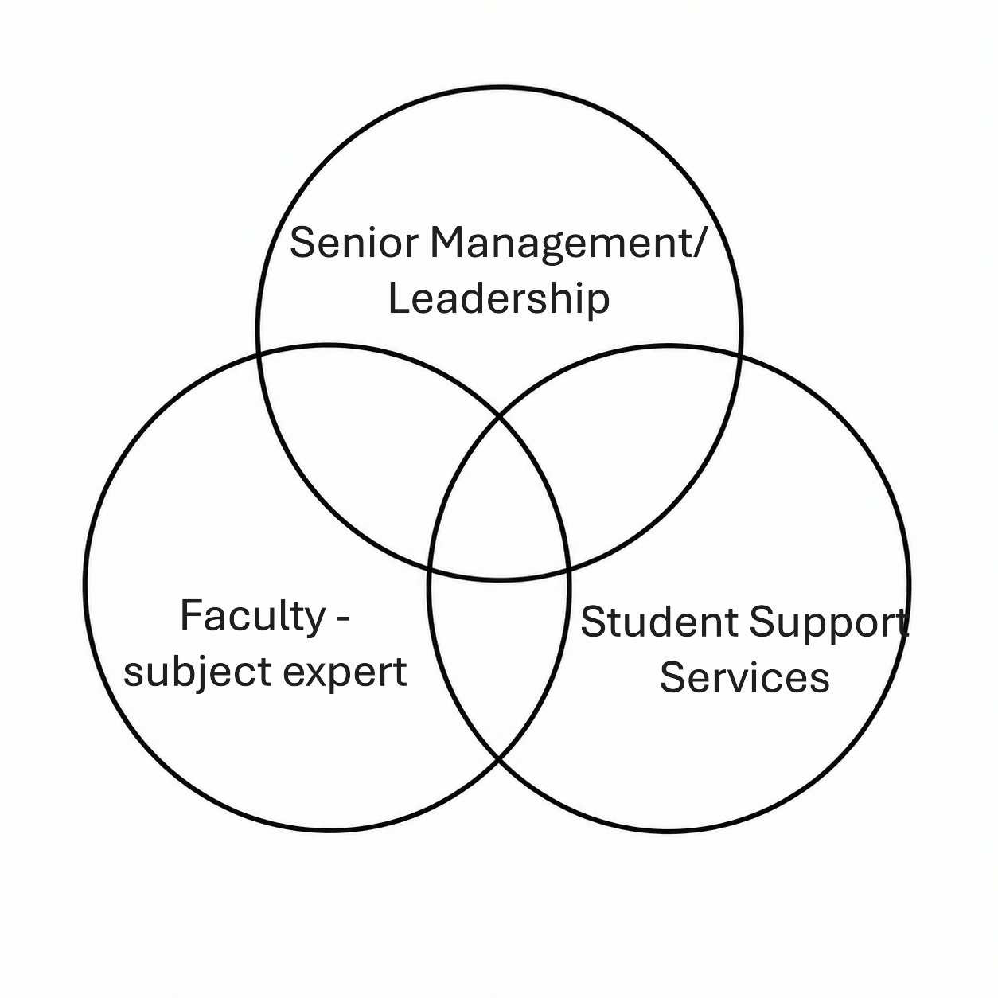
Building Learning Commons
GenAI (2026, April 28)

Slide 7
ASM Learning Commons: Wins & Challenges
Development of the Referral Form: an early alert initiative.
Between Sept 2025-present 87 referral forms were submitted- 41 were for research & APA support and 24 for English language support.
ASM Writing Centre with one student tutor and a faculty advisor
Academic Workshops
Establishing the online presence on the official website and student portal.
Low student engagement with the workshops and study sessions.
Finding reliable and good student tutors.
Financial constraints – most roles are voluntary including faculty advisors.

Slide 8

Future of ASM Learning Commons

Slide 9
References
Acsenda School of Management (n.d.) Acsenda Learning Commons. https://acsenda.com/learning-commons/
OpenAI. (2026, April 28) Illustration of timeline of study permit changes 2024-2026 [AI-generated image]. ChatGPT. https://chatgpt.com/c/69f0f272-192c-83e8-a66b-9465329fa059
OpenAI. (2026, April 28) Minimalist Venn diagram [AI-generated image]. ChatGPT. https://chatgpt.com/c/69f25609-0304-83e8-9dfc-9ebaa889c1b7

Slide 10


Slide 11
Name: Garima Yadav
Position: Manager, Learning Commons
Email: garima.yadav@acsenda.com

