Slide 1
Does your research study have credibility?
Here’s how to tell!
Gordon Moulden
Trinity Western University

Slide 2
Presenter
born and raised in Vancouver, BC
over twenty-years experience as an EFL/ESL teacher in Japan and Canada
have served as instructor for research methods, assessment, and leadership courses at TWU for 15 years.
have done classroom research as a student and overseen research as a research-methods course instructor and thesis advisor
have conducted survey research both within TWU and externally
professional interests: promoting professional development in teachers;
elements of credibility in assessment and in research

Slide 3
Today’s presentation
Focuses on
the question of how to evaluate teacher classroom research
the criteria for assessing credibility in classroom research
the application of these criteria to evaluate the credibility of a specific study
Source: TEACHER CLASSROOM RESEARCH FOR PROFESSIONAL DEVELOPMENT AND SOCIAL ADVOCACY:
Foundations for Success by Gordon Moulden (Available on Amazon, both ebook and paperback.)

Slide 4


Slide 5
What is the most important criterion for evaluating a research study?
What do you think?

Slide 6
Here’s a sample data-collection tool that could be used in study focused on proper language use.
What’s the most important criterion for evaluating the quality of this tool?

Slide 7
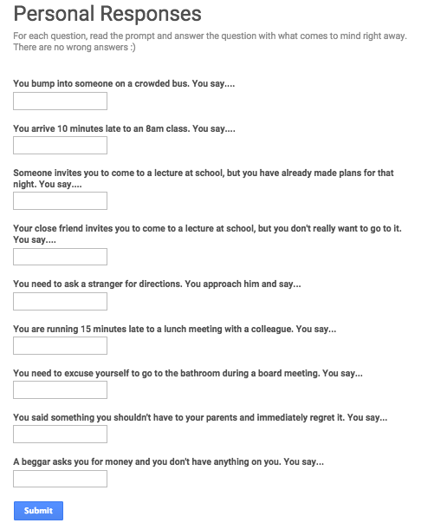
Notes:
Source: https://tabiera.weebly.com/uploads/3/4/4/6/3446986/4720019_orig.png

Slide 8
Evaluation criteria
Validity
Reliability
Authenticity

Slide 9
Considering these quality criteria together, I realized there was one overarching criterion connecting them: credibility: the “believe-ability” of the results

Slide 10
It is important that the researcher(s) and others concerned with the results of a particular study be satisfied that the results are trustworthy, that they have credibility.

Slide 11
credibility in research is largely dependent on the quality of the processes carried out by the researcher(s) involved.

Slide 12
Attaining credibility in a particular study involves taking the right steps in line with the approach selected by the researcher(s) carrying out the study.

Slide 14
General Credibility Criteria
for evaluating
educational research

Slide 16
Criterion #1: Identifying the research aim
What are the research aims that motivate teacher classroom research?

Slide 18
Criterion #2: selecting the right research approach
What are the research approaches used to achieve those aims?

Slide 19
As a researcher and research methods instructor,
I’ve identified four common to educational research:
Naturalistic research: used to describe learning and/or learners
in a particular educational setting
Multivariate/correlational research: used to describe statistical effects and/or relationships among factors related to learning
Experimental research: used to examine the effect(s) of a particular technique or material/device on students’ learning
Action research: used to measure the effect of a solution applied by one or more teachers to address a significant learning challenge experienced by one, some, or all students in a particular classroom

Slide 20
Criterion #3: selecting the right research design

Slide 21
Common Designs within each Research Approach

Slide 22
Criterion #4: knowledge of relevant theory and research (1)
Displaying a through knowledge of the theory and research pertaining to the issue of focus is critical for enabling a researcher or team to be recognized as having the necessary authority for carrying out a credible study.

Slide 23
Criterion #4: knowledge of relevant theory and research (2)
The means of accomplishing this is by conducting, and reporting on, a thorough review of the learning theory relevant to your topic, and previous research studies in that topic area.

Slide 24
Criterion #4: knowledge of relevant theory and research (3)
By discussing the theory, and especially the previous research relevant to your topic, one can also identify the gap in that area and thus provide a rationale for undertaking the specific study being planned.

Slide 25
Criterion #5: stating appropriate research questions/statements or hypotheses (1)
Once the research approach and design have been decided upon, and the specific focus for a planned study clarified based on the literature review, the next step is to articulate the purpose for which a study will be conducted (naturalistic research) or the specific research questions the researcher seeks to answer (multivariate, experimental, or action research).

Slide 26
Criterion #5: stating appropriate research questions/statements or hypotheses (2)
Naturalistic research, which involves an inductive approach to arrive at a thorough understanding of the research context under investigation (a classroom, school, or a single or small group of learners), typically begins with a general statement of purpose to guide the study rather than any specific research question.

Slide 27
Criterion #5: stating appropriate research questions/statements or hypotheses (3)
Most multivariate and experimental studies on the other hand, are driven by one or more specific research questions that the researcher(s) seek to answer.
Notes:
³Peacock, M., & Ho, B. (2003). Student language learning strategies across eight disciplines. International Journal of Applied Linguistics, 13(2), 179-200.

Slide 28
Criterion #5: stating appropriate research questions/statements or hypotheses (4)
Finally, action research studies may feature an experimental, or, with very small groups, case-study design to evaluate the effectiveness of a technique or type of teaching material intended to provide a solution to a teaching or learning challenge observed by a teacher.

Slide 29
Criterion #6: Designing or adapting appropriate and well-constructed data-collection tools (1)
Collecting data is a signature feature of empirical research. The type of data collected varies by research approach and design in keeping with their contrasting aims.

Slide 30
Design, Data Collection, and Data Analysis
Design | Data Sources | Data Collected | Analytic approach
Ethnography Case study | Interviews Questionnaires Discussions Observations Journals Recorded activities | Transcribed speech Field notes Writing (journal, essay, test answers) | Longitudinal, recursive approach to data collection and analysis Coding for categories/themes Aims at triangulation to build credibility Identification of specific instances of speech acts, LREs, etc. Data reduction (numbers or proportions of instances)
Experiment | Test(s) Task worksheets Questionnaire(s) Peer/Self assessment charts Recorded activities | Test answers Completed tasks Questionnaire responses Assessment chart responses Samples of specific types Transcribed speech Writing (essays, test responses) | Cross-sectional; data collection and analysis brief Calculating scores Tabulating frequencies (questionnaire responses) Counting instances of specific language types, (e.g., specific strategies) Comparing total scores, frequency counts across tests, tasks and/or groups of learners
Multivariate/ Correlational study | Survey Test Task | Survey responses Biodata Test answers Completed tasks | Calculating scores on task, tasks Tabulating frequencies (questionnaire responses) Counting instances of specific language types, (e.g., specific strategies) Assessing effects or strength of relationships among variables
Action Research study | Test(s) Task worksheets Questionnaire(s) Teacher’s notes/diary Others less popular | Test answers Completed tasks Questionnaire responses Writing (teacher’s notes/diary) | Cross sectional; data collection and analysis relatively brief Calculating scores on tests, tasks Tabulating frequencies (questionnaire responses) Coding responses to open ended items on questionnaires Using teacher’s notes to check validity of other analyses’ results

Slide 31
Criterion #6: Designing or adapting appropriate and well-constructed data-collection tools (2)
As can be seen on the previous slide, the type of data collected depends on the source. Data collected by means of interviews, journals, and recorded in-class activities will be verbal in nature, as well as data collected from writing samples and open-ended items in questionnaires.

Slide 32
Criterion #6: Designing or adapting appropriate and well-constructed data-collection tools (3)
On the other hand, data collected by means of tests, Likert-style questionnaires, task worksheets, and self-assessment charts will be mostly or wholly numeric in nature. The different data types may be designed by the researcher, commercially used (e.g. sections of a math or English test), or adopted for the learner group featured in the study. Whatever the source, numeric and verbal data will require different means of analysis.

Slide 33
Criterion #7: Carrying out suitable and sound research procedures (1)
Criterion #3 highlighted the importance of the researcher(s)selecting the right–most suitable–research design. Each research design involves a series of steps necessary for fulfilling the aim of a particular study. Articulating general research statements, or specific questions and hypotheses, are early stages in the research process.

Slide 34
Criterion #7: Carrying out suitable and sound research procedures (2)
Once the design is selected and the general purpose statement or research questions and hypotheses articulated, the next step is to identify and recruit participants.

Slide 35
Criterion #7: Carrying out suitable and sound research procedures (3)
These steps vary by design. For an ethnography or case study, the selection of the specific context may well have already been decided. However, recruiting participants and gaining permission to conduct the study in a specific location with a particular group of learners needs to be done with great care, particularly if the researcher is an outsider and/or is planning to do research using members of a vulnerable group (such as refugees and other immigrants), as well as minors and special needs learners.

Slide 36
Criterion #7: Carrying out suitable and sound research procedures (4)
Research ethics is a topic about which most teachers wishing to conduct a research study are likely unaware but one which they need to look into prior to actually recruiting participants. In Canada, the Tri-Council Policy Statement released every 3-4 years by the Government of Canada provides ethical guidelines relating to research in the areas of Health, Sciences, Engineering, the Social Sciences (incl. Education) and Humanities. It is of critical importance that educational researchers be aware of the guidelines for research involving people as participants and follow carefully the policies of both their home institution and administrators in the location where they wish to conduct their research.
Notes:
⁸ Government of Canada. (2022). Tri-council policy statement: Ethical conduct for research involving humans–TCPS 2 (2022).

Slide 37
Criterion #7: Carrying out suitable and sound research procedures (5)
In particular, it is important to gain informed consent from participants, and/or their guardians if participants are minors whether participation in a research study takes place online and/or in person. As well as consent, matters such as fairness and equity in research participation, privacy and confidentiality, and potential conflicts of interest on the part of the researcher(s) involved must be properly addressed to ensure that vulnerable participants–such as refugees, minorities, and special needs learners–can be well protected throughout the research process.
Notes:
⁸ Government of Canada. (2022). Tri-council policy statement: Ethical conduct for research involving humans–TCPS 2 (2022).

Slide 38
Criterion #7: Carrying out suitable and sound research procedures (6)
Once the necessary permissions have been granted, active recruitment of participants and introduction of the researcher to the identified prospective participants can take place and necessary consent forms distributed and signed. The data collection process can begin once consenting participants have been identified.
Notes:
⁸ Government of Canada. (2022). Tri-council policy statement: Ethical conduct for research involving humans–TCPS 2 (2022).

Slide 39
Criterion #8: Conducting appropriate data analyses
Data analysis in the case of experiments and surveys can be done in seconds using a statistical software program, although a mixed methods study involving interviews or a focus-group discussion will take considerably longer as the researcher(s) analyze the verbal data involved. Case studies and ethnographies feature a long and recursive inductive process of repeated data collection and analysis, which may include collection of quantitative data to achieve triangulation. It is recommended that researchers unsure of the most suitable analytic procedures, whether working with verbal or numerical data, seek advice from an experienced researcher to avoid making errors that can have a damaging effect on the credibility of the eventual findings.
Notes:
⁸ Government of Canada. (2022). Tri-council policy statement: Ethical conduct for research involving humans–TCPS 2 (2022).

Slide 40
Criterion #9: Making appropriate interpretations and conclusions
Finally, once the data analysis is complete, the researcher(s) can make their interpretations and draw conclusions based on the results. Accuracy for both is dependent on the reliability of the data collection instruments used and on an understanding of the information gleaned from the analytic procedure(s) conducted. An error in either step will severely compromise, and even negate, the credibility of the work carried out, all the more reason for less experienced researchers to seek the necessary advice from an expert.
Notes:
⁸ Government of Canada. (2022). Tri-council policy statement: Ethical conduct for research involving humans–TCPS 2 (2022).

Slide 41
Criterion #10: Applying the conclusions and evaluating the result(s)
This step comes after a study has been completed and the findings put into practice. It is beyond the scope of a research article to discuss this step, although it may take the form of a debrief (summary) to stakeholders, or a subsequent report, workshop, webinar, or conference presentation.
Notes:
⁸ Government of Canada. (2022). Tri-council policy statement: Ethical conduct for research involving humans–TCPS 2 (2022).

Slide 42
Evaluating a sample study

Slide 43
Article for Analysis
Ngo Cong-Lem. (2026). “Is This Really Your Work?”: A Qualitative Study of Teacher-Led Interviews and Student Accountability in the Age of Generative AI. Journal of Academic Ethics, 24(1). https://doi-org.twu.idm.oclc.org/10.1007/s10805-025-09704-1

Slide 44
Why this article?
            currently relevant topic
            adult participants
            Non-native learners of English

Slide 45
Criterion #1: selecting the right research approach
A naturalistic study appears well suited for this study. | Yes
Reason. Such an approach allows an opportunity for in-depth, reflective analysis of students’ use of AI for completing writing assignments.

Slide 46
Criterion #2: selecting the right research design
The research design selected appears to be the most suitable choice for the study. | Yes.
Reason. The researcher’s goal was to "explore how teacher-led interviews may foster ethical awareness, critical thinking, and academic accountability in MA-level coursework.”

Slide 47
Criterion #3: displaying thorough knowledge of relevant theory and research pertaining to the research topic
The literature review indicates a thorough knowledge of the relevant theory/ies and previous research studies undertaken pertaining to the research topic. | Yes
Reason. The literature review showed the researcher’s understanding of the ethical issues regarding the use of AI in higher ed. for completing writing assignments, as the value of interviews as a research tool, and of the research gap into which this particular study fits well.

Slide 48
Criterion #4: stating an appropriate purpose statement or research questions
Research questions: How do students perceive oral interviews as a means of verifying authorship and academic honesty in the age of GenAI? In what ways do these interviews influence students’ preparation strategies, emotional responses, and critical thinking?
The research questions are clear and appear appropriate to the goal of the study. | Yes
Reason. They reflect the researcher’s goal to "explore how teacher-led interviews may foster ethical awareness, critical thinking, and academic accountability.”

Slide 49
Criterion #5: Designing or adapting appropriate and well-constructed data-collection tools
The data collection tools/activities were well chosen and designed and appear appropriate to the purpose of the study. | Yes, mostly.
Reason: The tools used were an open-ended questionnaire and an interview, both of which promote reflection on the part of the participants. It was stated in the article that the questionnaire, at least, allowed for Vietnamese and/or English responses. It is not clear whether this was also permitted in the interview, although the learners were studying at the master’s level.

Slide 50
Criterion #6: Carrying out suitable and sound research procedures (1)
Participants chosen for the study: All were students enrolled in an English Linguistics graduate program at a Vietnamese public university.
The selection of participants was appropriate to the purpose of the study. | Somewhat.
Reason: The use of participants from a single culture enrolled in a single program limits external validity. As well, some participants, but not all, “had previously attended a faculty-led workshop on the use of GenAI in academic contexts”. (p. 29). This fact would also potentially limit the validity of the results.

Slide 51
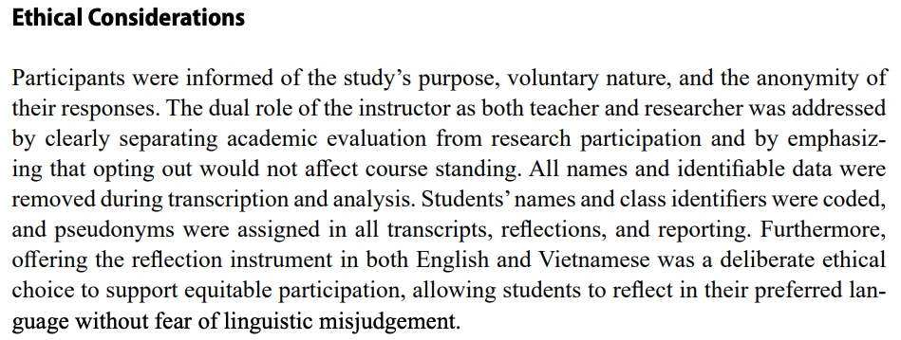
Criterion #6: Carrying out suitable and sound research procedures (2a)
Ethical procedures carried out by the researcher(s) (page 29):

Slide 52
Criterion #6: Carrying out suitable and sound research procedures (2b)
The researcher(s) gained informed consent from participants and/or guardians and were careful to protect their anonymity and the confidentiality of their data. Vulnerable participants faced no unnecessary risks. | Mostly.
Reason. Most or all of the needed steps were taken. The only information lacking concerned the security of the data collected. However, other steps were carefully taken.

Slide 53
Criterion #6: Carrying out suitable and sound research procedures (3)
Steps to check the reliability of their data collection tools and analyses
The researcher(s) took steps to check the reliability of their data collection tools and analyses and provided specific details. | Mostly
Reason. The researchers compared and refined their coding but did not provide specifics regarding the reliability of their coding (% of agreement).

Slide 54
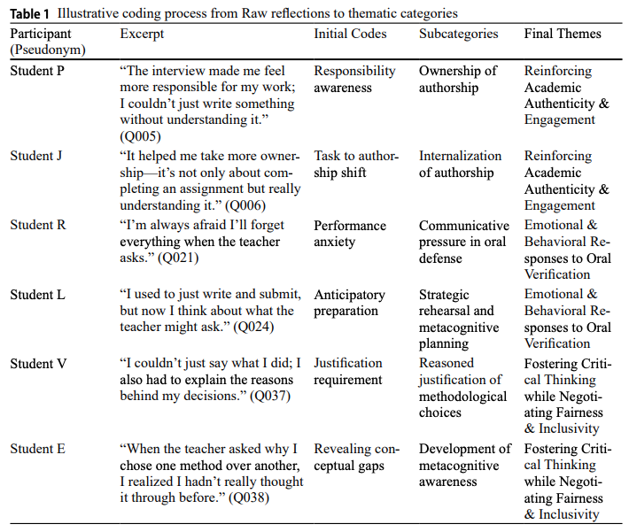
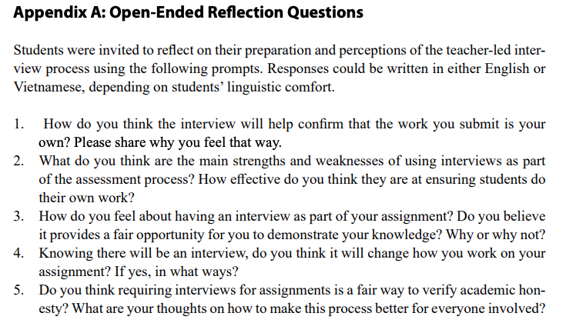
Criterion #6: Carrying out suitable and sound research procedures (4a)
Tables and charts, and/or other visual tools included in the article

Slide 55
Criterion #6: Carrying out suitable and sound research procedures (4b)
The researcher(s) explained the procedures clearly through the text and the use of tables and charts, and/or other visual tools. | Somewhat
Reason. A table was included showing codes, themes, and sample answers to questions, and the Appendix showed a list of reflection questions for participants. However, no information was provided about participants’ details, such as age, cohort, and English proficiency level. This may have been due to ethical constraints.

Slide 56
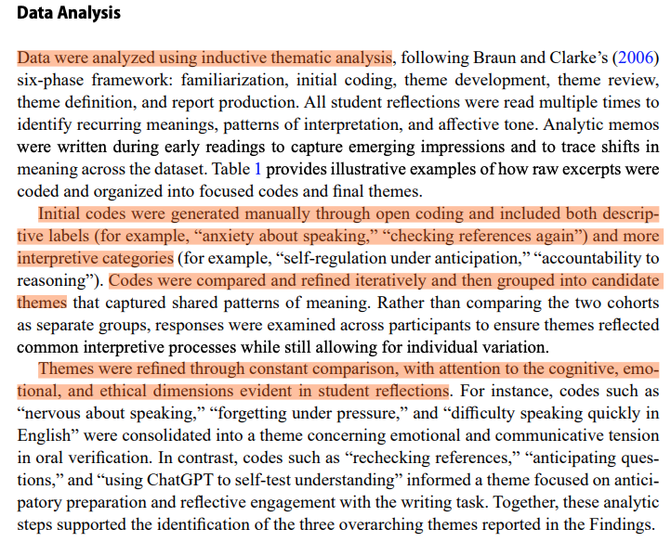
Criterion #7: Conducting appropriate data analyses(a)
Data analysis/es carried out by the researcher(s):

Slide 57
Criterion #7: Conducting appropriate data analyses (b)
The researcher(s) used data analytic procedures appropriate to the data collected during the study. | Mostly.
Reason. Qualitative data analytic producers were followed; the only “miss” was the lack of information about the statistical reliability of coding between researchers.

Slide 58
Criterion #8: Making appropriate interpretations and conclusions (1a)
Interpretations made by the researchers based on the findings.
Interpretations were discussed in detail based on findings from the data analyses and on the literature reviewed by the researchers.

Slide 59
Criterion #8: Making appropriate interpretations and conclusions (1b)
The interpretations were correct based on findings from the data analysis/es. | Yes
Reason. The researchers took the findings from the analyses into considerable account, as they applied expended considerable effort in this task.

Slide 60
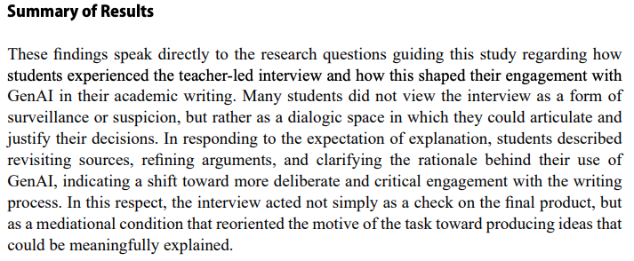
Criterion #8: Making appropriate interpretations and conclusions (2a)
Conclusions reached by the researchers:

Slide 61
Criterion #8: Making appropriate interpretations and conclusions (2b)
The conclusion(s) reached were logical based on interpretations and were well connected to the research questions. | Somewhat
Reason. The conclusions were connected not only on the research questions but also on findings from the data analyses and the connection of these findings to the literature they reviewed.

Slide 62
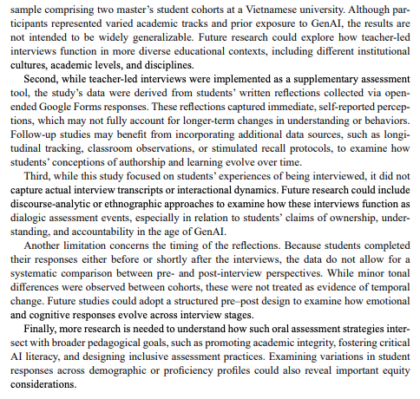
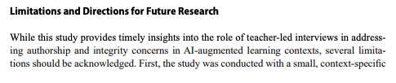
Criterion #8: Making appropriate interpretations and conclusions (3a)
Limitations of the study and suggestions for further research:

Slide 63
Criterion #8: Making appropriate interpretations and conclusions (3b)
The researcher(s) clearly identified the limitations of the study and provided suggestions for further research. | Mostly.
Reason: Most limitations were mentioned, aside from the potential impact of the AI workshop in which some participants had taken part in prior to the study. Suggestions for further research were duly discussed, however.

Slide 64
Summary
A study conducted by keen researchers with a strong knowledge of their topic and a good understanding of ethical concerns and data analytic procedures involved. As an example of teacher classroom research, it was well and thoroughly done and written up.

Slide 65
Concluding remarks
The Elephant in the room

Slide 66
When I wrote my textbook last year, there was one research credibility criterion that I did not consider because it does not pertain to the research process itself.
But this conference, and the article we’ve just looked at during this session, demands that I mention it because it pertains to the issue of professional ethics.

Slide 67
“Is this really your work?”

