Slide 1
Same Sum
Teaching Through Problems Worth Solving
You have three cards in front of you. On the back of each card is a different prime number. The sum of the digits on the front of each card is equal to the sum of the digits of the prime number on the back of that card.
What is the prime number on the back of each card?
22
13
Front
Back
2 + 2 = 1 + 3
Notes:
44 (17), 59 (149), 38 (29)

Slide 2
Okay, I Built the Thinking Classroom…Now What?
Katie Becraft, kbecraft@aacps.org
Mary Rathlev, mrathlev@aacps.org
Anne Arundel County, MD

Slide 3
Table of Contents
1
Ratios Missing Value Curricular Task
Tuning Protocol
2

Slide 4
• Fully participate in a Ratios Missing Values Curricular Task.
I can…
• Analyze the curricular task using the Tuning Protocol.

Slide 5
Rewriting Rationale
Launch
Thin Slicing Tasks - Type 1, 2, 3 (18 to 30)
Consolidation Tasks - Type 1, 2, 3
Show Me
Note Making - Type 1, 2, 3*
Check-Your-Understanding Problems & Answer Keys (6 – 9)

Slide 6

Evaluating what we value.
Risk Taking
avoids making mistakes
resisting new ideas
only follows procedures
willing to make mistakes
trying out new ideas
willing to guess and test
Notes:
Katie – Remember yesterday, you guys came up with these ideas.

Slide 7
Ratio Missing Values – Grade 6
Huddle Up

Slide 8
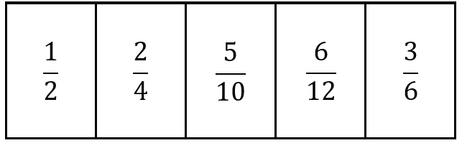
What do you notice?
What do you wonder?

Slide 9
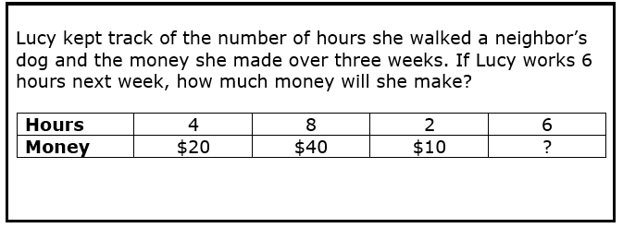
30
Hours | 3 | 3
Money | 3 | 3 | 3 | 3 | 3 | 3 | 3 | 3 | 3 | 3
6
30

Slide 10
1 | 2
4 | 3

Slide 11

Names
Would you Rather?
Notes:
Would you rather have a fire drill at the beginning of class or during your closure?

Slide 12
Random Groups
12 minutes to solve
Notes:
https://docs.google.com/spreadsheets/d/14Mx8H9LlVeQSd8xjBFFzRJBrDJyXJeo0qARhaUIqAsQ/edit?gid=0#gid=0

Slide 13
1
Frozen Treats Ice Cream Company packs 6 pints of ice cream in each box.
If you want to buy 72 pints of ice cream for a party, how many boxes do you need?
Pints | 6 | 12 | 24 | 72
Boxes | 1 | 2 | 3 | 9
equivalent ratio
scaling up
scaling down
multiplicative relationship
ratio table
Notes:
1. 8.07
2. 5.48

Slide 14
2
Henry’s heart beats 12 times in 10 seconds.
In 30 seconds, how many times does Harry’s heartbeat?
Times | 12 | 36
Seconds | 10 | 30
equivalent ratio
scaling up
scaling down
multiplicative relationship
ratio table
Notes:
1. 8.07
2. 5.48

Slide 15
3
Natalie packs peaches. It takes 14 boxes to pack 6 bushels of peaches.
How many boxes does Natalie need to pack 15 bushels of peaches?
Boxes | 14 | 7 | 35
Bushels | 6 | 3 | 15
equivalent ratio
scaling up
scaling down
multiplicative relationship
ratio table
Notes:
1. 8.07
2. 5.48

Slide 16
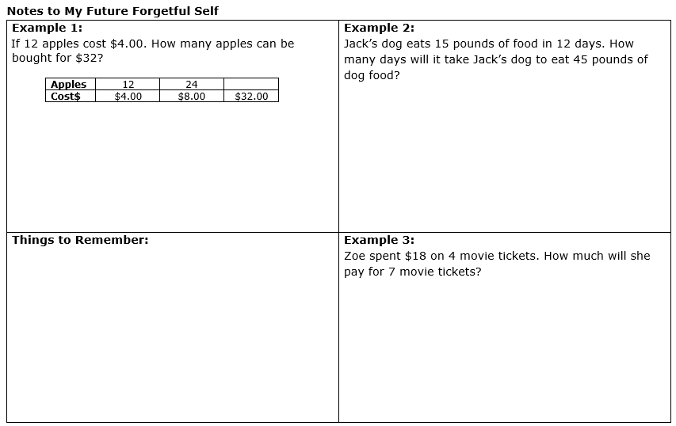

Slide 17
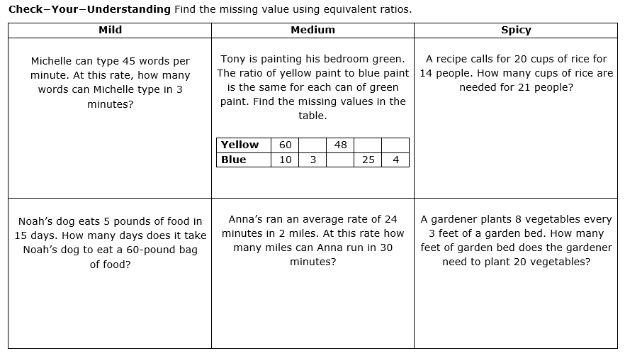
Reframe Practice

Slide 18
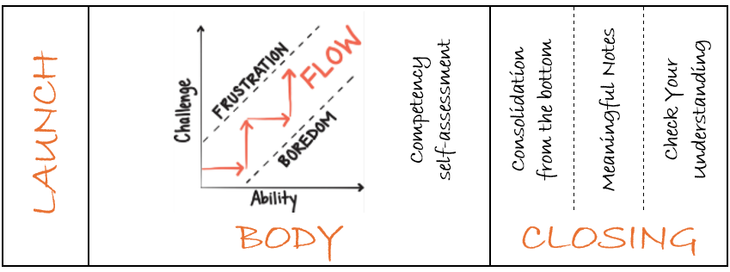
Lesson Sequence – 1 Day Lesson
Maintain Flow
Notes:
Mary
Point out the structure of the lesson includes these practices: thinking tasks; random groups; VNPS; competency rubrics; consolidation; notetaking; check your understanding
To maintain flow teachers will: answer keep thinking questions; encourage autonomy; use hints and extensions

Slide 19

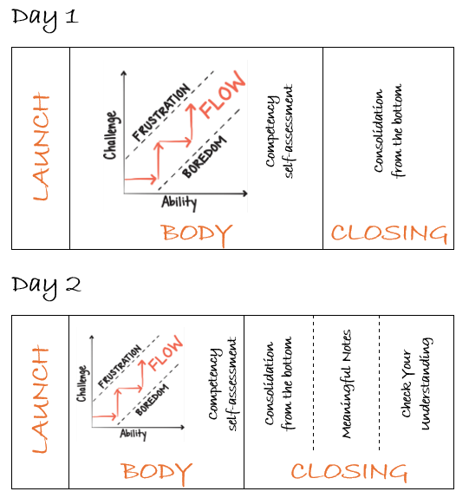
Lesson Sequence –
2 Day Lesson

Slide 20
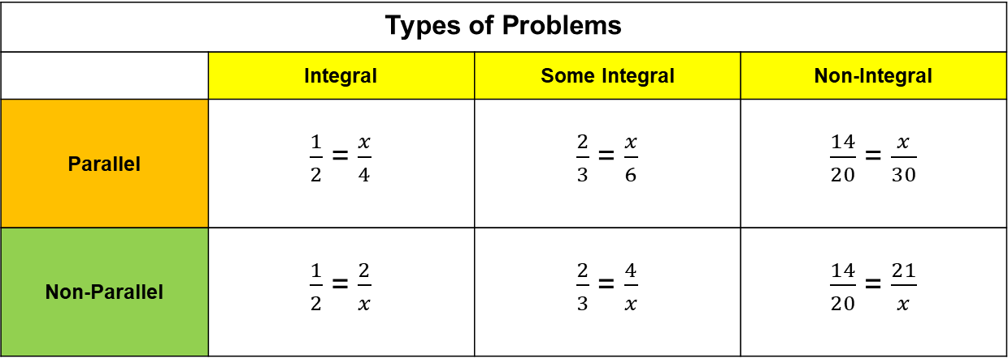
The Sequence
Types of Problems
 | Integral | Some Integral | Non-Integral
Parallel | $\frac{1}{2}$ = $\frac{x}{4}$ | $\frac{2}{3}$ = $\frac{x}{6}$ | $\frac{14}{20}$ = $\frac{x}{30}$
Non-Parallel | $\frac{1}{2}$ = $\frac{2}{x}$ | $\frac{2}{3}$ = $\frac{4}{x}$ | $\frac{14}{20}$ = $\frac{21}{x}$

Slide 21
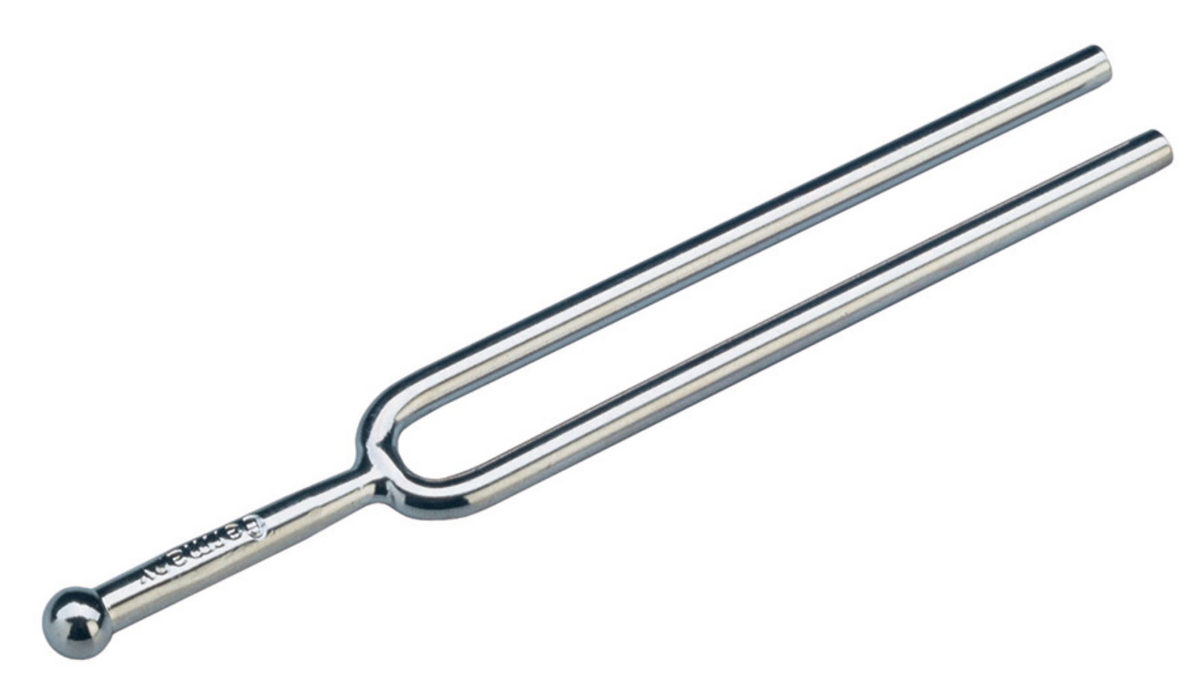
The Tuning Protocol
1. What clarifying questions do you have about the resources?
2. What warm feedback do you have about the resources?
3. What cool feedback do you have about the resources?
Ratio Missing Values

Slide 22

THINKING is the process of using one’s mind to consider or reason about something…
It’s not about MIMICKING someone or RECALL.
Give students the opportunity to make sense of the math. Give students a voice.

Slide 23

Awesome
Katie Becraft, kbecraft@aacps.org
Mary Rathlev, mrathlev@aacps.org
Anne Arundel County, MD

Slide 24


