Slide 1


Building Thinking Classrooms
Jared Sliger
jared@buildingthinkingclassrooms.com

Slide 2

REMOVE
FRICTION
Notes:
Open on the curling image. Let the room look before speaking. Then: Small practices can create seismic shifts.

Slide 3
The less time students spend
figuring out the classroom…
Notes:
Read it once. Pause. Click.

Slide 4
The less time students spend
figuring out the classroom…
…the more time they spend figuring out the thinking.
Notes:
Complete the sentence: …the more time they spend figuring out the thinking.

Slide 5
Friction
Anything that competes with thinking.
Notes:
Define it, then pause. The interruption questions begin on the next click.

Slide 6
Where do I put my card?
Who am I with?
Which marker works?
Where do I stand?
Notes:
Let each question land like a small interruption. Do not narrate the list. Let the room feel it.

Slide 7
Are we done?
Where do I put my card?
Who am I with?
Which marker works?
What are we supposed to do?
Can I borrow tape?
Where do I stand?
Can I use the bathroom?
Notes:
Let each question land like a small interruption. Do not narrate the list. Let the room feel it.

Slide 8
Are we done?
Where do I put my card?
Wait… what group was I in?
Who am I with?
Which marker works?
Can I…
What are we supposed to do?
Can I borrow tape?
Where do I stand?
Can I…
Where’s the eraser?
Can I use the bathroom?
Notes:
Let each question land like a small interruption. Do not narrate the list. Let the room feel it.

Slide 9
None of those questions
improve student thinking.
Notes:
Hold the silence. Then say: But they consume an incredible amount of instructional time.

Slide 10
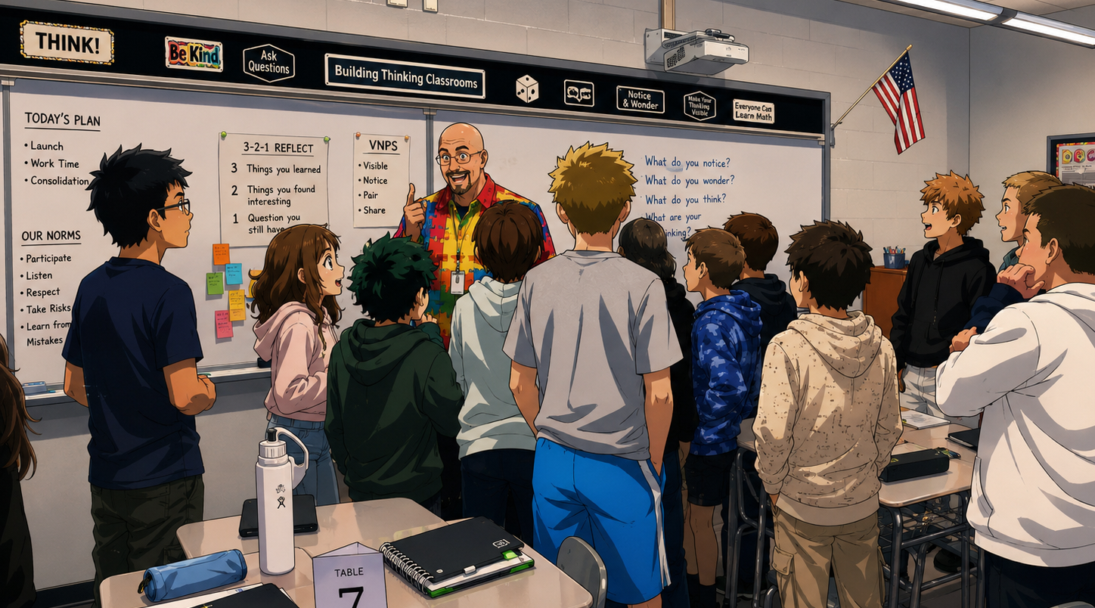
Great classrooms don’t eliminate challenge.
They eliminate everything that competes with thinking.
Notes:
Acknowledge that productive struggle should remain. The target is not difficulty; it is distraction.

Slide 11
WHY THESE IDEAS?
32
180
100+
Years teaching
Students every year
BTC classrooms visited
Notes:
Keep this human, not résumé-like. Give one sentence of context for each number, then move on.

Slide 12
THE TOOLKITS
Notes:
Introduce the four toolkits as the shared foundation. This is the bridge from credibility to practice.

Slide 13
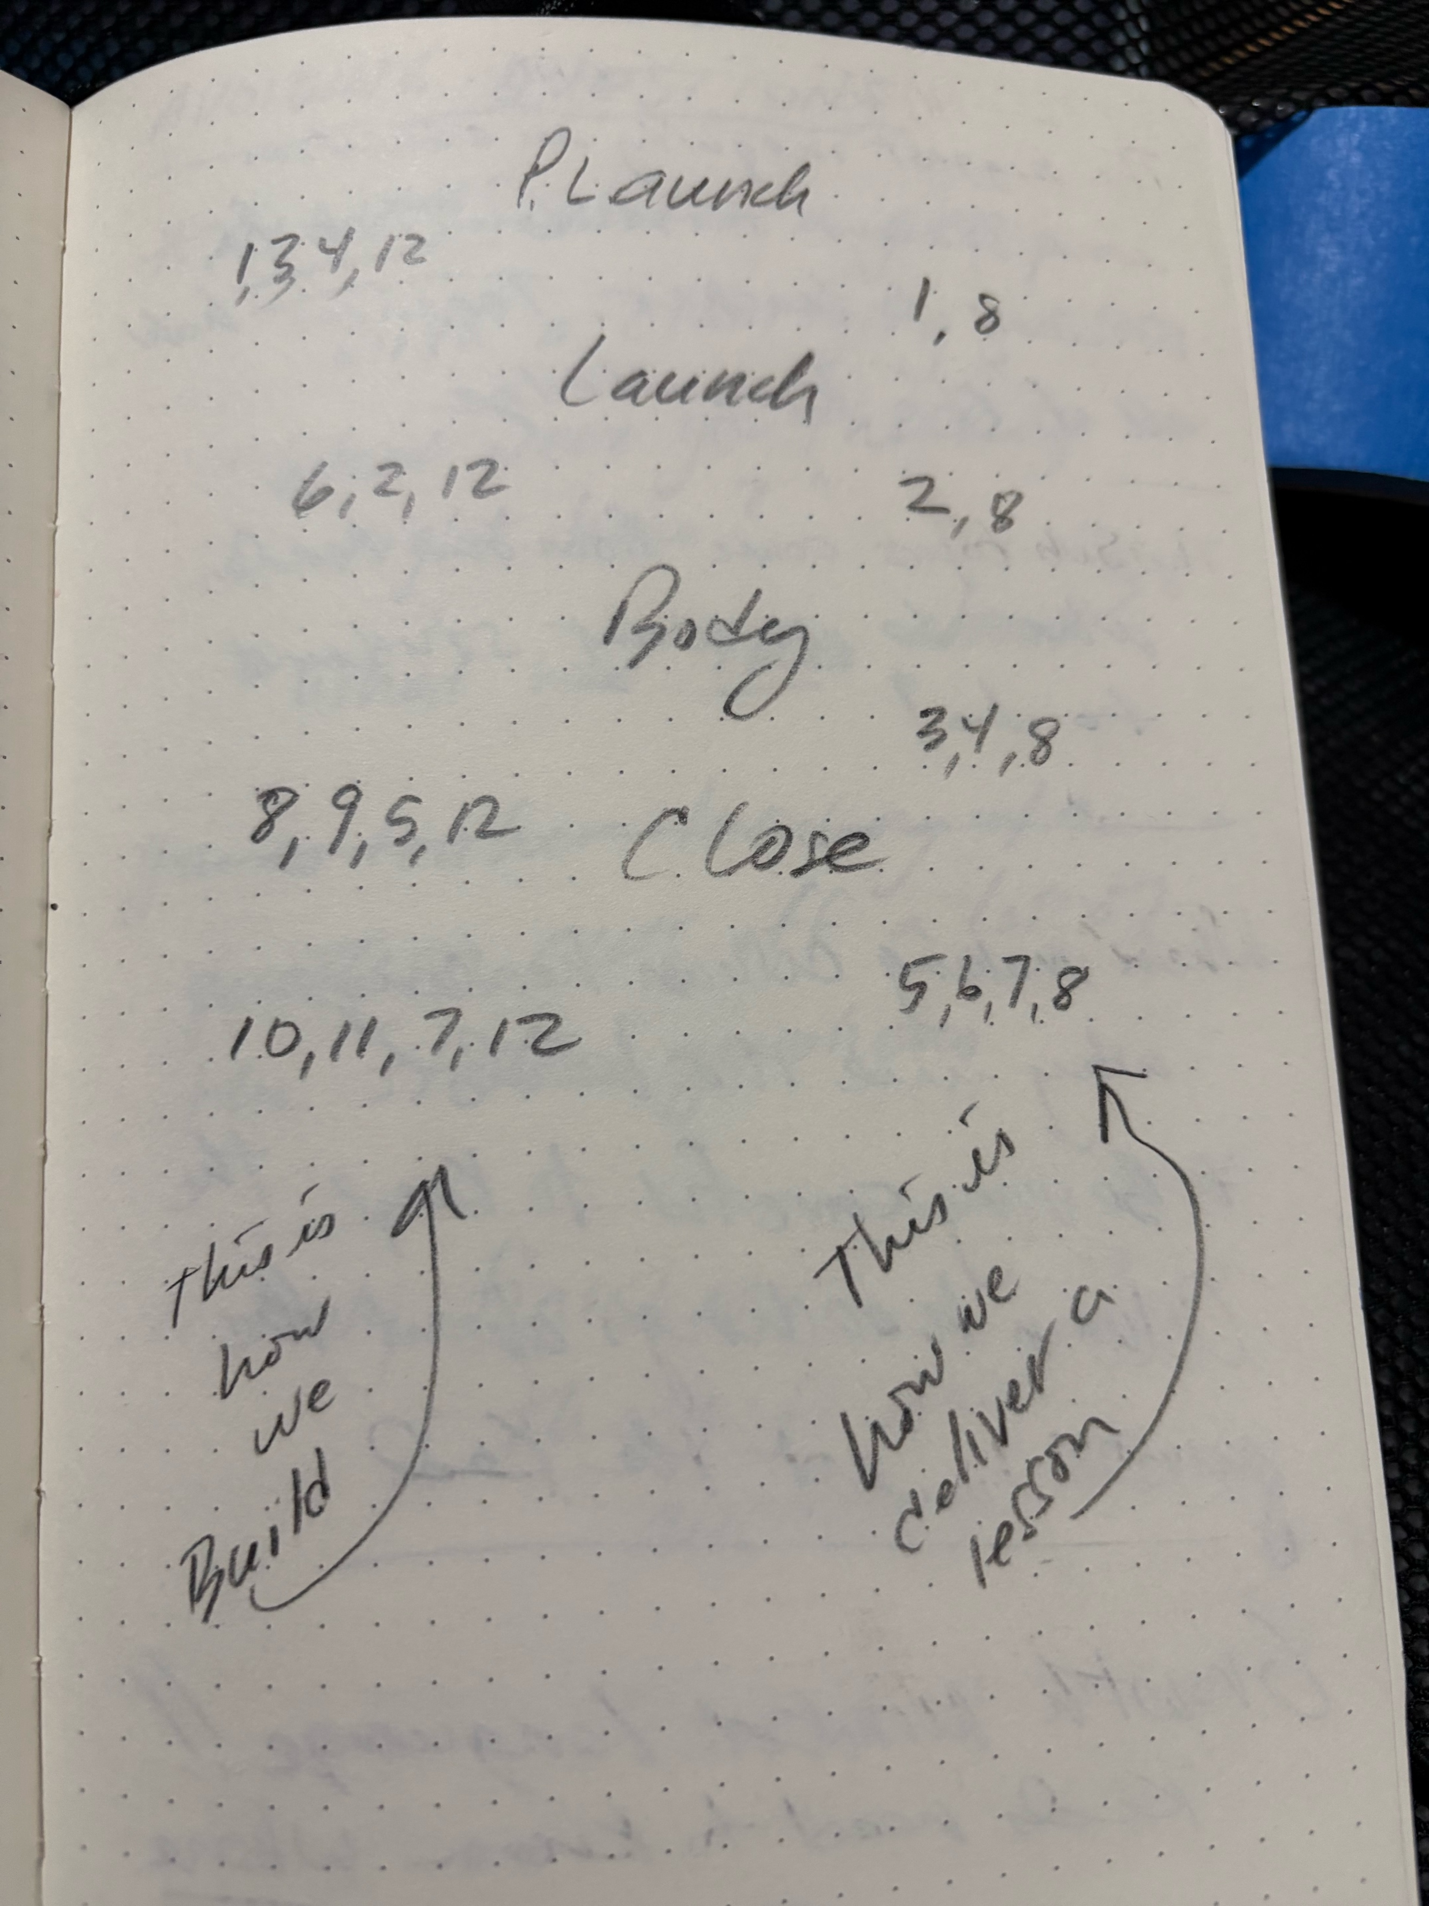
THE TOOLKITS
01
TOOLKIT 1
1. Use thinking tasks
2. Frequently form visibly random groups
3. Use vertical non-permanent surfaces
12. Evaluate what you value
Notes:
Name Toolkit 1, cite its chapter number, then tell one fast classroom story. Replace the two placeholders before presenting.

Slide 14
THE TOOLKITS
02
TOOLKIT 2
4. De-front the classroom
5. Answer only keep-thinking questions
6. Launch early, standing, and verbally
8. Foster autonomy
9. Use flow
Notes:
Name Toolkit 2, cite its chapter number, then tell one fast classroom story. Replace the two placeholders before presenting.

Slide 15
THE TOOLKITS
03
TOOLKIT 3
7. Give check-your-understanding questions
10. Consolidate from the bottom
11. Do note making
Notes:
Name Toolkit 3, cite its chapter number, then tell one fast classroom story. Replace the two placeholders before presenting.

Slide 16
THE TOOLKITS
04
TOOLKIT 4
13. Communicate to students where they are and where they are going
14. Grade based on data, not points
Notes:
Name Toolkit 4, cite its chapter number, then tell one fast classroom story. Replace the two placeholders before presenting.

Slide 17
The toolkits tell us what to do.
Notes:
Let WHAT sit for a beat. Click.

Slide 18
Today I want to talk about HOW.
Notes:
Shift the energy. The talk now moves from ideas into the choreography of the classroom.

Slide 19
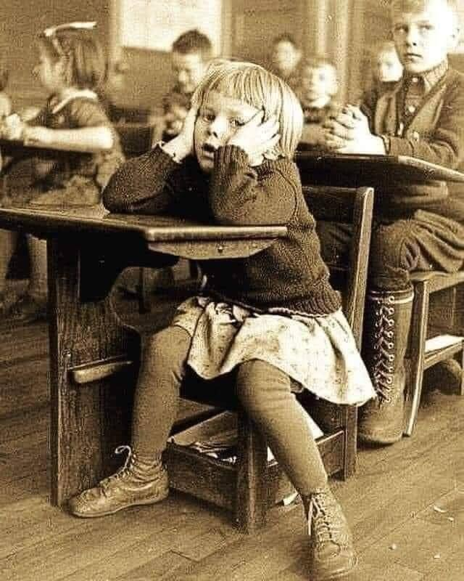
LAUNCH
Notes:
Say only: Launch. Then tell the story visible in the photograph.

Slide 20
BODY
Notes:
Say only: Launch. Then tell the story visible in the photograph.

Slide 21
CLOSE
Notes:
Say only: Launch. Then tell the story visible in the photograph.

Slide 22

Notes:
Randomness is valuable only if it is ready to use. Set up the animal-card story.

Slide 23
2/3 Eye Rolls
Notes:
Randomness is valuable only if it is ready to use. Set up the animal-card story.

Slide 24
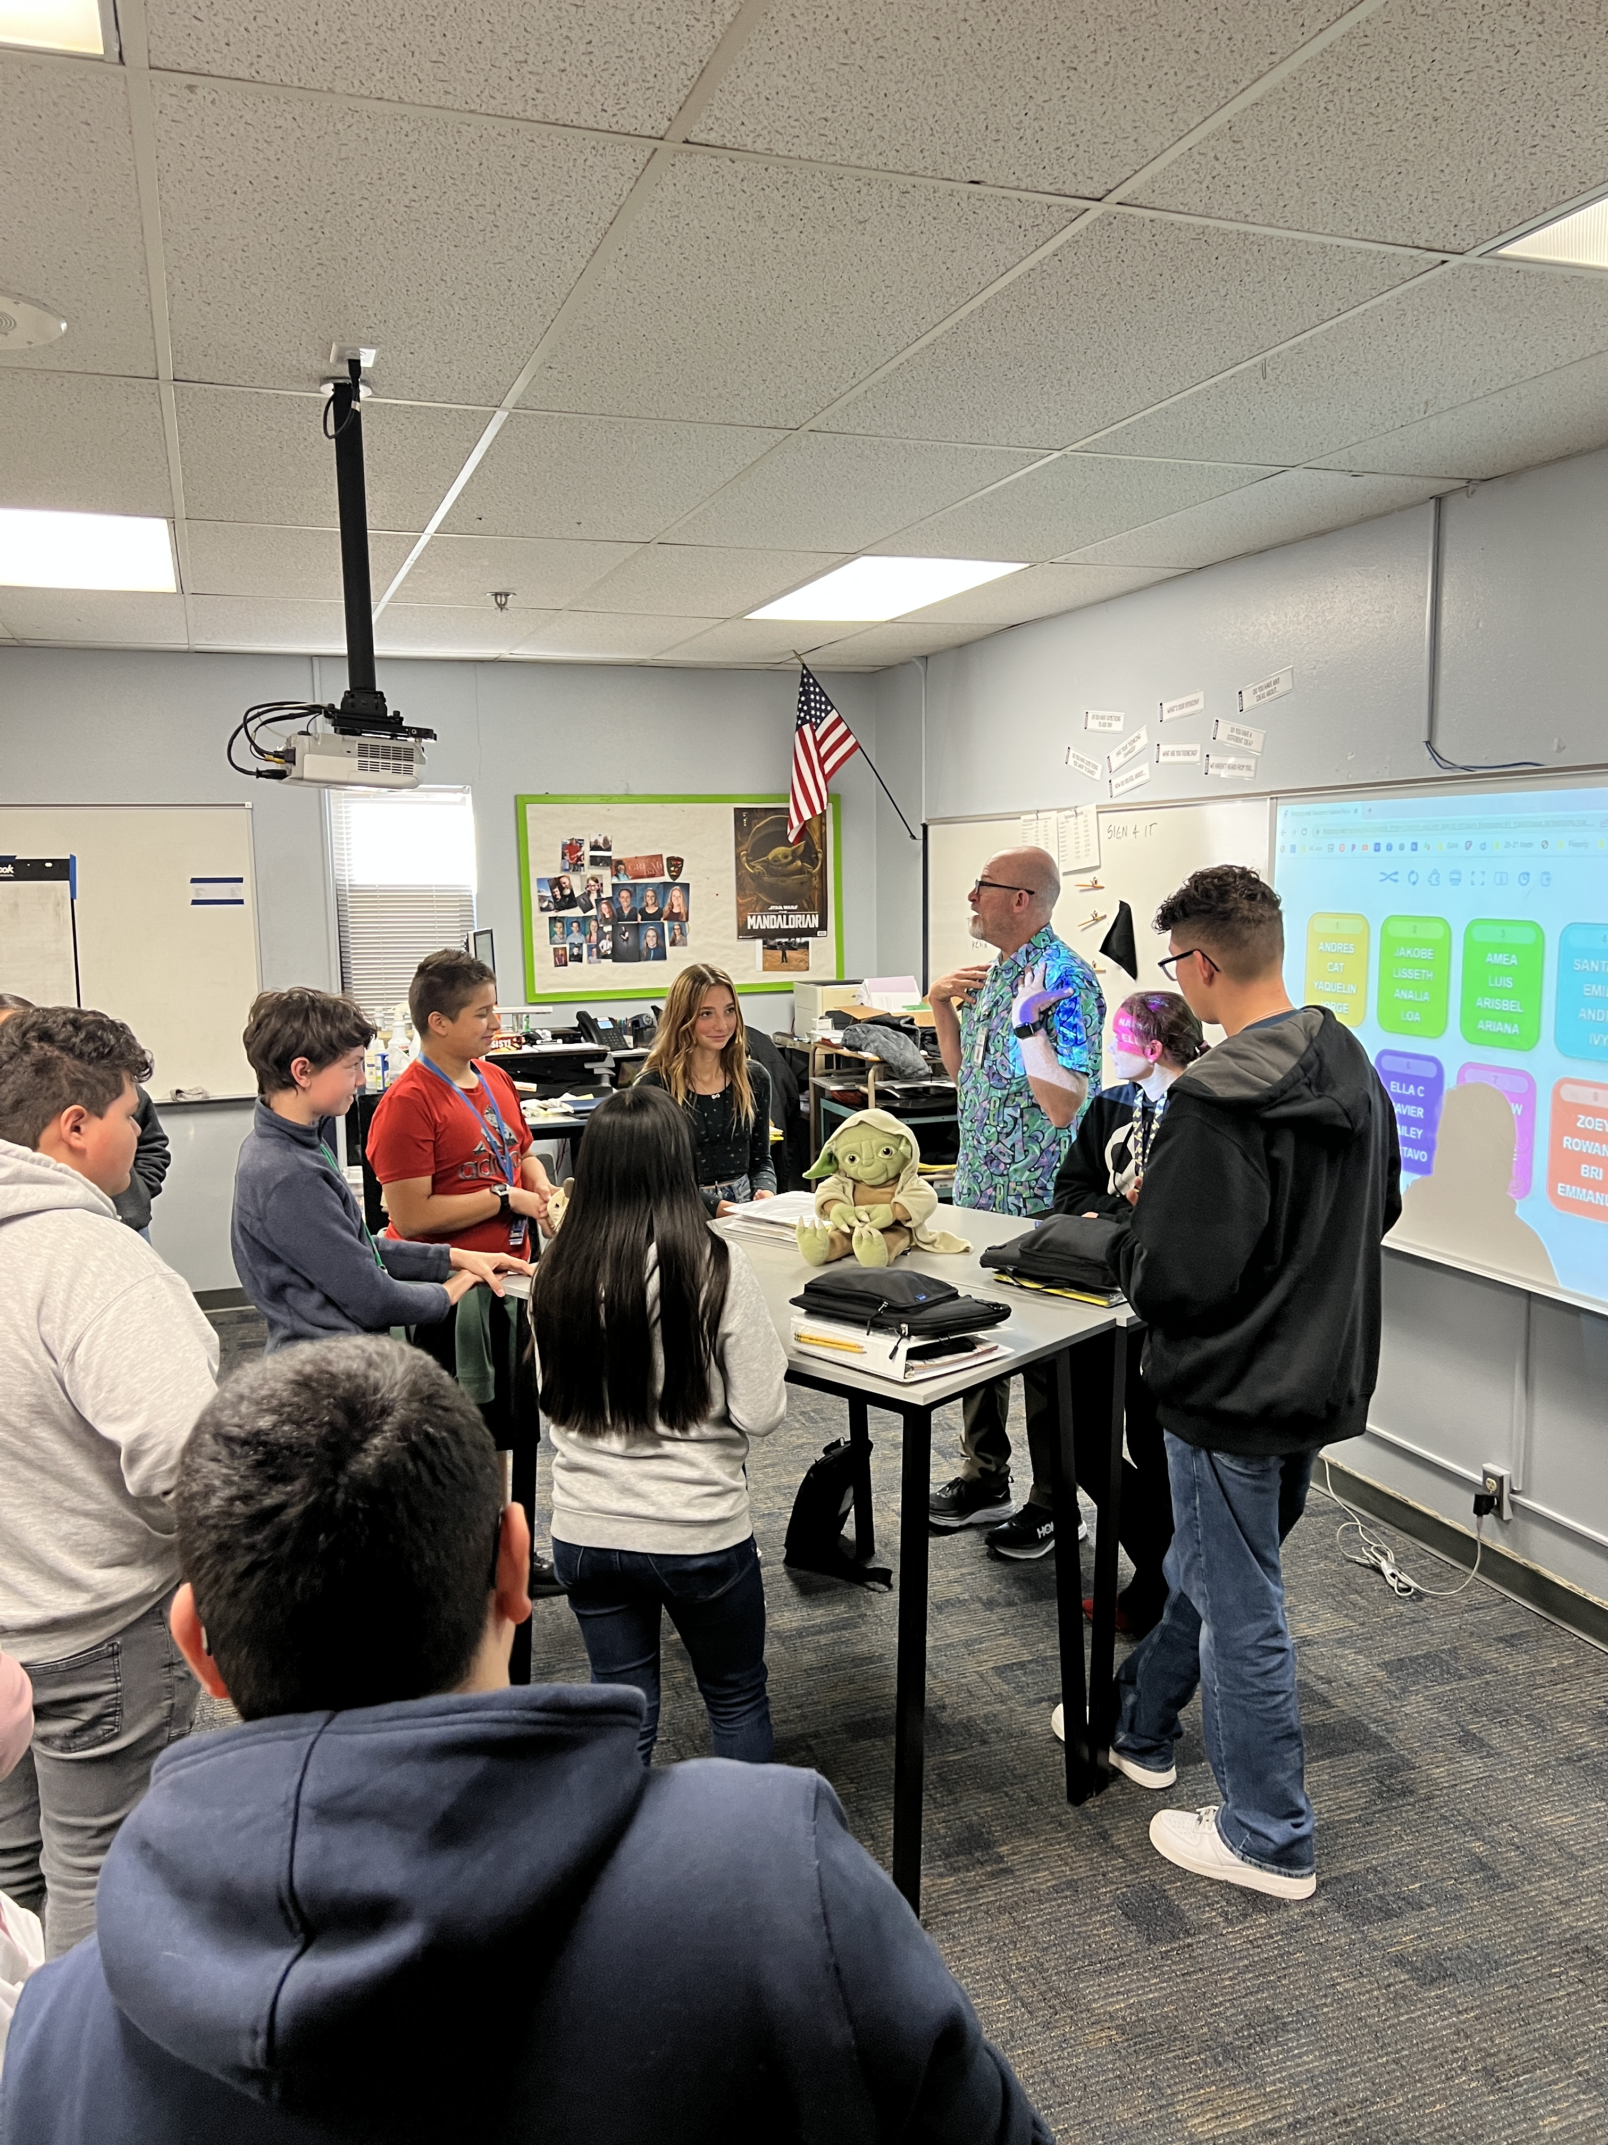
Notes:
Explain what the cards encode and how students know what to do without waiting for you.

Slide 25
Best Idea Ever
Notes:
Randomness is valuable only if it is ready to use. Set up the animal-card story.

Slide 26
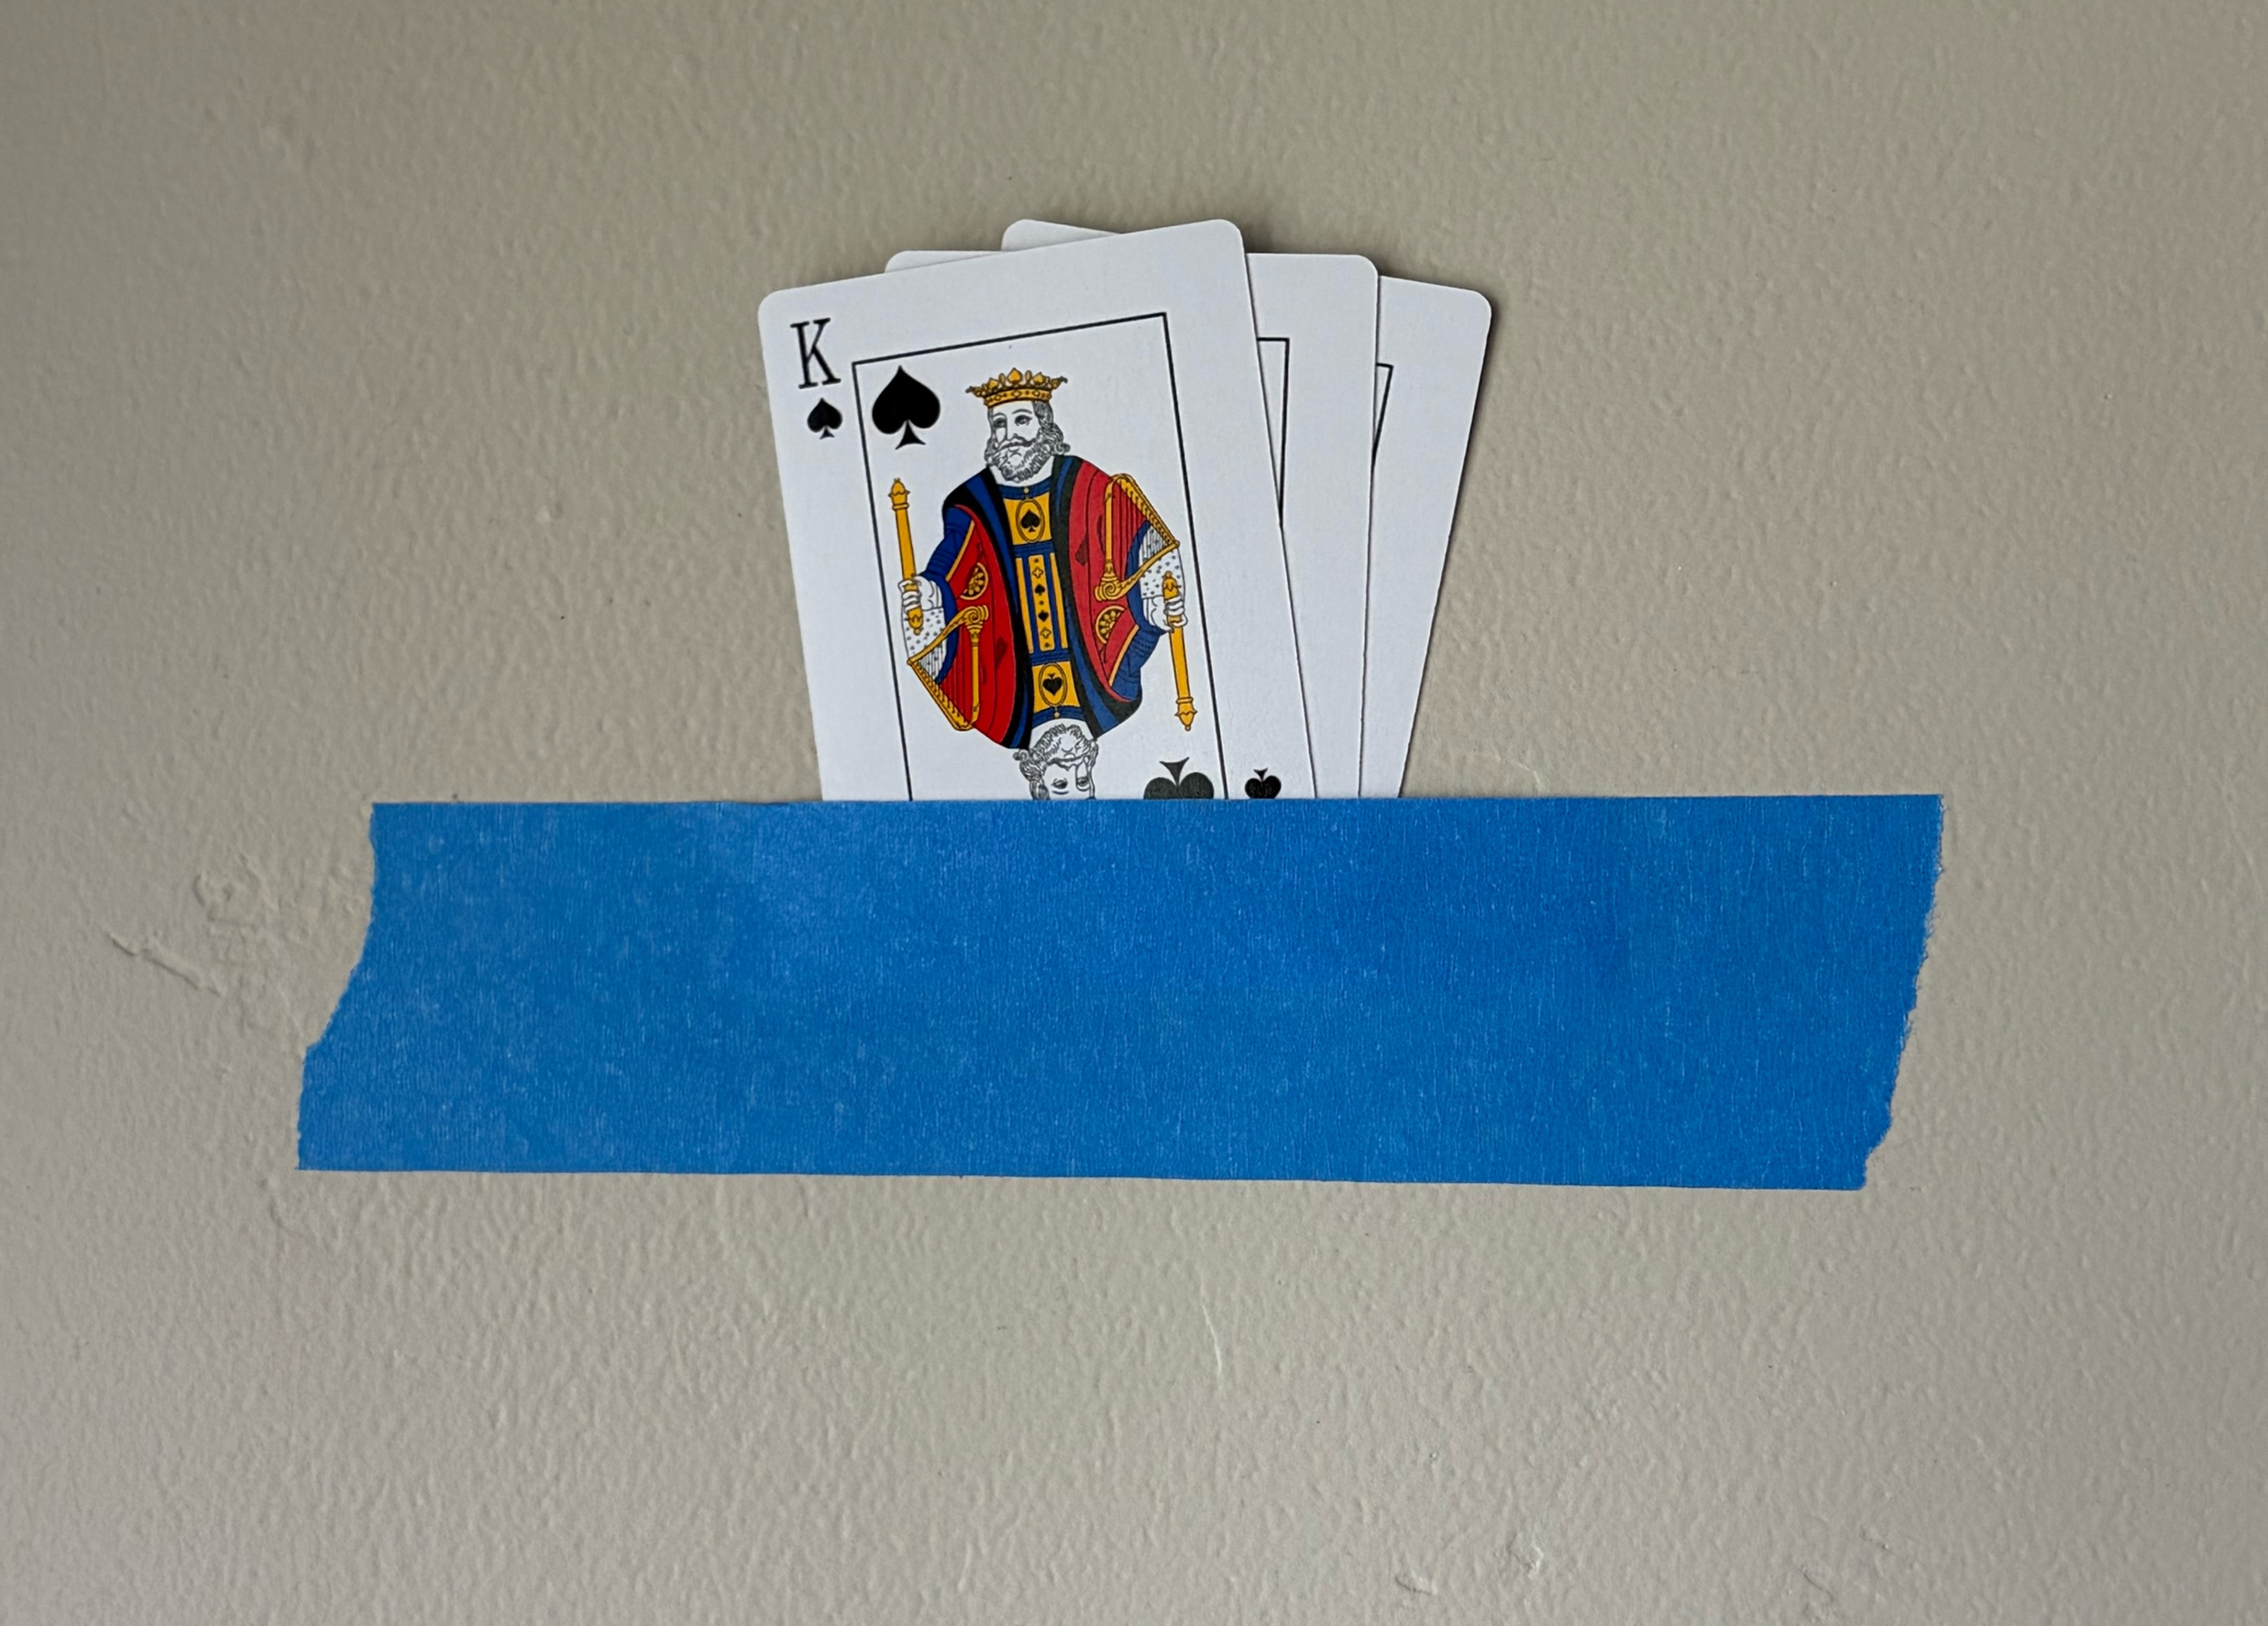
Best Idea Ever
Notes:
Every routine deserves a home. Explain how the pocket answers a question before it is asked.

Slide 27
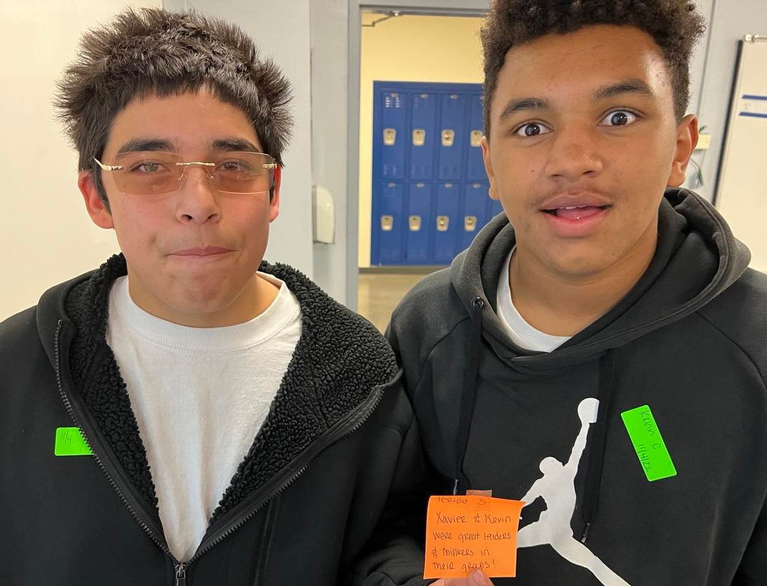
Trust the
Visual Randomness
Notes:
Zoom into the tiny practice. The point is not the card; the point is a predictable home.

Slide 28

Practice your Transitions
Notes:
Move from grouping to the physical movement of materials.

Slide 29
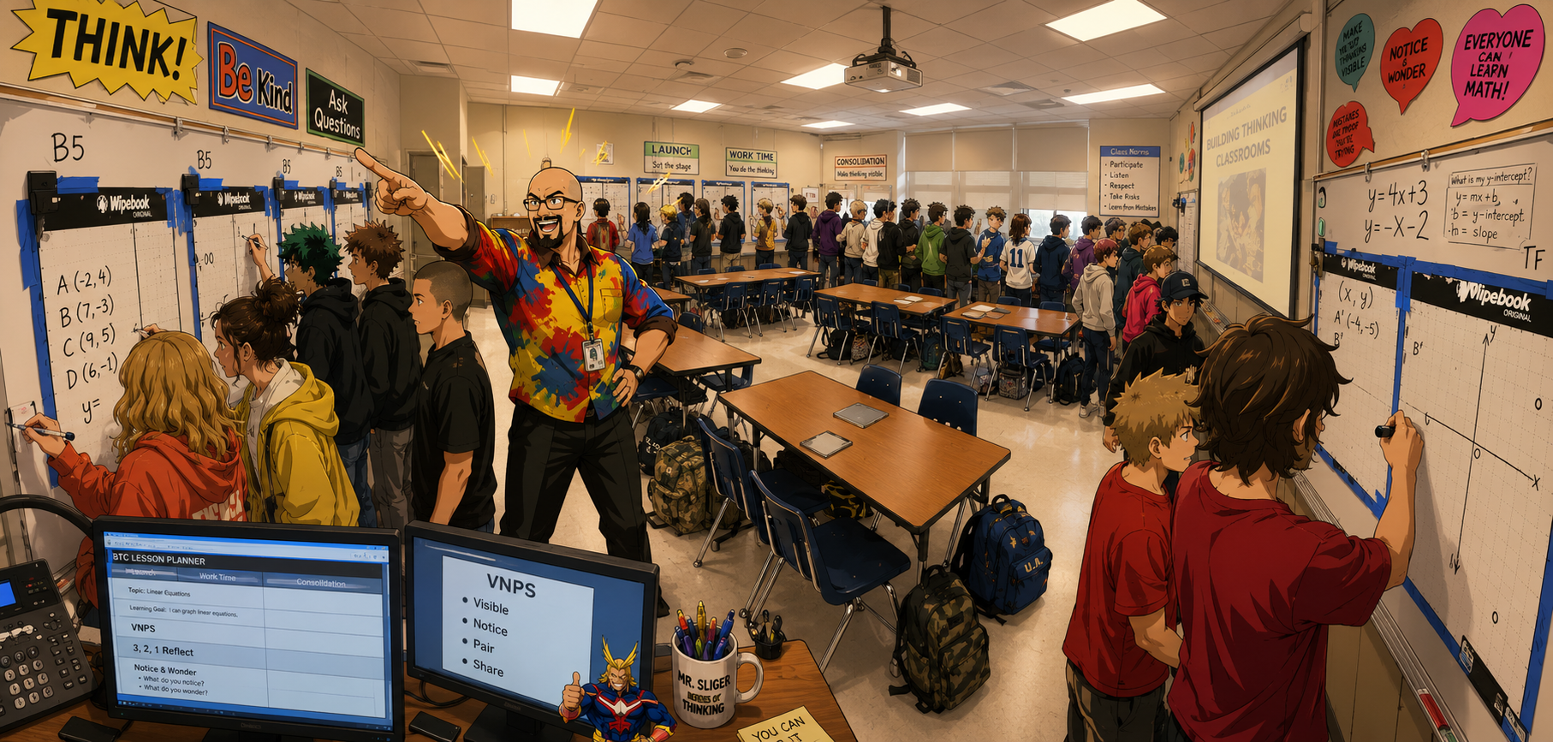
BODY
Notes:
Say only: Body. Then let the photograph establish the middle of the lesson.

Slide 30
BODY
Protect thinking.
Every interruption steals attention.
Notes:
Every interruption steals attention. Let that sentence be the verbal subtitle rather than putting more text on screen.

Slide 31
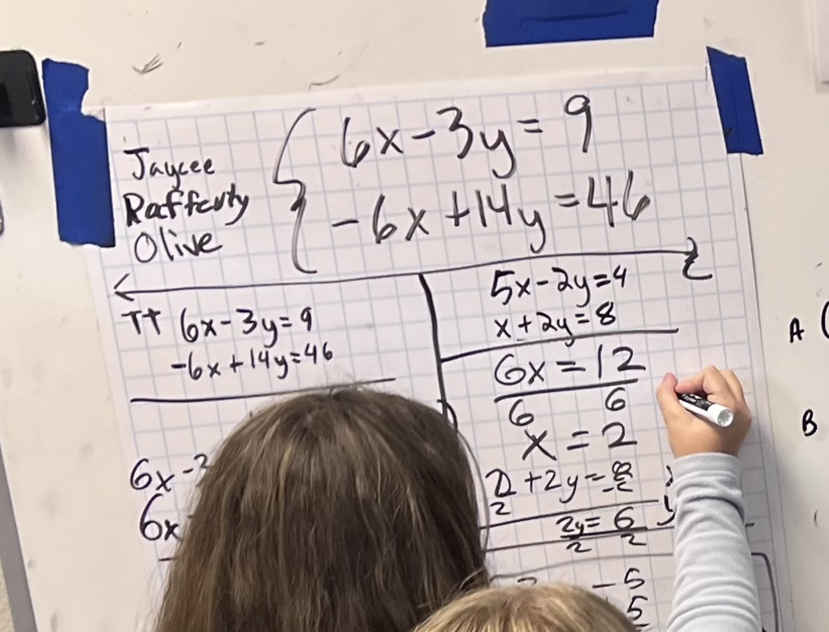
s
Banner Method
Three Rules for the Banner
1. Whatever task you are working on, you put in the banner.
2. When you are done, look around and steal a task you haven’t done yet.
3. Never make up your own tasks
Notes:
Use one example. The point is that clarity narrows attention without narrowing thinking.

Slide 32
s
Banner Method
Only three problems
  Groups behind
  Groups ahead
Common Banner
  Text rich tasks
  Tasks with diagrams
Notes:
Use one example. The point is that clarity narrows attention without narrowing thinking.

Slide 33
The Smartest Person in the Room…
is the room
Notes:
Every interruption steals attention. Let that sentence be the verbal subtitle rather than putting more text on screen.

Slide 34
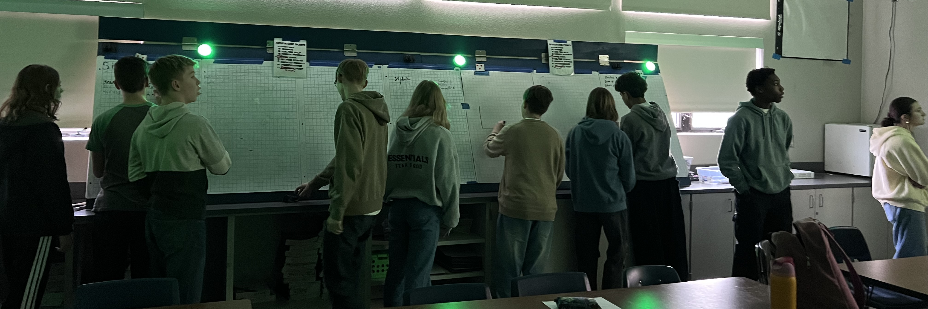
Green – everything is good
Yellow – Articulate how you are stuck (in writing)
Red – need teacher assistance
Notes:
Explain the problem the puck lights solve before revealing them in action.

Slide 35
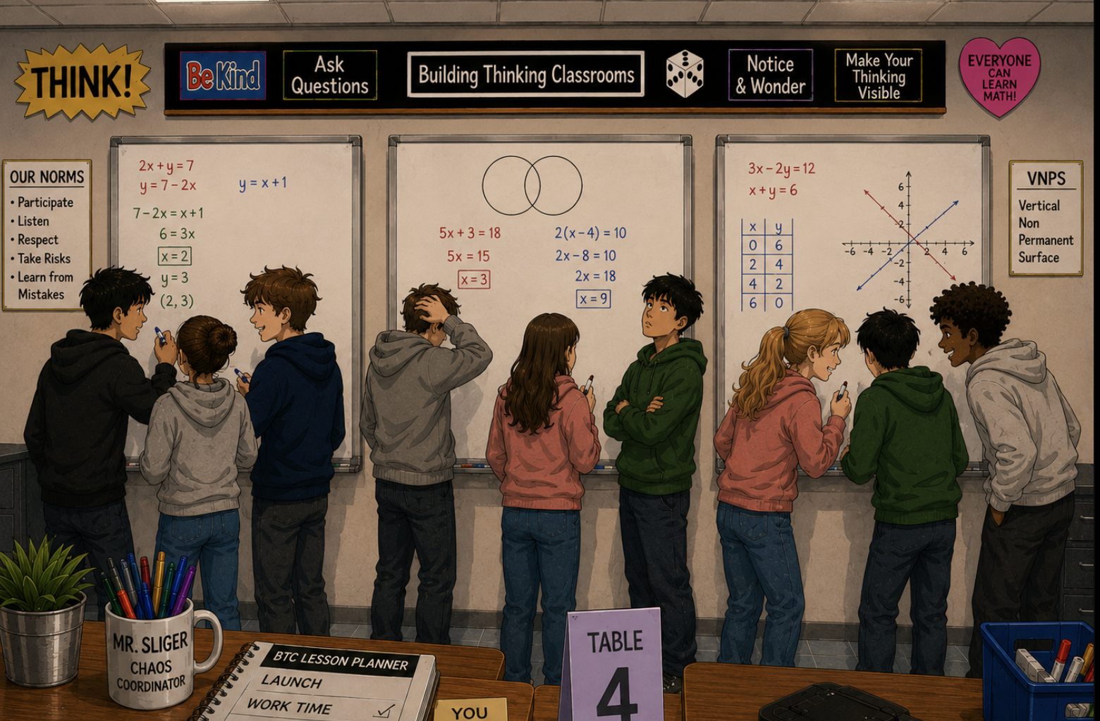
Body Language first…
Notes:
Summarize: students should not have to abandon the thinking to request support.

Slide 36
…board second
Notes:
Summarize: students should not have to abandon the thinking to request support.

Slide 37
s
Single Item Rubric
Notes:
Use one example. The point is that clarity narrows attention without narrowing thinking.

Slide 38
Enter with a question.
Notes:
Summarize: students should not have to abandon the thinking to request support.

Slide 39
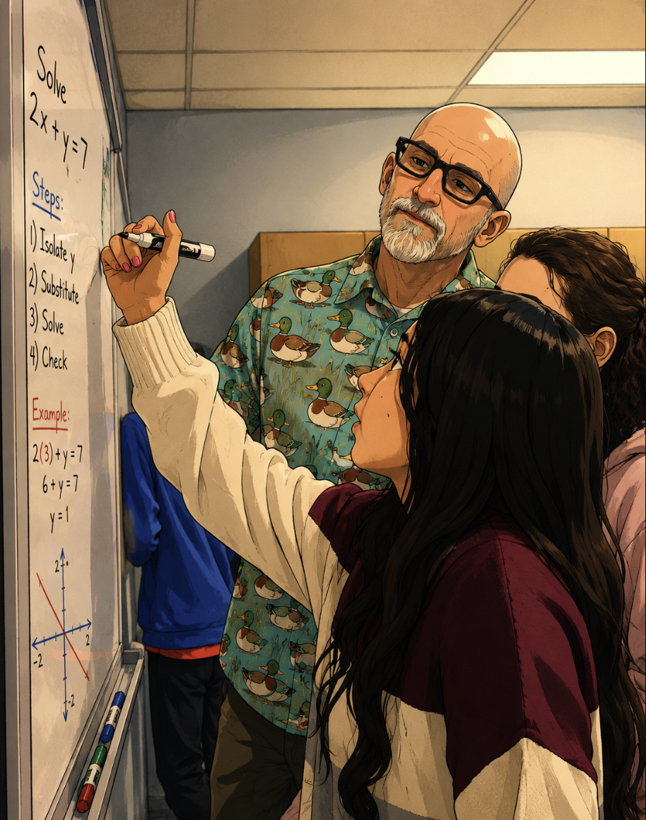
Notes:
Use one example. The point is that clarity narrows attention without narrowing thinking.

Slide 40
I can guarantee at least one of your answers is wrong…
Notes:
Transition from help systems to task design.

Slide 41
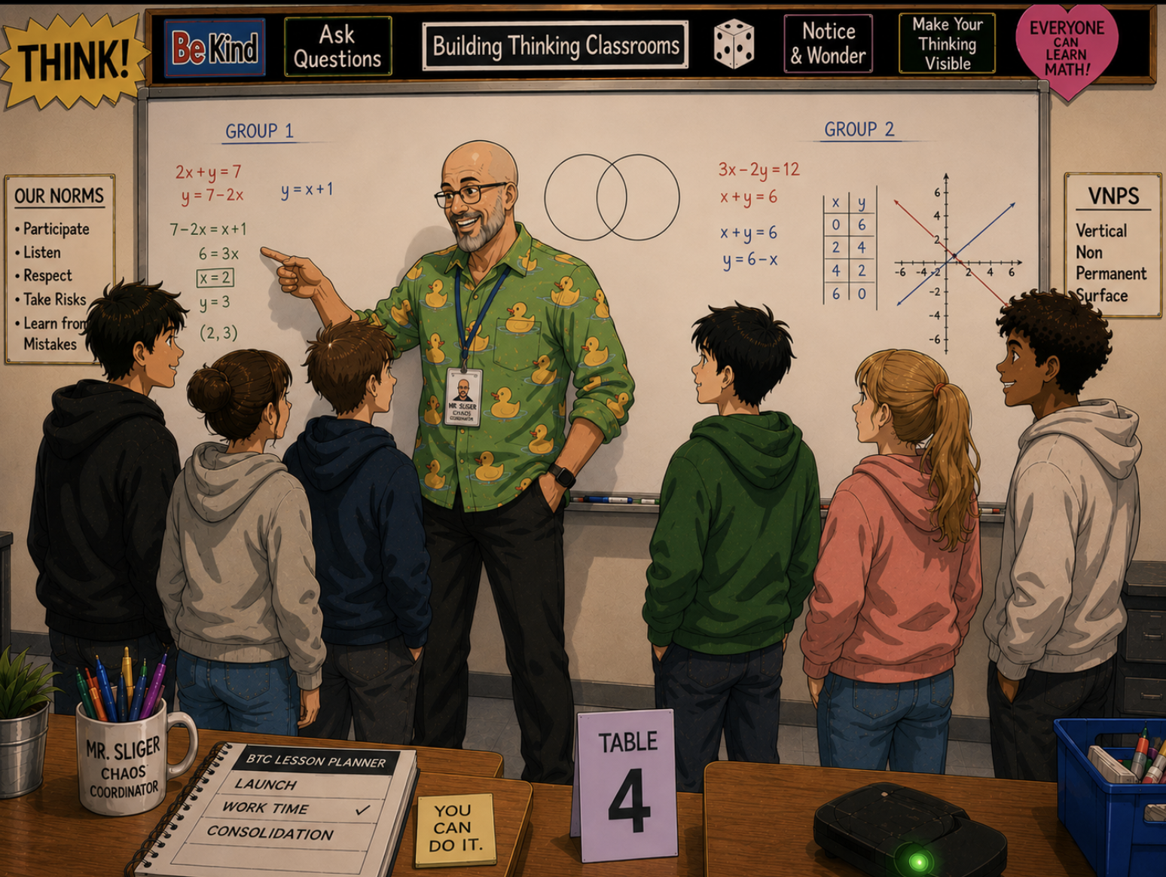
Notes:
Transition from help systems to task design.

Slide 42
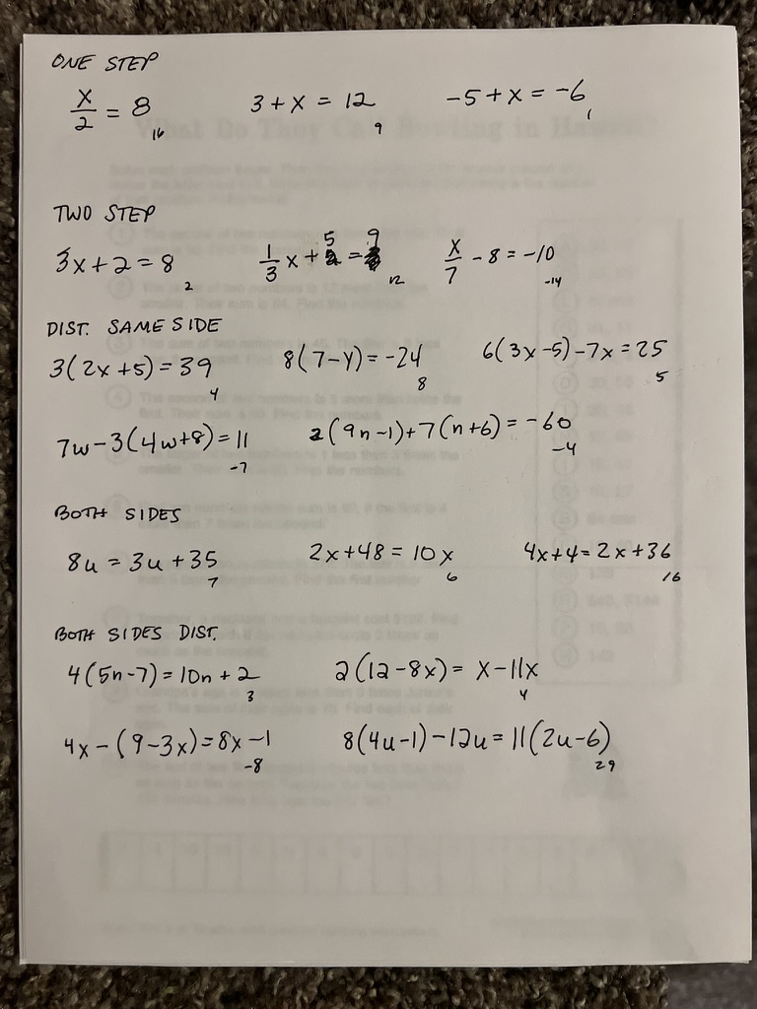
Notes:
Ask the audience what competes with thinking on this page. Do not answer immediately.

Slide 43
Smile and walk away…
Notes:
Keep this brisk. It is a punctuation slide, not a new argument.

Slide 44
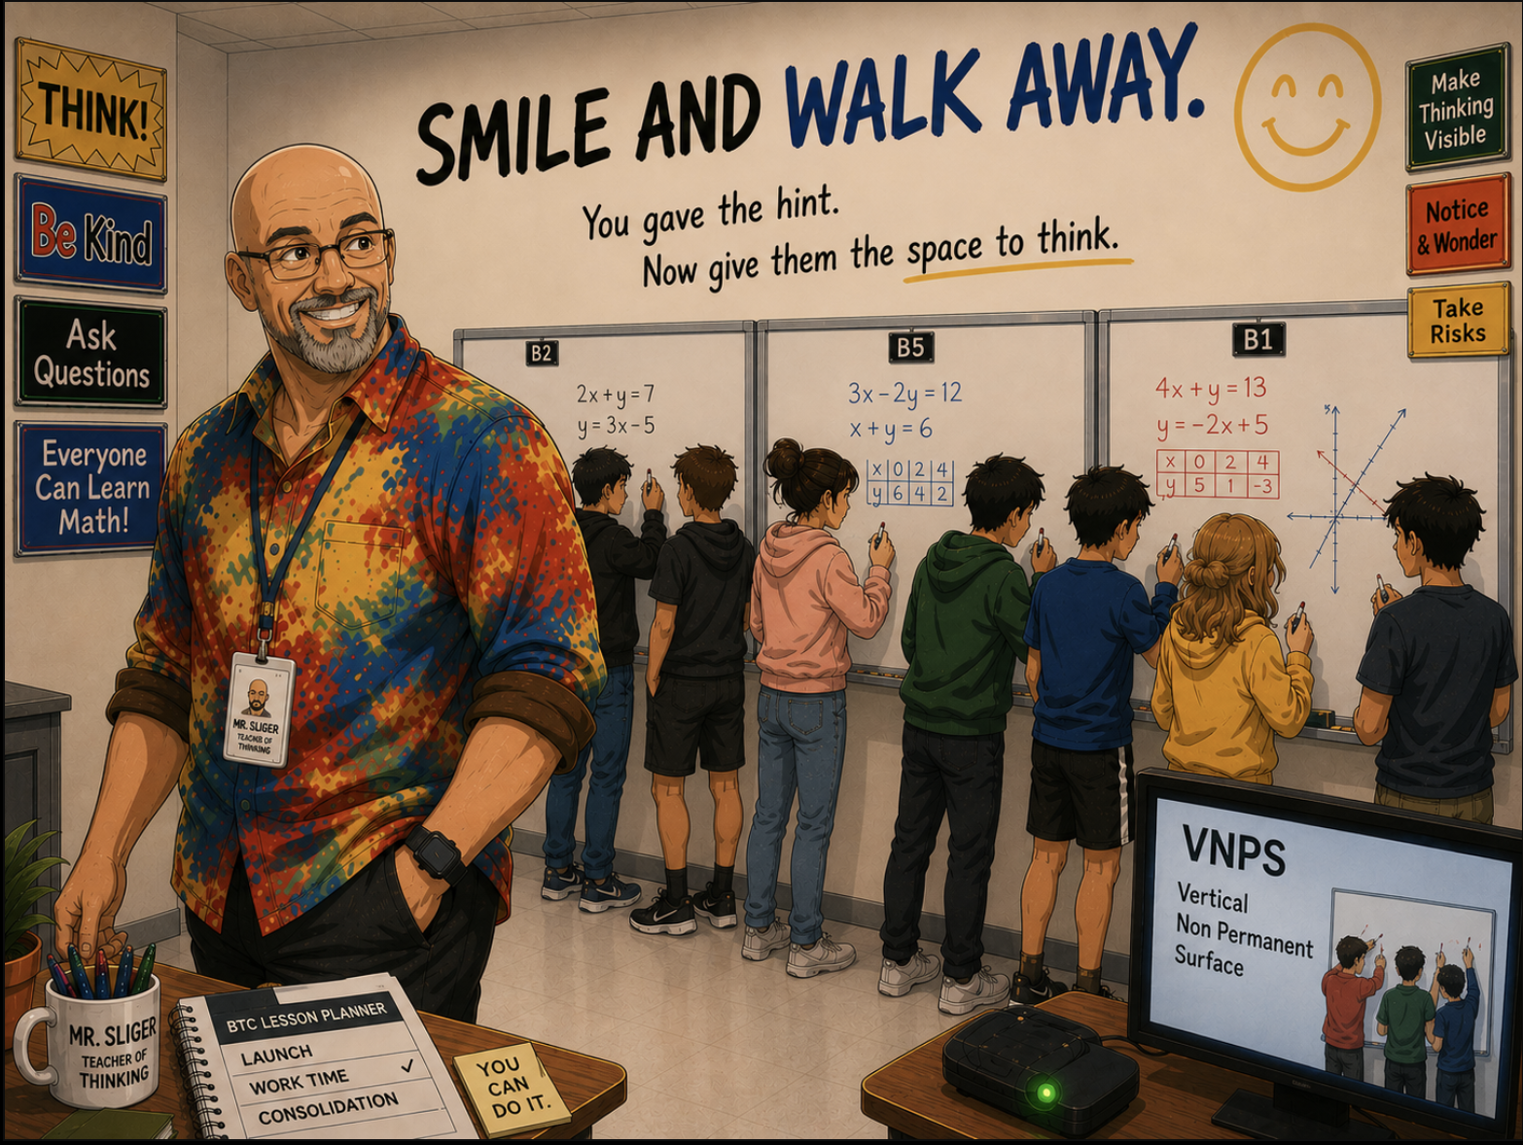
Notes:
Keep this brisk. It is a punctuation slide, not a new argument.

Slide 45
Don’t become the shortcut.
Notes:
Pause. This line should sting a little—in a useful way.

Slide 46
Laser Pointer
Notes:
The pointer lets you redirect attention without entering and taking over the group’s space.

Slide 47
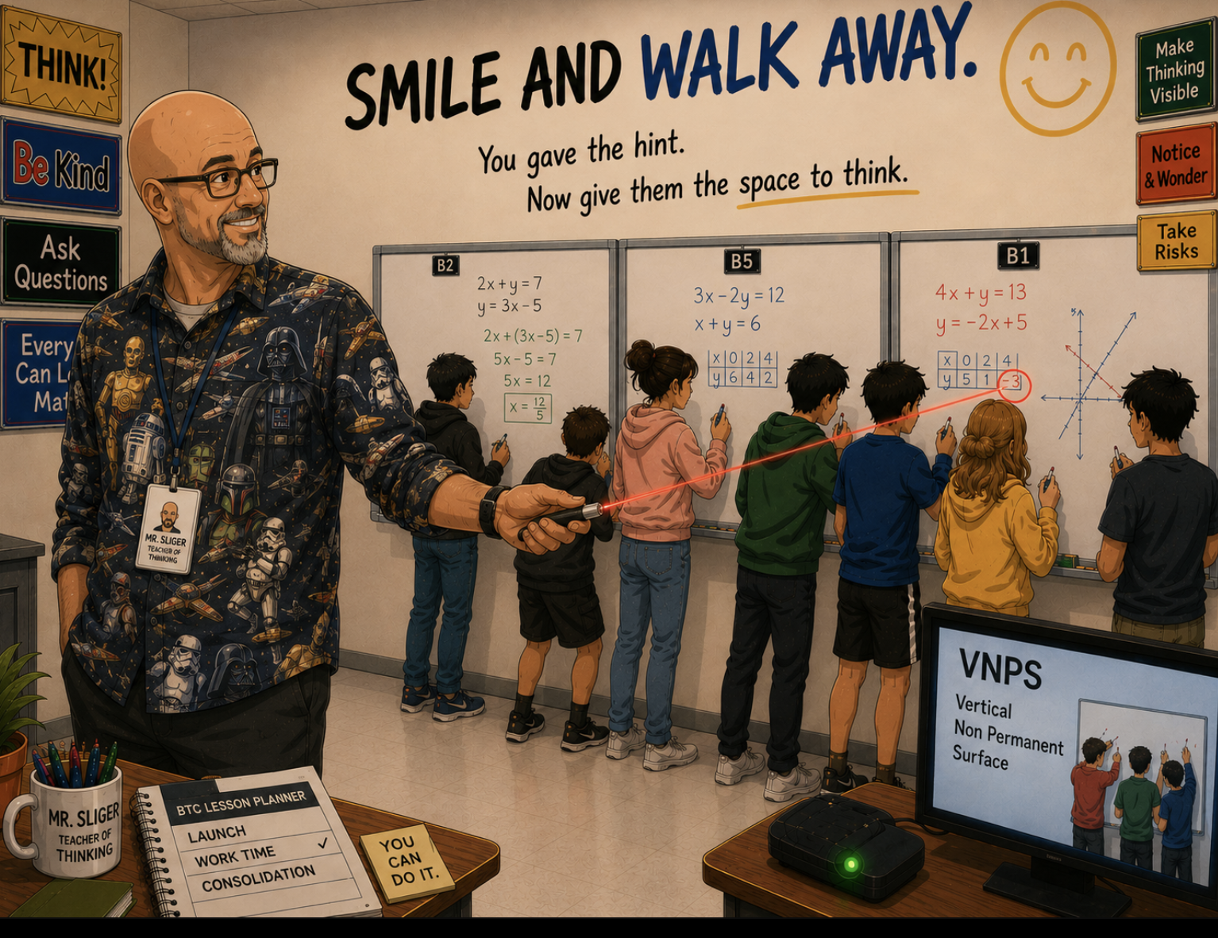
Notes:
Tell the story. The distance is purposeful, not neglectful.

Slide 48
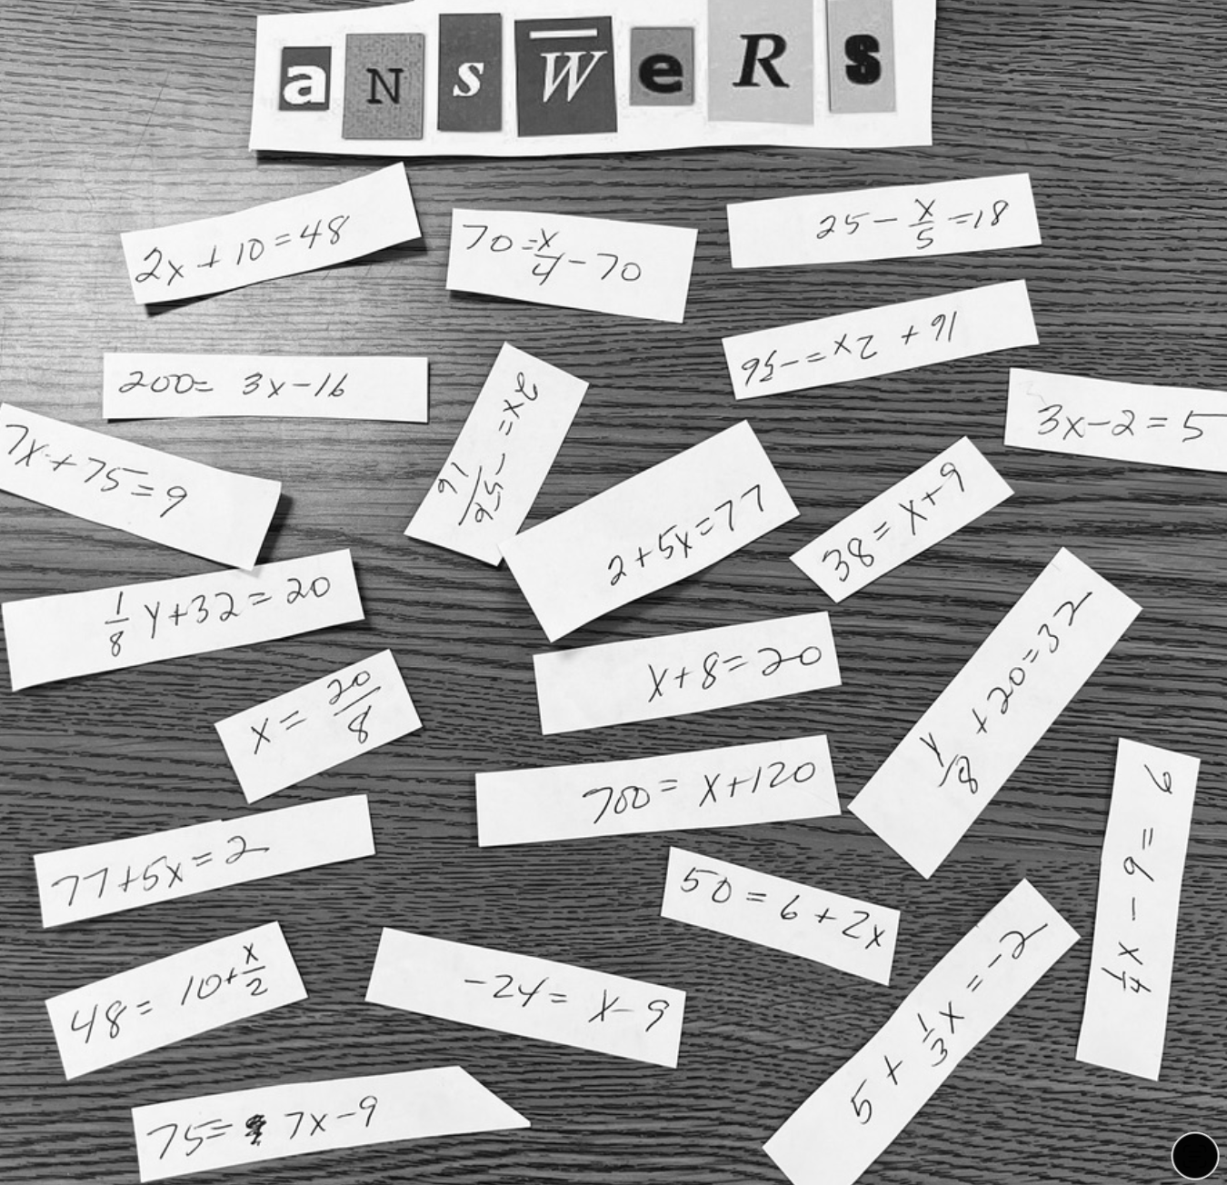
Notes:
Tell the standing story. Focus on the environment cue, not compliance.

Slide 49
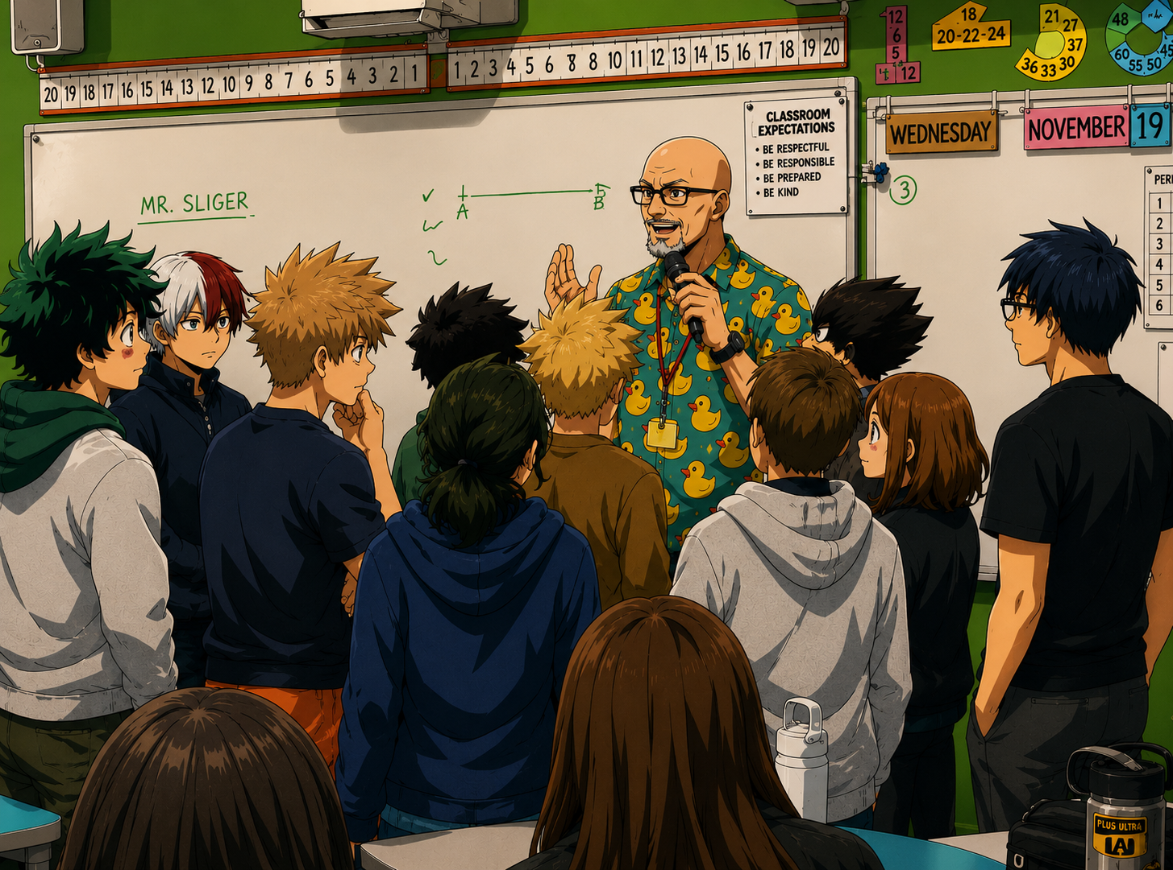
CLOSE
Notes:
The close begins by widening the view again. Let the image breathe.

Slide 50
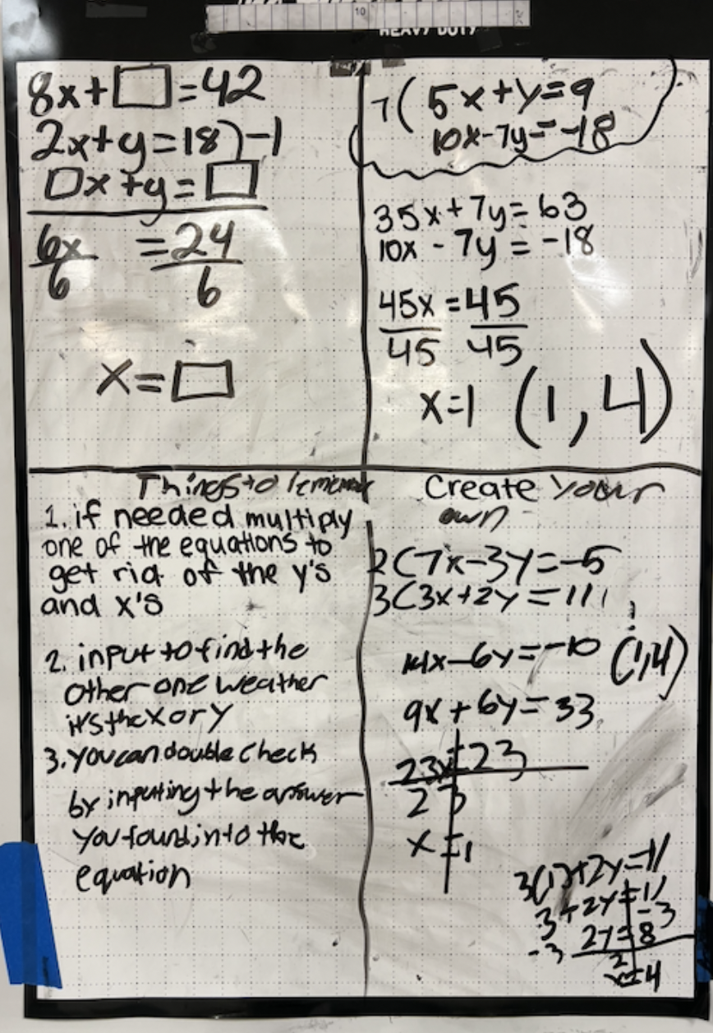
DROP PHOTO
4 Quadrant
Notes
Ideas captured after consolidation
Notes:
Notes should preserve mathematical ideas students can reuse, not merely copy a worked procedure.

Slide 51
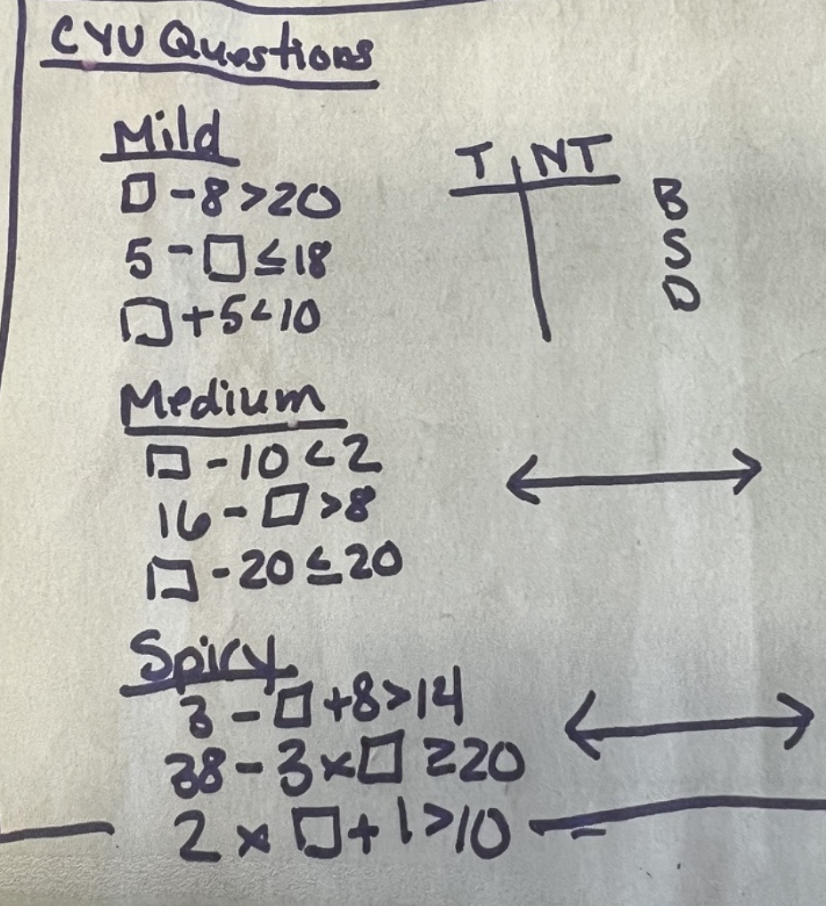
MAKE POSITION VISIBLE
DROP PHOTO
Check
Your
Understanding
Questions
CYU check
Notes:
Explain the check-your-understanding routine as orientation: current position and next direction.

Slide 52
YOUR TURN.
Notes:
Everything changes here. Give the room the challenge, then move quickly into instructions.

Slide 53
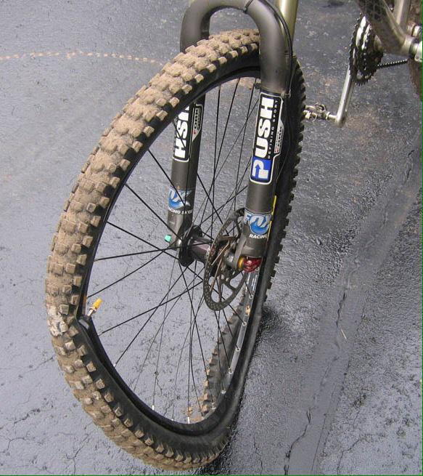
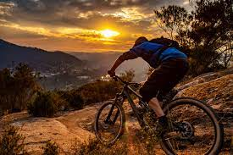
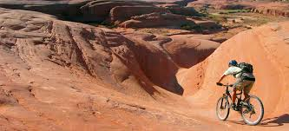
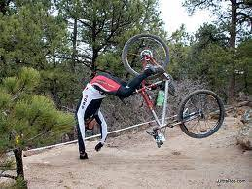

Slide 54
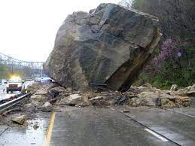
Just keep peddling…
And keep your eyes on the prize…

Slide 55

Jared Sliger
jared@buildingthinkingclassrooms.com
Notes:
Tell the one-third story. Let the number create curiosity before you explain what it means.

Slide 56
FIND THE FRICTION
VNPS
GROUPS OF 3
15 MINUTES
Find one source of friction.
Design one small practice that removes it.
Notes:
Give instructions cleanly: groups of three, at vertical non-permanent surfaces, fifteen minutes. Their task is to identify one source of friction and design one small practice that removes it.

Slide 57
DROP PHOTO
Gallery walk — participants photographing one another’s boards.
Take pictures.
Notes:
Send them into the gallery walk. Say: Take pictures. Borrow shamelessly. Improve generously.

Slide 58
Look what WE built.
Link to images from the boards
Notes:
Emphasize WE. The room has produced a collective toolkit, not completed an activity.

Slide 59
TOMORROW
Find one source of friction.
Remove it.
Repeat.
Notes:
Close quietly. Tomorrow: find one source of friction, remove it, repeat. Do not add another summary after this.

