Slide 1
Demystifying BTC STYLE Assessment and Grading
Don Newman
The Boys’ Latin School of Maryland
June 30, 2026

Slide 2
About Me
Algebra Teacher/Math Dept. Chair at All-Boys K-12 Independent School in Baltimore, Maryland
Five Years of BTC
Four Years BTC Style Grading
BTC Facebook Group Admin

Slide 3
Traditional Grading
Points Based. Often includes homework, class participation, etc.
Doesn’t allow students to master material over time
Encourages wrong behaviors

Slide 4
BTC Assessment and Grading
Mastery Grading Based on Data
Incentivizes students to keep working until mastery is achieved
Allows students to master material over time at their own pace

Slide 5
Rubrics
Learning Targets Rubric
Chapter 13 Navigation Map
Chapter 14 Grading Rubric

Slide 6
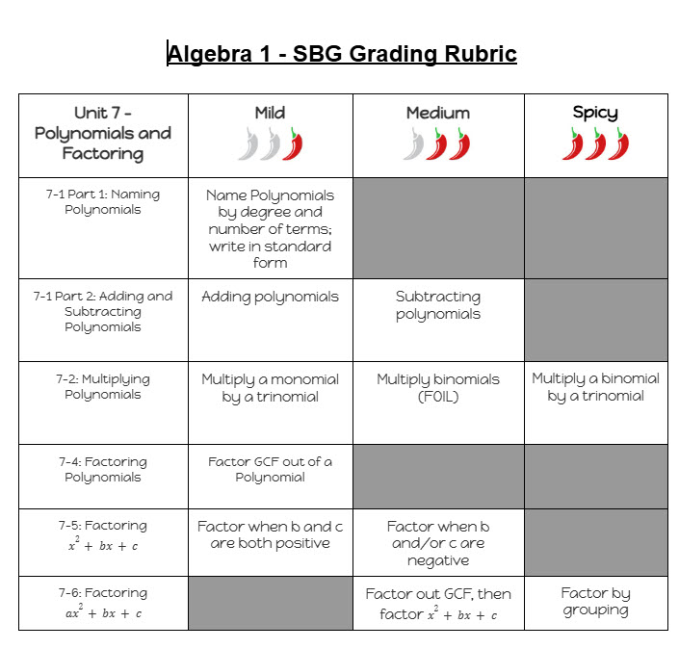
Learning Targets Rubric
Teacher Use Only
Helps for Unit Planning and Grading

Slide 7
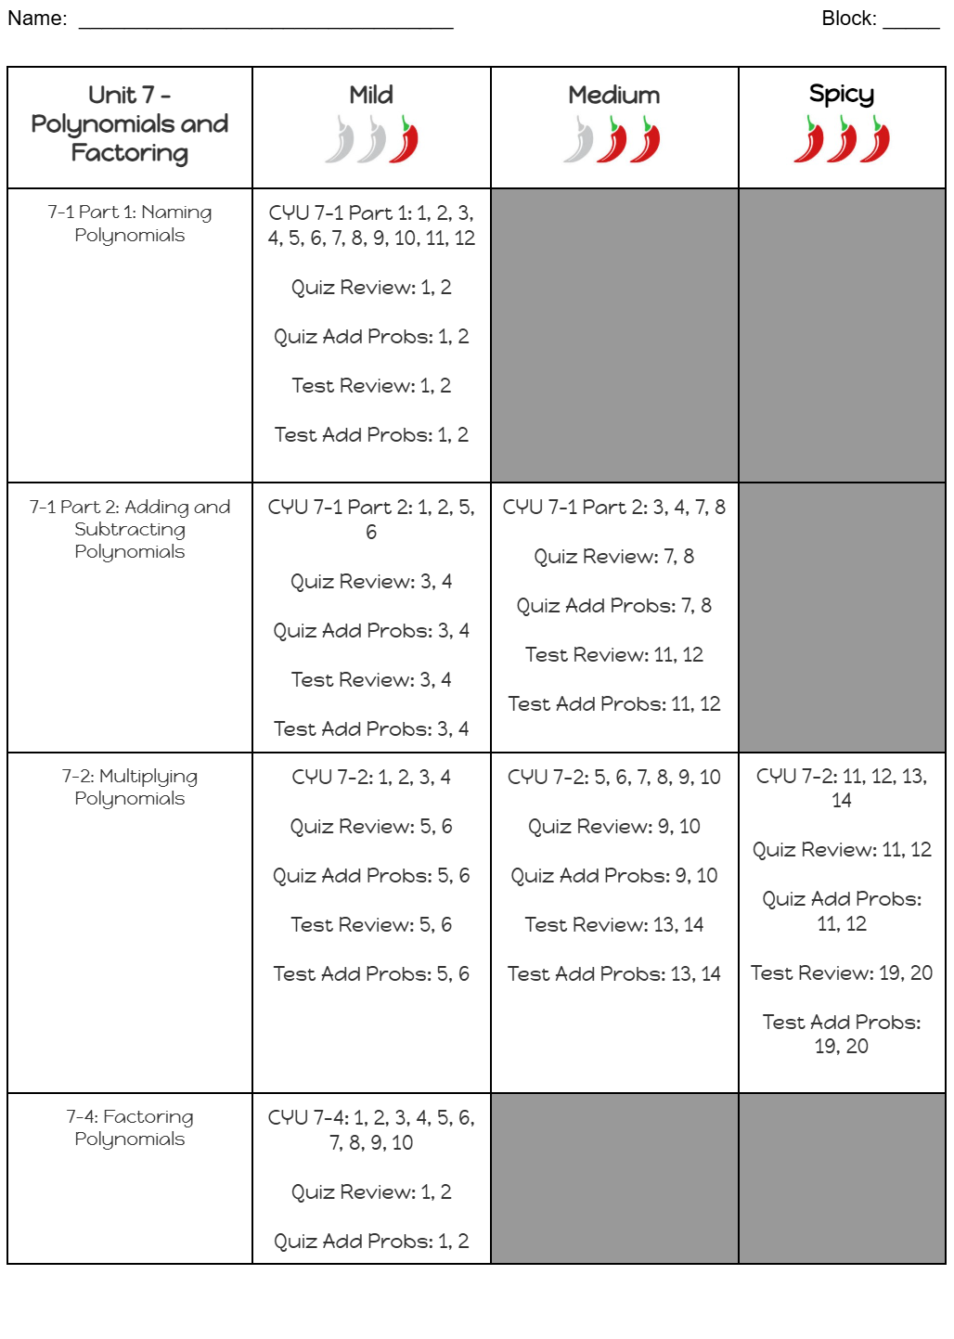
Chapter 13 Navigation Map
For Student Use
Problem Numbers Only (Not Standards Text)

Slide 8
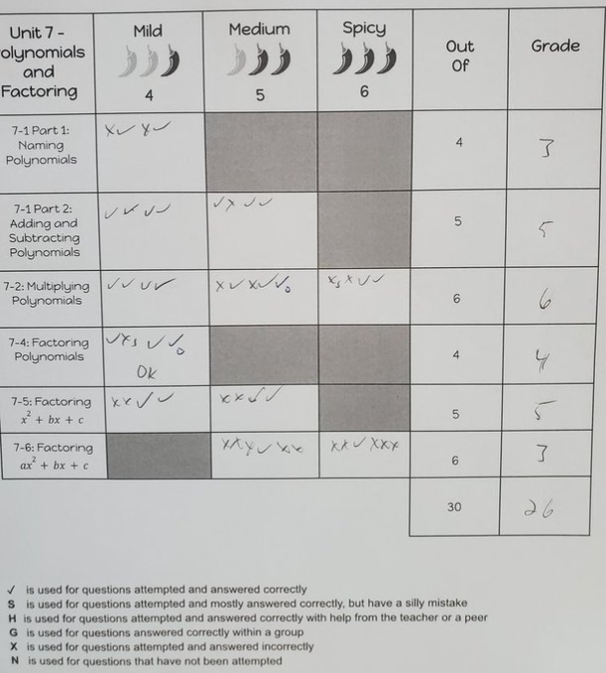
Grading Rubric
One rubric per student per unit
In pencil so numbers can be changed

Slide 9
Ways to Demonstrate Mastery
Quizzes and Tests
Do problems on whiteboard outside of class
Observations in class, particularly on assessment review days
Never during the lesson

Slide 10
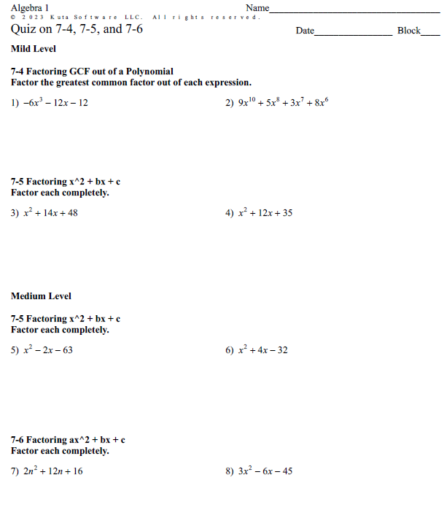
Quiz Example
Organized by level

Slide 11
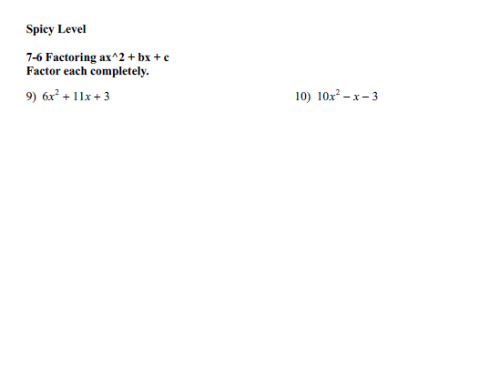
Quiz Example (cont’d)

Slide 12
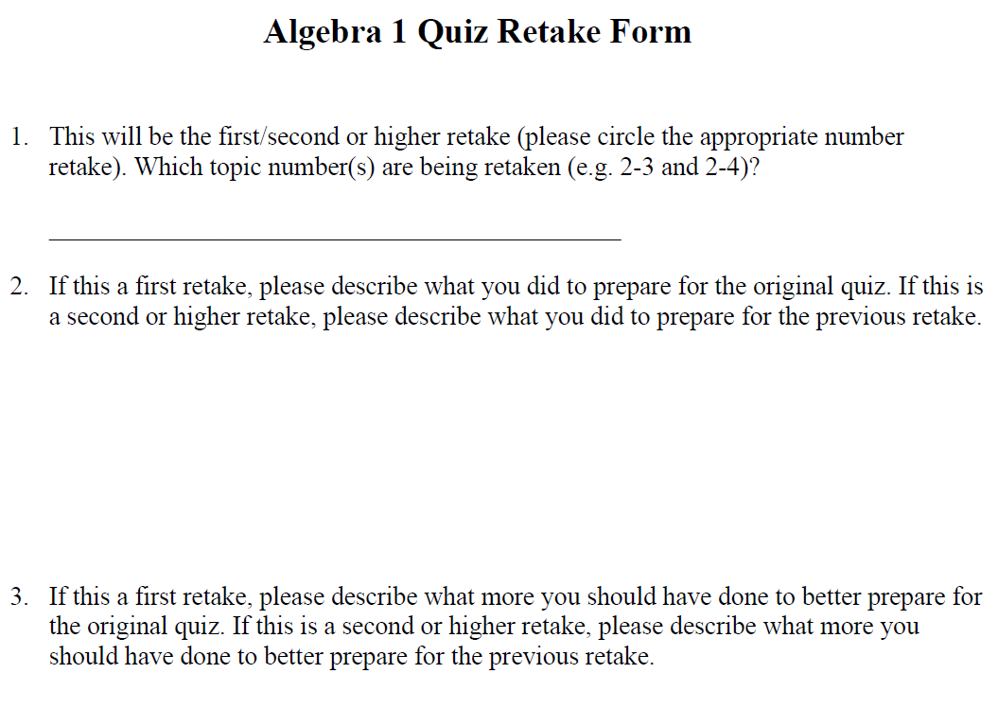
Quiz Retake Form

Slide 13
Gradebook
Total Points System
Only Learning Targets Go in Gradebook
Learning Targets Each Worth Max Of 6 Points (if there is spicy level)

Slide 14
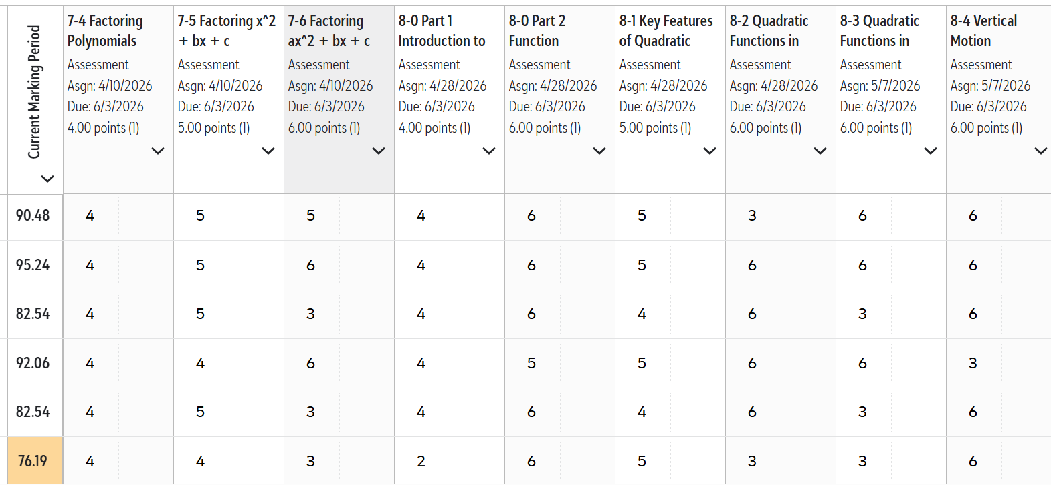
Gradebook Example

Slide 15
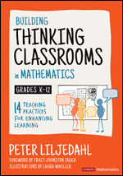
Contact Info/BTC Resources
School
The Boys’ Latin School of Maryland
dnewman@boyslatinmd.com
Facebook
Group:https://www.facebook.com/groups/buildingthinkingclassrooms

