Slide 1
Cultivating the Conditions: Leadership for a Sustainable Classroom
April Bright, ʻAikahi Elementary School
Janel Marr, Kailua-Kalāheo Complex Area

Slide 2
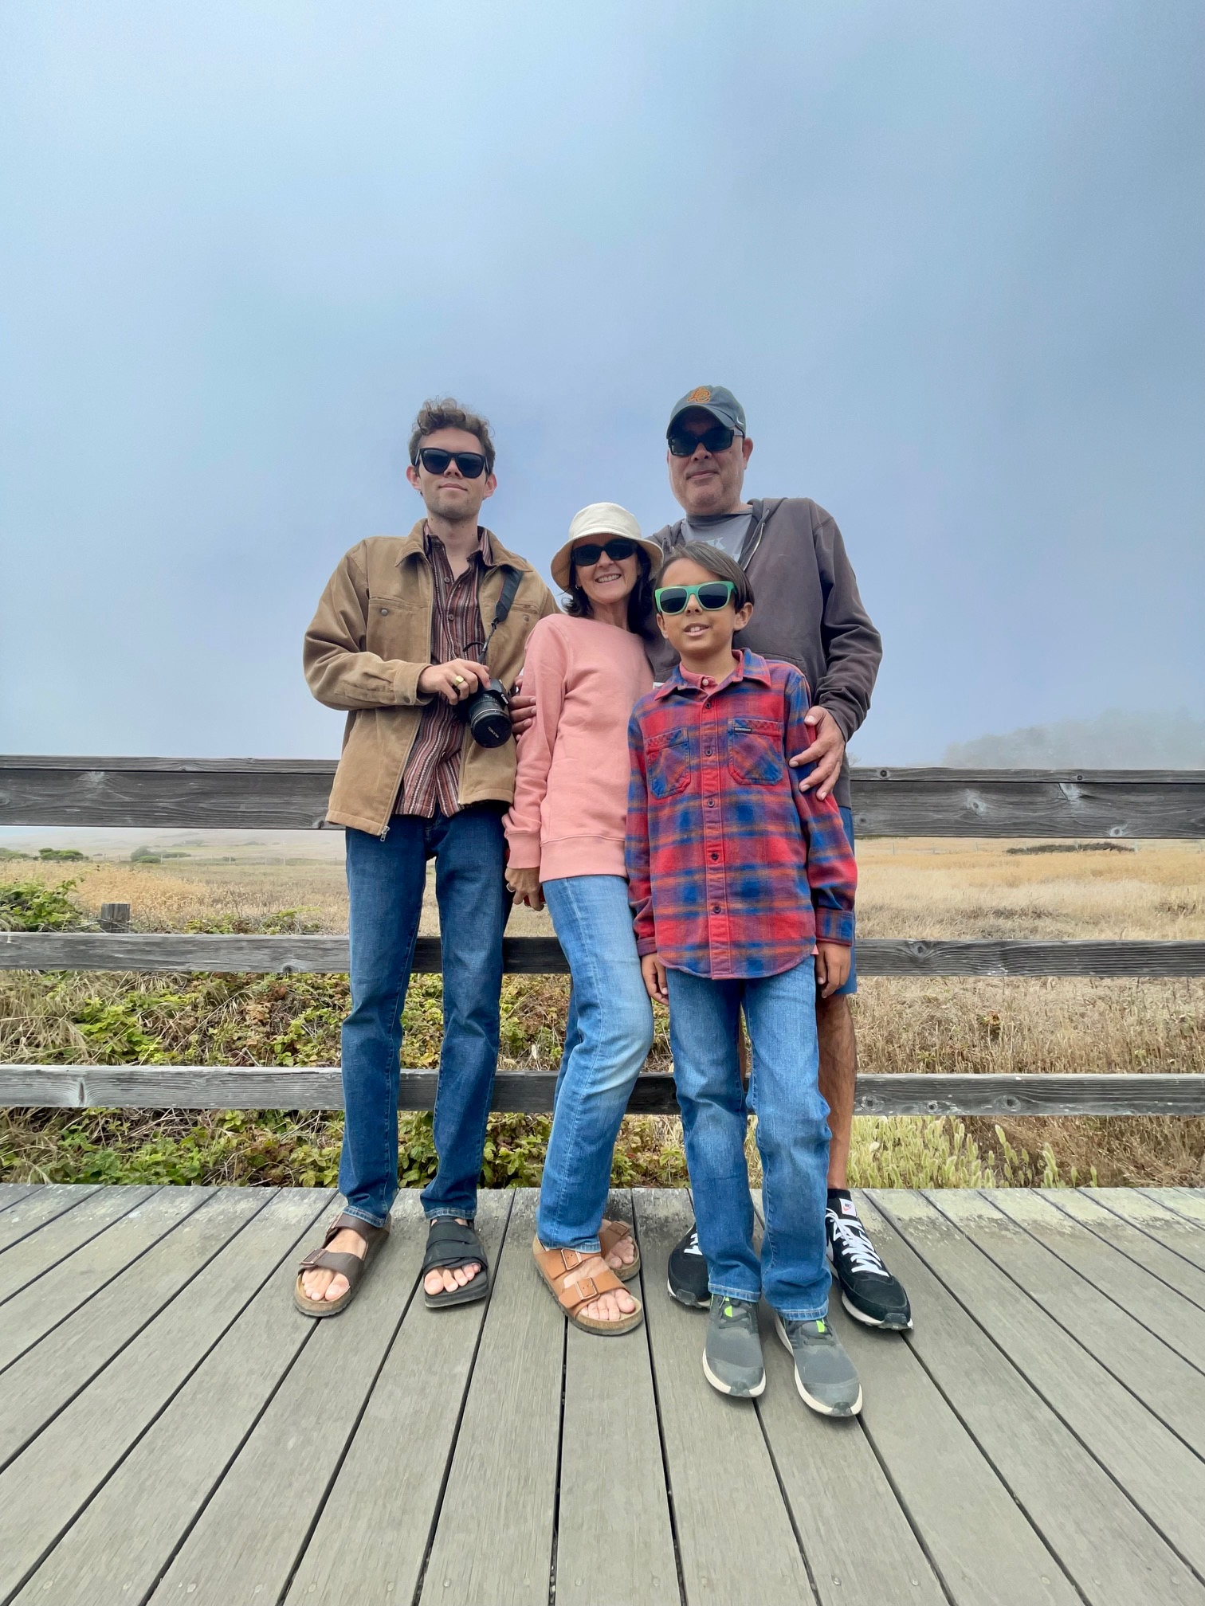
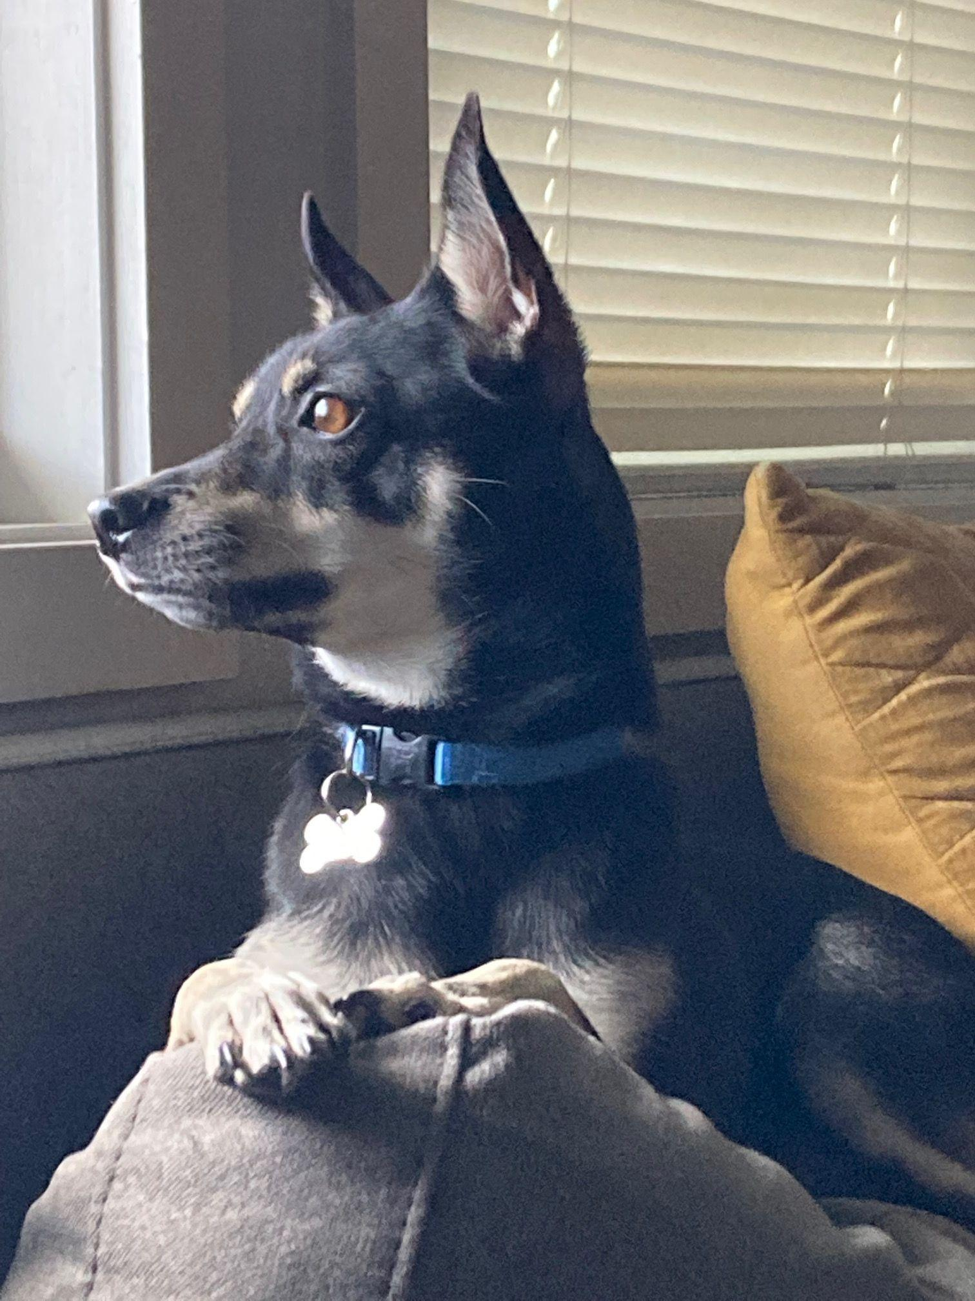


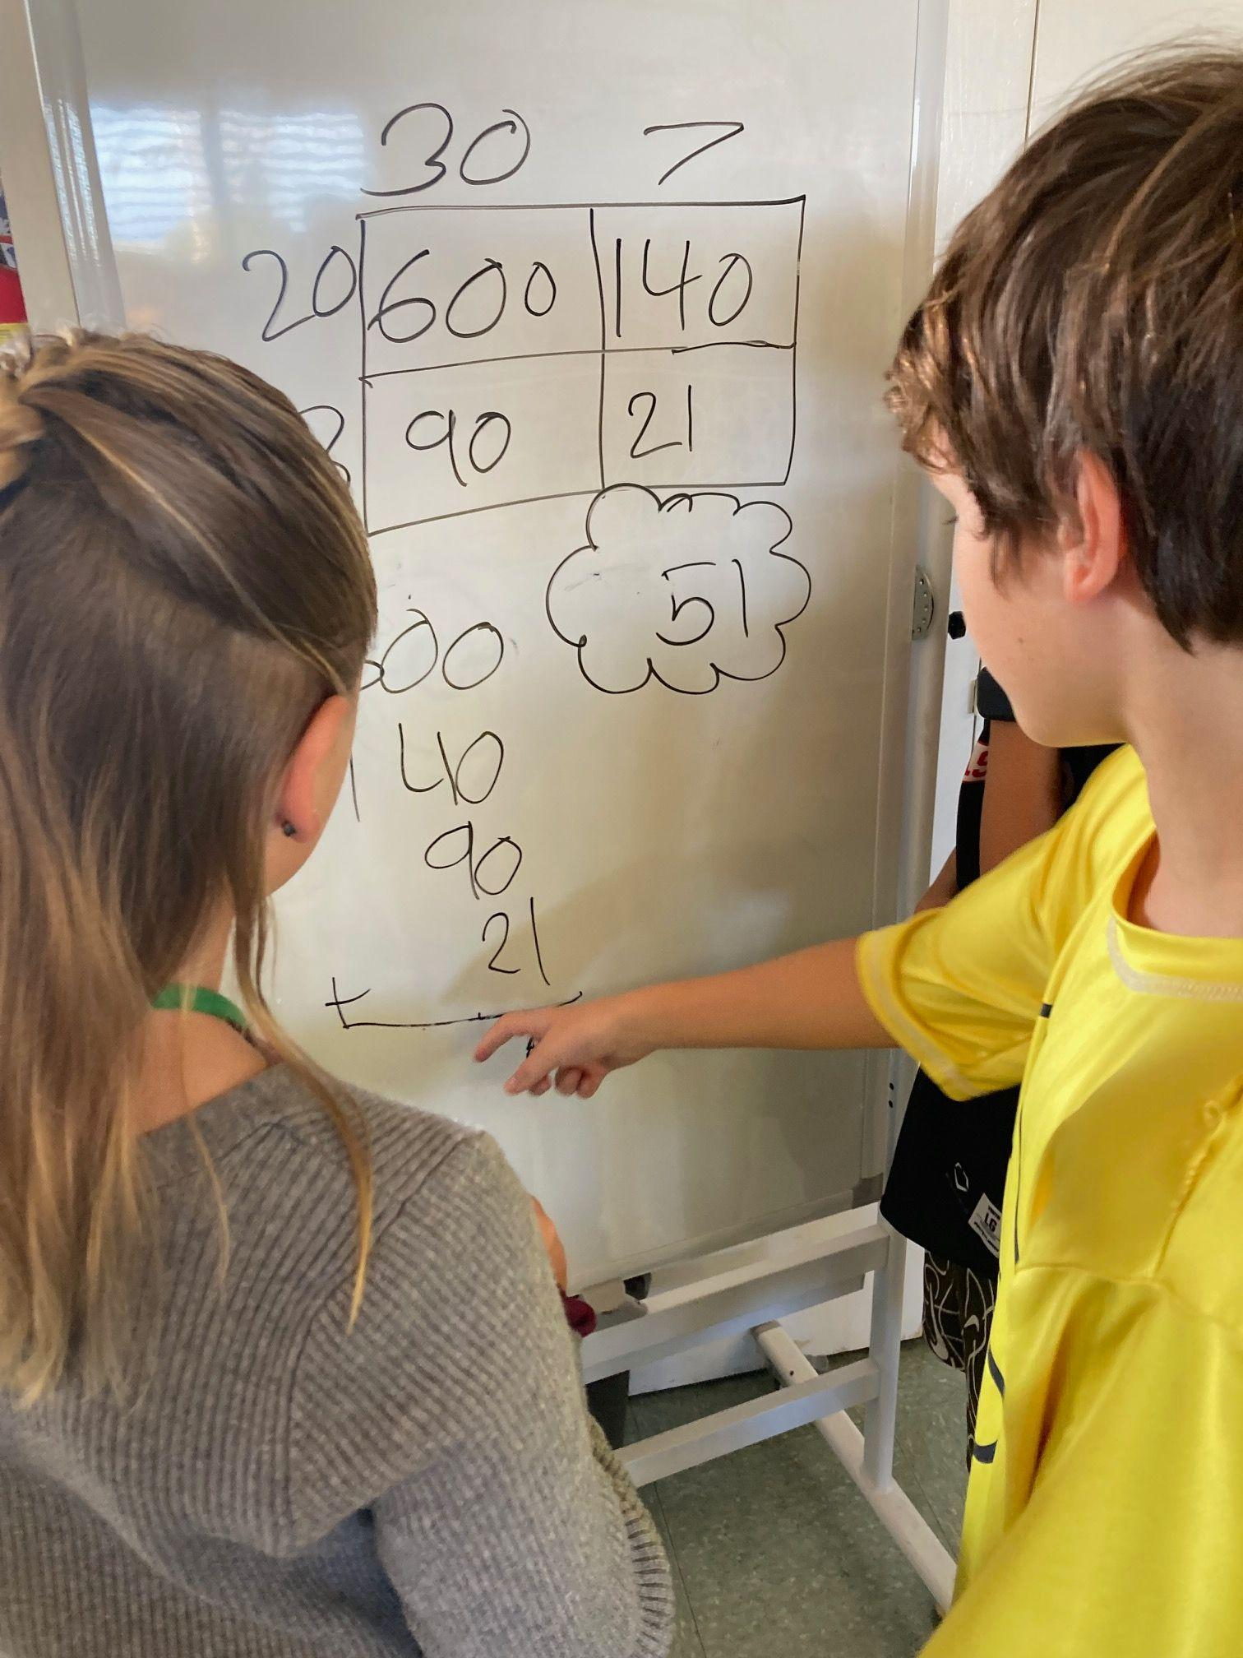
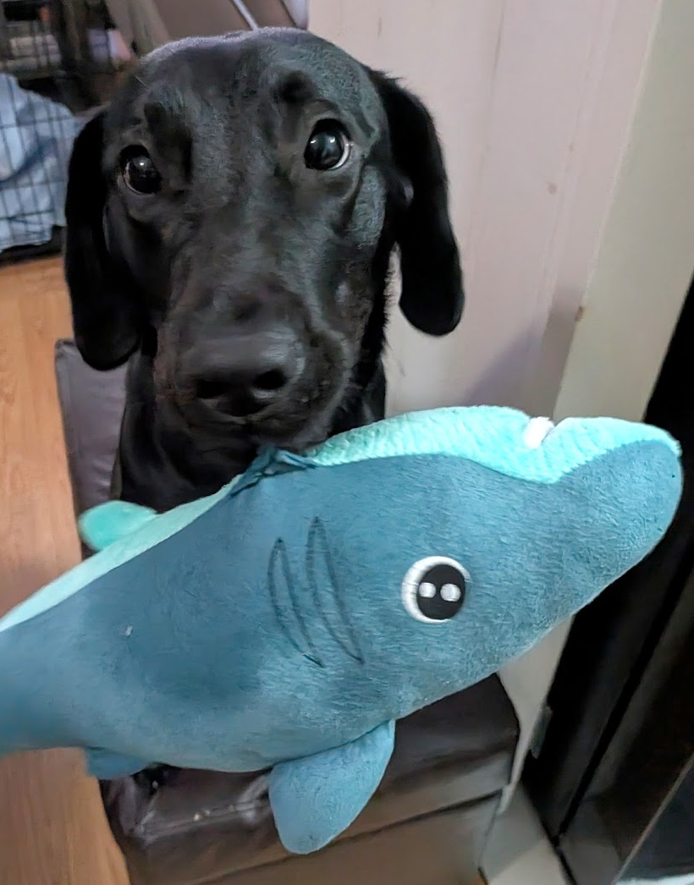
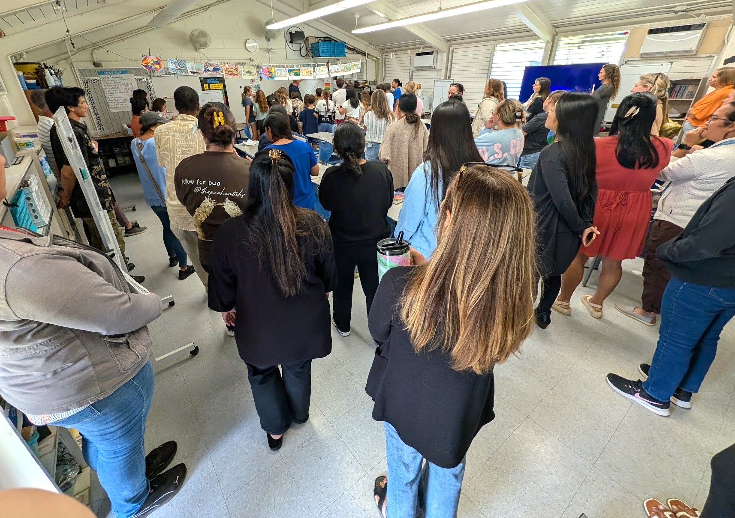

Introductions
April Bright
Janel Marr

Slide 3
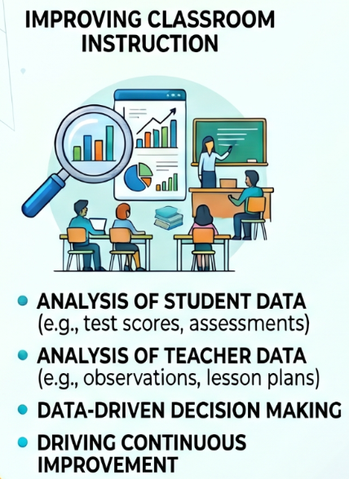
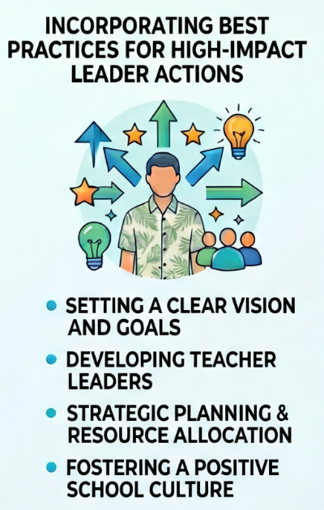
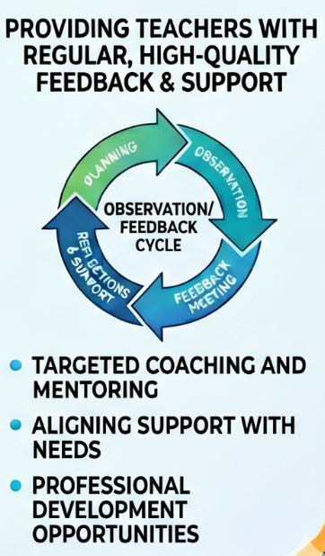
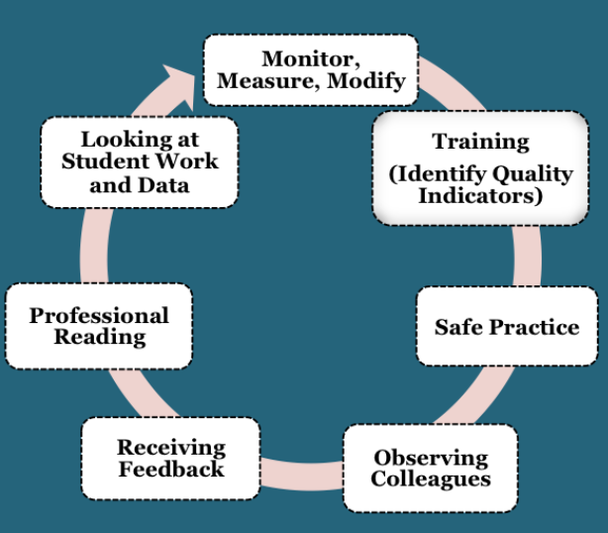

Journey - Starts with Instructional Leadership Team (ILT)
Notes:
Janel

Slide 4





Journey - Year 1 (SY 24-25)
Schoolwide Focus
Materials
Implement Toolkit 1
TEACHER
Notes:
April

Slide 5
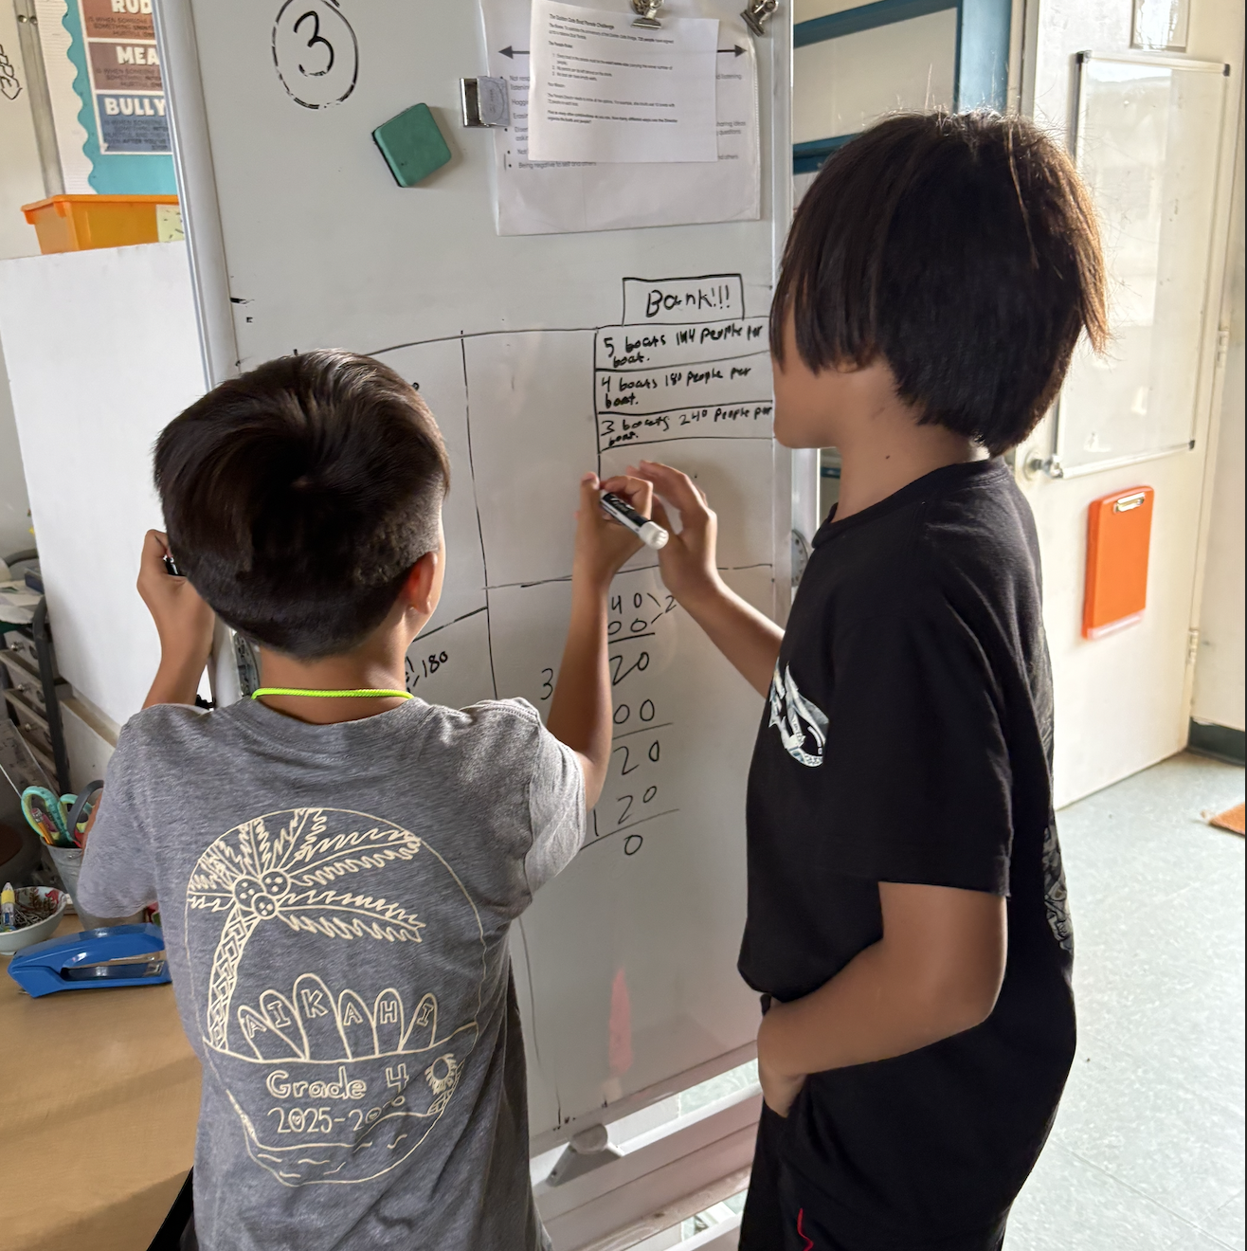
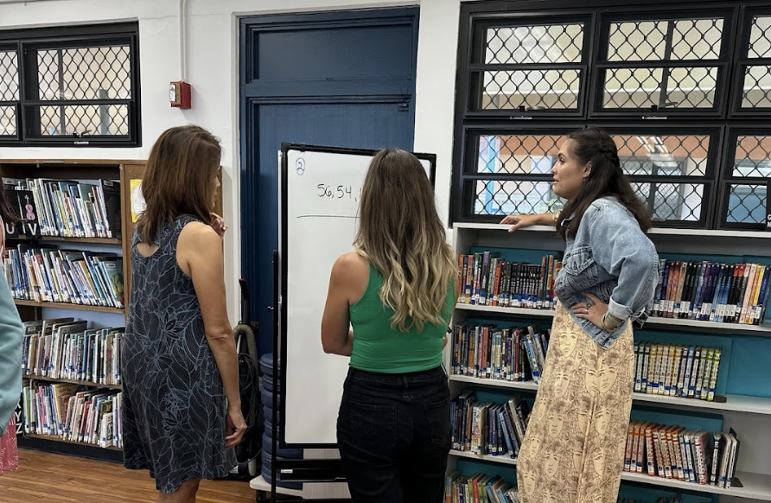
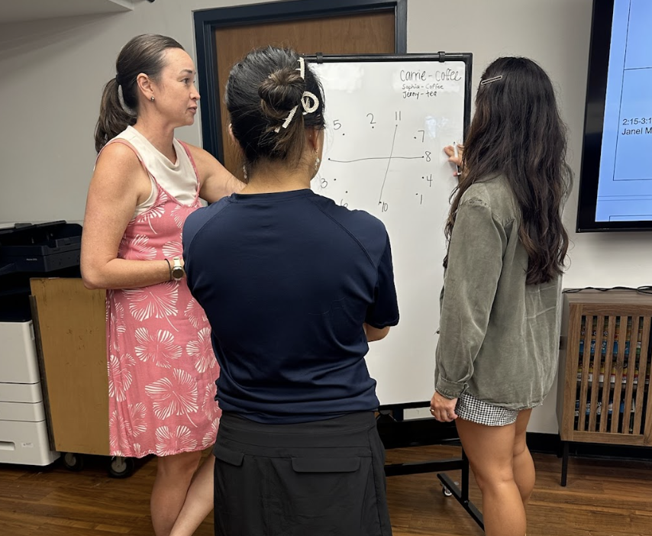
Journey - Year 1 (SY 24-25)
Cycle 1
Input training - non-curricular task
Reading
Safe Practice - non-curricular tasks
Share @ articulation
ILT walkthrough
Input training
Peer Observations & reflections
Notes:
April

Slide 6
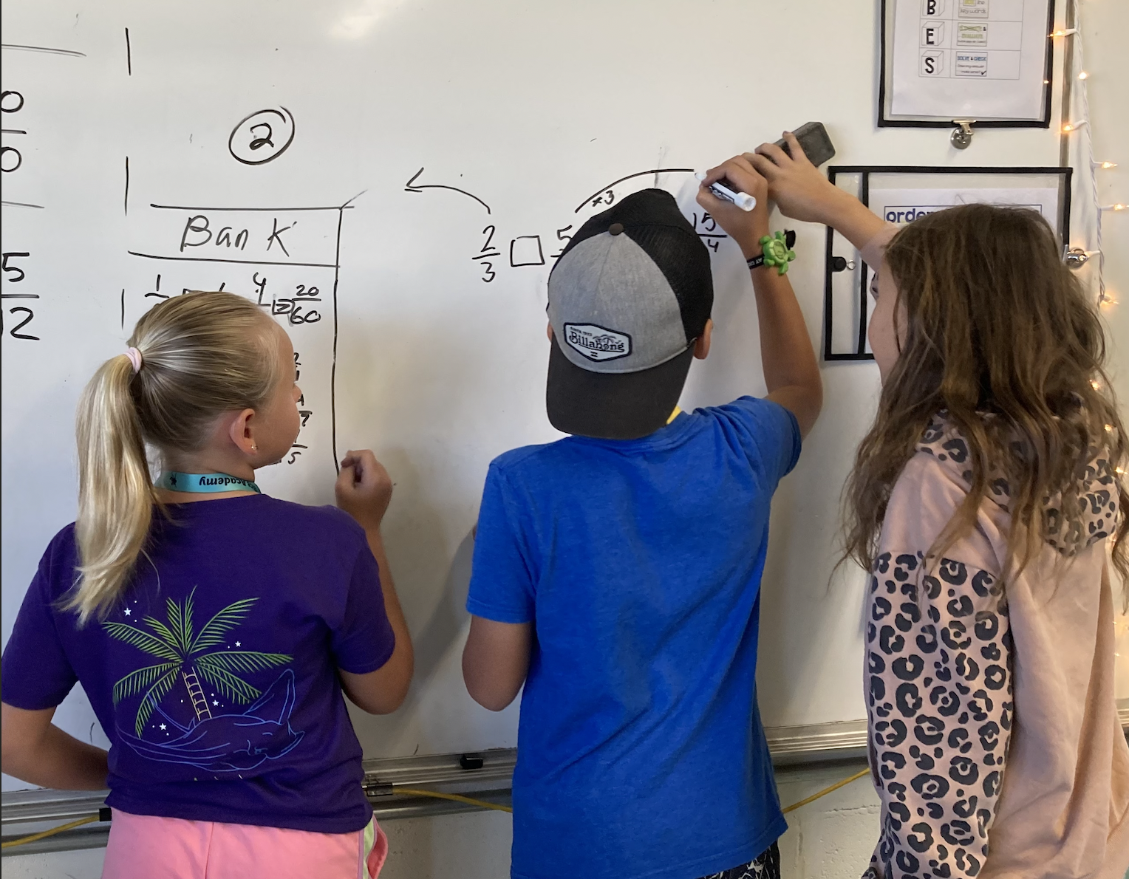
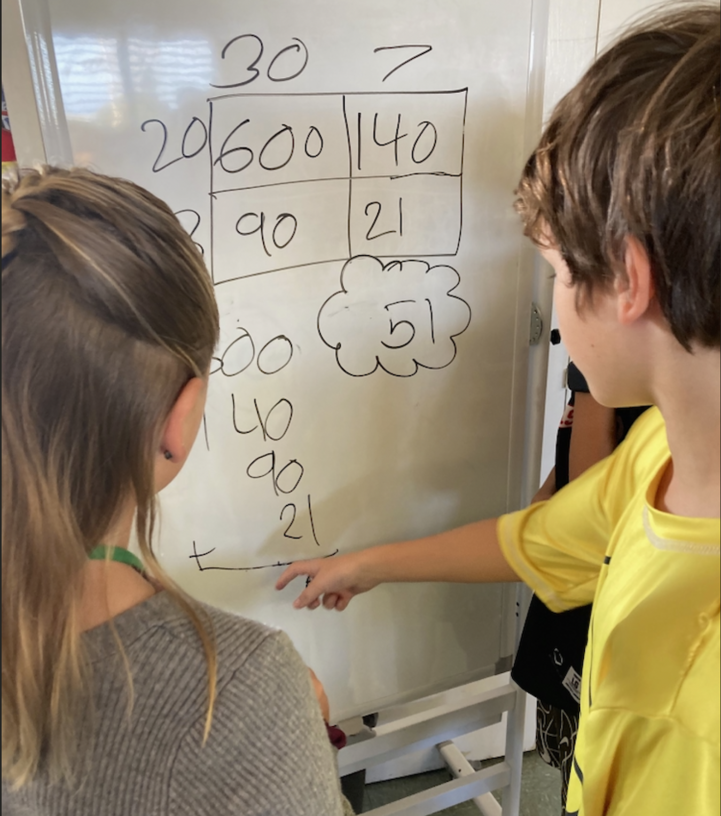
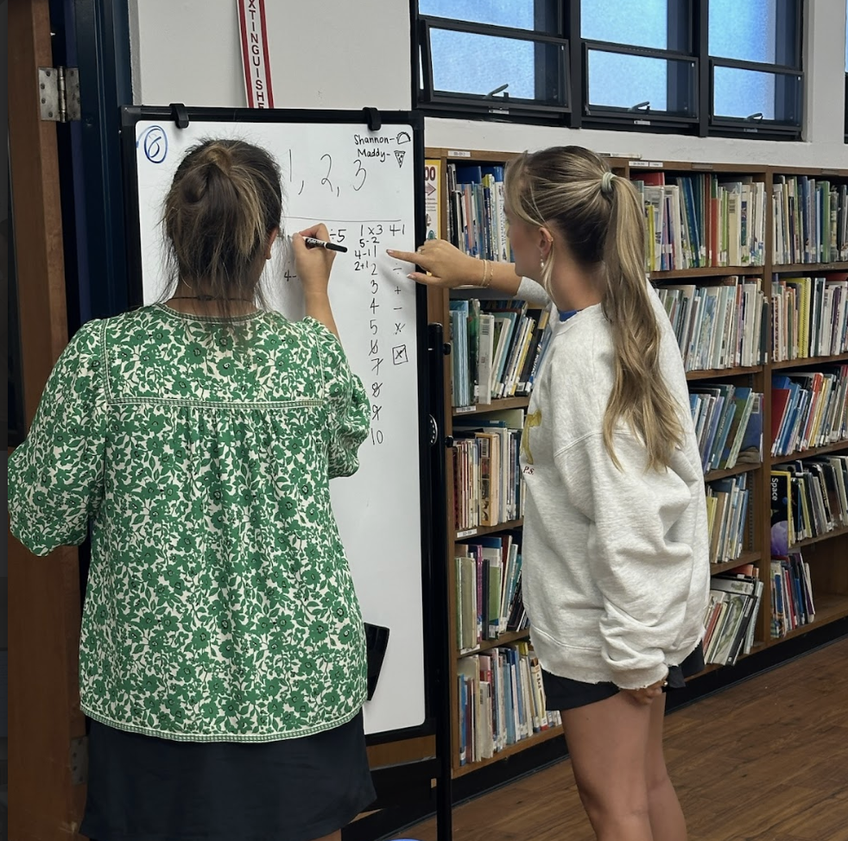
Journey - Year 1 (SY 24-25)
Cycle 2
Reading
Input training - curricular task
Safe practice
Input training
Reading
Reflection
Notes:
April

Slide 7



Teacher Feedback
“I love that I can see who gets it right away, and who needs additional practice and support.”
“Kids are EXCITED to do Math!”
“Kids LOVE it! They always ask if we are doing it. It has really helped my lower level students.”
Teachers are seeing an increase in engagement and plan to continue to use the practices next year.
“Students request math at whiteboards.”
Notes:
Janel

Slide 8
Student Feedback
“My friends help me learn math problems. They show me different ways to do a problem. Friends can help me do stuff I’m bad at.”
“I like standing because it makes me participate more.”
“I like working in groups at whiteboards because people have different ways of working.”
“I like writing on the whiteboard and hearing my peers’ ideas and correcting them a little if they make a mistake.”
“I like hearing others peoples ideas on a problem.”
Notes:
Janel

Slide 9
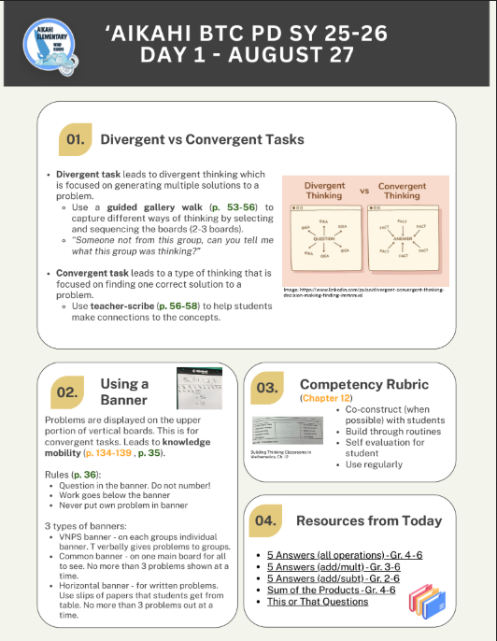
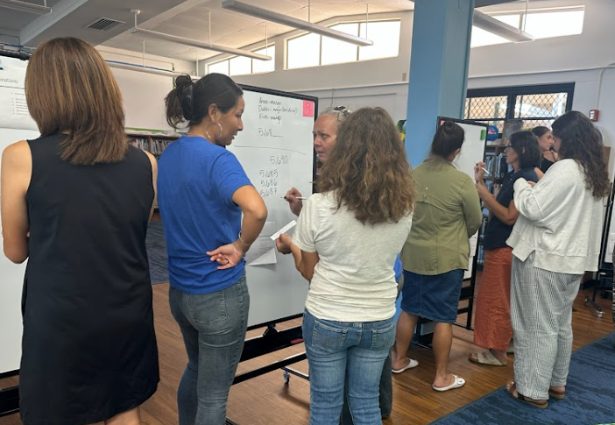
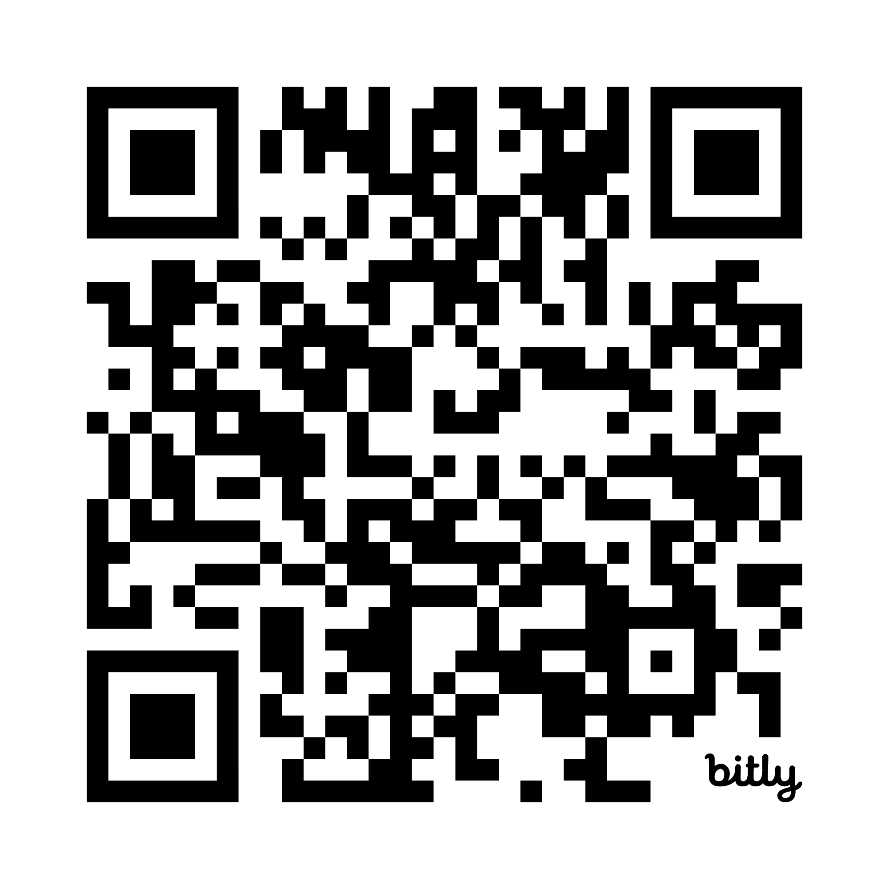
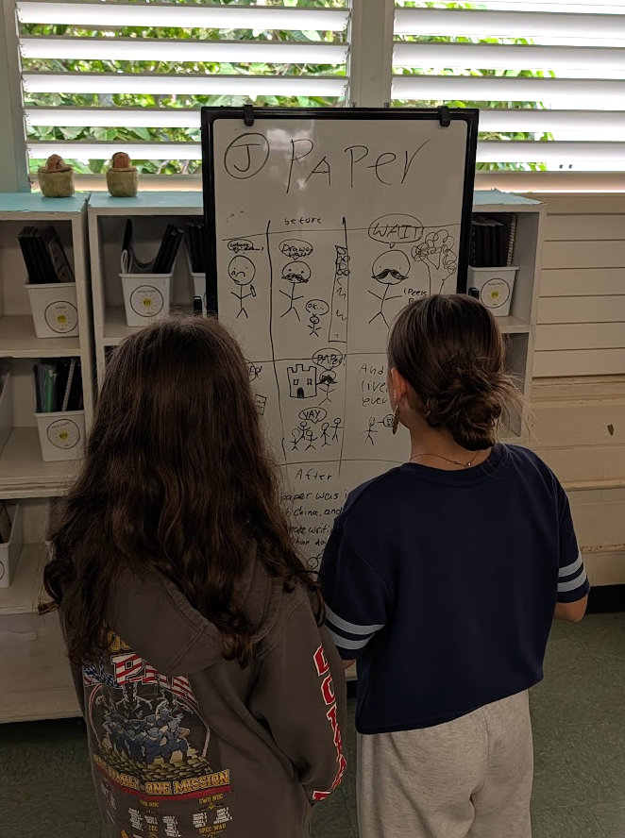
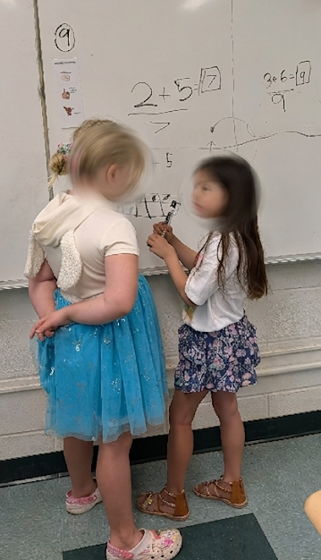
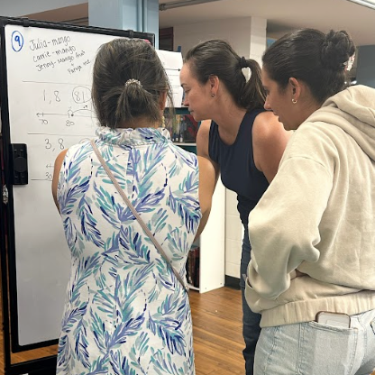
Journey - Year 2 (SY 25-26)
PD planning doc
5 Days of Professional Learning
Focus on BTC practices
Lesson planning
Reflecting
Notes:
April start
Janel do rest

Slide 10
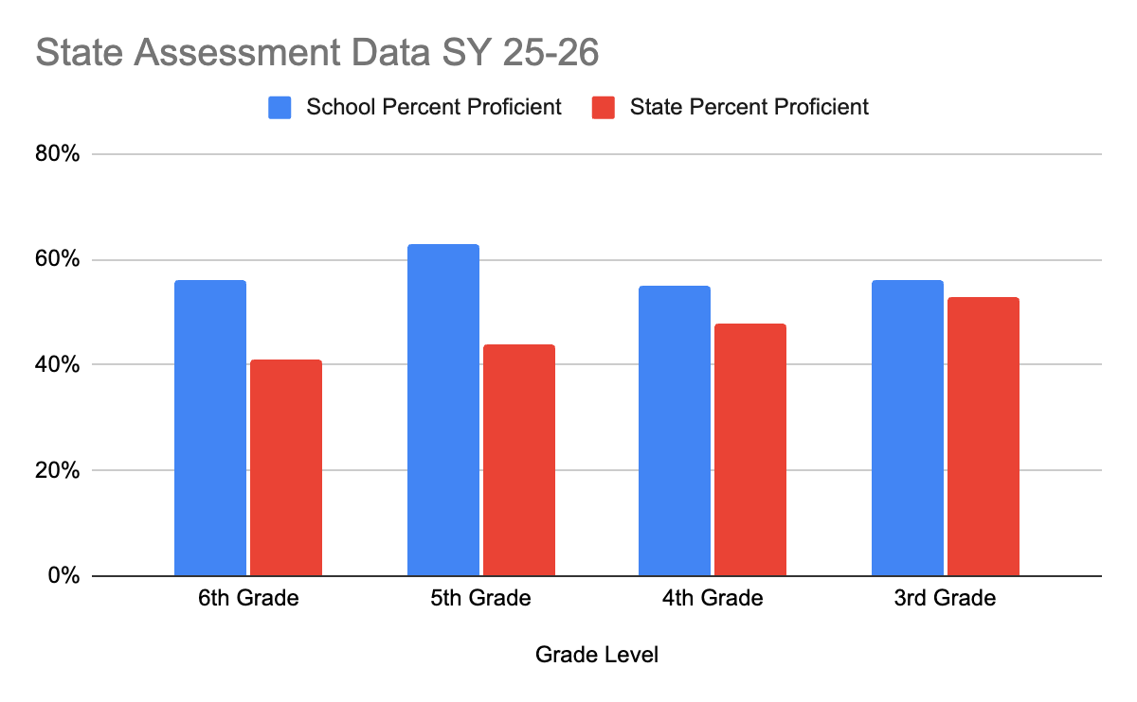
Results
+15%
+19%
+8%
+3%
Notes:
Janel

Slide 11
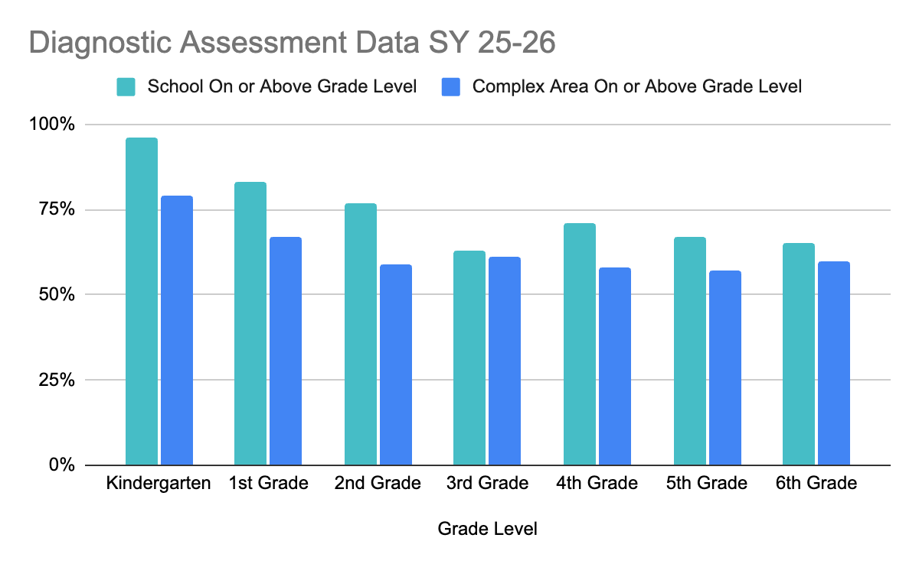
Results
+17%
+16%
+18%
+2%
+13%
+10%
+5%
Notes:
Janel

Slide 12
Planning for Next School Year
Continue with BTC Toolkit 1, 2, and 3
Options of how to continue:
How to lesson plan and incorporate BTC more into the existing curriculum
  Each grade-level creates one lesson per quarter
Productive Struggle
Incorporate Assessments (and building proficiency scales in data teams)
TEACHER

Slide 13


Key Takeaways
What are 3 points that you can share with your site?
What are some next steps that square with you?
What are some questions still circling in your head?
What are you celebrating?
Notes:
Janel

Slide 14

Mahalo

