Slide 1

Thin Slicing Lab
Brought your “Lab Materials?”
As you enter: If you brought (or think of) a standard or topic that you would like to explore creating a thin-sliced series of tasks, write on a VPNS around the room:
Example problem
Short Description of Skill
Grade level
Example:
Grade 6: Finding the area of compound shapes.
2 cm
5 cm
Notes:
Put your topics around on a board

Slide 2
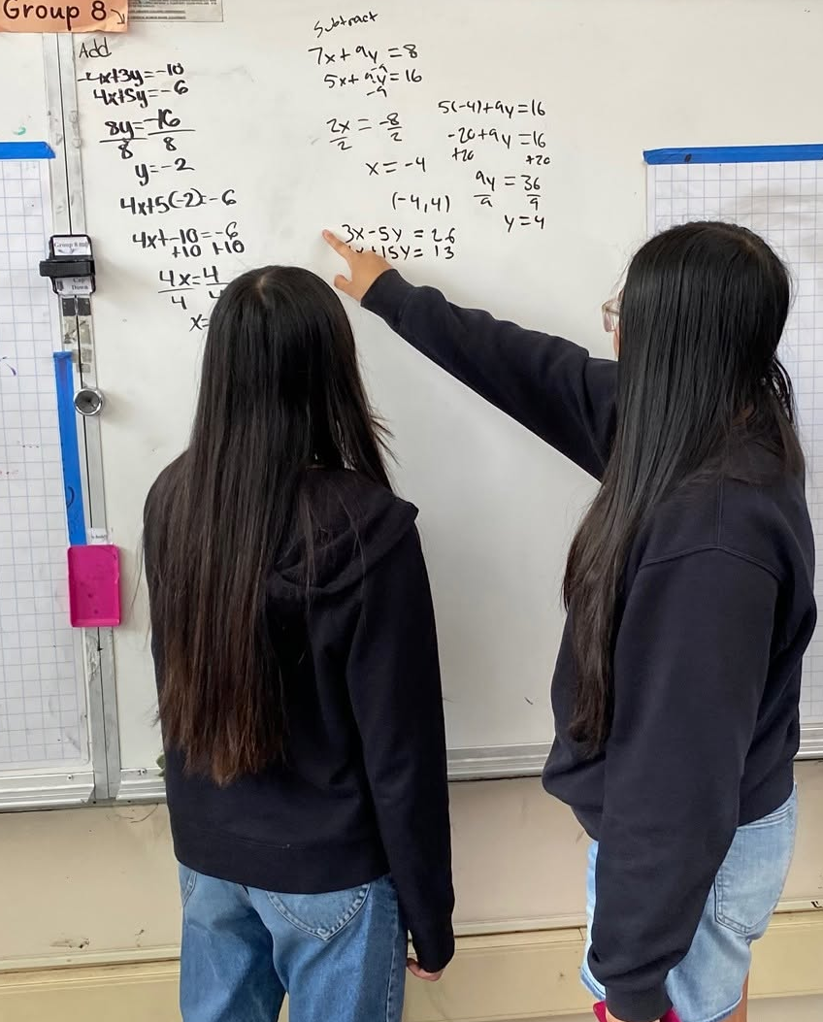
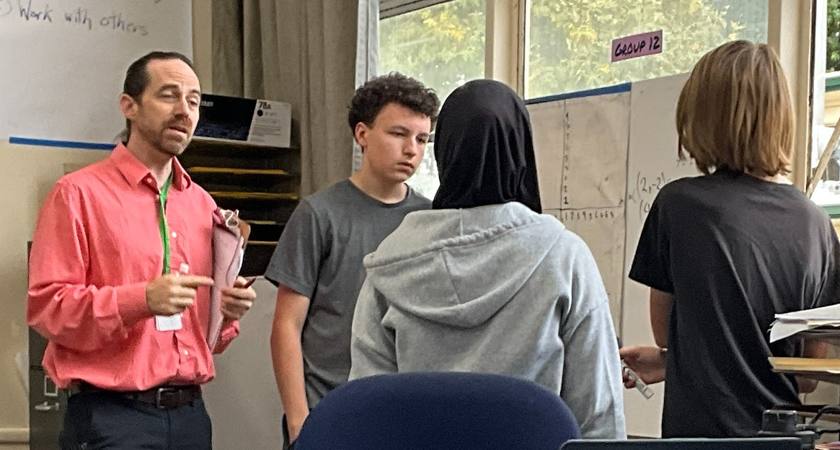

What might I get out of this session?
Framework for the process of creating thin-sliced sequences
Guidelines for anticipating and mitigating student “stuck points”
Collaborative experience creating thin-sliced sequences
Feedback from a veteran thin-slicer (me!— if I can say so myself)
Notes:
Short Introduction about my experience:
Immediately got the idea of thin slicing
Constantly refining it
7th through 10th grade standards
Remedial populations
What I mean by “Lab” For you to work it out.

Slide 3
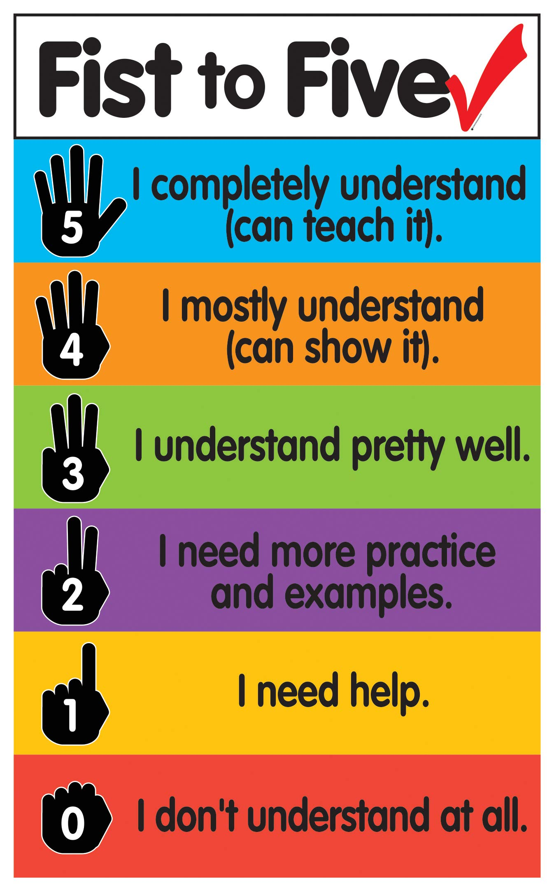
Rate yourself on
Thin Slicing
I could teach someone how to do it
I am confident in my ability to do it for myself
I’ve done it and have mixed results
I’ve tried it, but don’t feel very confident
I have an idea about what it is
I am a newbie— I’m here to learn what this is

Slide 4
Put these in A Logical Order
In a group of educators around you, put the problems in the given card sets in the ideal order for a thin-sliced sequence

Slide 5
Share Out
What reasons did you give for your order?
What would you change?

Slide 6
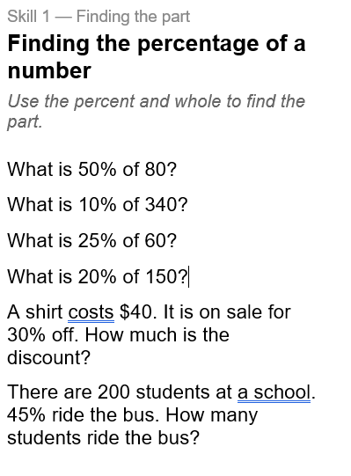
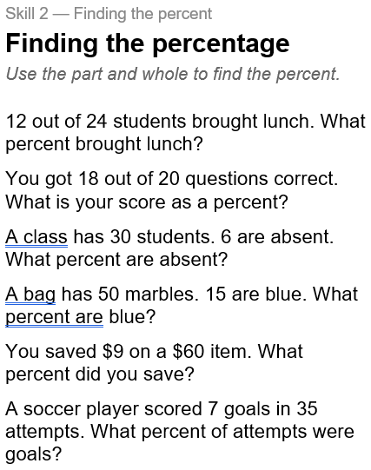
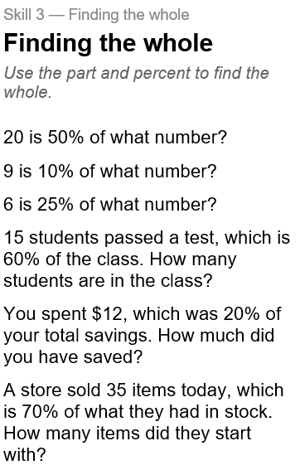
The Case for Real Intelligence

Slide 7


What is the right order?
Source: BTC Facebook Group “Curricular Tasks Spreadsheet”
Notes:
Thin slicing is not just 3 categories.

Slide 8
Four Key Segments
The Body: Mild to Medium
The On-Ramp: Back the train up
Build momentum
The Launch: A compelling story,
Review of prior knowledge
Extensions: We’re never “done.”
(Spicy and Beyond)

Slide 9
How would I do it?
FIVE Ways I think about it
Backwards Mapping from a Standard
Concrete to abstract
Creating a Visible Pattern
Forwards to Backwards
Procedure to Application
Notes:
Everyone can be a critic. Before I give you time to work on these, I wanted to go through 5 different ways I think of sequencing problems.

Slide 10
1. Backwards Mapping
Standard
  CCSS.Math.Content.6.RP.A.3.c
  Find a percent of a quantity as a rate per 100 (e.g., 30% of a quantity means 30/100 times the quantity);
  Solve problems involving finding the whole, given a part and the percent.
Test Question
  Open Up Resources: Grade 6, Unit 3, Assessment A, #4:
Lin’s family has completed 70% of a trip. They have traveled 35 miles. How far is the trip?
  Mild: What is 45% of 60?
  Medium: 12 out of 48 is the same as ___ out of 100
  Spicy: Lin’s electric car battery is at 52% and says it can drive 65 more miles. How many miles can it go if that battery is fully charged?
Student Outcomes
Mastery Levels
  “Percent” means out of 100
  Dividing by 100 moves the decimal
  Find the part / Find the percent
  Differentiate, conceptually, three unknowns
  Find the whole
  Apply to real world in increasing complexity.
Notes:
I learned this before I had ever heard of BTC, and it astounds me how many curricula I see that seem to have missed this process.

Slide 11

2. Concrete to Abstract
What is ALWAYS TRUE?
How would it change if….?
What is the formula for….?
Examples:
45% of 72 is the same as 7.2% of what?
n is p% of q. Fill in the Blanks $\frac{\boxed{}}{\boxed{}}=q$

Slide 12
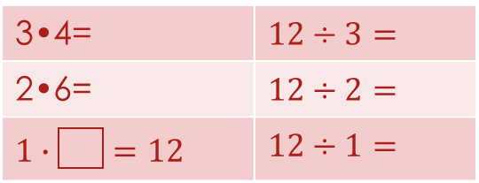

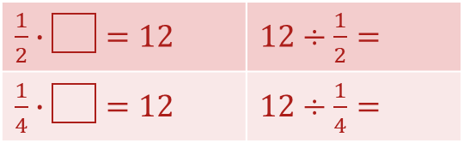
3. Creating a visible Pattern
A series of problems that invite students to use repeated reasoning
Procedural
Conceptual
Dividing by a fraction
Subtracting a negative
Multiplication | Division
12
4
3
4
5
6
7
8
3•4= | $12÷3=$
2•6= | $12÷2=$
$1∙\boxed{}=12$ | $12÷1=$
How do ensure they see it?
Give as a task card
Write as a series of questions (a,b,c)
Be explicit about when to erase
Board Layouts/Tables
Once they see the pattern,
apply that to a new problem.
6 – 3 =
6 – 2 =
6 – 1 =
6 – 0 =
6 – -1=
6 – -2 =
12
6
12
12
24
24
$\frac{1}{2}∙\boxed{}=12$ | $12÷\frac{1}{2}=$
$\frac{1}{4}∙\boxed{}=12$ | $12÷\frac{1}{4}=$
48
48
$\frac{2}{5}∙\boxed{}=10$ | $10÷\frac{2}{5}=$
8 – -7 =
Notes:
Sometimes, you need student to see a pattern, then apply it. The common core mathematical practice #8: Look for and express regularity in repeated reasoning.
So this involves both sequencing the problems AND getting students to do them in sequence AND getting them to look at it.
Two example here

Slide 13
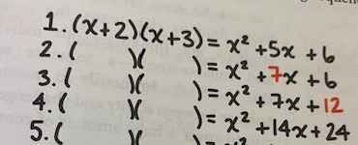
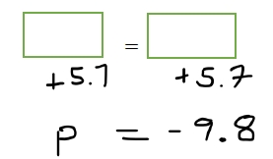
4. Forwards to Backwards
Classic example from Orange Book:
1 Step Equations:
Notes:
Peter suggests having them work forward BEFORE they work backwards
When I do 1-step equations, having them work backwards is the spicy level

Slide 14
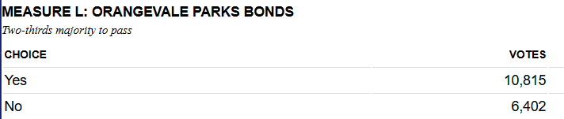

5. Procedure to application
Avoid contrived “word problems” (John has eaten 12 of his 30 apples)
Present data as it might appear:
Thin slice a rich task:
$\frac{2}{3}=?$ (answer as a decimal)
What is the total number of votes?
Did the measure pass as currently counted?
Extension: How many more yes votes would be needed for passage?
If there are 4000 more votes to be counted, what percent would need to vote “Yes” for it to pass?
Notes:
Reasoning from context to solve?
Or applying skills to real-world contexts.
Peter’s critique of word problems as a genre of problems is valid. But rich tasks are great, right?
So find situations where these math skills actually apply. Percentages are everywhere.
Ok to Make numbers friendlier. Maybe a class vote.
And then you can either apply this as a final question, or just work to thin slice the rich task.
First rich task thin sliced, then just the task.

Slide 15
Reflect
Backwards Mapping from a Standard
Concrete to abstract
Creating a Visible Pattern
Forwards to Backwards
Procedure to Application

Slide 16
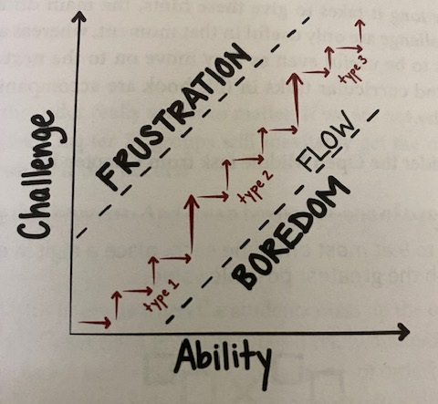
Inflection Points:
Careful Limiting of Variation,
Built in Scaffolding
Diagram from Burgundy Book:
Not just where they get stuck, but where they will take the wrong turn.
Notes:
One of the most important concepts that I’ve come to understand in my work with thin slicing-both for my self and colleauges, is something I’m naming an “inflection point.” Peter has talked a little about this. He talks about the larger leaps in challenge and where students need to engage in productive struggle. This is one instance of an “inflection point,” where you have to pay really careful attention.
But the other place is where students won’t get stuck, it’s where they will take the wrong turn. They keep going but miss the mistake.

Slide 17
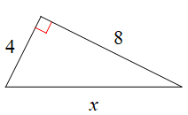
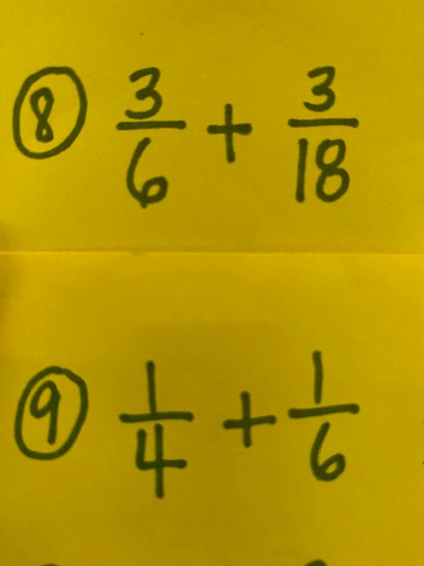
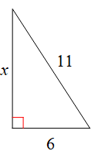

Inflection Points:
Careful Limiting of Variation
Example 1: Pythagorean Theorem:
Example 2: Adding Fractions
$$\frac{1}{6}+\frac{1}{9}$$
minimize variation in numbers to emphasize variation in structure
Notes:
One of the most important concepts that I’ve come to understand in my work with thin slicing-both for my self and colleauges, is something I’m naming an “inflection point.” Peter has talked a little about this. He talks about the larger leaps in challenge

Slide 18


More Examples of Varying Structure
Solving Equations:
$$3x+6=21$$
$$3+6x=21$$
$$−3+6x=21$$
$$3−6x=21$$
$$21=6−3x$$
Adding and Subtracting Integers:
$$16+9$$
$$16−9$$
$$−16−9$$
$$−16+9$$
$$−9+16$$
Notes:
Turn and Talk

Slide 19
Lab Time
Make a Random Group at a Vertical Non Permanent Surface

Slide 20
Complete This Sequence:
Come up with missing Problems
Assumption: students can add and multiply numbers with decimals
Odd Numbered Groups:
Students will have no calculators
Launch: We know that 30% means 30 out of what? What is 50% of 80?
  10% of 80
  11% of 64
  26% of 80
Even Numbered Groups:
Students will have calculators
Launch: We know that 40% means 40 out of what? What times 100 is 40?
  40% of 100 is ___ times 100
  52% of 88 is ____
  9% of 88 is _____

Slide 21
How I would do it
Number sense (no calculators)
Procedural fluency (calculators)
  10% of 80
  1% of 80
  11% of 80
  11% of 64
  5% of 64
  40% of 100 is ___ times 100
  52% of 100 = ____ • ____ =
  52% of 88 is __
  11% of 88 is __
  10% of 88 is __
  9% of 88 is __
  A) 15% of 60 is __
  B) 9 ÷ 60 = __
  C) 24 ÷ 60= __ = ____%.
  ____ % of 75 is 18
Creating a pattern
  26% 800
  26% of 64
Students’ capacity for struggle?
Contextual Rich Tasks
Different Unknowns
Parts A and B could be given as a hint.
7. 45% of registered voters say they support Proposition 34. There are 876,204 registered voters in Sacramento County. How many “Yes” votes would we expect?
8. Only 57% of registered say they are likely to vote.
Hint:
20%=10% + 1% __ % + __% ?
Notes:
So here’s an example of how I might approach this. It’s always important to have a clear idea about the balance between concept and procedure, about how much you want student to practice number sense vs. how much you want to lower that bar so that students are focusing on operations and logic for this topic.
For Number sense, after #4, you really have to gauge what is your student’s capacity for struggle. Can they make the leap that 11% is 1% plus 10%, 26% is 10+10+5+1? And see, once you really consider this, you have a hint ready.
For Procedural fluency (Where I am assuming comfort with decimal place value and they have calculators), Question 3 here is kind of a built in hint, that comes from a common mistake I see students make all the time, which is converting 9% to .9 instead of .09. So if they make that mistake, I have a built in way for them to check if their answer is sensible. Sometimes, they’ll catch it themselves, other times, I can just point to #3 and say, “Can you talk about how your answers to #3 related to your answer to #4?”

Slide 22
Workshop Your Own Lessons
Backwards Mapping
Concrete to abstract
Forwards to Backwards
Procedure to Application
Creating a Pattern
Inflection Points:
  Where you anticipate common mistakes or misconceptions
  Minimize variation in numbers
  Emphasize variation in structure

Slide 23
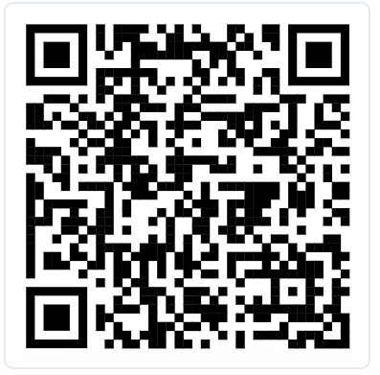
How to Find Me
These slides will be on Sched
BTC Facebook Group
Nathan.Woodward@sanjuan.edu
Please take a minute to complete this feedback form:
I value all types of feedback, and especially constructive criticism!

