Slide 1
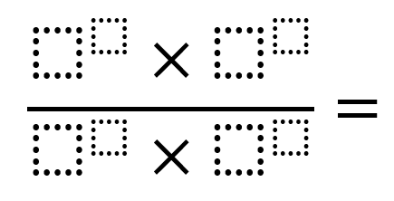
Using the digits 1 to 9 at most one time each, place a digit in each box to create an expression with the greatest value possible.
Notes:
Katie – 10 minutes
Largest numerator possible and smallest denominator possible.
6^8 x 7^9
1^4 x 2^3

Slide 2
Using the digits 1 to 9 at most one time each, place a digit in each box to create an expression with a value as close to 1 as possible.
“Even the richest tasks need extensions.”

Slide 3
Thinking Classrooms in Action: Engage, Analyze, and Strengthen a Five – Part Workshop Series
Katie Becraft, kbecraft@aacps.org
Mary Rathlev, mrathlev@aacps.org
Anne Arundel County, MD

Slide 4

From Middle School Book Studies to
K-12 Workshops
One Middle School
2021
Middle School Department Chairs
2022
District Wide Middle Schools
2023
Asynchronous Modules
2024
5-Part Workshop Series (K-12)
2025

Slide 5
BTC Workshop 1.0 Series
Session 1 | Session 2 | Session 3 | Session 4 | Session 5
Know Your Why Institutional Norms and Student Responses Speed Dating Reflection Questions | One Pager Non-Curricular Task Palindromes | Furniture Blog and Philosophical Chairs Responses to Keep Thinking Questions Two Steps Equation Thin Slicing Task Check-Your-Understanding (Questions, Warm and Cool Feedback) Sray during the Nickels, Dimes and Quarters Non-Curricular Task | Hints and Extensions with a Thin Slicing Task Hints and Extensions with Word Problems Consolidation Gallery Walk Consolidation Teacher Scribes Note Making Organizer Completion | Competency Rubric Design (Collaboration, Risk Taking, Perseverance) Navigation Tool Creation for Two Step Equations
Introduction Chapter 15 | Chapters 1, 2, 3 | Chapters 4, 5, 6, 7, 8 | Chapters 9, 10, 11 | Chapters 12, 13, 14

Slide 6
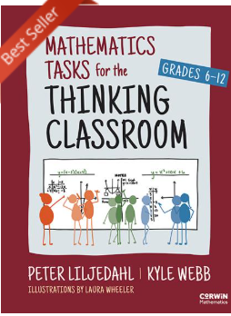
BTC Workshop 2.0 Series
Session 1 | Session 2 | Session 3 | Session 4 | Session 5
Good Thinking Tasks Non-Curricular Tasks | Non-Curricular Tasks Curricular Tasks – Day 1 The Banners Consolidation Options | Non-Curricular Tasks Curricular Tasks – Day 2 Check Your Understanding Questions Note Making | Thin Slicing From Scratch The Flow Curricular Task Creation | Word Problems Rich Tasks
Part 1: Chapter 1, 8 Part 2 | Part 1: Chapters 3, 5 Part 3 | Part 1: Chapters 6, 7 Part 3 | Part 1: Chapter 4, 9 Part 4 | Part 1: Chapter 9 Part 4

Slide 7
Session Agenda
Good Thinking Tasks, Manipulatives, & Technology Support
1
Frame the Cards: Non-Curricular Task
2
3
Area of Compound Shapes: Curricular Task
4
The Pythagorean Formula: Curricular Task
5
Activity Showcase and Closing
Briana and the Birdie: Non-Curricular Task
6

Slide 8
• Fully participate in two noncurricular tasks and two curricular tasks.
I can…
• Consider the characteristics of good thinking tasks, and how to use manipulatives and technology as supports.
• Thoughtfully reflect about the use of banners, different ways to consolidate, note making, and check-your-understanding questions.
• Sneak a peak at additional activities that highlight thin slicing from scratch, thin slicing word problems, and rich tasks.
Notes:
Mary

Slide 9
What Makes a Good Task?
It has a low floor | It has a high ceiling | It is novel
A way for every student to be able to start. | Everyone will meet the challenge at some point in the task. | It must be something that students have not seen before.
“Equity is what we want to achieve. Creating access is one of the ways we achieve it.” | “It is in the moments when we are stuck that we think. Thinking is what we do when we don’t know what to do.” | “Thinking is what we do when we don’t know what to do. If we know what to do, we just do it – we mimic.”
Notes:
Katie - 5
Talk to your tablemates, what makes a good task? Reveal and discuss.

Slide 10
Manipulatives as Support for Thinking Tasks
Students think about the patterns and relationships found in manipulatives. | Students use manipulatives to solve problems. | Students use manipulatives to make sense of problems.
Think About:
How did you use the manipulatives as a support for the task you completed?
Dice Task
Algebra Tiles Task
Painted Cube Task
Notes:
Mary – 20 total minutes (5 minutes each)
How do each of these tasks use manipulatives? How can we make manipulatives available to students?

Slide 11
Technology as Support for Thinking Tasks
Students use technology as a computational tool. | Students use technology as an exploratory tool.
Everything entered into the calculator must be written down. | Desmos, Geogebra, Polypad, or Scratch As a huddle up
One device per group.
Notes:
Katie – 5 minutes

Slide 12
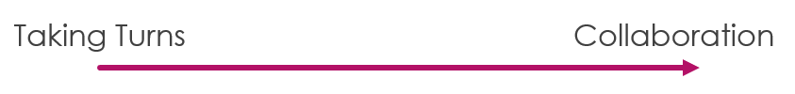
Evaluating what we value.
Collaboration
Risk Taking
Perseverance

Slide 13
Evaluating what we value.
Collaboration
closed to others’ ideas
disrespectful to others
actively excluding
hogging the marker
discouraging
open to others’ ideas
respectful of others
actively inclusive
sharing the marker
encouraging
Risk Taking
Perseverance

Slide 14
Frame the Cards
Teaching Through Problems Worth Solving
& Manipulatives
Huddle Up

Slide 15
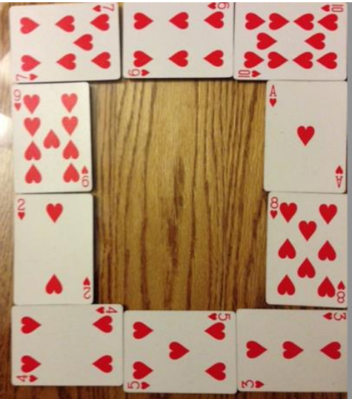
What do you notice?
What do you wonder?
Notes:
Arrange the cards from the ace to the ten into a picture frame so that each the top, bottom, and sides add to the same total of spots (hearts/diamonds…) Right now the top row adds to 23, the bottom adds to 12, the left side is 22 and the right side is 22. These four numbers should be the same. Apparently, there are 10 solutions to this problem.
https://aliciaburdess.weebly.com/uploads/2/4/7/6/24763920/3.0_teaching_through_problems_worth_solving_grade_8.pdf

Slide 16
Names
TT
C

Slide 17
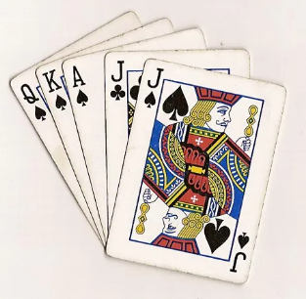
Random Groups
10 minutes to solve
Notes:
https://docs.google.com/spreadsheets/d/14Mx8H9LlVeQSd8xjBFFzRJBrDJyXJeo0qARhaUIqAsQ/edit?gid=0#gid=0

Slide 18
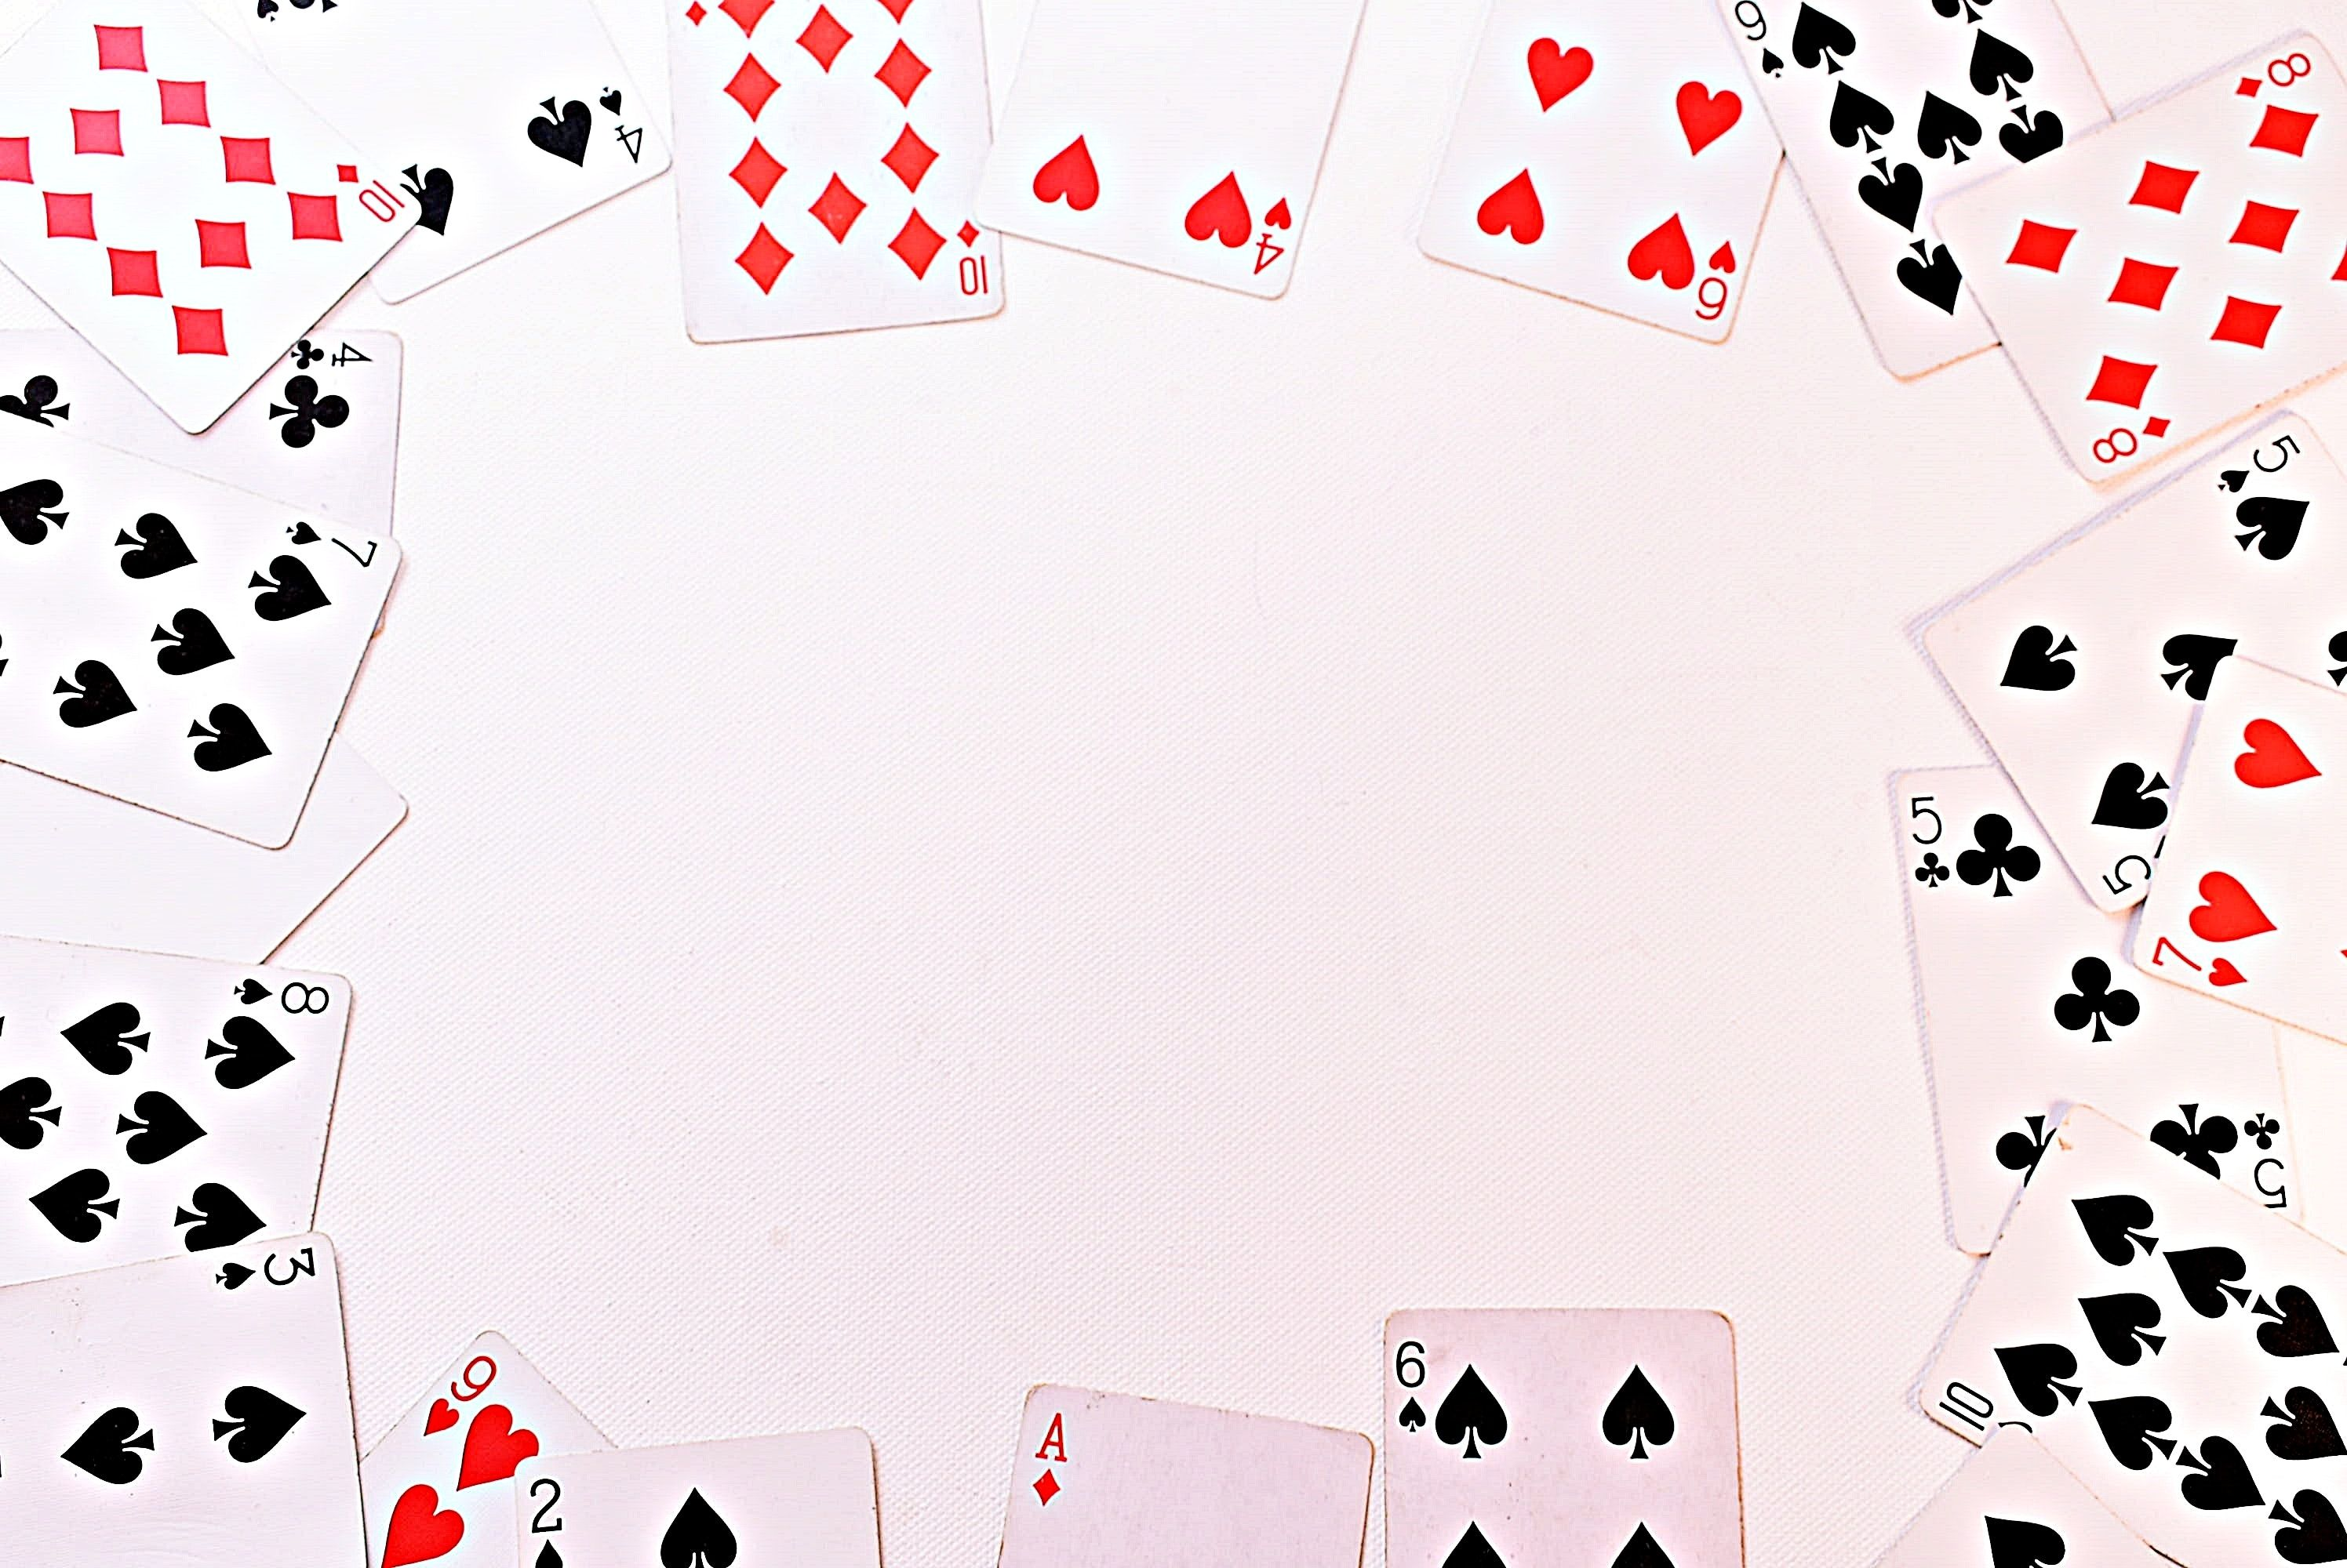

Reflection
Turn and Talk
How did the manipulatives help you think about the task?
How would your students respond to this task?

Slide 19
Area of Compound Shapes
Horizontal Banner, Gallery Walk Consolidation
& Check Your Understanding
Huddle Up
Notes:
Horizontal Banner; Gallery Walk Consolidation: Middle School class periods over 2 days. Session 3 – a few type 2 and move into 3. 1-3 together, 4-7 together, 8-9 together, 10-13 together, 14-17 together, 18-20 together. Colored paper and answer keys. Session 3 start with 18-20 type 2 and then move into type 3.

Slide 20

What is the area of this rectangle?

Slide 21
1 | 2
4 | 3

Slide 22

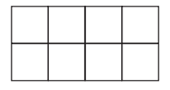
Names
Would you Rather?
Notes:
Would you rather teach a student who talks too much or one who is silent?

Slide 23
Random Groups
12 minutes to solve
Notes:
https://docs.google.com/spreadsheets/d/14Mx8H9LlVeQSd8xjBFFzRJBrDJyXJeo0qARhaUIqAsQ/edit?gid=0#gid=0

Slide 24
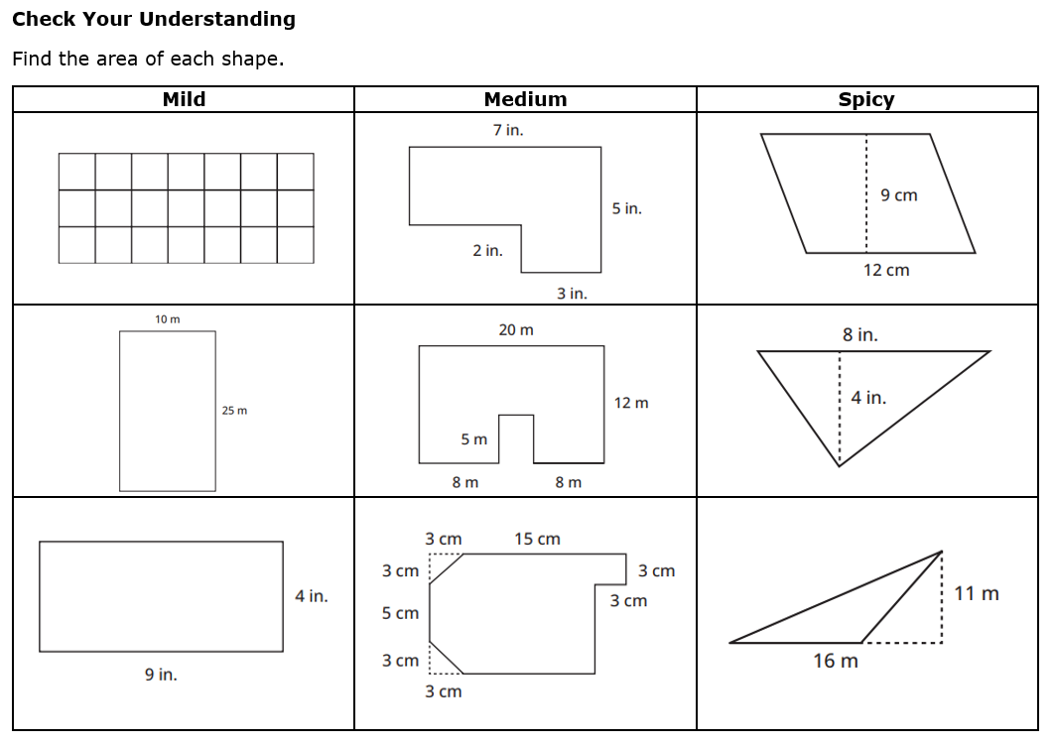
Notes:
10 minutes – ask what problems I can go over. Did you have any questions?

Slide 25
The Pythagorean Formula
Vertical Banner, Technology,
Teacher-Scribes Consolidation & Note Making
Huddle Up
Notes:
Vertical Distributed Banner (Vertical Common Banner instead); Guided Gallery Walk: answer key looks like the four quadrants. Have them solve a two step equation before starting type 2.

Slide 26
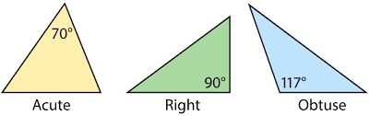
What do you notice?
What do you wonder?
Notes:
Mary

Slide 27
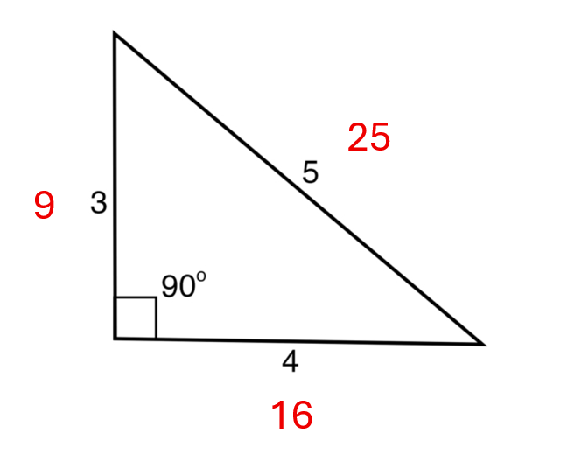
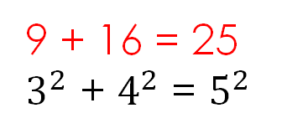
9 + 16 = 25
$3^{2}$ + $4^{2}$ = $5^{2}$

Slide 28
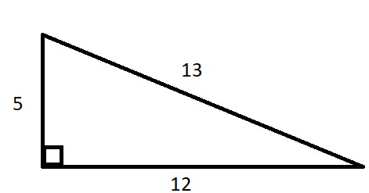
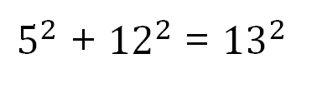
5, 12, 13
25, 144, 169
25 + 144 = 169
$5^{2}$ + ${12}^{2}$ = ${13}^{2}$

Slide 29
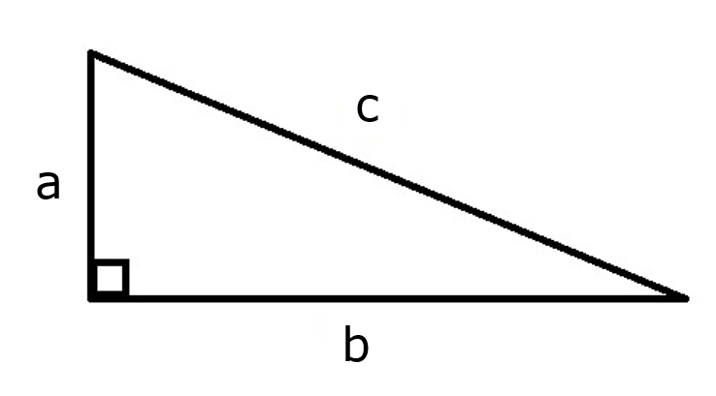
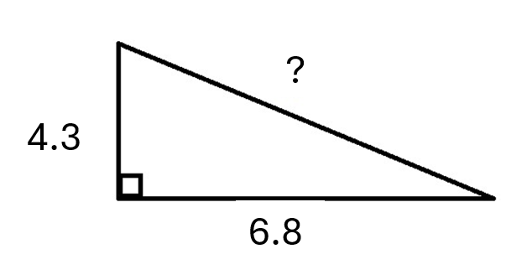

C
a² + b² = c²
$$\sqrt{c^{2}}$$

Slide 30
Names
Would you Rather?
a² + b² = c²
Notes:
Would you rather have fire drill during launch or during closure?

Slide 31
Random Groups
12 minutes to solve
Notes:
https://docs.google.com/spreadsheets/d/14Mx8H9LlVeQSd8xjBFFzRJBrDJyXJeo0qARhaUIqAsQ/edit?gid=0#gid=0

Slide 32
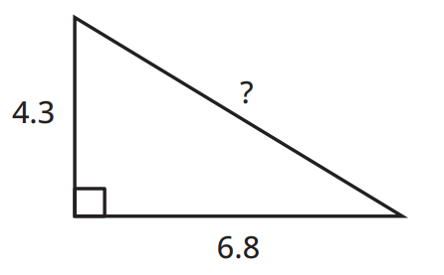
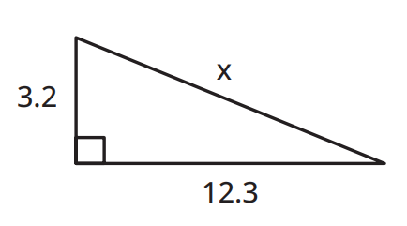
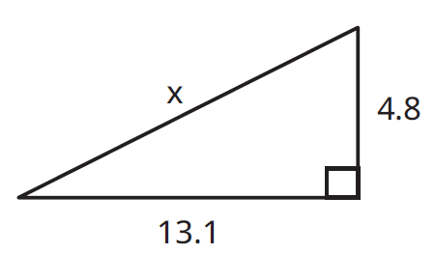

Slide 33
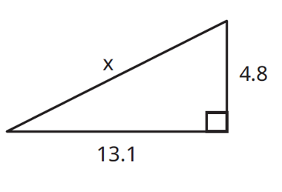

 | $5x + 20 = 110$

Slide 34
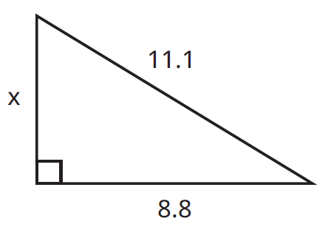
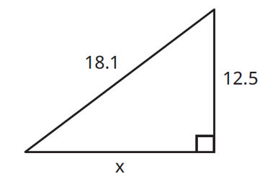
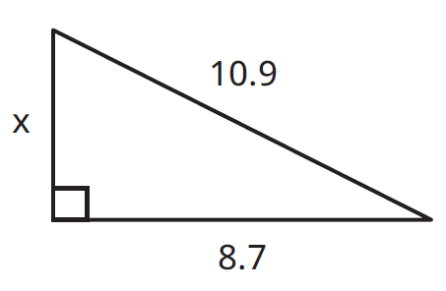

$$5x + 20 = 110$$

Slide 35
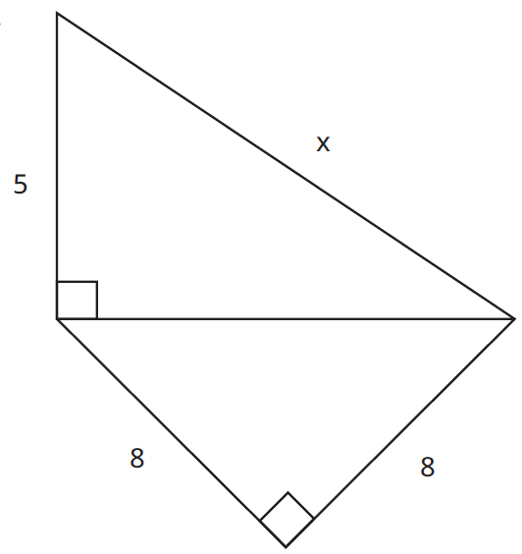
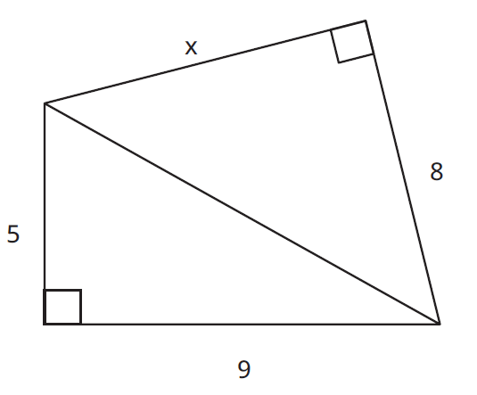
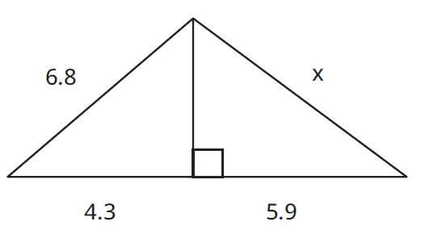

Slide 36
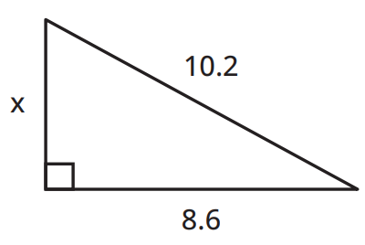
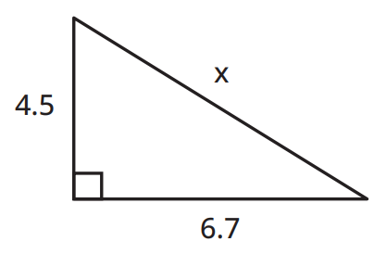
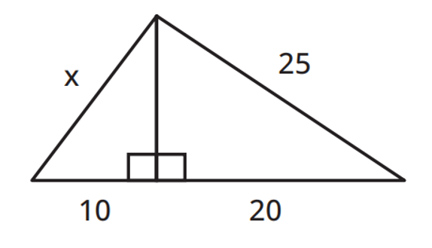


leg
hypotenuse
Pythagorean Theorem
$$a^{2 }+b^{2}= c^{2}$$
$$x$$
Notes:
1. 8.07
2. 5.48

Slide 37

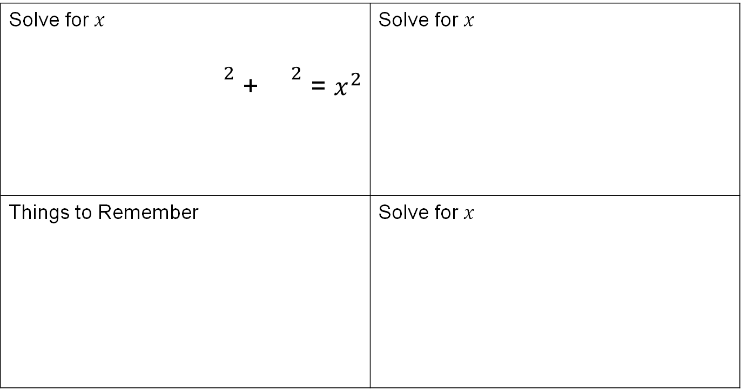

Solve for $x$ ${}^{2}$ + ${}^{2}$ = $x^{2}$ | Solve for $x$
Things to Remember | Solve for $x$
9.7
222
$$x$$
5
$$x$$
12.4
12

Slide 38
Banners
Horizontal Banner: The teacher prints the tasks on paper and place them on a table in a central location where group members can grab the next one.
Vertical Common Banner: The teacher has a banner, usually across the SMARTboard, when a group is ready for the next task, you add it to your banner. Groups still have their own banner.
Vertical Distributed Banner: Once the group is ready for the next task, you give it to them and only them. They write the task at the top of their whiteboard in the banner.
Notes:
Discuss that we will use the vertical distributed in session 3.

Slide 39
Consolidate (from the bottom after the tasks)
Guided Gallery Walk: The teacher leads a detailed discussion of the task(s) and solution(s) using student work on the vertical surfaces to work through the different layers of the solution.
Teacher-Scribes: The teachers leads a detailed discussion of the task(s) and solution(s) while recording on the board what is being discussed.
Conversation: The teacher leads a general discussion about the task(s) and solution(s) but writes nothing down.
Notes:
Conversation typically goes with non-curricular tasks.

Slide 40






Reflection
Roll the Dice
What prior knowledge did each Launch build upon?
What are the benefits of providing students an answer key for the thin slicing tasks?
What are the benefits and drawbacks of using a vertical or horizontal banner?
What makes note taking and note making the same and different?
How did different types of consolidation bring a lesson together?
How did the sequence of the thin slicing tasks build on each other?

Slide 41
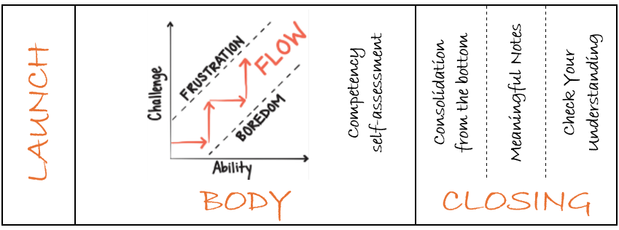
Lesson Sequence – 1 Day Lesson
Maintain Flow
Notes:
Mary
Point out the structure of the lesson includes these practices: thinking tasks; random groups; VNPS; competency rubrics; consolidation; notetaking; check your understanding
To maintain flow teachers will: answer keep thinking questions; encourage autonomy; use hints and extensions

Slide 42

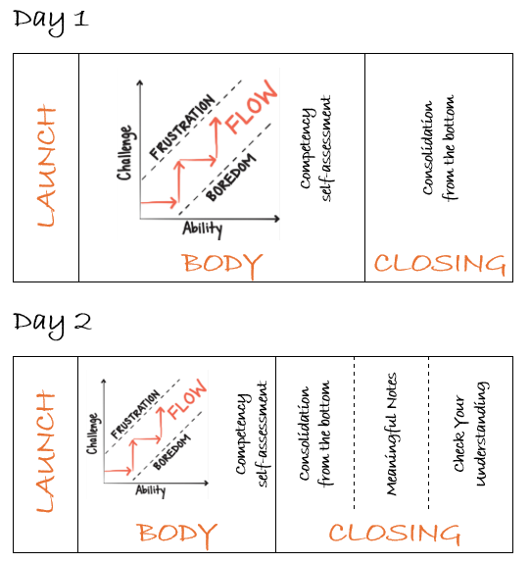
Lesson Sequence –
2 Day Lesson

Slide 43
BTC Workshop 2.0 Series
Session 1 | Session 2 | Session 3 | Session 4 | Session 5
Good Thinking Tasks Non-Curricular Tasks | Non-Curricular Tasks Curricular Tasks – Day 1 The Banner Consolidation Options | Non-Curricular Tasks Curricular Tasks – Day 2 Check Your Understanding Note Making | Thin Slicing From Scratch The Flow Curricular Task Creation | Word Problems Rich Tasks
Part 1: Chapter 1, 8 Part 2 | Part 1: Chapters 3, 5 Part 3 | Part 1: Chapters 6, 7 Part 3 | Part 1: Chapter 4, 9 Part 4 | Part 1: Chapter 9 Part 4

Slide 44
Activity Showcase
Thin Slicing from Scratch | Curricular Task Creation | Thin Slicing Word Problems | Rich Tasks
Adding Fractions Sort | Use curricular resources to create a thin slicing sequence | Probability Task | 100 x 100 Cheeseburger 3 Act Task
Notes:
Mary

Slide 45
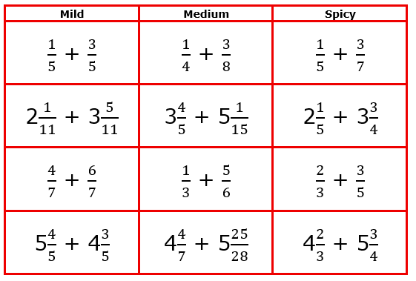
Thin Slicing From Scratch & Curricular Task Creation
Identify
Grouping
Sequencing
Filling
Refining
Teachers had the opportunity to take this process and practice creating a thin slicing activity using curricular resource problems.
Meet
Notes:
Mary

Slide 46
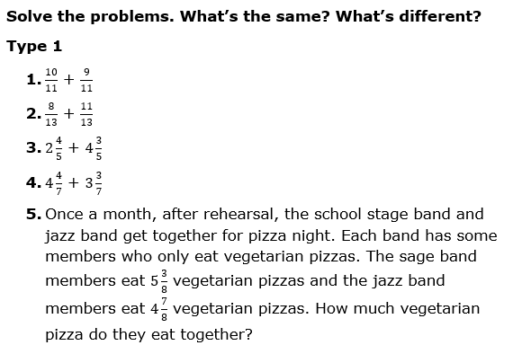
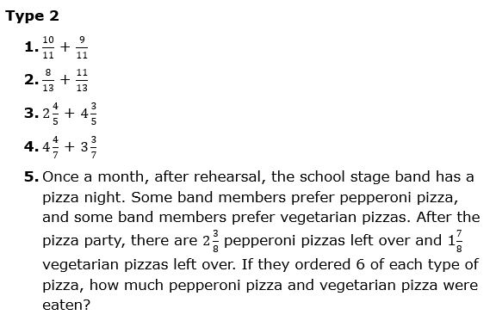
Thin Slicing Word Problems –
Probability Task
Passive
Active
Math Content
Wordiness

Slide 47
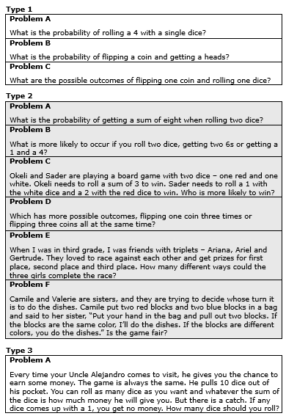
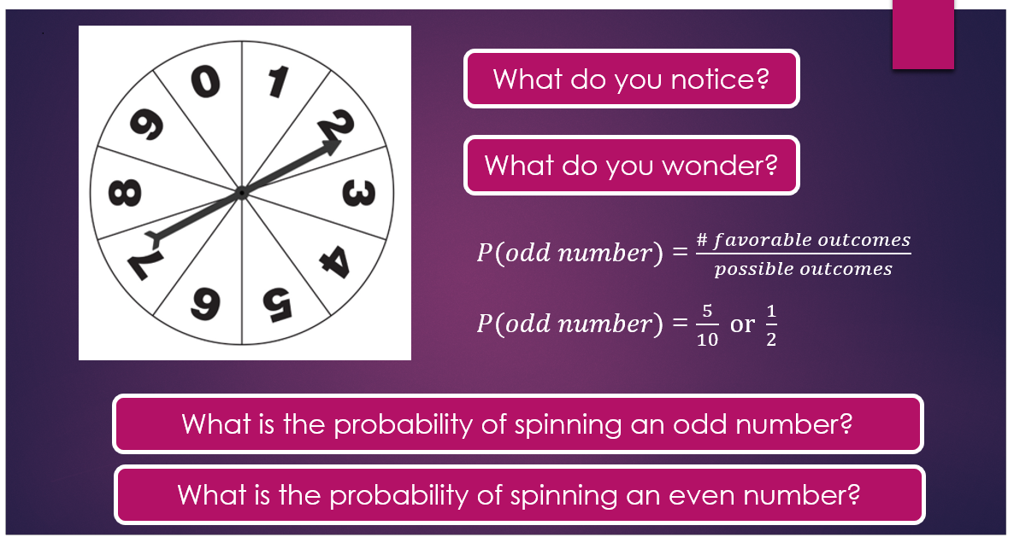
Huddle Up
Meet
Teachers worked in random groups of 3 to solve problems and analyze the sequence.
Notes:
Mary

Slide 48
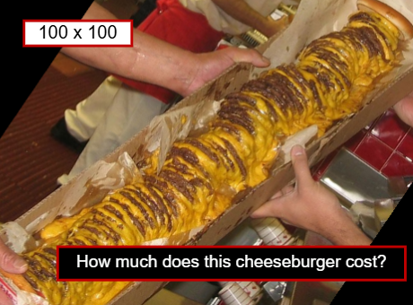
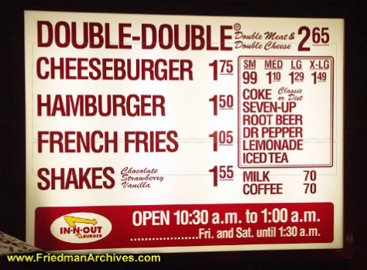
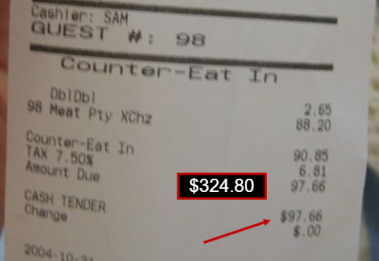
Rich Tasks – 3 Act Task
Cheeseburger Problem
Act 1
Act 2
Act 3
Meet
Extension Opportunities:
What is the biggest burger you could get for$100? For $N?
How many calories is a 3 x 3? A 20 x 20? A 100 x 100? A N x N?
Notes:
Mary

Slide 49
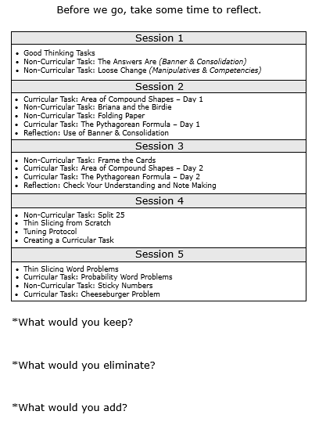
Reflecting and Refining the Workshop Series
Warm Feedback:
Loved the non-curricular tasks and will take back and use immediately.
Appreciated the reflection time to discuss classroom implications.
Thankful to work with teachers from all over the county.
Cool Feedback:
Consider reducing the number of tasks to save time.
Spend more time designing our own tasks.
Model another way to make random groups.

Slide 50
Briana and the Birdie
K-5; Competencies & Extensions
Huddle Up

Slide 51

What do you notice?
What do you wonder?

Slide 52
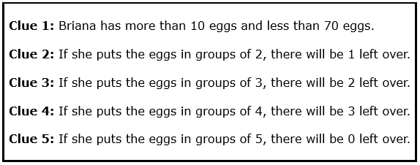
How many eggs does Briana have?
Notes:
Briana lied to us about her first clue. She actually has more than 50 eggs, but less than 100 eggs. How many eggs did she have?

Slide 53
Names
TT
C
Notes:
Stop teachers half way through to have them self reflect on the continuum. Continue task. Gallery Walk – give vocabulary.

Slide 54
Random Groups
10 minutes to solve
Notes:
https://docs.google.com/spreadsheets/d/14Mx8H9LlVeQSd8xjBFFzRJBrDJyXJeo0qARhaUIqAsQ/edit?gid=0#gid=0

Slide 55
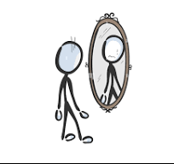
Reflection
Think – Pair - Share
What changes did your group make after self reflecting using the arrow?
How would your students respond to this task?

Slide 56

THINKING is the process of using one’s mind to consider or reason about something…
It’s not about MIMICKING someone or RECALL.
Give students the opportunity to make sense of the math. Give students a voice.
Notes:
Mary

Slide 57
Awesome
Katie Becraft, kbecraft@aacps.org
Mary Rathlev, mrathlev@aacps.org
Anne Arundel County, MD

Slide 58
