Slide 1

Lighting the Way: Growing Thinking Classrooms from a Single Spark to a Districtwide Movement
How Building Thinking Classrooms can grow beyond a classroom model—into a districtwide culture of curiosity, collaboration, and deep learning for both students and adults.
Notes:
Handout: https://docs.google.com/document/d/1RVgYkCznKTfwYPgRArX1R6bLimi1EWC5OzHdGvyfPss/edit?tab=t.jsgmxfc95161

Slide 2



Session Agenda
The Hamden Story
Systemic Diagnosis
Action Roadmap
Time: 20 Minutes
An in-depth chronological look at how one district successfully scaled math, ELA, and science innovations from pilot to district standard.
Time: 15 Minutes
Analyze the Five Domains of Systemic Scaling and evaluate your district's maturity level using our diagnostic rubric.
Time: 15 Minutes
Draft 2 highly specific friction-reduction actions to implement immediately in your schools.

Slide 3
Part 1: The Hamden Story
A multi-year timeline showing how classroom grass-roots "buzz" was transformed into structured, sustainable district architecture.
Sample Newsletter

Slide 4
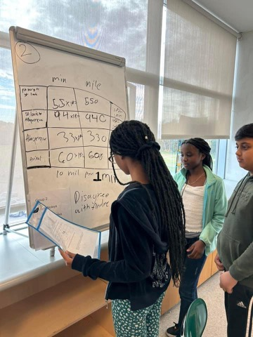
BTC Genesis & Grassroots Buzz
The Mathematics Spark (2021-2022)
The journey began when a teacher received the Building Thinking Classrooms (BTC) text and shared it with her principal and math specialist.
Organic Catalyst: Early adopters "tried it out" in elementary classrooms, generating dynamic visual student work and increased student engagement.
The Weekly Loop: Director launched a weekly Math Newsletter (Mondays, 6:30 AM) to share photos and tasks directly with all math teachers K-12.
Early Training: Specialists and Assistant Superintendent attended introductory training in late 2022 to build a shared understanding of the BTC process.

Slide 5
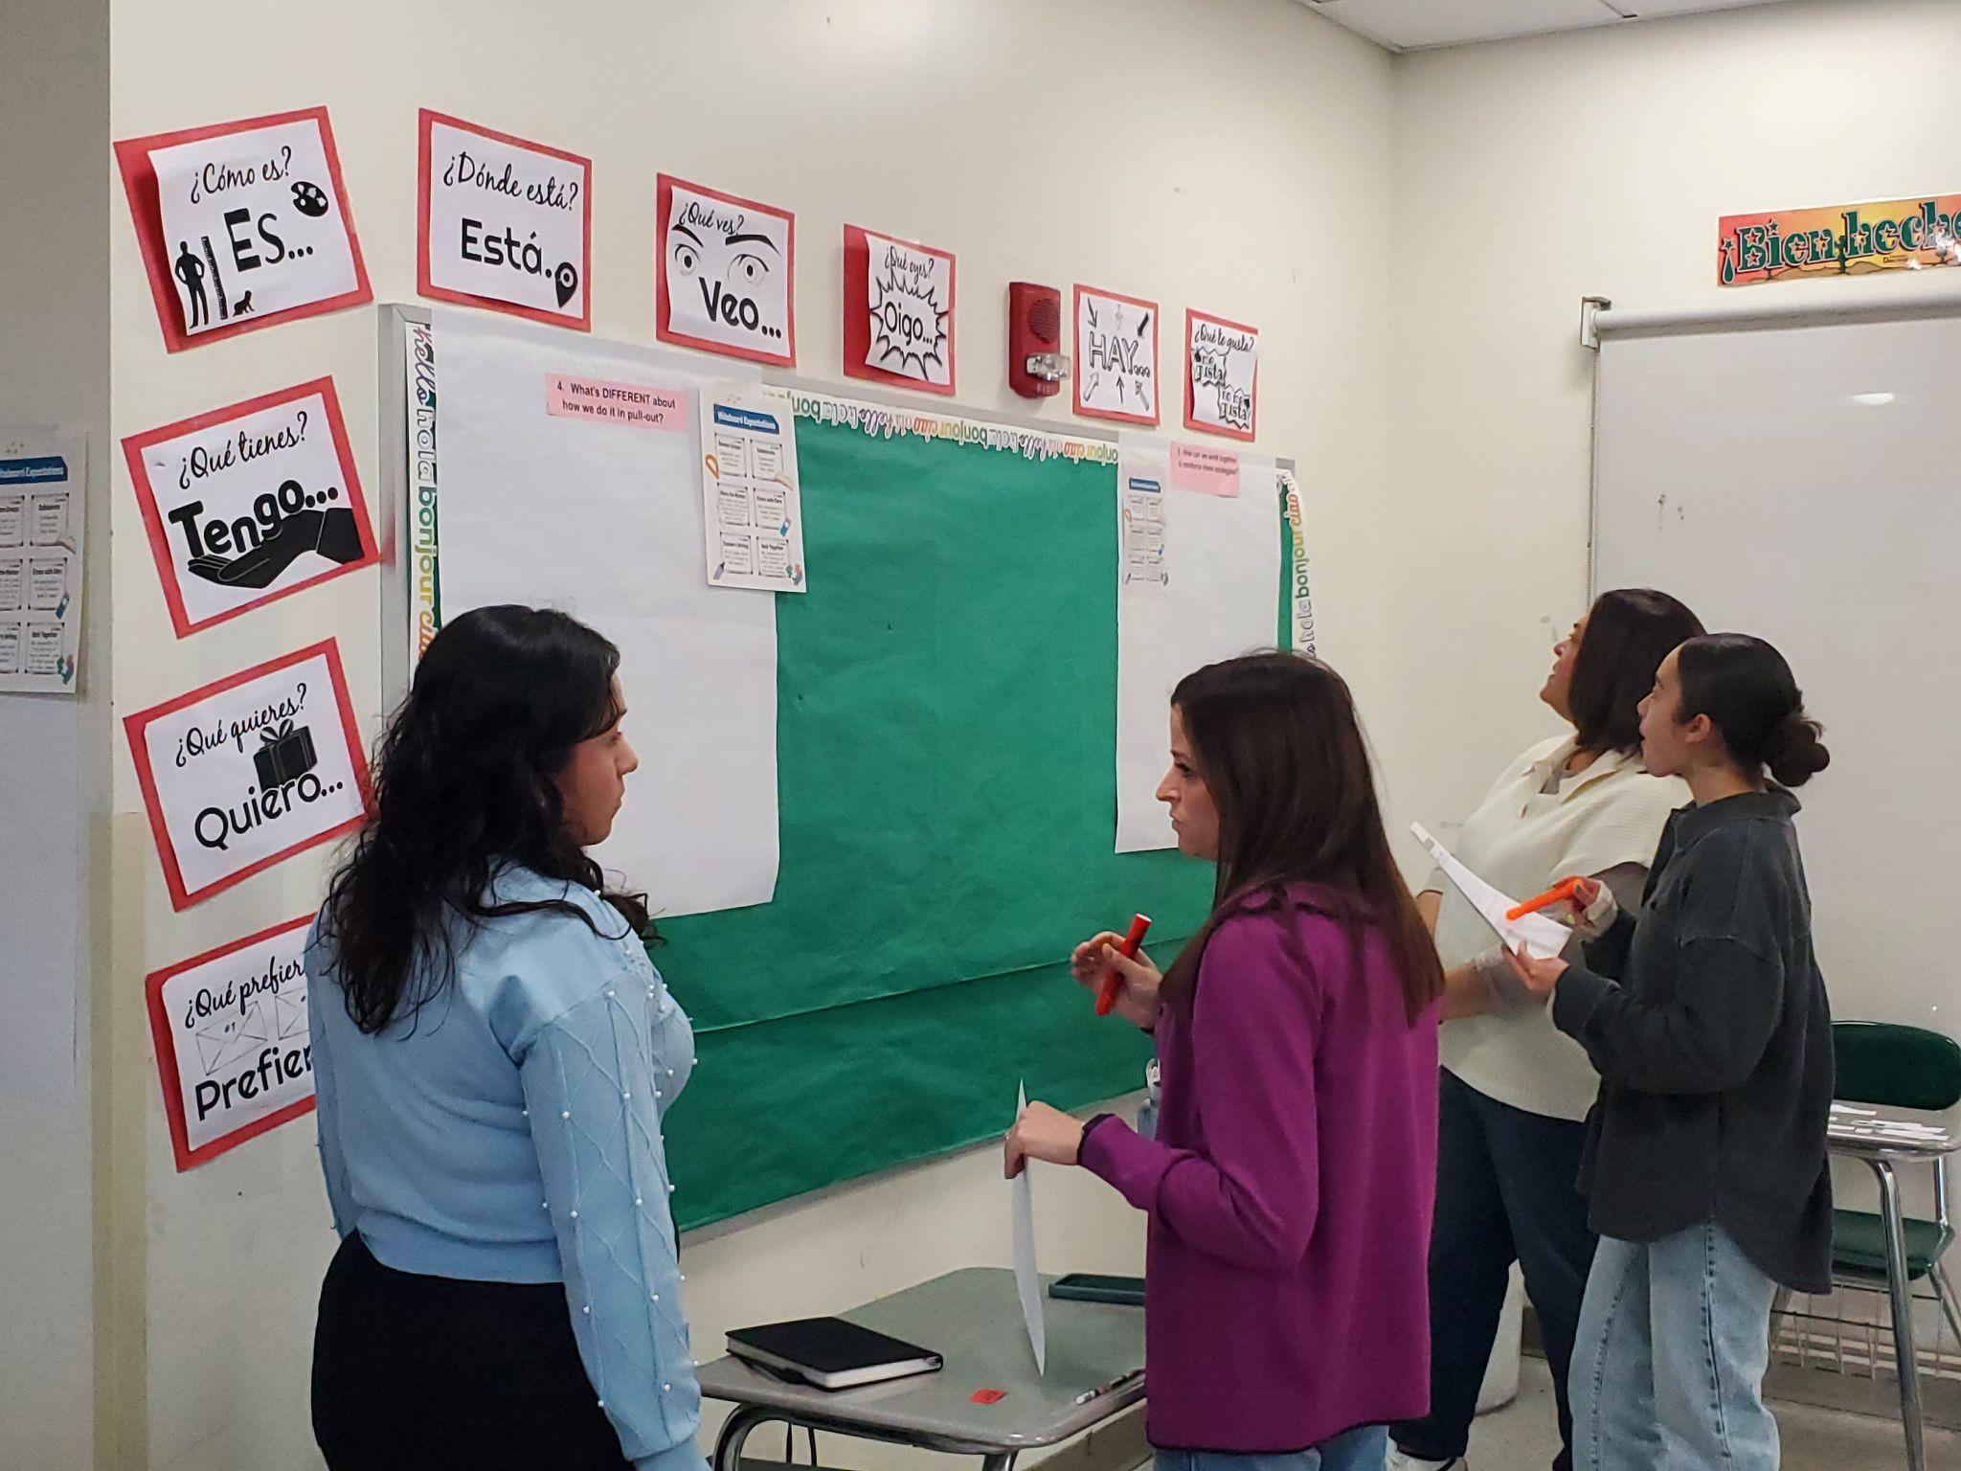
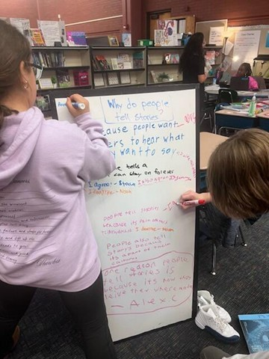
Literacy & Curricular Alignment
The Literacy Strategy (2022-2024)
In parallel, the district capitalized on state-level legislation and evidence-based structured literacy to build an aligned vision.
CSDE Masterclass Integration: Launched district and School-Based Literacy Teams (SBLT) with immediate post-meeting notes highlighting instruction aligned with the Science of Reading.
Newsletter Integration: Eventually, both newsletters merged to become one weekly newsletter for all K-12 ELA and Math teachers.
Intentional Scaling: The newsletter sections focused more on an intentional photo matched with an explanation of an encouraged strategy so that people could identify it as they were implementing.

Slide 6




Chronological Expansion of District Instructional Practices Vision
2023-24: ELA Joins
2025-26: HQI Shift
ELA added to weekly newsletter. Phonics & curriculum pilots featured. MS BTC tasks written into curriculum.
District focus shifts to "High-Quality Instruction" (HQI). HS Social Studies joins. Unified multi-subject PD.
2022-23: Launch
2024-25: Multi-Subject
Math newsletter debuts. BTC immersion for Middle School. Right to Read legislation served as a catalyst for literacy changes.
Science & ESOL join. Admin PD models BTC. 100% of MS/HS teachers trained in vertical alignment cohorts.

Slide 7
Part 2: The Leadership Moves
Now, let's deconstruct the specific structural "moves" Hamden used, so you can evaluate where your district stands in relation to this blueprint.

Slide 8









The Five Domains of Systemic Scaling
1.Communication Loops
2. Parallel Practice
3. Friction Removal
High-frequency, highly visible loops (6:30 AM Monday cadence) featuring actual classroom photos paired with corresponding lesson tasks.
Deliberate structural modeling of classroom expectations at every layer of adult learning, specifically in all administrator PD.
The total elimination of structural barriers by supplying materials, curriculum integrations, and onboarding supports to teachers.
4. Curricular Anchoring
5. Systems Architecture
Formally codifying methods into curriculum scope, pilot plans, and connecting them straight to state-level legislative mandates.
Grouping cohorts (such as MS and HS vertically) so secondary teachers directly witness the high caliber of work students can achieve.

Slide 9

Intentional Leadership Moves
1. Importance of Parallel Practice
2. Friction Removal: Materials
To avoid "do as I say, not as I do" syndrome, adult learning spaces were radically reconstructed to match ideal student spaces:
The Math and ELA directors recognized that teachers cannot implement new routines if they have to scramble for basic materials:
Admin PD Shift: 100% of administrator and principal PD was switched directly to the BTC structural format in 2024.
Resource Provided: Purchased sets of vertical boards for MS core content areas and portable WipeBooks for HS.
Standard Onboarding: Integrated BTC training directly into New Teacher Orientation from 2023 onward.
Additional Support: Supplied markers and erasers.
Curricular Changes: Wrote specific BTC tasks directly into ELA and Math scope/sequence documents.
Yearly Boosters: Implemented ongoing annual booster sessions at MS to deepen veteran practice and support new staff.

Slide 10
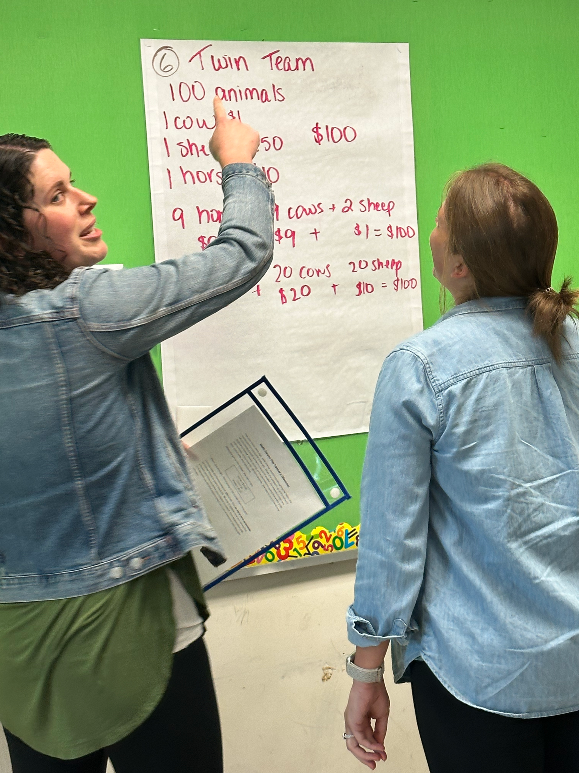
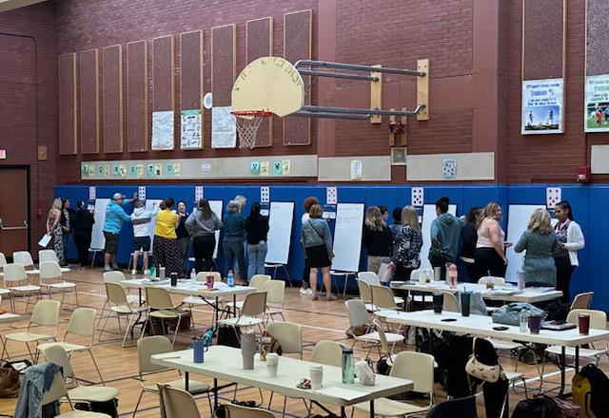
Staying the course: we continually chose to highlight the positive changes people were making across the district to lessen the negativity.
Friction: Mindsets
Encouraging Feedback
Implementation & Training To support the district-wide launch of Building Thinking Classrooms , literacy specialists participated in a BTC activity. This was followed by a conference designed to support literacy specialists in adapting the framework for non-math environments.
Feedback & Collaboration Channels Teachers actively share feedback, insights, and successes with their specialists and department directors. Teachers email directors frequently about their successes and experiences with BTC for the newsletter.
We continue to work on changing teacher and admin mindsets around the role of the teacher as facilitator versus being “maximally helpful” and over scaffolding for students.

Slide 11

Implementation Rubric
Operational Domain | Level 1: Emerging | Level 2: Proficient | Level 3: Exemplary
Communication | Ad-hoc, isolated email updates sent within departments. | Consistent, scheduled newsletters covering some classroom highlights. | High-frequency weekly loops with classroom photos paired with clear academic tasks.
Parallel Practice | Traditional lecture-style administrative/staff meetings. | Principals experience student learning styles on an occasional basis. | All administrator & teacher PD modeled on target classroom methods.
Friction Removal | Teachers expected to self-fund or request new classroom tools. | Vertical surfaces and curriculum resources purchased upon school request. | All materials (boards down to erasers) fully supplied and integrated.

Slide 12
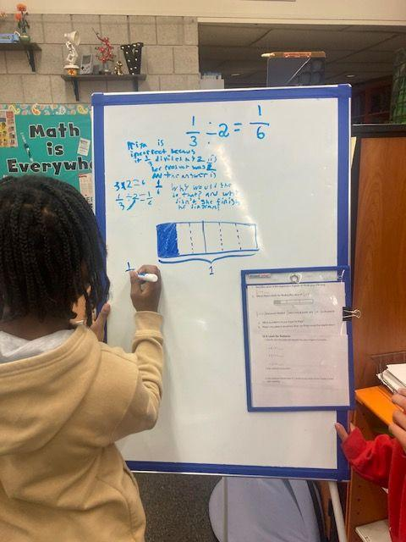
Rubric Self-Evaluation
Write down your specific BTC goal for your district.
Evaluate your district/school using the Implementation Rubric.
Identify one next step you can do this fall to move toward your goal.
Share with a table partner.

Slide 13
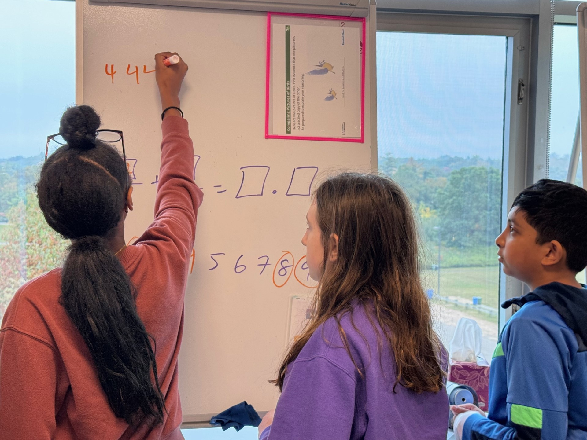
Your 2-Action Commitment
Drafting Operational Next Steps
Using today's diagnosis of Hamden's blueprint, record two highly specific, concrete "friction-reduction" actions to implement upon returning to your buildings:
Action 1: Communication Loop - How will you make high-quality instructional practices visibly celebrated in your district next year?
Action 2: Friction Removal - What material, structural, or curricular hurdle can you clear immediately for your teaching and/or administrative staff?

Slide 14


Questions & Thank You

