Slide 1
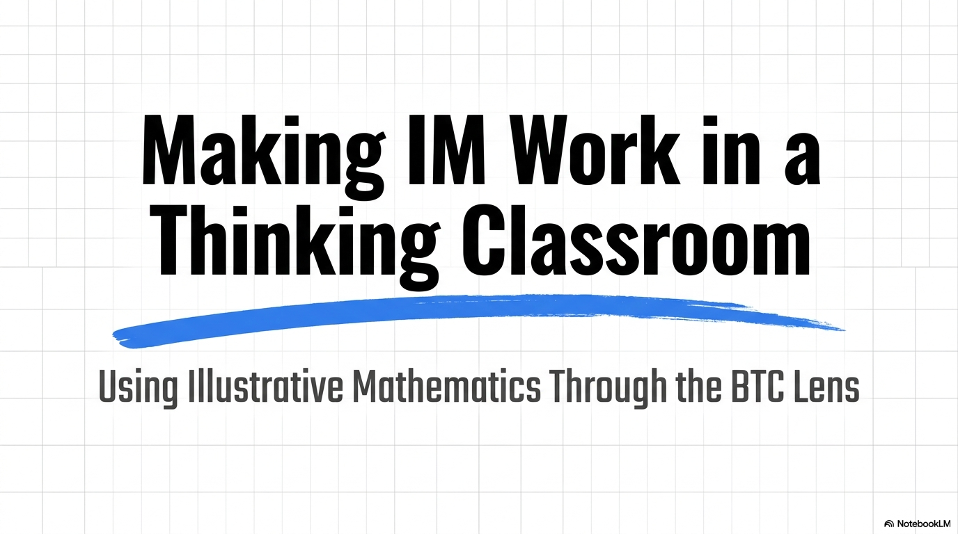

Slide 2
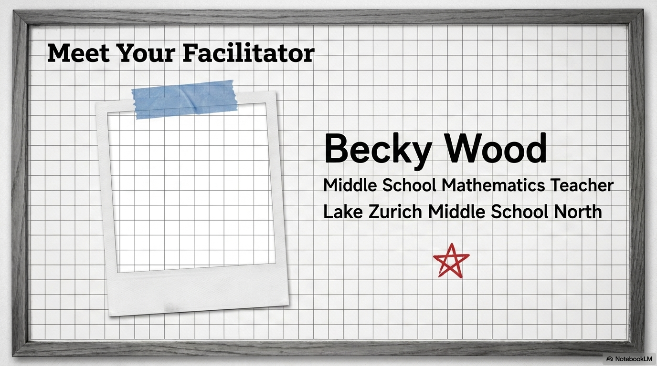
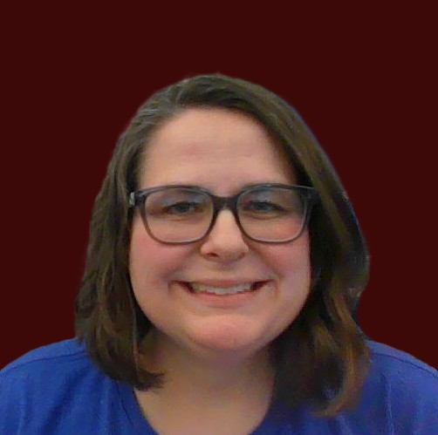

Slide 3
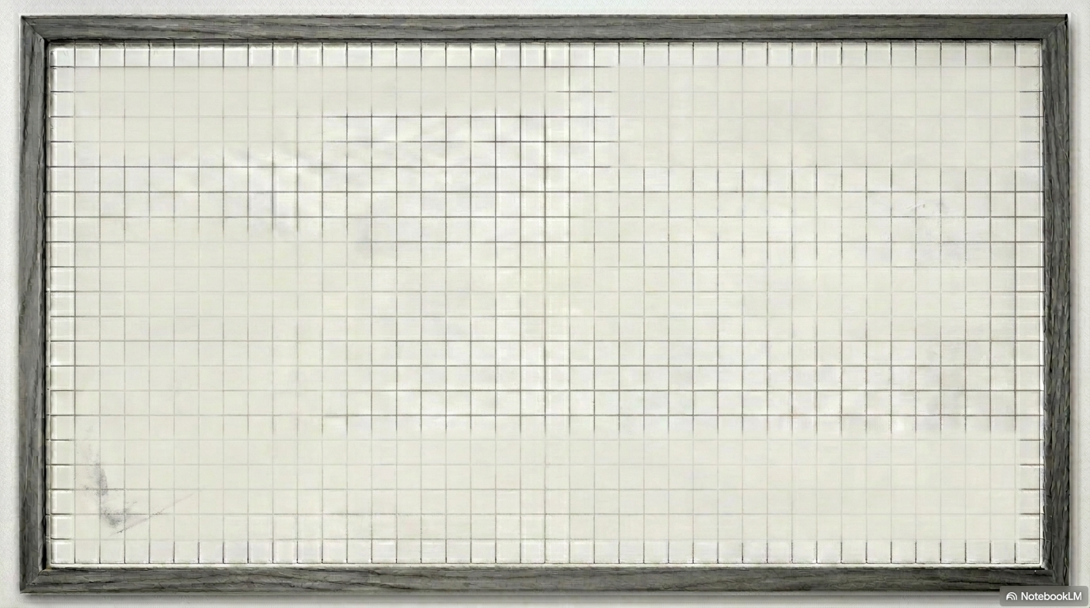
Agenda
The Launch
Transforming Activities for the Board
Thin-Slice
Notes:
Algebra 1 Unit 7 Lesson 8, do activity 2. This lesson is looking at quadratic equations in standard and factored form. The goal is to be able to rewrite each equation in the other form.

Slide 4
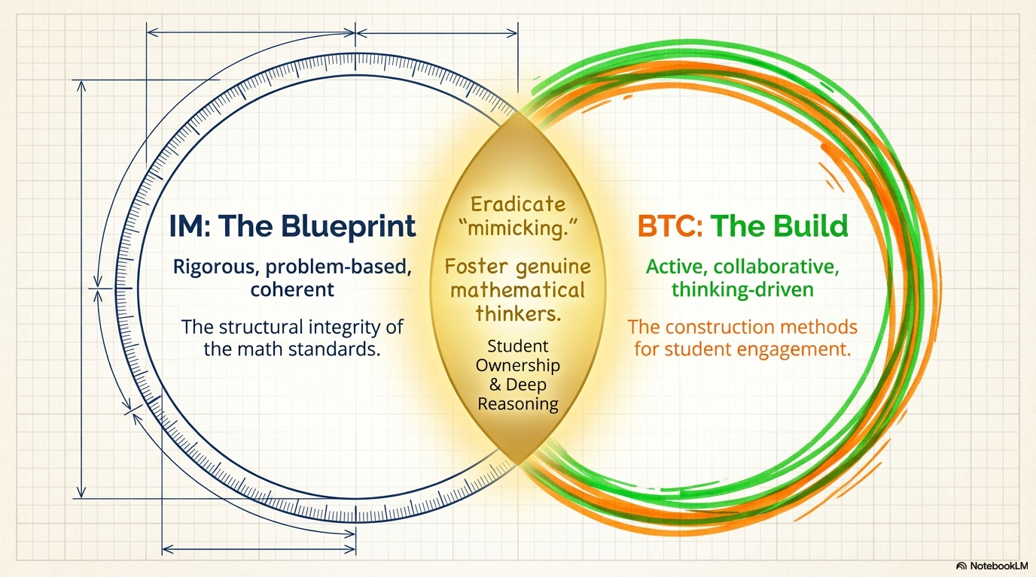

Slide 5
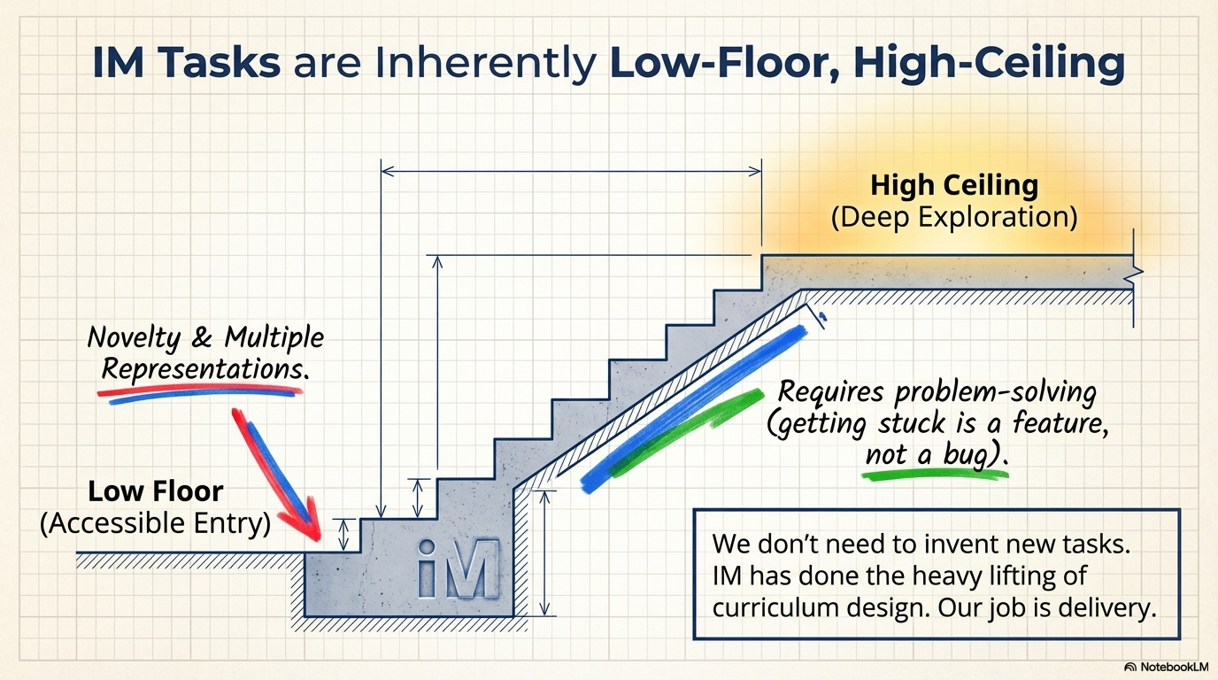

Slide 6
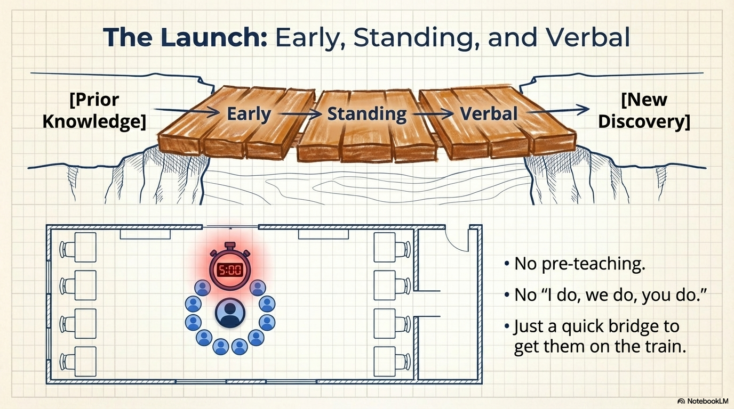

Slide 7
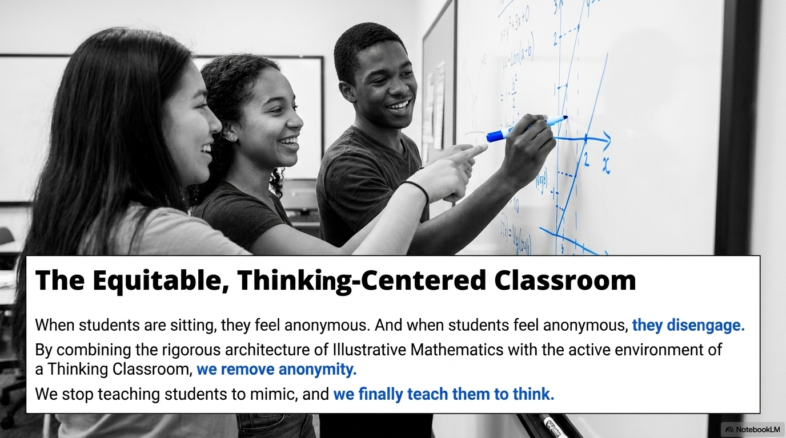

Slide 8
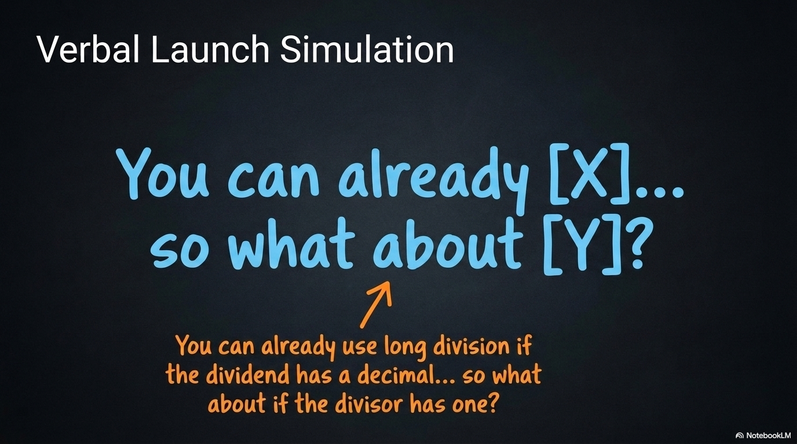

Slide 9
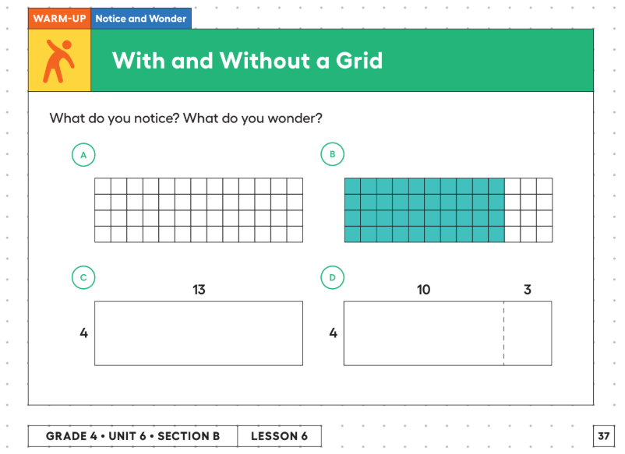
Notes:
Do this as gathered around the projection

Slide 10
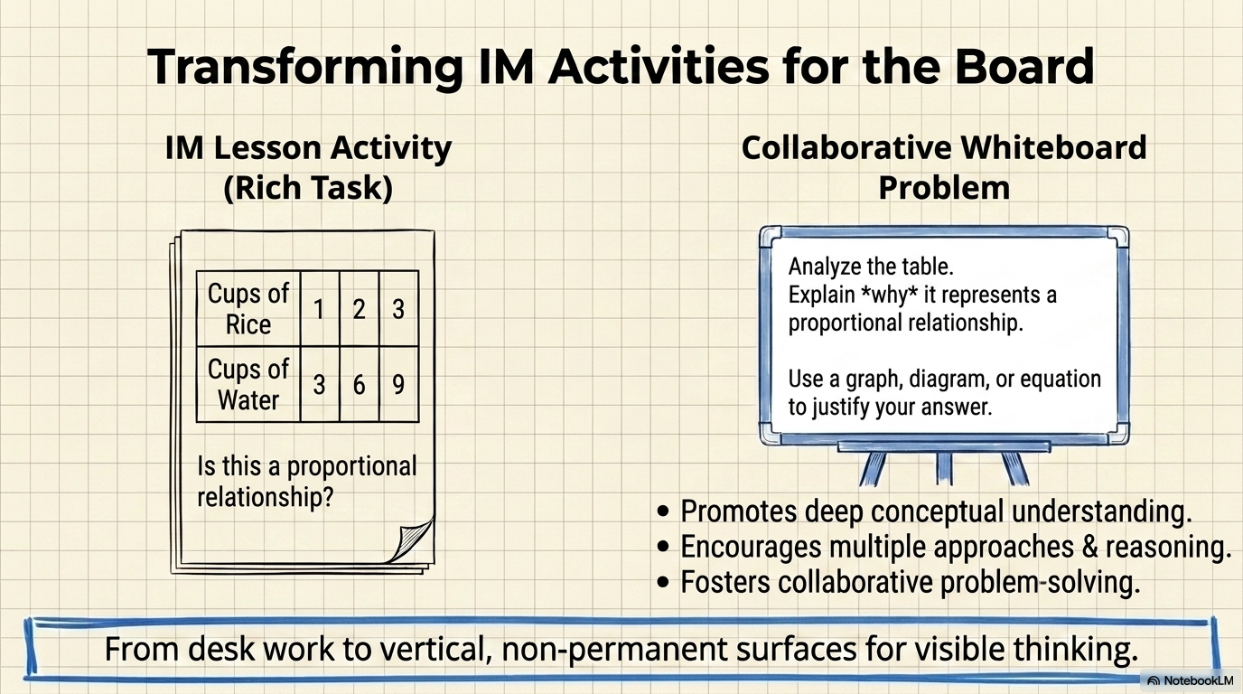

Slide 11
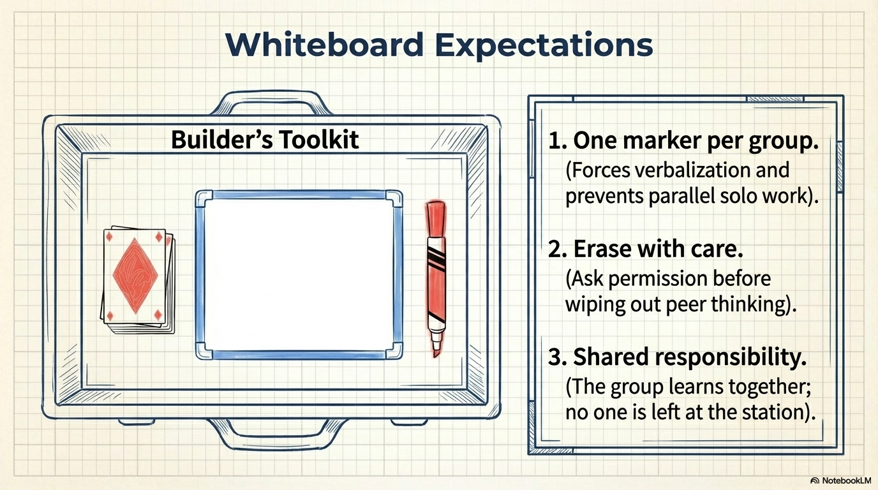

Slide 12
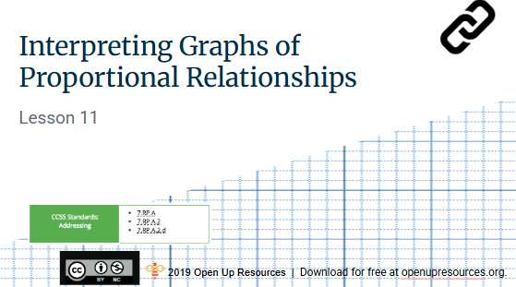
7th Grade Unit 2 Lesson 11
Notes:
Complete Tyler’s Walk. Explain the goal of this lesson is to be able to find the COP from a graph.

Slide 13
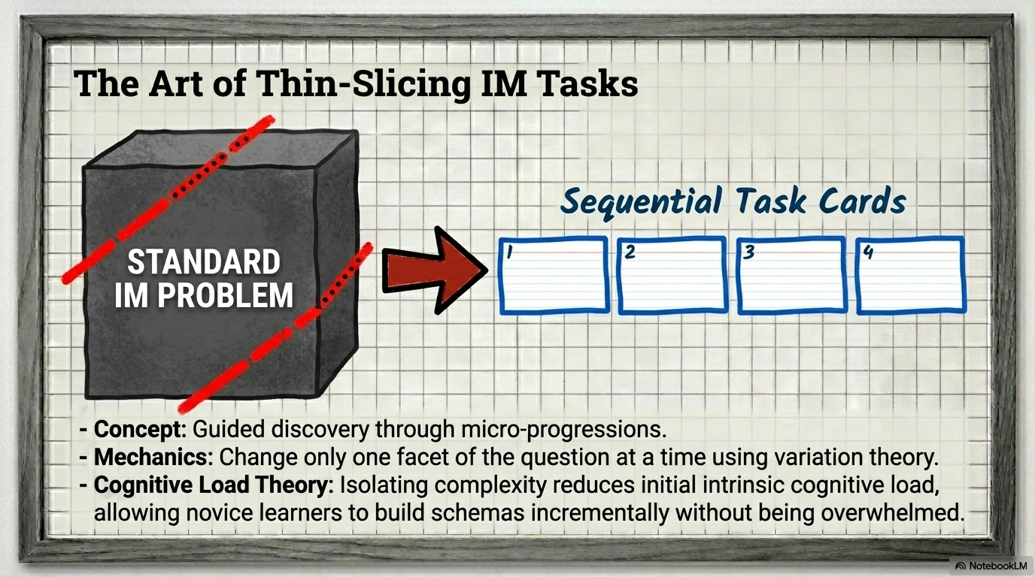

Slide 14
Creating Thin-Sliced Problems
Sequence of Problems
Start with a simple, accessible problem.
Incrementally increase difficulty or complexity.
Build towards the target concept.
Scaffolding Learning
Focus on one small change per step.
Think of your entry points to start low floor questions and build your way up to ceiling questions.
Encourage pattern recognition (MP 7).

Slide 15
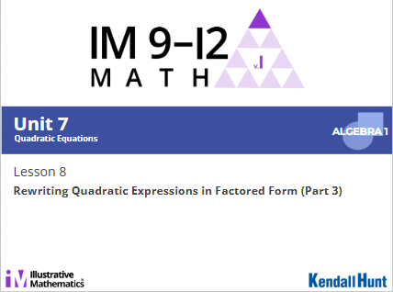
Algebra 1 Unit 7 Lesson 8
Notes:
Algebra 1 Unit 7 Lesson 8, do activity 2. This lesson is looking at quadratic equations in standard and factored form. The goal is to be able to rewrite each equation in the other form.

Slide 16
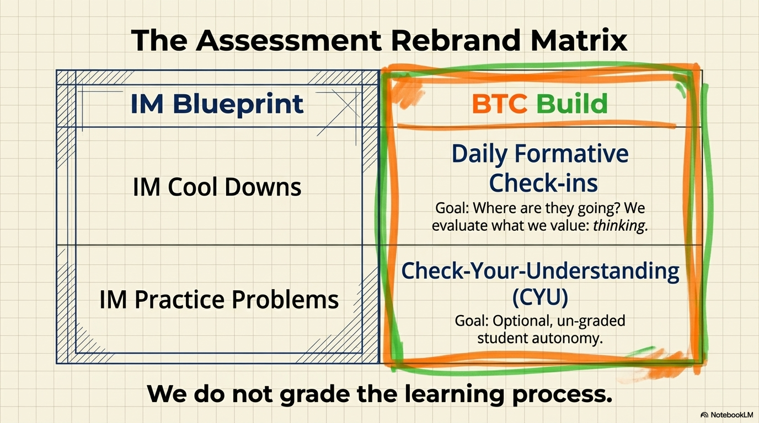

Slide 17
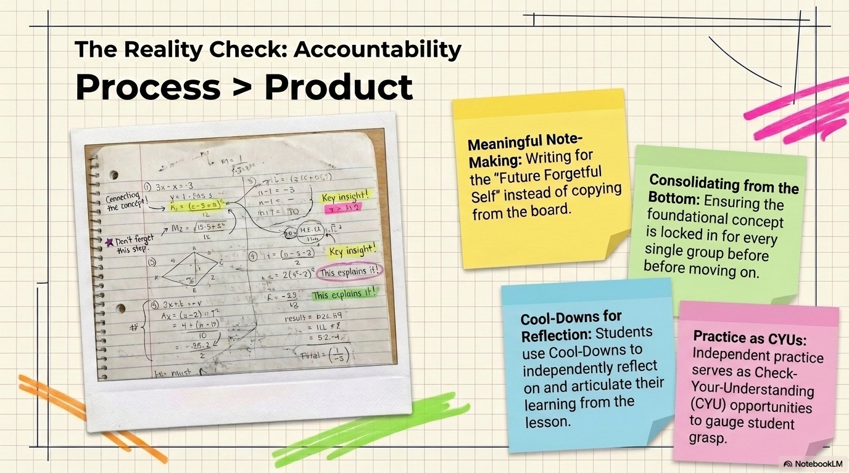

Slide 18
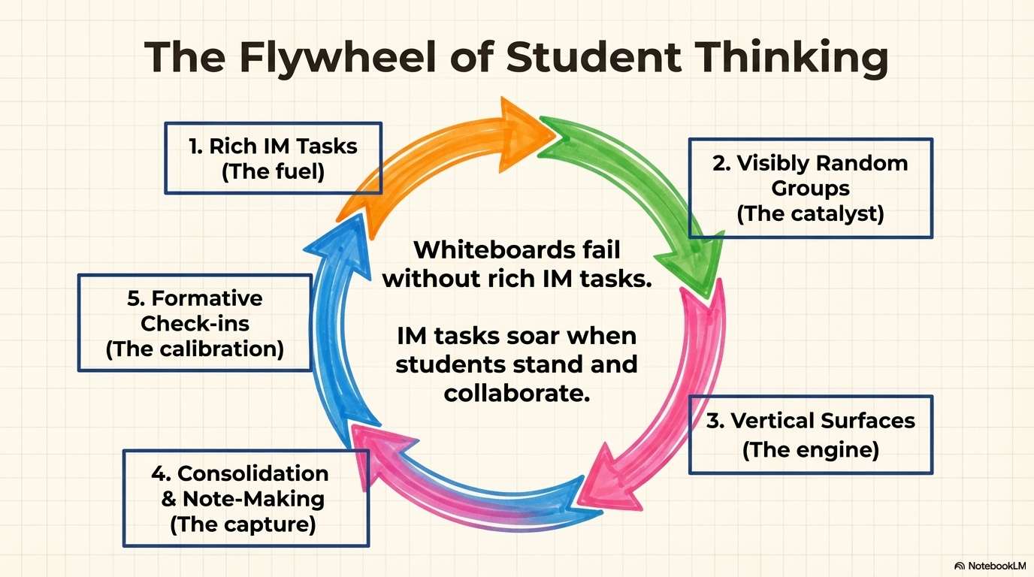

Slide 19
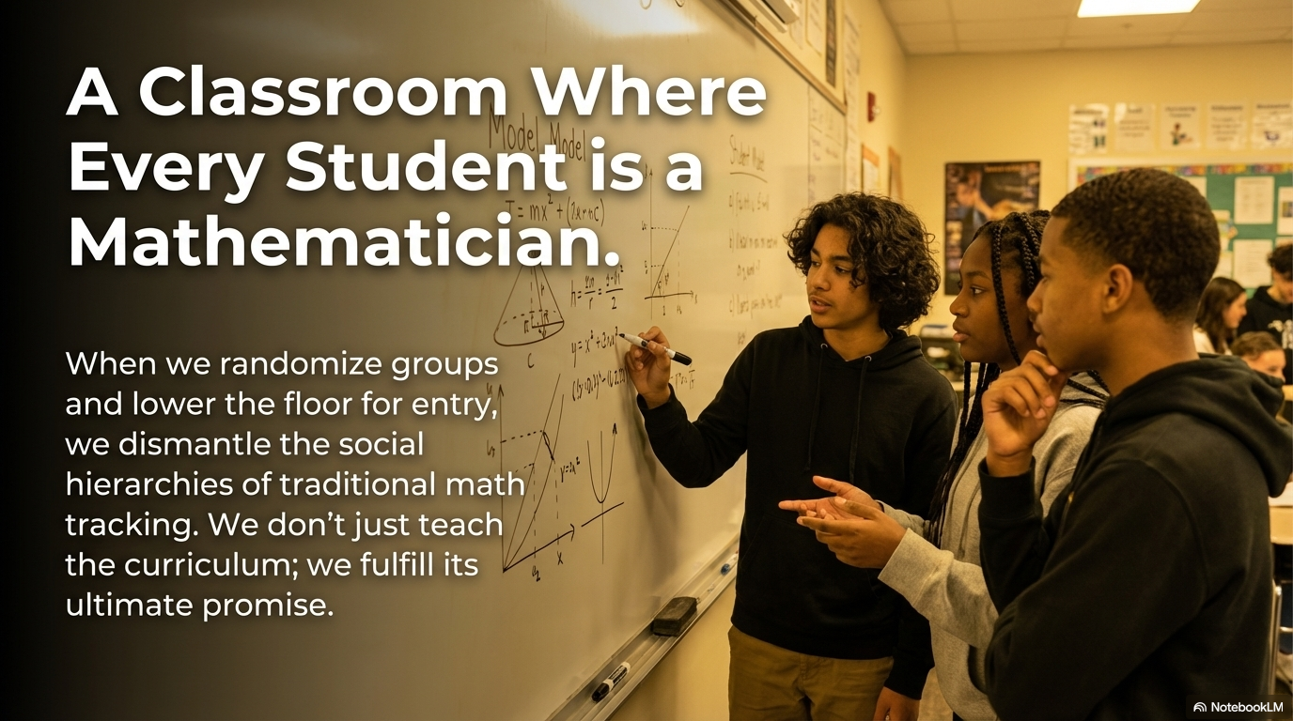

Slide 20
Questions?
Notes:
Algebra 1 Unit 7 Lesson 8, do activity 2. This lesson is looking at quadratic equations in standard and factored form. The goal is to be able to rewrite each equation in the other form.

Slide 21
Becky Wood
Becky.wood@lz95.org
Notes:
Algebra 1 Unit 7 Lesson 8, do activity 2. This lesson is looking at quadratic equations in standard and factored form. The goal is to be able to rewrite each equation in the other form.

