Slide 1

Math Vocabulary in BTC
Experience First,
Formalize Later

Slide 2

What you might get out of this session
Experience a Task
Experience a Thin-Sliced Lesson exhibiting experience first, formalize later
See Examples
See examples of student created “Meaningful Notes”
New Strategies
Adapting GLAD strategies (designed for English Learners) for BTC

Slide 3
Quick Poll:
1 Finger – Very Little
2 Fingers – Know about it
3 Fingers – implement it regularly
?
BTC Practices:
  Consolidation?
  Meaningful Notes?
  4-Quadrant Notes?

Slide 4
Thin Sliced Sequence For Linear Functions
Reminders for Working in Groups:
  If you are writing, someone else must be telling you what to write
  Look around for clues, and for the next step.
  If you think you are finished with one step, ask me “what’s next?”

Slide 5
Discuss and Record
1. How did we experience “function notation” first, before formalizing?
2. What other math lessons or language could you apply this approach to?
3. What notation or vocabulary do you find challenging for students to internalize and comprehend

Slide 6
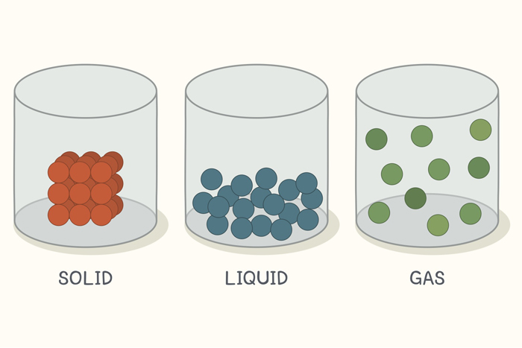

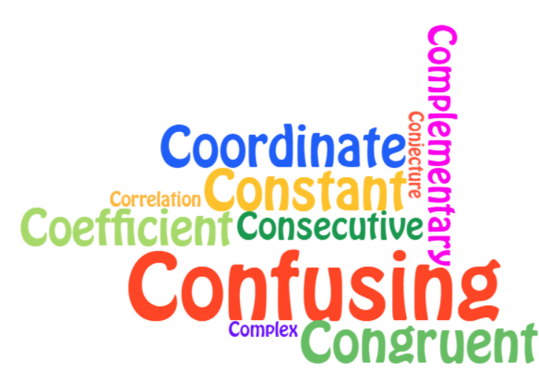











My journey on teaching Language in Math
Guided
Language
Acquisition
Design
SEE IT
HEAR IT
SAY IT
READ IT
WRITE IT
Collective
Knowing
Individual
Knowing
All this formal language is pedantic!
Students are getting confused about concepts they need to differentiate
Reifying: conSOLIDation
GLAD (ELL) Strategies
Notes:
Congruent, Corresponding, Complementary, Coefficient, Constant, Correlation
Numerator, Denominator,

Slide 7
What make Student Notes “Meaningful”?
Annotated Worked Example
Cognitively engaging
Summarizes what WAS learned
Uses mathematical vocabulary in context
Shows ALL steps of a problem
A Comprehensive example problem
Annotations:
  Reasoning (why does that make sense?)
  Strategy (how does that help us get to the solution?)
  Sequence (what moves do I make in which order?)
Notes:
So here are the principle’s I’ve come to understand as meaningful notes.

Slide 8
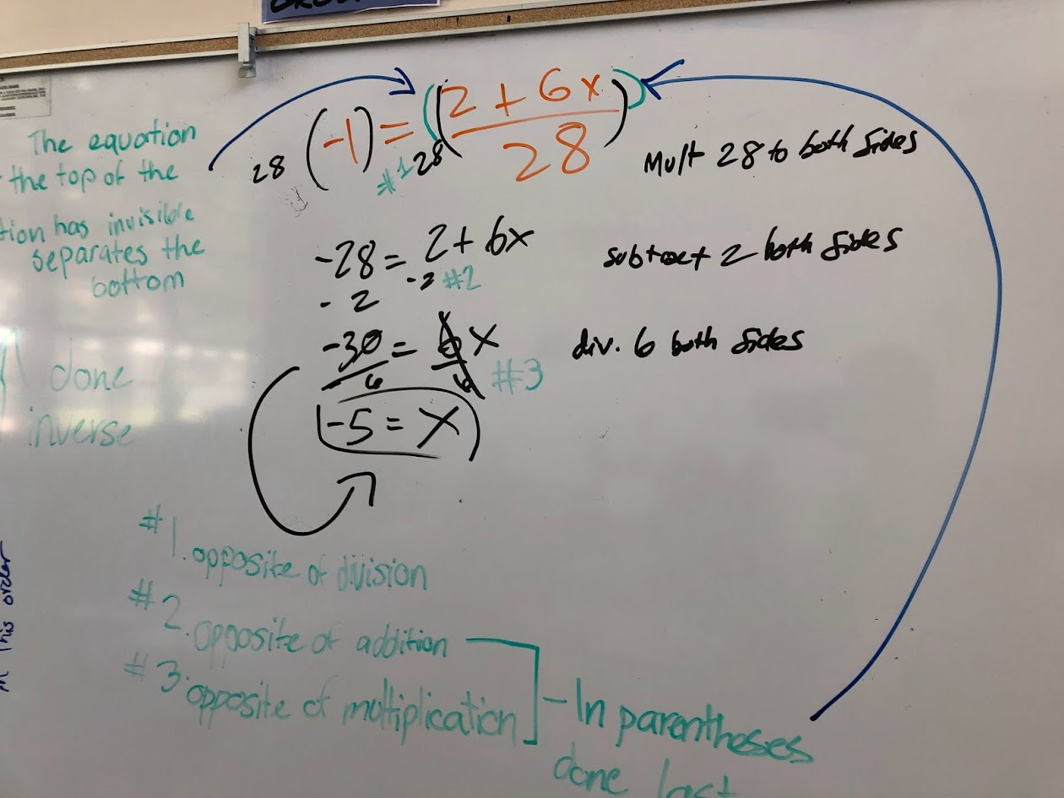
Annotation Day
Annotation Day:
Groups have similar, but not
identical problems
After finishing problem, switch groups and annotate
Annotations Guidance:
The General in the Particular
What, How, Why
No numbers

Slide 9
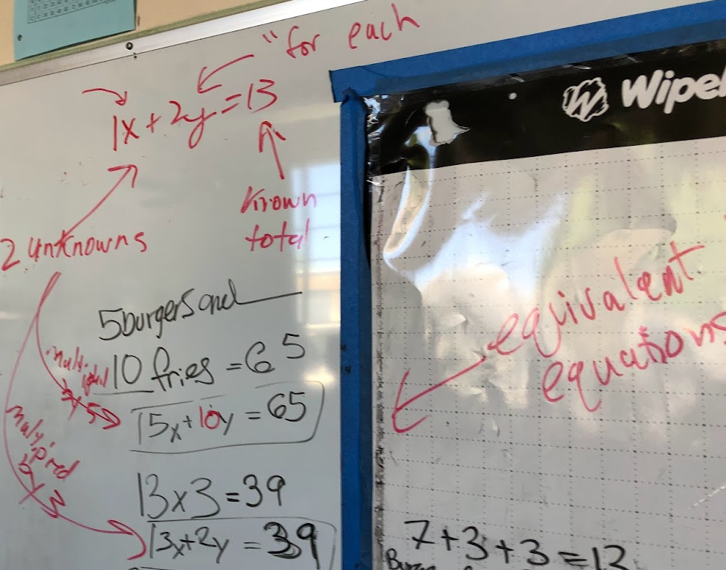
Teacher Annotates
During Consolidation
Students Describe using Turn and Talk
Teacher scribes what they explain
Teacher adds formal vocabulary

Slide 10
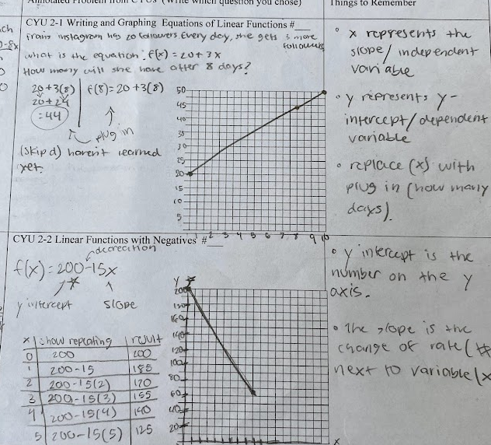
Student Accounatability: Portfolio of Annotated Problems
Students must annotate a new problem from their CYU using the annotations on the board as a guide

Slide 11




2-1 Group Notes
Ex1 : Amy’s Viral Video started with __ views. Each day, it got ____ more.
Counting the number of ________
Calculating the number of ________
How many views does the video have on day ____?
x | Repeating pattern: | (x, y)
0 | 54 | ( , 54 )
1 | ___ + ___= 61 | ( , 61 )
___ + ___ + ___ | ( , )
___ + ___ (3) | ( , )
___ + ___ (4) | ( , )
Things to Remember:
___ is the variable we count
___ is the variable we calculate
___ is the same variable as f(x)
Equation:
“f of x”
Notes:
BALANCE between STRUCTURE and FREEDOM
Challenge is always the balance of structure and freedom. We don’t want student’s copying mindlessly, but they are notoriously bad (Espec 8 and 9th graders) at coming up with good comprehensive notes. An instructional coach of mine observed, however, that the protocol for 4-quadrant notes (as part of consolidation, every student has a marker) appeared to visibly increase engagement. A lot of my meaningful notes looked like this. Students would do this on the board, then complete and annotate a comparable problem from their CYU on their portfolio. What I was still looking for, however, was how to get students to learn vocabulary by using it.

Slide 12
Still…How to get EVERY Student Engaged?

Slide 13
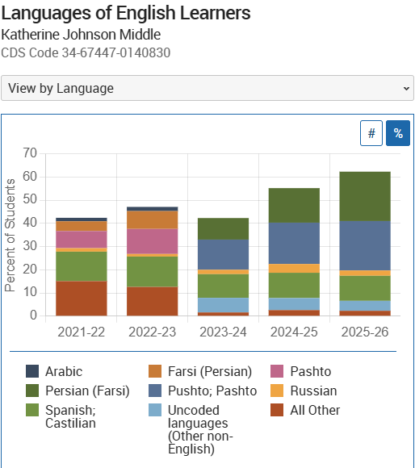
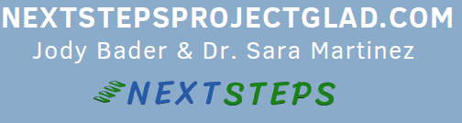
Project GLAD Training
My School
Project GLAD® – Guided Language Acquisition Design
Created by Marcia Brechtel & Linnea Haley
Including ELLs at All Grade Levels
My District engaged
for three Professional Development Days
BTC Link: GLAD also begins with building a culture of Cooperative Learning

Slide 14
5 MODALITIES
Three Strategies I’ve adapted:
Tiered Questions
Sentence Patterning Chart
Cognitive Content Dictionary.

Slide 15
1. Tiered Questions
Used for:
Group Check-ins,
Annotations,
Things to Remember
A hierarchy for student responses
Point To…
Yes or No?
Either/Or?
Open ended
Examples:
  Label: y-intercept, ∆y, and ∆x
  Is the slope greater than 1?
  Increasing or decreasing? (what tells you that?)
  What do all y-intercepts contain?

Slide 16
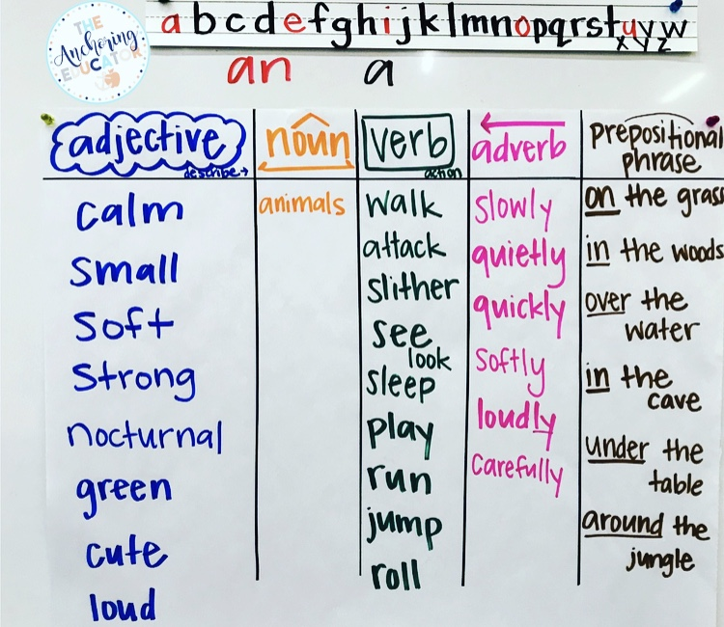
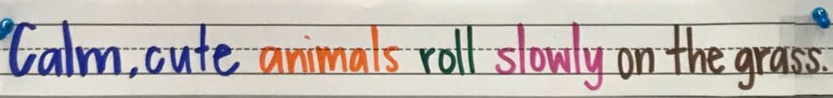
2. Sentence Patterning CHart
A class-created anchor chart for a variety of activities.

Slide 17
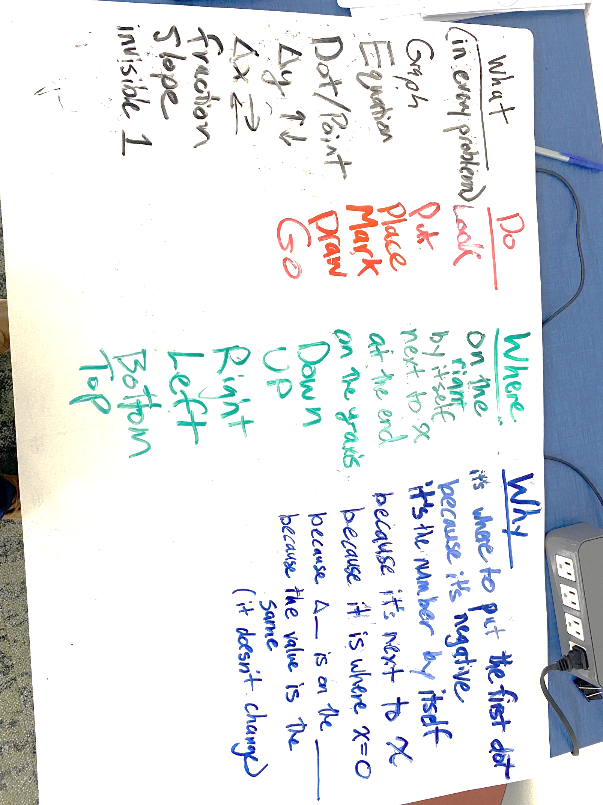
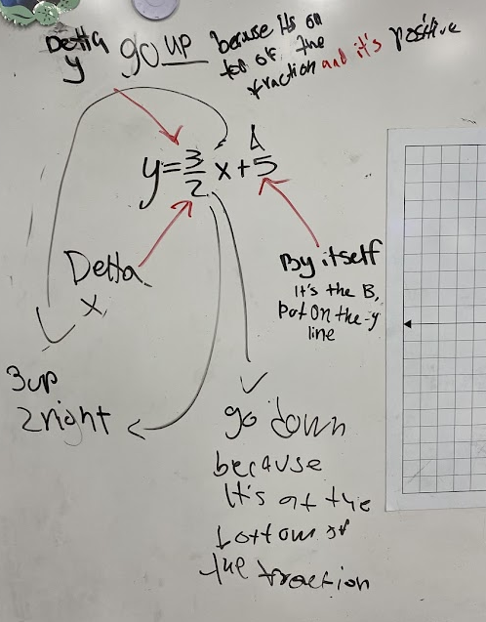
During Consolidation:
Students describe their process
Teacher categorizes words under each heading
Decide beforehand what vocabulary you must have

Slide 18
Adapting to Solving Equations
Adjective Noun Verb Adverb Prepositional Phrase
Type
Thing
Action
Where
Reason
Positive
Negative
Constant
CoefficientTerm
Add
Subtract Multiply
Divide
Combine
Distrcibute
Left side
Right side
Both Sides
Inside ( )
Next to ( )
To Eliminate..
To Simplify..
Notes:
During consolidation, write the category headings, and have students describe the process.
As you do, put words they use under each heading.
(Identify the vocabulary you want them to learn, so you can guide the discussion)

Slide 19
Adapting to Solving Equations
Sentence Patterning Chart
Adjective Noun Verb Adverb Prepositional Phrase
Type
Thing
Action
Where
Reason
Positive
Negative
Constant
CoefficientTerm
Add
Subtract Multiply
Divide
Combine
Distrcibute
Left side
Right side
Both Sides
Inside ( )
Next to ( )
To Eliminate..
To Simplify..
During Consolidation:
Students describe their process
Teacher categorizes words under each heading
Best: decide beforehand what vocabulary you must have.
Notes:
During consolidation, write the category headings, and have students describe the process.
As you do, put words they use under each heading.
(Identify the vocabulary you want them to learn, so you can guide the discussion)

Slide 20
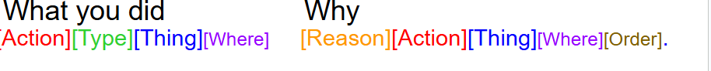
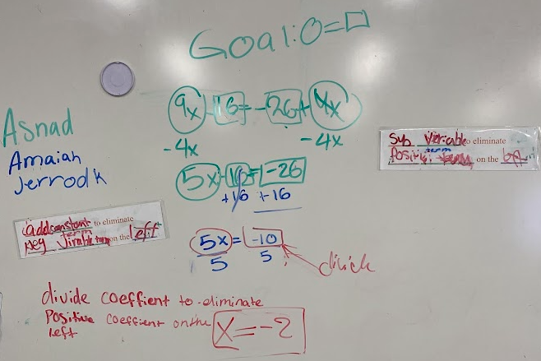
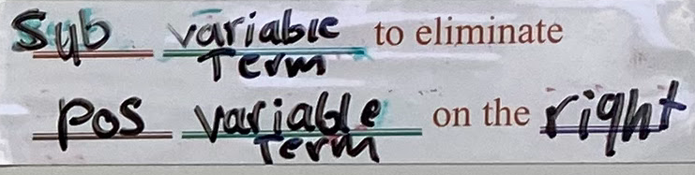
Sentence Patterning Chart: Solving Equations

Slide 21
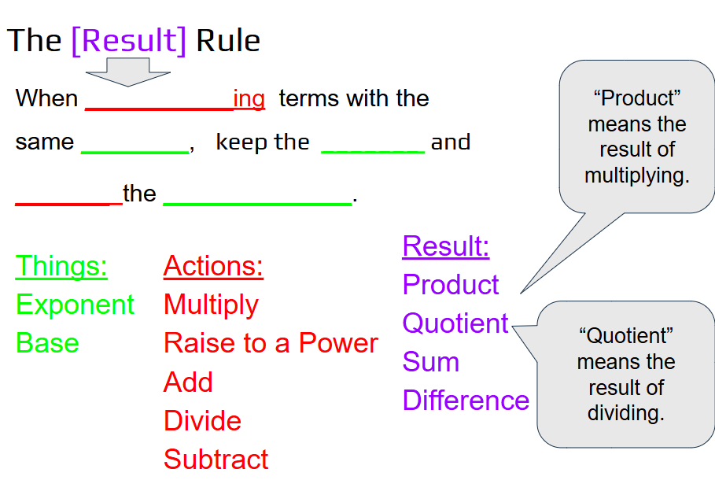
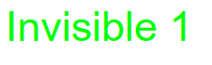
Sentence Patterning Chart:
Exponent Rules
The Result of multiplying
Result:
Product
Quotient
Sum
Difference
Where:
Product
Quotient
Sum
Difference
The Result of dividing

Slide 22
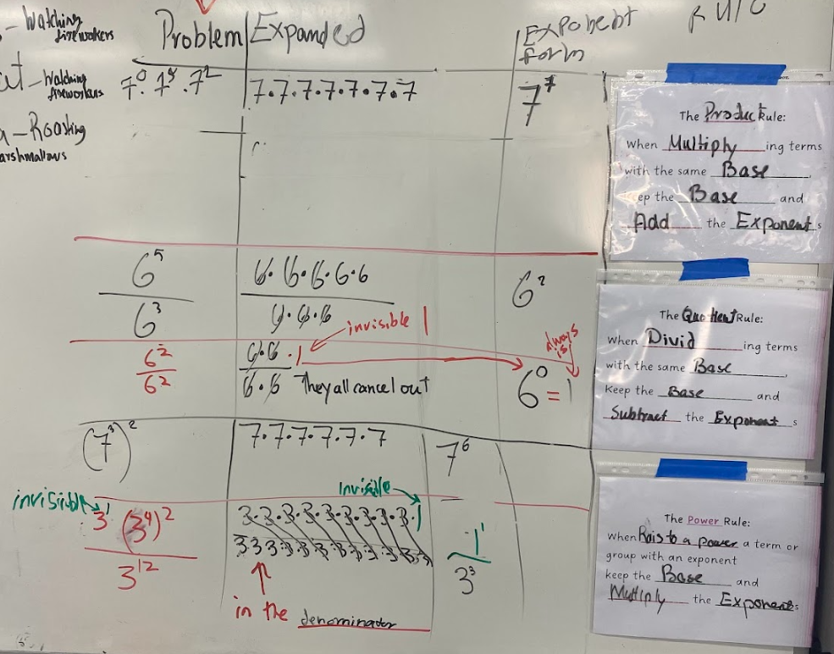
Student Created Notes on the Board
During consolidation, students wrote their own exponent rules.

Slide 23
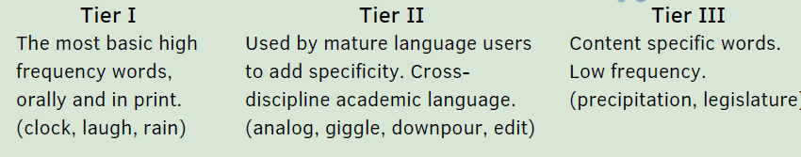
Cognitive Content Dictionary
Number
Little
Big
Top
Bottom
Result
Add
Subract
Multiply
Fraction
Exponent
Numerator
Denominator

Slide 24
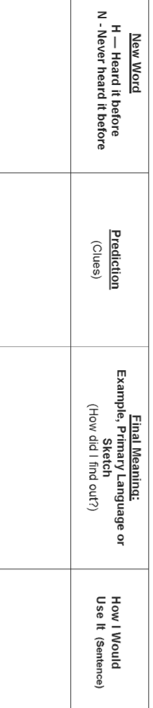
3) Cognitive Content Dictionary
A graphic organizer Anchor Chart:
Choral Response Practice Saying it.
Tally who has heard it before or not heard it
Predict based on clues
Final Meaning and Source
Example
11- 85 repetitions of a new word is needed to recall the word at will and use it correctly in academic discourse
Notes:
Backwards chaining by syllable
“-nuse,” “-tenuse,” “-potenus;” “hypotenuse”
Choral repetition in launch, used in Meaningful notes.
“If you can’t say it, you can’t use it. If you can’t use it, you can’t learn it.”

Slide 25
Q
Covered in this Session
Linear Functions Task
Learning Vocabulary through using it in context
&
Annotating Problems & Meaningful Notes
A
Tiered Questions
GLAD strategies
Sentence Patterning Chart
Cognitive Content Dictionary.

Slide 26
Thank You
Find me in the BTC Facebook Group
Nathan.Woodward@sanjuan.edu
Please complete the Survey in Sched. Especially if you have constructive criticism!

