Slide 1



Going to the Voters for Funding:
How the Basalt Library Won a Ballot Measure in 2025
Amy Shipley, Basalt Regional Library
David Flaherty, Magellan Strategies
September 9th, 2026

Slide 2
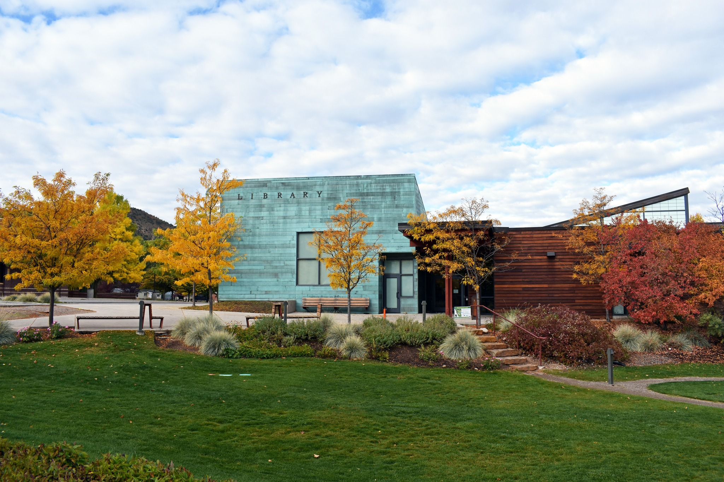

The Basalt Regional Library’s Story in 2025
The Basalt Library’s leadership and board members were contemplating the following short and long-term needs:
Pay staff a living wage
Care for the building
Continue and expand services
Insulate from economic ups and downs
2

Slide 3
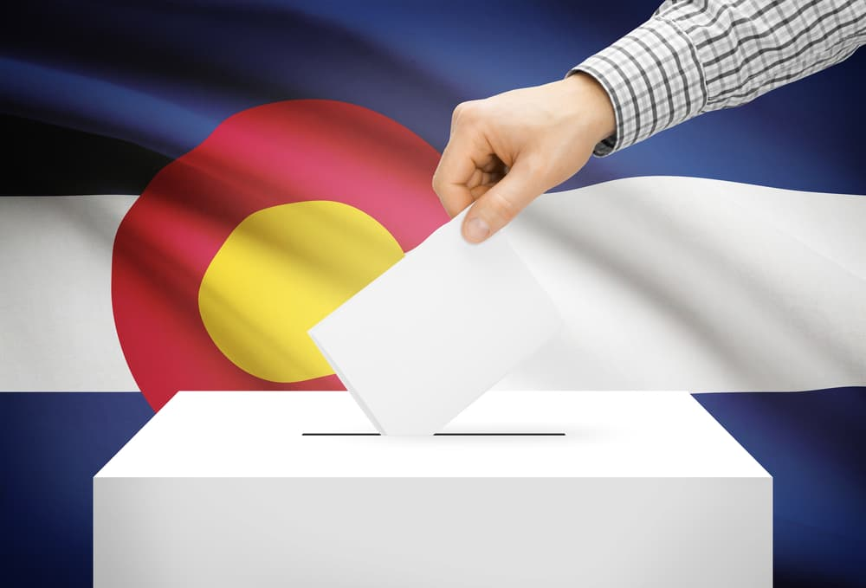
Figuring Out the Colorado Ballot
Measure Process
What Do District Leadership & Board Members Need to Do and When?
List District Needs
Figure Out the Cost of Needs
Discuss Process With Attorney
Interview Survey Research Firms & Community Engagement Consultants (If Needed)
3

Slide 4


Basalt Library 2025 Ballot Measure Process Consultants
Polling, Ballot Language, & General Ballot Measure Process Consulting
Community Engagement Services, Campaign Management, Paid Campaign Efforts (digital ads, mail, etc.)
Campaign & Election Attorney
4

Slide 5
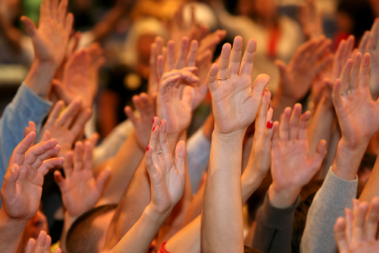
Questions About Initial Steps & Planning for the Ballot Measure Process?
5

Slide 6
Ballot Measure Survey Objectives
Measure voter awareness of the library’s services, how well they manage those services, and opinions on the library’s fiscal responsibility.
To measure support and opposition for a potential ballot measure
The survey also measured opinions on the reasons to continue funding.
6
Notes:
Measure resident and voter awareness of the library district’s services, how well they manage those services, and opinions on the library district's fiscal responsibility.
To measure support and opposition for a potential ballot measure to extend the 2006 voter-approved property tax to continue to fund library services and upkeep.
The survey also measured opinions on the reasons the Basalt Library Regional District needs to continue funding.

Slide 7

Knowing Your Library District or Department’s Voter Registration & Past Turnout Demographics
Developing an Effective Ballot Measure Survey That Will Lead to Voter Approval
7

Slide 8
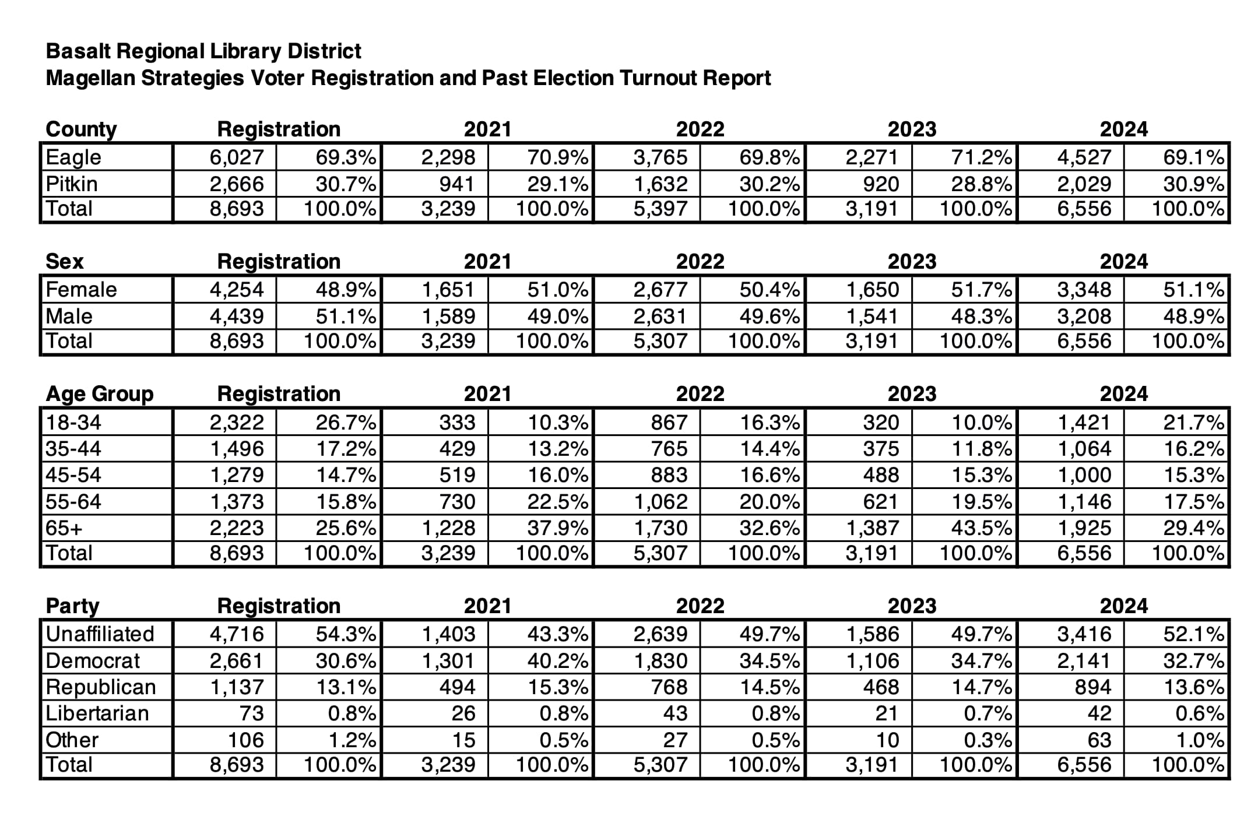
Basalt Regional Library District
Voter Registration & Past Turnout Demographics

Slide 9
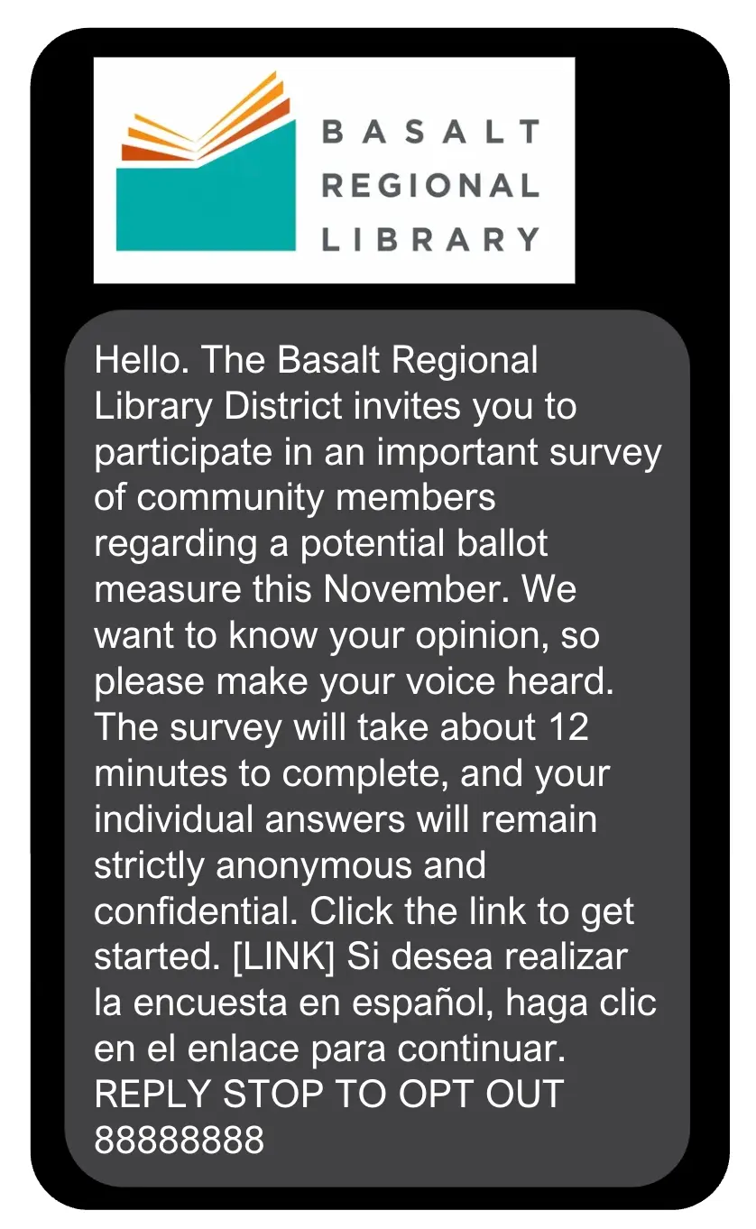
Survey Methodology
478 Voters were surveyed
The survey was conducted from March 27th through April 6th, 2025.
The overall survey responses have a margin of error of ±4.36 % at the 95% confidence level.
Population subgroups will have a higher margin of error than the overall sample.
The results are weighted to be representative of voter turnout demographics of an odd-year election in the District.
9
Notes:
Magellan Strategies is pleased to present the results of a survey of 478 registered voters in the Basalt Regional Library District. The interviews were conducted from March 27th through April 6th, 2025.
The overall survey responses have a margin of error of ±4.36 % at the 95% confidence level. Population subgroups will have a higher margin of error than the overall sample.
The survey results are weighted to be representative of the voter turnout demographics of an odd-year election in the Basalt Regional Library District.

Slide 10
Questions About Different Election Cycles or Survey Data Collection Methods?
10

Slide 11
Measuring Voter Awareness of Library Services & Opinions of the Library District or Department
Developing an Effective Ballot Measure Survey That Will Lead to Voter Approval
11

Slide 12
How often do you or a member of your household visit the Basalt Library or access digital library services
through the website?

Slide 13
Please describe the reasons why you or members of your household do not use or visit the Basalt Library.
[Asked to respondents who never go to the library.]
Preference for Digital or Online Alternatives
Lack of Time or Habit
No Perceived Need or Relevance
Notes:
Preference for Digital or Online Alternatives: Many respondents mentioned they get their reading material digitally—through eBooks, Libby, newspapers, or online research—and find it more convenient than visiting the library.
Lack of Time or Habit: Several people noted time constraints or simply not being in the habit of using the library. Even some who support libraries in principle said it just doesn’t occur to them to go.
No Perceived Need or Relevance: Some respondents said they have no particular reason to use the library, don't consider themselves library users, or feel it doesn't offer anything they currently need.

Slide 14

How satisfied are you with the following attributes
of the Basalt Library?

Slide 15
Do you approve or disapprove of the job the Basalt Library is doing in providing services and programs in your community?
Strongly Approve | 73%
Somewhat Approve | 15%
Strongly Disapprove | 0%
Somewhat Disapprove | 1%

Slide 16
Do you agree or disagree with the following statement? “The Basalt Library is fiscally responsible and spends taxpayer money wisely.”
Strongly Agree | 50%
Somewhat Agree | 15%
Strongly Disagree | 0%
Somewhat Disagree | 3%

Slide 17
Do you think the Basalt Library has the financial resources needed to provide adequate services and programs in your community?
Yes, Definitely | 16%
Yes, Probably | 28%
No, Definitely Not | 1%
No, Probably Not | 17%

Slide 18
Questions About Measuring Opinions of a Library District or Department?
18

Slide 19
Measuring Voter Support & Opposition: The Uninformed Ballot Test
Developing an Effective Ballot Measure Survey That Will Lead to Voter Approval
19

Slide 20
Informing Respondents That No Decisions Have Been Made
Before we continue, it is important to understand that the Basalt Library has not decided whether to put a ballot measure before voters this November. Your participation in this survey and sharing your honest opinions will help the district make that decision. Let’s continue the survey now.
20

Slide 21
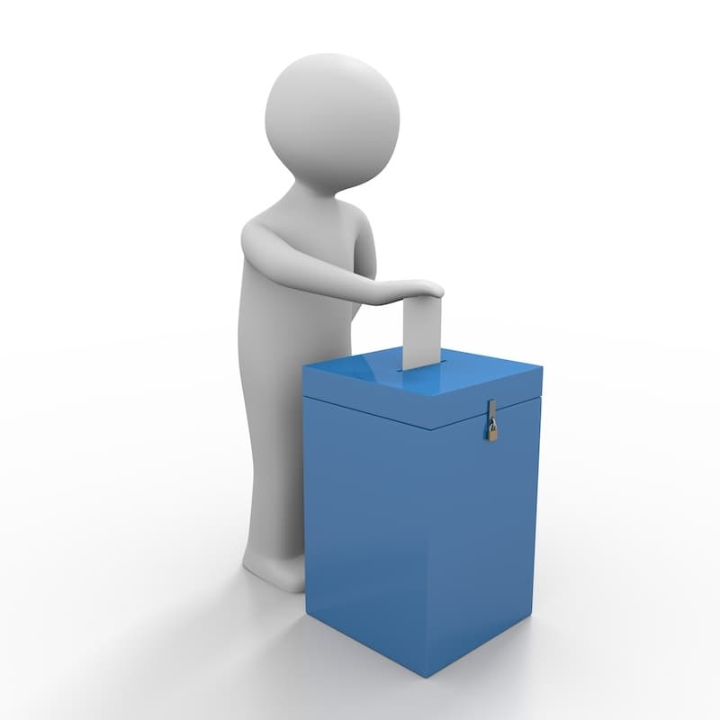
Basalt Library 1.08 Mill Levy Extension Uninformed Ballot Test
The Basalt Regional Library District is considering the following ballot measure this November. Please read the ballot language and indicate whether you would vote yes to approve it or no to reject it. The ballot measure reads as follows:
WITHOUT INCREASING THE TAX RATE, SHALL THE BASALT REGIONAL LIBRARY DISTRICT PROPERTY TAXES CURRENTLY IMPOSED PURSUANT TO EXPIRING 2006 VOTER APPROVAL BE EXTENDED AT THE CURRENT RATE OF 1.08 MILLS TO:
PROPERLY FUND THE ONGOING MAINTENANCE OF LIBRARY FACILITIES;
PROVIDE FUNDING NECESSARY TO RETAIN STAFF AND MAINTAIN/EXPAND OPERATING HOURS AT THE LIBRARY;
PROPERLY FUND COMMUNITY ACCESS TO BOOKS, INTERNET, INFORMATION AND PROGRAMS;
IMPROVE JOB SEARCH AND AFTER-SCHOOL PROGRAMS; AND
SUPPORT OTHER ESSENTIAL LIBRARY SERVICES AND PROGRAMS
THROUGH A PERMANENT PROPERTY TAX PRODUCING $782,000 IN TAX REVENUES IN CALENDAR YEAR 2025 AND WHATEVER IS GENERATED EACH YEAR THEREAFTER FROM THE EXTENDED RATE OF 1.08 MILLS FOR DEPOSIT INTO THE DISTRICT’S GENERAL FUND, TO CONSTITUTE A VOTER-APPROVED REVENUE CHANGE UNDER ARTICLE X, SECTION 20 OF THE STATE CONSTITUTION?

Slide 22
Basalt Library 1.08 Mill Uninformed Ballot Test
If an election were being held today, would you vote yes and approve this ballot measure, or would you vote no and reject it?
Definitely Yes | 51%
Probably Yes | 28%
Definitely No | 6%
Probably No | 7%

Slide 23
Tell Your Story! Educate and Inform Voters Why the Ballot Measure is Being Considered & How the Funding Will Be Spent
Developing an Effective Ballot Measure Survey That Will Lead to Voter Approval
23

Slide 24
Basalt Library
Information Questions
We will now share information about why the Basalt Library is considering this ballot measure and the operations, programs, and services that would be funded. After reading the information, please indicate if you are more likely to vote yes and approve the ballot measure or if you are more likely to vote no and reject it. Let’s get started:
24

Slide 25
Basalt Library Ballot Measure
Information Questions
The Basalt Library currently employs 18 full-time and 5 part-time staff members. However, due to limited funding, the district has been unable to provide wages that reflect the local cost of living. This ballot measure would enable the district to offer more competitive salaries, which would help retain staff and maintain full staffing levels at the library.
In 2006, voters in the Basalt Regional Library District approved a ballot measure to fund the Basalt Library. The district is set to pay off the bond this year, a year ahead of schedule, and the associated mill levy will expire in 2026. This ballot measure would extend the current mill levy to support staff salaries, ongoing building maintenance, and potential new services or programs.

Slide 26
Basalt Library Ballot Measure
Information Questions
If the ballot measure is approved, a portion of the revenue will be allocated for the ongoing maintenance of the library building, enabling the Basalt Library to address maintenance needs and continue offering its current services proactively.
Currently, in 2025, homeowners in the Basalt Regional Library District pay approximately $67 annually for each $1 million of home value toward the ballot measure that was passed in 2006 to build the library. If the present ballot measure were to pass, the mill levy rate would remain and homeowners would continue to pay at the current rate of 1.08 mills to maintain the library and its services.

Slide 27
Basalt Library Ballot Measure – Expanded Library Services
Revenue from the ballot measure could fund the following expanded library services: For each service, please indicate if you are more likely to vote yes and approve the ballot measure or if you are more likely to vote no and reject it if the specific service were to be funded.

Slide 28
Basalt Library Ballot Measure – Expanded Library Services
Revenue from the ballot measure could fund the following expanded library services: For each service, please indicate if you are more likely to vote yes and approve the ballot measure or if you are more likely to vote no and reject it if the specific service were to be funded.

Slide 29
Questions About Ballot Measure Information Questions & Telling Your Story?
29

Slide 30
Measuring Voter Support & Opposition: The Informed Ballot Test
Developing an Effective Ballot Measure Survey That Will Lead to Voter Approval
30

Slide 31
Basalt Regional Library District 1.08 Mill Levy Extension Informed Ballot Test
Thank you for learning why the Basalt Regional Library District is considering this ballot measure. We will now ask you again to read the specifics of the ballot measure and indicate if you would vote yes and approve it or vote no and reject it:
WITHOUT INCREASING THE TAX RATE, SHALL THE BASALT REGIONAL LIBRARY DISTRICT PROPERTY TAXES CURRENTLY IMPOSED PURSUANT TO EXPIRING 2006 VOTER APPROVAL BE EXTENDED AT THE CURRENT RATE OF 1.08 MILLS TO:
PROPERLY FUND THE ONGOING MAINTENANCE OF LIBRARY FACILITIES;
PROVIDE FUNDING NECESSARY TO RETAIN STAFF AND MAINTAIN/EXPAND OPERATING HOURS AT THE LIBRARY;
PROPERLY FUND COMMUNITY ACCESS TO BOOKS, INTERNET, INFORMATION AND PROGRAMS;
IMPROVE JOB SEARCH AND AFTER-SCHOOL PROGRAMS; AND
SUPPORT OTHER ESSENTIAL LIBRARY SERVICES AND PROGRAMS
THROUGH A PERMANENT PROPERTY TAX PRODUCING $782,000 IN TAX REVENUES IN CALENDAR YEAR 2025 AND WHATEVER IS GENERATED EACH YEAR THEREAFTER FROM THE EXTENDED RATE OF 1.08 MILLS FOR DEPOSIT INTO THE DISTRICT’S GENERAL FUND, TO CONSTITUTE A VOTER-APPROVED REVENUE CHANGE UNDER ARTICLE X, SECTION 20 OF THE STATE CONSTITUTION?

Slide 32
Basalt Library 1.08 Mill Informed Ballot Test
If an election were being held today, would you vote yes and approve this ballot measure, or would you vote no and reject it?
Definitely Yes | 54%
Probably Yes | 29%
Definitely No | 6%
Probably No | 6%

Slide 33

Basalt Library
Ballot Measure Comparison
Uninformed
Informed
+4
-1
-3

Slide 34
Basalt Library Verbatim Responses
Please describe why you would vote yes and approve this ballot measure.
The Library as a Vital Community Resource
Support for Public Access, Equity, and Inclusion
Desire to Maintain or Expand Services and Programs
Support for Library Staff and Living Wages
Notes:
The Library as a Vital Community Resource; Many respondents view the library as the heart of the community—a safe, welcoming, and inclusive place that supports education, connection, and quality of life for people of all ages.
Support for Public Access, Equity, and Inclusion: People deeply value that the library offers free access to knowledge, technology, and services—especially in a region marked by income disparity. People liked that the library is fair and open to everyone, no matter who they are.
Desire to Maintain or Expand Services and Programs: There was strong support for preserving and even expanding current offerings—including children's programs, digital services, arts, music, and multilingual support.
Support for Library Staff and Living Wages: Many respondents explicitly mentioned their support for raising staff salaries and ensuring library workers can afford to live in the area.

Slide 35
Basalt Library Verbatim Responses
Please describe why you would vote no and reject this ballot measure.
Concern About High Property Taxes
Frustration About the “Temporary” Tax Becoming Permanent
Lack of Transparency or Specifics in the Proposal
Notes:
Concern About High Property Taxes: Many people said their property taxes have already risen significantly—some reported increases of 100% or more. They feel overwhelmed and believe now is not the time to incur additional costs, even if the tax is only being extended.
Frustration About the “Temporary” Tax Becoming Permanent: Several residents feel misled because the original tax was supposed to be temporary. They’re upset that it’s now being proposed as permanent.
Lack of Transparency or Specifics in the Proposal: Some said the ballot language is too vague or confusing. They want more detail about how the money will be used, how much is needed, and a clear financial plan.

Slide 36
Final Thoughts & Questions Regarding the Survey?
36

Slide 37
Community Engagement Phase
(library led)
Community Engagement Efforts & Initiatives
Interest-holder Conversations
Digital Advertising
Library Website
Ballot Information Flyer
TABOR Notice
37

Slide 38
Vote Yes Campaign Phase
(volunteer led)
Community Engagement Efforts & Initiatives
Yard Signs
Doorknob Hangers
Posters
38

Slide 39
What Worked Well
Polling
Ballot Measure Consultant
Clarify Board Role vs Staff Role
39

Slide 40
What Could Have Gone Better
Communicate Legal Deadlines & Completed Action Steps
Newspaper Ran Letters Against
Newspaper Declined to Endorse
40

Slide 41
BASALT REGIONAL LIBRARY DISTRICT BALLOT ISSUE 7B
WITHOUT INCREASING THE TAX RATE, SHALL THE BASALT REGIONAL LIBRARY DISTRICT PROPERTY TAXES BE EXTENDED TO RETAIN THE EXPIRING 2006 VOTER APPROVAL AT THE CURRENTLY IMPOSED RATE OF 1.08 MILLS TO:
(i) PROPERLY FUND THE ONGOING MAINTENANCE OF LIBRARY FACILITIES;
(ii) PROVIDE FUNDING NECESSARY TO RETAIN STAFF AND MAINTAIN/EXPAND OPERATING HOURS AT THE LIBRARY;
(iii) PROPERLY FUND COMMUNITY ACCESS TO BOOKS, INTERNET, INFORMATION AND PROGRAMS;
(iv) IMPROVE JOB SEARCH AND HOMEWORK SUPPORT; AND
(v) SUPPORT OTHER ESSENTIAL LIBRARY SERVICES AND PROGRAMS
THROUGH A PERMANENT PROPERTY TAX PRODUCING $782,000 IN TAX REVENUES IN CALENDAR YEAR 2025 AND WHATEVER IS GENERATED EACH YEAR THEREAFTER FROM THE EXTENDED RATE OF 1.08 MILLS FOR DEPOSIT INTO THE DISTRICT’S GENERAL FUND, TO CONSTITUTE A VOTER-APPROVED REVENUE CHANGE UNDER ARTICLE X, SECTION 20 OF THE STATE CONSTITUTION?
_____ YES/FOR _____ NO/AGAINST
Final Ballot Language

Slide 42
Thank You for Your Time Today!
Amy Shipley, Basalt Library
David Flaherty, Magellan Strategies

