Slide 1


Dr. Amanda Ziegler
National University
Managing at a Distance
Research-backed strategies for engaging remote and hybrid academic library teams

Slide 2





LEADERSHIP JOURNEY

Slide 3

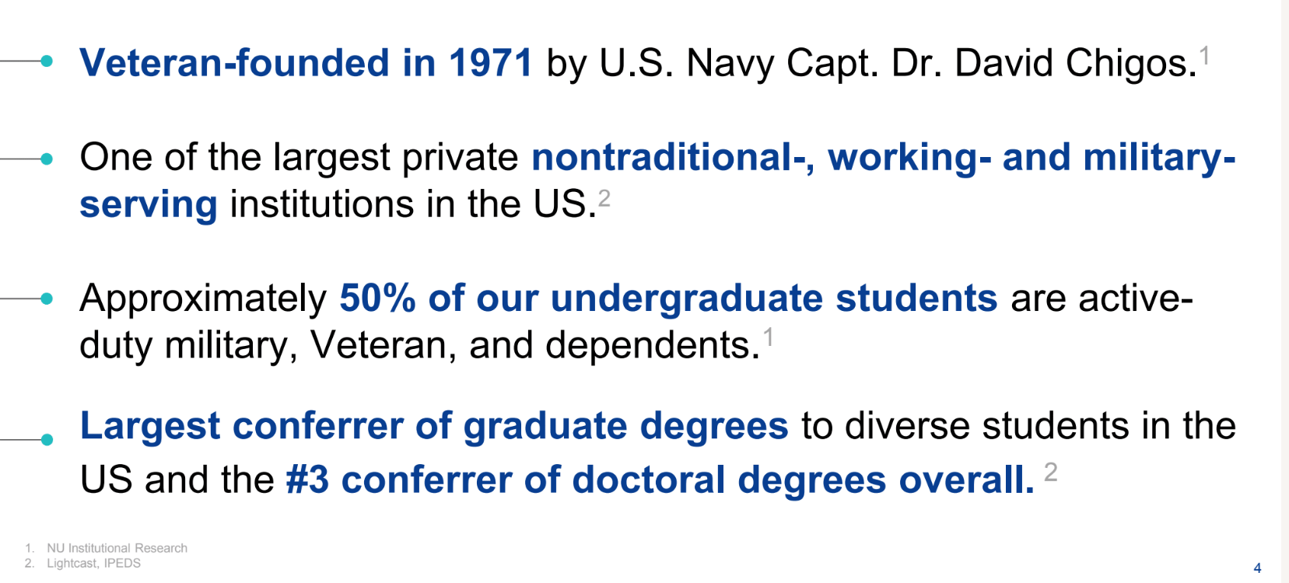

Slide 4

Why This Topic
Matters Now
  Remote and hybrid work has fundamentally changed academic libraries...and how we lead them
  Engagement, connection, and motivation are harder to maintain at a distance.
  Which leadership strategies and practices are still effective in these environments?

Slide 5
Question for you:
What is your biggest challenge in managing and leading your remote and hybrid folks?

Slide 6

Research design, methodology, and the questions that guided this study on remote leadership.
Exploring these questions
01
What I studied
Key findings on transformational leadership behaviors and their impact on engagement.
02
What I found
Practical implications for leading remote and hybrid academic library teams effectively.
03
What it means
for managers
Concrete strategies and actionable steps to implement research-backed leadership practices.
04
How to apply it

Slide 7


Research
Quantitative predictive correlational study
Design
Online survey with 108 usable responses
I examined whether transformational leadership behaviors predict work engagement among remote and hybrid academic library workers.
MLQ for transformational leadership
UWES-9 for work engagement

Slide 8



What Counts as Engagement?
Work engagement is the positive, fulfilling state where employees bring energy, commitment, and focus to their roles. It represents the enthusiasm and connection that drives meaningful contribution in academic library settings.
Vigor
Dedication
Absorption
Enthusiasm for work

Slide 9
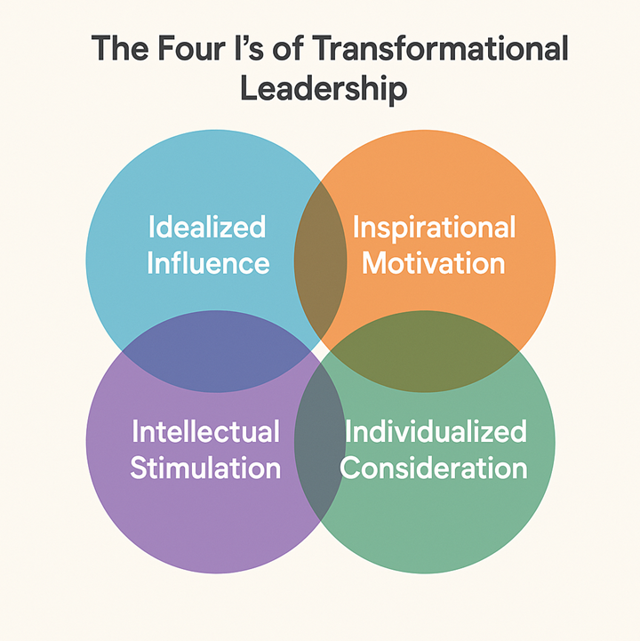
The Leadership Framework
Transformational leadership includes five key components: Idealized Influence (idealized attributes & idealized behaviors), inspirational motivation, intellectual stimulation, and individualized consideration.

Slide 10

The Bottom Line
All five transformational leadership variables correlated with work engagement. However, only two emerged as significant predictors in the final regression model.
This finding reveals which specific leadership behaviors matter most for remote and hybrid academic library teams.

Slide 11

The Two Predictors
1) Idealized Attributes
Trust, authenticity, integrity, and acting in the interest of the group
2) Inspirational Motivation
Optimism, confidence, meaning, and shared vision
Together, these two factors explained 29.4% of engagement variance in remote and hybrid academic library workers.

Slide 12

Predictor 1:
Idealized Attributes
Trust
Idealized attributes represent the character and ethical foundation that makes leaders worthy of trust and respect. These qualities form the bedrock of effective remote leadership.
Authenticity
Integrity
Acting in the interest of the group

Slide 13

Maintain the same tone, expectations, and approach whether communicating via email, chat, video, or in person.
Be consistent across all channels
01
Explicitly name and demonstrate your core values in daily interactions and decisions with your team.
Make your values visible
02
Share the reasoning behind choices so team members understand the why, not just the what.
Explain decisions transparently
03
Idealized Attributes
in Action
Recognize team contributions publicly and demonstrate composure and purpose during challenges.
Share credit and model calm
04

Slide 14

Predictor 2:
Inspirational Motivation
A compelling sense of where the work is going—leaders who inspire through vision create engaged teams even at a distance.
Optimism
Confidence
Meaning
Shared vision

Slide 15

Inspirational Motivation
in Action
01
Name the purpose
Articulate the "why" behind every initiative and project to give remote team members clear direction.
Connect work to student and community impact
Show how daily tasks contribute to student success and broader community outcomes.
02
Celebrate progress
Recognize milestones and achievements regularly to maintain momentum and motivation.
03
Frame change with clarity and optimism
Communicate transitions with confidence and a forward-looking perspective.
04

Slide 16

The "Related but Not Predictive" Variables
Idealized behaviors, Intellectual stimulation, and Individualized consideration still matter—but did not predict engagement uniquely in the final model.
Idealized behavior is closely related to the idealized attributes (which were predictive)
Intellectual stimulation is often linked to innovation.
Without clarity and support, innovation initiatives can feel like added pressure rather than opportunity.
Informal coaching and spontaneous check-ins are significantly reduced in remote environments, making individualized support harder for team members to perceive and experience.

Slide 17

Micro-Level
Moves
Begin meetings with purpose
01
Start each meeting by stating why you're meeting and what success looks like. Ground the team in shared goals.
Narrate values behind decisions
When making decisions, explain the principles guiding your choice. Transparency builds trust in remote settings.
02
Use recognition tied to impact
03
Acknowledge contributions by connecting them to outcomes. Show how individual work serves the larger mission.
Make expectations explicit
Clearly communicate what you need, by when, and why it matters. Remove ambiguity that distance amplifies.
04

Slide 18

Macro-Level
Moves
System-level strategies that embed engagement-focused leadership into your library's culture and operations.
Hire and promote values-based leaders
Train leaders in vision communication
Build feedback loops around trust
Celebrate team impact routinely

Slide 19

Engagement at a distance is not just about more communication. It is about more meaningful, values-aligned, purpose-centered communication.
What This Means
for Library Leaders

Slide 20

Self-report data
Cross-sectional design
Convenience sample
Follower perceptions only

Slide 21

Future
Research
Explore leadership behaviors in digital channels
Use longitudinal research designs
Study targeted leadership interventions
Include qualitative and leader self-report methods

Slide 22
Question for you:
What is one behavior you can implement in the next two weeks?

Slide 23

Questions?
Happy to chat more
aziegler@nu.edu

