Slide 1

SCALE
SMART
Growing your business without
losing your foundation
Initiative Foundation 2026 Do Business with Purpose Mini Summit
August 27, 2026 | Sarah Sengupta, PhD
Build capacity before demand exposes the cracks.
Notes:
[Sources]
Session title, date, and description provided by the presenter.

Slide 2
OPENING FRAME
Scaling is not “more.” It is a different operating system.
Growth creates value only when capacity, cash, capability, and customer promise stay aligned.
CUSTOMER
PROCESS
PEOPLE
ECONOMICS
A repeatable promise
Work that flows
Capability at the right level
Margin and cash resilience
Interactive prompt: Where is your foundation strongest? Where is it most likely to crack?
PAIR + SHARE | 3 MIN

Slide 3
THE 2026 CONTEXT
The growth window is open, but the margin for error is thin.
Central Minnesota businesses are navigating a tight workforce, cost uncertainty, and rapid technology change.
WORKFORCE
Design roles and training for productivity, not headcount alone.
Minnesota continues to experience a tight labor market, limiting growth and increasing competition for talent.
COST + POLICY
Tariffs and policy uncertainty pressure planning
Scenario-test landed cost, pricing, and working capital.
TECHNOLOGY
AI is changing workflows faster than job titles
Start with a bounded workflow and human review. Solid processes are key.
2026 Business Benchmarks report | Minnesota Chamber of Commerce
GROUND THE DECISION
Notes:
[Sources]
Minnesota Chamber of Commerce, 2026 Business Benchmarks Report.
Federal Reserve Bank of Dallas, February 12, 2026.

Slide 4
SCALE-READINESS PULSE
Score the system, not the ambition.
Use 1 = fragile, 3 = workable, 5 = repeatable under pressure.
Customer demand is validated
1
2
3
4
5
Unit economics are visible
1
2
3
4
5
Core workflow is documented
1
2
3
4
5
Capacity can flex
1
2
3
4
5
Managers can make decisions
1
2
3
4
5
Cash can absorb the lag
1
2
3
4
5
Your lowest score is today’s scaling constraint.
SELF-ASSESS | 5 MIN

Slide 5
ECONOMICS
Know the cost of one more customer.
Revenue growth can consume cash before it produces profit.
CONTRIBUTION MARGIN
Price − variable cost
THREE QUESTIONS
1. What gets more expensive with every sale?
2. When do you pay versus get paid?
3. What breaks first when volume doubles?
Must cover fixed cost, working capital, and reinvestment.
Tool: model a base case, growth case, and shock case before committing.

Slide 6
CAPACITY
Find the constraint before adding volume.
Map the flow from first customer signal to cash collected.
LEAD
QUOTE
DELIVER
QA
BILL
LEARN
WAIT
REWORK
OWNER
DATA
Where does work queue?
Where does work return?
Where must the owner decide?
Where are you blind?
MAP ONE REAL ORDER

Slide 7
OPERATING MODEL
Standardize the repeatable. Protect the distinctive.
Scale does not require eliminating customization. It requires choosing where customization creates value.
STANDARDIZE
MODULARIZE
CUSTOMIZE
Intake, handoffs, quality checks, reporting
Options, packages, service levels, configurations
High-value judgement, relationship moments, exceptions
Fewer errors • faster training
Choice without chaos
Differentiation where it matters

Slide 8
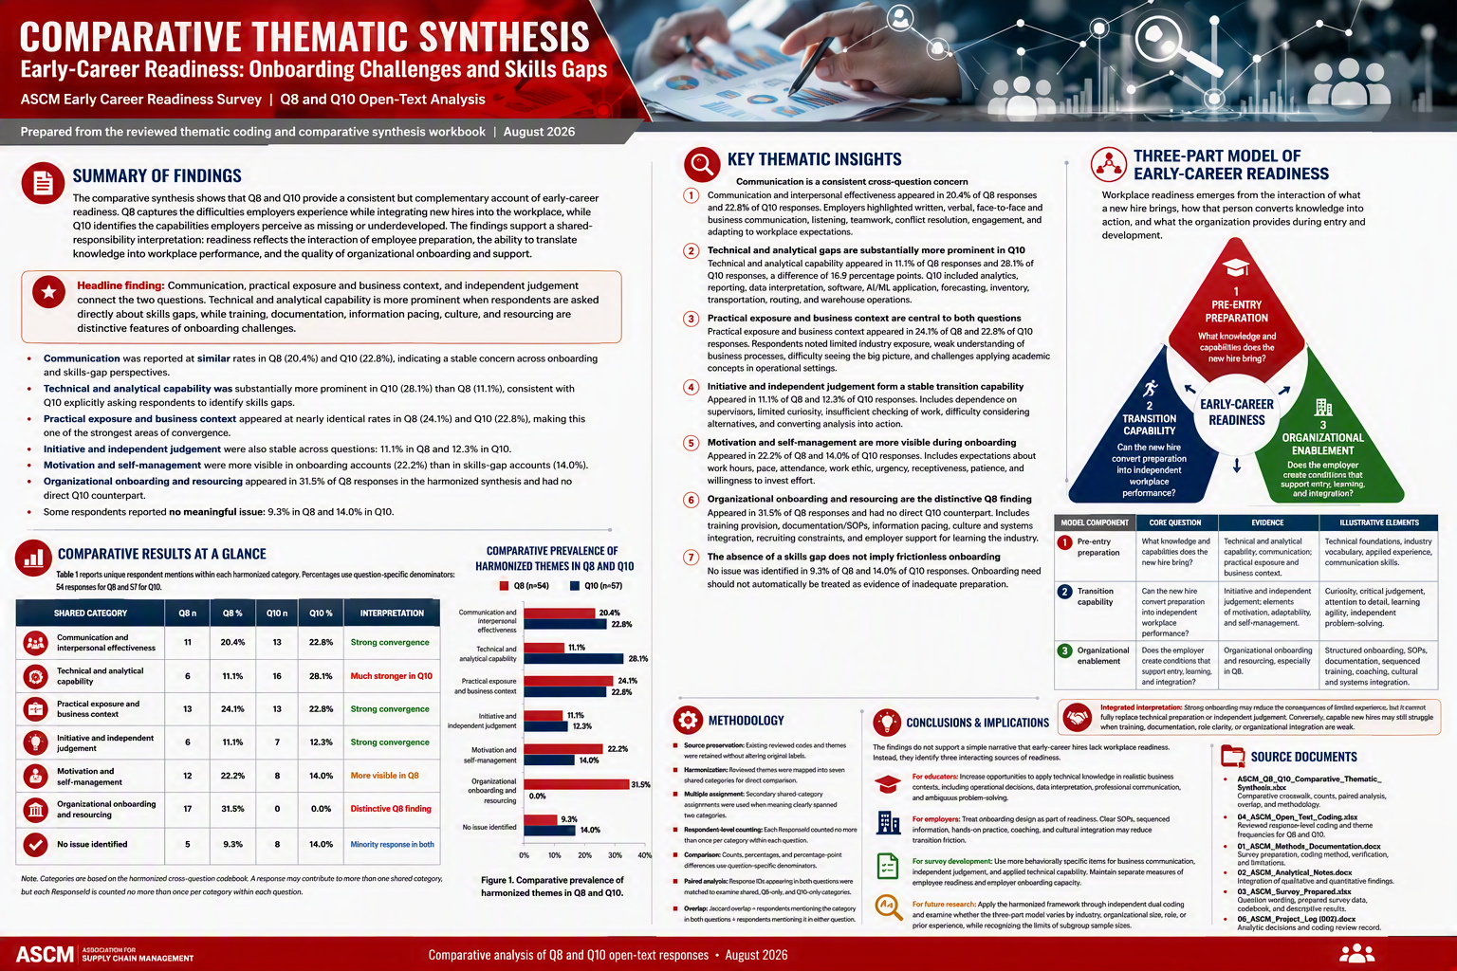
EVIDENCE
Skills gaps and onboarding friction are two sides of readiness.
Research from the ASCM early-career survey highlights capability gaps and the employer systems that enable performance.
Notes:
[Sources]
ASCM_Q8_Q10_Comparative_Thematic_Synthesis_Report.docx, August 2026.
Visual on this slide was generated with Microsoft Copilot.

Slide 9
PEOPLE + PERFORMANCE
Readiness is a three-part system.
Hiring alone will not solve a scaling constraint.
1
PRE-ENTRY
PREPARATION
2
TRANSITION
CAPABILITY
3
ORGANIZATIONAL
ENABLEMENT
Technical, analytical, communication, and business context
Judgement, curiosity, self-management, and learning agility
SOPs, sequenced training, coaching, and integration
Scaling question: Are you adding people, or building capability?

Slide 10
UPSKILLING
Training is not a benefit added after growth. It is growth infrastructure.
Build the learning loop into the operating rhythm.
MEASURE
Quality, speed, judgement, transfer
DEFINE
LEARNING
LOOP
Critical work + performance standard
COACH
Fast feedback at the point of work
PRACTICE
Hands-on, job-relevant application
Rule of thumb: training should remove a bottleneck, reduce a risk, or unlock an opportunity.

Slide 11
CASE STUDY
Northstar Fabrication: demand doubled. Capacity did not.
Hypothetical composite created for discussion; not a real company case.
SIGNAL
A new channel offers a 2× volume opportunity
RISK
Quotes vary, owner approves exceptions, training is informal
CHOICE
Hire immediately, automate intake, or stage the launch?
SMART SCALE
Pilot one segment; standardize quote rules; cross-train QA; gate expansion on margin + cycle time
TABLE DISCUSSION | 6 MIN

Slide 12
PITFALLS
Growth amplifies what already exists.
The goal is not zero risk. It is visible, bounded, reversible risk.
SCALING CHAOS
Adding volume to an unstable process
Stabilize one flow first
HIRING THE BOTTLENECK
Adding labor without decision rights or training
Redesign work + manager span
AUTOMATING WASTE
Digitizing a broken handoff
Simplify before tooling
REVENUE WITHOUT CASH
Winning work that extends the cash gap
Model working capital
PURPOSE DRIFT
Chasing opportunities that weaken the promise
Use explicit no-go criteria

Slide 13
OPPORTUNITY FILTER
Say yes to the right growth.
Score each opportunity from 1–5, then name the evidence behind the score.
STRATEGIC FIT
Does it strengthen our purpose and customer promise?
1 2 3 4 5
ECONOMIC FIT
Does it improve contribution margin and cash resilience?
1 2 3 4 5
CAPACITY FIT
Can we deliver without breaking quality or the team?
1 2 3 4 5
CAPABILITY FIT
Can our people learn and perform the work quickly?
1 2 3 4 5
REVERSIBILITY
Can we pilot, pause, or exit without major damage?
1 2 3 4 5
USE THE HANDOUT

Slide 14
ACTION PLAN
A 90-day scaling experiment.
Choose one constraint, one learning target, and one reversible move.
0–30
31–60
61–90
DIAGNOSE
PILOT
DECIDE
Baseline margin, cycle time, quality, capacity, and skill risk
Test one segment, workflow, product, or team with clear guardrails
Scale, adapt, or stop based on evidence and team learning
Commitment: “In the next 7 days, I will…”
WRITE + COMMIT

Slide 15
REGIONAL PARTNERSHIP
Bring the challenge. RASP helps connect the capability.
Research, Advanced Studies, and Partnerships is designed as a connected platform for advanced learning and regional impact.
1
2
3
4
BRING
CONNECT
BUILD
LEARN
A growth constraint, skill need, data question, or innovation idea
Faculty expertise, research, grants, instructional design, PACE, and student talent
A diagnostic, pilot, customized training, applied project, or funded partnership
Measure results, improve, and decide what to scale next
Start anywhere. We connect you to the right mix of expertise and resources.

Slide 16
CLOSE
Scale smart. Protect the promise. Build the system.
Your next growth move should strengthen the foundation, not borrow against it.
1
2
3
4
5
Know the economics
Find the constraint
Build capability
Stage the risk
Learn before you leap
Sarah Sengupta, Ph.D. | Associate Dean (Interim)
Research, Advanced Studies, and Partnerships (RASP)
419.574.2213 | sarah.sengupta@stcloudstate.edu | stcloudstate.edu

