Slide 1
Let There Be Light!
A Fun & Practical Guide to Stage Lighting
Amanda Clark and Aaron Wicks

Slide 2
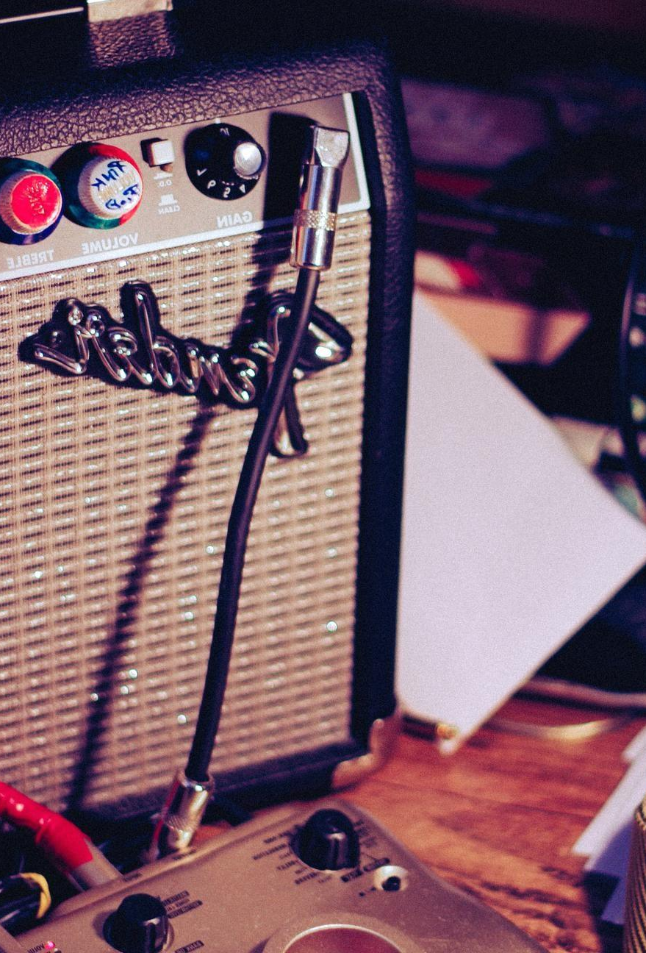
Description
🎭 Let There Be Light! – A Fun & Practical Guide to Stage Lighting
Description:
Ready to shine a spotlight on your school shows? Whether you're working with a workshop clamp light or dreaming of a full lighting grid, this session is your backstage pass to understanding basic stage lighting for theatre, music, and dance. Learn how to make the most of what you've got, discover budget-friendly tips for borrowing or renting gear, and leave with simple, effective lighting tricks that will wow your audience without burning out your budget (or your bulbs). Perfect for beginners—no techie experience required!
Session highlights:
💡 Lighting 101 – Learn the basic types of stage lights, what they do, and how to use them effectively in school performances.
🛠 Maximize What You’ve Got – Tips and tricks for getting the most out of your current equipment—yes, even if it’s just a desk lamp and a dream!
💰 Budget-Friendly Solutions – Discover creative and cost-effective ways to rent lighting gear that looks professional.
🎭 Lighting for Impact – Explore how lighting enhances mood, focus, and storytelling in theatre, music, and dance performances.
📋 Simple Setups & Pro Tips – Leave with easy-to-follow lighting setups, and practical advice for stress-free show days.

Slide 3
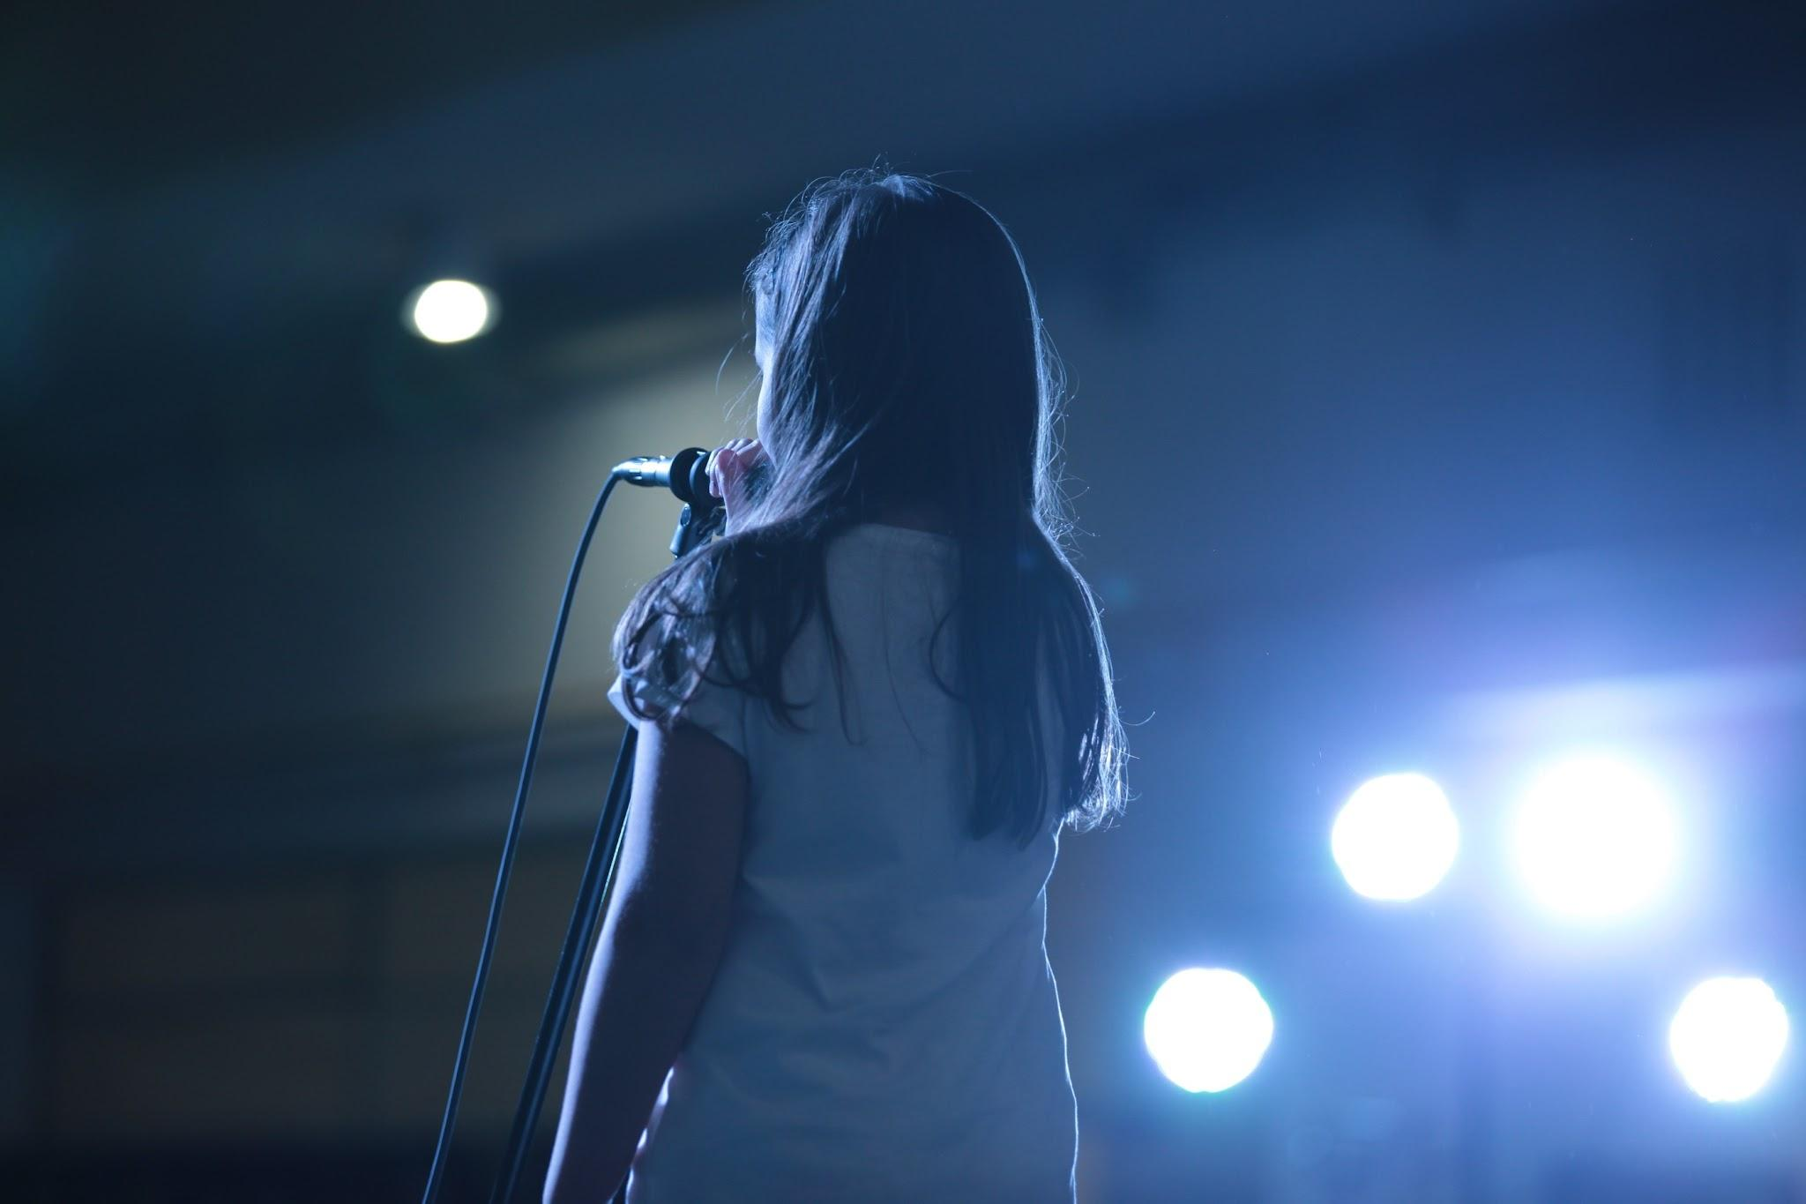
01
Introductions

Slide 4

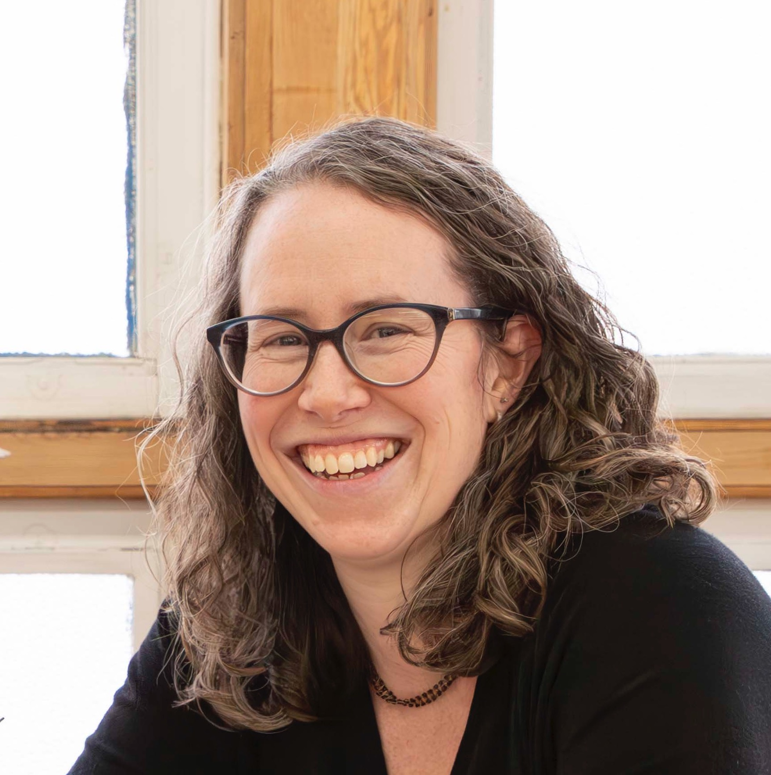
Aaron Wicks
Amanda Clark
Who are you?

Slide 5
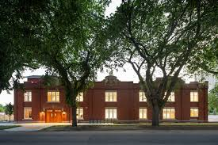
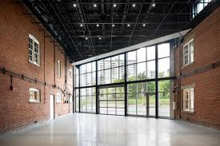


Slide 6


Slide 7
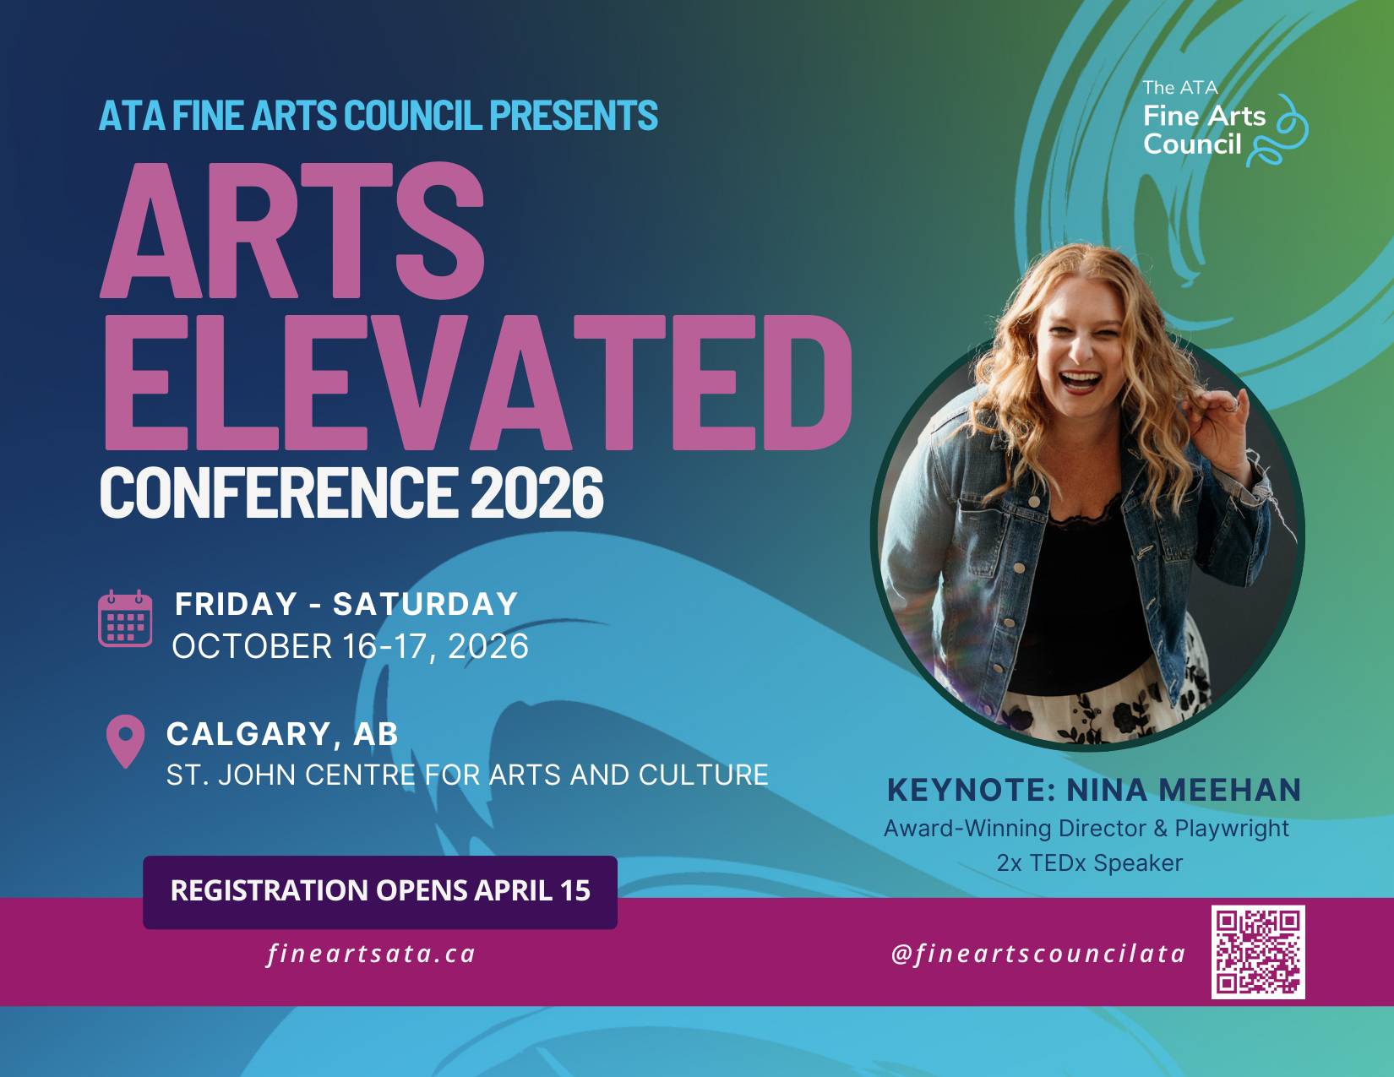

Slide 8

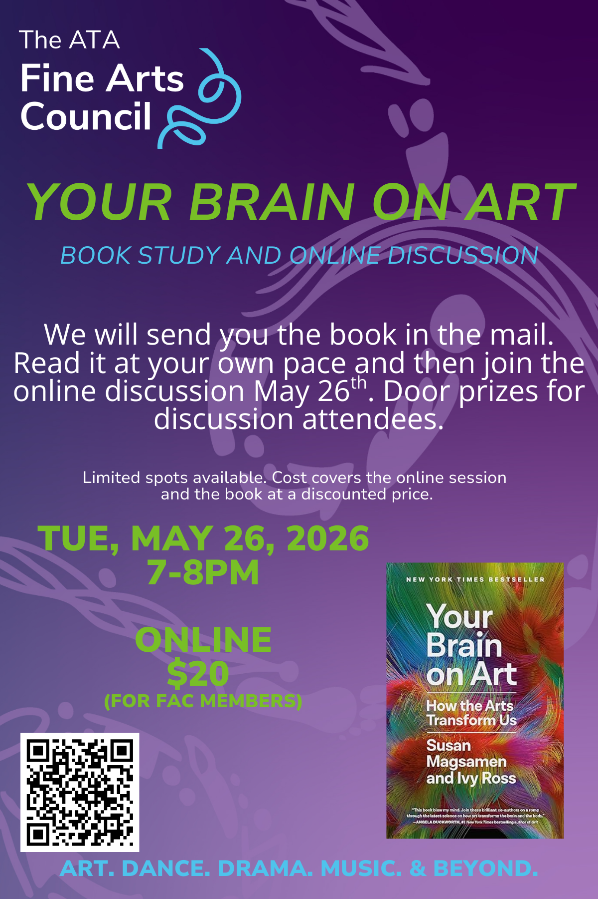
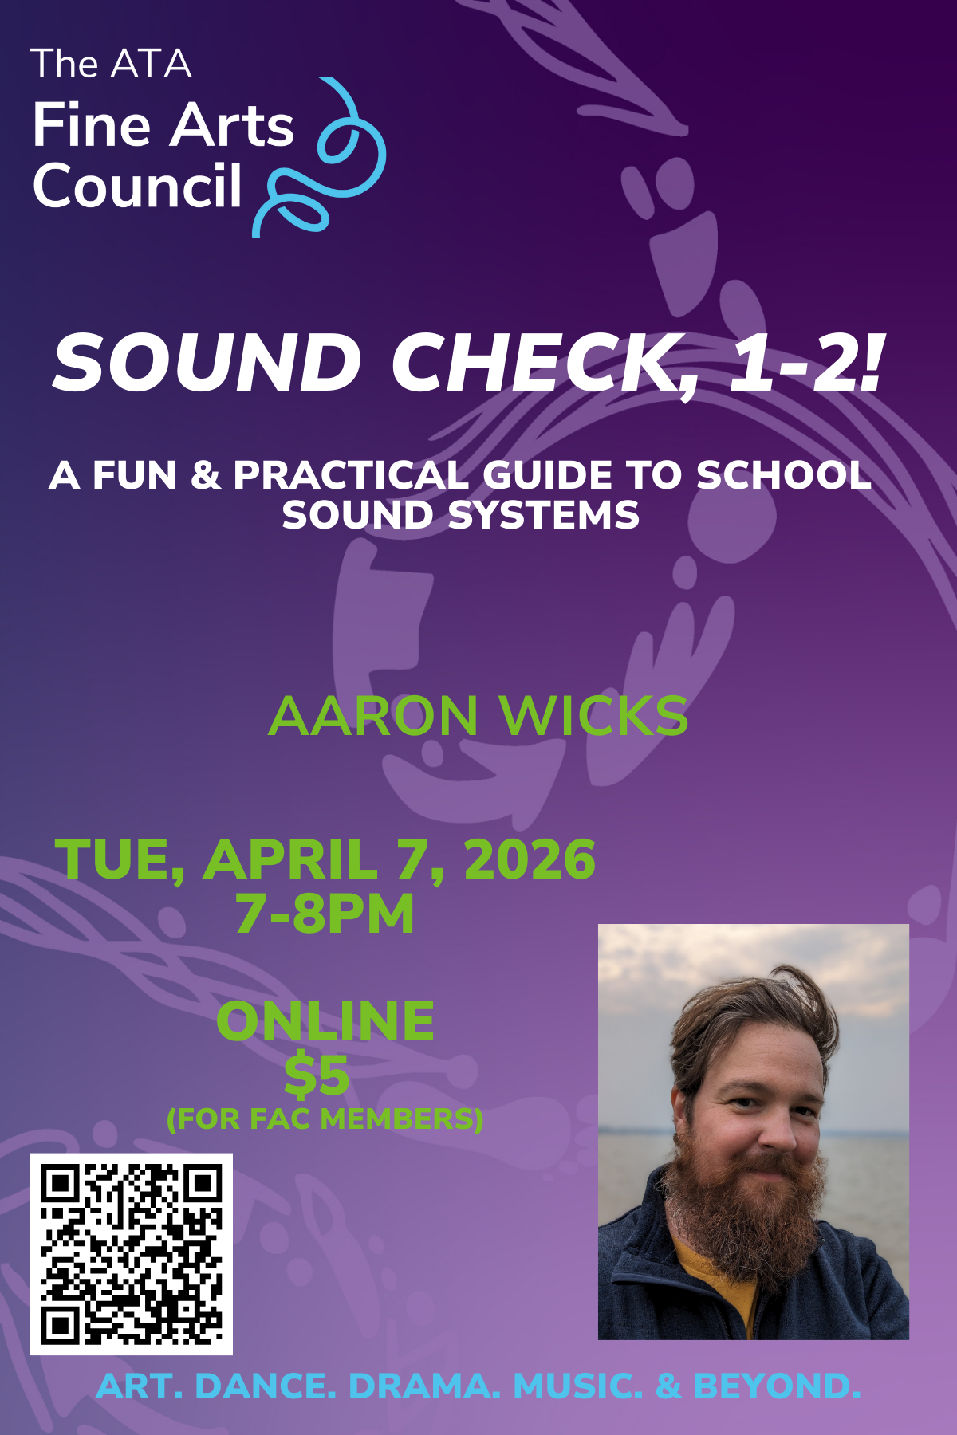

Slide 9
Lighting 101
Fundamentals:
Common tools and techniques
Bring Your Own
Lighting
Solutions on a budget
GoTo Cue Next
If I have more time, people-power, or money, what can I do with it?
Resources
Connect and keep learning

Slide 10
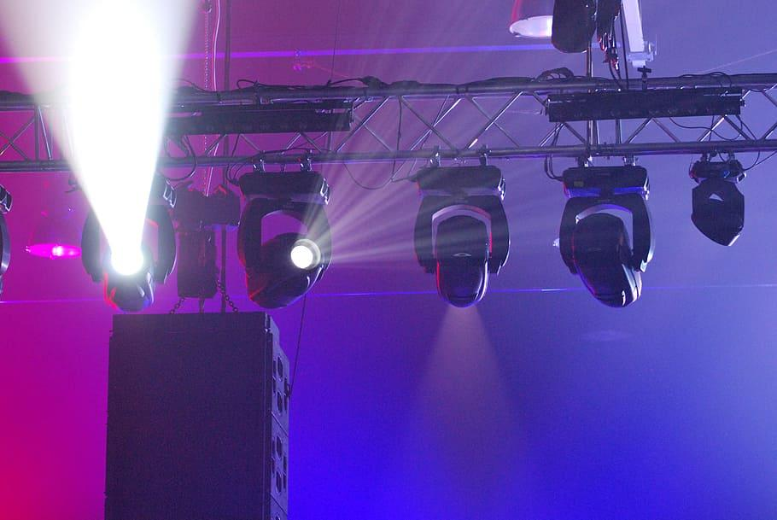
01
Fundamentals

Slide 11
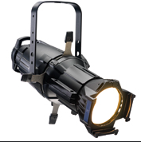
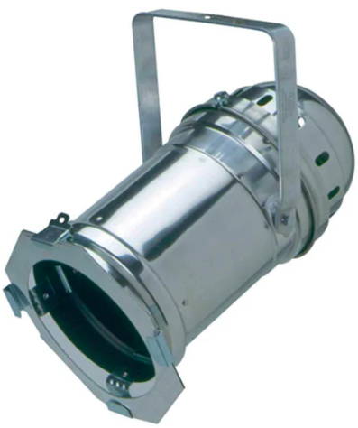
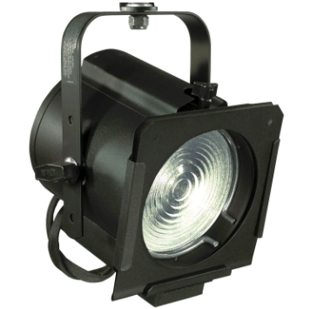
Instrument Families
Leko
Par Can
Fresnel

Slide 12


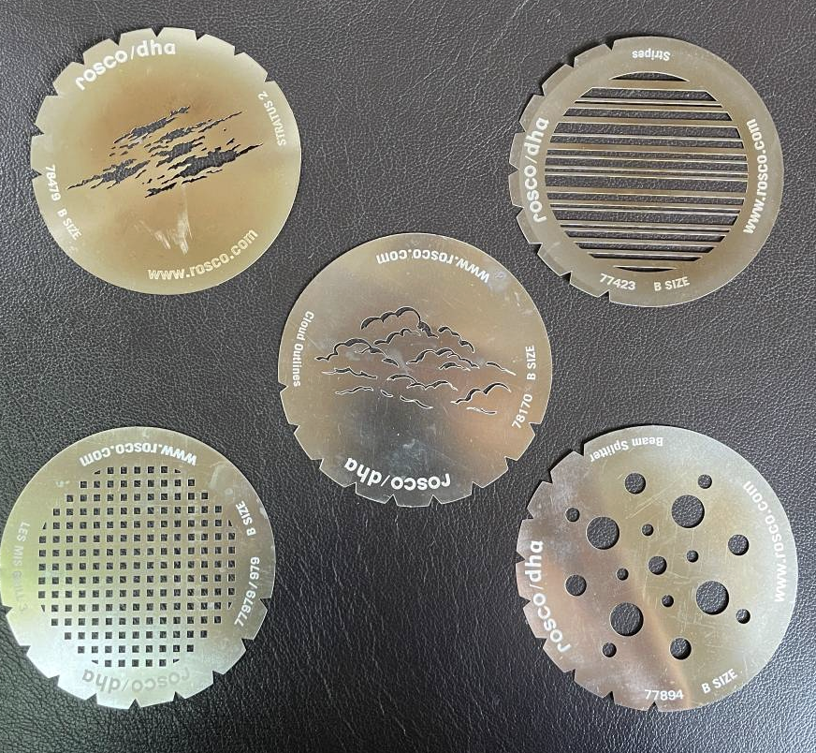
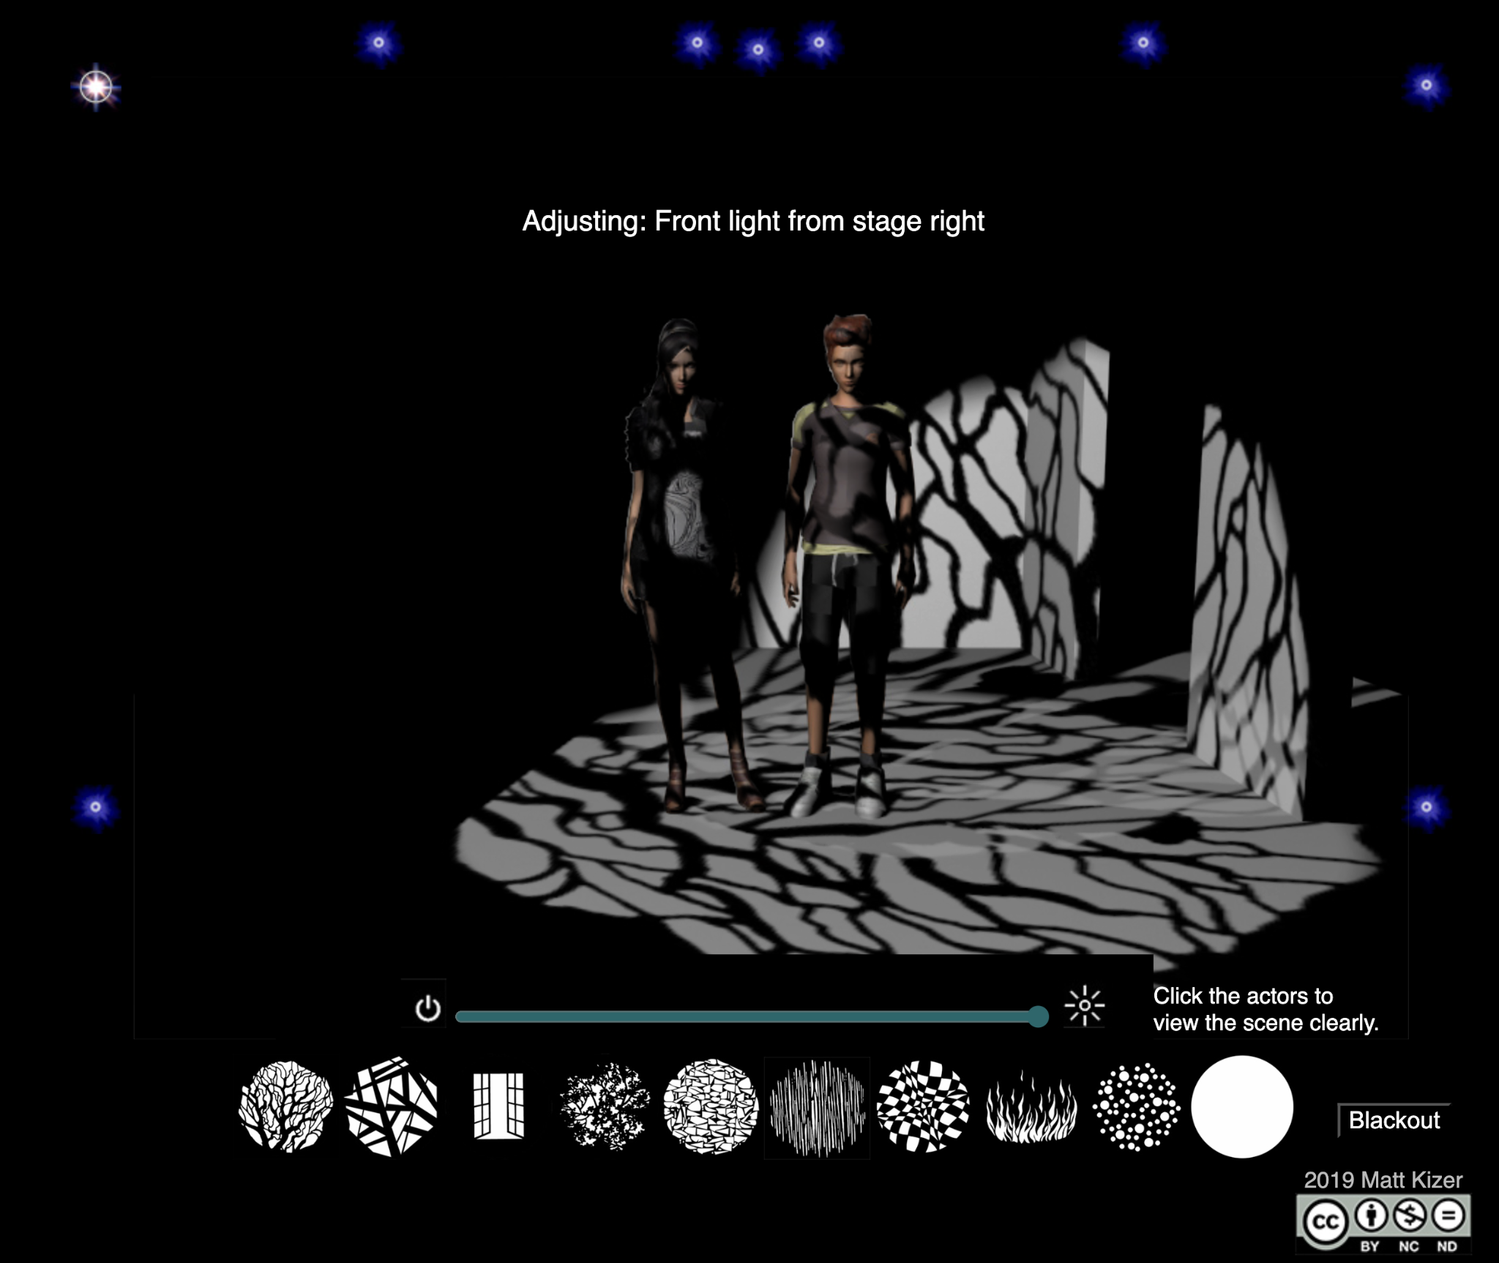
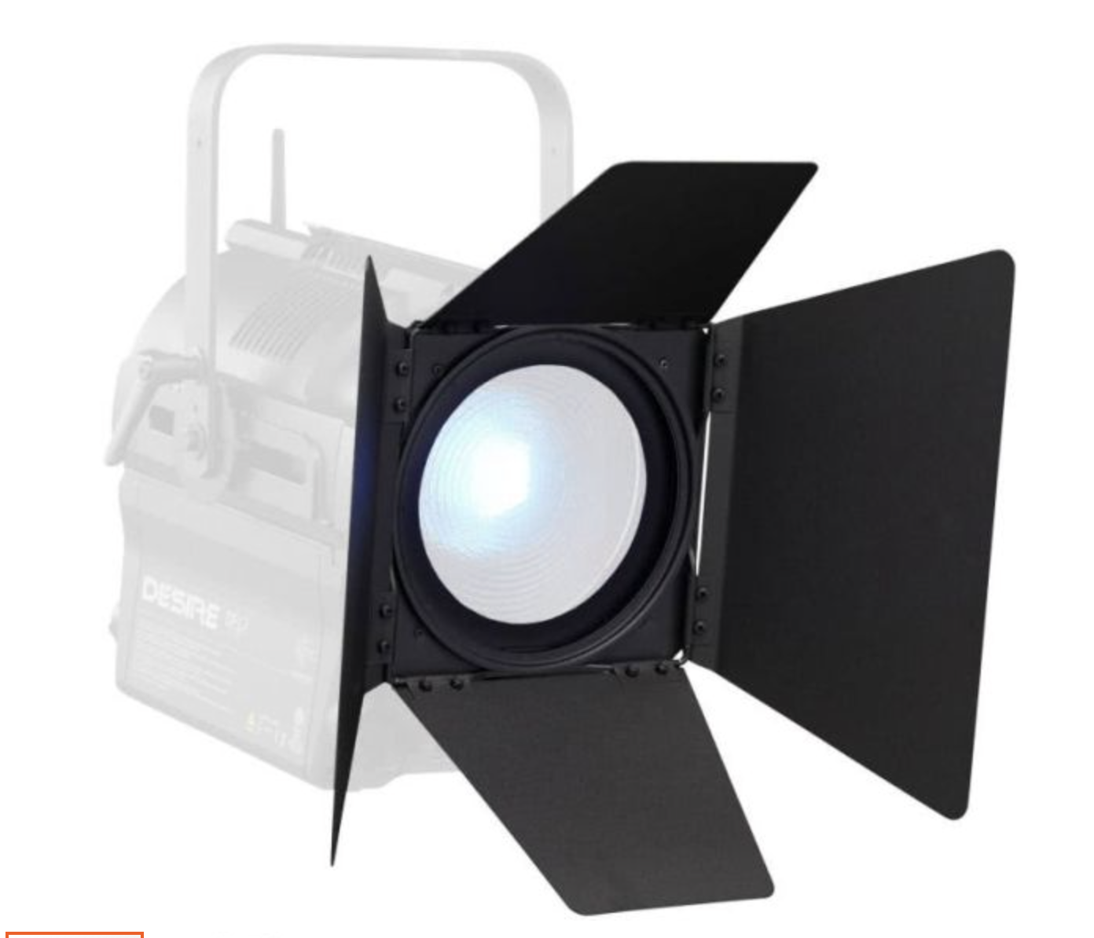
Accessories-
Effect the shape and colour of your light
Gel (Incandescent)
Diffusion
Gobos (For Lekos)
Barn Doors (Fresnels)

Slide 13
02
Bring Your Own Lighting

Slide 14
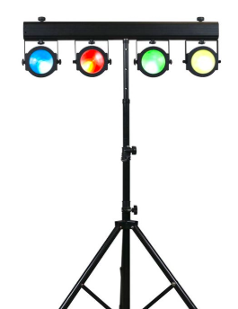
What you can get your hands on:
Cheap and Cheery LED Pars!
Pro’s:
Affordable and accessible
Require only a little power
Easy to set-up and focus
Lots of functionality
Safe and durable
Con’s:
Might not be a good long-term investment if purchasing
Poor Colour Quality
Too many “bells and whistles”
Not bright enough

Slide 15
I rented lights, now what?!?
P
Power:
Most LED Pars draw less than 35 Watts. This means you can put lots of them on a single outlet if you need to. Remember though, distributing your power load to as many circuits as possible is always the safest option.
A
Angle:
Aim your lights towards the stage from the same direction the audience is watching from. The Agle from the lights to the performers faces should ideally be between 30 and 45 degrees.
R
Ready:
Keep the stands well clear of audience and performer traffic. The feet of the Tripod should have a wide stance. Visual and physical barricades are always a good idea

Slide 16
03
GoTo Cue Next

Slide 17
Create Contrast
Add lights from the sides or back. Even without control, try adding complementary colours from opposing angles. Hide Lights from your audience for a clean, subtle look.
Take Control
Even a simple set-up is more effective with a little control. Connect your rented LED Pars to a DMX Controller using common mic cables, and change the side or back colours for each scene or song.
Light Beyond the Actor
Build your world by creating atmosphere. What do we not see: What is around the character, and where are light sources coming from? Create texture and depth by illuminating sets.

Slide 18
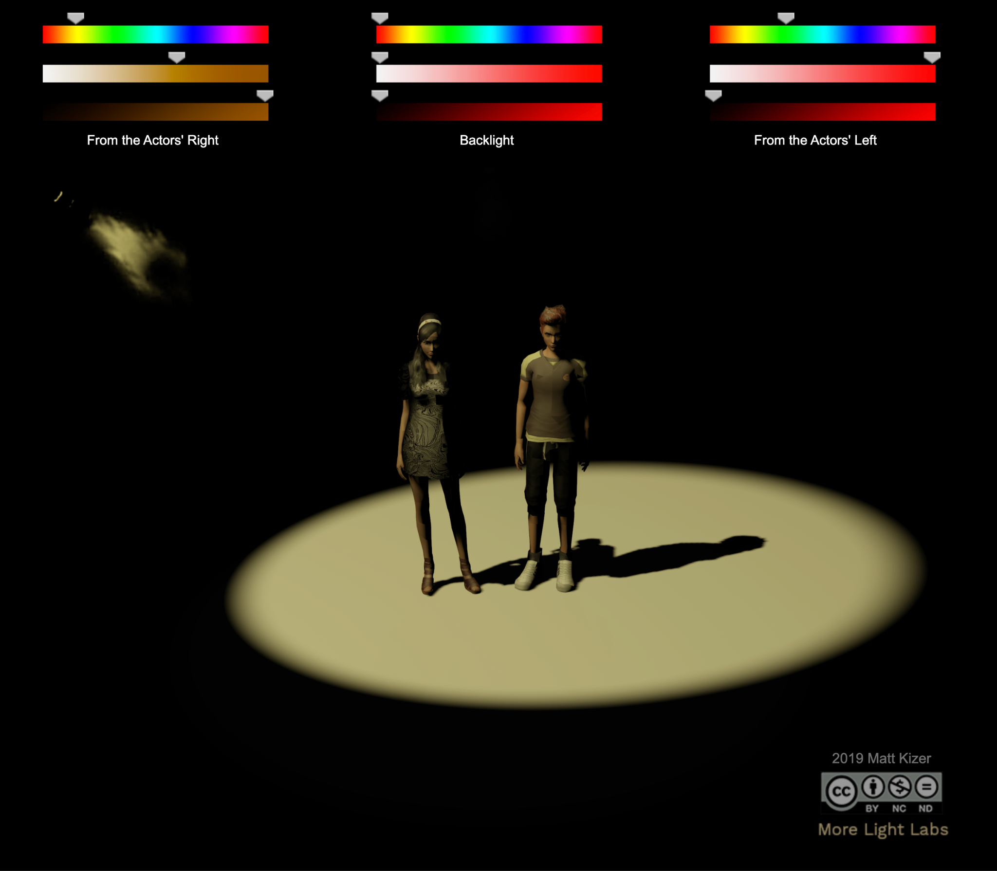
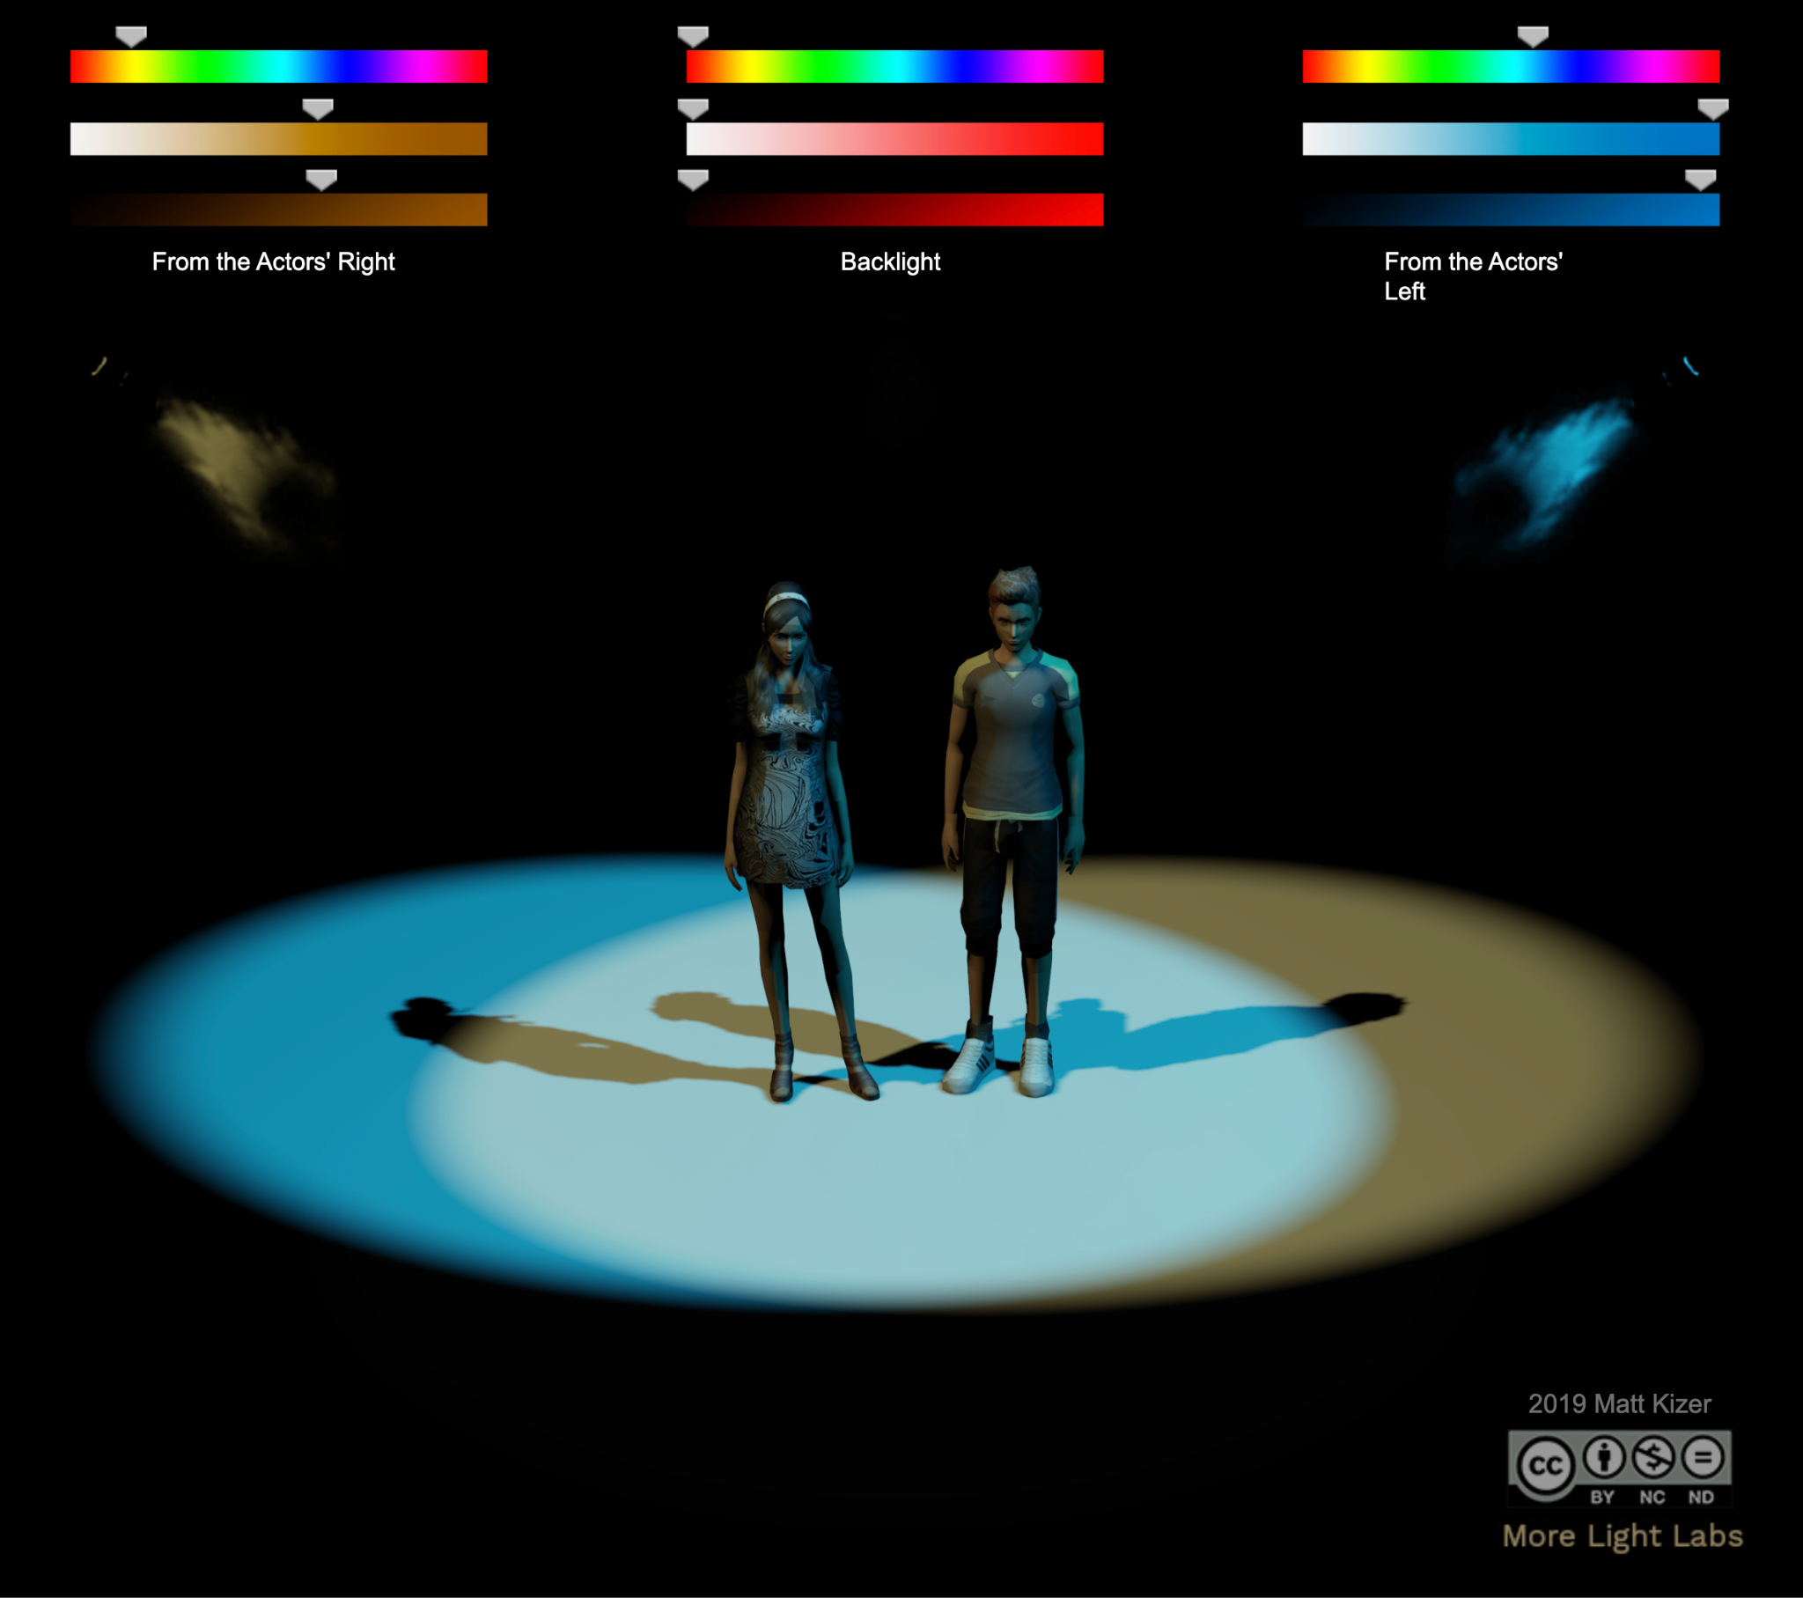
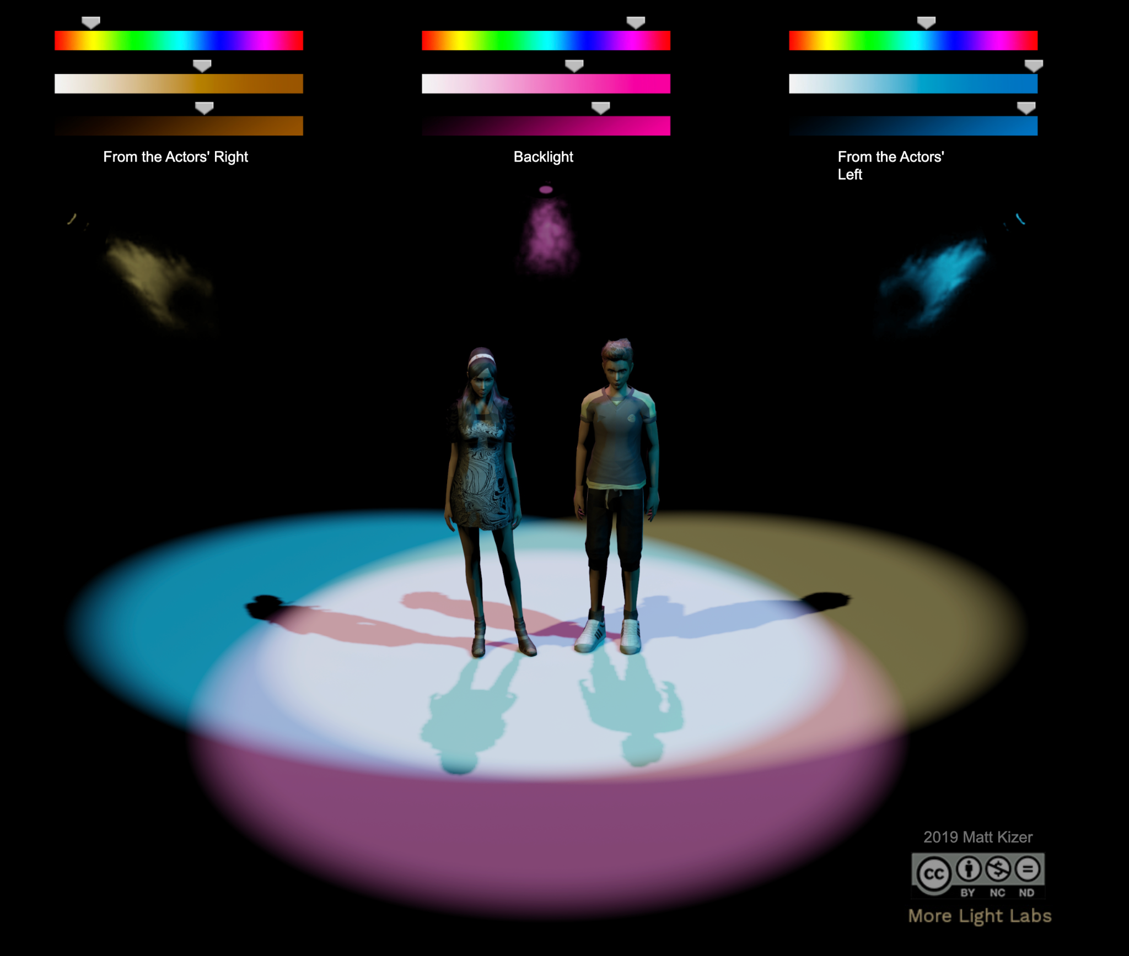
McCandless’ 3- Point of Lighting
Front Lighting- Points 1 & 2:
From about 45 Degrees above and beside the Actor, in complementary colours
Back or Top Lighting- Point 3
From about 45 degrees up and behind the Actor
https://scenicandlighting.com/lightlabs/
https://scenicandlighting.com/colorlab/

Slide 19
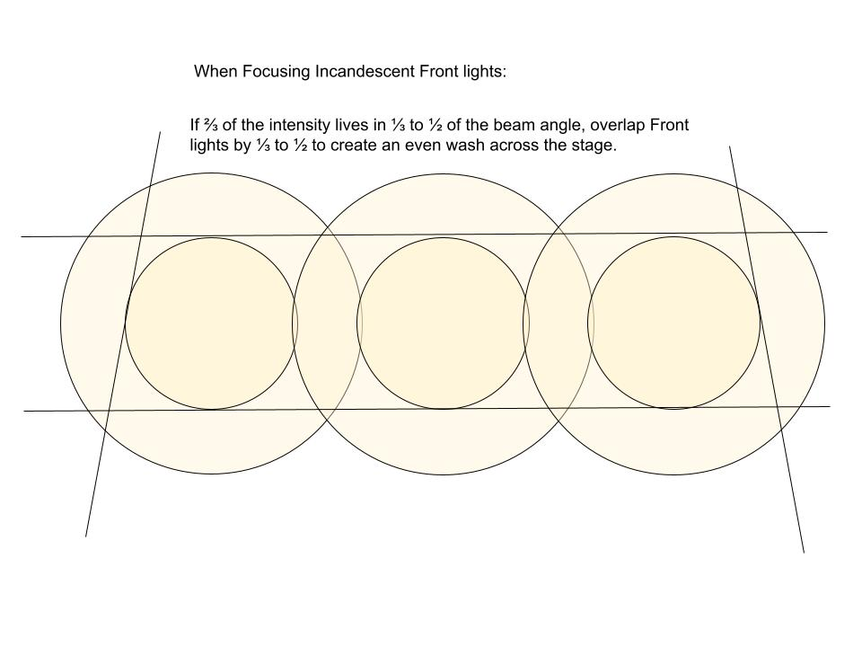

Slide 20
Basic DMX Controllers
Rental packages may include a simple controller, and this is a great learning entry point. Quickly understand the basics of DMX Addressing, group lights into channels, and create scenes.
QLab for Lights
Rent a QLab License for lighting, along with your sound cues. Licenses are affordable and customizable. Qlab offers fantastic customer support and good online training. Mac computer and hardware required.
ETC EOS Software family of consoles.
Train tomorrow's Pro’s. ETC Eos is North America’s most ubiquitous theatre lighting control software. Excellent customer support, professional training, and a wide online community. Program from a console or any computer. Hardware required for playback.

Slide 21
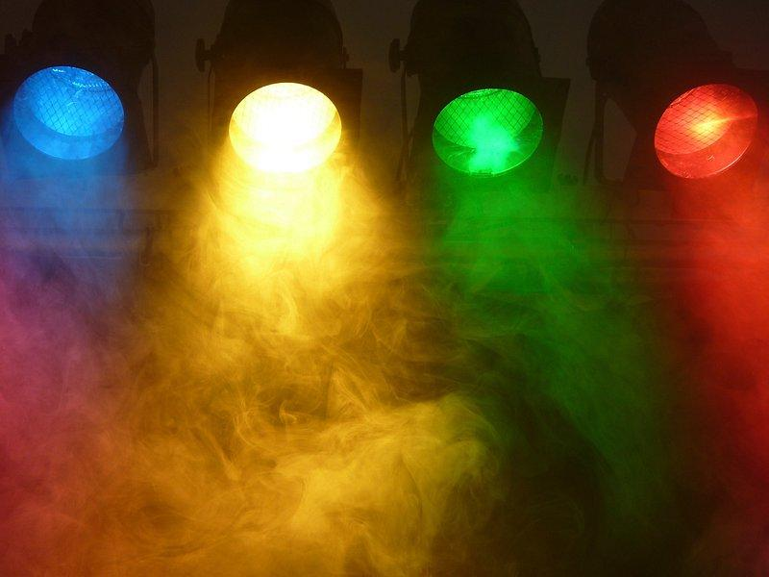
04
Resources

Slide 22
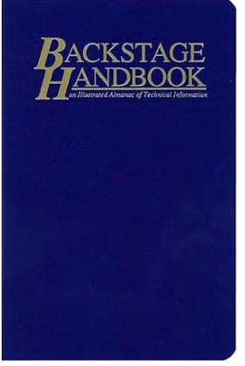
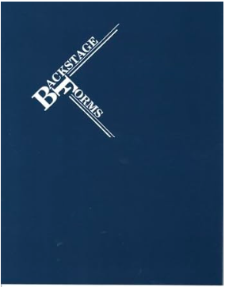
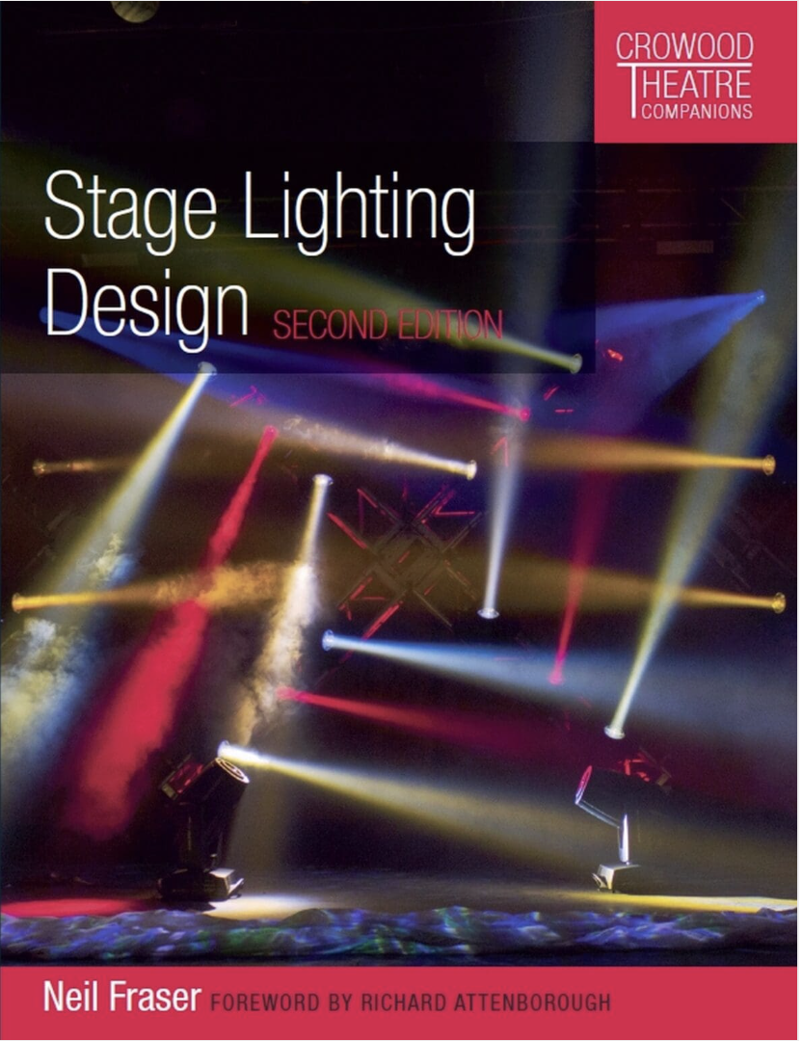
Books
The Backstage Handbook
Backstage Forms
Stage Lighting Design

Slide 23
https://scenicandlighting.com/lightlab/ (Matt Kizer’s Online Light Lab)
A free, online stage for experimenting with lighting design
https://qlab.app/educational-pricing/
Learn more about using QLab in schools.
https://learningstage.etcconnect.com/learn/public/catalog/view/9
Online professional training resources, and links to an online community forum

Slide 24
Shopping:
Local:
Production Lighting
Theatre Garage- costume shop Edmonton
Online:
AVShop.ca

Slide 25

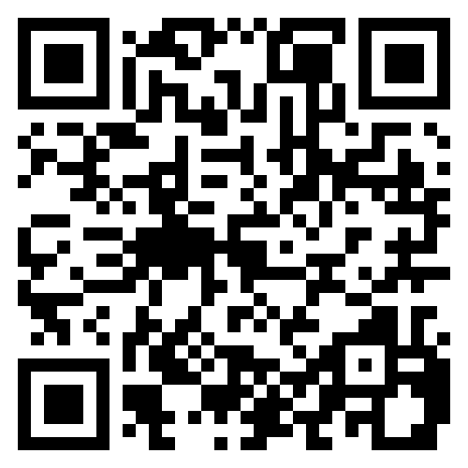
Join us!
www.fineartsata.ca
Conference 2026
Calgary - October 16-17, 2026
Early Bird Registration opens April 1st

Slide 26
Thanks!
Do you have any questions?
amanda.clark@fineartsata.ca
wicks.aaron@gmail.com
www.fineartsata.ca

