Slide 1
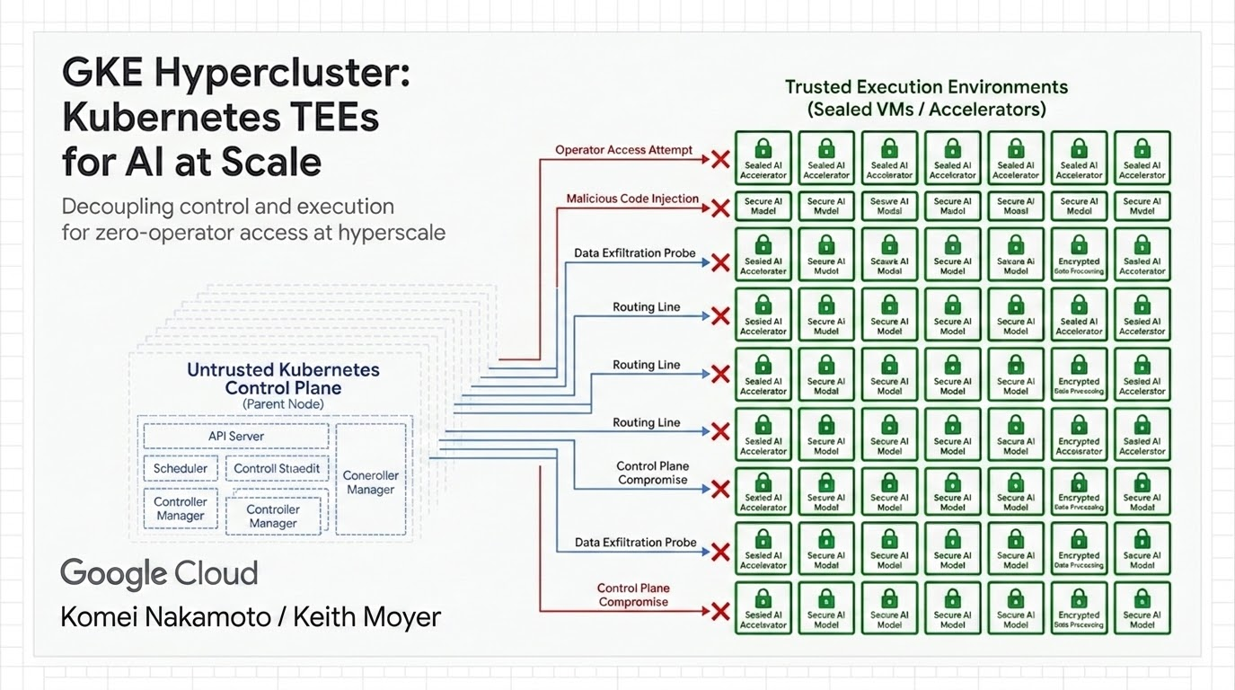
Notes:
Welcome everyone. We’re here to talk about GKE Hypercluster
a specialized orchestration layer we’ve built specifically for the frontier of large-scale AI workloads

Slide 2
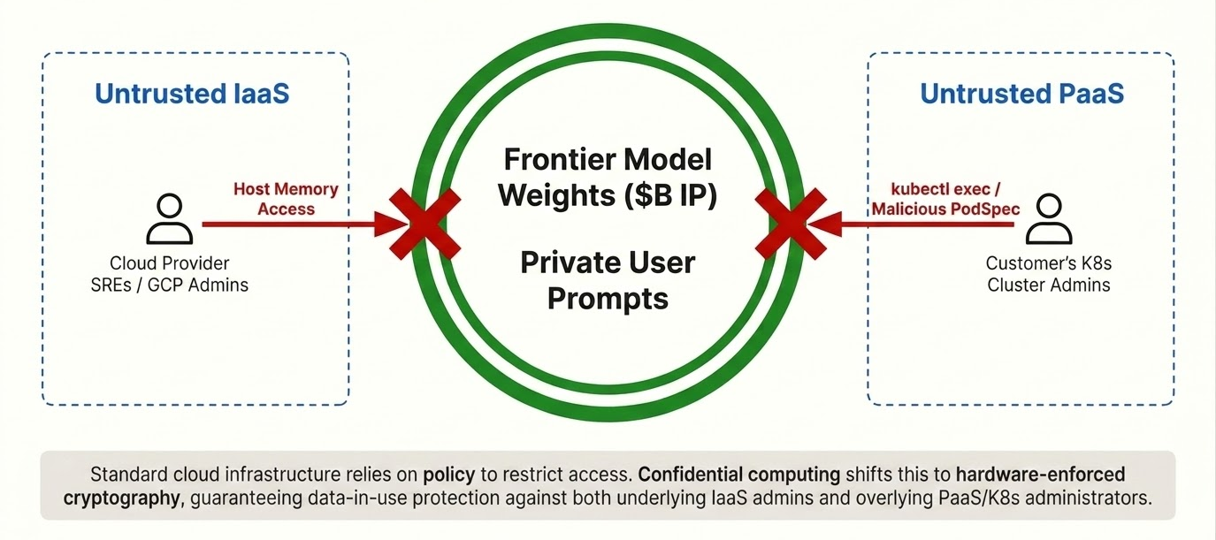
Frontier AI Require Cryptographic Boundaries,
Not Policy Boundaries
Notes:
"Before we look at the engineering, let's examine why confidential compute has become a non-negotiable requirement for modern AI workloads.. Why do customers need Confidential compute?
Think about the assets involved. A frontier model’s weights represent billions of dollars in R&D and training compute. These weights, along with user prompts containing highly sensitive proprietary information, are processed in cloud memory.
Under traditional cloud trust models, you rely on policy. You trust that infrastructure admins or cloud provider operators won't access your host memory. But you also have to trust your own Kubernetes cluster administrators who hold high privileges. For frontier labs, sovereign environments, and highly regulated enterprises, policy is not enough.
If a cluster administrator is compromised, or if a cloud provider operator makes an administrative error, your most valuable IP and your users' private queries are exposed in plaintext.
They require cryptographic proof that their assets are protected from both sides. GKE Hypercluster makes this possible by ensuring data is encrypted in use, excluding both cloud provider operators and the customer's own platform administrators from the trust boundary. It moves the security boundary from policy to cryptography."

Slide 3
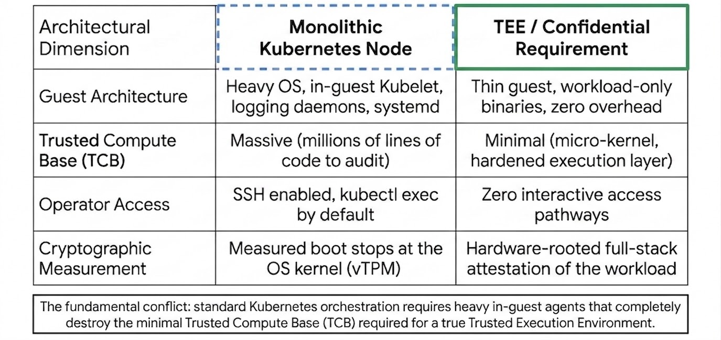
The Standard Kubernetes Gaps
Notes:
"When we tried to run Confidential Computing on standard Kubernetes, we hit a fundamental walls.
Standard Kubernetes nodes are monolithic. The guest OS runs a heavy local agent stack—the Kubelet, logging daemons, monitoring agents, and debug shells.
From a security perspective, this represents a bloated Trusted Compute Base. Anyone with operator access or cluster-admin rights can run kubectl exec or SSH into the node and dump memory.
Furthermore, standard measured boot only goes so far—it uses a vTPM to measure the firmware, bootloader, and kernel, but it has no visibility into the workloads themselves. If the OS boots securely, standard measured boot doesn't care if an attacker later schedules a malicious container or attaches a hostile debugger.
TEEs require a hardware-rooted attestation pipeline extending all the way into the specific workload config and PodSpec. But running all those complex attestation checks and maintaining local agents inside the secure guest severely limits scale, creating control plane bottlenecks. To get both security and scale, we had to tear down the monolithic node."

Slide 4
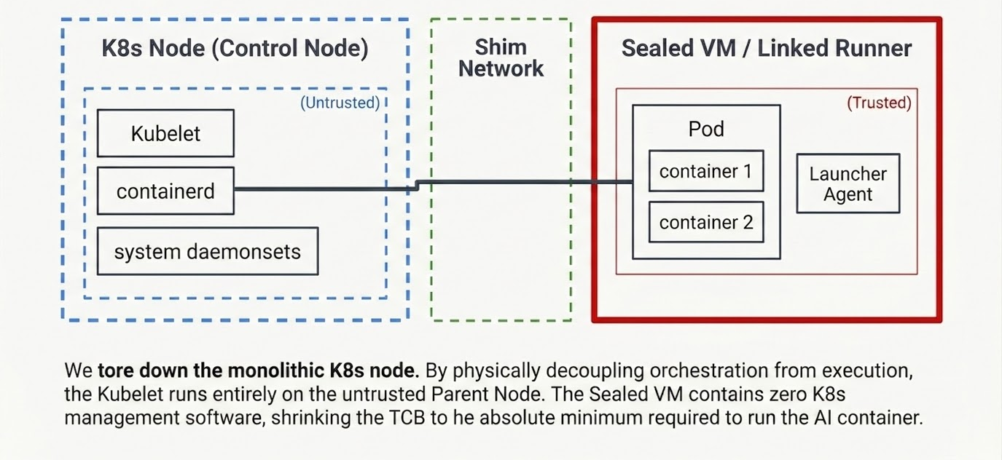
The Decoupled Architecture
Notes:
"Our solution to this architectural hurdles is the Linked Runner Model. Instead of forcing the runner nodes to run the full Kubernetes stack, we split the node in two.
The Kubelet, system logging, monitoring, and cluster-management daemonsets are moved entirely off the accelerator host onto a dedicated VM called the 'Control Node'. This node handles all GKE API interactions.
The actual AI workloads run in a stripped-down, lightweight VM called the 'Sealed Runner'. It contains no Kubelet, no SSH, and no admin shell. It is dedicated purely to executing the container.
By consolidating the orchestration management onto a single Control Node for every 16 to 64 runners, we decrease API server overhead by up to 64x.
This separation allows us to keep the control plane interfaces external to the secure boundary, shrinking the Trusted Compute Base inside the runner to the absolute minimum."

Slide 5
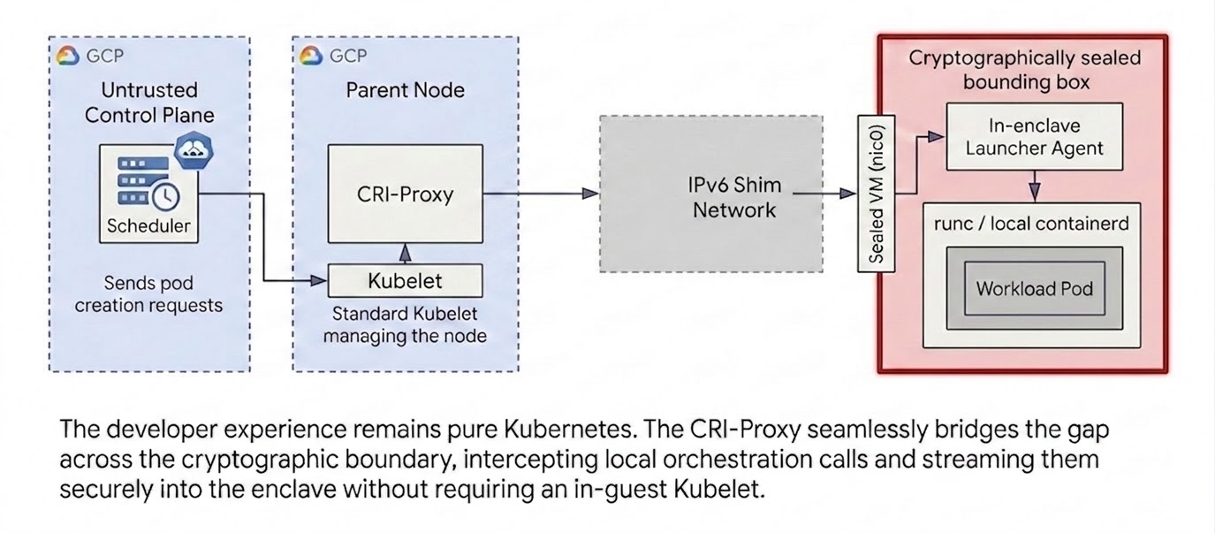
Bridging Orchestration and Execution
Notes:
"Let's look at how this works under the hood. The GKE control plane schedules a pod. The Kubelet on the Control Node receives the request.
Since there is no Kubelet on the runner, how does containerd start the pod? We built a custom CRI-Proxy.
The CRI Proxy translates local container commands and streams them remotely to the Runner's internal containerd engine.
"This orchestration separation of concerns is critical. The Control Node handles the dirty work of management, logging, and cluster federation.
For the developer, the Kubernetes API remains fully conformant. You write standard manifests and use standard tooling. GKE transparently separates the orchestration state from your secure hardware execution.
Even though the Kubelet is running on a different virtual machine, the Pod scheduling mechanics behave exactly as you expect, matching pods to available TPU or GPU enclaves without exposing the underlying guest memory."

Slide 6
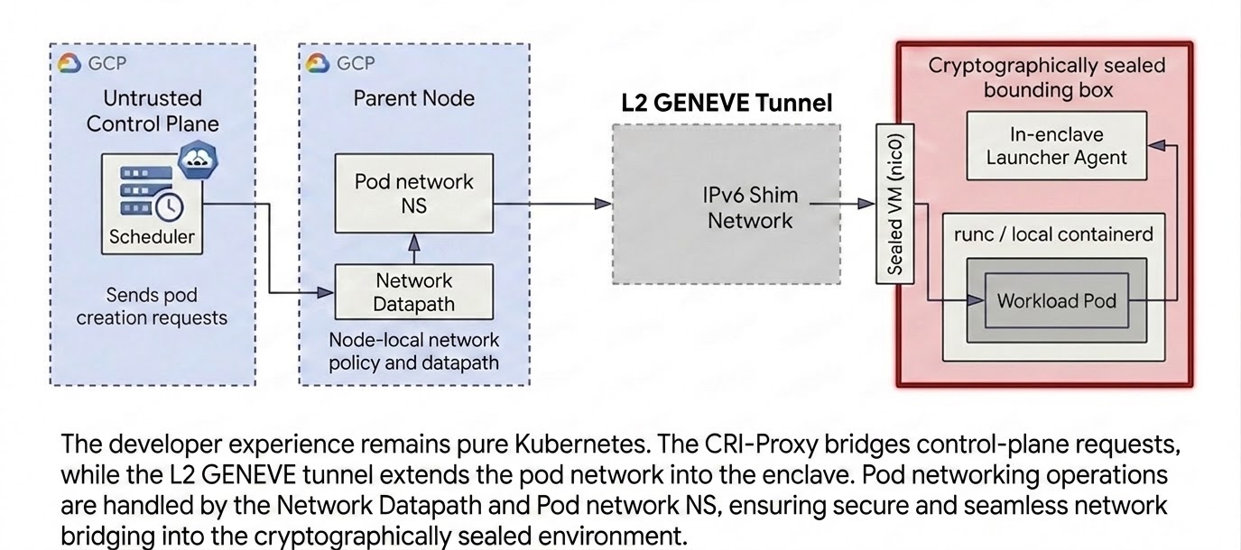
Bridging Pod Networking
Notes:
let's zoom in on the networking layer that allows these decoupled components to .
This tunnel provides direct L2 peer-to-peer connectivity between the Control Node and the Sealed Guest.
The runner VM executes the container directly. Data plane network traffic routes directly via Dataplane V2, wrapped in a VPC-SC perimeter, ensuring it never touches the control network. This guarantees that container orchestration signals are strictly separated from the high-speed data path."

Slide 7
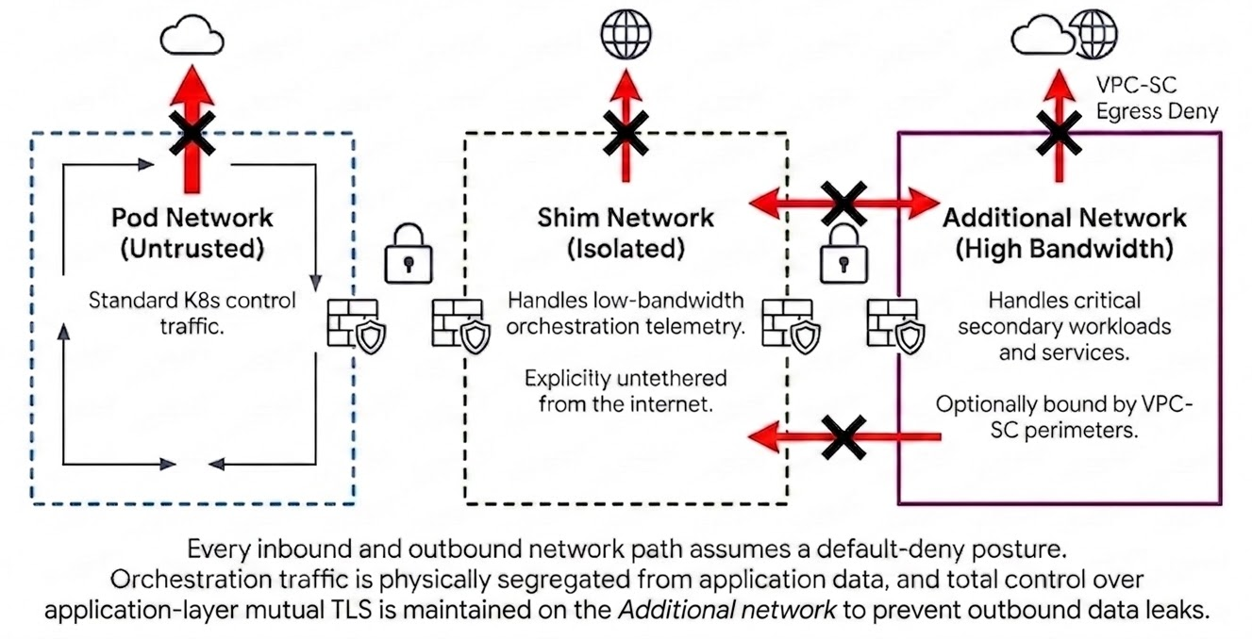
Network Security Boundaries & Default Deny Topologies
Notes:
Pod/Cluster Network - untrusted network for standard k8s traffic
Shim Network - dedicated network for linking k8s node and TEEs
Additional Network - optional network you can setup for High Bandwidth traffic

Slide 8
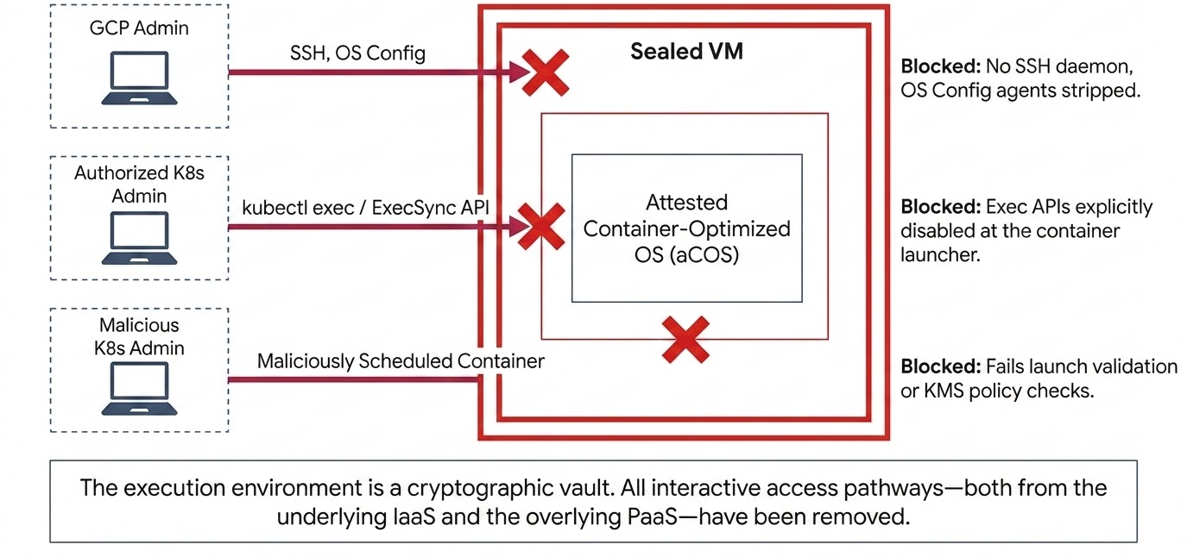
Zero-Operator Access and the Sealed Guest
Notes:
Keith
This Sealed VM is a stripped down, measured, fully attested, environment that commits to having zero operator access.
For some of you who may be familiar, it’s built on the same foundation as our Confidential Space TEE product, using our aCOS baseline - attested Container-Optimized OS.
With aCOS, the normal administrative pathways - kubectl exec, SSH, cloud guest agent - are all gone. Instead, you have a limited set of input parameters to launch your workload, which are included in attestation.
Even people with full administrative access to the GKE or GCE control planes can’t change that commitment and workload signature. Once it boots, it is running what it says on the tin, nothing else.

Slide 9
Hardware-Rooted Trust
GKE Hypercluster's multi-tier security model enforces silicon-level containment through all layers.
Layer 4
Accelerator
04 ACCELERATOR CONFIDENTIAL COMPUTING | Google TPUs & NVIDIA GPUs
Protects data-in-use inside accelerator memory pages. Enforces encrypted PCIe DMA transfers, cryptographically isolating GPU/TPU execution from the host kernel.
Layer 3
Guest
03 CONFIDENTIAL VIRTUAL MACHINES (CVM) | Intel TDX / AMD SEV-SNP / ARM CCA
Hardware-enforced virtual machine isolation. Encrypts guest OS memory pages in real-time, preventing the host hypervisor and neighboring VMs from inspecting guest memory.
Layer 2
Host
02 HOST ISOLATION & SYSTEM LOCKDOWN | Titanium Intelligence Enclave (TIE)
Tightens host security, removing administrative pathways, configures and protects CVM and accelerator layers.
Layer 1
Platform
01 PHYSICAL ROOT OF TRUST | Google Titan Chip (Platform Root of Trust)
The foundational silicon anchor. Performs hardware-level signature validation of the boot ROM, secure flash, and kernel, establishing the verified cryptographic measurement chain.
Notes:
Keith
And, as a good TEE should be, you aren’t taking our word for it. The measurements included in attestation are based on independent trust elements through the stack.
When the physical machine starts, it all begins with Google’s Titan chip, which allows us to establish legitimate Google production hardware in our datacenters. And, beyond the guest, we’ve locked down our host environment as well using TIE - Titanium Intelligence Enclave.
Then the provided attestation includes the entire guest stack, from the firmware to the kernel to the container launching daemon to the launched pod containers themselves. Depending on your trust model and deployment needs, this can be based AMD SEV with our vTPM or in Intel TDX.
As Komei has alluded to, a lot of the recent demand has been centered around LLMs, and LLMs need accelerator hardware. With Intel, you can get AMX out of the box but for a bigger punch, we also support Confidential GPUs and TPUs attached to the guest.
What this builds up to is a remotely verifiable set of evidence that shows that the environment lives up to the integrity and zero operator access guarantees.

Slide 10
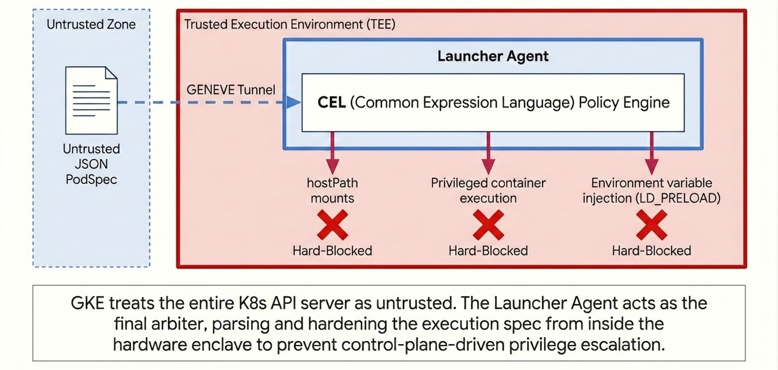
The Launcher-Agent as the In-Enclave API Gateway
Notes:
Komei
"Because the GKE control plane is external to the TEE, it is considered untrusted. A compromised control plane could attempt to inject malicious configurations via the PodSpec.
To prevent this, the Launcher Agent inside the Sealed VM acts as an API gateway defense.
It parses the incoming container execution spec and evaluates it against a strict policy using Common Expression Language (CEL).
If the PodSpec attempts to mount host paths, inject dynamic linkers like LD_PRELOAD which could hijack execution, or run privileged containers, the Launcher Agent rejects the call locally.
It enforces that only authorized environment variables, volume mounts, and commands are admitted, defending the boundary from malicious control plane inputs.

Slide 11
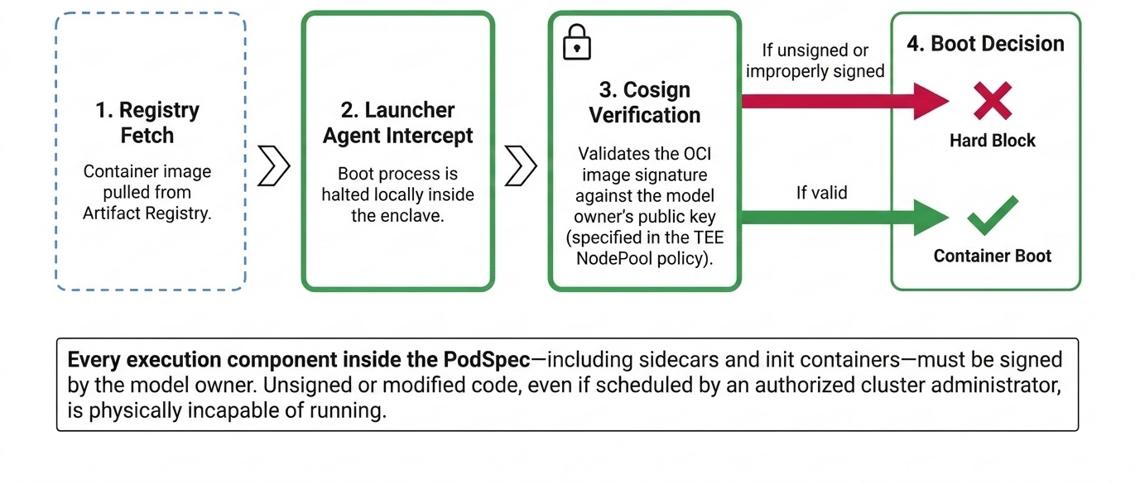
Enforcing Code-level Integrity with Cryptographic Launch
Notes:
Komei
"We also need to guarantee code-level integrity. We must prove that only approved containers run.
The Launcher Agent enforces cryptographic image signature verification before startup.
Using Cosign, it checks the container image signature against public keys managed in Cloud KMS.
If the signature is missing or does not match the authorized key, the container will not boot, blocking unauthorized code execution.
Importantly, this validation is applied to every container defined in the PodSpec. If an attacker attempts to inject a malicious sidecar or init container to sniff traffic or access local memory, it will be caught and blocked unless it is also signed by the trusted key."

Slide 12
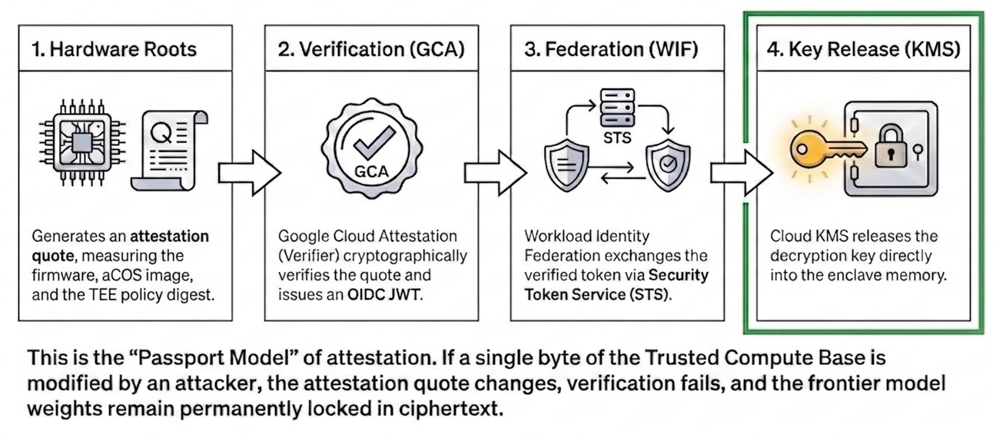
The Remote Attestation Pipeline
Notes:
Keith
This slide is an illustrative example of using attestation for releasing sensitive data to the workload running in the Sealed VM TEE. For convenience, we have drop-in integration with our Google Cloud Attestation service, GCP IAM, and Cloud KMS services.
The TEE generates its attestation evidence, including all of the boot and launch information described before, and sends it to the attestation verification service. The attestation results represent a distilled set of claims that are convenient to reference in key access IAM policies. So now, you have a simple way to gate secret decryption to exactly the code you want accessing it, and only when it’s running in a secure TEE environment.
To decouple yourself from Google as the CSP, you can also swap out these verification, IAM, and KMS services for other versions on prem or in other clouds.

Slide 13
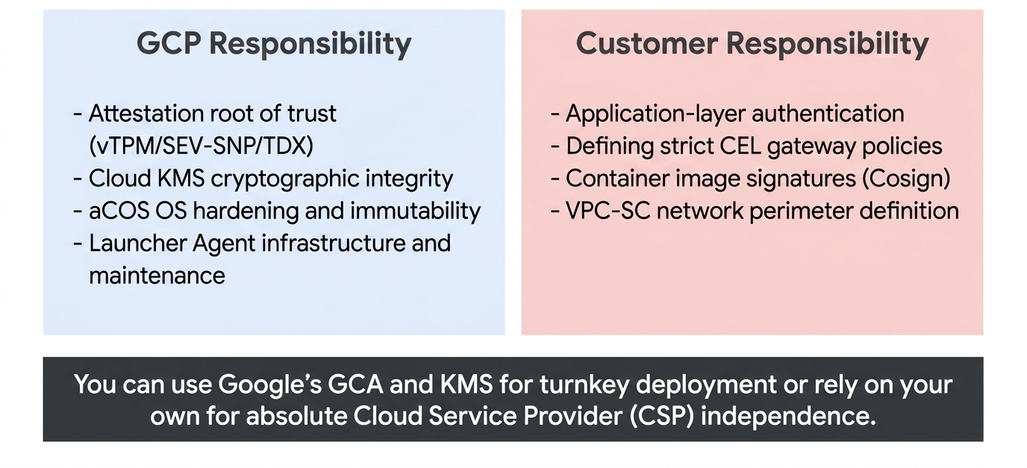
The Shared Responsibility Matrix
Notes:
Keith
What we’ve tried to do here is create an easy to use TEE platform with a clean separation between what the platform itself can do (while being open and attested) and the business logic that you deploy into it.
Once your pod is running, it can behave as a normal application does. And, it should still perform authentication and encryption to keep the application layer secure - but now it has the added tool of attestation to use for those needs.

Slide 14
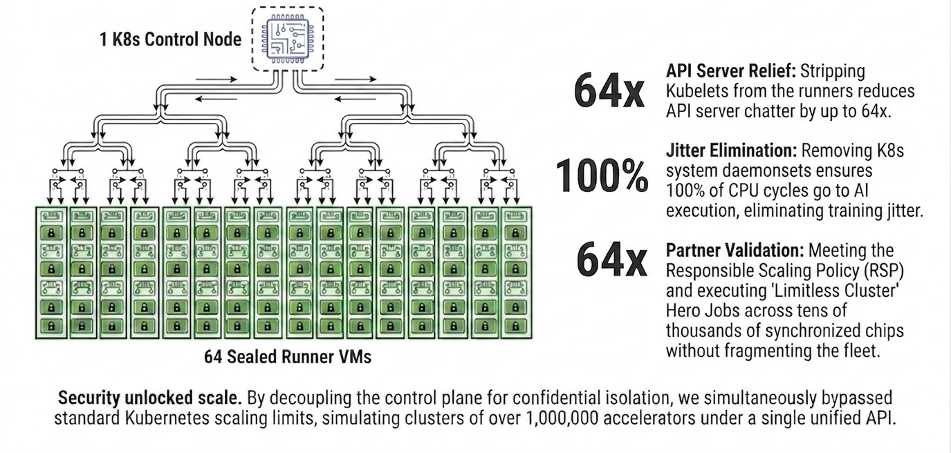
The Scale Relief Valve: Orchestrating 1 Million Chips
Notes:
"Let's talk about the scaling benefits of this architecture. We call it our Scale Relief Valve.
In a standard Kubernetes cluster, scaling beyond 5,000 nodes is challenging due to the constant status 'chatter' from Kubelets to the API server.
By moving the Kubelet onto Control Nodes, we consolidate that overhead by up to 64x. The API server sees fewer Control Nodes, rather than hundreds of thousands of individual runner nodes.
This enables us to schedule over a million chips under a single GKE API.
Furthermore, removing Kubelet CPU execution from the runner nodes eliminates background noise. There are no cron jobs, no metric collection loops, and no logging agents stealing CPU cycles on your training nodes, minimizing jitter and maximizing training goodput."

Slide 15
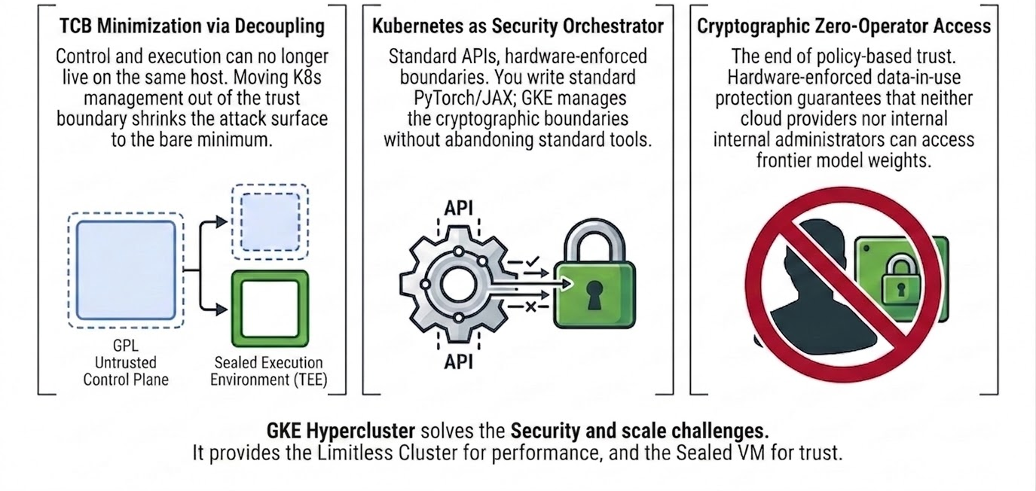
Architectural Synthesis: The Future of AI Orchestration

Slide 16

Q&A
Thank you for your time.

Slide 17
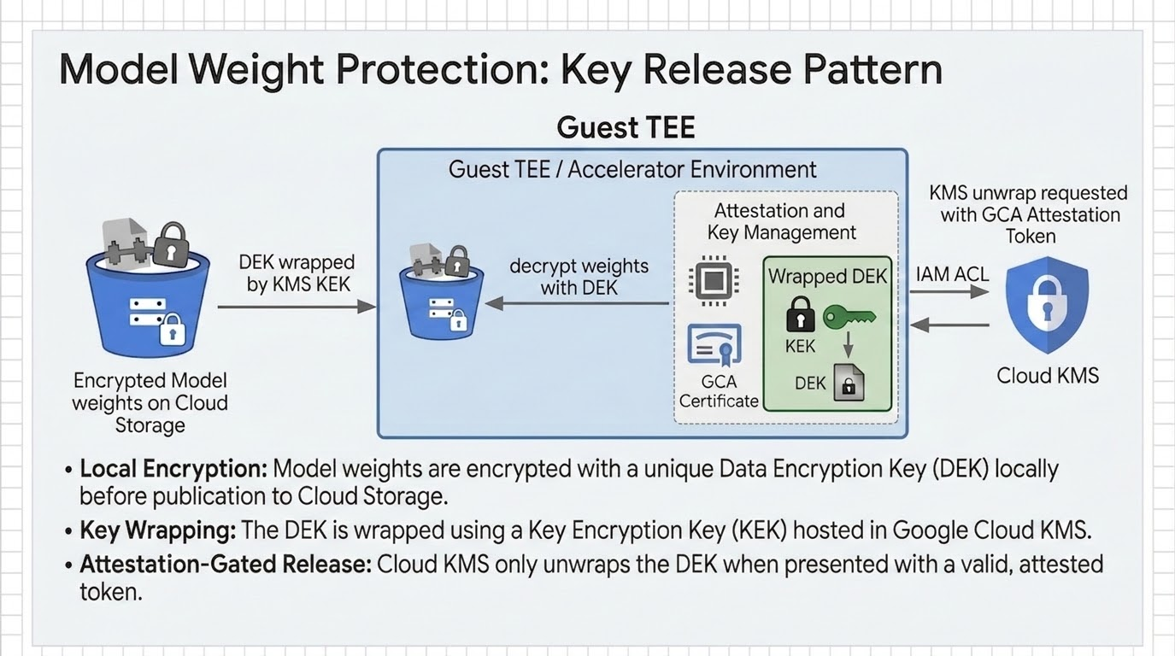
Notes:
Keith to see if any changes to 12/13

