Slide 1


Vision
Unlock confidential data for AI training enabling organizations to jointly train AI.
PetalGuard
What makes us unique
Zero data exposure
E2E crypto guarantees
Compliance by design
No accuracy loss
Modular & scalable

Slide 2










PETs Team
MPC, FHE, VC, and IAM

Slide 3
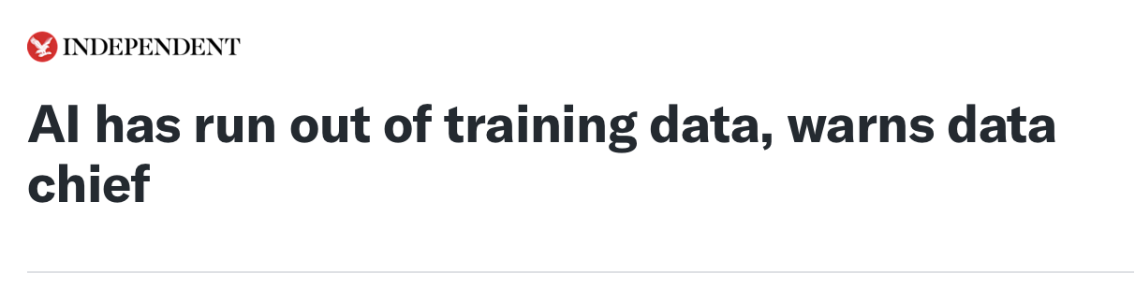
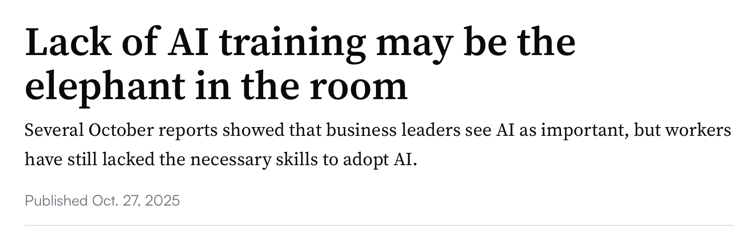
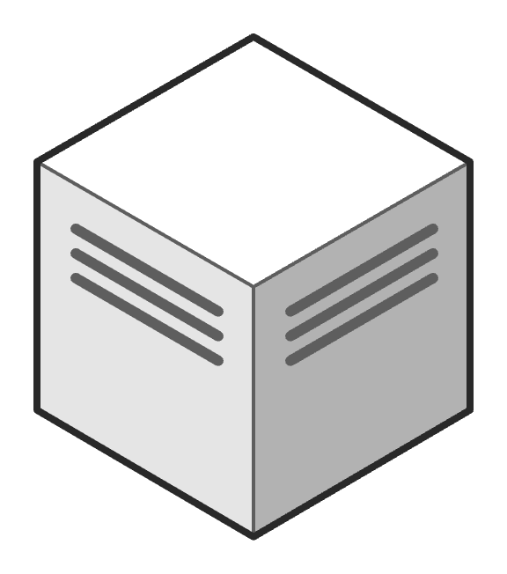
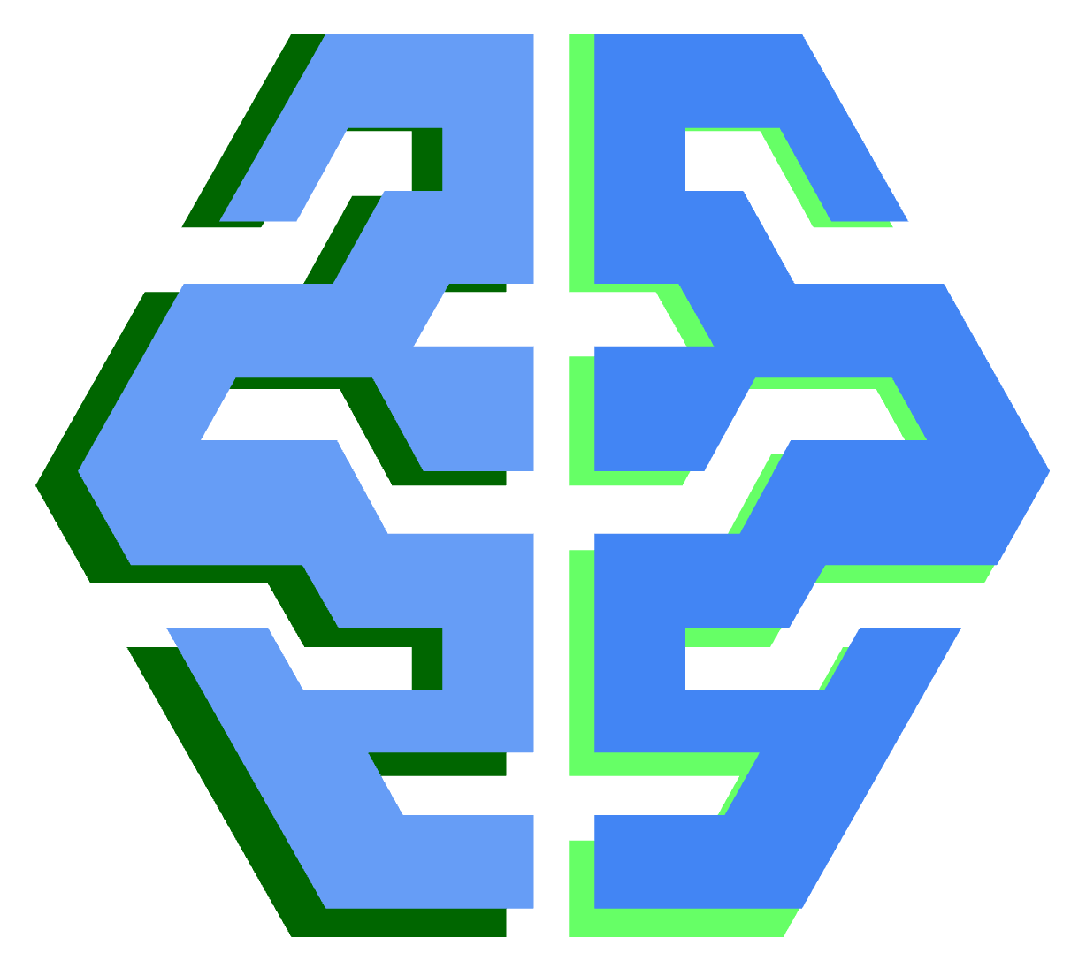
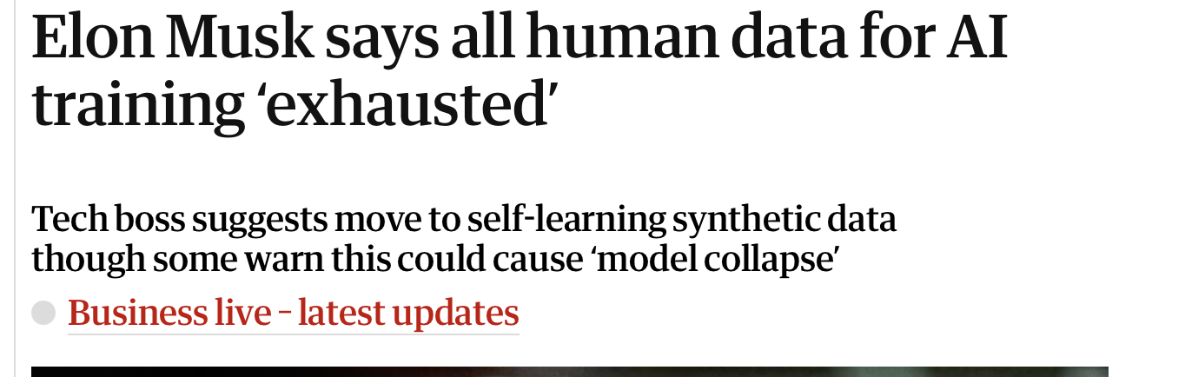
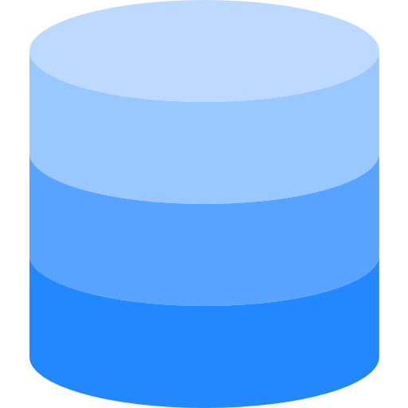

Why Federated Learning (FL)?
The problem to solve
Training model with sensitive data from different sources cannot be achieved achieved with centralized AI training strategies
Training
Entity
AI Model
Sensitive
Data
Entity 1
Entity 2
Entity 3

Slide 4



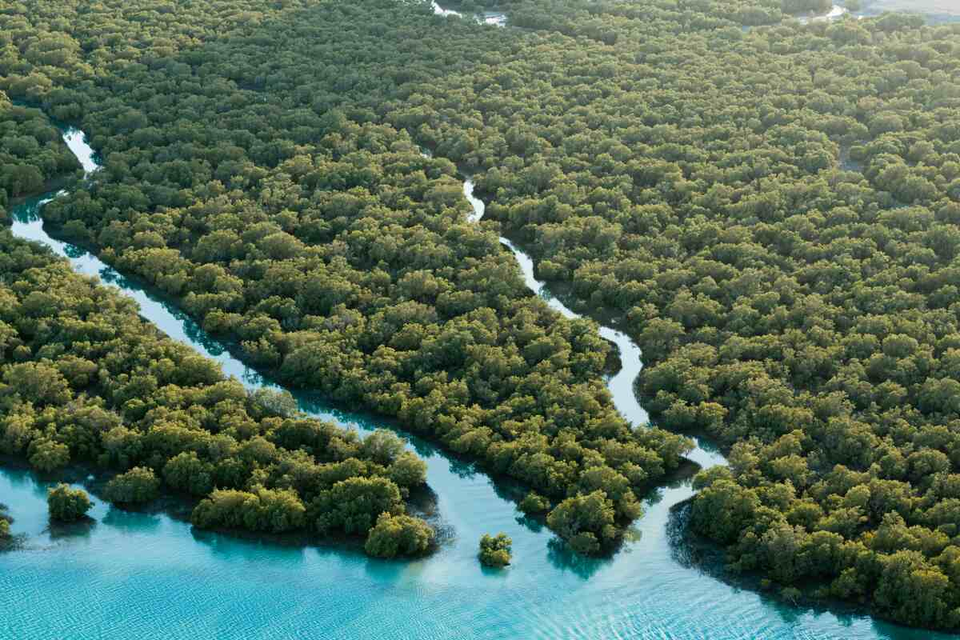



Use cases in UAE
M42 planning to build models on Environmental data collected across multiple public and private institutions
Emirates Health Services planning to build models with sensitive data from different healthcare institutions:
Appointment absence prediction
X-Ray and MRI diagnosis
GCC Police planning to build models for crime prediction combining data from multiple Emirates and Gulf Nations.

Slide 5





The problem with conventional FL
Conventional FL trains models locally, but it sends the locally trained models to one single aggregator…
Local training
phase
Privacy vulnerabilities
Entity 1
Aggregation
phase
Exposes local model updates that can leak training data information.
Susceptible to membership inference attacks by malicious aggregator.
Sensitive
Data
Extract
Data
Entity 2
Sensitive Data is stolen!
Entity 3
Re-start process!

Slide 6










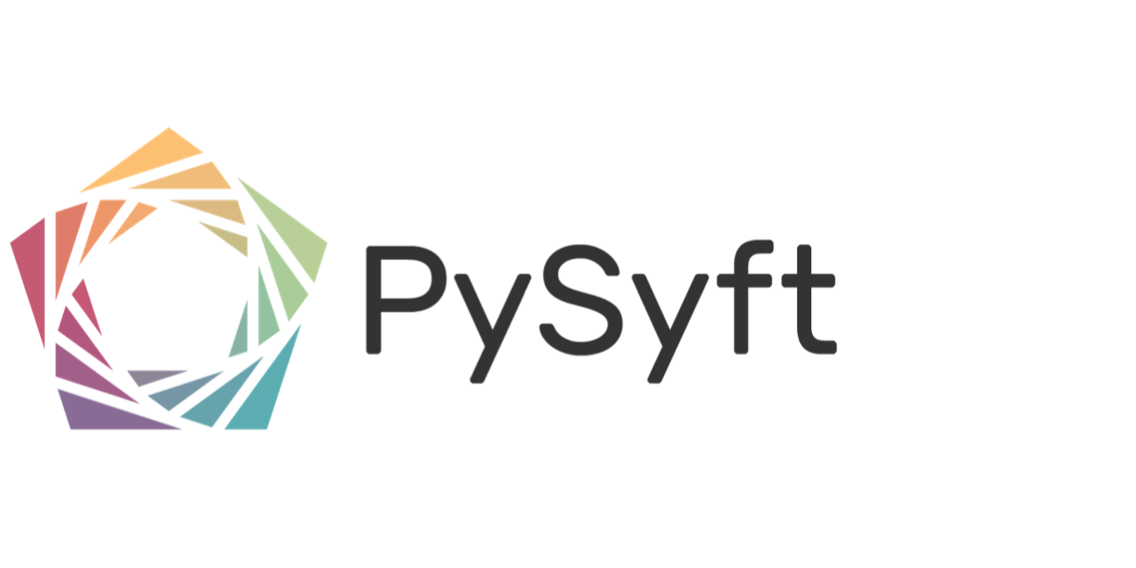
Market overview:
Key federated learning players
High
FL champions
(productized/enterprise ready, FL focus)
Platform leaders
(productized/enterprise ready, broad solution)
FLARE
Leveraging NVIDIA Flare,
focus on healthcare
Previously FedML
by IBM
Productization level
Readiness for real-world deployment
Experimental
(not fully productized, PFL focus)
Emerging platforms
(not fully productized, broad solution)
By Owkin
Low
Offering depth
Integration of federated learning within broader AI offering
High
Low

Slide 7


Federated Learning with Secure Aggregation
+
+
=
Masked
aggretation
+
+
=
0
Transmission
Aggregator
Masking
Training Phase
Data
Data
Data
Client coordination
Entity 1
Entity 2
Entity 3

Slide 8



Federated Learning with Secure Aggregation - Problems
+
+
=
No model poisoning detection or other checks possible on models
Protecting against malicious aggregator is very challenging
Aggregator
+
+
$$≠$$
0
If one client fails to transmit, unmasking is very difficult (requires threshold settings)
Data
Data
Data
Complex coordination if all clients need to talk to each other
If masks are negotiated with limited number of clients, then we need to trust them
Entity 1
Entity 2
Entity 3

Slide 9

Federated Learning with Differential Privacy
+
+
=
Aggregation
Aggregator
Transmission
Adding Noise
Training Phase
Data
Data
Data
Entity 1
Entity 2
Entity 3

Slide 10

Federated Learning with Differential Privacy - Problems
+
+
=
The added noise seriously deteriorates the accuracy of the aggregated model
Aggregator
+
+
=
Applying DP noise directly in the aggregated model is a good practice, but this does not protect the locally trained models
Data
Data
Data
Entity 1
Entity 2
Entity 3

Slide 11
PetalGuard, applying MPC

Slide 12

Federated Learning with MPC (I)
Share 1
Share 2
Share 3
Decentralized aggretation
,1
,2
,3
Aggregator 1
Aggregator 2
Aggregator 3
Transmission
Different
random
shares
Secret Sharing
,1
,2
,3
,1
,2
,3
,1
,2
,3
Training Phase
Data
Data
Data
Entity 1
Entity 2
Entity 3

Slide 13
Federated Learning with MPC (II)
,1
,2
,3
Aggregator 1
Aggregator 2
Aggregator 3
Copies
,1
,1
,1
,2
,2
,2
,3
,3
,3
Transmission
Reconstruction of aggregated model
Re-training Phase
Data
Data
Data
Re-start process!
Entity 1
Entity 2
Entity ‘n’

Slide 14
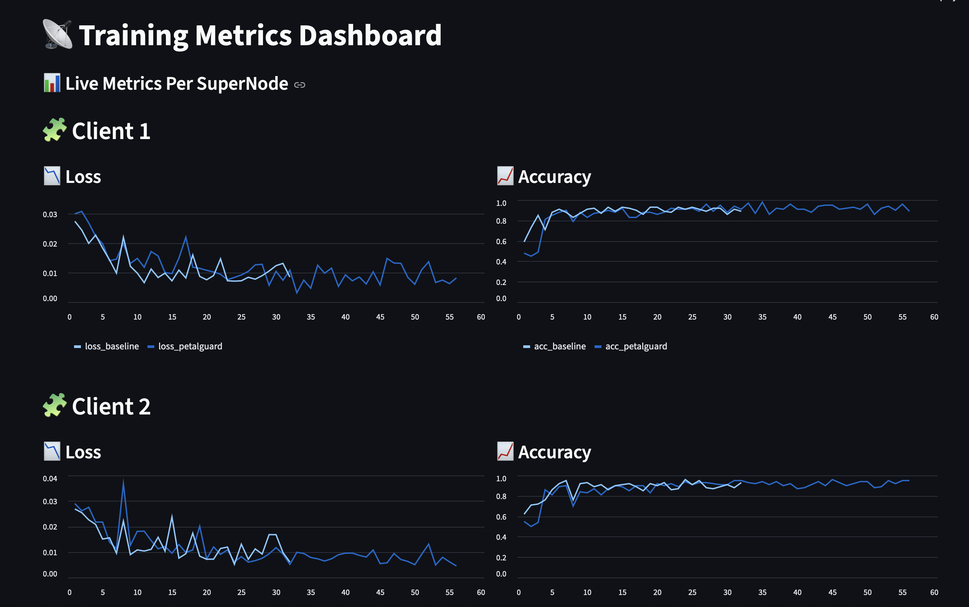


Federated Learning with MPC – No accuracy issues
Zero data exposure: Entities keep full control over their data, no raw data is ever shared
End-to-end cryptographic guarantees: Multi-party computation ensures secured computations
Compliant by design: In line with data protection laws, ensuring legal compliance
No accuracy loss: Maintains accuracy levels, with no degradation from encryption
Modular and scalable: Easily integrates into diverse IT environments and scales across many entities
with MPC
baseline

Slide 15

Federated Learning with MPC – Optimizing bandwidth (I)
PRNG
PRNG
PRNG
Aggregator 1
Aggregator 2
Aggregator 3
1 share per parameter and aggregator?
😰
Different
random
shares
,1
,2
,3
,1
,2
,3
,1
,2
,3
Data
Data
Data
Entity 1
Entity 2
Entity 3

Slide 16
Federated Learning with MPC – Optimizing bandwidth (II)
We can place one aggregator in each client
,1
,2
,3
Entity 1
Entity 2
Entity 3

Slide 17
Federated Learning with MPC – Optimizing bandwidth (III)
The shares of the aggregated model cannot be obtained with random seeds ☹
,1
,3
,1
,3
,2
,2
Entity 1
Entity 2
Entity 3

Slide 18
Security

Slide 19
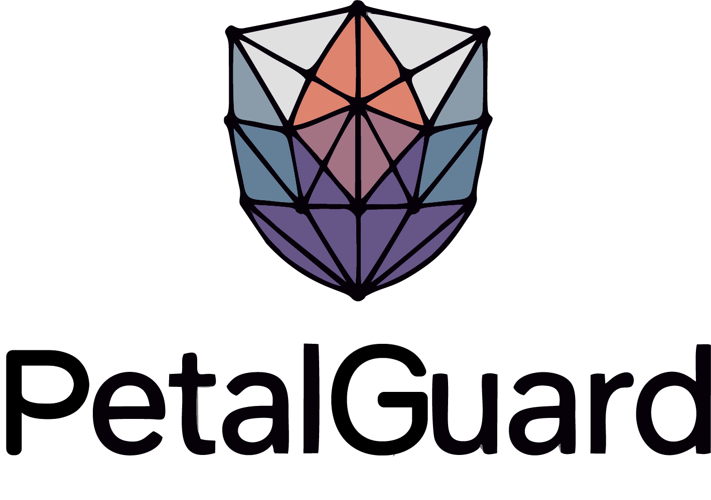
Privacy
,2
,3
,n
. . .
Zero data exposure: Entities keep full control over their data, no raw data is ever shared
End-to-end cryptographic guarantees: Multi-party computation ensures secured computations
Compliant by design: In line with data protection laws, ensuring legal compliance
No accuracy loss: Maintains accuracy levels, with no degradation from encryption
Modular and scalable: Easily integrates into diverse IT environments and scales across many entities
Aggregator 1
Aggregator 2
Aggregator 3
Aggr ‘n’
Information theoretically secure
Data
Entity 1

Slide 20

Privacy… but not verifiability
Aggregator 1
Aggregator 2
An attacker controlling an aggregator cannot extract any data
An attacker controlling an aggregator cannot tamper the resulting model in a “smart way”.. It cannot produce an AI model with trapdoors – is limited to additive attacks
An attacker controlling an aggregator can tamper the final model.. And we will not know who was ☹
Aggregator 3
,1
,2
,3
Entity 1

Slide 21
Verifiability

Slide 22
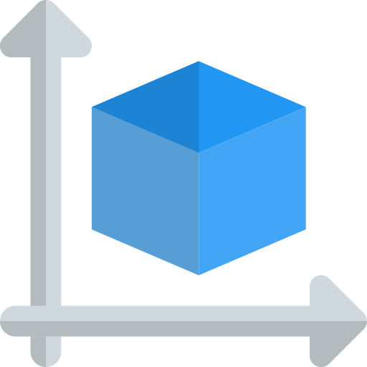
Confidentiality & Verifiability (I)
Private aggregation
Bigger Size
Bigger Size
Bigger Size
Share 1
Share 2
Share 3
Private
Aggregation
,1
,2
,3
Verifiability
Aggregator 1
Aggregator 2
Aggregator 3
x3 or x4
Trust
reduced
x1

Slide 23

Confidentiality & Verifiability (II)
Private aggregation
Bigger Size
Bigger Size
Bigger Size
Share 1
Share 2
Share 3
Private
Aggregation
,1
,2
,3
Verifiability
Aggregator 1
Aggregator 2
Aggregator 3
x3 or x4
Deployment inside TEEs provides verifiablity without any protocol costs.

Slide 24
Private Computation

Slide 25
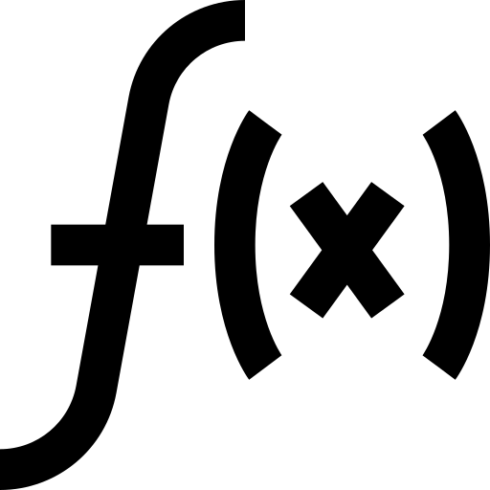

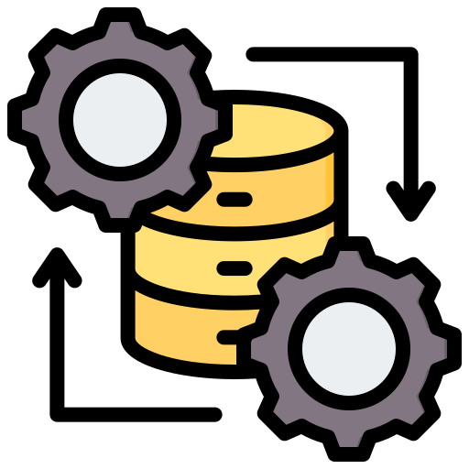
MPC goes beyond aggregation
Private Computation
Differential privacy
,1
,2
,3
Model poisoning detection
Aggregator 1
Aggregator 2
Aggregator 3
Pre-processing Engine: It delivers correlated randomness, independent from client inputs

Slide 26
Deployment

Slide 27
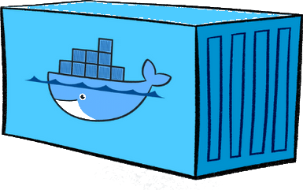
Deployable in dockerized envs
Docker container for the aggregator. Should run on CPU (no GPU power needed)
Aggregator
Docker container for the local training. Comaptible with AI models of any type – CNNs, transformers, LLMs of any size. Should run on GPU – CUDA compatible
Entity
We can deploy aggregators:
Separately (each entity needs to trust at least 1)
One aggregator in each entity (no trust needed)
1. MPC stands for Multi-Party Computation
Note: Entities are equivalent to ‘users’ or ‘clients’, each of them will deploy a container

Slide 28
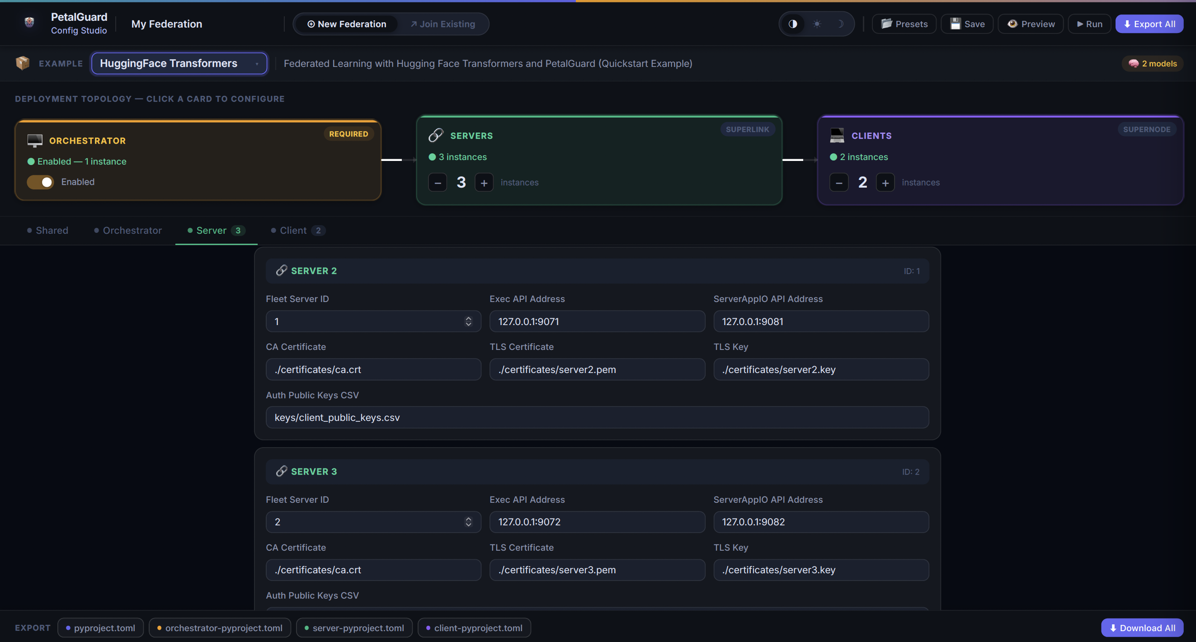
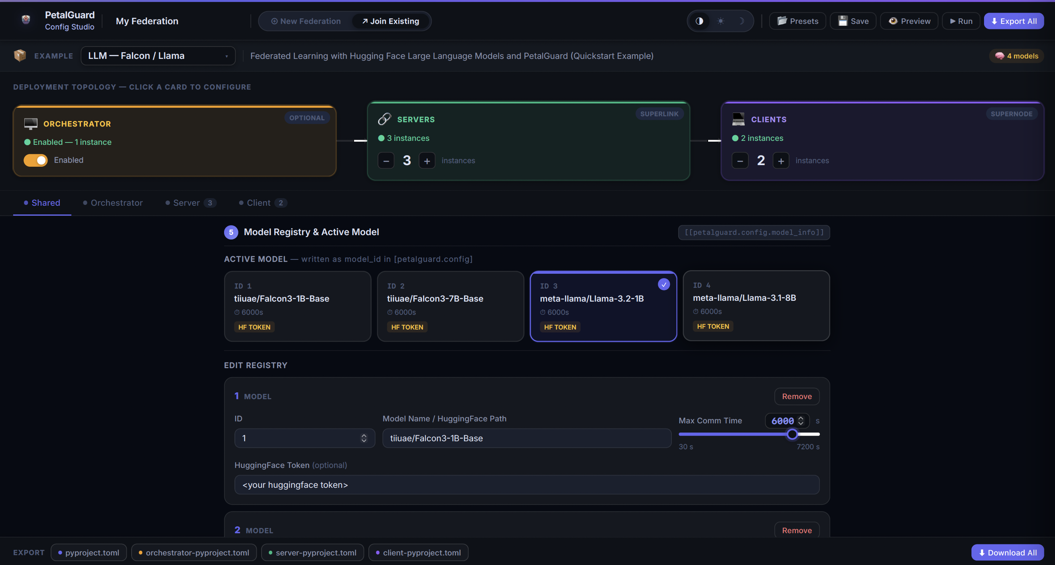
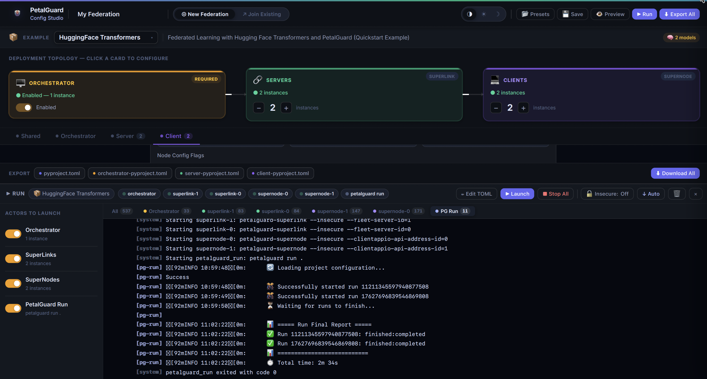
UI

Slide 29
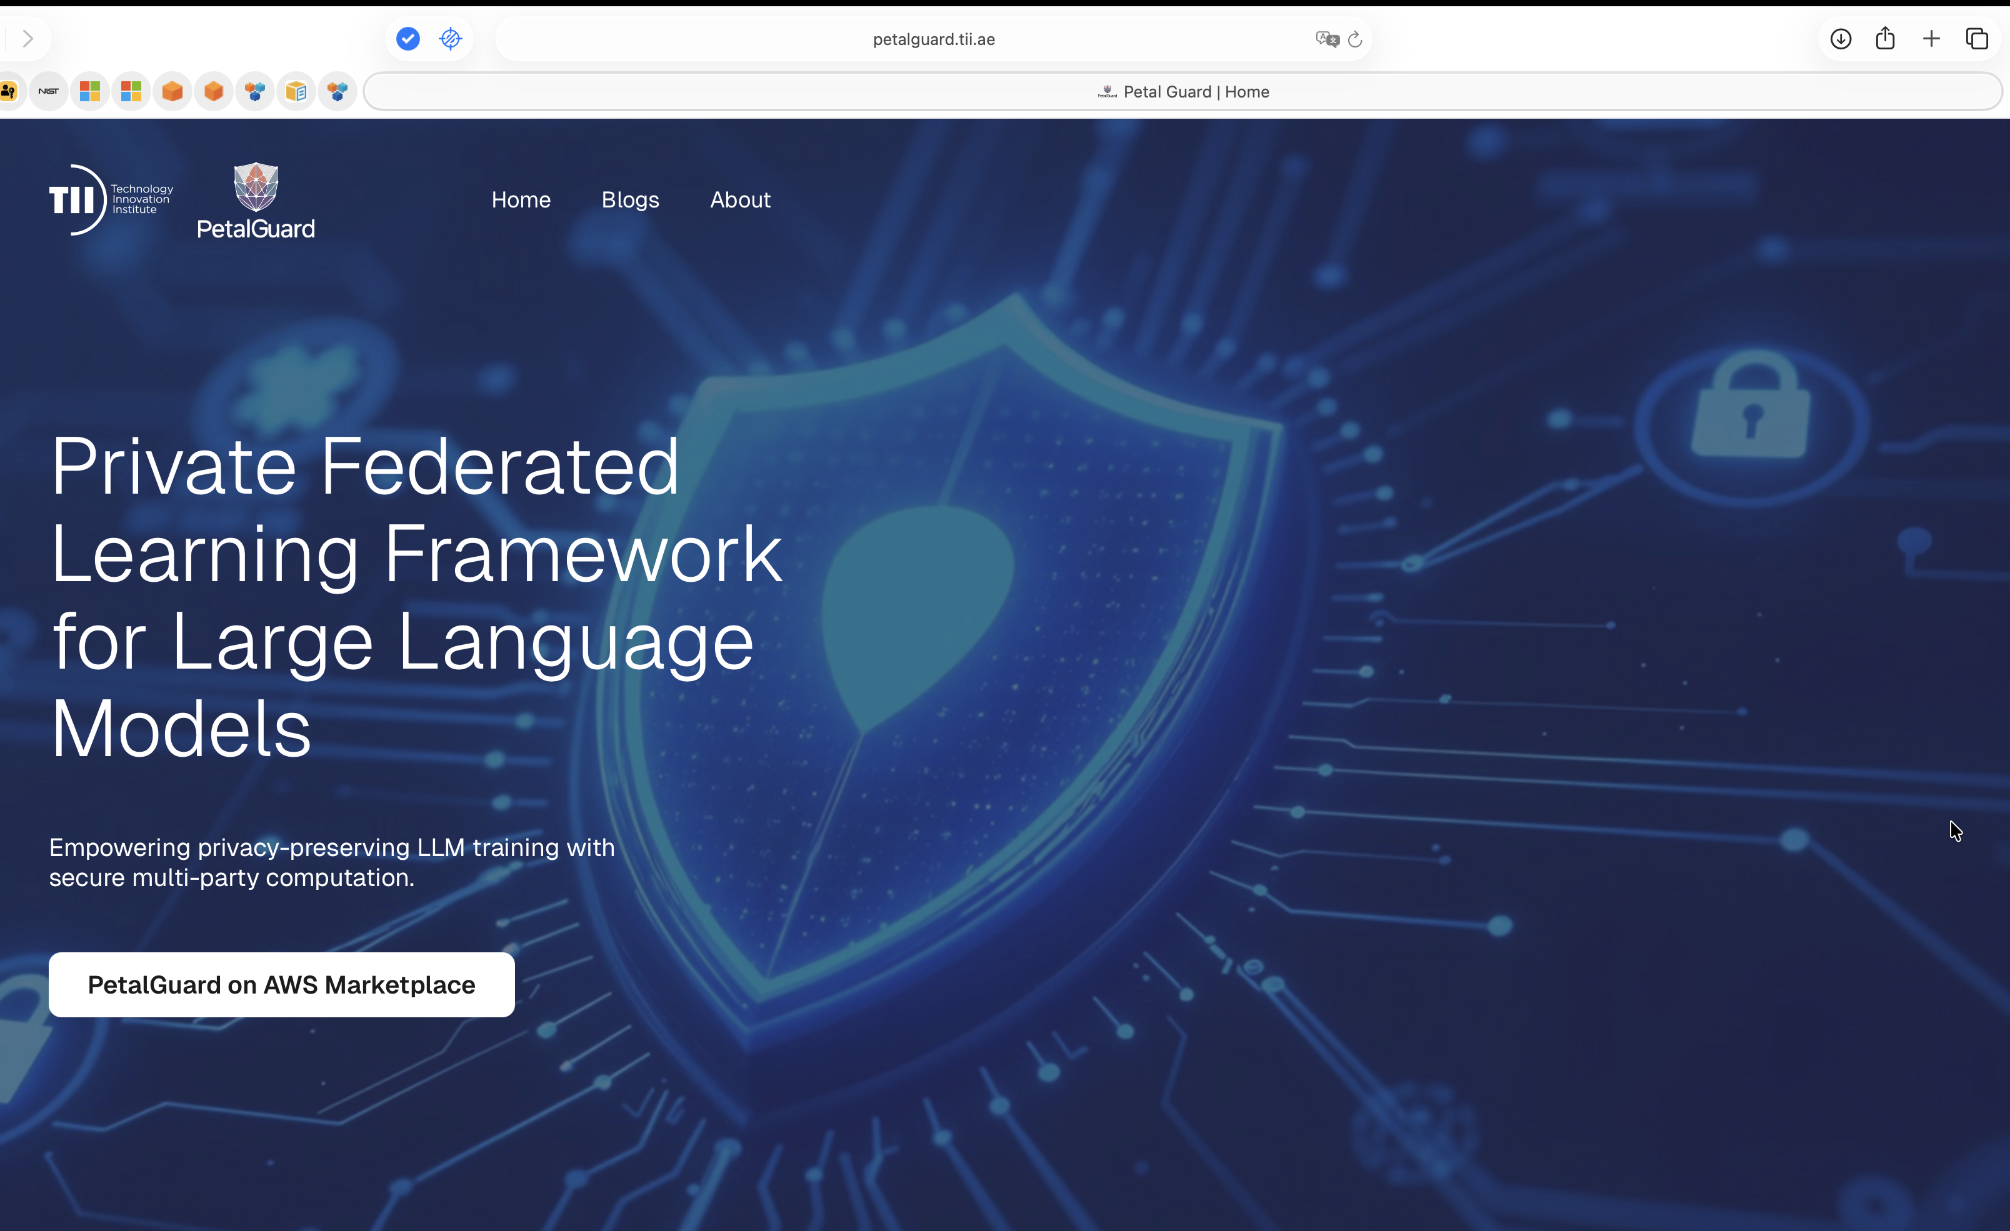
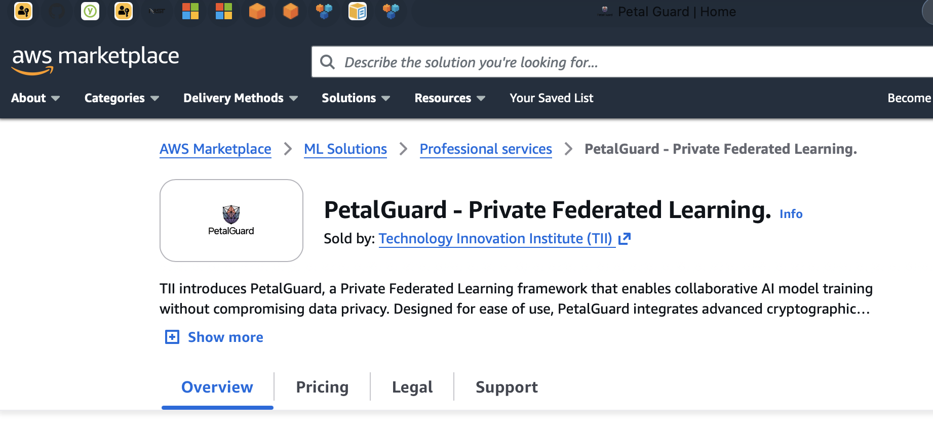
PetalGuard: end-to-end data privacy for model training

Slide 30




Integrated with OPAQUE platform
Confidential AI Platform
Confidential Federated Learning
Confidential Inference
Local training and model aggregation can be deployed in per-client instances inside OPAQUE platform.
Verifiable Attestation & Audit Log
Deployment inside TEEs provides verifiablity without any protocol trade-offs.
1. MPC stands for Multi-Party Computation
Note: Entities are equivalent to ‘users’ or ‘clients’, each of them will deploy a container

Slide 31

Technology Commercialization
THANK YOU
www.ventureone.ae

