Slide 1
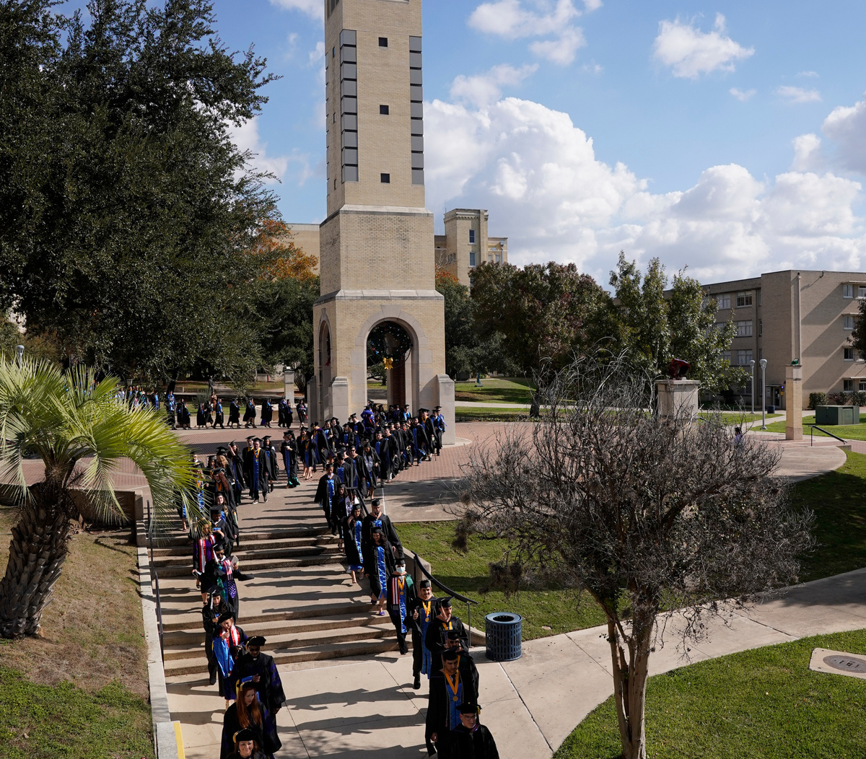
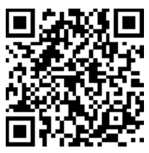


Discover the Opportunities of Graduate Studies
Learn More About
St. Mary’s University
Office of Graduate Admission
210-436-3126
graduate@stmarytx.edu

