Slide 1
THE BEST ADVICE I NEVER GOT
Leading Without a Manual
Amos Ngai
Academic Programs and Instruction Manager
01
Notes:
Open warmly. Introduce yourself and the premise: nobody hands you a manual for leadership.

Slide 2
ORIGIN
The Plan I Didn't Have
None of it postsecondary.
Urban Planning
BA, University of Calgary
Yet.
Financial Advisor, TD Canada Trust
Architectural Technologist, 8 years in industry
???
02
Notes:
Walk through the winding path before education — none of it planned.

Slide 3

CHAPTER ONE
Bow Valley College
I applied to teach AutoCAD.
I left the interview helping design a new school.
03
Notes:
Section break: Bow Valley College. A teaching job that became something bigger.

Slide 4
THE FIRST LESSON
Low attendance.
Lower engagement.
One very wrong assumption.
04
Notes:
The first hard lesson in the classroom.

Slide 5
WHAT I GOT WRONG
Teaching isn't bringing students up to your expectations.
It's helping them reach theirs.
05
Notes:
The reframe: teaching is meeting students where they are.

Slide 6
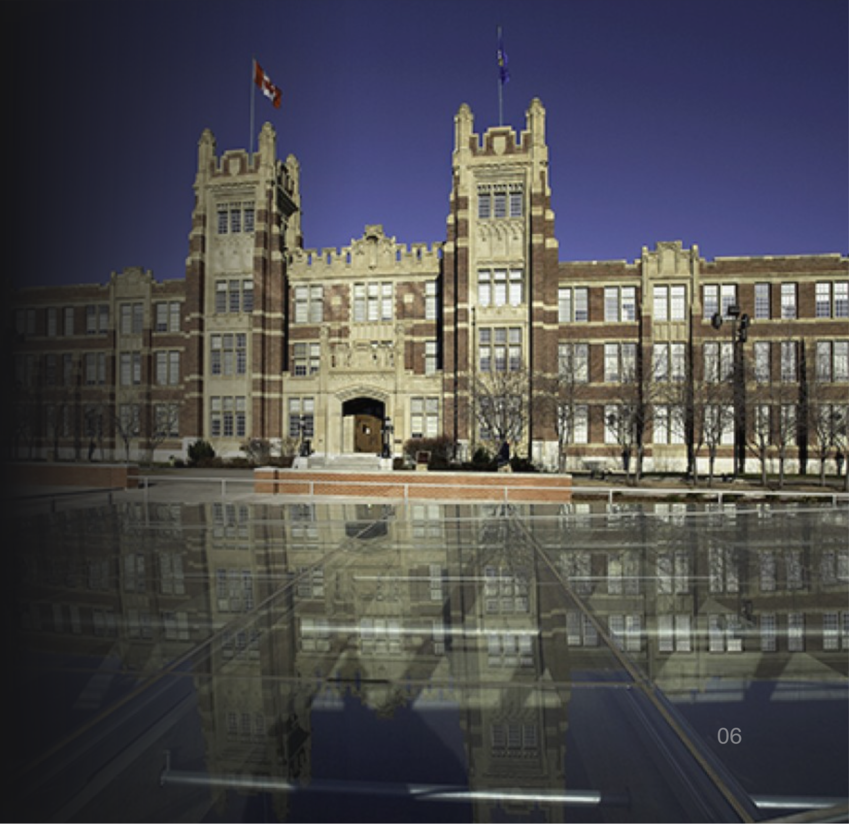
CHAPTER TWO
SAIT
One donation. Two schools to merge.
One five-year roadmap to build.
Associate Dean, leading the change initiative and roadmap for the newly reimagined school.
06
Notes:
Section break: SAIT. A $30M donation and a merger of two schools.

Slide 7
THEN THE WORLD STOPPED
NOVEMBER 2019
MARCH 2020
$30M donation announced
Global pandemic hits
The vision didn't change. Only the timeline did.
07
Notes:
Timeline: the donation announcement, then the pandemic five months later.

Slide 8
WHAT ACTUALLY MOVES THINGS
Influence, not authority.
A larger, more relational institution. Many departments, many stakeholders, nobody fully aligned. Getting anything done meant earning influence across teams that never reported to me.
08
Notes:
Influence over authority in a large, relational institution.

Slide 9
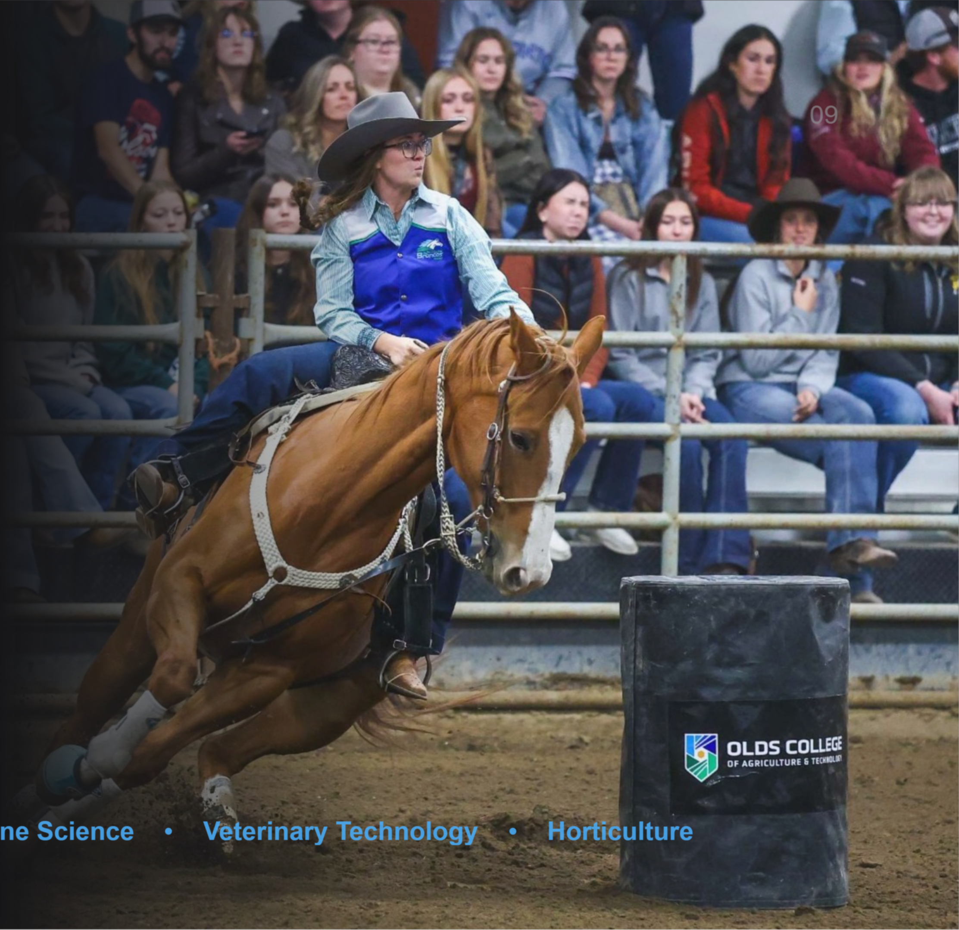
CHAPTER THREE
09
Olds College
Dean of Business. Also responsible for:
I knew business. I did not know horses.
Business Administration
Equine Science
Veterinary Technology
Horticulture
Notes:
Section break: Olds College, Dean of Business, with unexpected departments.

Slide 10
THE HUMBLING PART
Accountable for results.
Expert in none of it.
10
Notes:
Accountable without being the expert.

Slide 11
WHEN THE NUMBERS TURN
International enrolment surged, then fell sharply. Domestic enrolment declined alongside it. The institution needed hard financial decisions, fast.
Leaned on the change-management playbook built at SAIT.
11
Notes:
Enrolment swings force hard financial decisions.

Slide 12
THE HARDEST CALL
Knowing when you're not the right person for the job.
12
Notes:
The most difficult decision: recognizing you're not the right fit.

Slide 13
THE THROUGHLINE
Self-awareness is half the battle.
Bow Valley College
SAIT
Olds College
MaKami College
13
Notes:
Tie the four institutions together with one idea: self-awareness.

Slide 14
KNOW YOUR POSITION
A great athlete isn't automatically the right tight end.
Skill and position are different questions.
14
Notes:
The athlete metaphor: skill and position are different questions.

Slide 15
THE LEADERSHIP LESSON
The strongest leaders don't try to be everything.
They know exactly what they are, and they build the rest of the team around it.
15
Notes:
Close the arc: know your role, build the team around it.

Slide 16
Thank you.
The Best Advice I Never Got: Leading Without a Manual
Academic Programs and Instruction Manager · MaKami College
16
Notes:
Closing slide. Thank the audience and invite questions.

