Slide 1
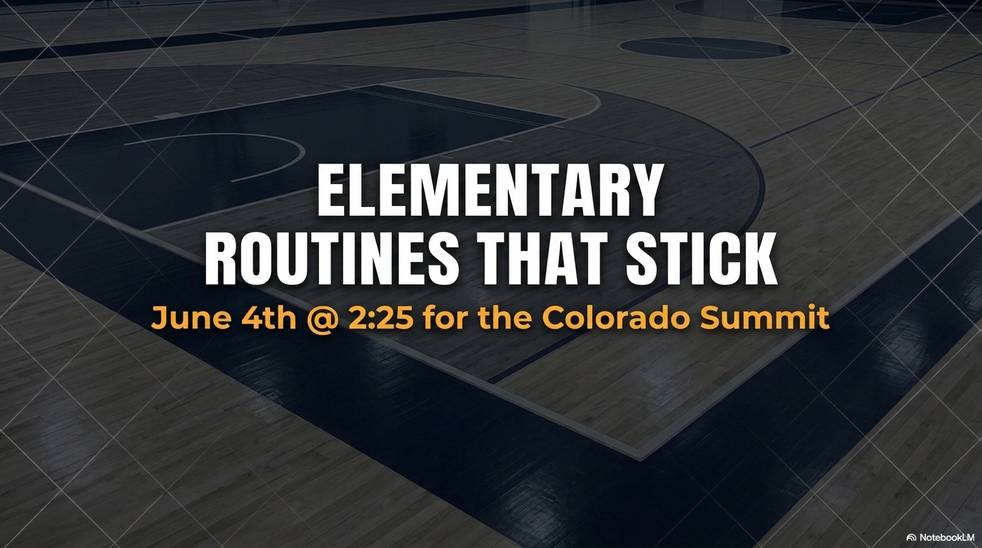
YOUTUBE LINK – Coach Chapla
Chapla Master List
BY: COACH CHAPLA

Slide 2
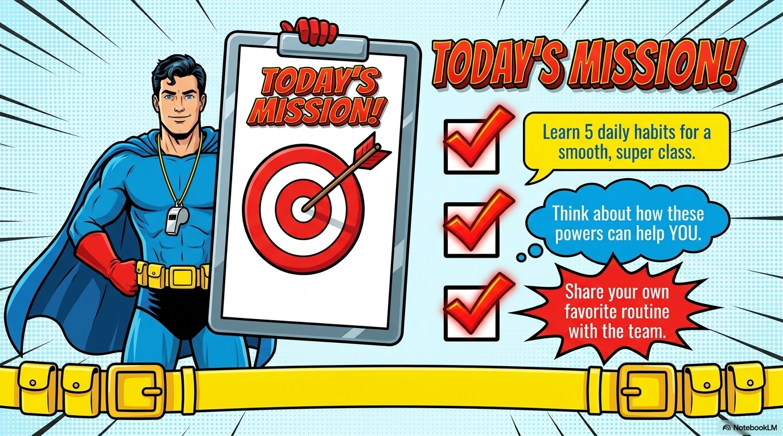

Slide 3
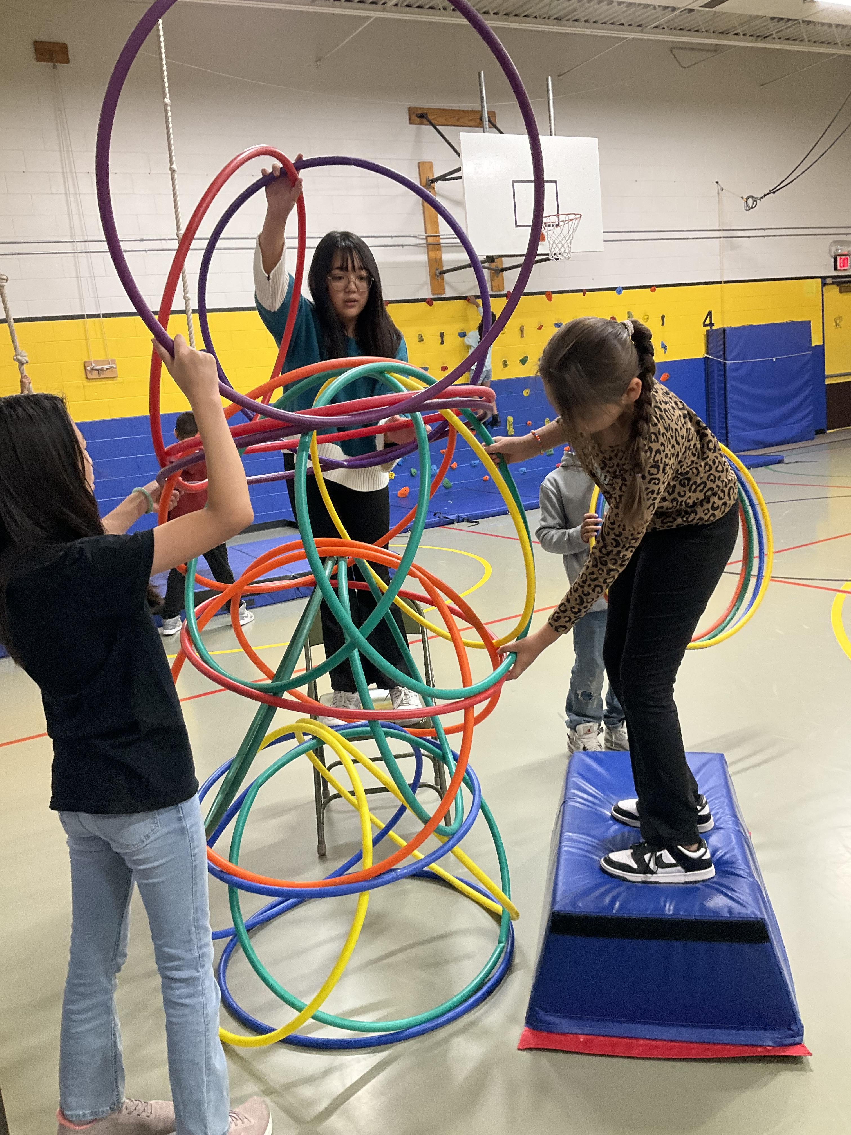
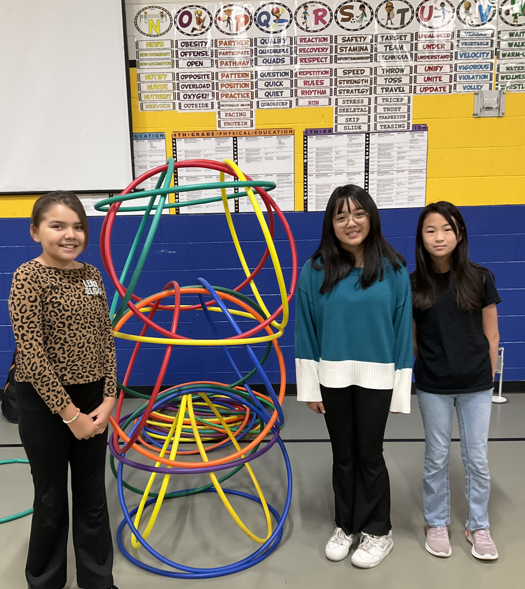
Fitness BREAKS / Classroom Games
Juggling
Bottle Flip
Marble Madness
Desk Bocce
Hula Huts

Slide 4
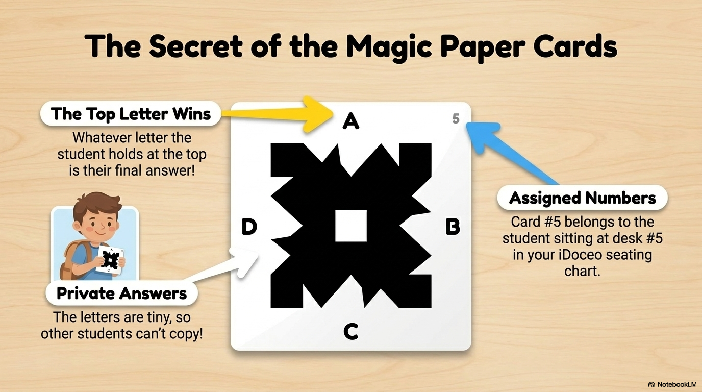

Slide 5
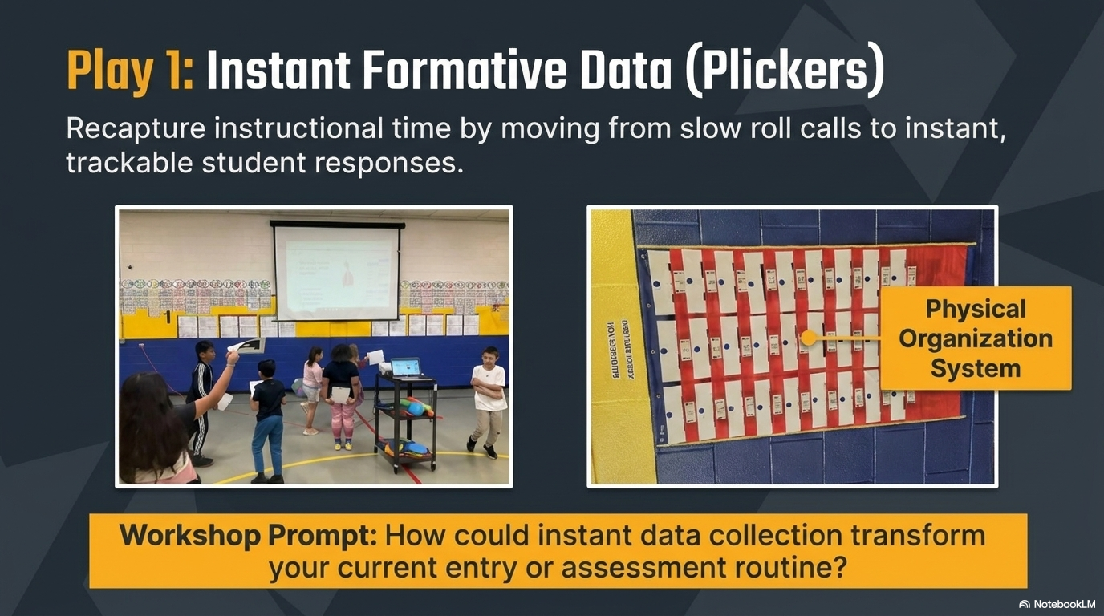
ROUTINE
TIPS

Slide 6
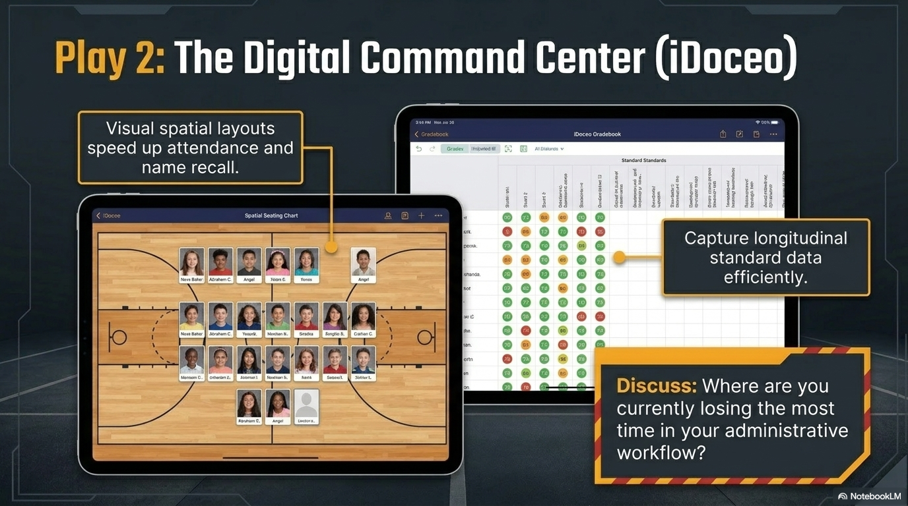
VIDEO
Seating charts

Slide 7


Slide 8
Transitions
What is a transition?
What do you look for in a transition?
Do you use transitions to scaffold learning?

Slide 9
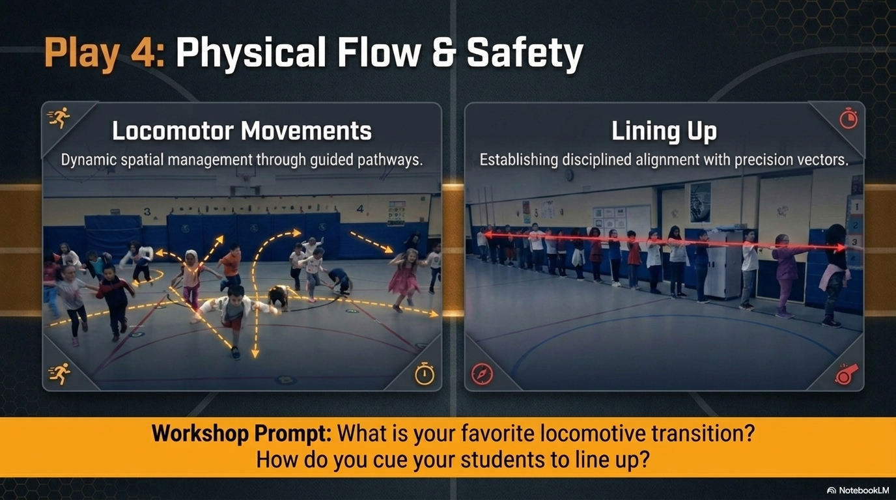
Why this routine?
Free PE?

Slide 10
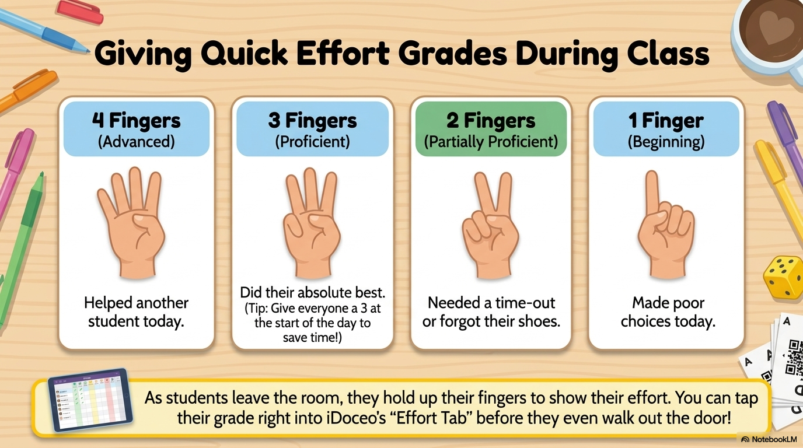

Slide 11
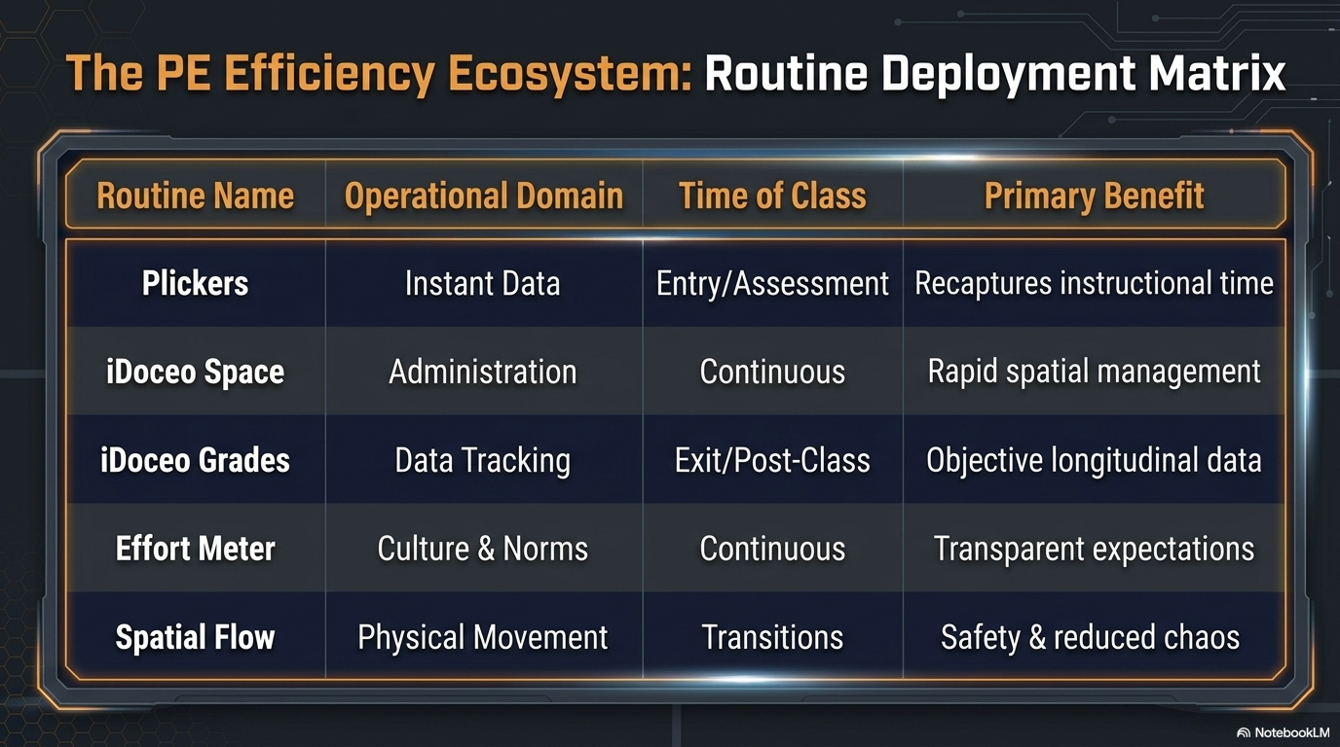

Slide 12
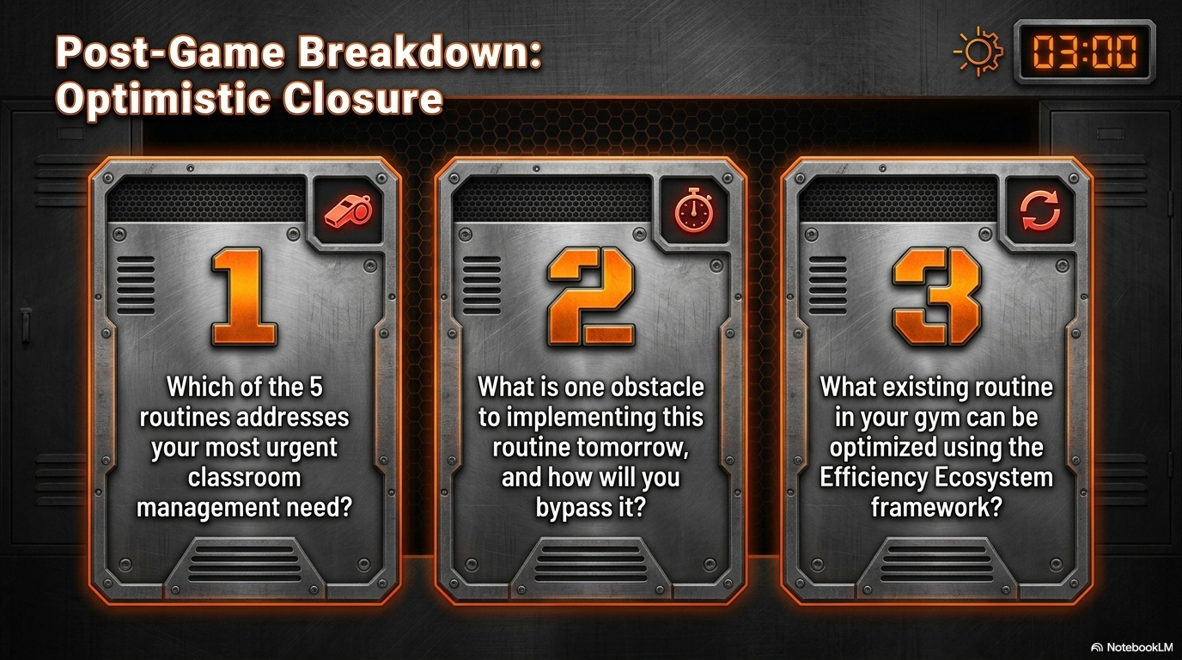

Slide 13
YOUTUBE LINK – Coach Chapla
Chapla Master List
BY: COACH CHAPLA

Slide 14
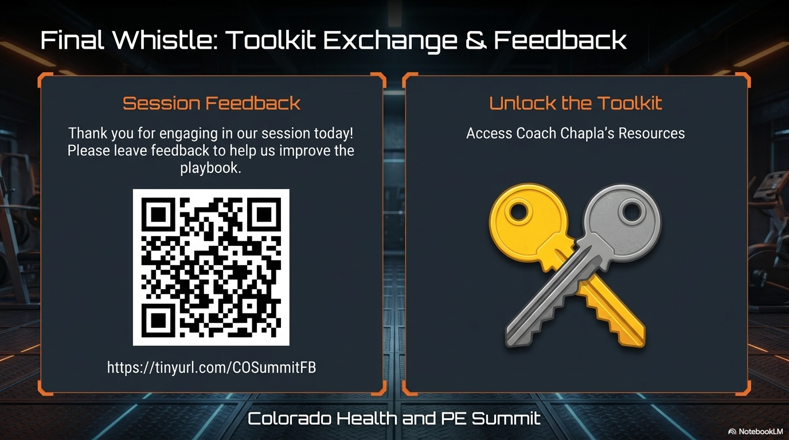


COACH CHAPLA’s RESOURCES

