Slide 1


How to Make the Most Out of Advisory Connect and Expert Labs Assets in IBM i Subscription Bundles
Yan Zhuo, yzhuo@us.ibm.com
Product Management Leader, IBM i
Claude Roustan, claude.roustan@fr.ibm.com
WW Business Design Consultant – Expert Labs
Eric Barsness, ericbar@us.ibm.com
Global Resiliency Practice Leader – Expert Labs
2026 June

Slide 2
Topics
IBM i Subscription Bundle Overview
Who is IBM Expert Labs?
Bundled Products and Expert Labs Assets
  IBM iDoctor for IBM i
  PowerHA Tools for IBM i
IBM i Advisory Connect
Q&A

Slide 3
Infrastructure choices are
business risk decisions.
78%
$300K+
90%
of CDOs say leveraging proprietary data is their top strategic objective — yet only 26% are confident their data capabilities can support new AI-enabled revenue streams
cost of downtime per hour for 90% of firms — every unplanned outage is a business event, not just an IT event
of cyberattacks exploit trusted access — the threat is inside your perimeter, not knocking at the door
IBM Institute for Business Value, 2025
ITIC, 2024
Gartner, 2025
2026 IBM Corporation
Notes:
These three numbers frame the business context every IT Manager in this room is navigating — whether they say it out loud or not.
57%: More than half of organizations cannot actually use their data for AI because it is fragmented, unclean, or ungoverned. IBM i does not have this problem. Your data has been structured, integrated, and governed for decades. That is a competitive starting position.
$300K+/hour: Downtime is not an IT metric anymore — it is a board-level risk. When you defend the platform budget, this is the number. Power11 delivers 99.9999% availability. That is roughly 31 seconds of unplanned downtime per year.
90%: The threat model has changed. Attackers are not breaking in — they are walking in with compromised credentials. IBM i's object-based authority and OS-level security model is designed exactly for this threat. Security is not bolted on. It is in the architecture.
These three risks — AI readiness, availability, security — are where IBM i already wins. The rest of this keynote shows you how to activate that advantage.

Slide 4
Business Resilience
1. Near zero downtime
2. Cyber resilience
3. Security and compliance
App modernization without disruptions
IBM i is your most strategic AI platform
IBM i: a fully integrated, open application system for mission-critical applications and innovations.
Decades of trusted,
high-integrity business data.
Operational Efficiency
With built-in
Notes:
Near Zero Down Time
Eliminating planned downtime for:
software updates
Infrastructure migration
Eliminating unplanned downtime
Security
Rapid recovery with trusted data
Improved security posture against cyber threats
Reduced compliance cost and effort
Application Modernization
Increased confidence in modernization initiatives
Increased developer productivity
AI and Agentic AI In application and business workflows

Slide 5
Introducing …
Why Subscription Bundles?
Simplify Licensing:
Streamline purchase decision, simplify license compliance, and increase flexibility to deploy capabilities
Accelerate Innovation:
Gain access to more capabilities right out of the gate to modernize your infrastructure
Reduce Total Investment:
Bundles provide more value at a lower price than purchasing ala carte.
    IBM i P30 Enterprise Edition
    A strategic bundle that offers comprehensive IBM i enterprise capabilities
    IBM i P20 Standard Edition
    A simplified bundle with essential capabilities
5
Notes:
We want to streamline how client purchases licenses and make it easy for them to modernize and innovate with low TCO. And we put together two subscription bundles. A big bundles for our top-tier clients, and a simplified one for our mid-tier clients.

Slide 6
IBM i P30 Enterprise Edition (5770-30E)
A strategic bundle that helps Enterprise clients unlock more value of IBM i capabilities:
Advanced HA/DR and cyber security capabilities to maximize uptime for mission-critical workloads
Automation-driven operational management to increase IT productivity and minimize disruptions
Open and modern application development and modernization to accelerate innovation
Expert guidance to accelerate value adoption
Continuous availability
Modernize application development
BRMS
PowerHA Tools for IBM i*
  IASP Manager
  Full System FlashCopy (FSFC) Manager
  Full System Replication (FSR) Manager
  Smart Assist for PowerHA on IBM i
PowerHA SystemMirror for i
Migrate While Active
Db2 Mirror for i
Rational Development Studio
(all compilers)
[NEW] IBM i Extensions for VS Code Enterprise Support
Cyber resilience
Improve productivity through automation
PowerSC
PowerHA Tools for IBM i*
  Safeguarded Copy Toolkit
Red Hat Ansible Automation **
iDoctor toolkit*
[NEW] Advisory Connect: Expert guidance to accelerate value adoption
P30 Tier IBM i integrated operating environment
(OS, database, middleware, and built-in security)
License and maintenance for Expert Labs assets and tool kits only
** RedHat Ansible Automation: 1 year support for 100 managed nodes with a minimum purchase of 10 P30 Enterprise Edition cores
6
Notes:
A strategic bundle that helps enterprise clients unlock more value of IBM i enterprise capabilities:
Advanced HA/DR capabilities to maximize uptime for mission-critical workloads
Automation-driven operational management to increase IT productivity and minimize disruptions
AI-powered application development and modernization to accelerate innovation
Expert guidance to accelerate value adoption

Slide 7
IBM i P20 Standard Edition
A simplified bundle that helps large clients unlock essential IBM i capabilities:
Advanced HA/DR and cyber security capabilities to maximize uptime for mission-critical workloads
Automation-driven operational management to increase IT productivity and minimize disruptions
Improve productivity through automation
Enhance availability
Migrate While Active
iDoctor toolkit*
BRMS
PowerHA Tools for IBM i*
  IASP Manager
  Full System FlashCopy (FSFC) Manager
  Full System Replication (FSR) Manager
  Smart Assist for PowerHA on IBM i
PowerHA SystemMirror for i
Migrate While Active
iDoctor toolkit*
Cyber resilience
PowerSC
PowerHA Tools for IBM i*
  Safeguarded Copy Toolkit
P20 Tier IBM i integrated operating environment
(OS, database, middleware, and built-in security)
* License and maintenance for assets only
Additional products may be purchased separately
  Db2 Mirror, RDS, etc.
IBM Confidential
7
Notes:
A simplified bundle with core capabilities for
HA/DR capabilities and cyber resilience to maximize uptime for mission-critical workloads
Automation-driven operational management to increase IT productivity and minimize disruptions

Slide 8


IBM Experts at your service.
The right technology.
The full potential.
8
8
Notes:
So who are we…
We are the professional services organization within IBM for Power Systems, powered by an experienced team of product experts, using proven methodologies and practices to help develop solutions to complex problems.
Let’s be clear. Having the right technology is important, Power Systems is an incredible technology stack but it is critical to have the right expertise to equip your business with the right methods and best practices.
This is where IBM Technology Expert Labs comes into play - the leading provider of cutting-edge technology solutions and services for IBM products, including Power Systems.
<next slide>

Slide 9
Custom Technology Center (CTC)
Lab Services
Power Lab Services / System Lab Services
Lab Services Power Delivery Practice
Technology Lifecycle Services
Technology Expert Labs

Slide 10



Why work with us?
01
02
IBM technology expertise
4,000+ experts
Proven
best practices
6,500+
certifications
03
04
05
06
Direct access to development and research
200+ technology
offerings
Proactive
delivery services
+19,000 annual engagements
Over the past 3 years we’ve engaged with +2,000 IBM Power customers.
Partner collaboration
450+ business
partners
Project
outcome
assurance
World Class NPS
10
Notes:
Why choose to work with us?
This chart represents our global scale and reflects our broader organization. Part of the magic behind our name change is that Expert Labs spans all of IBM’s technology stack aligning us with IBM Software and market, the hardware infrastructure teams, not just Power but z, Storage and IBM Cloud. That enables us to help you on your broader journey in a more cohesive fashion, bringing the right resources at the right time to meet your needs.
4000+ technical Experts, 6500+ certifications and 200+ technology offerings… speaks to our broad capabilities at a global scale.
Specific to Power we’ve had engagements with over 2000 Power Systems clients in the last three years. And we’ve achieved world class NPS results in those numerous successful engagements.
For market, the Business Partner EcoSystem is key. We focus on strong partner collaboration where clients have trusted partner relationships. Half of our engagements are on partner paper in my US market, and we work hard to collaborate well with partners, filling in gaps where they need skills but recognizing the are a critical part of the client technology journey for many of our clients.
<next slide>

Slide 11
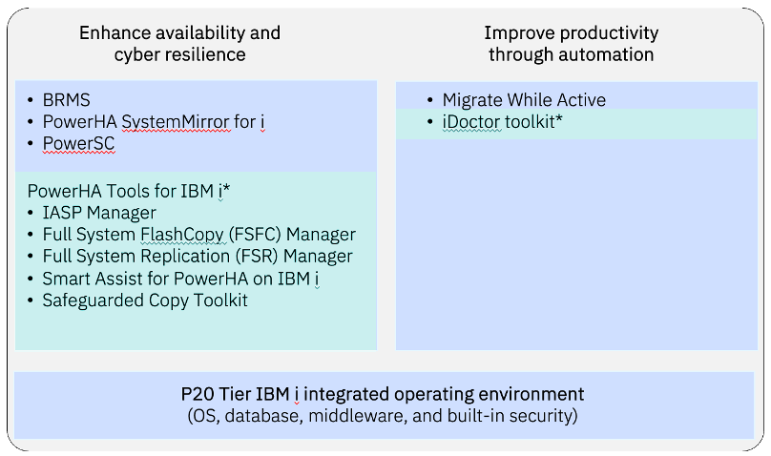
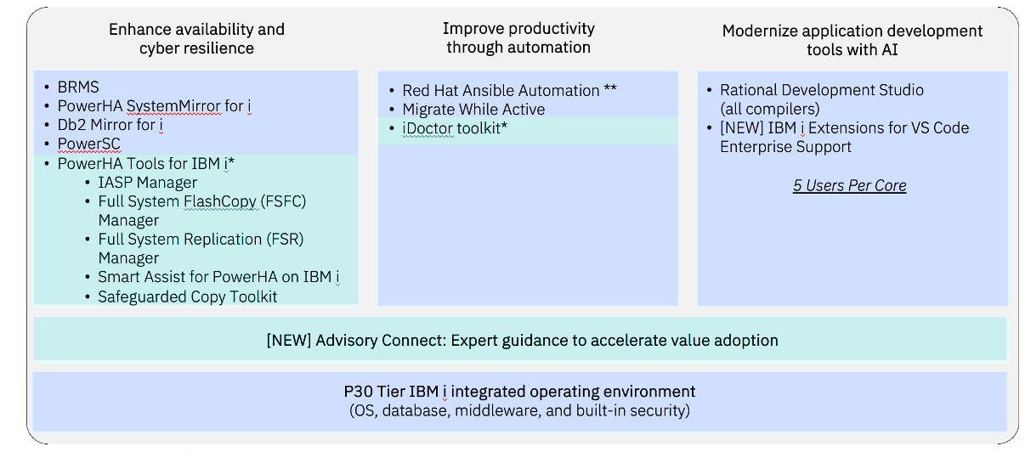
P20 Standard Edition includes PowerHA tools & iDoctor
Why Expert Labs assets and Advisory Connect in IBM i Subscriptions bundles?
Integrate powerful tools and advisory services to help enterprises optimize performance, enhance resiliency, and accelerate technology adoption.
With access to Technology Expert Labs, clients benefit from proactive guidance, advanced diagnostics, and customizable business continuity solutions — all included in their IBM i subscription.
P30 Enterprise Edition includes Advisory Connect, PowerHA tools & iDoctor
Notes:
Growing complexity managing modernization and skills
Embedding proven Expert Labs assets > Streamlined procurement, renewal under IBM i subscription
Embedding proven Expert Labs assets & Advisory Connect > Accelerated IBM i outcome

Slide 12
IBM iDoctor for IBM i
Power
Quick Reference Guide
Target Audience
System administrators managing IBM i operations and IT architects responsible for IBM i application performance optimization.
Why Use iDoctor?
  Do you need detailed insights to optimize resource utilization and improve system efficiency?
  Is slow performance of a critical application impacting your business operations?
  Benefits
  iDoctor empowers organizations with actionable insights to improve the performance of IBM i workloads.
  iDoctor’s advanced diagnostic capabilities ensure that organizations can maintain optimal performance for critical applications.
iDoctor Features
  Wait analysis
  Graphically show waits, identify conflicts, pinpoint causes.
  Monitoring
  Collect data 24x7 so you’re ready to start analysis when need.
  Dynamic legend
  Quickly add or remove selected metrics to best suit your needs.
  Situational analysis
  Identify problem areas based on earlier issues and anomalies.
  Report generator
  Automatically create and e-mail PDF reports of valuable graphs.
  Make comparisons
  Compare good and bad runs or review data sets side-by-side.
  Collection Services Investigator
  Visualize data to monitor or investigate performance issues.
  Job Watcher
  Get real-time, detailed views of job/thread/task performance data.
  PEX Analyzer
  Pinpoint issues affecting system and application performance.
Components
  iDoctor components and extensions include:
    Job Watcher
    Collection Services Investigator
    Disk Watcher
    Plan Cache Analyzer
    PEX Analyzer
    FTP GUI
    QMGTOOLS
Scope
  Included in IBM i L30 and L20 per core subscription
  Contacts
  Contact us at systems-expert-labs@ibm.com or your local Technology Expert Labs team
  https://www.ibm.com/products/idoctor
Overview
IBM iDoctor for IBM i (iDoctor) is a suite of performance tools used by IBM and clients to collect and analyze performance data to quickly solve performance problems on IBM i.
iDoctor tools may be used to monitor overall system health at a high level or for analyzing performance details within job(s), disk unit(s) and application programs.
Notes:
Talk about iDoctor first because is the asset they can start using immediately if they are not using it already.

Slide 13
iDoctor - Immediate Value for Everyone
Start Immediately
No Implementation Required - Included in bundle - Use right away with existing data
Beginner
Quick visibility
Understand overall system health instantly
Identify obvious bottlenecks (CPU, disk, memory)
Use prebuilt views and graphical dashboards
No deep performance expertise required
Quickly answer: “Where is the problem?”
Intermediate
Structured analysis
Perform wait analysis to understand system behavior
Correlate performance patterns across workloads
Compare good vs degraded performance scenarios
Identify root cause direction (not just symptoms)
Support troubleshooting and performance reviews
Expert
Deep diagnostics
Analyze Job Watcher and PEX data in depth
Investigate complex, multi-layer performance issues
Optimize application and system-level behavior
Perform detailed workload and resource tuning
Support advanced performance engineering strategies
From day-one insight → expert-level diagnostics in one tool

Slide 14
IBM PowerHA
Tools for IBM i
Power
Quick Reference Guide
Target Audience
IT Managers and system administrators managing IBM i operations and responsible for IBM i backup, high availability, disaster recovery and cyber resilience.
Why Use PowerHA Tools?
  Do you need a simplified solution for HA/DR and cyber resilience management for mission-critical IBM i workloads?
  Are manual processes for high availability causing operational inefficiencies?
  Benefits
  PowerHA tools for IBM i deliver robust HA/DR and cyber resilience solutions that ensure minimal disruption to business operations of planned and unplanned outages.
  By automating failover and replication, organizations can reduce downtime, protect data integrity, and simplify disaster recovery processes.
PowerHA Tools
  IASP Manager
  Manage storage, HMC and CSM functions on IBM i with commands and automated scripts for clients with IASP-enabled applications. IASP Manager solutions include FlashCopy, LUN-Level Switching, Remote or Multi-Target Copy, and HyperSwap.
  Full System Flash Copy
  Automates full system flash copy for daily off-line backup with integrated support for BRMS and without IASP-enabled applications. Increases application availability by reducing or eliminating backup window for routine daily backups.
  Full System Replication
  Provides full system replication and automated system recovery for HA or DR without IASP-enabled applications. Enables seamless operation of integrated server and storage operations for two-site HA or DR recovery.
  Safeguarded Copy Toolkit
  Automates and manages the lifecycle of immutable data copies. Used as a base for cyber resilient solutions such as Cyber Vault.
Additional Required Services
  PowerHA Tools for IBM i provide a range of customizable templates for HA/DR solutions that are implemented with separately chargeable build services from IBM Expert Labs:
    Build IBM PowerHA SystemMirror for IBM i
    Build HA/DR Solution with PowerHA Tools for IBM i IASP Manager
    Build Full System FlashCopy and Replication for IBM i
    Build Safeguarded Copy
    with IBM i
  Scope
  Included in IBM i L30 and L20 per core subscription
  Contacts
  Contact us at systems-expert-labs@ibm.com or your local Technology Expert Labs team
  https://www.ibm.com/support/pages/powerha-tools-ibm-i
Overview
PowerHA Tools for IBM i provide customizable templates for high availability solutions designed to ensure business continuity by minimizing downtime and simplifying HA/DR processes.
PowerHA Tools leverage IBM i and IBM Storage technologies to provide seamless failover and data replication across systems.
PowerHA tools help organizations protect critical workloads, maintain operational resilience, and reduce the complexity of managing high availability and disaster recovery environments.

Slide 15
PowerHA Tools for IBM i Summary
PowerHA Tools for IBM i | Capability | Benefit | DS8000 | Storage Virtualize* | PowerVS* | Internal Storage
Smart Assist for PowerHA on IBM i | Provides various administrative and operator utilities to supplement PowerHA installations for IASP enabled applications. | Simplifies deployment and ongoing management of high availability for critical IBM i applications. | Yes | Yes |  | Yes
IASP Manager (Automated backup and recovery with IASP-level vary on to active cluster node, no system IPL)
Flash Copy | Automates Flash Copy of IASP for daily off-line backup with seamless BRMS integration. | Increases application availability by reducing or eliminating backup window for routine daily backups. | Yes | Yes
LUN-level Switch | Simplifies deployment and automates switching of an IASP between IBM i cluster nodes in one data center. | Enables a business continuity manager to provide a simple, single site HA solution. | Yes
Remote Copy | Simplifies initial deployment and automates ongoing server and storage management of two-site Metro Mirror or Global Mirror HA or DR solutions. Requires IASP enabled applications. | Enables a business continuity manager to provide seamless operation of integrated server and storage operations for two-site high availability or disaster recovery. | Yes |  | Yes
Multi-Target Copy supporting HyperSwap, LUN-level switch, & GMIR | Provides three-site server/storage replication solution for HA/DR broadcast topologies including two Metro Mirror relationships or a Metro Mirror and Global Mirror relationship. Requires IASP enabled applications and IBM Copy Services Manager (CSM). | Enables lowering business risk and maximizing business resilience for highly critical business applications that require three-site HA/DR protection. | Yes
Full System Manager (Automated backup and recovery with system activation/IPL on target LPAR)
Flash Copy | Automates Full System Flash Copy for daily off-line backup with integrated support for BRMS without IASP-enabled applications. | Increases application availability by reducing or eliminating backup window for routine daily backups. | Yes | Yes | Yes
Replication | Supports Full System Replication and automated system recovery for HA or DR without IASP-enabled applications. | Enables seamless operation of integrated server and storage operations for two-site high availability or disaster recovery. | Yes | Yes | Yes
Safeguarded Copy (Automated management of immutable copies and as a base for cyber resilient solutions)
Safeguarded Copy | Provides a native IBM i interface for the main Safeguarded Copy features in support of a SYSB or an IASP environment. | Supports logical corruption protection for critical data by automatically creating periodic recovery points. | Yes | Yes
*Notes: IBM Storage Virtualize includes SVC ,Storwize, or IBM Flash System. PowerVS Remote Copy limited to GRS enabled PowerVS locations

Slide 16
PowerHA SystemMirror vs PowerHA Tools for IBM i
SystemMirror for IBM i = capability / PowerHA Tools for IBM i = operationalization
IBM i SystemMirror
- HA engine
- Backup capability
- Replication capability
- Supports failover with expertise
- Manuel Process
PowerHA Tools for IBM i
- Operational layer
- Minimal or no backup window
- Automation & templates
- Simplified HA / DR workflows
- Repeatable operations
Notes:
*Resiliency assessment would also include HA and DR partitions.
While assessments are done on a single partition, findings are discussed at a multi-partition ‘IBM i environment’ level.
Choice of Technology Area Assessment is made by the client, with input from the Expert Labs team.

Slide 17
CyberVault vs Safeguarded Copy on IBM Power
Cybervault = recovery capability / Safeguarded Copy = continuous cyber resilience
Cybervault
- Isolated recovery environment
- Secure separation from production systems
- Manual orchestration and recovery steps
- Primarily used during a cyber incident
Safeguarded Copy
- Immutable recovery points
- Integrated workflows
- Automated copy and lifecycle management
- Enables continuous validation and readiness
Notes:
*Resiliency assessment would also include HA and DR partitions.
While assessments are done on a single partition, findings are discussed at a multi-partition ‘IBM i environment’ level.
Choice of Technology Area Assessment is made by the client, with input from the Expert Labs team.

Slide 18
FlashCopy – Best Place to Start with PowerHA?
Limited implementation required - Included in bundle – Next level backup solution
Traditional Backup
- Scheduled backup window
- Production impact
- Long data copy process
- Manual operations
- Delayed recovery
FlashCopy (PowerHA)
- Snapshot in seconds
- No production impact
- Fully automated
- Continuous protection
- Instant recovery readines
2 options available – Fits any IBM i environment
Full System
- Whole system snapshot
- No IASP required
- Immediate backup simplification
IASP
- Application-level snapshot
- Integrated with HA environments
- Supports advanced resiliency strategies
From constrained backup windows → near-zero impact protection

Slide 19
Product & Asset Licenses Provided – not Services
Example: Db2 Mirror for IBM i
License keys for Db2 Mirror for IBM i are included in the P30 IBM i Subscription Bundle
Implementation services are not included with the bundle
Implementing Db2 Mirror takes months of effort
Other than iDoctor, don’t expect to immediately leverage the products and assets bundled (if you aren’t already using them).
…but they are there when you are ready for them

Slide 20
IBM i End-to-End Resiliency Architecture
Performance (iDoctor)
  Visibility
  Wait analysis
  Root cause diagnostics
Availability (SystemMirror + PowerHA tools)
  Backup
  Replication
  Automation
  Operational workflows
Cyber Resilience (Safeguarded Copy)
  Immutable recovery points
  Automated protection
  Continuous cyber readiness
Foundation: IBM i (OS + Database + Security)
Overlay: Advisory Connect / Expert Labs
From reactive operations to continuous resilience
Notes:
Overlay: Advisory Connect / Expert Labs – this is the lead in to the next slide (Advisory Connect)

Slide 21
Expert Labs Toolkits – Use Cases
The standalone maintenance renewals must cover any systems that are not part of a subscription bundle
Use Case 1: you currently have a Per System License for PowerHA toolkit
  Standalone maintenance should not be renewed at expiration if bundle subscription is active for this system
Use Case 2: you currently have an Enterprise License for PowerHA toolkit
  All systems using the PowerHA toolkit have a subscription bundle: no standalone maintenance renewal required
  Some systems using the PowerHA toolkit don’t have a subscription bundle: standalone maintenance should be renewed
Use Case 3: you currently have an iDoctor License active
  iDoctor standalone license should not be renewed at expiration if bundle subscription is active for this system
There are issues due to toolkit misconfiguration, what support is provided?
  Defect support for the tooling is provided, misconfiguration issues will require an Expert Labs service agreement

Slide 22
IBM Advisory Connect for
IBM i on IBM Power
Power
Quick Reference Guide
Target Audience
Designed for large enterprise executives and managers responsible for IBM i operations and application delivery that need in-depth advice across multiple technical domains
Why Use This Service?
  Do you want to ensure your enterprise subscription for IBM i is driving measurable business outcomes faster?
  Do you want to ensure you are adopting and optimized to exploit the latest IBM i technologies?
  Benefits
  IBM i Advisory Connect is a proactive advisory service with access to the experience and expertise of IBM Expert Labs consultants.
  Advisory Connect for IBM i helps you ensure you are maximizing the adoption of new IBM i technologies such as database mirroring, cyber resiliency, advanced SQL methods, Quantum Safe encryption, Ansible automation.
Activities
  After subscribing to the IBM i Advisory Connect service via your IBM i operating system subscription, you will be paired with a named Expert Labs expert as your primary contact.
  You will be able to request remote advice on new technology adoption from a variety of specialist Expert Labs consultants across the following domains:
    Database
    Resiliency
    Performance
    Security
    Automation
  In addition, you can utilize one remote annual technology assessment for:
    System Health
    Performance
    Availability
    IBM i Security
    Shared Utility Capacity
Scope
  Provide an IBM i subject matter expect as the primary contact
  Provide remote advice related to the covered technology domains
  Provide one remote annual technology domain assessment
  Make recommendations on best practices.
  Included in IBM i L30 per core subscription
  Contact
  Contact us at systems-expert-labs@ibm.com or your local Expert Labs team
Overview
Do you want to get better business outcomes by connecting your team with IBM’s most trusted technical advisors?
Designed for large enterprises with an IBM i subscription, IBM i Advisory Connect service provides simple and rapid access to Expert Labs advice and insights on database, performance, resiliency, security, and automation.
With expert guidance and advice on adoption of new technologies, the IBM i Advisory Connect ensures that your technology investments drive measurable business outcomes faster.

Slide 23
IBM Advisory Connect – What’s Included (per year)
An initial ‘IBM i Environment Assessment’ (to be initiated by local market Experts Lab team)
A ‘Technology Area Assessment’ for one of the following domains (single partition*):
  System Health
  Performance
  Availability
  Security
  Shared Utility Capacity
Development of multi-year, prioritized action plans that are reviewed during recurring interlocks.
Advising on IBM i best practices and adoption of new IBM i technologies
Note: All services are provided remotely.
Notes:
*Resiliency assessment would also include HA and DR partitions.
While assessments are done on a single partition, findings are discussed at a multi-partition ‘IBM i environment’ level.
Choice of Technology Area Assessment is made by the client, with input from the Expert Labs team.

Slide 24
Advisory Connect Process Example
An Expert Labs Consultant will contact someone at the client
  Finding the right person can be challenging for us.
  Consider contacting us proactively if you are the right person - systems-expert-labs@ibm.com
Hold an initial call to explain what’s included in the service
Perform the IBM i Discovery/Environment Assessment
Review the assessment findings and select which Technology Area Assessment will be done
Perform the selected Technology Area Assessment and review the findings
Ongoing:
  Available to provide ad-hoc advice related to IBM i
  Periodic checks of progress on assessment recommendations

Slide 25
Advisory Connect and Business Partners
Advisory Connect is not intended to compete with Partner services.
  The Partner remains the primary trusted advisor and delivery partner for the client.
  No ownership of the customer relationship is transferred.
  Transparency and collaboration are core principles.
Services are advisory only.
  Assessments are used to facilitate discussion.
  Suggestions from assessments may be implemented by the client, the Partner, or – with a separate contract – Expert Labs
A key goal of Advisory Connect is to encourage clients to invest in their IBM i environments
  This should lead to additional Partner-provided services/engagements
Business Partners should be involved with Advisory Connect
  Encouraging their customers to engage with Advisory Connect services
  For BP-led accounts, Business Partners can participate to the Advisory Connect planning sessions
Notes:
Want this slide ear;ly in the Advisory Connect discussion so that any BPs, MSPs or Cloud Providers don’t get concerned.

Slide 26
Understanding IBM Advisory Connect
Advisory Connect is a service to provide remote access to Expert Labs consultants for advice on best practices and adoption of new technologies.
It does not provide the following:
  Opening, monitoring, or troubleshooting a defect case with IBM Support (or Premium/Platinum Support)
  Implementation services (even for iDoctor or PowerHA Tools)
  Training (even for iDoctor or PowerHA Tools)
  Off-shift or on-demand access to consultants
  In-person, on-site consultations

Slide 27
IBM Advisory Connect – Usage Example for Performance
Why and What? Questions – Covered
Why should I be using iDoctor for IBM i?
What are best practices for configuring performance tools?
What are some monitoring solutions for IBM i?
How do I? Questions – Not Covered
How do I install IBM iDoctor for IBM i? -> Contact iDoctor support (idoctor@us.ibm.com)
How do I use iDoctor to analyze performance? -> Expert Labs workshop
How do I resolve the performance problem I’m experiencing? -> Open a Case with Support
How do I optimize my applications? Expert Labs - custom Statement Of Work
How do I get ongoing help with performance? -> Expert Labs - Expertise Connect

Slide 28
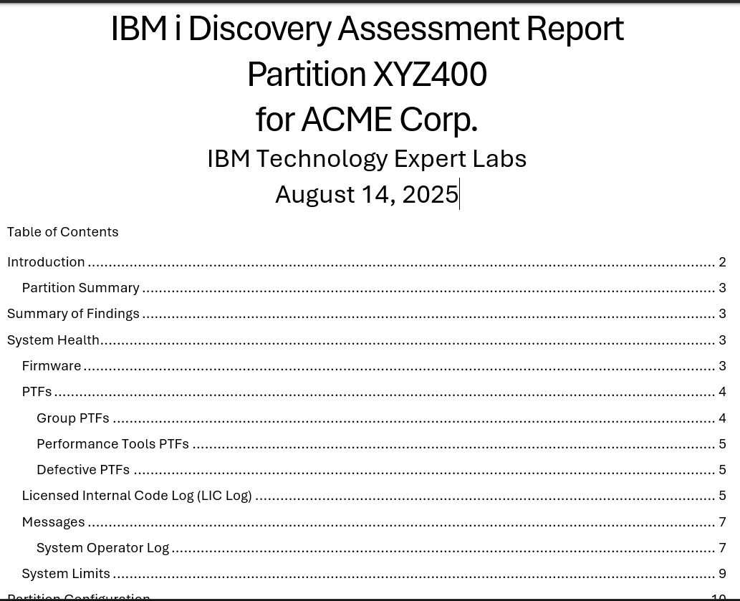
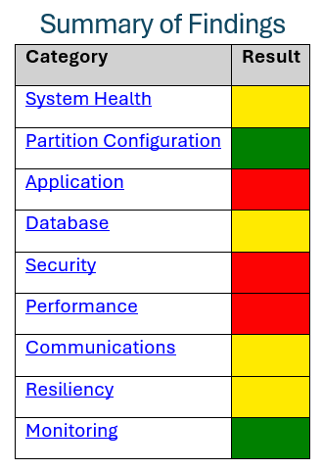
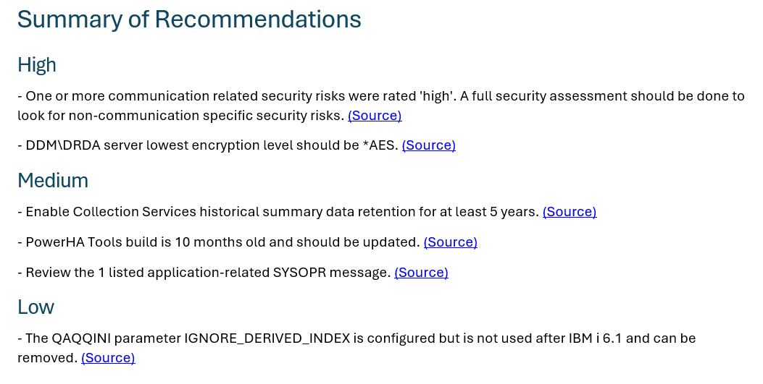
IBM i Environment Assessment
Notes:
Clients will run the IBM i Performance Assessment Tool (iPAT) to collect information that the Expert Labs team will use to evaluate the state of the client’s IBM i environment. While only one partition will be reviewed, the resulting discussion will encompass the client’s entire IBM i environment.

Slide 29
IBM i Environment Assessment
PC-based tool that connects to an IBM i
  uses APIs and SQL Services to collect diagnostic data
Your Expert Labs contact will summarize the assessment findings into a report which will include findings and recommendations.
One or more meetings will be held to review the results, and to develop any remediation plans.
The assessment may help you decide which Technology Area Assessment to perform
Progress on remediation plans will be reviewed from time to time.
The Environment Assessment can be run yearly to validate progress and identify and new concerns or opportunities.

Slide 30
Offering Differentiation
Advisory Connect – Expert Labs
  No charge as part of IBM i Subscription Bundle
  Advisory in nature
  Ongoing, but intermittent interaction
Expertise Connect – Expert Labs
  25% or more FTE of an Expert Labs consultant
  Advisory in nature
  Ongoing, regular interaction
Platinum Support – IBM Support / TLS
  ‘Concierge Support’
  Enterprise clients only

Slide 31
IBM Advisory Connect – Usage Example for a Toolkit/Asset
Covered:
Why should I use this toolkit/asset? What does it do for me?
License keys for included partitions – delivered upon request
Not covered:
Implementing the toolkit (e.g., PowerHA tools)
How to use the asset (e.g., iDoctor)
Support for the toolkit/asset (use existing support methods)
Notes:
1 - license keys are technically separate from Advisory Connect
2 – support is provided separately from Advisory Connect

Slide 32
Potential Advisory Connect Discussions
Resiliency Strategy
  Benefits of Implementing an IASP
  High availability and disaster recovery best practices
  Benefits of Power Cyber Vault
  Roadmap to Db2 Mirror
New(er) technologies
  Row and column access controls (RCAC)
  Temporal databases
  Post-Web Query reporting options/alternatives
  Possible uses for Ansible
  Benefits of using Instana
  AI / Project Bob
Recurring progress checks on assessment recommendations

Slide 33
Unleash IBM i Subscription Bundles with Expert Labs
This is not a set of tools, but
Built-in Resiliency consistently delivered through the Subscription Bundle
Solid Foundation
IBM i Platform
Integrated OS
Database
Security
Enhanced Capabilities
Performance
iDoctor toolkit
Availability
PowerHA Tools for IBM i
Cyber Resilience
Safeguarded Copy
Business Accelerator
Expert Labs / Advisory Connect
Guidance
Best Practices
Continuous Optimization
From fragmented operations to consistent, continuous resilience

Slide 34
Thank you

Slide 35
Backup

Slide 36
IBM i Subscription Bundles and Expert Labs - Recap

Slide 37
IBM Graphical Performance Analysis Tools
IBM provides two powerful tools to aid in making your performance analysis more efficient and productive:
Both solutions support data analysis (varying degrees) for the 4 collectors:
      Collection Services
      Job Watcher
      Disk Watcher
      Performance Explorer (PEX)
Performance Data Investigator (PDI)
IBM iDoctor for IBM i
37

Slide 38
Graphical Analysis Tools
You have two graphical interfaces for performance data analysis… Which is right for you?
Feature | iDoctor | PDI
Interface | Windows client | Browser
Wait Analysis | Yes | Yes
Collection Services | Yes | Yes
Job Watcher | Yes | Yes
Disk Watcher | Yes | Yes
Performance Explorer | Yes | No
Level of analysis provided | Deep | Basic to Medium
Job Watcher Monitors (Built –in) | Yes | No
User Defined graphs and queries | Yes | On roadmap for New Nav/PDI
Update Frequency | Quarterly | HTTP Group & individual PTFs shipped several times a year
Support | Email idoctor@us.ibm.com | Standard SWMA
Chargeable | Yearly license for each component (by serial number) Job Watcher Includes Job Watcher, Collection Services Investigator, and Disk Watcher PEX Analyzer Included in IBM i Subscription Bundles | No
DS8K graphs & VIOS Investigator | Yes | No
Multinational language support | No | Yes
38
Notes:
Since June 2022, JW is no longer a chargeable option for PDI. PT1 is a zero priced product.
Other: OS Version – PDI does not handle pre-6.1 Job Watcher Data – for 5.4 Collection Services & DW data – need to use the CVTPFRCOL command

Slide 39
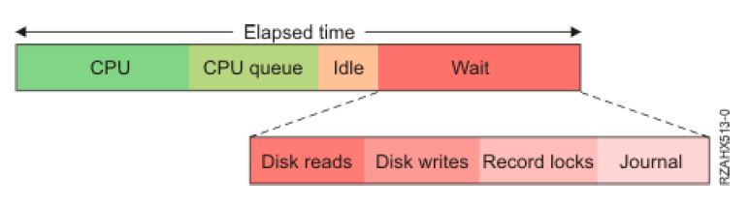
Wait Accounting
  Now you can start asking questions such as:
    Are my pool sizes appropriate?
    Can I/O be done asynchronously?
    Are all the journals required and optimally configured?
    Am I locking records or objects unnecessarily?
Notes:
You now have a better idea of where to focus your analysis effort

Slide 40
Wait Accounting Buckets
Collection Services and Job Watcher
Time dispatched on a CPU
CPU queuing
Reserved
Other waits
Disk page faults
Disk non-fault reads
Disk space usage contention
Disk operation start contention
Disk writes
Disk other
Journaling
Semaphore contention
Mutex contention
Machine level gate serialization
Seize contention
Database record lock contention
Object lock contention
Ineligible waits
Main storage pool contention
Journal save while active (7.2+)
Classic Java JVM (up to 6.1)
Classic Java other (up to 6.1)
Reserved
Socket transmits
Socket receives
Socket other
IFS
PASE
Data queue receives
Idle/waiting for work
Synchronization Token contention
Abnormal contention
Notes:
Waits buckets 6.1 and beyond -- The bold blue are ones are the more interesting ones and most will be cover in more depth in other sections
NOTE: for lock related ones – when you come of lock is when the wait bucket is updated

Slide 41
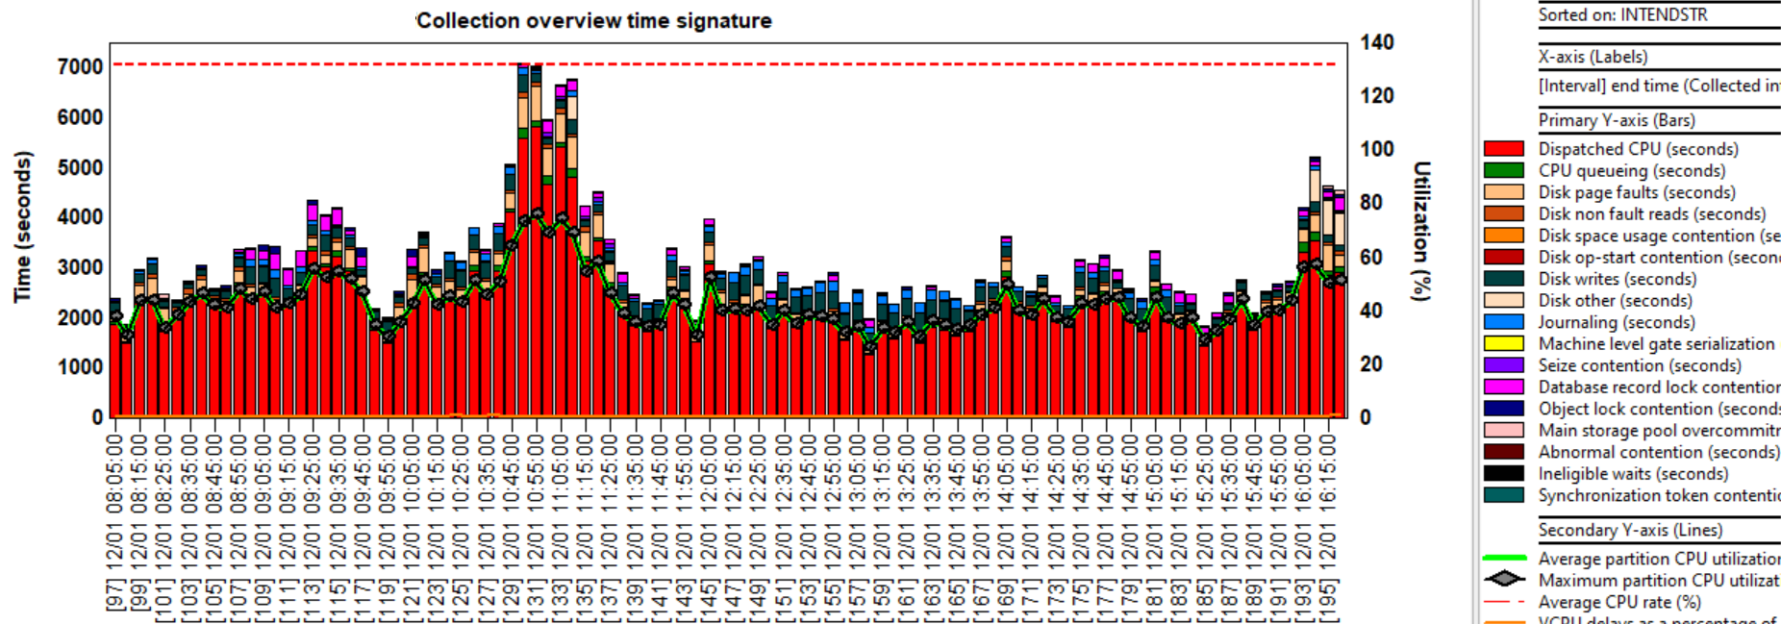
IBM iDoctor for IBM i
Microsoft Windows based client
Service/Support offering (chargeable, or included in IBM i Subscription Bundles)
Deep Job Watcher and PEX analysis capability
41
Notes:
Same chart as previous, just showing iDoctor instead of PDI. Colors different, but otherwise is the same setup, except PDI combines some things (just a single “disk time” bucket)
(CTCLWPERF, DTDEC21 lib)

Slide 42
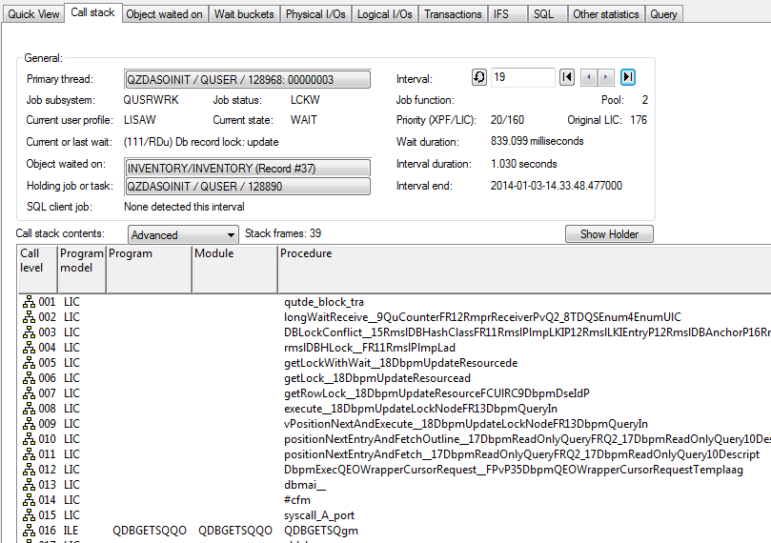
iDoctor Job Watcher – Interval Details
42
Notes:
Used to show that iDoctor GUI has same features (and more, will have labs to demonstrate)

Slide 43
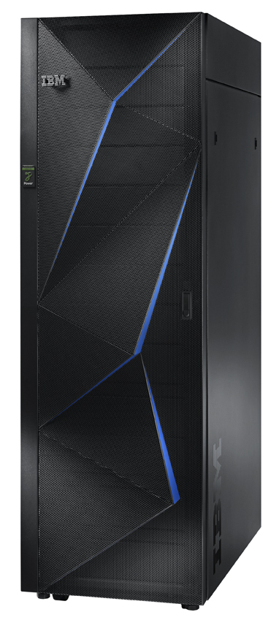
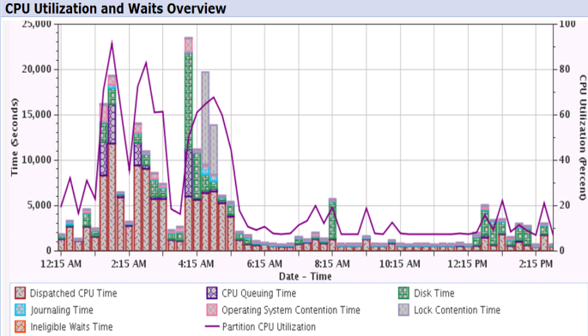
IBM i Performance Analysis Workshop
Learn the science and art of performance analysis, methodology and problem solving
Managing and analyzing the data can be quite complex. During this workshop, the IBM Expert Labs IBM i team will share useful techniques for analyzing performance data on key IBM i resources, and will cover strategies for solving performance problems. It will aid in building a future foundation of performance methodology you can apply in your environment.
Overview:
  Topics covered include:
    Key performance analysis concepts
    Performance tools
    Performance data collectors (Collection Services, Job Watcher,
    Disk Watcher, and Performance Explorer)
    Wait accounting
  Core methodology and analysis of:
    Locks
    Memory
    I/O subsystem
    CPU
  Concept reinforcement through case studies and lab exercises
  Discussions on theory, problem solving, prevention and best practices
Workshop details:
  Intermediate IBM i skill level
  3-4 day workshop, private (on-site)
    For additional information please contact Stacy Benfield at stacylb@us.ibm.com
IBM Expert Labs - ibm.com/products/expertlabs/infrastructure- ibmsls@us.ibm.com
© 2026 IBM Corporation

Slide 44
For more information
IBM Sites:
IBM i Home Page | https://www.ibm.com/it-infrastructure/power/os/ibm-i
IBM Strategy Whitepaper | https://www.ibm.com/it-infrastructure/us-en/resources/power/i-strategy-roadmap/
IBM Client Success | https://www.ibm.com/it-infrastructure/us-en/resources/power/ibm-i-customer-stories/
Support Life Cycle | https://www.ibm.com/support/lifecycle/
License Topics | https://www-01.ibm.com/support/docview.wss?uid=nas8N1022087
IBM i Release Life Cycle | https://www.ibm.com/support/pages/release-life-cycle
IBM i TR Wikis | IBM i Technology Updates

Slide 45
For more information:
Blogs to follow
More to follow
Hashtags to Use
TechChannel You and i (Steve Will)
TechChannel: i Can (Dawn May)
TechChannel: OpenYour i with Jesse Gorzinski
IBM Db2 for i (Kent Milligan)
IBM i Analytics Blog (Jon Westcott Jr)
iSee with Scott and Tim
@IBMservers
@COMMONug
@IBMChampions
@IBMSystemsISVs
@LinuxIBMMag
@OpenPOWERorg
@ITJungleNews
@SAPonIBMi
@SiDforIBMi
@IBMAIXeSupp
@IBMAIXdoc
#IBMPower
#IBMi
#IBMAIX
#Power10
#LinuxonPower
#HANAonPower
#ITinfrastructure
#OpenSource
#HybridCloud

Slide 46
Special notices
This document was developed for IBM offerings in the United States as of the date of publication. IBM may not make these offerings available in other countries, and the information is subject to change without notice. Consult your local IBM business contact for information on the IBM offerings available in your area.
Information in this document concerning non-IBM products was obtained from the suppliers of these products or other public sources. Questions on the capabilities of non-IBM products should be addressed to the suppliers of those products.
IBM may have patents or pending patent applications covering subject matter in this document. The furnishing of this document does not give you any license to these patents. Send license inquires, in writing, to IBM Director of Licensing, IBM Corporation, New Castle Drive, Armonk, NY 10504-1785 USA.
All statements regarding IBM future direction and intent are subject to change or withdrawal without notice, and represent goals and objectives only.
The information contained in this document has not been submitted to any formal IBM test and is provided "AS IS" with no warranties or guarantees either expressed or implied.
All examples cited or described in this document are presented as illustrations of the manner in which some IBM products can be used and the results that may be achieved. Actual environmental costs and performance characteristics will vary depending on individual client configurations and conditions.
IBM Global Financing offerings are provided through IBM Credit Corporation in the United States and other IBM subsidiaries and divisions worldwide to qualified commercial and government clients. Rates are based on a client's credit rating, financing terms, offering type, equipment type and options, and may vary by country. Other restrictions may apply. Rates and offerings are subject to change, extension or withdrawal without notice.
IBM is not responsible for printing errors in this document that result in pricing or information inaccuracies.
All prices shown are IBM's United States suggested list prices and are subject to change without notice; reseller prices may vary.
IBM hardware products are manufactured from new parts, or new and serviceable used parts. Regardless, our warranty terms apply.
Any performance data contained in this document was determined in a controlled environment. Actual results may vary significantly and are dependent on many factors including system hardware configuration and software design and configuration. Some measurements quoted in this document may have been made on development-level systems. There is no guarantee these measurements will be the same on generally-available systems. Some measurements quoted in this document may have been estimated through extrapolation. Users of this document should verify the applicable data for their specific environment.

Slide 47
Special notices (cont.)
IBM, the IBM logo, ibm.com AIX, AIX (logo), AIX 5L, AIX 6 (logo), AS/400, BladeCenter, Blue Gene, ClusterProven, Db2, ESCON, i5/OS, i5/OS (logo), IBM Business Partner (logo), IntelliStation, LoadLeveler, Lotus, Lotus Notes, Notes, Operating System/400, OS/400, PartnerLink, PartnerWorld, PowerPC, pSeries, Rational, RISC System/6000, RS/6000, THINK, Tivoli, Tivoli (logo), Tivoli Management Environment, WebSphere, xSeries, z/OS, zSeries, Active Memory, Balanced Warehouse, CacheFlow, Cool Blue, IBM Systems Director VMControl, pureScale, TurboCore, Chiphopper, Cloudscape, Db2 Universal Database, DS4000, DS6000, DS8000, EnergyScale, Enterprise Workload Manager, General Parallel File System, , GPFS, HACMP, HACMP/6000, HASM, IBM Systems Director Active Energy Manager, iSeries, Micro-Partitioning, POWER, PowerExecutive, PowerVM, PowerVM (logo), PowerHA, Power Architecture, Power Everywhere, Power Family, POWER Hypervisor, Power Systems, Power Systems (logo), Power Systems Software, Power Systems Software (logo), POWER2, POWER3, POWER4, POWER4+, POWER5, POWER5+, POWER6, POWER6+, POWER7, System i, System p, System p5, System Storage, System z, TME 10, Workload Partitions Manager and X-Architecture are trademarks or registered trademarks of International Business Machines Corporation in the United States, other countries, or both. If these and other IBM trademarked terms are marked on their first occurrence in this information with a trademark symbol (® or ™), these symbols indicate U.S. registered or common law trademarks owned by IBM at the time this information was published. Such trademarks may also be registered or common law trademarks in other countries.
A full list of U.S. trademarks owned by IBM may be found at: http://www.ibm.com/legal/copytrade.shtml.
Adobe, the Adobe logo, PostScript, and the PostScript logo are either registered trademarks or trademarks of Adobe Systems Incorporated in the United States, and/or other countries.
AltiVec is a trademark of Freescale Semiconductor, Inc.
AMD Opteron is a trademark of Advanced Micro Devices, Inc.
InfiniBand, InfiniBand Trade Association and the InfiniBand design marks are trademarks and/or service marks of the InfiniBand Trade Association.
Intel, Intel logo, Intel Inside, Intel Inside logo, Intel Centrino, Intel Centrino logo, Celeron, Intel Xeon, Intel SpeedStep, Itanium, and Pentium are trademarks or registered trademarks of Intel Corporation or its subsidiaries in the United States and other countries.
IT Infrastructure Library is a registered trademark of the Central Computer and Telecommunications Agency which is now part of the Office of Government Commerce.
Java and all Java-based trademarks and logos are trademarks or registered trademarks of Oracle and/or its affiliates.
Linear Tape-Open, LTO, the LTO Logo, Ultrium, and the Ultrium logo are trademarks of HP, IBM Corp. and Quantum in the U.S. and other countries.
Linux is a registered trademark of Linus Torvalds in the United States, other countries or both.
Microsoft, Windows and the Windows logo are registered trademarks of Microsoft Corporation in the United States, other countries or both.
NetBench is a registered trademark of Ziff Davis Media in the United States, other countries or both.
SPECint, SPECfp, SPECjbb, SPECweb, SPECjAppServer, SPEC OMP, SPECviewperf, SPECapc, SPEChpc, SPECjvm, SPECmail, SPECimap and SPECsfs are trademarks of the Standard Performance Evaluation Corp (SPEC).
The Power Architecture and Power.org wordmarks and the Power and Power.org logos and related marks are trademarks and service marks licensed by Power.org.
TPC-C and TPC-H are trademarks of the Transaction Performance Processing Council (TPPC).
UNIX is a registered trademark of The Open Group in the United States, other countries or both.
Other company, product and service names may be trademarks or service marks of others.

