Slide 1

Welcome to Lyon, France
and the 2026 Common Europe Congress
Bienvenue à Lyon, en France,
et au Congrès de Common Europe 2026

Slide 2

Al Agents: Best
Practices for
the Next Era of
Software
From Passive Chatbots to
Autonomous Digital Workers
MIRZA ĆUTUK, Head of AI, InnoBoost SA

Slide 3




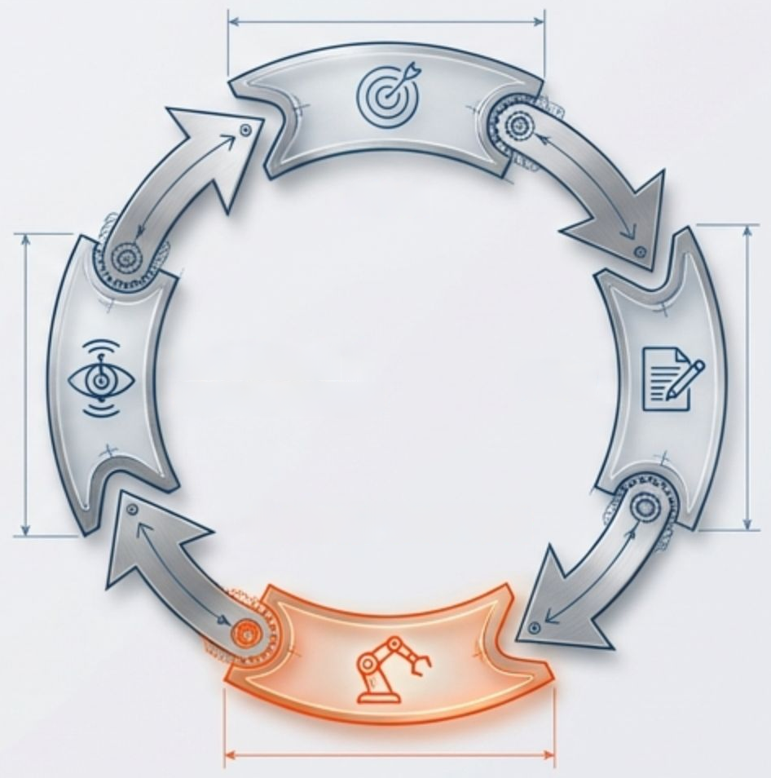




Beyond the Chatbot: The Shift to Agency
PASSIVE GENERATION (The Chatbot)
ACTIVE EXECUTION (The Agent)
Prompt
Goal
Model
Feedback
|
Plan
Observation
Action/Tool Use
Text Response
Linear interaction. Ends
after generation.
Iterative loop. Reasons, acts, and
adapts to achieve outcome.
InnoBoost SA

Slide 4




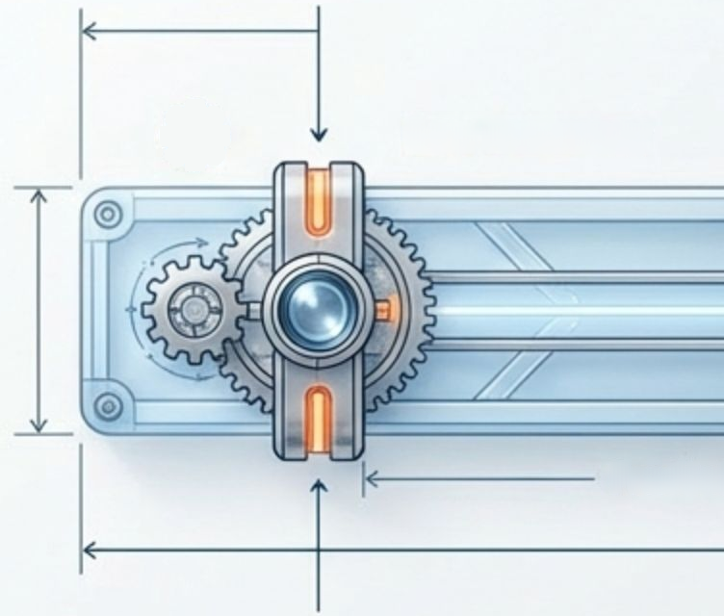








The Spectrum of Autonomy
Prescriptive
Workflows
"Customers draw an important architectural
Distinction between workflows and agents. Reliability
correlates with lower autonomy initially." - Anthropic
Autonomous
Agents
Low Autonomy
High Autonomy
Predictability Range
Complexity Scale
Workflows
General Agents
Defined paths. Strict scripts.
Predictable.
Open-ended goals.
Independent pathing.
Best for: Compliance,
Best for: Research
Standard Operating Procedures.
complex problem solving.
InnoBoost SA

Slide 5


The Anatomy of an Agent
Orchestration
(Executive Function)
The Brain
(Model)
Memory
(Context)
API
Batabase
Function
The Hands
(Tools)
InnoBoost SA

Slide 6


The Market Inflection Point is Now
End of 2026
40%
40%
Adoption by 2026
%ofEnterpriseAppswithAgents
$450
Billion
30%
20%
10%
5%
Projected Agentic Al
revenue by 2035.
2024
2025
2026
2026
Strategic Window:
Source: Gartner, 2025
Executives have 3-6 months
to define agentic strategy.
InnoBoost SA

Slide 7














Supercharging the Workforce
Current State
Agentic Era
High Value
30%
30%
Strategic Work
70%
70%
High Value
Strategic Work
Value Created
Routine Tasks (Research,
Drafting, Analysis)
70%
70%
30%
%
00
Routine Tasks
(Augmented by Agents)
Current State
Agentic Era
Address
60-70%
Shift from One-to-Many to One-to-One interactions
of employee time
From Automation (Faster) to Augmentation (Better)
(Source: Databricks)
InnoBoost SA

Slide 8



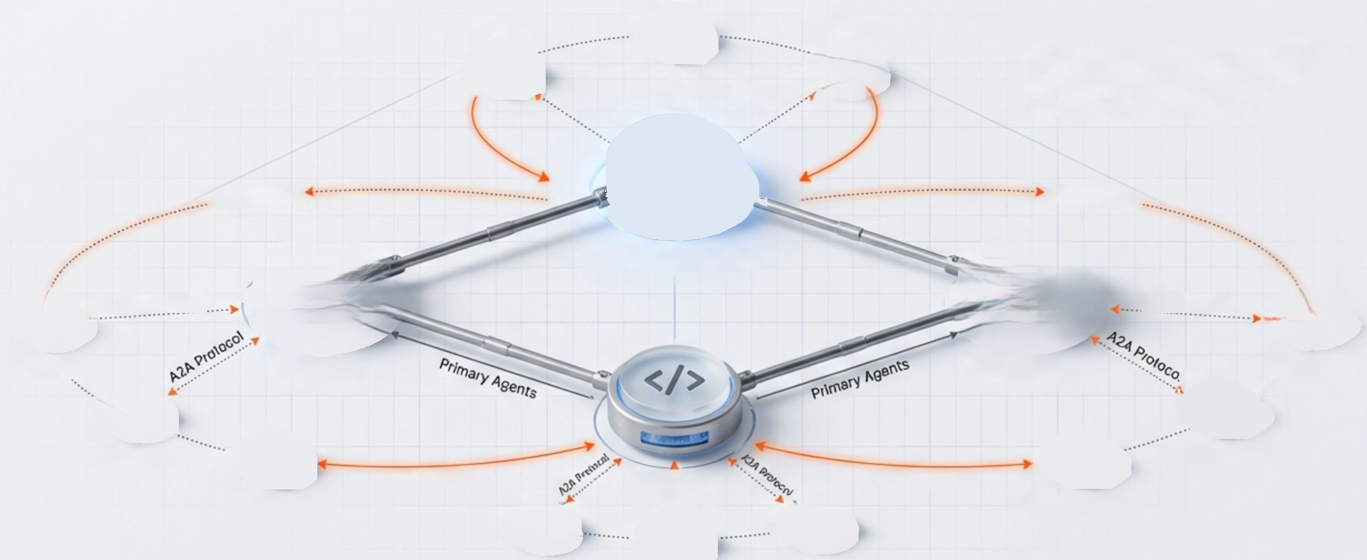

















The Future of Work:
Agent Ecosystems
Agent Status:
Orchestrating swarm...
Debugger
Tester
Deployer
Democratization of Agency
Everyday users become agent builders.
Humans orchestrate swarms of specialized
digital workers.
A2A Protocol
A2A Protocol
A2A Protocol
Human Manager
A2A Protocol
A2A Protocol
Scheduler
Planner
Researcher
Data Miner
Resource Allocator
Synthesizer
A2A Protocol
Coder
A2A Protocol
Sub-Agents
Fact Checker
Tester
Debugger
Deployer
InnoBoost SA

Slide 9
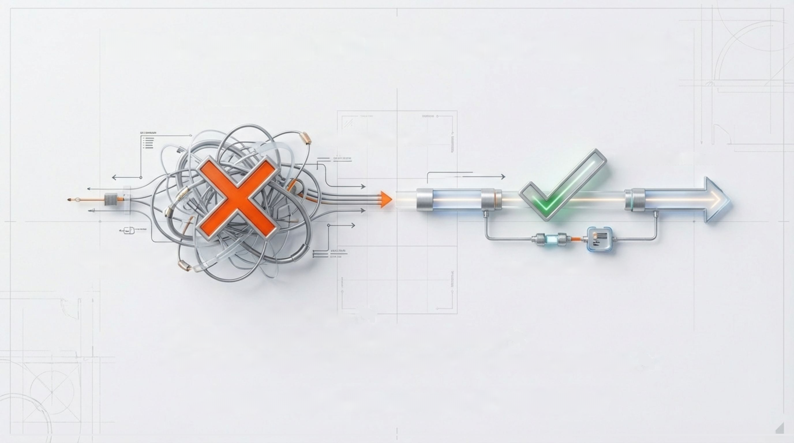
Best Practice #1: Design for Simplicity
Path A
Path B
COTT pepOs coen
COETING
Over-Engineered/
Generalist
Specialized Workflow
Reduce abstraction layers.
Start with explicit workflows, then add autonomy.
Define the 'Instruction' parameter clearly: Task, Persona, Constraints.
"Complexity is the enemy of reliability."
InnoBoost SA

Slide 10






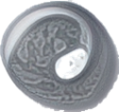









Best Practice #2: The Toolset Strategy
Agent Status:
Orchestrating swarm...
Tool:
Customer_Lookup
Description: Retrieves customer order history
and warranty status.
Input: customer_id (string)
Output:
JSON object
Ground Truth:
Tools provide the agent with reality.
Clear Signals:
Make tool names and descriptions unique to prevent confusion.
Categories:
Data Retrieval (Read), Actions (Write), Extensions (Connect).
InnoBoost SA

Slide 11

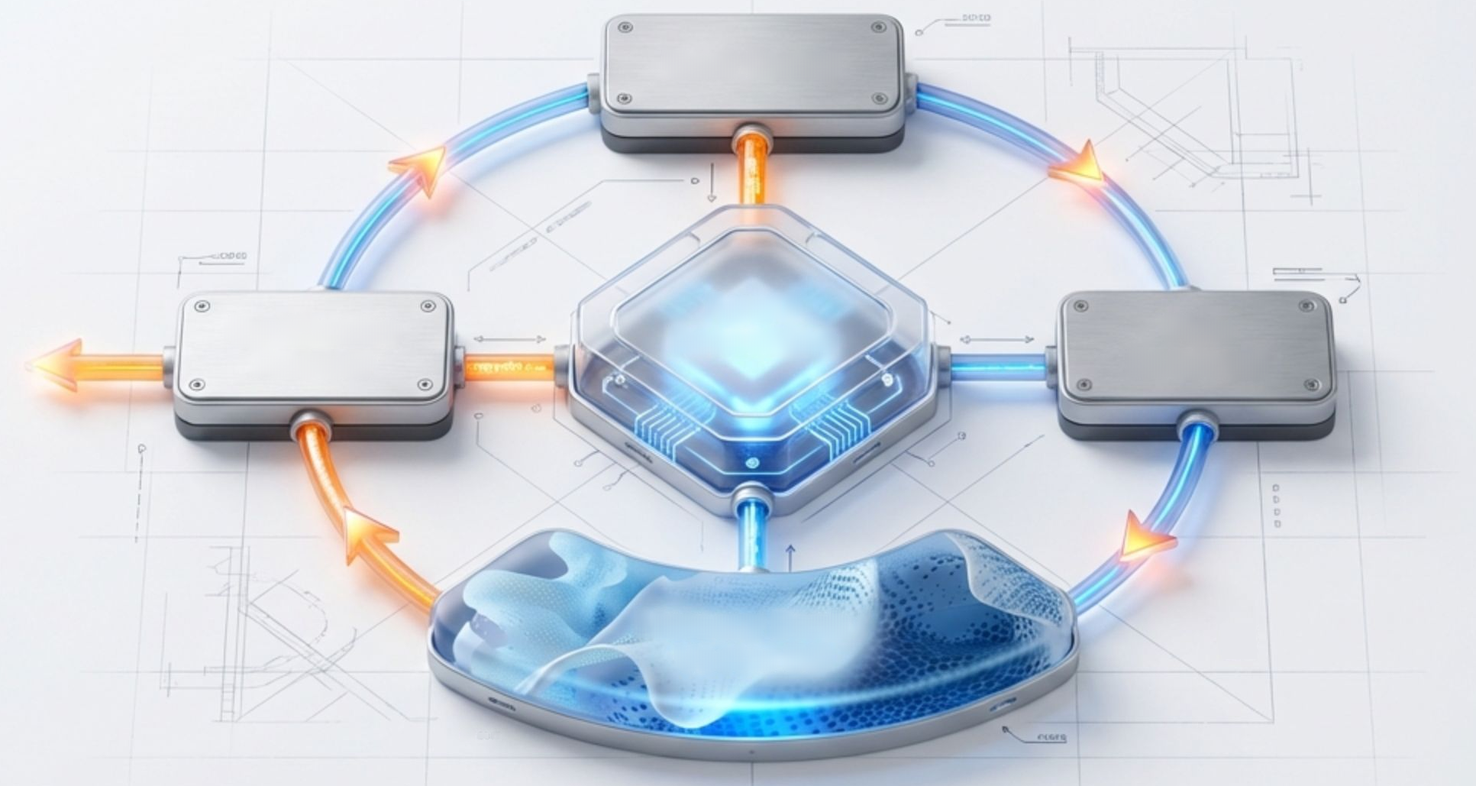

Best Practice #3: Context is King (Agentic RAG)
User Query
Synthesize
Answer
Agent
Reasoning
Plan
Retrieval
Memory Bank/
Vector DB
0
Passive Retrieval -> Active Reasoning.
Agents formulate plans to retrieve the right data reducing hallucination.
Key Value:
Access to real-time inventory, warranty status, and internal docs.
InnoBoost SA

Slide 12










Best Practice #4: Orchestration Patterns
Single Agent (ReAct Loop)
Multi-Agent (Router Pattern)
Thought
Router / Orchestrator
Observation
Action
Specialist A
Specialist B
Specialist C
Simple tasks. Direct execution.
Complex workflows. Task delegation.
Mastering orchestration moves you beyond single-shot limitations.
InnoBoost SA

Slide 13









Best Practice #5: Transparency & Observability
Show Your Work!
USER:"Book a flight to NYC."
AGENT THOUGHT:
Checking calendar availability...
Inspect the 'trajectory' to
debug reasoning errors.
AGENT ACTION:
Call tool
'Calendar_API'
OBSERVATION:
Free slot found
on Tuesday.
AGENT Thought : Searching flights...
Implement AgentOps:
Logging
Tracing
Token Metrics.
InnoBoost SA

Slide 14

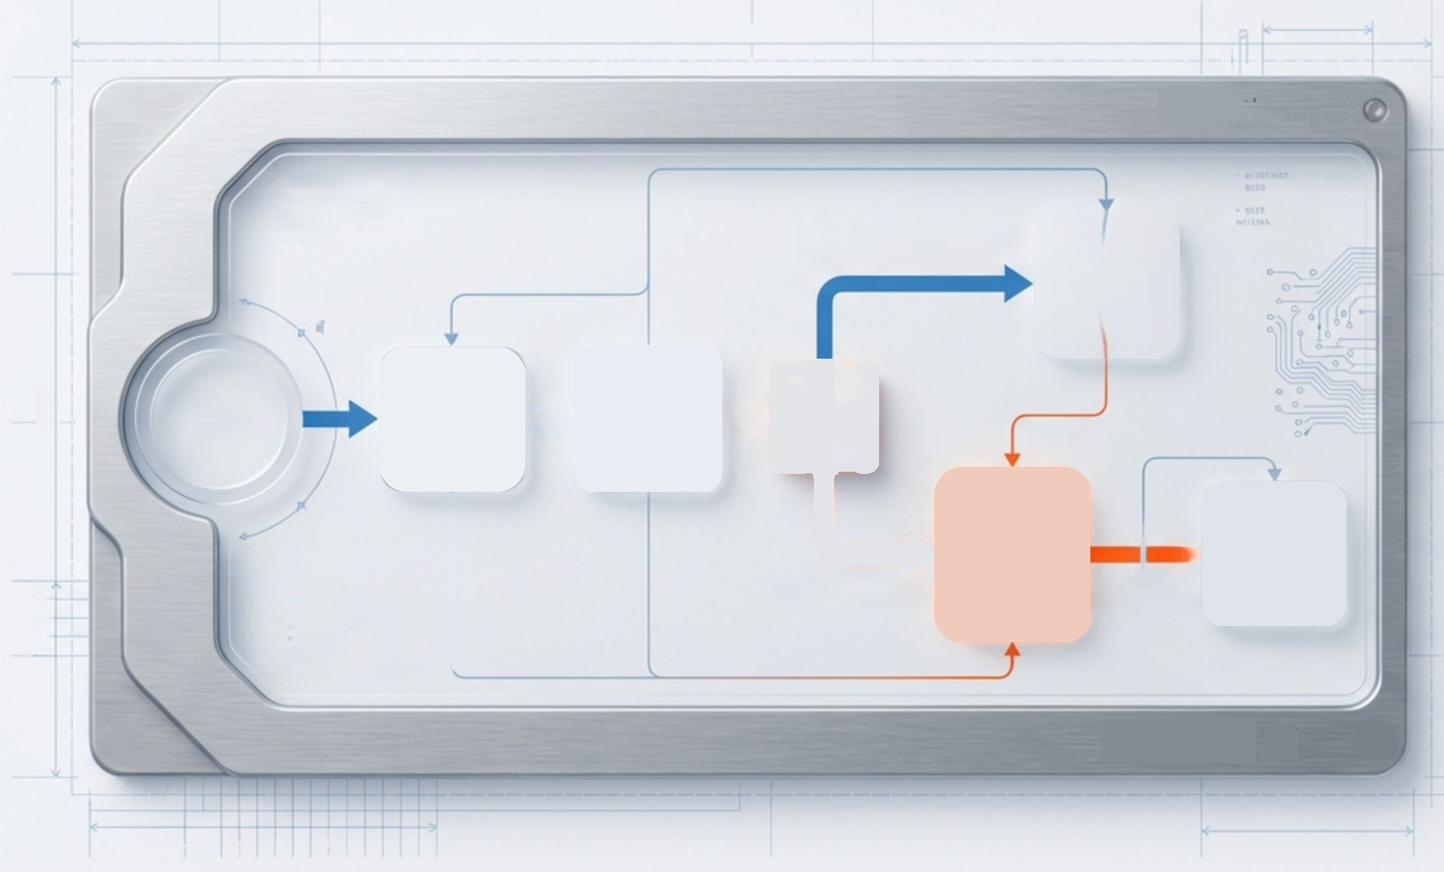




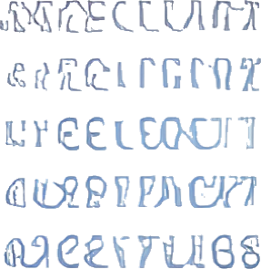














Best Practice #6: Safety & The Human-in-the-Loop
a50=00881
5.00
1300
0
JetBrains Mono
Escalation: Hand off
when confidence is low.
TONRESO ROCEISI DGIESTSSTSNG
10%
10G
Confidence > 90%
Auto
Execute
Approval: Pause for
confirmation on high-
stakes actions (e.g.,
executing code, sending
emails).
Agent
Reasoning
Confidence
Start
Check
Human
Execute
U7
Confidence <90%
Review
Approval
9
I0M04:
M5AICJSO2S
01
EGECN:
#ERICTSD
04
#EPOCESS
EOIRO
BEtOCISSCT
SOECAI4S:
2ETSCCICD
Engineered Precision
SAESSS:
#1250113
Result: Fail gracefully,
not destructively.
109
InnoBoost SA

Slide 15
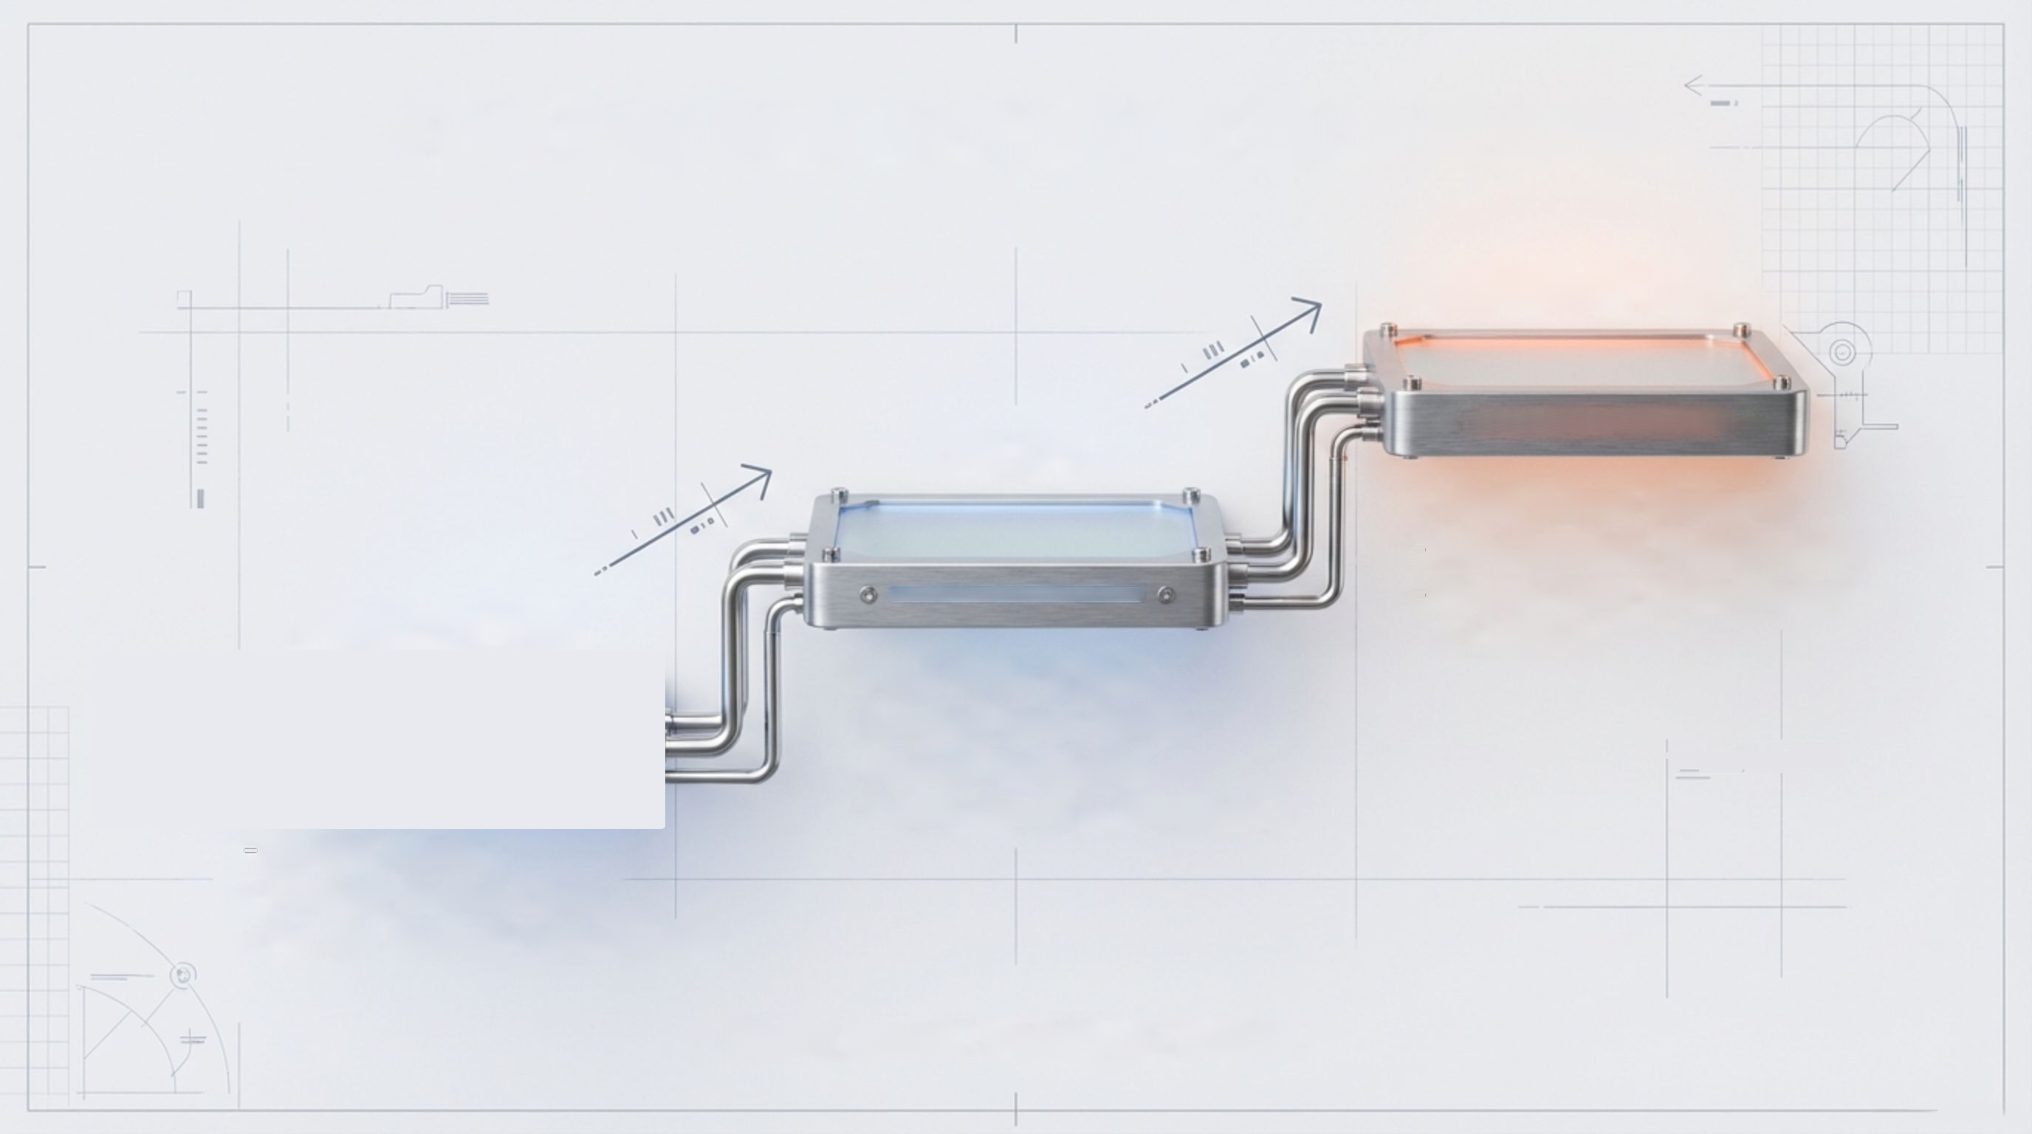


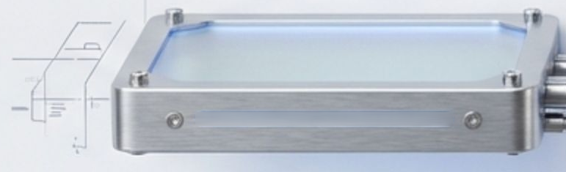






The Implementation Roadmap
PRODUCTION
PILOT
Multi-Agent Systems
Autonomous Orchestration
Focus: Cost Optimization & Latency
PROTOTYPE
Add Tools & RAG
Limited User Group
Focus: Semantic Correctness & Grounding
Single Agent
Human-in-the-Loop
Focus: Lexical Correctness
Start small. Validate. Scale.
InnoBoost SA

Slide 16






S
The New Agentic Normal
006
750
E
20
1B
15
18
1002
000
From Using Software to
Managing Outcomes.
1.
Identify a
workflow
2.
Define the
tools
3.
Build the
agent
910
"The brands that act now will lead the next era." - Gartner
InnoBoost SA

Slide 17
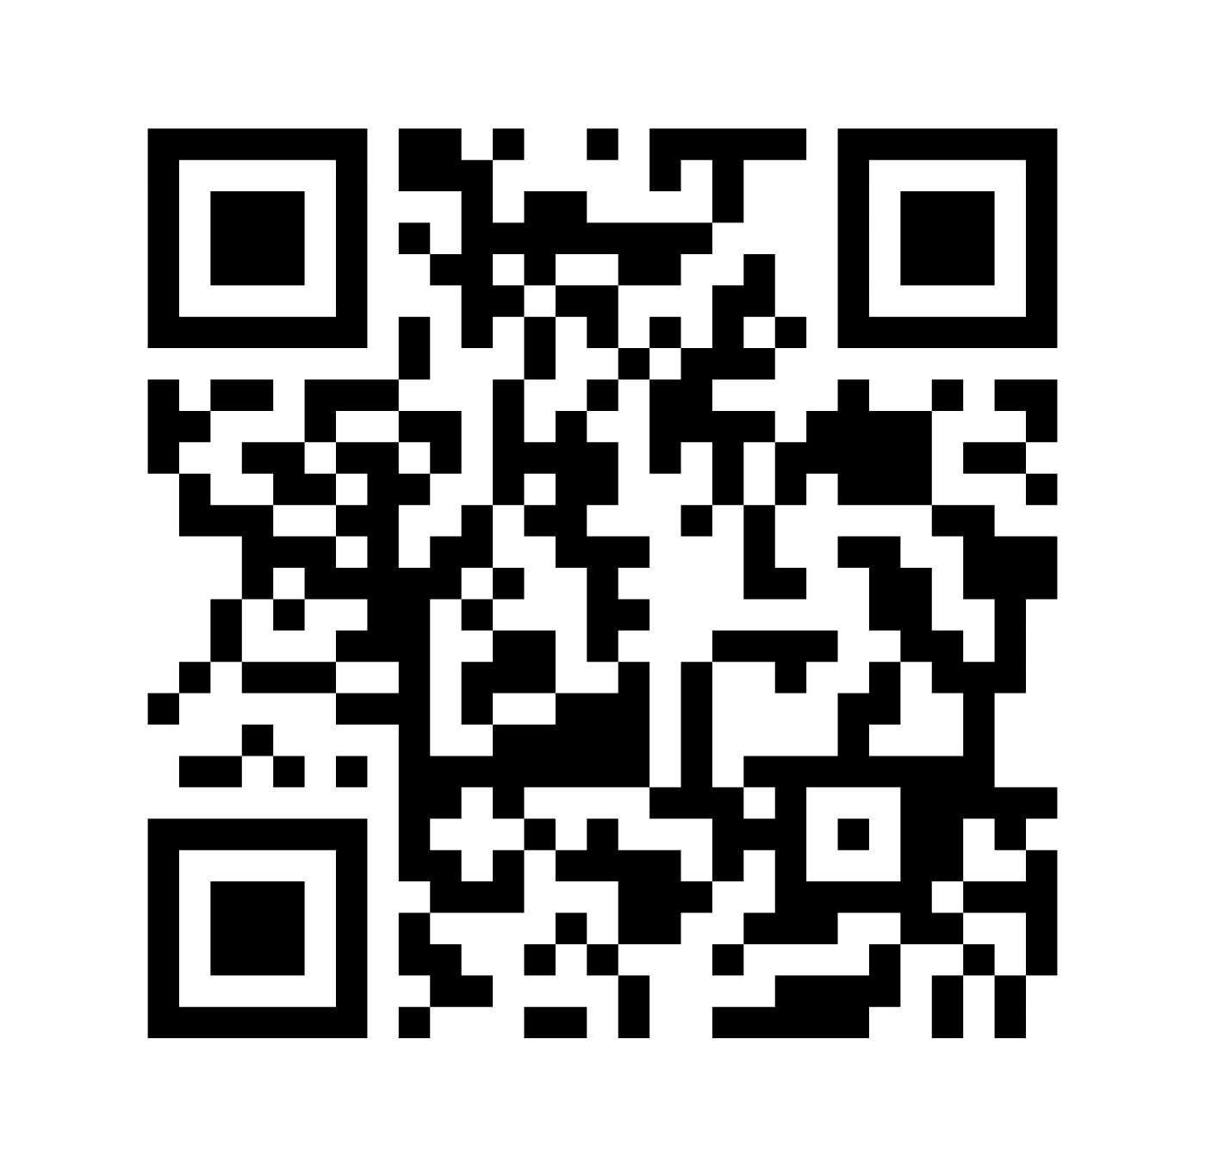
S
Thank you!
006
750
E
20
1B
15
18
1002
000
910
MIRZA ĆUTUK, Head of AI, InnoBoost SA
InnoBoost SA

