Slide 1
IBM FlashSystem
Designed to Protect Engineered to Adapt Built to Perform

Slide 2


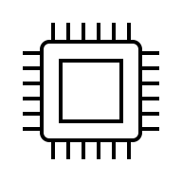





Title
Traditional storage approaches aren’t keeping pace
Monolithic
System-Centric
Disaggregated
SLA-Centric
Leaf-Spine Connectivity
Manual
Processes
Fabric-Based
Agentic
Notes:
Key Message: Traditional enterprise storage approaches limit our flexibility, are expensive to scale, and are reactive, not proactive.
<This slide communicates the complexity of traditional approaches, especially as infrastructure scales to keep up with ever increasing demands, The other point to make, related to the key speaker point, is that it slows us down (i.e., falling behind), leaving businesses exposed to competitive threats and missing business opportunities because the infrastructure is not keeping pace with the velocity of business change. >
Suggested talking points:
Traditional storage was built for highly predictable operations — but today’s environments are anything but predictable. Manual tuning and static configurations simply can’t keep pace with the speed of modern workloads.
As data grows and infrastructure sprawls across on‑prem, cloud, and edge, traditional systems become bottlenecks—slowing response times, increasing operational burden, and amplifying risk.
In a world where threats evolve every hour and business demands change daily, relying on human‑driven processes isn’t just inefficient—it’s unsafe.
The reality is simple: traditional storage reacts to problems after they happen. Modern enterprises need infrastructure that anticipates, adapts, and acts in real time.

Slide 3
Title
We need a new approach
Monolithic
System-Centric
Disaggregated
SLA-Centric
Leaf-Spine Connectivity
Manual
Processes
Fabric-Based
Agentic
Notes:
Key Message: A new framework is needed for enterprise storage – one that transforms storage into an intelligent, autonomous data layer.
<Communicate the journey we’ve been on to embed intelligence and flexibility into FlashSystem, and how the confluence of technologies – the rapidly maturing capabilities of AI, the ability to deliver agentic solutions – has created this moment when we can expect more of out of our infrastructure. Much more. >
Suggested talking points:
We need to rethink how storage shows up in the enterprise, by delivering a more flexible and responsive infrastructure. This is a journey we’ve been on for years now, with our delivery of FlashSystem Grid and an SLA-driven approach to storage that we introduced last year.
Today, we’re building on that progress by delivering capabilities that anticipates and delivers on the intent of the business.

Slide 4
IBM FlashSystem key features
Built with the solid foundation of IBM Storage Virtualize
Storage Object Management and Capabilities
System & Security Management and Capabilities
Snapshot & Clone Capabilities
Replication & HA Capabilities

Slide 5
IBM FlashSystem key features Built with the solid foundation of IBM Storage Virtualize
Storage Object Management and Capabilities
System & Security Management and Capabilities
Snapshot & Clone Capabilities
Replication & HA Capabilities
Industry unique FCM Computational Storage with onboard hardware Data Reduction, Post Quantum Cryptography & internal smart data placement tiering.
Distributed RAID with dynamic expansion and smart rebuild.
Child Pools with logical separation & perf/capacity quotas including I/O throttles (QoS).
Hardware Thin Provisioning with zero detect & offload built in FCM.
Volume Mirroring (Thick to Thin etc)
Volume Groups for Policy-based mgmt
FDMI host discovery, management & automatic Fibre Channel zoning.
Non-disruptive volume, controller, and Storage Partition migration.
Scale out FlashSystem grid for capacity, performance and object scalability.
External Storage Virtualization.
FCM Ransomware Threat Detection & Inline Data Corruption Detection. (coming soon Data Exfiltration detection)
Data at rest Encryption - via self-encrypting drives or interface ports for externally virtualised capacity.
Cyber resilience separation of duties & Multi-tenancy for logical air gap, Role & Object based access controls.
Volume delete protection.
MFA - Multi-factor Authentication.
SSO - Single sign-on integration.
TPI - Two Person Integrity.
Integrated encrypted GUI/CLI/REST API.
Storage Intelligence Control (Insights/Control) cloud management, pro-active support, advisories and .AI agent integrations.
Ansible modules/playbooks.
FlashSystem.ai agents.
Pause-less Volume Group Snapshots with clones and thin-clones and implicit data immutability.
Simple refresh & restore operations from Snapshots or thin-clones volume(s) or Volume Groups.
Restore, refresh onto PBR production or PBHA active management site volume(s) or Volume Groups.
Cascaded copies and restores.
Highly-available Snapshots with zero sync restore and HA thin-cloning.
IBM Safeguarded Copy immutable logical air-gapped snapshots for Cyber Resilience
Internal scheduling of Volume Group Snapshots & TCT - or integration with external scheduling tools.
PBR - Policy-based Replication featuring Adaptive async journaling/cycling operational modes & DR test mode with checkpointing.
PBHA - Policy-based High Availability with active/active Storage Partitions - uniform and non-uniform host modes and switchable active management site preferences
Integrated 3-site HA-DR with automated recovery process from any site.
Consistency Protection for added safety during recovery.
Partition Migration maintaining PBR DR stance.
Native IPsec Replication

Slide 6
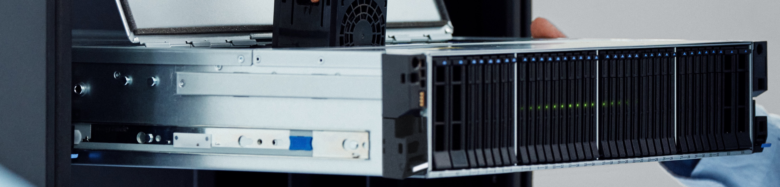
Inside FlashSystem
Unveiling the next generation

Slide 7
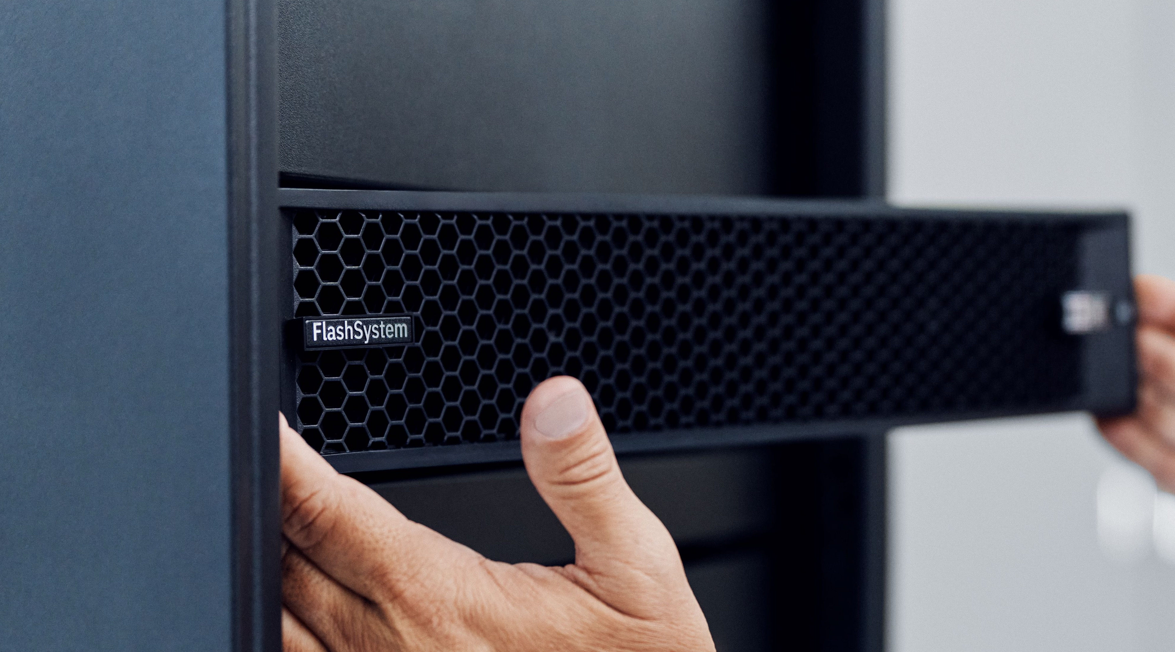

Slide 8
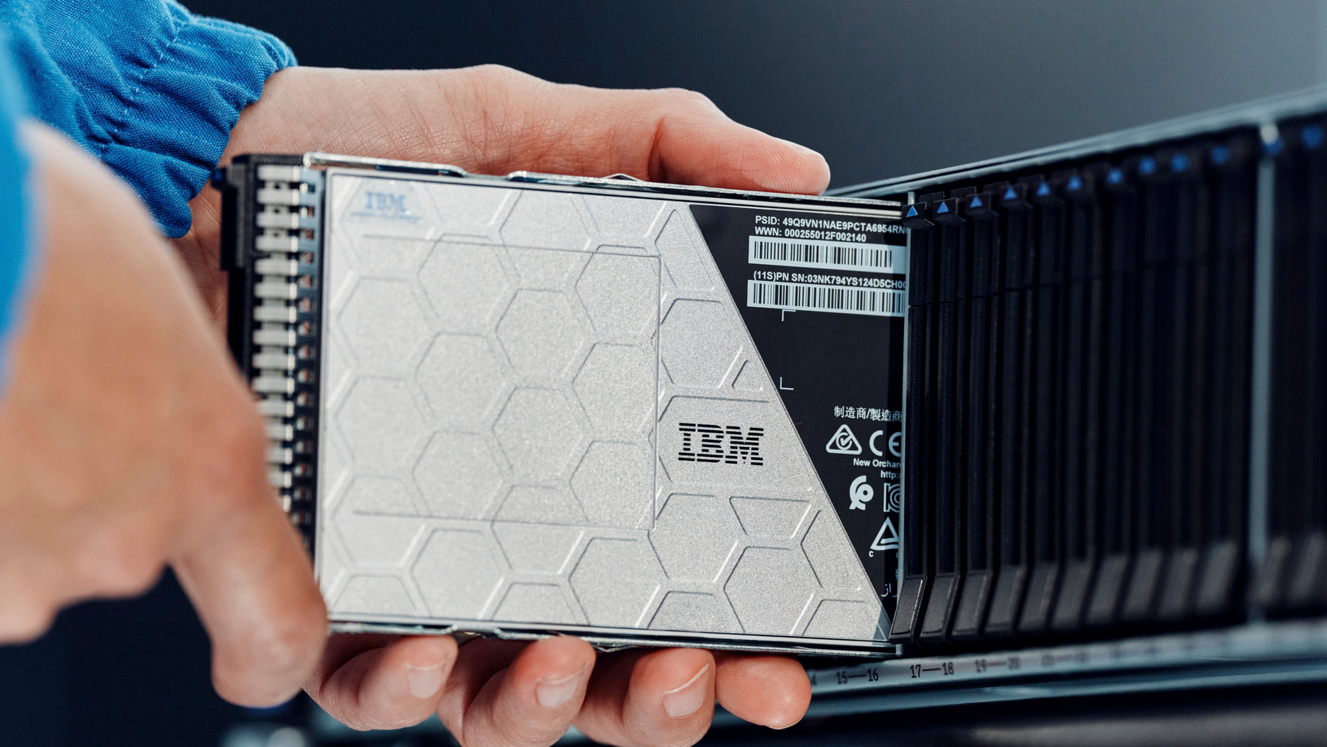
2026 Introducing FCM5
Performance
Better power delivery
and signal integrity
Cooling
Optimised shapes allow
for more efficient airflow
Scalability
Supports future needs for
higher capacities, faster speeds

Slide 9

FCM4 vs FCM5
Longer / Thinner / Taller / Faster Form Factor
Designed for solid state not spinning disks
New additional card capacity FCM5-XXL
20% more raw capacity across the range
PCIe Gen5 interface
Longer / Thinner / Taller / Faster Form Factor
Designed for solid state not spinning disks
New additional card capacity FCM5-XXL
20% more raw capacity across the range
PCIe Gen5 interface
Enterprise Datacenter Form Factor (EDSFF) E3.L 1T

Slide 10
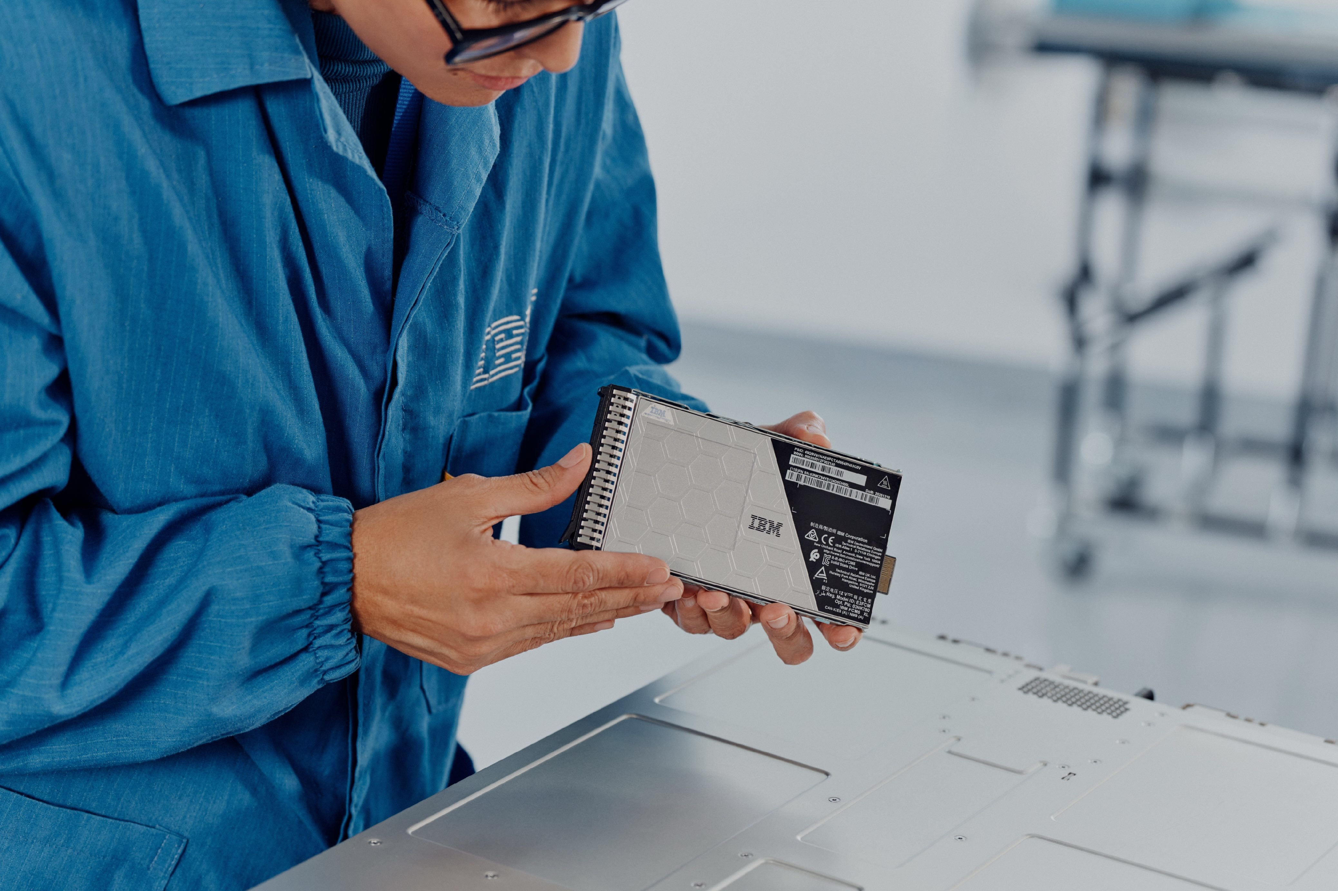
FCM5
Datacenter Optimized
FCM5
Latest 2Tb QLC NAND, same FlashCore Reliability
Increased :
Raw Capacity
Effective Capacity
Performance
Computational Offload
Security
Data Reduction
Capacity Points in TB |  | Small |  | Medium |  | Large |  | XL |  | XXL
RAW Capacity |  | 6.6 |  | 13.2 |  | 26.4 |  | 52.8 |  | 105.6
Physical Capacity (1:1) |  | 5.6 |  | 11.2 |  | 22.4 |  | 44.8 |  | 89.6
Effective Capacity |  | 33.6 |  | 67.2 |  | 134.4 |  | 268.8 |  | 438.0
Platform Support |  | x600 |  | x600 |  | x600 |  | x600 |  | 9600

Slide 11
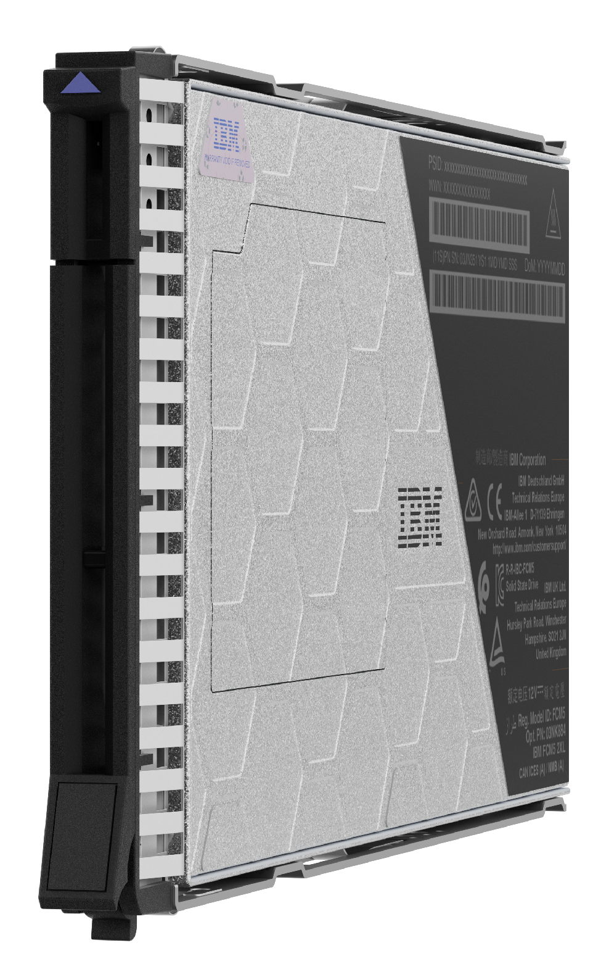
FCM Intelligence
Worlds smartest Computational Storage Device
High density flash that performs and endures
Health Binning - asymmetric wear levelling, Heat Binning - minimise write amplification, Variable Voltage - lifespan
Dynamic workload reactive performance
Pseudo-SLC read caching, Smart data placement - hinting architecture
Internal anomaly & ransomware threat detection
Meta-data collected from every I/O, Summary data every 2s, Statistical analysis -median - mean
Zero impact encryption and compression…
100% hardware logic, Post-Quantum Cryptography for key transport and authentication, always on zero performance impact
…and NEW deduplication

Slide 12
With the new FCM5 E3 form factor…
Don’t we need some new enclosures?

Slide 13
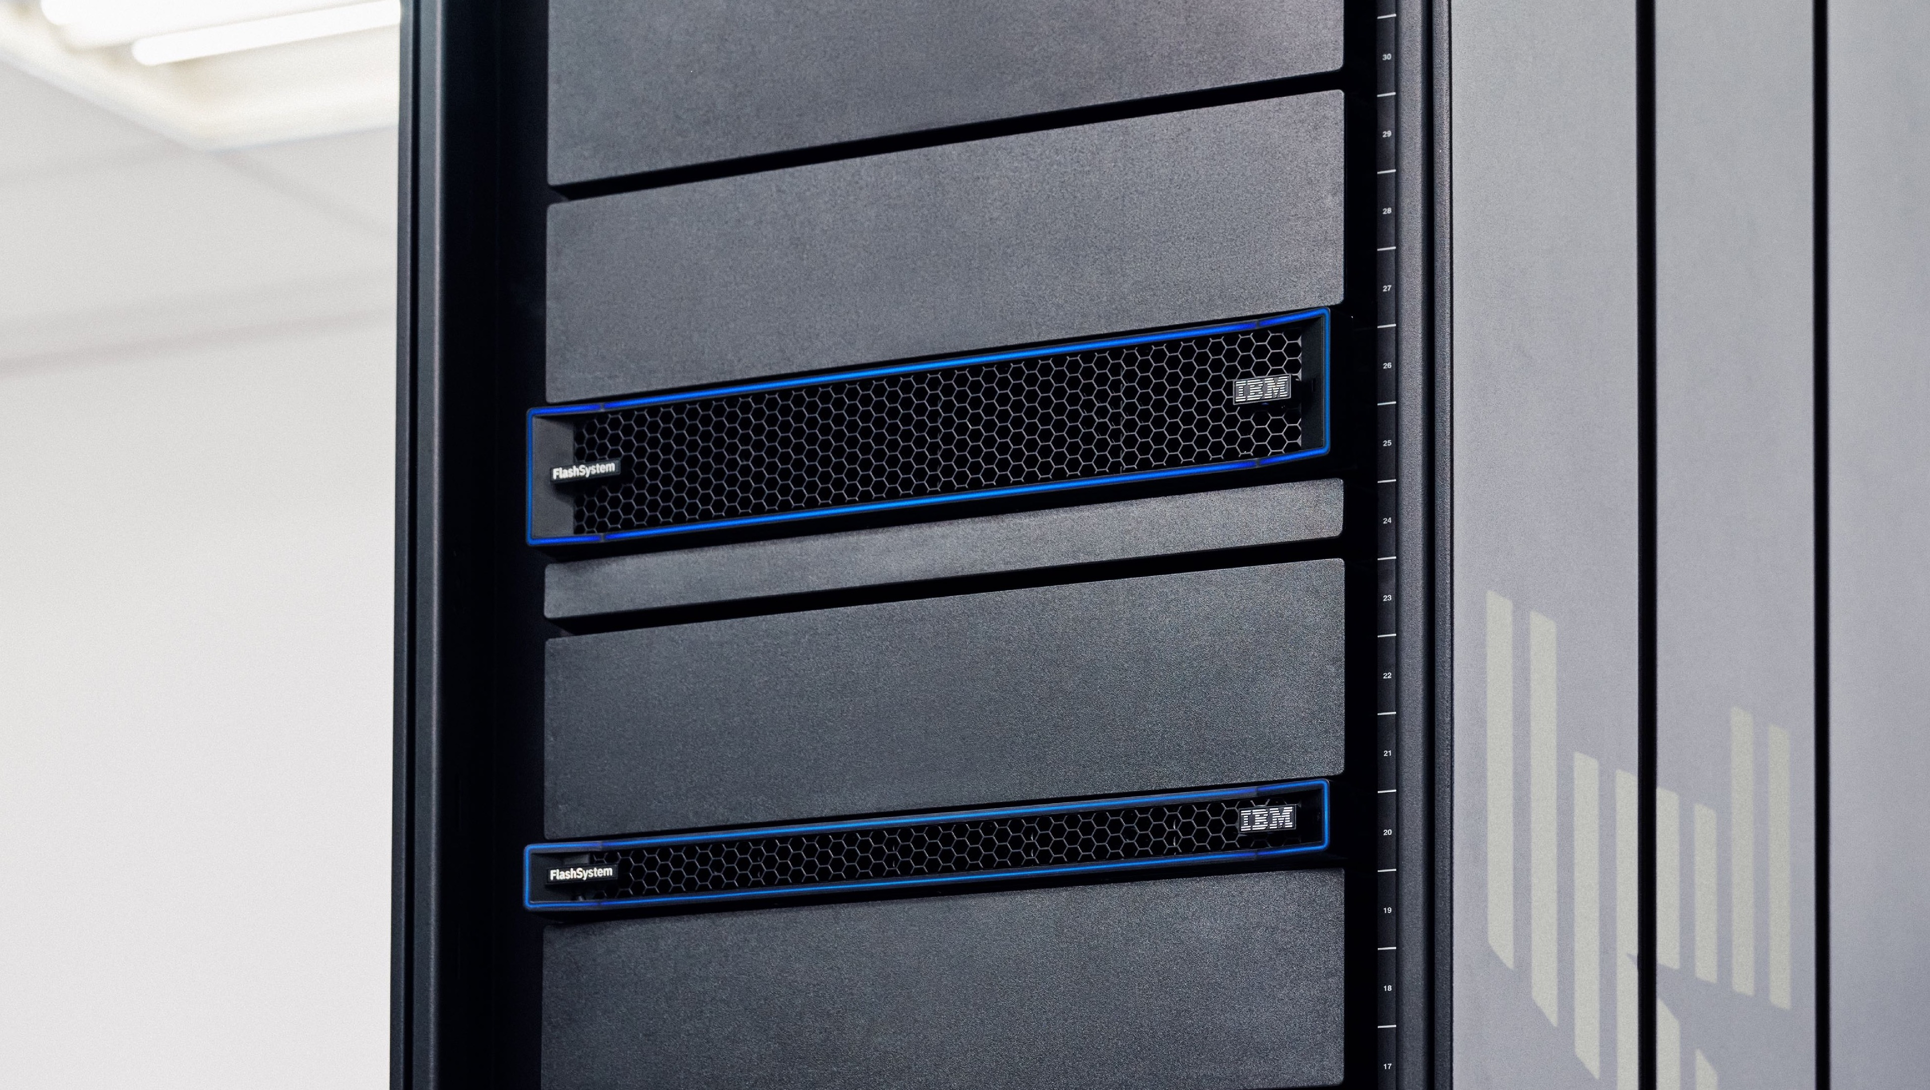

Slide 14

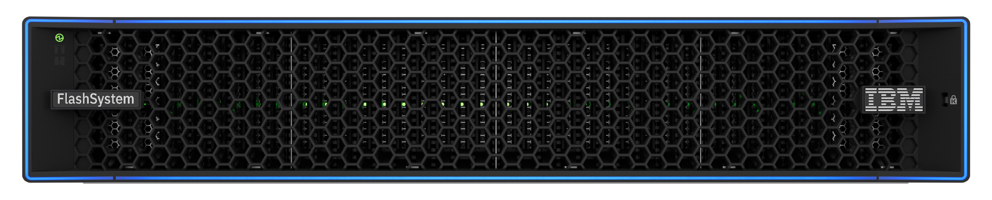
Introducing the new IBM FlashSystem 9600
Almost 12PBe, 1.75M real world OLTP IOPs and 86GB/s in 2U
Notes:
The high-capacity magic of the FlashSystem 7600 occurs within the central thirty-two 1T-3E drive slots. It is anticipated that ~95% of organizations will purchase FlashSystem 7600 with IBM FlashCore Module 5s (FCM5s). What really makes the FlashSystem 7600 a superstar is that it easily delivers high-performance storage, while simultaneously delivering unparalleled resilience and protection. All these things genuinely help the 7600 stand out from the competition. Bear in mind all the features that the 7600 delivers on top of the stunning amount of capacity.
<CLICK>
At each end of the FlashSystem 7600 front panel there are two 2T-3E slots for potential future use-cases. They are double wide slots for what will likely be extremely high density modules at some point.
<CLICK>
Since there are currently no 2T-E3 modules there is very little to be gained by spending time discussing the four slots. It is probably best to mention them, point out they are further evidence of future-proofing, and then move on.
What should be mentioned are the things that deliver real value from day one. FlashSystem 7600 provides immutable Safeguarded Copy snapshots. They cannot be altered or deleted except by the appropriate security administrator. On top of that they are invisibly stored right on the primary storage array where they were taken. This prevents “bad actors” from messing with them. Because they are stored locally, they can deliver very rapid data recovery. In fact, it is so rapid, that IBM has a 60-second data recovery guarantee. Perhaps even more interesting is that IBM provides all FlashSystem models with software-based ransomware threat detection that spots anomalous behavior within a few minutes. Things get even better when organizations use FCM5s which contain ransomware threat detection embedded in hardware. That enables anomalous behavior to be detected in seconds. Things get even better when companies realize they can use IBM FlashSystem grid to non-disruptively migrate data between systems. This is all handled by a sophisticated AI-driven intelligence.. But things get even better, because FlashSystem 7600 is able to virtualize over 500 different storage systems at which point those systems gain IBM’s amazing features and abilities.
Terminology:
1T-E3: Single Thickness E3 Open-Source memory slot
2T-E3: Double Thickness E3 Open-Source memory slot
FCM: FlashCore Module
NVMe: Non-Volatile Memory express
SGC: Safeguarded Copy
SSD: Solid State Drive

Slide 15
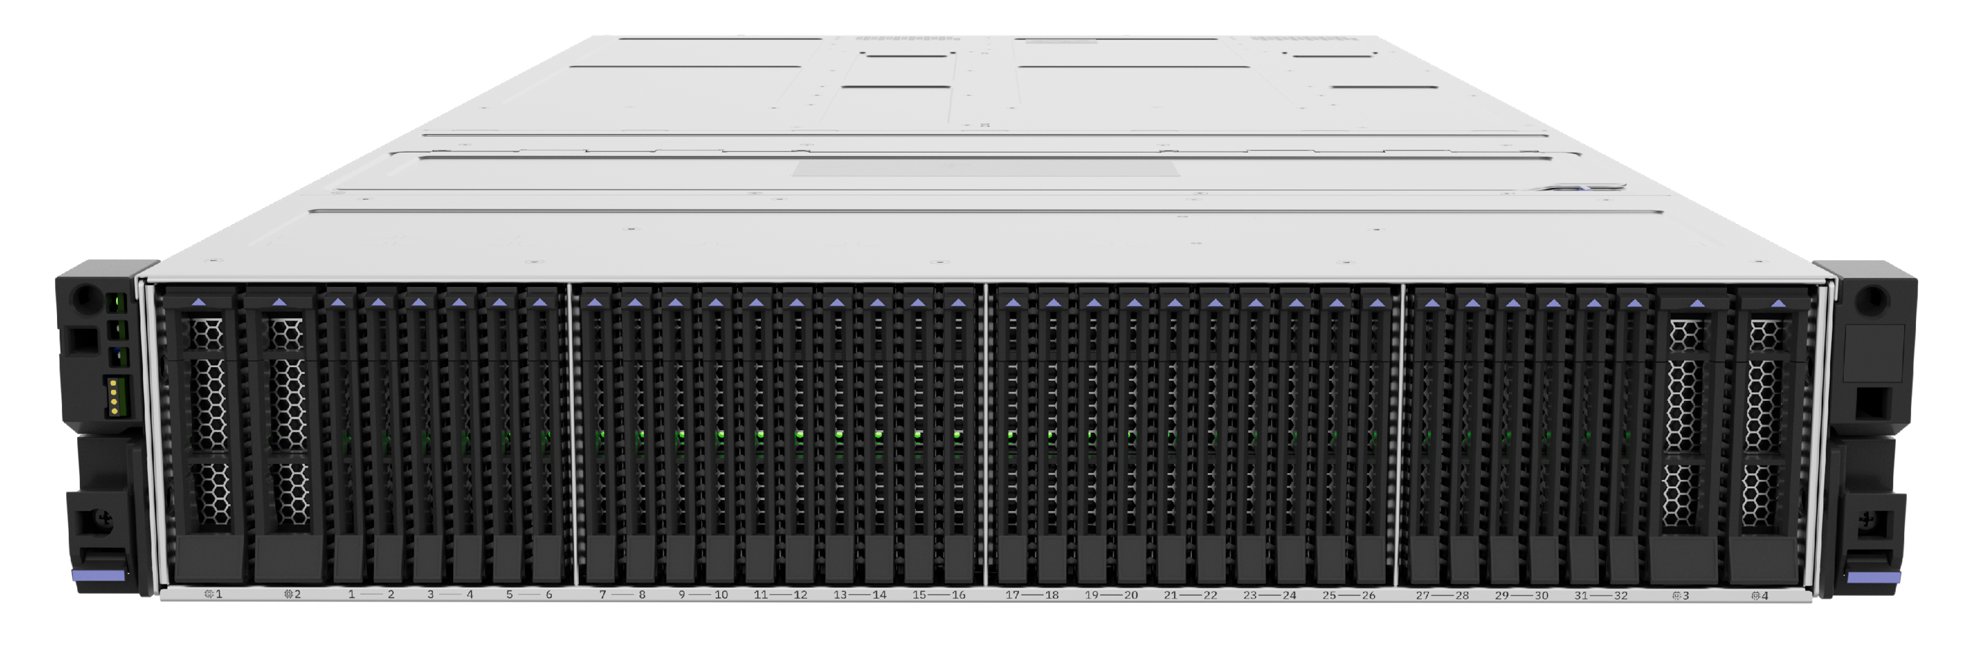
Introducing the new IBM FlashSystem 9600
The new 2XL
105.6TB FCM5
is exclusive to
to the 9600
Capacity Points in TB |  | Small
x1 FCM5 RAW |  | 6.6
x1 FCM5 physical |  | 5.6
x1 FCM5 effective |  | 33.6
x32 FCM5 physical w/RAID |  | 151.9
x32 FCM5 effective w/ RAID |  | 911.4
Capacity Points in TB |  | Small |  | Medium
x1 FCM5 RAW |  | 6.6 |  | 13.2
x1 FCM5 physical |  | 5.6 |  | 11.2
x1 FCM5 effective |  | 33.6 |  | 67.2
x32 FCM5 physical w/RAID |  | 151.9 |  | 303.8
x32 FCM5 effective w/ RAID |  | 911.4 |  | 1822.8
Capacity Points in TB |  | Small |  | Medium |  | Large
x1 FCM5 RAW |  | 6.6 |  | 13.2 |  | 26.4
x1 FCM5 physical |  | 5.6 |  | 11.2 |  | 22.4
x1 FCM5 effective |  | 33.6 |  | 67.2 |  | 134.4
x32 FCM5 physical w/RAID |  | 151.9 |  | 303.8 |  | 607.6
x32 FCM5 effective w/ RAID |  | 911.4 |  | 1822.8 |  | 3645.6
Capacity Points in TB |  | Small |  | Medium |  | Large |  | XL
x1 FCM5 RAW |  | 6.6 |  | 13.2 |  | 26.4 |  | 52.8
x1 FCM5 physical |  | 5.6 |  | 11.2 |  | 22.4 |  | 44.8
x1 FCM5 effective |  | 33.6 |  | 67.2 |  | 134.4 |  | 268.8
x32 FCM5 physical w/RAID |  | 151.9 |  | 303.8 |  | 607.6 |  | 1215.2
x32 FCM5 effective w/ RAID |  | 911.4 |  | 1822.8 |  | 3645.6 |  | 7291.2
Capacity Points in TB |  | Small |  | Medium |  | Large |  | XL |  | 2XL
x1 FCM5 RAW |  | 6.6 |  | 13.2 |  | 26.4 |  | 52.8 |  | 105.6
x1 FCM5 physical |  | 5.6 |  | 11.2 |  | 22.4 |  | 44.8 |  | 89.6
x1 FCM5 effective |  | 33.6 |  | 67.2 |  | 134.4 |  | 268.8 |  | 438.0
x32 FCM5 physical w/RAID |  | 151.9 |  | 303.8 |  | 607.6 |  | 1215.2 |  | 2430.4
x32 FCM5 effective w/ RAID |  | 911.4 |  | 1822.8 |  | 3645.6 |  | 7291.2 |  | 11880.8
Notes:
The high-capacity magic of the FlashSystem 7600 occurs within the central thirty-two 1T-3E drive slots. It is anticipated that ~95% of organizations will purchase FlashSystem 7600 with IBM FlashCore Module 5s (FCM5s). What really makes the FlashSystem 7600 a superstar is that it easily delivers high-performance storage, while simultaneously delivering unparalleled resilience and protection. All these things genuinely help the 7600 stand out from the competition. Bear in mind all the features that the 7600 delivers on top of the stunning amount of capacity.
<CLICK>
At each end of the FlashSystem 7600 front panel there are two 2T-3E slots for potential future use-cases. They are double wide slots for what will likely be extremely high density modules at some point.
<CLICK>
Since there are currently no 2T-E3 modules there is very little to be gained by spending time discussing the four slots. It is probably best to mention them, point out they are further evidence of future-proofing, and then move on.
What should be mentioned are the things that deliver real value from day one. FlashSystem 7600 provides immutable Safeguarded Copy snapshots. They cannot be altered or deleted except by the appropriate security administrator. On top of that they are invisibly stored right on the primary storage array where they were taken. This prevents “bad actors” from messing with them. Because they are stored locally, they can deliver very rapid data recovery. In fact, it is so rapid, that IBM has a 60-second data recovery guarantee. Perhaps even more interesting is that IBM provides all FlashSystem models with software-based ransomware threat detection that spots anomalous behavior within a few minutes. Things get even better when organizations use FCM5s which contain ransomware threat detection embedded in hardware. That enables anomalous behavior to be detected in seconds. Things get even better when companies realize they can use IBM FlashSystem grid to non-disruptively migrate data between systems. This is all handled by a sophisticated AI-driven intelligence.. But things get even better, because FlashSystem 7600 is able to virtualize over 500 different storage systems at which point those systems gain IBM’s amazing features and abilities.
Terminology:
1T-E3: Single Thickness E3 Open-Source memory slot
2T-E3: Double Thickness E3 Open-Source memory slot
FCM: FlashCore Module
NVMe: Non-Volatile Memory express
SGC: Safeguarded Copy
SSD: Solid State Drive

Slide 16
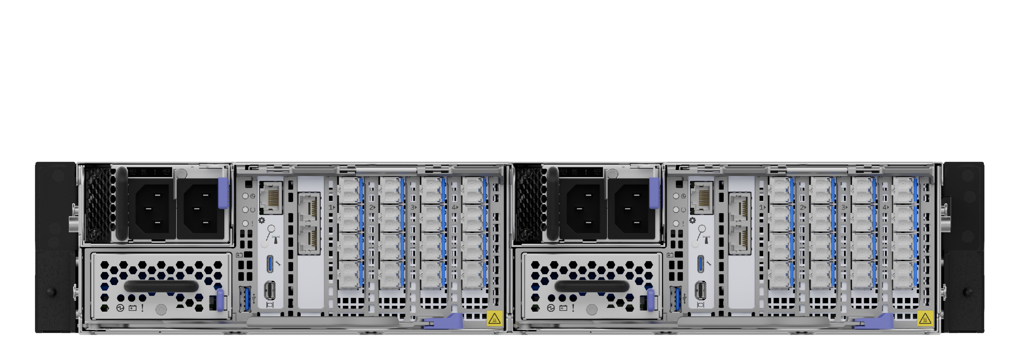
Introducing the new IBM FlashSystem 9600
Notes:
The high-capacity magic of the FlashSystem 7600 occurs within the central thirty-two 1T-3E drive slots. It is anticipated that ~95% of organizations will purchase FlashSystem 7600 with IBM FlashCore Module 5s (FCM5s). What really makes the FlashSystem 7600 a superstar is that it easily delivers high-performance storage, while simultaneously delivering unparalleled resilience and protection. All these things genuinely help the 7600 stand out from the competition. Bear in mind all the features that the 7600 delivers on top of the stunning amount of capacity.
<CLICK>
At each end of the FlashSystem 7600 front panel there are two 2T-3E slots for potential future use-cases. They are double wide slots for what will likely be extremely high density modules at some point.
<CLICK>
Since there are currently no 2T-E3 modules there is very little to be gained by spending time discussing the four slots. It is probably best to mention them, point out they are further evidence of future-proofing, and then move on.
What should be mentioned are the things that deliver real value from day one. FlashSystem 7600 provides immutable Safeguarded Copy snapshots. They cannot be altered or deleted except by the appropriate security administrator. On top of that they are invisibly stored right on the primary storage array where they were taken. This prevents “bad actors” from messing with them. Because they are stored locally, they can deliver very rapid data recovery. In fact, it is so rapid, that IBM has a 60-second data recovery guarantee. Perhaps even more interesting is that IBM provides all FlashSystem models with software-based ransomware threat detection that spots anomalous behavior within a few minutes. Things get even better when organizations use FCM5s which contain ransomware threat detection embedded in hardware. That enables anomalous behavior to be detected in seconds. Things get even better when companies realize they can use IBM FlashSystem grid to non-disruptively migrate data between systems. This is all handled by a sophisticated AI-driven intelligence.. But things get even better, because FlashSystem 7600 is able to virtualize over 500 different storage systems at which point those systems gain IBM’s amazing features and abilities.
Terminology:
1T-E3: Single Thickness E3 Open-Source memory slot
2T-E3: Double Thickness E3 Open-Source memory slot
FCM: FlashCore Module
NVMe: Non-Volatile Memory express
SGC: Safeguarded Copy
SSD: Solid State Drive

Slide 17
Introducing the new IBM FlashSystem 7600
Over 7PBe, 700K real world OLTP IOPs and 60GB/s in 2U
Notes:
The high-capacity magic of the FlashSystem 7600 occurs within the central thirty-two 1T-3E drive slots. It is anticipated that ~95% of organizations will purchase FlashSystem 7600 with IBM FlashCore Module 5s (FCM5s). What really makes the FlashSystem 7600 a superstar is that it easily delivers high-performance storage, while simultaneously delivering unparalleled resilience and protection. All these things genuinely help the 7600 stand out from the competition. Bear in mind all the features that the 7600 delivers on top of the stunning amount of capacity.
<CLICK>
At each end of the FlashSystem 7600 front panel there are two 2T-3E slots for potential future use-cases. They are double wide slots for what will likely be extremely high density modules at some point.
<CLICK>
Since there are currently no 2T-E3 modules there is very little to be gained by spending time discussing the four slots. It is probably best to mention them, point out they are further evidence of future-proofing, and then move on.
What should be mentioned are the things that deliver real value from day one. FlashSystem 7600 provides immutable Safeguarded Copy snapshots. They cannot be altered or deleted except by the appropriate security administrator. On top of that they are invisibly stored right on the primary storage array where they were taken. This prevents “bad actors” from messing with them. Because they are stored locally, they can deliver very rapid data recovery. In fact, it is so rapid, that IBM has a 60-second data recovery guarantee. Perhaps even more interesting is that IBM provides all FlashSystem models with software-based ransomware threat detection that spots anomalous behavior within a few minutes. Things get even better when organizations use FCM5s which contain ransomware threat detection embedded in hardware. That enables anomalous behavior to be detected in seconds. Things get even better when companies realize they can use IBM FlashSystem grid to non-disruptively migrate data between systems. This is all handled by a sophisticated AI-driven intelligence.. But things get even better, because FlashSystem 7600 is able to virtualize over 500 different storage systems at which point those systems gain IBM’s amazing features and abilities.
Terminology:
1T-E3: Single Thickness E3 Open-Source memory slot
2T-E3: Double Thickness E3 Open-Source memory slot
FCM: FlashCore Module
NVMe: Non-Volatile Memory express
SGC: Safeguarded Copy
SSD: Solid State Drive

Slide 18
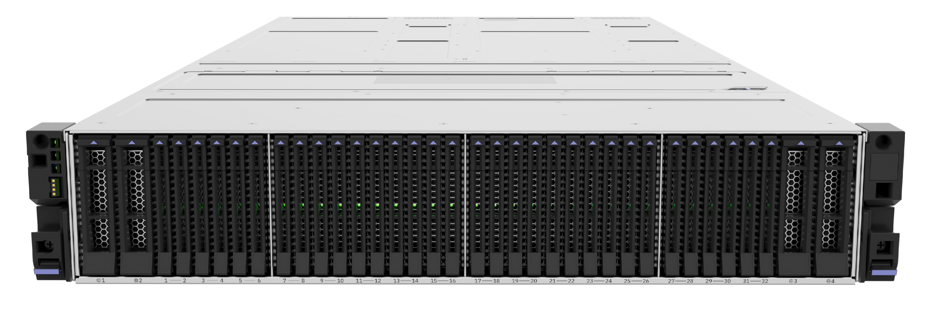
Introducing the new IBM FlashSystem 7600
Capacity Points in TB |  | Small |  | Medium |  | Large |  | XL
x1 FCM5 RAW |  | 6.6 |  | 13.2 |  | 26.4 |  | 52.8
x1 FCM5 physical |  | 5.6 |  | 11.2 |  | 22.4 |  | 44.8
x1 FCM5 effective |  | 33.6 |  | 67.2 |  | 134.4 |  | 268.8
x32 FCM5 physical w/RAID |  | 151.9 |  | 303.8 |  | 607.6 |  | 1215.2
x32 FCM5 effective w/ RAID |  | 911.4 |  | 1822.8 |  | 3645.6 |  | 7291.2
Notes:
The high-capacity magic of the FlashSystem 7600 occurs within the central thirty-two 1T-3E drive slots. It is anticipated that ~95% of organizations will purchase FlashSystem 7600 with IBM FlashCore Module 5s (FCM5s). What really makes the FlashSystem 7600 a superstar is that it easily delivers high-performance storage, while simultaneously delivering unparalleled resilience and protection. All these things genuinely help the 7600 stand out from the competition. Bear in mind all the features that the 7600 delivers on top of the stunning amount of capacity.
<CLICK>
At each end of the FlashSystem 7600 front panel there are two 2T-3E slots for potential future use-cases. They are double wide slots for what will likely be extremely high density modules at some point.
<CLICK>
Since there are currently no 2T-E3 modules there is very little to be gained by spending time discussing the four slots. It is probably best to mention them, point out they are further evidence of future-proofing, and then move on.
What should be mentioned are the things that deliver real value from day one. FlashSystem 7600 provides immutable Safeguarded Copy snapshots. They cannot be altered or deleted except by the appropriate security administrator. On top of that they are invisibly stored right on the primary storage array where they were taken. This prevents “bad actors” from messing with them. Because they are stored locally, they can deliver very rapid data recovery. In fact, it is so rapid, that IBM has a 60-second data recovery guarantee. Perhaps even more interesting is that IBM provides all FlashSystem models with software-based ransomware threat detection that spots anomalous behavior within a few minutes. Things get even better when organizations use FCM5s which contain ransomware threat detection embedded in hardware. That enables anomalous behavior to be detected in seconds. Things get even better when companies realize they can use IBM FlashSystem grid to non-disruptively migrate data between systems. This is all handled by a sophisticated AI-driven intelligence.. But things get even better, because FlashSystem 7600 is able to virtualize over 500 different storage systems at which point those systems gain IBM’s amazing features and abilities.
Terminology:
1T-E3: Single Thickness E3 Open-Source memory slot
2T-E3: Double Thickness E3 Open-Source memory slot
FCM: FlashCore Module
NVMe: Non-Volatile Memory express
SGC: Safeguarded Copy
SSD: Solid State Drive

Slide 19
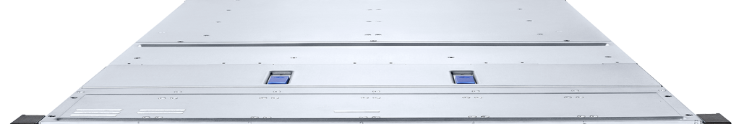
Introducing the new IBM FlashSystem 5600
Almost 2.5PBe, 400K real world OLTP IOPs and 30GB/s in 1U
Notes:
FlashSystem 5600 is exciting and new yet has a comfortable sense of familiarity about it. The front of the array looks somewhat familiar, yet it is clearly new. It is still one rack unit in height, but it is employing a new industry-standard flash form factor known as E3.L. Where FlashSystem 5300 was 1U with 12 flash media slots, the new 5600 has 15 flash media slots of which the system uses 12 slots to maximize performance. The rear of the 5600 will be very familiar. It looks identical to the backend of the 5300.
Terminology:
FCM5: FlashCore Module 5
GbE: Gigabit Ethernet
GB/s: Gigabyte per second
I/O: Input / Output
IP: Internet Protocol

Slide 20
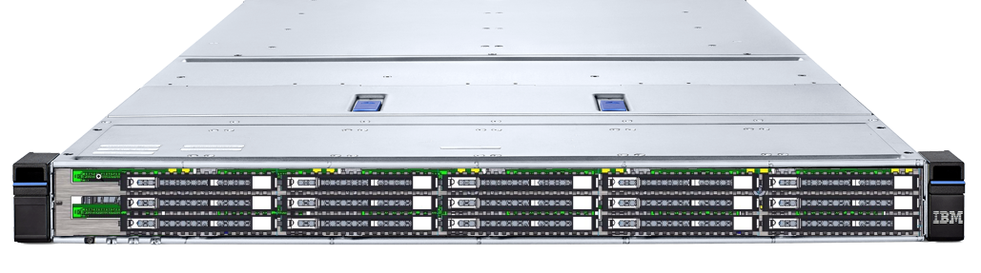
Introducing the new IBM FlashSystem 5600
Capacity Points in TB |  | Small |  | Medium |  | Large |  | XL
x1 FCM5 RAW |  | 6.6 |  | 13.2 |  | 26.4 |  | 52.8
x1 FCM5 physical |  | 5.6 |  | 11.2 |  | 22.4 |  | 44.8
x1 FCM5 effective |  | 33.6 |  | 67.2 |  | 134.4 |  | 268.8
x12 FCM5 physical w/RAID |  | 50.4 |  | 100.8 |  | 201.6 |  | 403.2
x12 FCM5 effective w/ RAID |  | 302.4 |  | 604.8 |  | 1209.6 |  | 2419.2
Notes:
FlashSystem 5600 is exciting and new yet has a comfortable sense of familiarity about it. The front of the array looks somewhat familiar, yet it is clearly new. It is still one rack unit in height, but it is employing a new industry-standard flash form factor known as E3.L. Where FlashSystem 5300 was 1U with 12 flash media slots, the new 5600 has 15 flash media slots of which the system uses 12 slots to maximize performance. The rear of the 5600 will be very familiar. It looks identical to the backend of the 5300.
Terminology:
FCM5: FlashCore Module 5
GbE: Gigabit Ethernet
GB/s: Gigabyte per second
I/O: Input / Output
IP: Internet Protocol

Slide 21
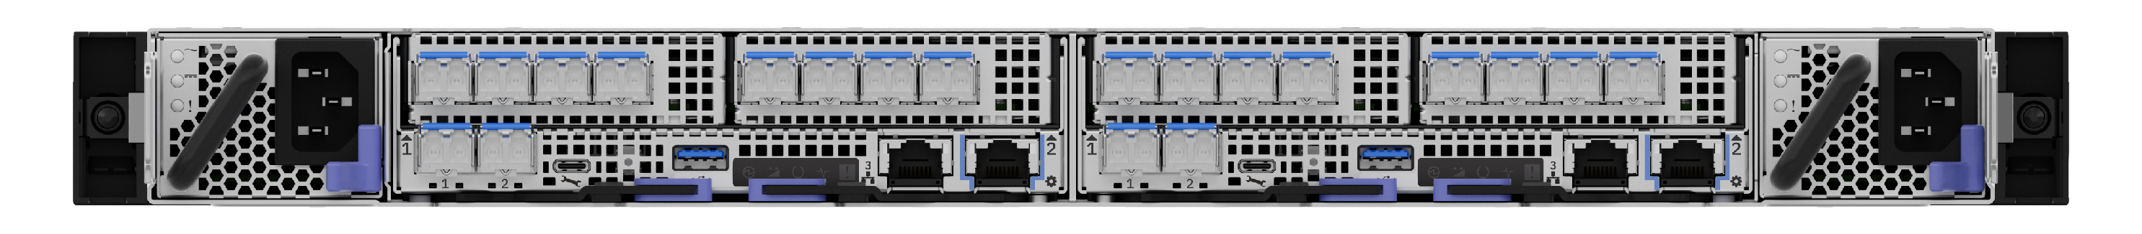
Introducing the new IBM FlashSystem 5600
Notes:
FlashSystem 5600 is exciting and new yet has a comfortable sense of familiarity about it. The front of the array looks somewhat familiar, yet it is clearly new. It is still one rack unit in height, but it is employing a new industry-standard flash form factor known as E3.L. Where FlashSystem 5300 was 1U with 12 flash media slots, the new 5600 has 15 flash media slots of which the system uses 12 slots to maximize performance. The rear of the 5600 will be very familiar. It looks identical to the backend of the 5300.
Terminology:
FCM5: FlashCore Module 5
GbE: Gigabit Ethernet
GB/s: Gigabyte per second
I/O: Input / Output
IP: Internet Protocol

Slide 22
IBM FlashSystem
Designed to Protect Engineered to Adapt Built to Perform

Slide 23
What’s new in Virtualize Software
8.7.x, 9.1.0, 9.1.1, 9.1.2
FlashSystem x600 models are running 9.1.2+

Slide 24
8.7.x highlights
Policy-based 3-site HA and DR
FlashSystem grid
Partition migration
HA snapshots
Restore & Refresh PBR & PBHA volumes
iSCSI support for PBHA hosts
PBHA support SCSI persistent reservations

Slide 25
9.1.0 highlights
Rename PBR, PBHA, Partition objects
Expand PBR, PBHA volumes
Partition support hostcluster object
Grid scaling to 32 systems, 32 partitions per system
Use case specific certificates
Auto update FCM firmware
SI based partition placement recommendations
Restore back to production from thin-clone snapshot

Slide 26
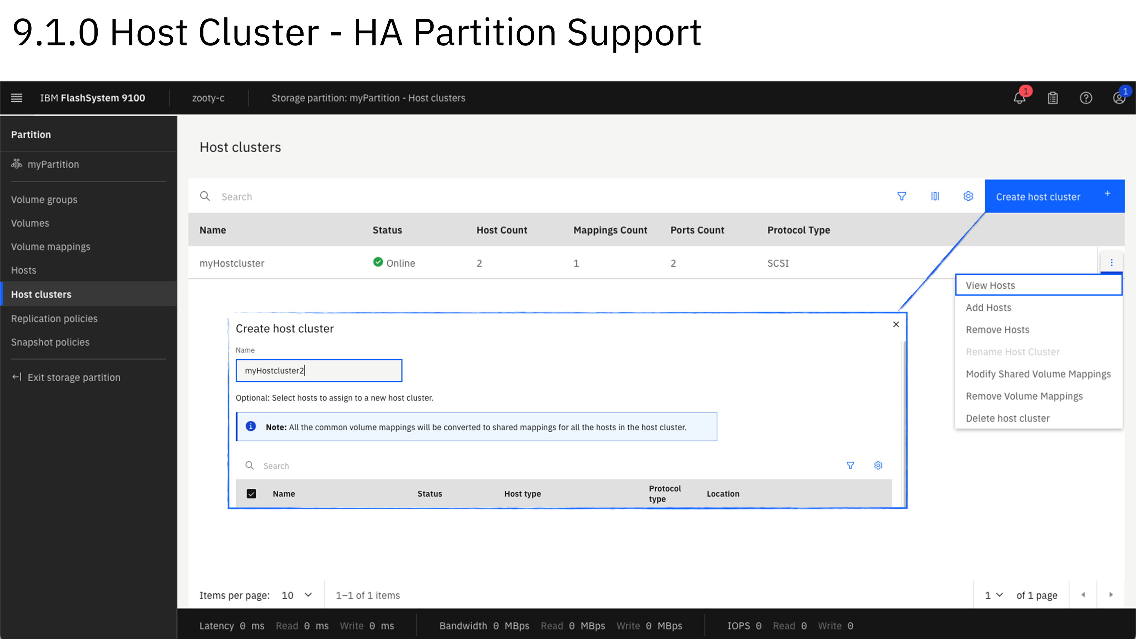
9.1.0 highlights
Rename PBR, PBHA, Partition objects
Expand PBR, PBHA volumes
Partition support hostcluster object
Grid scaling to 32 systems, 32 partitions per system
Use case specific certificates
Auto update FCM firmware
SI based partition placement recommendations
Restore back to production from thin-clone snapshot

Slide 27
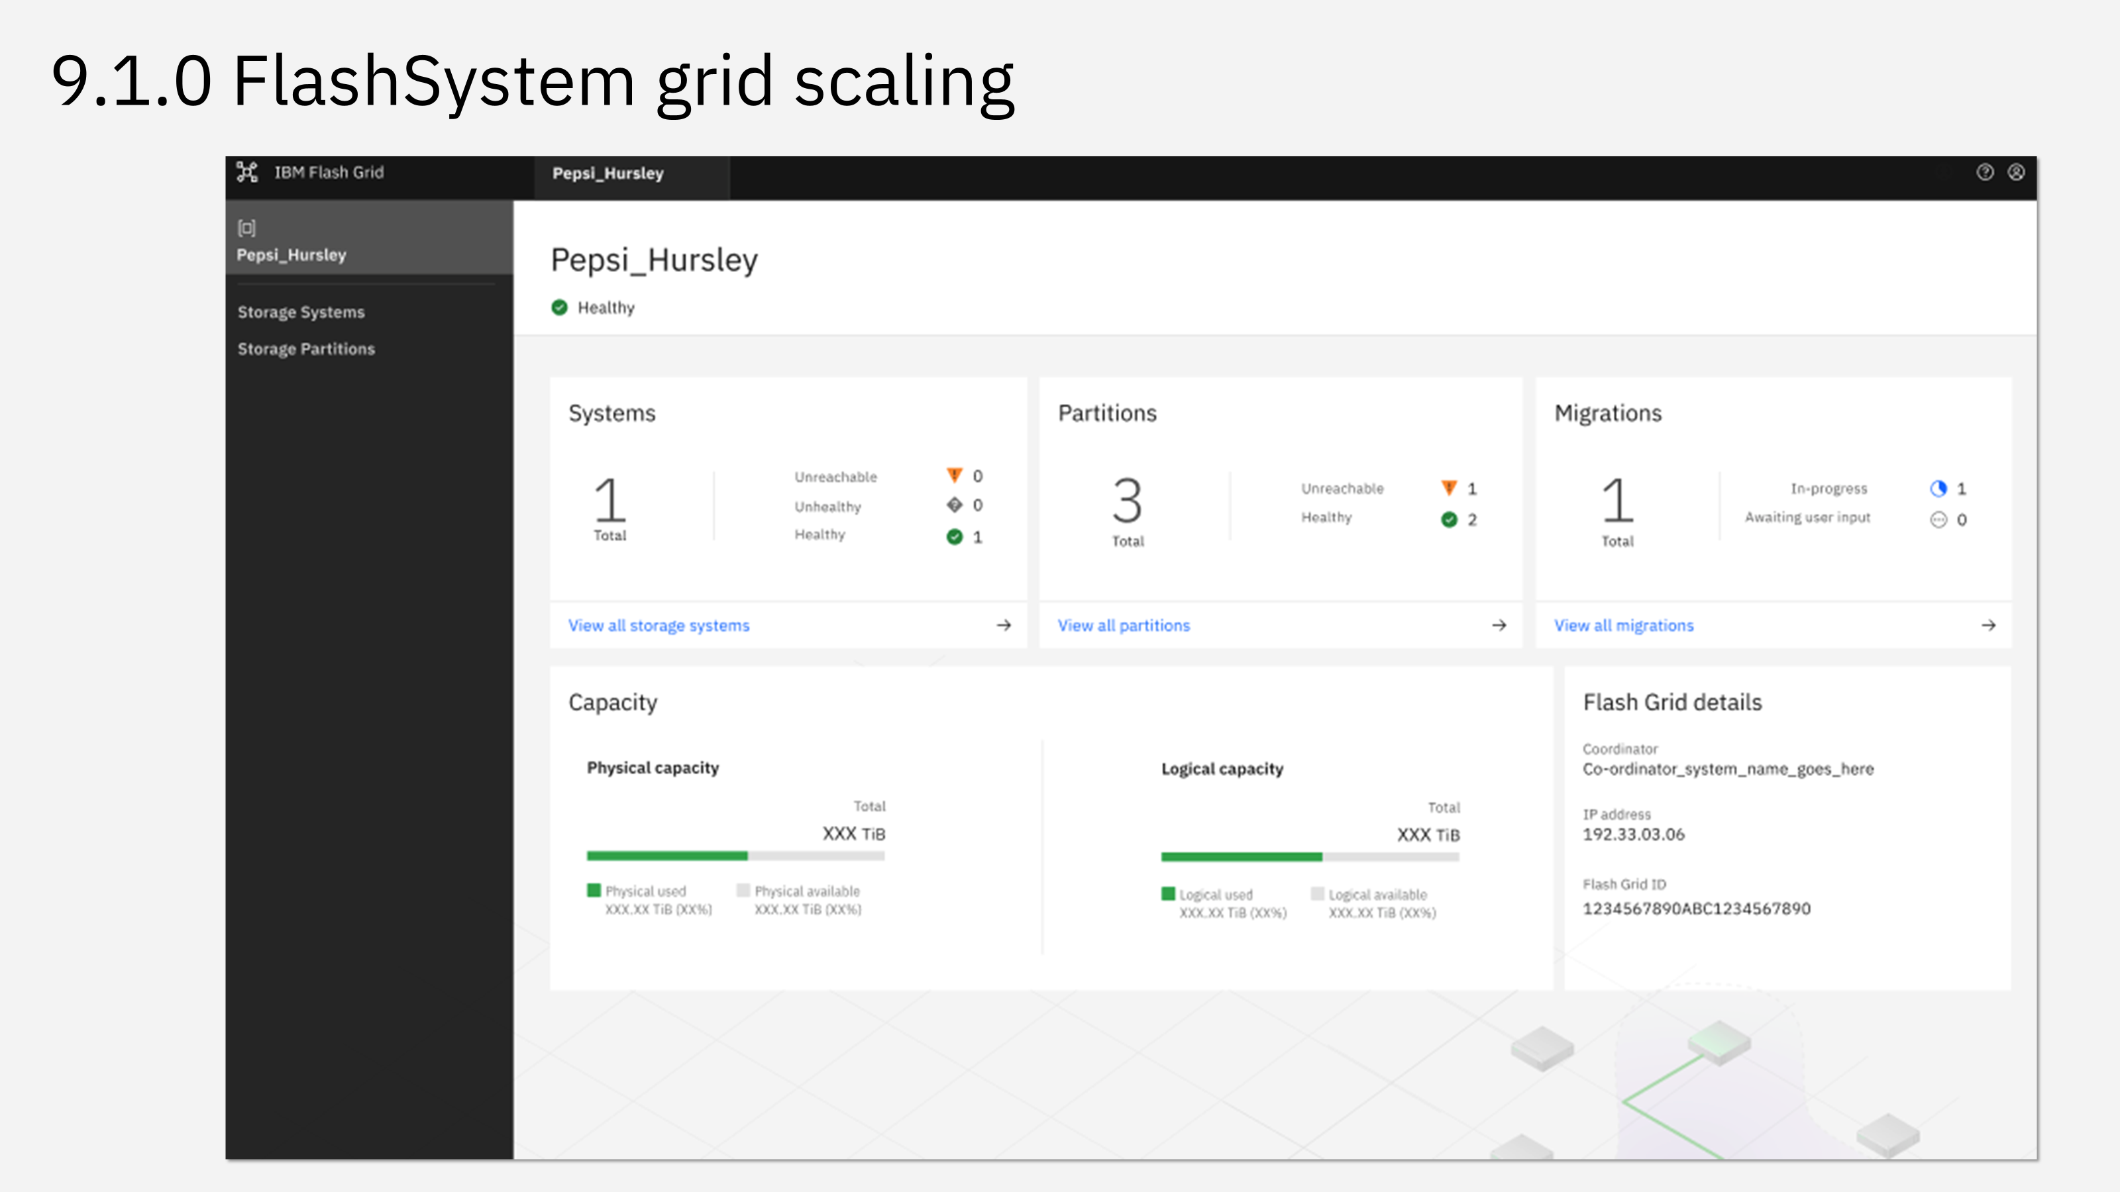
9.1.0 highlights
Rename PBR, PBHA, Partition objects
Expand PBR, PBHA volumes
Partition support hostcluster object
Grid scaling to 32 systems, 32 partitions per system
Use case specific certificates
Auto update FCM firmware
SI based partition placement recommendations
Restore back to production from thin-clone snapshot

Slide 28
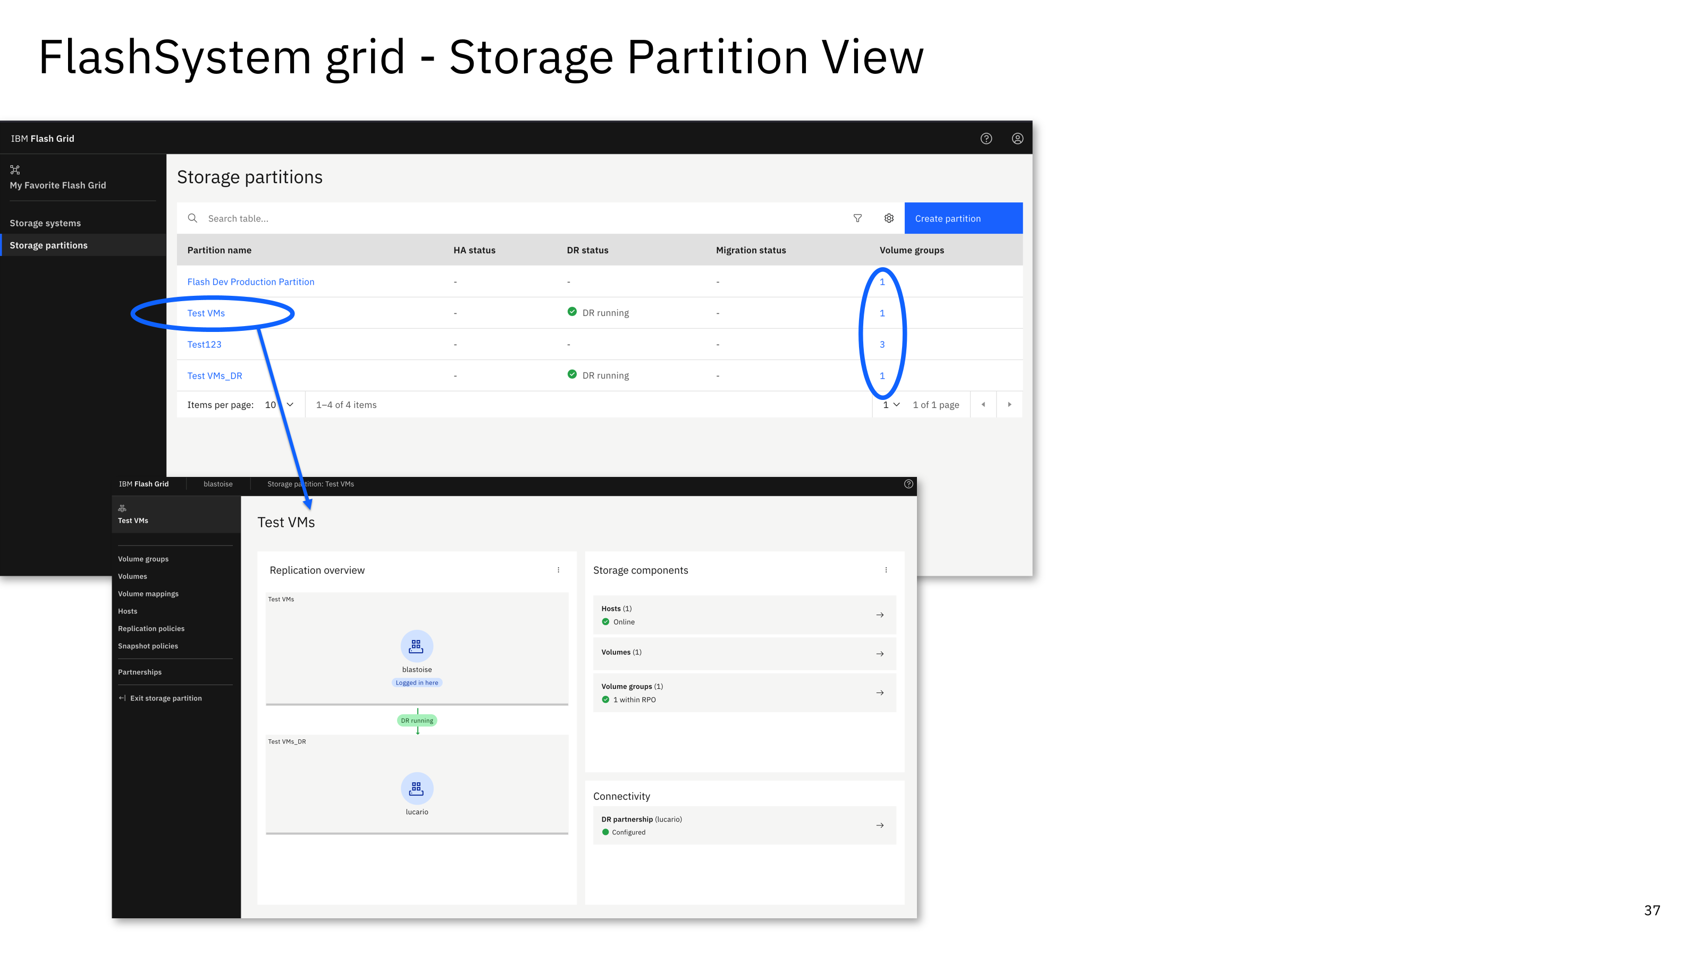
9.1.0 highlights
Rename PBR, PBHA, Partition objects
Expand PBR, PBHA volumes
Partition support hostcluster object
Grid scaling to 32 systems, 32 partitions per system
Use case specific certificates
Auto update FCM firmware
SI based partition placement recommendations
Restore back to production from thin-clone snapshot

Slide 29
9.1.0 highlights
Rename PBR, PBHA, Partition objects
Expand PBR, PBHA volumes
Partition support hostcluster object
Grid scaling to 32 systems, 32 partitions per system
Use case specific certificates
Auto update FCM firmware
SI based partition placement recommendations
Restore back to production from thin-clone snapshot

Slide 30
9.1.1 highlights
Increase snapshot capacity (paged bitmaps)
RTD enhancements / automated actions
HA thin-clone
HA support NVMe-FC/TCP (VMware)
SI advisories in Grid dashboard
Disable vVol support

Slide 31
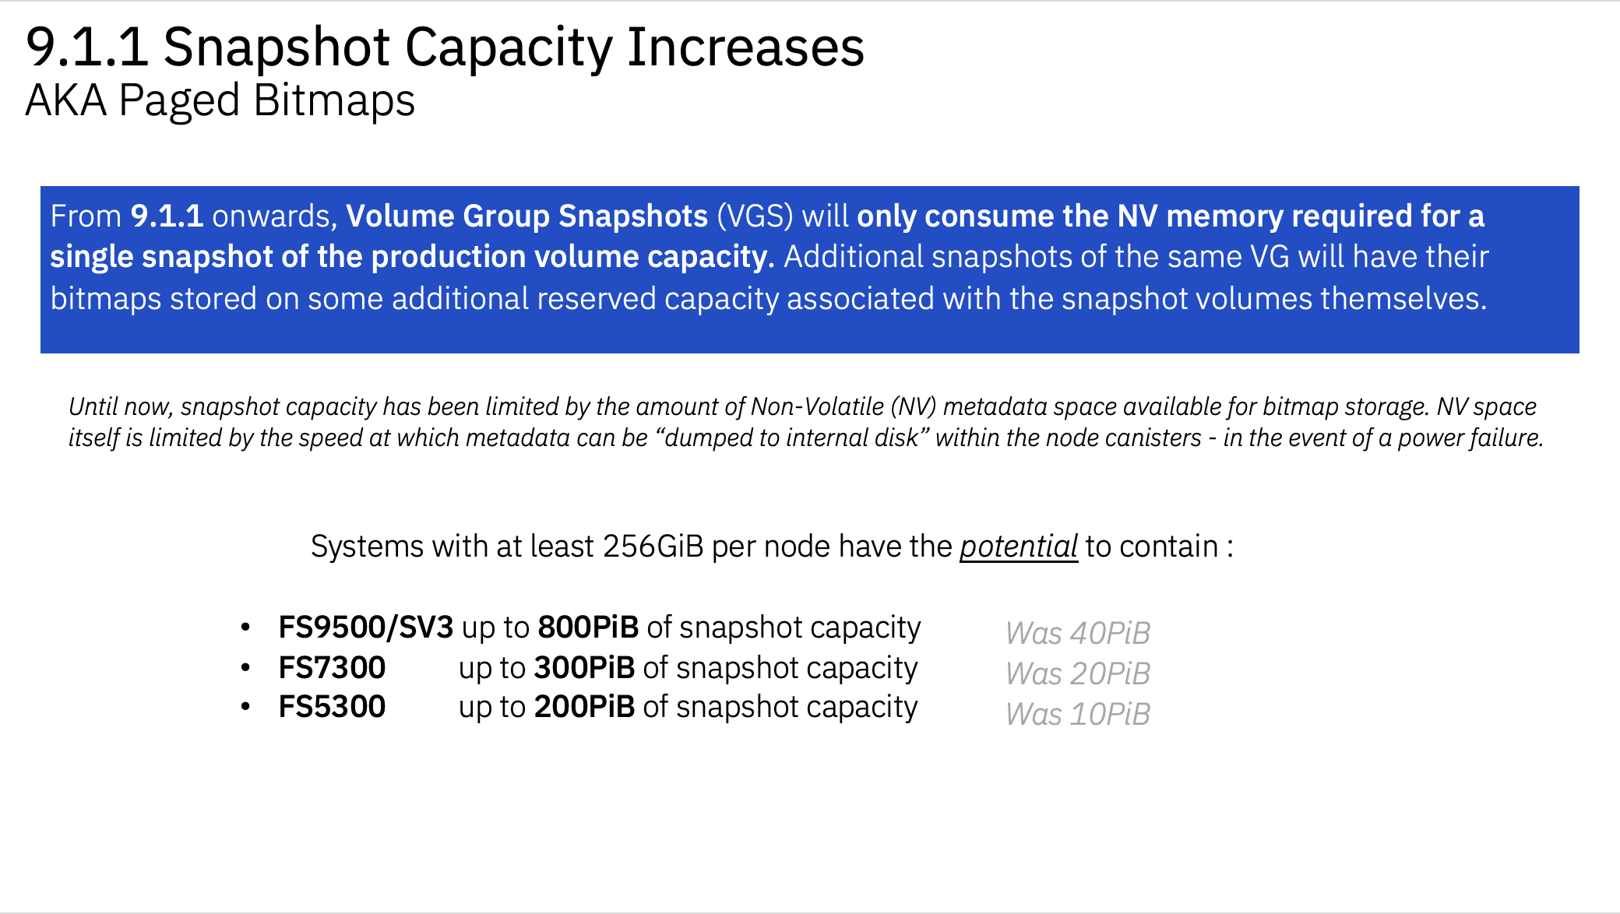
9.1.1 highlights
Increase snapshot capacity (paged bitmaps)
RTD enhancements / automated actions
HA thin-clone
HA support NVMe-FC/TCP (VMware)
SI advisories in Grid dashboard
Disable vVol support

Slide 32
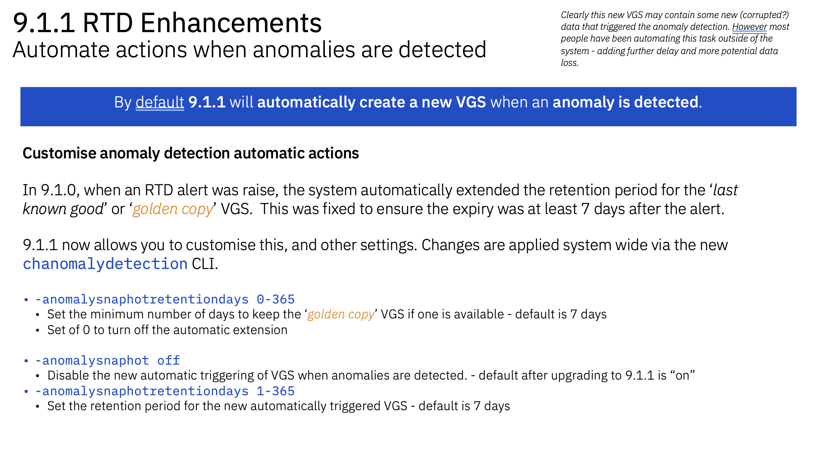
9.1.1 highlights
Increase snapshot capacity (paged bitmaps)
RTD enhancements / automated actions
HA thin-clone
HA support NVMe-FC/TCP (VMware)
SI advisories in Grid dashboard
Disable vVol support

Slide 33
9.1.1 highlights
Increase snapshot capacity (paged bitmaps)
RTD enhancements / automated actions
HA thin-clone
HA support NVMe-FC/TCP (VMware)
SI advisories in Grid dashboard
Disable vVol support

Slide 34
9.1.2 highlights
Split partition
FCM5 thin provisioning (single volume/pool type)
Simplified system setup
Fibre Channel Auto Zoning
Independent quorum IP
Extent awareness for faster DRAID rebuild

Slide 35
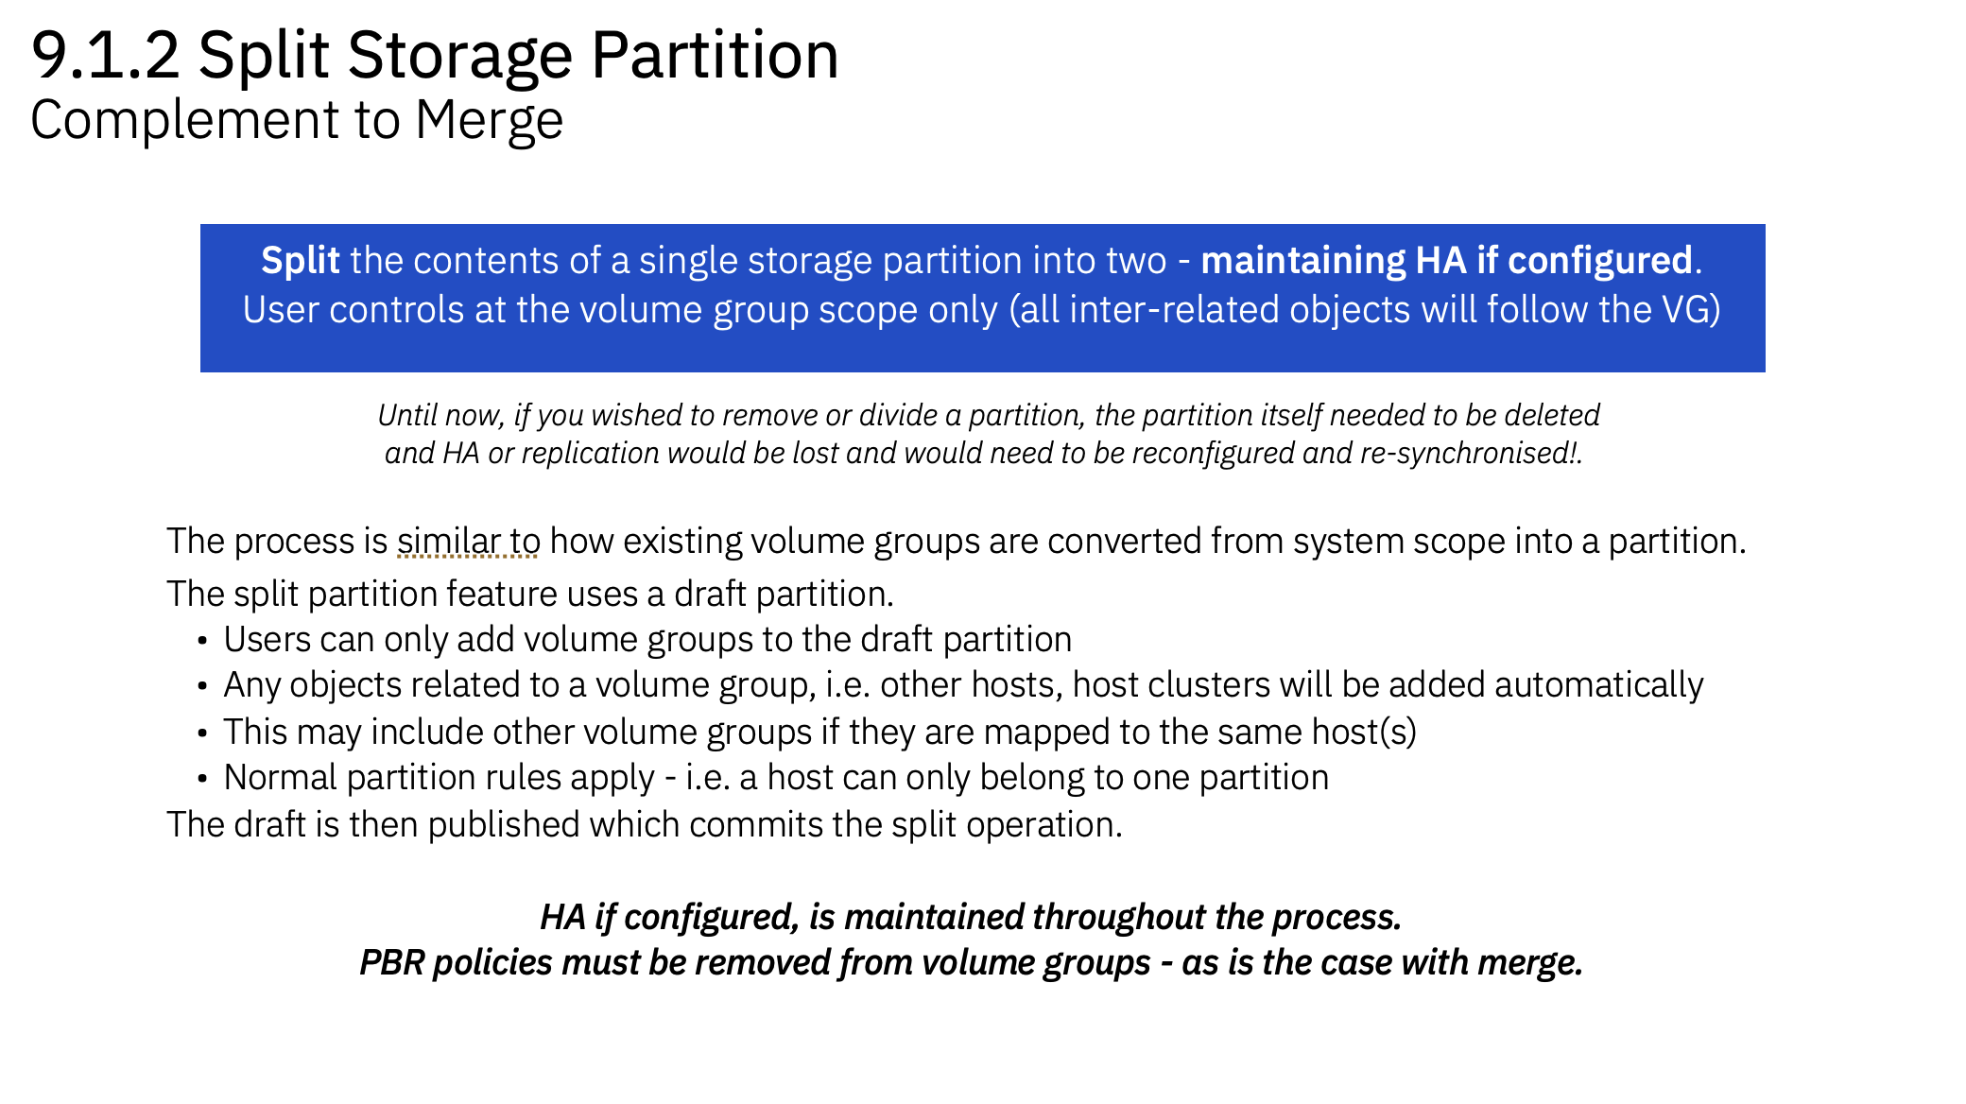
9.1.2 highlights
Split partition
FCM5 thin provisioning (single volume/pool type)
Simplified system setup
Fibre Channel Auto Zoning
Independent quorum IP
Extent awareness for faster DRAID rebuild

Slide 36
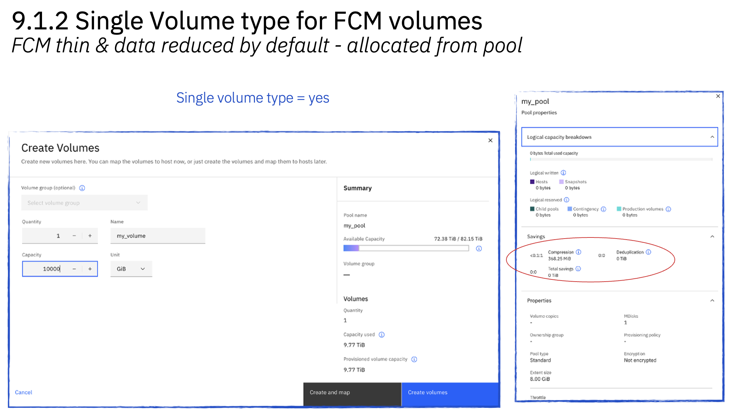
9.1.2 highlights
Split partition
FCM5 thin provisioning (single volume/pool type)
Simplified system setup
Fibre Channel Auto Zoning
Independent quorum IP
Extent awareness for faster DRAID rebuild

Slide 37
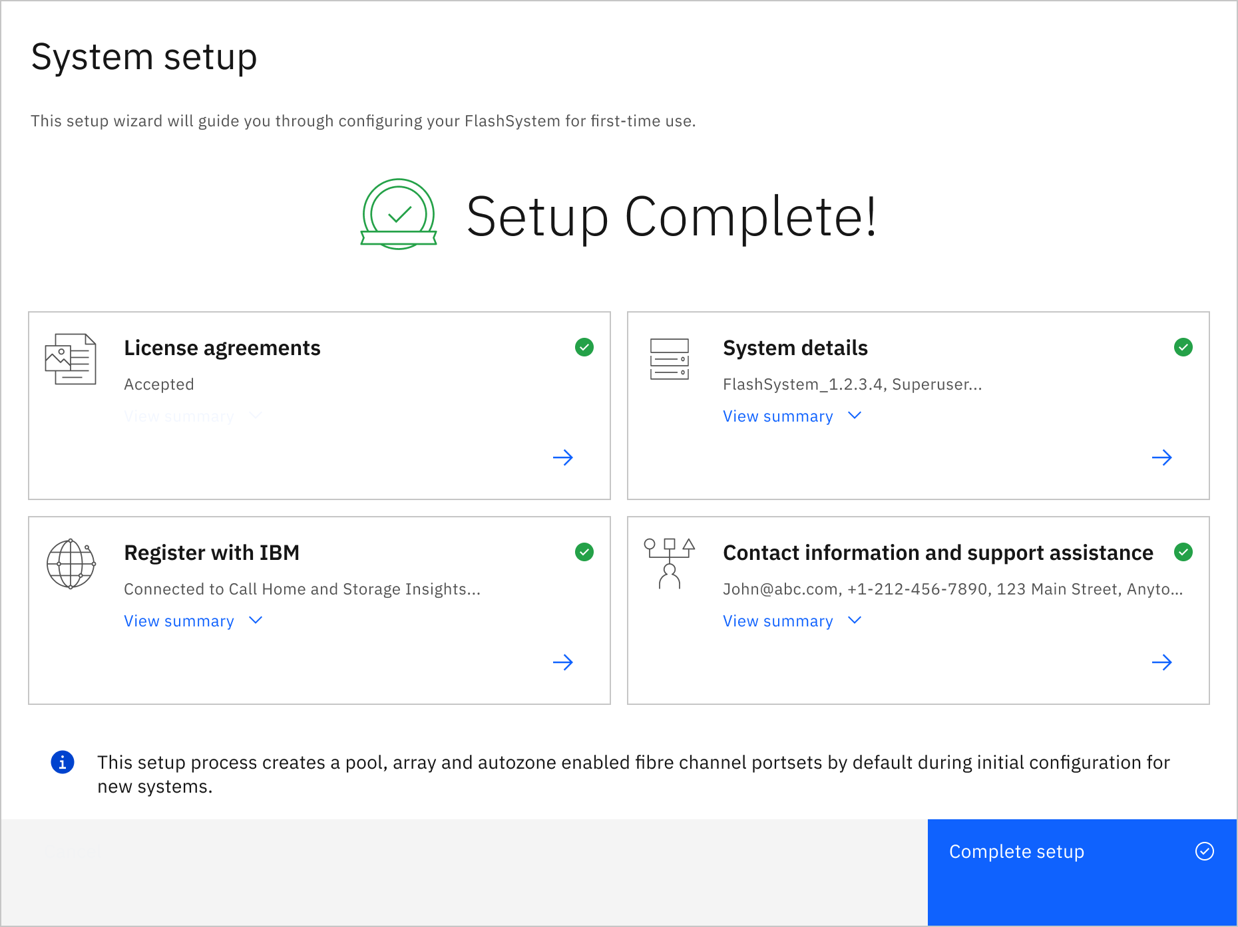
9.1.2 highlights
Split partition
FCM5 thin provisioning (single volume/pool type)
Simplified system setup
Fibre Channel Auto Zoning
Independent quorum IP
Extent awareness for faster DRAID rebuild

Slide 38
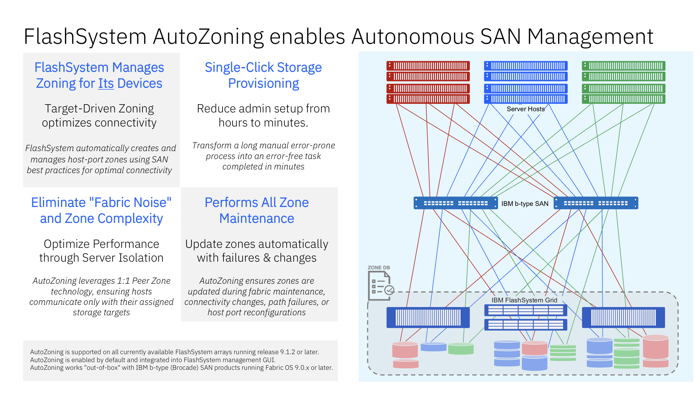
9.1.2 highlights
Split partition
FCM5 thin provisioning (single volume/pool type)
Simplified system setup
Fibre Channel Auto Zoning
Independent quorum IP
Extent awareness for faster DRAID rebuild

Slide 39
9.1.2 highlights
Split partition
FCM5 thin provisioning (single volume/pool type)
Simplified system setup
Fibre Channel Auto Zoning
Independent quorum IP
Extent awareness for faster DRAID rebuild

Slide 40
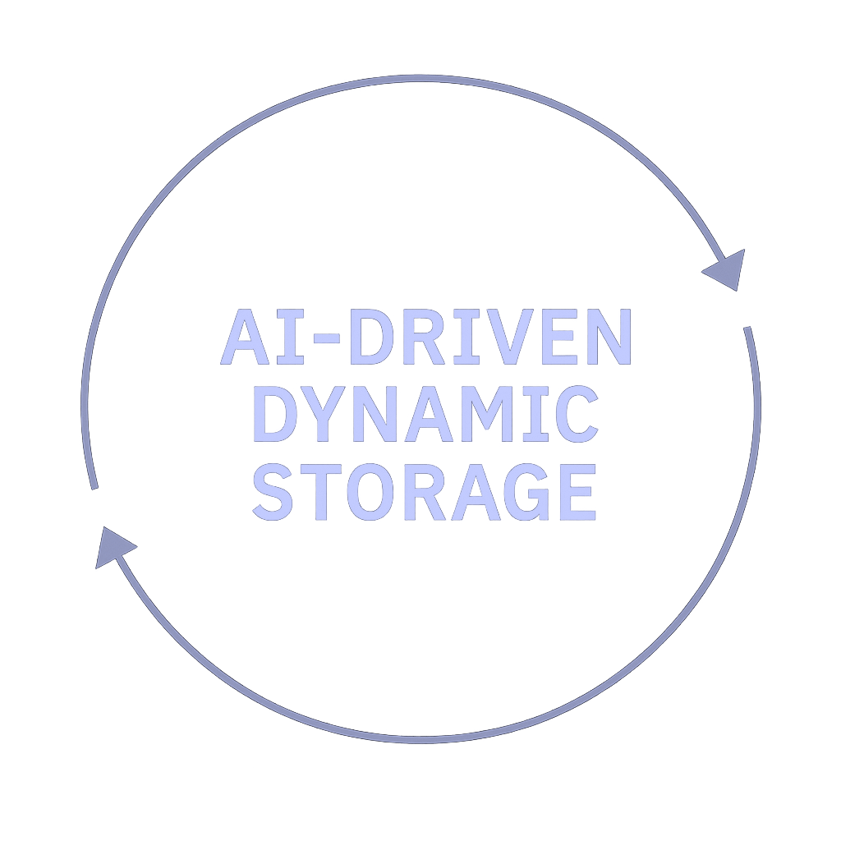
The future of storage starts here
Intelligent
Autonomous
Agent-Driven
IBM STORAGE
Notes:
Key message: FlashSystem transforms storage into an intelligent, autonomous data layer.
Suggested talking points:
For the first time, storage isn’t just reacting—it’s understanding. With embedded intelligence, FlashSystem works alongside operators, interpreting intent, learning from expert feedback, and turning human guidance into consistent, automated action.
We are delivering storage built on an AI‑driven architecture that is able to act the moment it’s needed—identifying emerging issues, adjusting performance, or enforcing compliance in real time—long before they become disruptions.
Routine tasks that once consumed hours of valuable Storage Operations time now execute autonomously, while expert‑driven operations happen faster and more reliably because the system understands the outcomes you’re trying to achieve, not just the commands you issue.

Slide 41




IBM FlashSystem.ai
Context Aware Security
Dynamic Compliance
Amplify Human Expertise
Proactive Optimization
Intelligent performance management
Clickless provisioning
Proactive operational resilience
IBM STORAGE
Notes:
Key Message: Say hello to your Storage Admin colleague that never sleeps.
Suggested talking points:
We’ve talked about AI‑Driven Dynamic Storage—now let’s make that real. FlashSystem.ai is our new intelligence layer that brings this vision to life. It represents a new class of storage: one that collaborates with your experts, understands your intent, and takes informed action on your behalf.
FlashSystem.ai delivers –
Context Aware Security: we use the context of the data interactions (user/host behaviors, changes in the IO patterns, changes in the data itself) to look for anomalies and respond before problems occur to help protect you against threats like ransomware and other anomalies
Dynamic Compliance: enforces real-time SLA and policy adherence, helping you tame complexity and rapidly adapt as your compliance needs change.
Amplify Human Expertise: enhances decision-making that amplifies human expertise, learns from administrator feedback, and can accelerate time to response.
Proactive Optimization: Dynamically tunes and adjusts workloads to optimize system performance & identify potential failures to minimize downtime.
<Intercut the demo script: After making these points, Sam receives a notification (audible to the room), apologizes to the audience for not silencing his phone, and reaches into his pocket….>

Slide 42
What if you could have a conversation with your Storage?
…and your Storage could take action for you?

Slide 43
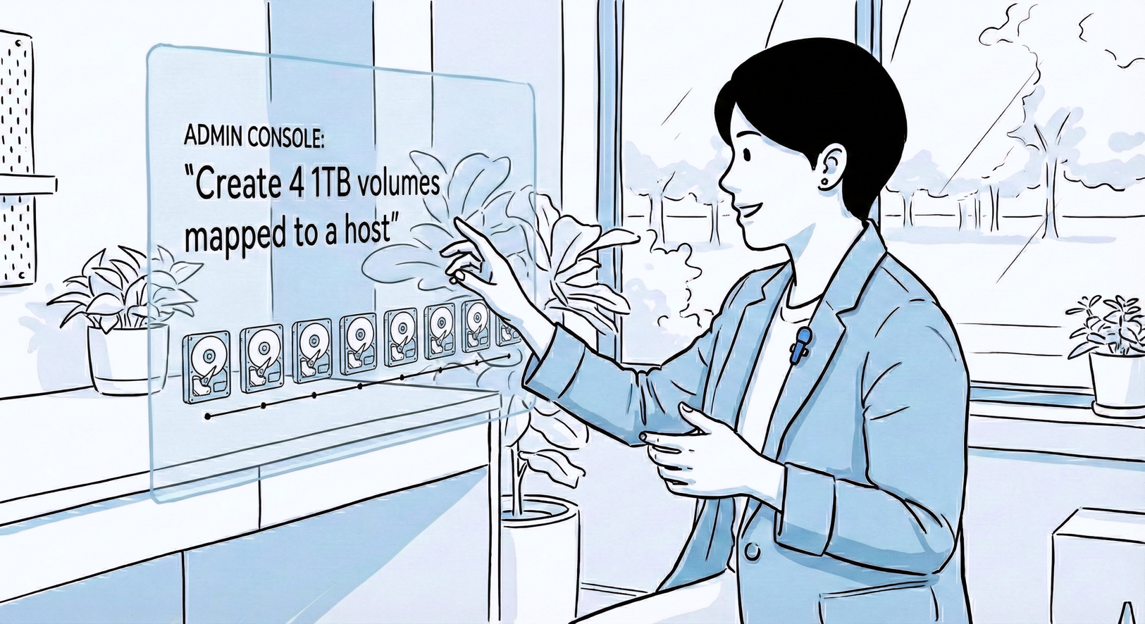
Natural Language Administration
  AI agents assist users in day-to-day administration tasks, including:
  Provisioning workloads by creating volumes, volume groups, hosts and snapshots.
  Enabling disaster recovery solutions by configuring replication and immutable snapshots.
  Conversational interactions to query and update the system configuration, such as expanding volumes, renaming objects and more.

Slide 44


Agentic AI
Large Language Model (LLM) agent
Update steps
Key Features of an AI agent
Performs tasks (goal oriented) defined by incoming user query, using “skills” - tools you give your model access to, such as:
Feedback loop to refine results
LLM
LLM creates steps to answer query using available tools
Incoming
User Query
Execute
steps
Return
result
Tools Library
Flash
API
Flash
CLI
Other API
IBM FlashSystem
An AI Agent connects an LLM to your real-time operations data
to not just to answer questions, but to perform actions

Slide 45
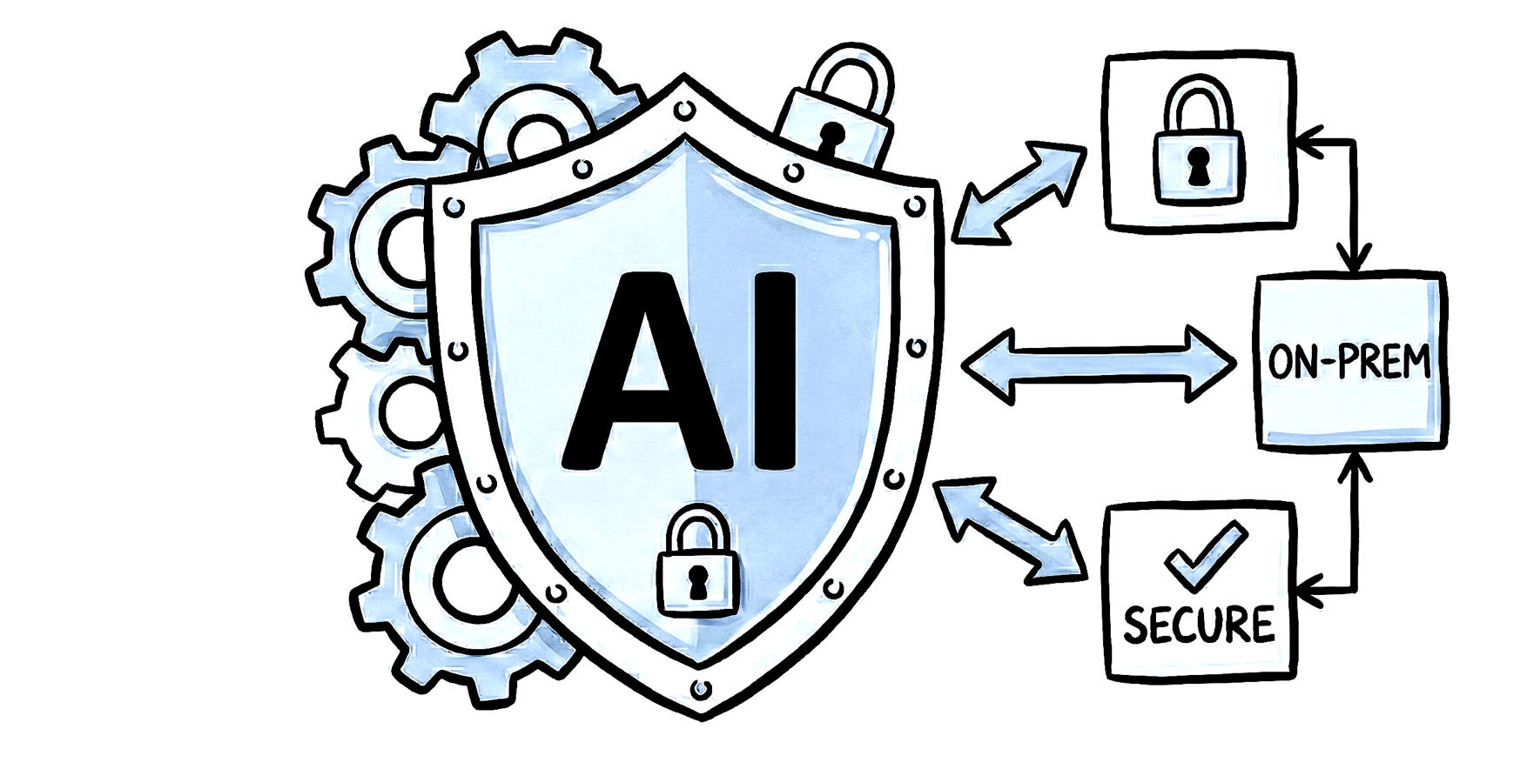
Enterprise Level AI Safeguards
Actions executed on FlashSystem devices are done with agents that are on-premise and not in the Cloud
Configuration changes performed by AI agents must always be confirmed by a human first (Human-in-the-Loop)
AI agents cannot perform any actions which can affect the availability of data, such as deleting system objects or performing any security-related tasks
AI assistance is only enabled if deployed by an administrator

Slide 46
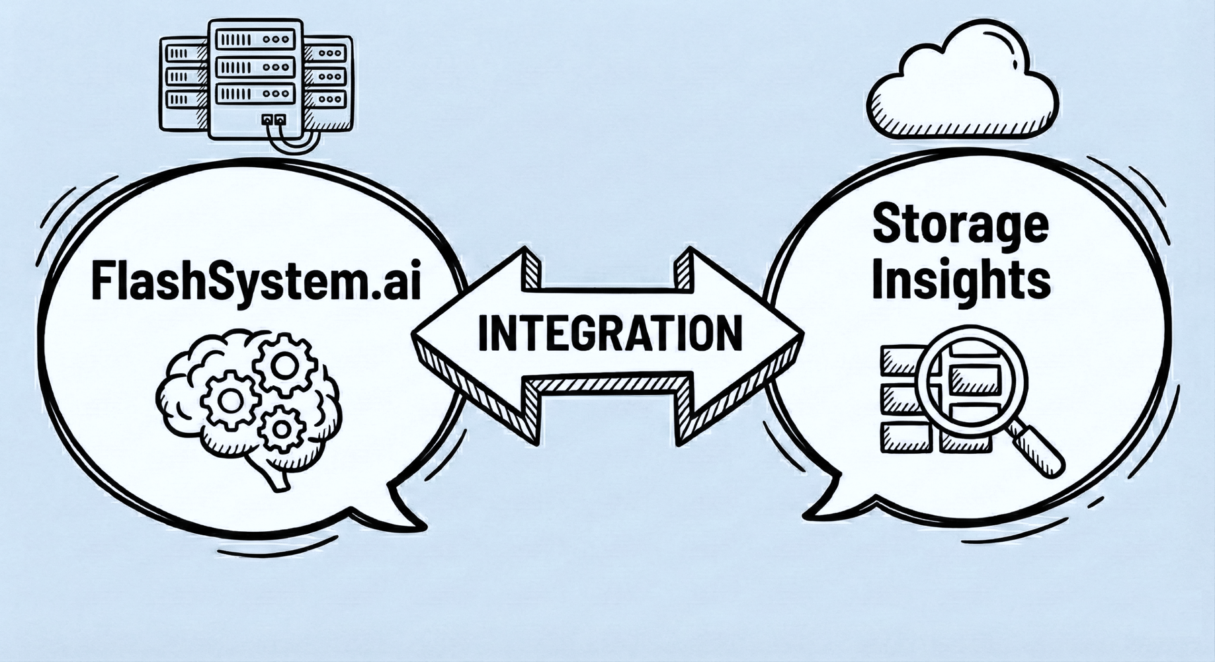
Integration with Storage Insights
Storage Insights AI agents seamlessly integrate with on-premise agents to deliver a unified AI experience.
SI provides workload placement recommendations directly to the on-premise agents to action.
SI is mandatory for FlashSystem.ai
Connection via REST API key

Slide 47
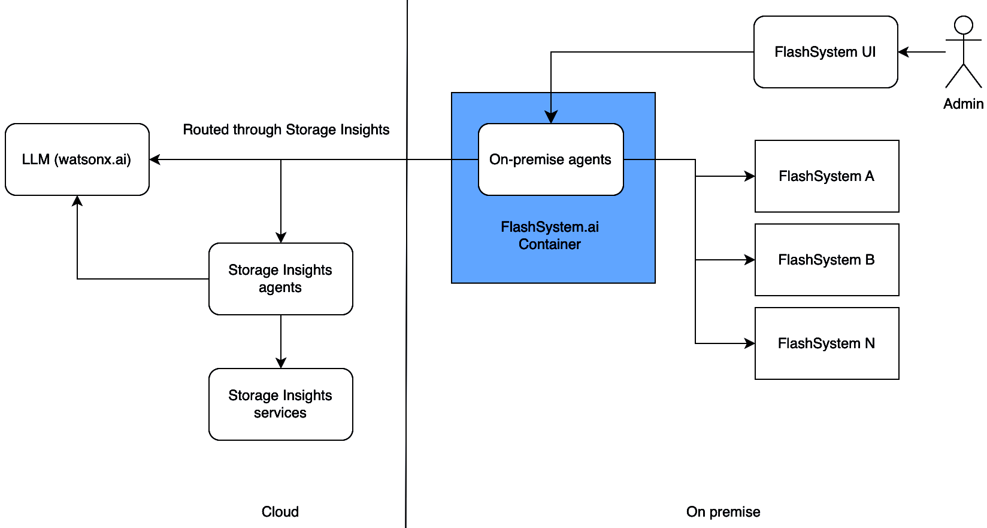
FlashSystem.ai Setup
A container hosted in on-premise compute infrastructure provides the AI capabilities
No on-prem GPUs needed
No watsonx subscription needed
The container must be registered and able to communicate with each FlashSystem
The container must be able to contact Storage Insights for outbound traffic only
FlashSystem.ai chat interface is available via the Graphical User Interface (GUI)

Slide 48




FlashSystem.ai Upcoming Use Cases
…. As seen from the Launch Keynote
Human-AI Collaboration
Storage configuration and setup
Proactive
Optimisation & Balancing
Performance evaluation
Partition migration within a FlashSystem grid
Predictive Maintenance & Knowledge
Notifications on issues in the environment
Security & Regulation Compliance
Apply Safeguarded Snapshot policies to volume groups

