Slide 1
IBM PowerVC Workshop
Upendra Rajan
Senior Technical Program Manager at IBM Infrastructure
Content Manager for IBM Power and Storage Technical Training

Slide 2
Notices and disclaimers
© 2026 International Business Machines Corporation.
All rights reserved.
This document is distributed “as is” without any warranty, either express or implied. In no event shall IBM be liable for any damage arising from the use of this information, including but not limited to, loss of data, business interruption, loss of profit or loss of opportunity.
Case studies and client examples are presented as illustrations of how customers or IBM has used IBM products in production or test environments and the results they may have observed. Actual performance, cost, savings or other results in other operating environments may vary.
Workshops, sessions and associated materials may have been prepared by independent session speakers, and do not necessarily reflect the views of IBM.
Not all offerings are available in every country in which IBM operates.
Any statements regarding IBM’s future direction, intent or product plans are subject to change or withdrawal without notice.
IBM, the IBM logo, and ibm.com are trademarks of International Business Machines Corporation, registered in many jurisdictions worldwide. Other product and service names might be trademarks of IBM or other companies. A current list of IBM trademarks is available on the Web at “Copyright and trademark information” at: www.ibm.com/legal/copytrade.shtml.
Certain comments made in this presentation may be characterized as forward looking under the Private Securities Litigation Reform Act of 1995.
Forward-looking statements are based on the company’s current assumptions regarding future business and financial performance. Those statements by their nature address matters that are uncertain to different degrees and involve a number of factors that could cause actual results to differ materially. Additional information concerning these factors is contained in the Company’s filings with the SEC.
Copies are available from the SEC, from the IBM website, or from IBM Investor Relations.
Any forward-looking statement made during this presentation speaks only as of the date on which it is made. The company assumes no obligation to update or revise any forward-looking statements except as required by law; these charts
and the associated remarks and comments are integrally related and are intended to be presented and understood together.

Slide 3
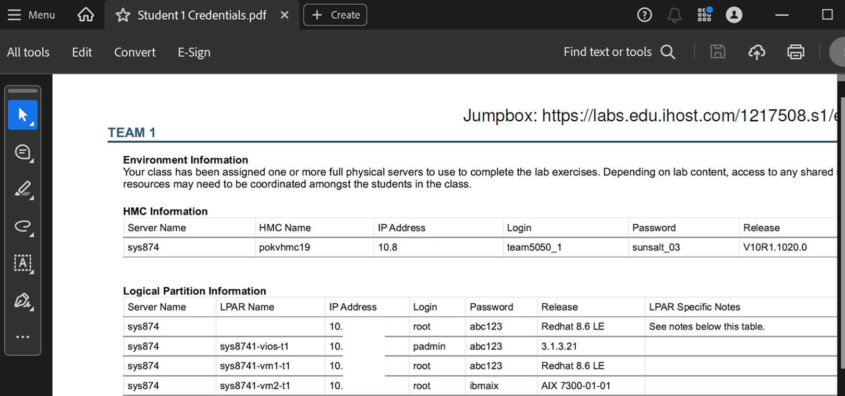
How to get started?
Go to https://ibm.biz/common-power
Open the credentials PDF corresponding to your student number (do not use someone else’s)
Click the lab link at the top-right of this PDF to launch your Windows Jumpbox
Follow the exercise guide in the folder - PowerVC-Workshop-UR.pdf
-> For use within exercise
Your browser
Windows Jumpbox VM
IBM Power environment

Slide 4
IBM authorized worldwide training for IBM PowerVC
QZC30G: IBM PowerVC Workshop
  Duration: 4 days
Overview:
  Cloud and OpenStack deep-dive
  Planning and implementation of IBM PowerVC for Private Cloud
  Advanced administrative tasks
  Set up, configure and work with IBM PowerVM NovaLink
  More details and enrollment: https://www.ibm.com/training/course/QZC30G
This course prepares you for the official certification (IBM PowerVC v2.2 Administrator Specialty): https://www.ibm.com/training/certification/ibm-powervc-v22-administrator-specialty-S2112900

Slide 5
IBM authorized worldwide training for Ansible on Power
QZC51G: Ansible on IBM Power Workshop
  Duration: 2 days
Overview:
  Set up and configure Ansible
  Use IBM Power Collections on AIX, VIOS and HMC to automate routine tasks
  Use IBM Power Collections to automate using IBM PowerVC
  Advanced administrative tasks
  More details and enrollment: https://www.ibm.com/training/course/QZC51G

Slide 6
How to continue your learning journey
1
Search for IBM Power training at: ibm.com/training
2
Hands-on DevOps and Ansible on IBM Power course: ibm.com/training/course/qzc51g
3
IBM PowerVC Workshop: ibm.com/training/course/qzc30g

Slide 7
Thank you
Upendra Rajan
Senior Technical Program Manager at IBM Infrastructure
Content Manager for IBM Power and Storage Technical Training

